Slide 1

Let’s Protect Your Ish NOW!
Chasity Sharp Grice, LL.M. in Elder Law and Estate Planning
The Estate and Family Law Group, PLLC
www.protectourish.com

Slide 2

WHAT SHOULD YOU EXPECT?

Slide 3

Where is my
Money?!!!!!!

Slide 4

Probate
Probate proceeding declares whether a will is valid and then insures the proper distribution of the estate to the beneficiaries.

Slide 5
COMMON Assets of the family
401(k)
Individual Retirement Accounts
Bank accounts/Certificates of Deposit
Pension
Life insurance
Annuities
Stock Options
Real estate
Vehicles
Jewelry
Personal belongings
Wrongful death suits

Slide 6
What Is Probate?
Probate with a will – individual dies testate
The will becomes an active document upon the death of the will maker and establishes the legatees for the designated property
Will must be “filed” with the court and accepted
Probate without a will – individual dies intestate
The state laws on intestacy are used to determine the heirs of property owned by the deceased
Intestate laws vary from state to state

Slide 7
Intestacy
Intestate → to die without an executed will or if a court declares a will invalid
Statutes of descent and distribution/ statutes of intestate succession govern
inheritance when no valid will exists.

Slide 8
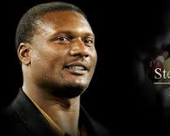

What happens if no estate planning at all?
Results:
Mother’s home ⇒ Estate
Widow v. Mother in-law =
Notes:
Steve McNair was shot and killed by a woman with whom he’d had an extramarital affair.
He did not have a will.
He had purchased a home for his mother, which is where she’d lived at his death. Unfortunately, this residence was not in his mother’s name, but in McNair’s.
Immediately after his death, the widow demanded $3,000 per month rent from the mother, for the home.
Ultimately, the home went to the Estate, divided according to the laws of intestate succession.

Slide 9
What happens if no estate planning at all? (cont.)
  Costly – the process may require legal fees to settle potential claims, contest the will, pay administrator, etc.
  Delays in distribution of property – process may take anywhere from 4 to 24 months depending on the assets, claims, will, etc.
  Loss of Privacy – Wills and probate proceedings are public documents
  Non-traditional partners claims (and designations from will) can be set aside via challenge to will or outside intestate laws of the state
  (DOMA – Defense of Marriage Act)
  Ancillary Probate for real property in a non-domiciled state
Notes:
Steve McNair was shot and killed by a woman with whom he’d had an extramarital affair.
He did not have a will.
He had purchased a home for his mother, which is where she’d lived at his death. Unfortunately, this residence was not in his mother’s name, but in McNair’s.
Immediately after his death, the widow demanded $3,000 per month rent from the mother, for the home.
Ultimately, the home went to the Estate, divided according to the laws of intestate succession.

Slide 10

Types of Property Ownership
Fee Simple/Fee Simple Absolute/ Ownership by Severalty
Tenancy in Common
Joint Tenancy
Tenancy by the entirety
Community property
Separate property
Notes:
Fee simple- The greatest possible estate in land, wherein the owner has the right to use it, exclusively possess it, commit waste upon it, dispose of it by deed or will, and take its fruits. A feesimple represents absolute ownership of land, and therefore the owner may do whatever he or she chooses with the land. If an owner of a fee simple dies intestate, the land willdescend to the heirs.
The term fee used independently is an adequate designation of this type of estate in land. The term simple is added to distinguish clearly this estate from other interests in realproperty.
No rights of survivorship. Only one owner.
Can be disposed in 3 ways: 1) Gifting to a bene in will, 2) Gifting to a trust for the benefit of a bene, 3) Dying intestate
Tenancy in common- 2 or more persons hold a possessory interest in the same property. No survivorship rights.
Joint tenancy- A single estate in property held by 2 or more persons created under one instrument at one time. All of the tenants have equal right to share in the use and enjoyment of the property. At each death, the property passes to the surviving tenants.
Unity of possession
Each acquired ownership at the same TIME, and acquired TITLE with the same document.
Tenancy by the entirety- ownership by a husband and wife.
5 unities: THOSE of possession, TIME, TITLE, INTEREST, and PERSON (presumed one person bc of marriage)
Right of survivorship
Nonprobate asset
Turns into Tenants in common at divorce.
Separate property- Property acquired by the man or woman prior to the marriage or acquired during the marriage by gift, will, or inheritance.

Slide 11
TENANTS IN COMMON: EXAMPLE 1
REAL PROPERTY
JOHN
JIM
Notes:
Jim and John are brothers who own real property as tenants in common. This means that they both own an equal share of the property. 50%

Slide 12
TENANTS IN COMMON: EXAMPLE 1
REAL PROPERTY
JOHN
JIM
KIM
JERRY
Kim and Jerry each have a ¼
Interest in the property at Jim’s death.
Notes:
Jim dies. He was never married, but has 2 children, named Kim and Jerry.
At Jim’s death, his children inherit his interest in the real property, in equal shares (per stirpes). This means that Kim and Jerry each owns ½ of their dad’s ½ interest = 1/4

Slide 13
JOINT TENANCY with rights of survivorship: EXAMPLE 2
REAL PROPERTY
JOHN
JIM
Notes:
Jim and John are brothers who own real property as joint tenants. This means that they both the whole 100% (right of survivorship)

Slide 14
TENANTS IN COMMON with rights of survivorship: EXAMPLE 1
REAL PROPERTY
JOHN
JIM
KIM
JERRY
Kim and Jerry have no interest in the
Property at Jim’s death.
Notes:
Jim dies. He was never married, but has 2 children, named Kim and Jerry.
At Jim’s death, John owns the property outright.

Slide 15
Probate vs. Non-Probate Property
Non-Probate Property consists of assets that will transfer automatically at death to a new owner by operation of law because of the way they are titled or by virtue of a beneficiary designation.
Probate Property consists of the assets that are in the Decedent’s name as of death and do not transfer upon death without the appointment of a Personal Representative. The distribution of probate assets will be either pursuant to the Will or the laws of intestacy.
Notes:
Non-Probate assets:
Life insurance policy with designate bene- Passes outside of the probate proceedings.
If no bene or bene is deceased, passes to the estate. Now= probate asset
Living trust- nonprobate asset
Probate assets:
Civil lawsuit damages
Sale of business
Proceeds passing to a trust

Slide 16
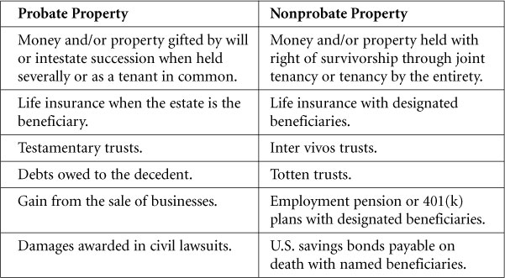
Probate vs. Non-Probate Property

Slide 17
Only Probate Assets are Controlled by the Will
Examples of Probate Assets Include:
Real Estate titled solely in the Decedent’s name or titled as Tenants in Common (**Another Common Misconception and unique to SC- we do not recognize Tenancy by the Entirety – which in other states is an automatic transfer at death between husbands and wives owning real estate together)
Stocks or Brokerage Accounts solely in the Decedent’s name or titled as Tenants in Common
Cash accounts solely in the Decedent’s name (Most joint accounts are Joint Tenants with Right Of Survivorship)
Insurance or Annuities payable to the Estate
Personal Effects (cars, boats, etc) in the Decedent’s name

Slide 18
What is estate planning?
The process of anticipating the disposal of your assets and arranging a plan to do so effectively.
Notes:
Estate planning eliminates uncertainties over the administration of a probate and maximize the value of the estate by reducing taxes and other expenses. Guardians are often designated for minor children and beneficiaries in incapacity.
Appointing a guardian for your minor children.
Minimizing the estate and income tax effects of the disposal.
Client comes in your office and they say they need a will. The first question you need to ask is why? You need to be able to accomplish the overall goal, and more likely than not, the will is only one step of a major analysis.

Slide 19
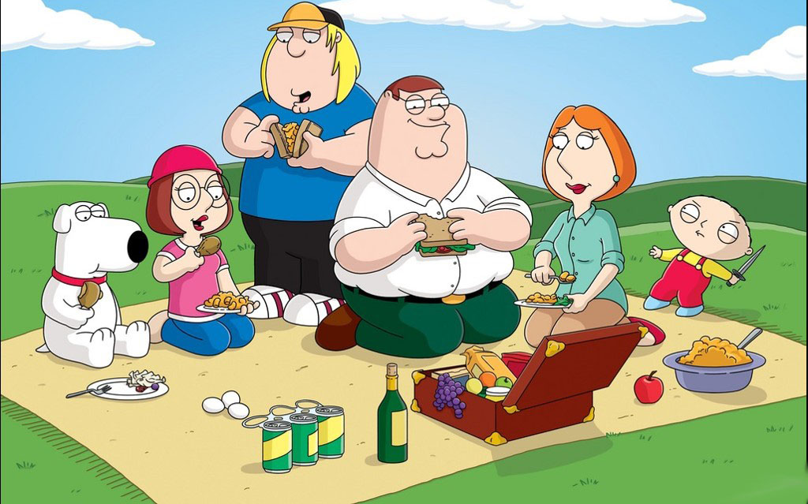
Who exactly is the “FAMILY”?
Notes:
I’m sure that we would all agree that perhaps a talking dog and toddler that curses, drives, and drinks beer may not be common.
Common family- mom, dad, and children
When I say common family, I mean the wage-earner, not much financial planning, other than what the job gives them. Someone who believes that they need no estate planning.

Slide 20

WHY DO ANY ESTATE PLANNING?
What happens to your property?
What happens with your children?
What happens with your bank accounts?
What if you become incapacitated?
Who will care for you?
Who receives your family heirlooms?
Notes:
Most clients have the same statement: I don’t own anything. I usually tell them the store of two of my clients:
Tell about Greene estates. How it passed intestate? Probably against LaKeyshia’s desire?
You can overwhelm them with this story, but it convinces them of why it is so essential.

Slide 21

THE BASICS OF ESTATE PLANNING
LAST WILL AND TESTAMENT
DURABLE POWER OF ATTORNEY
  “Magic language”
STATUTORY MEDICAL POWER OF ATTORNEY
TRUSTS
DESIGNATION OF GUARDIAN FOR MINOR CHILDREN
LIVING TRUSTS
MEDICAL DIRECTIVES/ LIVING WILLS
FUNERAL ARRANGEMENTS
Notes:
Last Will & Testament:
Remember that the goal of estate planning is to reduce tax burden on your client’s estate at his or her death, but really, to relieve the burden on his or her families.
I call the “Last Will and Testament” the “catch-all” document. That means that when all else fails, look at the Will. Despite very popular belief, drafting a will is not the main tool in estate planning. The Will is what you use should you need to open an estate in Probate Court. Usually, the idea is to avoid probate as much as you can. Therefore, the real estate planning starts in your analysis.
Are your beneficiary forms updated? Have you had more children? Gotten married/divorced? Get into a big fight with your sister and now decided that you no longer want to make her rich? Remember, it is ALL mental.
Remember that your client expects you to know all and do all. So, you have to be able to think with the big picture and work your way backwards. It is up to you to determine whether a will is enough.
Living Trust- revocable, during life. Considered a Grantor Trust because you retain the control.
Living Will- some leave up to spouse to make decision but explain how it feels for a spouse to let go. It brings more of a peace of mind when there is already direction directly from you.

Slide 22
IMPORTANT ISSUES TO CONSIDER
Appointment of Guardian
No bond
Executor/Alternate
Minor beneficiaries
Elder abuse
Undue influence
Notes:
Creditor protection
No contest, unless valid
If minor children
Biggy!
Always choose alternates so don’t have to change their will every time a friend/relative passes away. Good for us, not for them! Also, if several children, consider a tiebreaker/corporate trustee if trust
Back to the family dynamics. Can this person be trusted with money? Especially a large lump sum of money? Can this person do what is right, according to your wishes? What is their credit like? Responsible?
If appointing a guardian, have you discussed with appointee? Do they have other minor children? Do they get along?
What will happen if you put $50,000 or $100,000 into the hands of your 20-something children? Or teenagers?
Also consider having trust named as beneficiary of life insurance policy
Will v. Trust- public v. private
If not, give client succinct directions on law regarding finalizing a will. T.C.A. 32-1-104
Marital property- explain to client that he can only dispose of a portion of his property. What if new wife and children from a prior marriage. Give house to new wife? What if own property from prior marriage?
Specific omissions- tell story about homosexual client and partner who died. Will not valid)

Slide 23
PLANNING FOR INCAPACITY
DURABLE POWER OF ATTORNEY
“Magic language”
STATUTORY MEDICAL POWER OF ATTORNEY
Include HIPAA language
No “springing” power
TRUSTS
Special Needs Trusts (d4(a) vs. d4(c))
Third party v. First party
Medicaid Asset Protection Trusts
DESIGNATION OF GUARDIAN FOR MINOR CHILDREN/DISABLED LOVED ONES
LIVING TRUSTS
Trust Protectors
MEDICAL DIRECTIVES/ LIVING WILLS
GIFTING
Medicaid Pre-crisis planning
Notes:
Last Will & Testament:
Remember that the goal of estate planning is to reduce tax burden on your client’s estate at his or her death, but really, to relieve the burden on his or her families.
I call the “Last Will and Testament” the “catch-all” document. That means that when all else fails, look at the Will. Despite very popular belief, drafting a will is not the main tool in estate planning. The Will is what you use should you need to open an estate in Probate Court. Usually, the idea is to avoid probate as much as you can. Therefore, the real estate planning starts in your analysis.
Are your beneficiary forms updated? Have you had more children? Gotten married/divorced? Get into a big fight with your sister and now decided that you no longer want to make her rich? Remember, it is ALL mental.
Remember that your client expects you to know all and do all. So, you have to be able to think with the big picture and work your way backwards. It is up to you to determine whether a will is enough.
Living Trust- revocable, during life. Considered a Grantor Trust because you retain the control.
Living Will- some leave up to spouse to make decision but explain how it feels for a spouse to let go. It brings more of a peace of mind when there is already direction directly from you.

Slide 24
Conservatorships: How did we get here?
Determination of disability by a court of competent jurisdiction
  Burden on the Petitioner
  Respondent is entitled to an independent evaluation to disprove
Determination that based upon the disability, the disabled person needs the assistance of the court
  Consideration of any prior appointments (healthcare power of attorney, financial power of attorney, etc.)
  Consideration of any supported decisionmaking attempts
    Is the disabled person able to exercise good judgment in his or her best interest, even if with assistance? Does he or she understand the nature and consequences of his and her financial and medical decisions?

Slide 25
How did we get here? (cont.)
MOST LITIGATED QUESTION: Who is the appropriate fiduciary?
  Guardian/Conservator of the Person
    Must they be an in-state resident?
    Do they have statutory priority to serve (nearest of kin)?
    Able to make decisions in the best interest of the disabled person
  Guardian/Conservator of the Estate
    Must they be an in-state resident?
    Do they have statutory priority to serve (nearest of kin)?
    Have they demonstrated the ability to manage their personal money properly?
      Bankruptcies
      Prior felonies or convictions regarding violation of public trust (thefts, etc.)
    Able and willing to make decisions in the best interest of the disabled person

Slide 26
Long-term care planning
Nursing Home Care
Skilled nursing care
Adult Day Care
Independent Living
Home Health services

Slide 27

Funding Long-term care
  Private pay
  LONG-TERM CARE INSURANCE
  Medicaid
    MEDICARE V. MEDICAID
  Veteran’s benefits

Slide 28
QUESTIONS?
cgrice@eflawgroup.com
901.290.0650
Protectourish.com

