Slide 1
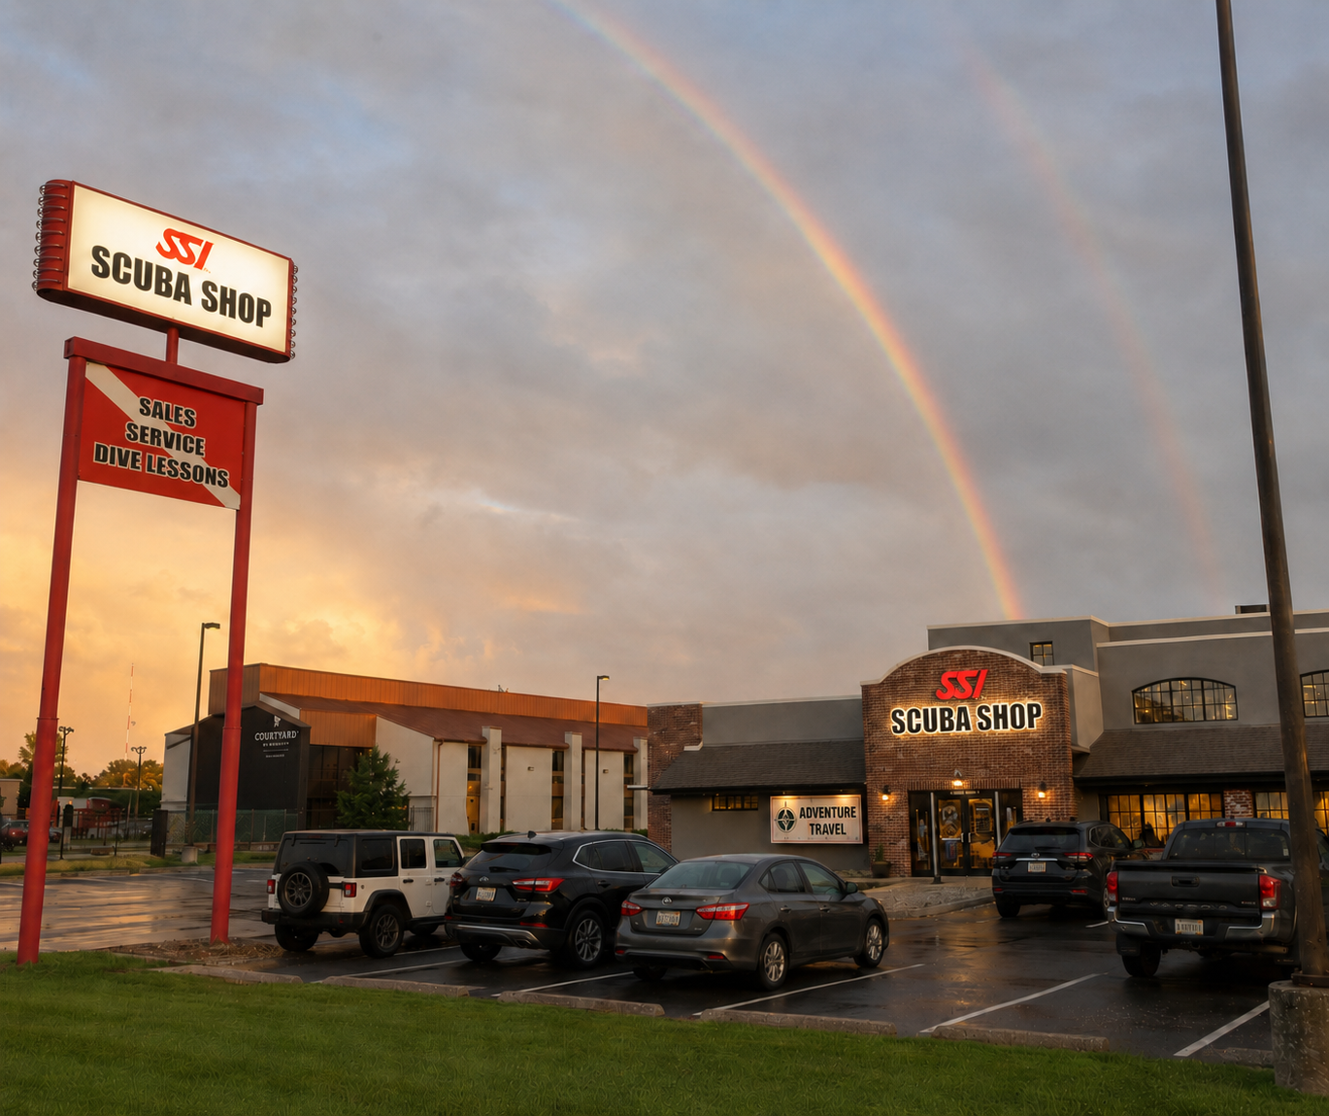
BUILD YOUR
CUSTOMER BASE
A practical Zoom session for dive centers that need more conversations, more new students, and fewer “hope the phone rings” marketing plans.
Create contact first
Registrations come after conversations
Ken Konyshak | kkonyshak@us.divessi.com

Slide 2
The Problem Is Upstream
The issue is not just registrations. It is not enough new customer conversations.
A dive center cannot register students it does not have.
What shops say
What it usually means
Real objective
“How do we get
more students?”
“We need more
people to talk to.”
Create contact first.
Then convert activity.
CHAT PROMPT
What is the #1 reason your phone is not ringing?
No essay required. Drop the honest answer in chat.
Build Your Customer Base

Slide 3
Today’s Roadmap
Four moves. Simple enough to use immediately, structured enough to repeat.
1
Pick the Audience
Pre-trip, experience, or reactivation.
2
Build One Offer
One clear next step for one group.
3
Put It Where They Are
Local groups, schools, gyms, HR teams, parent pages, activity networks, and some travel partners.
4
Follow Up Fast
Questions create the path from curiosity to action.
The whole session is about creating conversations before registrations can happen.

Slide 4
FRAMEWORK
Three customer lanes make vague marketing much easier to manage.

Slide 5
The Three Lanes
Pick the lane that fits your market this week. Do not promote everything to everyone.
Pre-Trip Customers
People planning vacations, resort stays, lake weekends, honeymoons, family trips, or “maybe I’ll try scuba” moments.
Experience Customers
People looking for something different: families, couples, teens, groups, gyms, schools, and local activity seekers.
Reactivation Customers
People already certified but inactive. They may be rusty, traveling soon, or waiting for a reason to come back.
Pick one audience. Build one offer. Make the next step obvious.
CHAT CHECK: Which lane is easiest for your center to act on this week?
Build Your Customer Base
Ken Konyshak | kkonyshak@us.divessi.com | 5

Slide 6
Lane 1: Pre-Trip Customers
This is broader than cruises and travel advisors. Think “people planning activities near water.”
Where to Find Them
Local community pages
Parent and family groups
Destination wedding or honeymoon contacts
Neighborhood pages and HOA groups
Vacation-minded customers already in your store
Search Ideas
• [city] vacation ideas
• [city] parent groups
• [city] things to do
• destination wedding planner [city]
• family travel [city]
Build Your Customer Base
Ken Konyshak | kkonyshak@us.divessi.com | 6

Slide 7
Lane 1: The Offer
Make scuba part of the trip they already care about.
Simple Offers
Try Scuba before the trip
Refresh before the resort dive
Learn locally before you go
Get properly fitted before travel
Why It Works
They already care about the trip, family activity, or experience. Scuba becomes a way to improve something they are already doing.
Working message: If water is part of the plan, start locally before you go.
Ken Konyshak | kkonyshak@us.divessi.com | 7

Slide 8
Pre-Trip Campaigns
Use travel as one practical doorway — not the whole strategy.
Pick one simple campaign.
Catch people before water-based activities become an afterthought.
Vacation-Ready Night
Before You Book It
Short info night for trips, lake weekends,
family vacations, or resort stays.
Mini-clinic for people considering scuba,
snorkeling, or water-based excursions.
Snorkeling Gateway
Group Prep Session
Masks, fins, snorkels, and advice can
start the relationship without forcing a class.
Water-comfort session for families,
couples, or small groups heading to water.
The trip creates the opening. The center creates the relationship
Build Your Customer Base
Ken Konyshak | kkonyshak@us.divessi.com | 8

Slide 9
CUSTOMER LANE 2
Experience customers are often searching for activities, not scuba.
Build Your Customer Base
Ken Konyshak | kkonyshak@us.divessi.com | 9

Slide 10
Lane 2: Experience Customers
Try Scuba is the doorway for people who are curious but not ready to commit.
Where They Already Gather
• Gyms and YMCAs
• Swim schools and community pools
• Scout and youth groups
• Schools and homeschool groups
• Outdoor clubs and parent groups
Also Look For
• Corporate wellness / HR
• Local things-to-do pages
• Apartment communities
• Date-night pages
• Parks and recreation programs
My Suggestion: Apartment Community Managers & HOAs and Gyms & Swim Schools
Build Your Customer Base
Ken Konyshak | kkonyshak@us.divessi.com | 10

Slide 11
Lane 2: The Hook
Make it feel like an event, not homework.
The Hook
“Not ready for a full certification class? Try it in the pool first.”
The Real Product
A safe, supervised, memorable first experience that creates the next conversation.
The job of Try Scuba is not to explain everything.
The job is to open the door.
Build Your Customer Base
Ken Konyshak | kkonyshak@us.divessi.com | 11

Slide 12
Experience Campaigns Built for Real People
Use the activity they already understand, then connect it to scuba.
Try Scuba Date Night
Target couples, local event pages, apartments, hotels, and young professionals. Message: “Tired of dinner and a movie?”
Family Try Scuba Day
Target parents, swim teams, scout groups, schools, and summer camp families. Message: “Try something different with your teenager.”
Corporate Try Scuba Night
Target HR, wellness teams, employee engagement, and Chambers. Message: “A team-building event they’ll actually talk about afterward.”
Gym / Fitness Partnership
Target gyms, climbing gyms, CrossFit, yoga, running clubs, and triathlon groups. Message: “Try something different from your usual workout.”
Do not just sell a pool slot. Sell the experience people can picture saying yes to.
Build Your Customer Base
Ken Konyshak | kkonyshak@us.divessi.com | 12

Slide 13
CUSTOMER LANE 3
Past divers are often the fastest warm audience.
Build Your Customer Base
Ken Konyshak | kkonyshak@us.divessi.com | 13

Slide 14
Lane 3: Reactivation Customers
These people already said yes to scuba once. Give them a reason to come back.
Certified But Rusty?
Offer: refresher, buoyancy session, Nitrox, Computer Diving, gear service, or travel prep.
Snorkeling Gateway
Not everyone is ready for scuba. Start with masks, fins, snorkels, rash guards, travel bags, and a useful conversation.
WARM LEADS ARE STILL LEADS
Build Your Customer Base
Ken Konyshak | kkonyshak@us.divessi.com | 14

Slide 15
The Referral Ask
“Tell your friends” is too vague. Give people a person to picture.
Ask Better Questions
• Who do you know going somewhere warm this year?
• Who do you know who would try scuba if the first step felt easy?
• Who has a teenager looking for something different to do this summer?
• Who is certified but probably needs a refresher before the next trip?
Referrals work best when you do not ask people to promote your whole store.
Build Your Customer Base
Ken Konyshak | kkonyshak@us.divessi.com | 15

Slide 16
EXECUTION
One audience. One message. One obvious next step.
Build Your Customer Base
Ken Konyshak | kkonyshak@us.divessi.com | 16

Slide 17
The Simple Offer Builder
Use this before writing the post, email, or flyer.
1 Who is this for?
Families, couples, local groups, inactive divers, parents, teens, or activity seekers.
2 Why should they care now?
A trip is coming. Summer is coming. The group needs an activity. They want something different.
3 What are we offering?
Try Scuba, Open Water, refresher, snorkeling gear fitting, or a short prep session.
4 What is the next step?
Call, message, complete a form, or reserve the next pool date.
If the next step is unclear, the offer is not finished.
Build Your Customer Base
Ken Konyshak | kkonyshak@us.divessi.com | 17

Slide 18
Social Posts That Speak Human
Write for travelers, families, and first-timers - not just certified divers.
Pre-Trip Post
“Heading somewhere with water this summer? If scuba or snorkeling is on the maybe-list, this is the time to ask questions before you go. We can help with Try Scuba, certification, refreshers, and gear that actually fits.”
Try Scuba Post
“Ever wondered what it feels like to breathe underwater? Try Scuba is a pool-based introduction for people who are curious but not ready for a full certification class. Message us for upcoming pool dates.”
Take a look at your last few posts. Did they start with the customer’s life, or did they start with your program?
Build Your Customer Base
Ken Konyshak | kkonyshak@us.divessi.com | 18

Slide 19
Social Posts: Family Activity
Talk to the parent’s problem first. Scuba becomes the answer after that.
Family Activity Post
“Looking for something different to do with your teenager this summer? Scuba can be a great family activity, especially if vacations, lake trips, or future travel are on the calendar.”
Why This Works
• Starts with a real parent problem
• Feels like an activity, not homework
• Opens the door to Try Scuba, family classes, refreshers, and travel prep
Where to Use It
Parent groups, school pages, swim teams, scout groups, community pages, and family activity calendars.
Family messaging works when it feels like an invitation, not a course announcement.
Build Your Customer Base
Ken Konyshak | kkonyshak@us.divessi.com | 19

Slide 20
Using Hashtags
Helpful for discovery. Not a substitute for a real offer.
What They Help With
• Categorize posts
• Improve local discovery
• Signal the audience
• Help public posts surface
What They Do Not Fix
• Boring offers
• Confusing messages
• Weak follow-up
• One-and-done posting
1. Program: #TryScuba #LearnToDive
2. Audience: #FamilyFun #DateNightIdeas #Adventure
3. Local: #[City]Events #[City]ThingsToDo #[City]Families
Use 5–10 focused hashtags. Mix broad + local. Then stop decorating and follow up.
Hashtags support the post. The offer still has to do the work.
Build Your Customer Base
Ken Konyshak | kkonyshak@us.divessi.com | 20

Slide 21
The Follow-Up Is Where the Money Usually Lives
The first reply is not the win. The follow-up turns curiosity into action.
Ask Better Follow-Up Questions
• When are you traveling?
• How many people may be interested?
• Full certification or pool experience first?
• Already certified but rusty?
• Would a private group date help?
Capture the Basics
• Name and best contact method
• Travel or event date
• Program interest
• Referral source
• Next promised follow-up
If nobody owns the follow-up, the lead quietly dies in the inbox.
Build Your Customer Base
Ken Konyshak | kkonyshak@us.divessi.com | 21

Slide 22
What Kills This Before It Starts
A quick list of things that make good ideas die quietly.
Promoting Everything
If the post mentions every program, nobody knows what to do next. Pick one audience and one offer.
Talking Only to Divers
Non-divers do not speak in course codes. Talk like a normal human.
No Follow-Up Owner
If nobody owns the follow-up, the lead quietly dies in the inbox.
No Next Step
“Call us for details” is weaker than “message us to reserve the next pool date.”
Marketing dies when nobody owns the next step.
Build Your Customer Base
Ken Konyshak | kkonyshak@us.divessi.com | 22

Slide 23
THE BOTTOM LINE
Create customer contact first. Registrations come after conversations.
1
Choose an audience
Travelers. Families. Groups. Inactive divers.
2
Make one clear offer
Try Scuba. Refresher. Gear fitting. Prep session.
3
Make the next step obvious
Call. Message. Register interest. Reserve a date.
Stop waiting for the phone to ring. Give people a reason to call.
Q&A
Ken Konyshak | kkonyshak@us.divessi.com
Build Your Customer Base
Ken Konyshak | kkonyshak@us.divessi.com | 23

Slide 24
Disclaimer
General guidance for SSI Training Centers.
General Guidance
This presentation is intended as a general business-development resource for SSI Training Centers. Ideas, examples, and templates should be adapted to each center’s local market, staffing, facility access, training schedule, and business model.
Standards, Safety, and Requirements
All training activities, promotional programs, and customer experiences must be conducted in accordance with current SSI Training Standards, applicable laws, insurance requirements, facility rules, and safe industry practices.
No Guaranteed Results
This presentation does not guarantee specific sales results, student registrations, revenue, or customer response. Each Training Center is responsible for how it markets, prices, promotes, schedules, and delivers its programs.
Prepared by Ken Konyshak | kkonyshak@us.divessi.com
Build Your Customer Base
Ken Konyshak | kkonyshak@us.divessi.com | 24

Slide 25


Slide 26

SSI NE Region Communication
Area Monthly Newsletter
http://www.div3rken.com
Add to your list of FRIENDLY senders:
kkonyshak@us.divessi.com
ken@div3rken.com

Slide 27
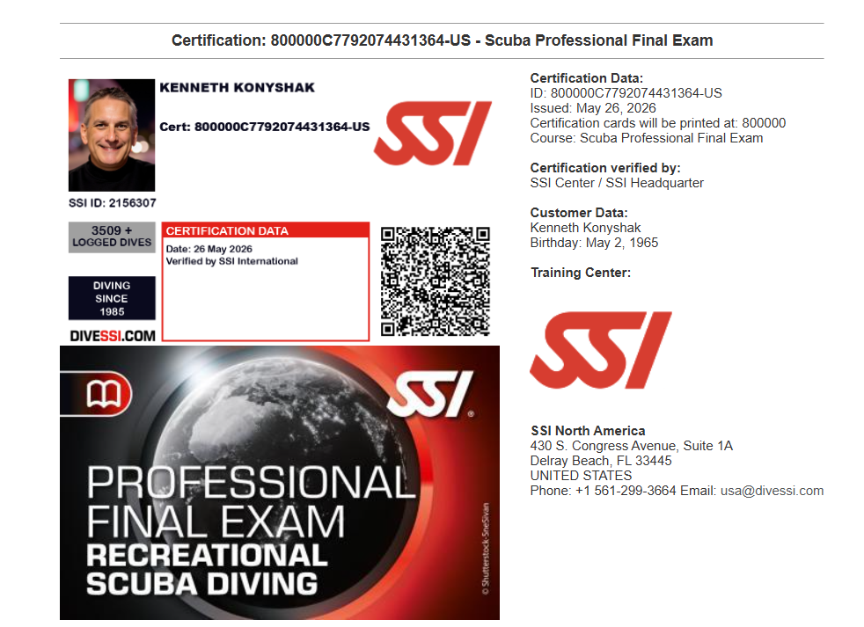
Professional Final Exam
Beginning June 8
All dive pros required to pass prior to certification
  No fee
  Automatically assigned upon pro course registration
All current pros are unaffected
Recommended all current pros read & complete for certification but not mandatory

Slide 28
BUILD YOUR
CUSTOMER BASE
A practical Zoom session for dive centers that need more conversations, more new students, and fewer “hope the phone rings” marketing plans.
Create contact first
Registrations come after conversations
Ken Konyshak | kkonyshak@us.divessi.com

