Slide 1
Ireland
France
10 Triathlons
Northern Ireland
Belgium
10 Countries
Scotland
24 Hours
Netherlands
England
Luxembourg
4km
200km
50km
2024
Wales
Germany

Slide 2
Overview Map Of The TEN Proposed Triathlon Locations

Slide 3
Part 1 – Home Nations & Ireland
Ireland
Northern Ireland
Scotland
Isle of Man or England
Wales

Slide 4
Leg 1 - Ireland Location - DunDalk/ Omeath
0200hrs
Swim Bike Run Road Sea - - - Air - - -
Swim 400m –
In Jenkinstown Bay
Bike 20km -
Jenkinstown to Omeath
Run 5km -
from Omeath to border

Slide 5
Leg 2 - Northern Ireland Location -Newry/Dromore
Swim Bike Run Road Sea - - - Air - - -
0310hrs
Swim –
400m Newry River
Bike –
20km from Newry towards Dromore
Run –
5km Banbridge towards Dromore

Slide 6
Leg 2 to Leg 3 Travel – Ireland to Scotland
0430hrs
Swim Bike Run Road Sea - - - Air - - -
Car will then take Matt + two support people from Dromore to the East coast of N.Ireland near Donaghee to take a high speed boat crossing, 23 nautical miles, to Cairngaan in Scotland, (Mull of Galloway).
20 nautical miles

Slide 7
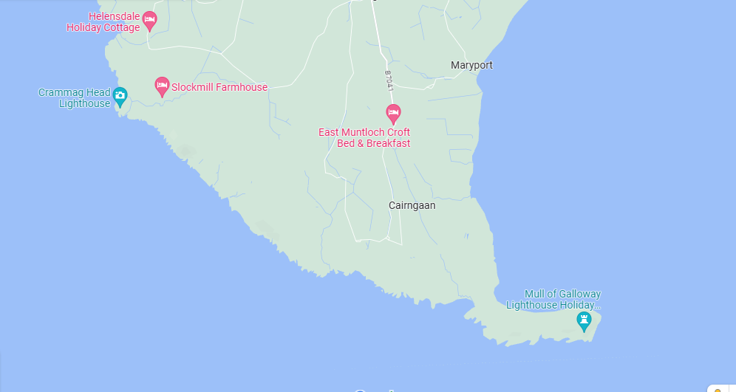
Leg 3 – Scotland Location – Caringaan/ Mull of Gallaway
0530hrs
Swim Bike Run Road Sea - - - Air - - -
Swim 400m –
Along coast of Cairngaan near Mull of Gallaway Lighthouse.
Bike 20km –
Out and back from beach back to Mull of Gallaway Lighthouse.
Run 5km –
Out and back, from and to Mull of Gallaway Lighthouse.

Slide 8
Leg 3 to Leg 4 Travel – Scotland to Isle of Man
0645hrs
Swim Bike Run Road Sea - - - Air - - -
Speed boat will be prepared to leave Mull of Gallaway 1hr and 10 mins after arrival and travel 20 nautical miles to the north coast of the Isle of man near Smeale Beach (The Lhen).
23 Nautical miles

Slide 9
Leg 4 – Isle of Man Location – Smeale Beach to (Helicopter Landing Site)
0745hrs
Swim Bike Run Road Sea - - - Air - - -
Swim 400m –
Dropped by boat on North coast of Isle of Man near Smeale beach and swim the shore
Bike 20km –
Main road from The Lhem to the south end of the island towards the helicopter site.
Run 5km –
Continuing the bike/road route as close to helicopter site as possible. Car will take the final distance.
X

Slide 10
Leg 4 to Leg 5 Travel –Isle of Man to Wales
0900hrs
Swim Bike Run Road Sea - - - Air - - -
Helicopter will be waiting at predesignated point on the south of the island to take Matt + 2 support to the next point. Wales.
40 nautical miles
x
x

Slide 11
Leg 5 – Wales Location – Caemes (Helicopter Landing Site)
0950hrs
Swim Bike Run Road Sea - - - Air - - -
Swim 400m –
Dropped by helicopter to closest point to shore. Bay Swim in Caemes
Bike 20km –
Main road ride, out and back to helicopter site
Run 5km –
Out and back run from and to helicopter landing site
x

Slide 12
Leg 5 to Leg 6 Travel –Wales to Dunkirk
1100hrs
Swim Bike Run Road Sea - - - Air - - -
Helicopter will be waiting at predesignated point near Caemes, Wales and will undertake the journey to the Kent coast near Dover. This will be followed by a high speed power boat crossing to Dunkirk, France.
Helicopter – 250 miles
Boat – 35 nautical miles
x
x

Slide 13
Part 2 – Mainland Europe
6. France
7. Belgium
8. Holland
9. Luxembourg
10. Germany

Slide 14
Leg 6 – France Location – Dunkirk
1300hrs
Swim Bike Run Road Sea - - - Air - - -
Swim 400m –
Dropped by helicopter in the Graveline/Dunkirk Port Swim off the Dunkirk coast/bay
Bike 20km –
Main road towards Belgian coast (Possibly need to out and back due to shortness of road
Run 5km –
Run is measured to take us to the border of Belgium as close as possible
x
x

Slide 15
Leg 7 – Belgium Location – De Panne
1430hrs
Swim Bike Run Road Sea - - - Air - - -
Swim 400m –
Swim off coast at nearest convenient spot.
Bike 20km –
Main road towards Main Road North/East towards the Holland border
Run 5km –
Run off bike towards Holland border and coast near Cadzand
x

Slide 16
Leg 8 – Netherlands Location – Cadzand
1540hrs
Swim Bike Run Road Sea - - - Air - - -
Swim 400m –
Swim off coast at nearest convenient spot to border.
Bike 20km –
Main road towards North/East to closest point to Luxembourg
Run 5km –
Run off bike towards Belgian border and coast.
x

Slide 17
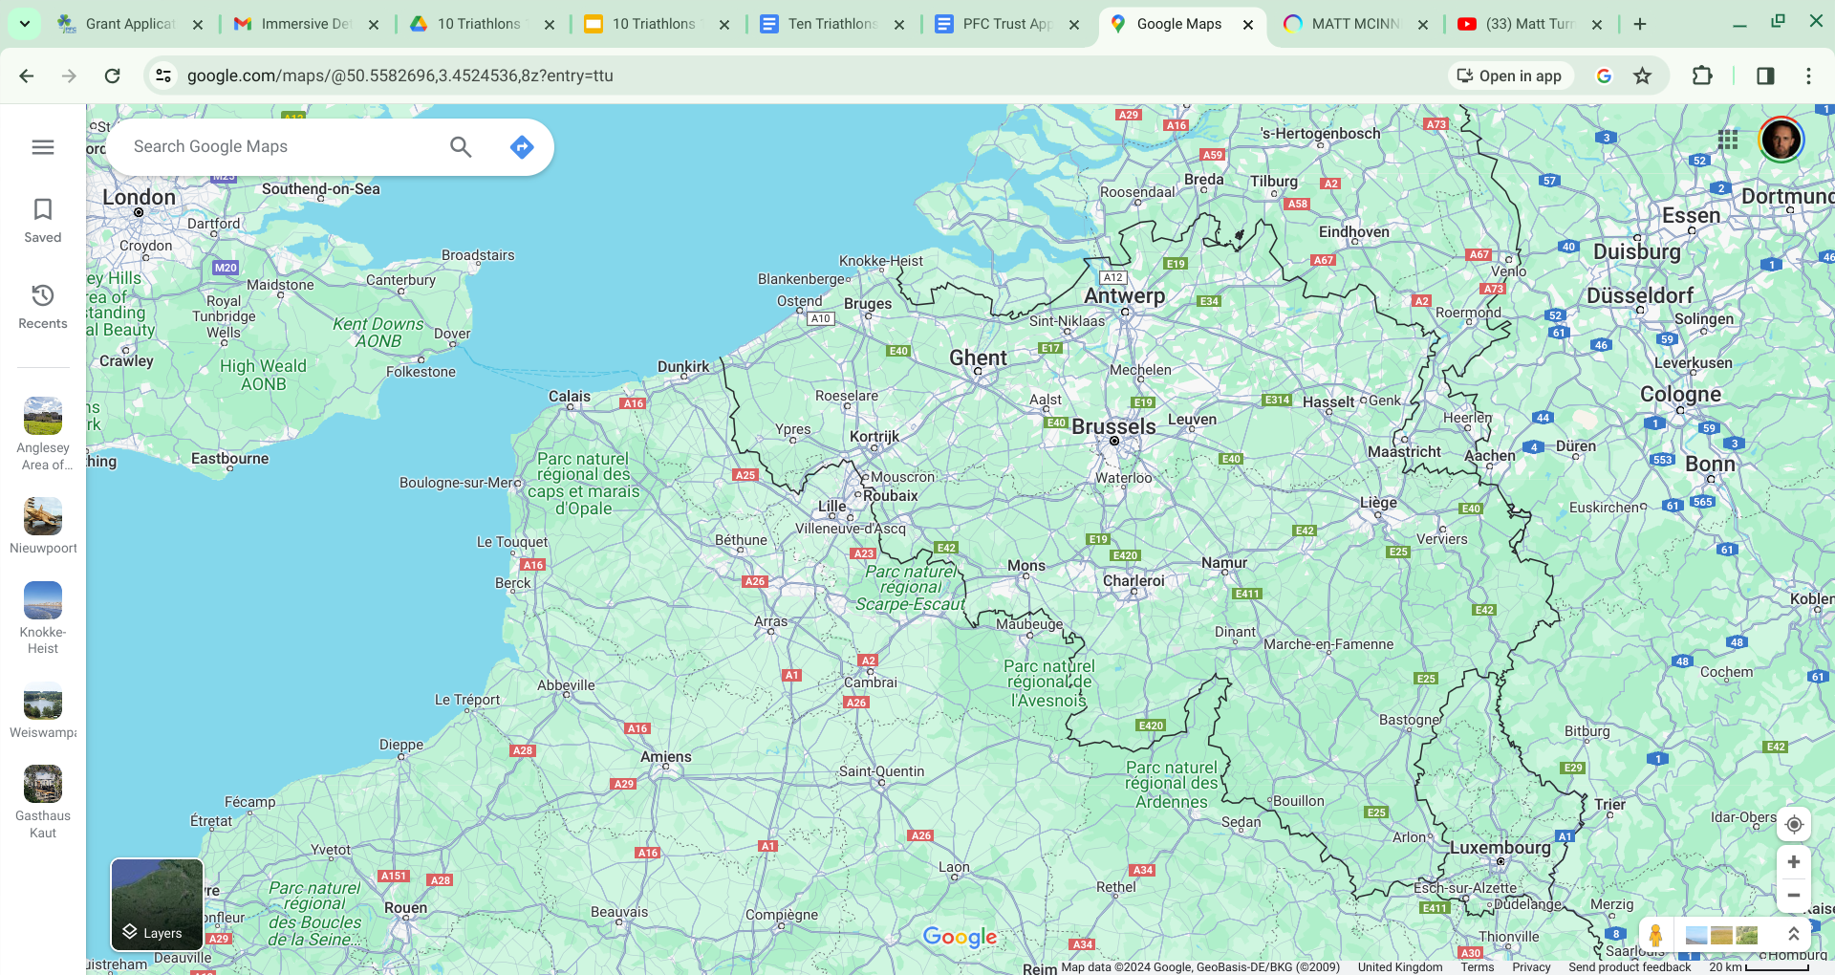
Leg 8 to Leg 9 Travel –Holland to Lux
1700hrs
Swim Bike Run Road Sea - - - Air - - -
This transition from Holland to Luxemburg has not yet been defined. The SLOWEST route is via car at 3.30 hrs duration. It is hoped that local knowledge will prevail and get us across Belgium in a quicker time. Motor bike club?
x
x

Slide 18
Leg 9 –Luxemburg Location – Weiswampach
2130hrs
Swim Bike Run Road Sea - - - Air - - -
Swim 400m –
Bike 20km –
Run 5km –
x

Slide 19
Leg 10 – Germany Location – Dasburg?
2245hrs
Swim Bike Run Road Sea - - - Air - - -
Swim 400m –
Bike 20km –
Run 5km –
x

