Slide 1
RecycleBoxBin, LLC
Some hints about these graphics…
CATION: printers default to print ALL pages. Make sure you delete the pages you are not using – we don’t want you to use up all your printer ink!
The first eleven (10) labels are in our standard format and will match the labels sent with your bin(s).
If you have not done so already, check with your trash hauler to see what restrictions they may have on any items you intend to recycle. This varies widely from community to community.
There are no locks on the MS PPT document… modify the content to match the type of material you are recycling. Don’t forget to save it to your hard drive. All text is Arial and should be loaded on most computers. Pick and chose what you need. Have fun customizing your labels!
Let us know if we can help with any options not shown, or if you struggle with MS PPT. Send a note to admin@recycleboxbin.com
If you have multiple locations for recycling, keep the order of the signs left to right the same for all locations! And remember… keep words minimal and graphics as simple as you can.
Most of our graphic options provide five types of typical content…
1. Compostable
2. Plastic, Metal & Glass
3. State Returnable Bottles
4. Paper
5. Trash
Other options and misc. labels are mixed in as well as some labels will have bilingual (Spanish) added.
We highly suggest printing on the photo paper or presentation paper. Let dry and cut to noted outer black lines. Set your printer to allow borderless printing - the images are just under 8” wide so you need to be able to print within ¼” of the vertical edges of the paper. You can always send this to a local copy center (like FedEx-Kinkos) and have them do all the work and save your ink.

Slide 2

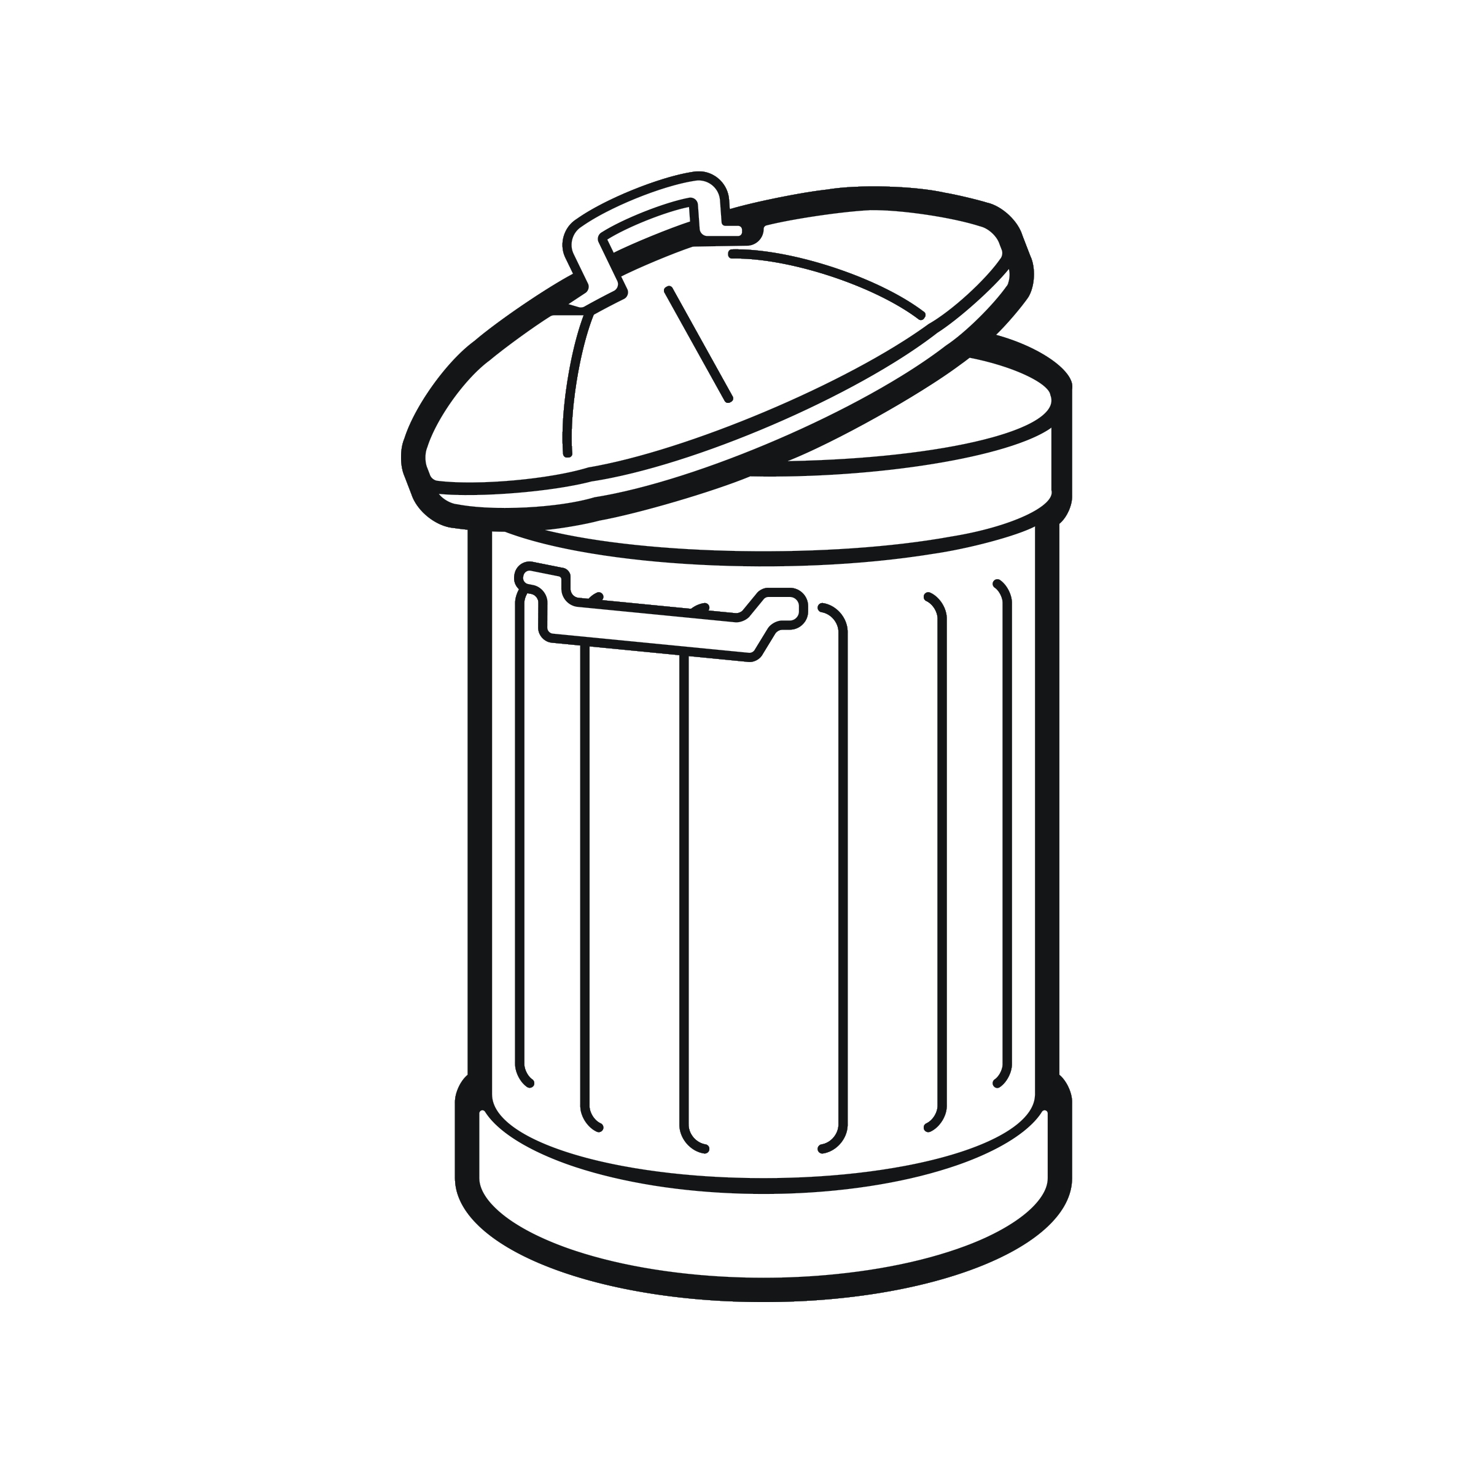

RecycleBoxBin, LLC
CAUTION: Printers default to print ALL pages! Select the pages you need and delete the others. We don’t want to waste your ink!
Set your printer setting for “borderless printing”. We highly suggest using photo or brochure paper for bright color and crisp images . Cut to black line.
waste
Better to send to landfill than to contaminate recyclables
Graphic images are proprietary and may not be altered or used for any other use beyond RecycleBoxBin labels. You are free to move, shrink, enlarge, manipulate the images for use with our label system. Any other distribution, copying or disclosure is prohibited and may be unlawful. We accept no responsibility for changes made to this document or any alterations after transmission from our office.

Slide 3




RecycleBoxBin, LLC
CAUTION: Printers default to print ALL pages! Select the pages you need and delete the others. We don’t want to waste your ink!
Set your printer setting for “borderless printing”. We highly suggest using photo or brochure paper for bright color and crisp images . Cut to black line.
compost
Paper
All #0 Plastics
Pizza Boxes
Paper Towels
Waxed Paper
Cardboard
Soiled Paper
Food Waste
Coffee Grounds
Leaves
Plants
Leftovers
Graphic images are proprietary and may not be altered or used for any other use beyond RecycleBoxBin labels. You are free to move, shrink, enlarge, manipulate the images for use with our label system. Any other distribution, copying or disclosure is prohibited and may be unlawful. We accept no responsibility for changes made to this document or any alterations after transmission from our office.

Slide 4
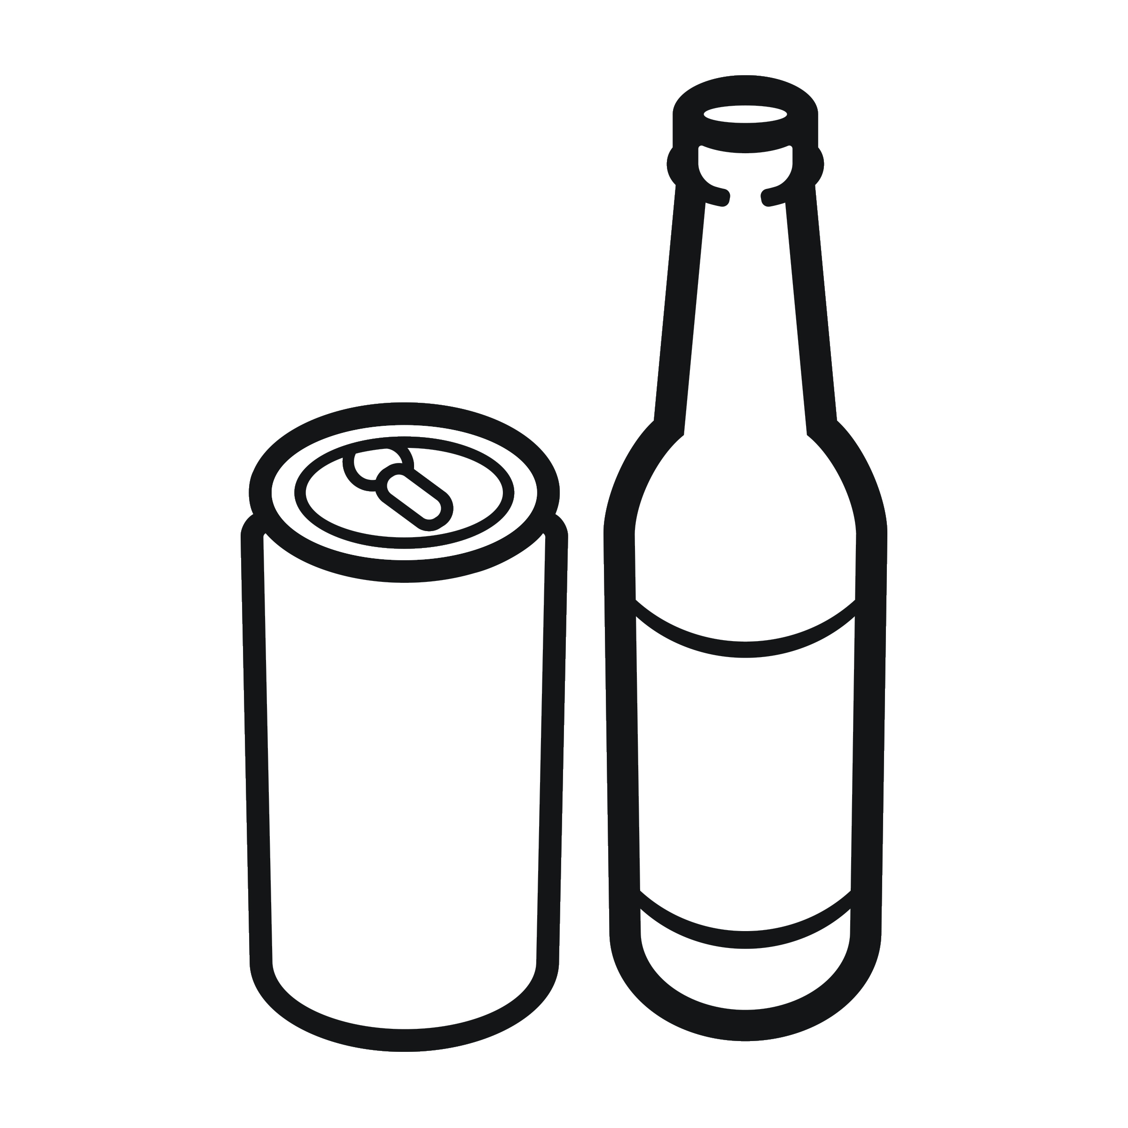
RecycleBoxBin, LLC
CAUTION: Printers default to print ALL pages! Select the pages you need and delete the others. We don’t want to waste your ink!
Set your printer setting for “borderless printing”. We highly suggest using photo or brochure paper for bright color and crisp images . Cut to black line.
deposit
returns
Check for state label
Graphic images are proprietary and may not be altered or used for any other use beyond RecycleBoxBin labels. You are free to move, shrink, enlarge, manipulate the images for use with our label system. Any other distribution, copying or disclosure is prohibited and may be unlawful. We accept no responsibility for changes made to this document or any alterations after transmission from our office.

Slide 5

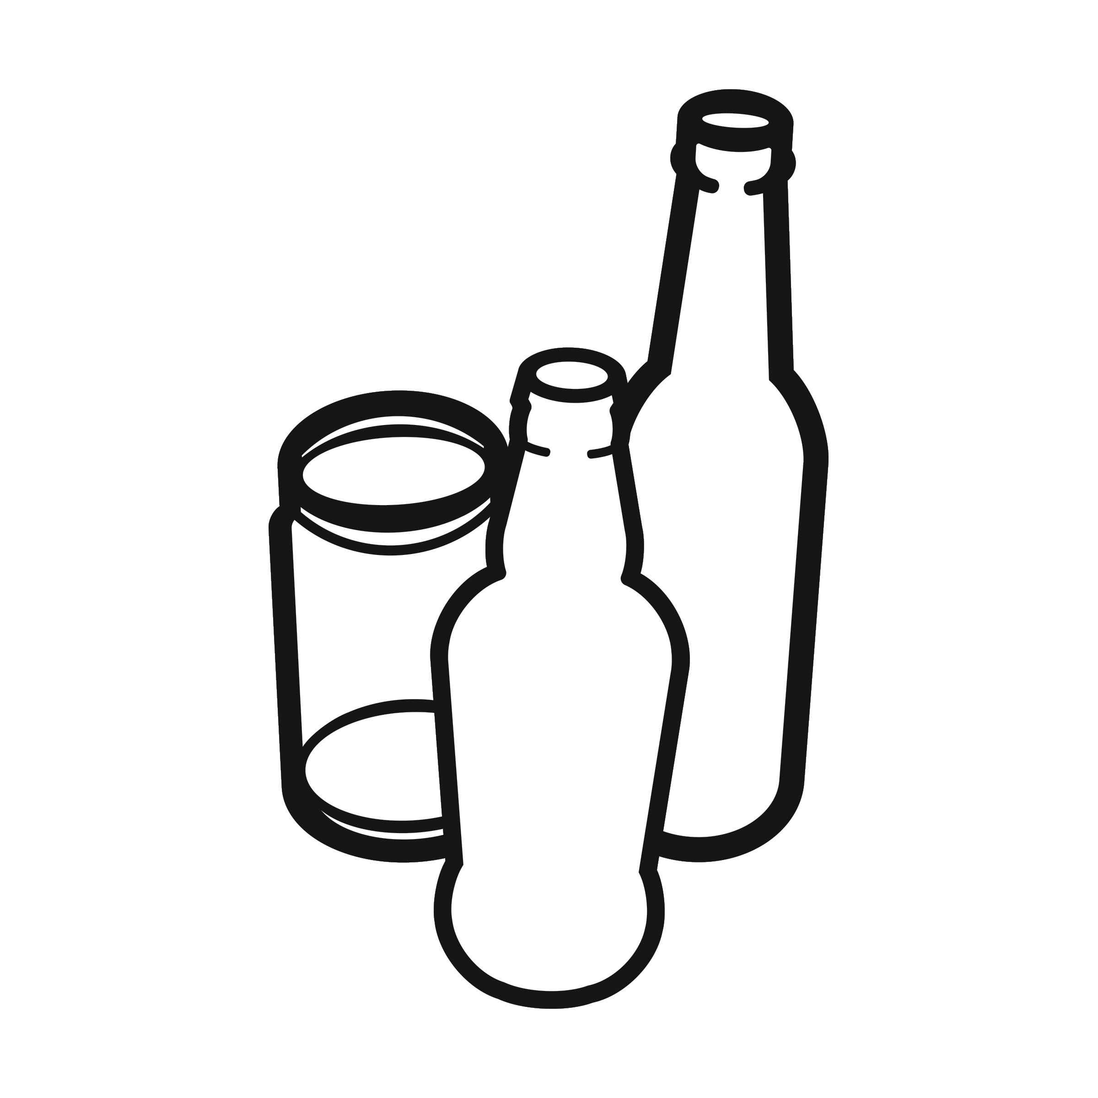
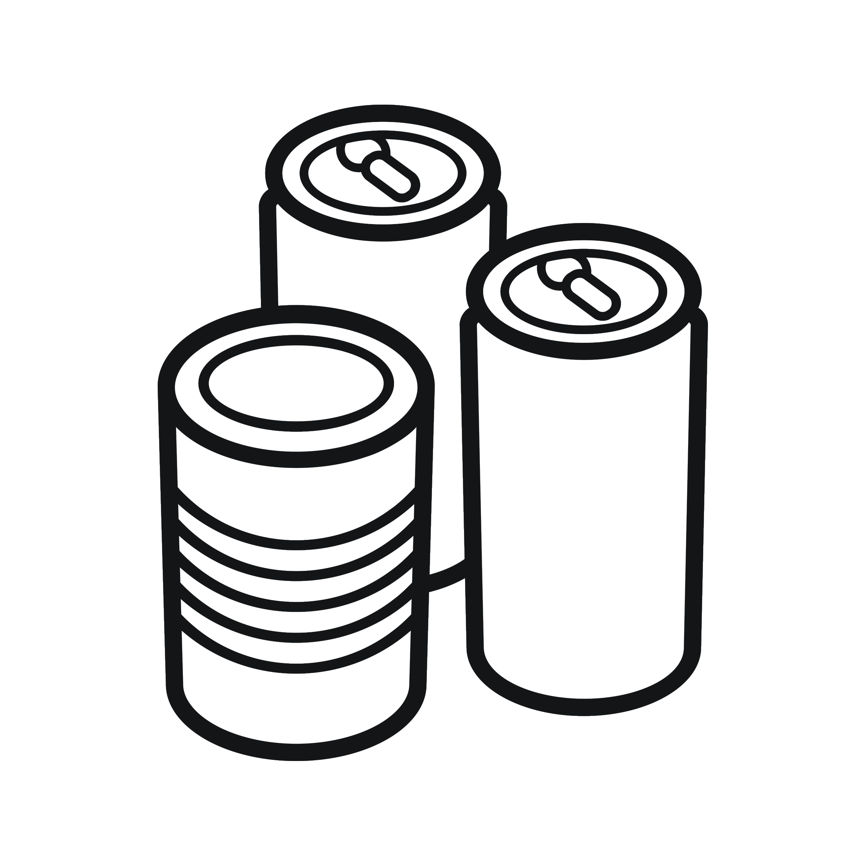
RecycleBoxBin, LLC
CAUTION: Printers default to print ALL pages! Select the pages you need and delete the others. We don’t want to waste your ink!
Set your printer setting for “borderless printing”. We highly suggest using photo or brochure paper for bright color and crisp images . Cut to black line.
plastic
glass
metal
Plastic #1 - #7
Aluminum & tin cans
Glass bottles & jars
Please rinse & clean
Graphic images are proprietary and may not be altered or used for any other use beyond RecycleBoxBin labels. You are free to move, shrink, enlarge, manipulate the images for use with our label system. Any other distribution, copying or disclosure is prohibited and may be unlawful. We accept no responsibility for changes made to this document or any alterations after transmission from our office.

Slide 6



RecycleBoxBin, LLC
CAUTION: Printers default to print ALL pages! Select the pages you need and delete the others. We don’t want to waste your ink!
Set your printer setting for “borderless printing”. We highly suggest using photo or brochure paper for bright color and crisp images . Cut to black line.
paper
Business paper
Mail
Envelopes
Magazines
Cardboard
Small Staples Okay
Graphic images are proprietary and may not be altered or used for any other use beyond RecycleBoxBin labels. You are free to move, shrink, enlarge, manipulate the images for use with our label system. Any other distribution, copying or disclosure is prohibited and may be unlawful. We accept no responsibility for changes made to this document or any alterations after transmission from our office.

Slide 7

RecycleBoxBin, LLC
CAUTION: Printers default to print ALL pages! Select the pages you need and delete the others. We don’t want to waste your ink!
Set your printer setting for “borderless printing”. We highly suggest using photo or brochure paper for bright color and crisp images . Cut to black line.
batteries
All common batteries
Graphic images are proprietary and may not be altered or used for any other use beyond RecycleBoxBin labels. You are free to move, shrink, enlarge, manipulate the images for use with our label system. Any other distribution, copying or disclosure is prohibited and may be unlawful. We accept no responsibility for changes made to this document or any alterations after transmission from our office.

Slide 8

RecycleBoxBin, LLC
CAUTION: Printers default to print ALL pages! Select the pages you need and delete the others. We don’t want to waste your ink!
Set your printer setting for “borderless printing”. We highly suggest using photo or brochure paper for bright color and crisp images . Cut to black line.
small electronics
Graphic images are proprietary and may not be altered or used for any other use beyond RecycleBoxBin labels. You are free to move, shrink, enlarge, manipulate the images for use with our label system. Any other distribution, copying or disclosure is prohibited and may be unlawful. We accept no responsibility for changes made to this document or any alterations after transmission from our office.

Slide 9

CAUTION: Printers default to print ALL pages! Select the pages you need and delete the others. We don’t want to waste your ink!
Set your printer setting for “borderless printing”. We highly suggest using photo or brochure paper for bright color and crisp images . Cut to black line.
eye glasses
Graphic images are proprietary and may not be altered or used for any other use beyond RecycleBoxBin labels. You are free to move, shrink, enlarge, manipulate the images for use with our label system. Any other distribution, copying or disclosure is prohibited and may be unlawful. We accept no responsibility for changes made to this document or any alterations after transmission from our office.

Slide 10
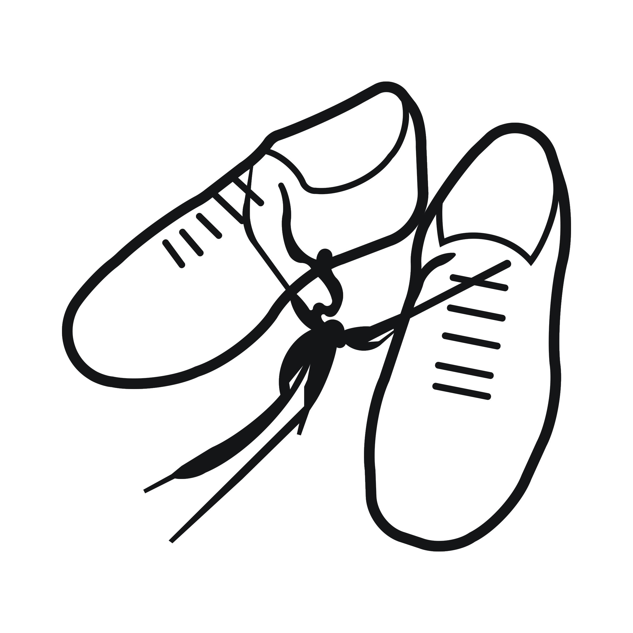
RecycleBoxBin, LLC
CAUTION: Printers default to print ALL pages! Select the pages you need and delete the others. We don’t want to waste your ink!
Set your printer setting for “borderless printing”. We highly suggest using photo or brochure paper for bright color and crisp images . Cut to black line.
shoes
Clean, wearable shoes for donation
Graphic images are proprietary and may not be altered or used for any other use beyond RecycleBoxBin labels. You are free to move, shrink, enlarge, manipulate the images for use with our label system. Any other distribution, copying or disclosure is prohibited and may be unlawful. We accept no responsibility for changes made to this document or any alterations after transmission from our office.

Slide 11
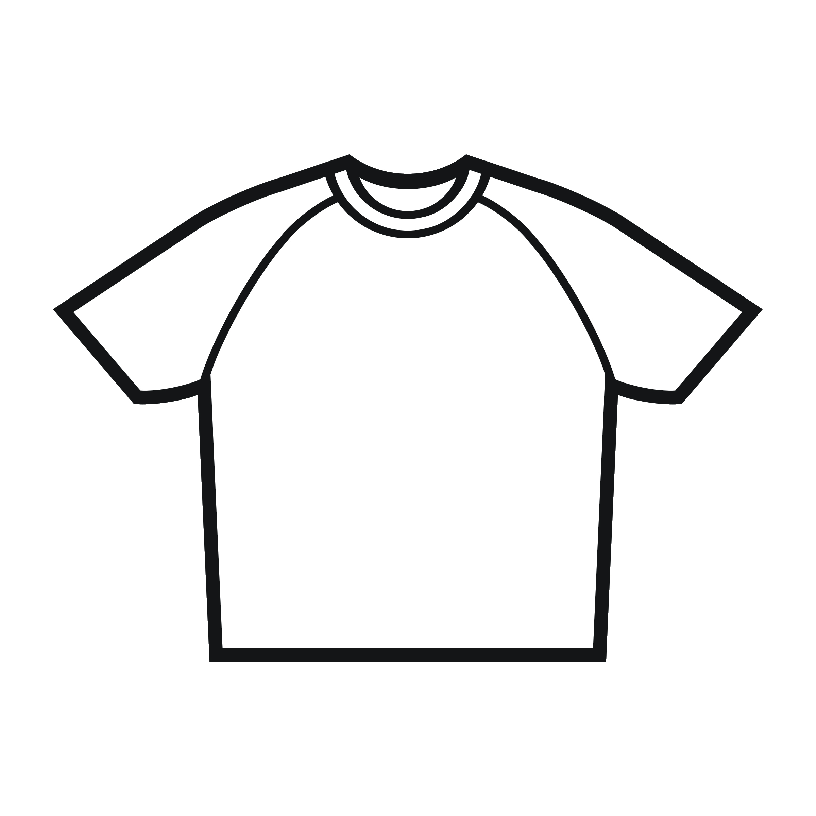
RecycleBoxBin, LLC
CAUTION: Printers default to print ALL pages! Select the pages you need and delete the others. We don’t want to waste your ink!
Set your printer setting for “borderless printing”. We highly suggest using photo or brochure paper for bright color and crisp images . Cut to black line.
clothing
Clean, wearable items for donation
Graphic images are proprietary and may not be altered or used for any other use beyond RecycleBoxBin labels. You are free to move, shrink, enlarge, manipulate the images for use with our label system. Any other distribution, copying or disclosure is prohibited and may be unlawful. We accept no responsibility for changes made to this document or any alterations after transmission from our office.

Slide 12
RecycleBoxBin, LLC
CAUTION: Printers default to print ALL pages! Select the pages you need and delete the others. We don’t want to waste your ink!
Set your printer setting for “borderless printing”. We highly suggest using photo or brochure paper for bright color and crisp images . Cut to black line.
tazas para bebidas calientes y frías
envases de alimentos
cubiertos de plástico
servilletas
sobras de comida
Favor de NO contaminar este contenedor con artículos que no estén marcados para composta
composta
compost
hot & cold cups
food containers
plastic cutlery
napkins
food scraps ok
please do NOT contaminate this container with items not labeled compostable.
Graphic images are proprietary and may not be altered or used for any other use beyond RecycleBoxBin labels. You are free to move, shrink, enlarge, manipulate the images for use with our label system. Any other distribution, copying or disclosure is prohibited and may be unlawful. We accept no responsibility for changes made to this document or any alterations after transmission from our office.

Slide 13
RecycleBoxBin, LLC
CAUTION: Printers default to print ALL pages! Select the pages you need and delete the others. We don’t want to waste your ink!
Set your printer setting for “borderless printing”. We highly suggest using photo or brochure paper for bright color and crisp images . Cut to black line.
plásticos marcados como
#1 al #7 enjuagados y limpios
aluminio
latas
Favor de NO contaminar con plásticos sucios o con artículos con residuos
metal,
plástico,
vidrio
metal,
plastic,
glass
please do NOT contaminate with unclean plastics or items with residue
all rinsed, clean, labeled
#1 through #7 plastics
aluminum and tin cans
glass
Graphic images are proprietary and may not be altered or used for any other use beyond RecycleBoxBin labels. You are free to move, shrink, enlarge, manipulate the images for use with our label system. Any other distribution, copying or disclosure is prohibited and may be unlawful. We accept no responsibility for changes made to this document or any alterations after transmission from our office.

Slide 14
RecycleBoxBin, LLC
CAUTION: Printers default to print ALL pages! Select the pages you need and delete the others. We don’t want to waste your ink!
Set your printer setting for “borderless printing”. We highly suggest using photo or brochure paper for bright color and crisp images . Cut to black line.
Latas de aluminio marcadas con el nombre de su estado
Botellas de plástico marcadas con el nombre de su estado
Botellas de vidrio marcadas con el nombre de su estado
verifique que estén marcados con el nombre del estado
Favor de vaciar y enjuagar todos los envases retornables
retornables
del estado
MI 5C
state
returnables
MI 5C
MI 5C
check for state labels
State labeled aluminum cans
State labeled plastic bottles
State labeled glass bottles
please empty and rinse all State returnables
Graphic images are proprietary and may not be altered or used for any other use beyond RecycleBoxBin labels. You are free to move, shrink, enlarge, manipulate the images for use with our label system. Any other distribution, copying or disclosure is prohibited and may be unlawful. We accept no responsibility for changes made to this document or any alterations after transmission from our office.

Slide 15
RecycleBoxBin, LLC
CAUTION: Printers default to print ALL pages! Select the pages you need and delete the others. We don’t want to waste your ink!
Set your printer setting for “borderless printing”. We highly suggest using photo or brochure paper for bright color and crisp images . Cut to black line.
documentos de papel
correo
sobres
revistas
cartón
grapas pequeñas están bien
papel de oficina
office paper
business paper
mail
envelopes
magazines
cardboard
small staples are OK
Graphic images are proprietary and may not be altered or used for any other use beyond RecycleBoxBin labels. You are free to move, shrink, enlarge, manipulate the images for use with our label system. Any other distribution, copying or disclosure is prohibited and may be unlawful. We accept no responsibility for changes made to this document or any alterations after transmission from our office.

Slide 16
RecycleBoxBin, LLC
CAUTION: Printers default to print ALL pages! Select the pages you need and delete the others. We don’t want to waste your ink!
Set your printer setting for “borderless printing”. We highly suggest using photo or brochure paper for bright color and crisp images . Cut to black line.
todo lo demás no reciclable
todo lo demás no que no es composta
reciclables contaminados
en caso de duda, es mejor tirar artículos al la basura que contaminar reciclables
basura
trash –
land fill
all other non-recyclables
all other non-compostables
contaminated recyclables
if in doubt, it is OK to trash rather than contaminate recyclables
Graphic images are proprietary and may not be altered or used for any other use beyond RecycleBoxBin labels. You are free to move, shrink, enlarge, manipulate the images for use with our label system. Any other distribution, copying or disclosure is prohibited and may be unlawful. We accept no responsibility for changes made to this document or any alterations after transmission from our office.

Slide 17
RecycleBoxBin, LLC
CAUTION: Printers default to print ALL pages! Select the pages you need and delete the others. We don’t want to waste your ink!
Set your printer setting for “borderless printing”. We highly suggest using photo or brochure paper for bright color and crisp images . Cut to black line.
compostables
composta
hot & cold cups
food containers
plastic cutlery
napkins
food scraps ok
tazas para bebidas calientes y frías
envases de alimentos
cubiertos de plástico
servilletas
sobras de comida
please do NOT contaminate this container with items not labeled compostable.
Favor de NO contaminar este contenedor con artículos que no estén marcados para composta
Graphic images are proprietary and may not be altered or used for any other use beyond RecycleBoxBin labels. You are free to move, shrink, enlarge, manipulate the images for use with our label system. Any other distribution, copying or disclosure is prohibited and may be unlawful. We accept no responsibility for changes made to this document or any alterations after transmission from our office.

Slide 18
RecycleBoxBin, LLC
CAUTION: Printers default to print ALL pages! Select the pages you need and delete the others. We don’t want to waste your ink!
Set your printer setting for “borderless printing”. We highly suggest using photo or brochure paper for bright color and crisp images . Cut to black line.
metal, plastic, glass
metal, plástico, vidrio
all rinsed, clean, labeled
#1 through #7 plastics
aluminum
tin cans
plásticos marcados como #1 al #7, enjuagados y limpios
aluminio
latas
please do NOT contaminate with unclean plastics or items with residue
Favor de NO contaminar con plásticos sucios o con artículos con residuos
Graphic images are proprietary and may not be altered or used for any other use beyond RecycleBoxBin labels. You are free to move, shrink, enlarge, manipulate the images for use with our label system. Any other distribution, copying or disclosure is prohibited and may be unlawful. We accept no responsibility for changes made to this document or any alterations after transmission from our office.

Slide 19
RecycleBoxBin, LLC
CAUTION: Printers default to print ALL pages! Select the pages you need and delete the others. We don’t want to waste your ink!
Set your printer setting for “borderless printing”. We highly suggest using photo or brochure paper for bright color and crisp images . Cut to black line.
state returnables
retornables del estado
State labeled aluminum cans
State labeled plastic bottles
State labeled glass bottles
Latas de aluminio marcadas con el nombre de su estado
Botellas de plástico marcadas con el nombre de su estado
Botellas de vidrio marcadas con el nombre de su estado
MI 5C
MI 5C
verifique que estén marcados con el nombre del estado
check for state labels
MI 5C
please empty and rinse all State returnables
Favor de vaciar y enjuagar todos los envases retornables
Graphic images are proprietary and may not be altered or used for any other use beyond RecycleBoxBin labels. You are free to move, shrink, enlarge, manipulate the images for use with our label system. Any other distribution, copying or disclosure is prohibited and may be unlawful. We accept no responsibility for changes made to this document or any alterations after transmission from our office.

Slide 20
RecycleBoxBin, LLC
CAUTION: Printers default to print ALL pages! Select the pages you need and delete the others. We don’t want to waste your ink!
Set your printer setting for “borderless printing”. We highly suggest using photo or brochure paper for bright color and crisp images . Cut to black line.
office paper
papel de oficina
business paper
mail
envelopes
magazines
cardboard
documentos de papel
correo
sobres
revistas
cartón
small staples are OK
grapas pequeñas están bien
Graphic images are proprietary and may not be altered or used for any other use beyond RecycleBoxBin labels. You are free to move, shrink, enlarge, manipulate the images for use with our label system. Any other distribution, copying or disclosure is prohibited and may be unlawful. We accept no responsibility for changes made to this document or any alterations after transmission from our office.

Slide 21
RecycleBoxBin, LLC
CAUTION: Printers default to print ALL pages! Select the pages you need and delete the others. We don’t want to waste your ink!
Set your printer setting for “borderless printing”. We highly suggest using photo or brochure paper for bright color and crisp images . Cut to black line.
trash – landfill
basura
all other non-recyclables
all other non-compostables
contaminated recyclables
todo lo demás no reciclable
todo lo demás no que no es composta
reciclables contaminados
if in doubt, it is OK to trash rather than contaminate recyclables
en caso de duda, es mejor tirar artículos al la basura que contaminar reciclables
Graphic images are proprietary and may not be altered or used for any other use beyond RecycleBoxBin labels. You are free to move, shrink, enlarge, manipulate the images for use with our label system. Any other distribution, copying or disclosure is prohibited and may be unlawful. We accept no responsibility for changes made to this document or any alterations after transmission from our office.

Slide 22
RecycleBoxBin, LLC
CAUTION: Printers default to print ALL pages! Select the pages you need and delete the others. We don’t want to waste your ink!
Set your printer setting for “borderless printing”. We highly suggest using photo or brochure paper for bright color and crisp images . Cut to black line.
compostables
composta
hot & cold cups
food containers
plastic cutlery
napkins
food scraps ok
tazas para bebidas calientes y frías
envases de alimentos
cubiertos de plástico
servilletas
sobras de comida
please do NOT contaminate this container with items not labeled compostable.
Favor de NO contaminar este contenedor con artículos que no estén marcados para composta
Graphic images are proprietary and may not be altered or used for any other use beyond RecycleBoxBin labels. You are free to move, shrink, enlarge, manipulate the images for use with our label system. Any other distribution, copying or disclosure is prohibited and may be unlawful. We accept no responsibility for changes made to this document or any alterations after transmission from our office.

Slide 23
RecycleBoxBin, LLC
CAUTION: Printers default to print ALL pages! Select the pages you need and delete the others. We don’t want to waste your ink!
Set your printer setting for “borderless printing”. We highly suggest using photo or brochure paper for bright color and crisp images . Cut to black line.
metal, plastic, glass
metal, plástico, vidrio
all rinsed, clean, labeled
#1 through #7 plastics
aluminum
tin cans
plásticos marcados como
#1 al #7, enjuagados y limpios
aluminio
latas
please do NOT contaminate with unclean plastics or items with residue
favor de NO contaminar con plásticos sucios o con artículos con residuos
Graphic images are proprietary and may not be altered or used for any other use beyond RecycleBoxBin labels. You are free to move, shrink, enlarge, manipulate the images for use with our label system. Any other distribution, copying or disclosure is prohibited and may be unlawful. We accept no responsibility for changes made to this document or any alterations after transmission from our office.

Slide 24
RecycleBoxBin, LLC
CAUTION: Printers default to print ALL pages! Select the pages you need and delete the others. We don’t want to waste your ink!
Set your printer setting for “borderless printing”. We highly suggest using photo or brochure paper for bright color and crisp images . Cut to black line.
state returnables
retornables del estado
State labeled aluminum cans
State labeled plastic bottles
State labeled glass bottles
Latas de aluminio marcadas con el nombre de su estado
Botellas de plástico marcadas con el nombre de su estado
Botellas de vidrio marcadas con el nombre de su estado
MI 5C
MI 5C
verifique que estén marcados con el nombre del estado
MI 5C
check for state labels
please empty and rinse all State returnables
favor de vaciar y enjuagar todos los envases retornables
Graphic images are proprietary and may not be altered or used for any other use beyond RecycleBoxBin labels. You are free to move, shrink, enlarge, manipulate the images for use with our label system. Any other distribution, copying or disclosure is prohibited and may be unlawful. We accept no responsibility for changes made to this document or any alterations after transmission from our office.

Slide 25
RecycleBoxBin, LLC
CAUTION: Printers default to print ALL pages! Select the pages you need and delete the others. We don’t want to waste your ink!
Set your printer setting for “borderless printing”. We highly suggest using photo or brochure paper for bright color and crisp images . Cut to black line.
office paper
papel de oficina
business paper
mail
envelopes
magazines
cardboard
documentos de papel
correo
sobres
revistas
cartón
small staples are OK
grapas pequeñas están bien
Graphic images are proprietary and may not be altered or used for any other use beyond RecycleBoxBin labels. You are free to move, shrink, enlarge, manipulate the images for use with our label system. Any other distribution, copying or disclosure is prohibited and may be unlawful. We accept no responsibility for changes made to this document or any alterations after transmission from our office.

Slide 26
RecycleBoxBin, LLC
CAUTION: Printers default to print ALL pages! Select the pages you need and delete the others. We don’t want to waste your ink!
Set your printer setting for “borderless printing”. We highly suggest using photo or brochure paper for bright color and crisp images . Cut to black line.
trash – land fill
basura
all other non-recyclables
all other non-compostables
contaminated recyclables
todo lo demás no reciclable
todo lo demás no que no es composta
reciclables contaminados
if in doubt, it is OK to trash rather than contaminate recyclables
en caso de duda, es mejor tirar artículos al la basura que contaminar reciclables
Graphic images are proprietary and may not be altered or used for any other use beyond RecycleBoxBin labels. You are free to move, shrink, enlarge, manipulate the images for use with our label system. Any other distribution, copying or disclosure is prohibited and may be unlawful. We accept no responsibility for changes made to this document or any alterations after transmission from our office.

Slide 27
RecycleBoxBin, LLC
CAUTION: Printers default to print ALL pages! Select the pages you need and delete the others. We don’t want to waste your ink!
Set your printer setting for “borderless printing”. We highly suggest using photo or brochure paper for bright color and crisp images . Cut to black line.
hot & cold cups
food containers
plastic cutlery
napkins
food scraps ok
tazas para bebidas calientes y frías
envases de alimentos
cubiertos de plástico
servilletas
sobras de comida
favor de NO contaminar este contenedor con artículos que no estén marcados para composta
please do NOT contaminate this container with items not labeled compostable.
compostables
composta
Graphic images are proprietary and may not be altered or used for any other use beyond RecycleBoxBin labels. You are free to move, shrink, enlarge, manipulate the images for use with our label system. Any other distribution, copying or disclosure is prohibited and may be unlawful. We accept no responsibility for changes made to this document or any alterations after transmission from our office.

Slide 28
RecycleBoxBin, LLC
CAUTION: Printers default to print ALL pages! Select the pages you need and delete the others. We don’t want to waste your ink!
Set your printer setting for “borderless printing”. We highly suggest using photo or brochure paper for bright color and crisp images . Cut to black line.
all rinsed, clean, labeled
#1 through #7 plastics
aluminum
tin cans
plásticos marcados como
#1 al #7, enjuagados y limpios
aluminio
latas
please do NOT contaminate with unclean plastics or items with residue
favor de NO contaminar con plásticos sucios o con artículos con residuos
metal, plastic, glass
metal, plástico, vidrio
Graphic images are proprietary and may not be altered or used for any other use beyond RecycleBoxBin labels. You are free to move, shrink, enlarge, manipulate the images for use with our label system. Any other distribution, copying or disclosure is prohibited and may be unlawful. We accept no responsibility for changes made to this document or any alterations after transmission from our office.

Slide 29
RecycleBoxBin, LLC
CAUTION: Printers default to print ALL pages! Select the pages you need and delete the others. We don’t want to waste your ink!
Set your printer setting for “borderless printing”. We highly suggest using photo or brochure paper for bright color and crisp images . Cut to black line.
State labeled aluminum cans
State labeled plastic bottles
State labeled glass bottles
Latas de aluminio marcadas con el nombre de su estado
Botellas de plástico marcadas con el nombre de su estado
Botellas de vidrio marcadas con el nombre de su estado
MI 5C
MI 5C
MI 5C
verifique que estén marcados con el nombre del estado
check for state labels
please empty and rinse all State returnables
favor de vaciar y enjuagar todos los envases retornables
state returnables
retornables del estado
Graphic images are proprietary and may not be altered or used for any other use beyond RecycleBoxBin labels. You are free to move, shrink, enlarge, manipulate the images for use with our label system. Any other distribution, copying or disclosure is prohibited and may be unlawful. We accept no responsibility for changes made to this document or any alterations after transmission from our office.

Slide 30
RecycleBoxBin, LLC
CAUTION: Printers default to print ALL pages! Select the pages you need and delete the others. We don’t want to waste your ink!
Set your printer setting for “borderless printing”. We highly suggest using photo or brochure paper for bright color and crisp images . Cut to black line.
business paper
mail
envelopes
magazines
cardboard
documentos de papel
correo
sobres
revistas
cartón
small staples are OK
grapas pequeñas están bien
office paper
papel de oficina
Graphic images are proprietary and may not be altered or used for any other use beyond RecycleBoxBin labels. You are free to move, shrink, enlarge, manipulate the images for use with our label system. Any other distribution, copying or disclosure is prohibited and may be unlawful. We accept no responsibility for changes made to this document or any alterations after transmission from our office.

Slide 31
RecycleBoxBin, LLC
CAUTION: Printers default to print ALL pages! Select the pages you need and delete the others. We don’t want to waste your ink!
Set your printer setting for “borderless printing”. We highly suggest using photo or brochure paper for bright color and crisp images . Cut to black line.
all other non-recyclables
all other non-compostables
contaminated recyclables
todo lo demás no reciclable
todo lo demás no que no es composta
reciclables contaminados
if in doubt, it is OK to trash rather than contaminate recyclables
en caso de duda, es mejor tirar artículos al la basura que contaminar reciclables
trash – land fill
basura
Graphic images are proprietary and may not be altered or used for any other use beyond RecycleBoxBin labels. You are free to move, shrink, enlarge, manipulate the images for use with our label system. Any other distribution, copying or disclosure is prohibited and may be unlawful. We accept no responsibility for changes made to this document or any alterations after transmission from our office.

Slide 32
RecycleBoxBin, LLC
CAUTION: Printers default to print ALL pages! Select the pages you need and delete the others. We don’t want to waste your ink!
Set your printer setting for “borderless printing”. We highly suggest using photo or brochure paper for bright color and crisp images . Cut to black line.
tazas para bebidas calientes y frías
envases de alimentos
cubiertos de plástico
servilletas
sobras de comida
favor de NO contaminar este contenedor con artículos que no estén marcados para composta
composta
compost
hot & cold cups
food containers
plastic cutlery
napkins
food scraps ok
please do NOT contaminate this container with items not labeled compostable.
Graphic images are proprietary and may not be altered or used for any other use beyond RecycleBoxBin labels. You are free to move, shrink, enlarge, manipulate the images for use with our label system. Any other distribution, copying or disclosure is prohibited and may be unlawful. We accept no responsibility for changes made to this document or any alterations after transmission from our office.

Slide 33
RecycleBoxBin, LLC
CAUTION: Printers default to print ALL pages! Select the pages you need and delete the others. We don’t want to waste your ink!
Set your printer setting for “borderless printing”. We highly suggest using photo or brochure paper for bright color and crisp images . Cut to black line.
favor de NO contaminar con plásticos sucios o con artículos con residuos
plásticos marcados como
#1 al #7 enjuagados y limpios
aluminio
latas
metal,
plástico,
vidrio
metal,
plastic,
glass
all rinsed, clean, labeled
#1 through #7 plastics
aluminum and tin cans
glass
please do NOT contaminate with unclean plastics or items with residue
Graphic images are proprietary and may not be altered or used for any other use beyond RecycleBoxBin labels. You are free to move, shrink, enlarge, manipulate the images for use with our label system. Any other distribution, copying or disclosure is prohibited and may be unlawful. We accept no responsibility for changes made to this document or any alterations after transmission from our office.

Slide 34
RecycleBoxBin, LLC
CAUTION: Printers default to print ALL pages! Select the pages you need and delete the others. We don’t want to waste your ink!
Set your printer setting for “borderless printing”. We highly suggest using photo or brochure paper for bright color and crisp images . Cut to black line.
Latas de aluminio marcadas con el nombre de su estado
Botellas de plástico marcadas con el nombre de su estado
Botellas de vidrio marcadas con el nombre de su estado
favor de vaciar y enjuagar todos los envases retornables
verifique que estén marcados con el nombre del estado
retornables
del estado
MI 5C
state
returnables
MI 5C
MI 5C
check for state labels
State labeled aluminum cans
State labeled plastic bottles
State labeled glass bottles
please empty and rinse all State returnables
Graphic images are proprietary and may not be altered or used for any other use beyond RecycleBoxBin labels. You are free to move, shrink, enlarge, manipulate the images for use with our label system. Any other distribution, copying or disclosure is prohibited and may be unlawful. We accept no responsibility for changes made to this document or any alterations after transmission from our office.

Slide 35
RecycleBoxBin, LLC
CAUTION: Printers default to print ALL pages! Select the pages you need and delete the others. We don’t want to waste your ink!
Set your printer setting for “borderless printing”. We highly suggest using photo or brochure paper for bright color and crisp images . Cut to black line.
documentos de papel
correo
sobres
revistas
cartón
grapas pequeñas están bien
papel de oficina
office paper
business paper
mail
envelopes
magazines
cardboard
small staples are OK
Graphic images are proprietary and may not be altered or used for any other use beyond RecycleBoxBin labels. You are free to move, shrink, enlarge, manipulate the images for use with our label system. Any other distribution, copying or disclosure is prohibited and may be unlawful. We accept no responsibility for changes made to this document or any alterations after transmission from our office.

Slide 36
RecycleBoxBin, LLC
CAUTION: Printers default to print ALL pages! Select the pages you need and delete the others. We don’t want to waste your ink!
Set your printer setting for “borderless printing”. We highly suggest using photo or brochure paper for bright color and crisp images . Cut to black line.
todo lo demás no reciclable
todo lo demás no que no es composta
reciclables contaminados
en caso de duda, es mejor tirar artículos al la basura que contaminar reciclables
basura
trash –
land fill
all other non-recyclables
all other non-compostables
contaminated recyclables
if in doubt, it is OK to trash rather than contaminate recyclables
Graphic images are proprietary and may not be altered or used for any other use beyond RecycleBoxBin labels. You are free to move, shrink, enlarge, manipulate the images for use with our label system. Any other distribution, copying or disclosure is prohibited and may be unlawful. We accept no responsibility for changes made to this document or any alterations after transmission from our office.

Slide 37
RecycleBoxBin, LLC
CAUTION: Printers default to print ALL pages! Select the pages you need and delete the others. We don’t want to waste your ink!
Set your printer setting for “borderless printing”. We highly suggest using photo or brochure paper for bright color and crisp images . Cut to black line.
compostables
hot & cold cups
food containers
plastic cutlery
napkins
food scraps ok
please do NOT contaminate this container with items not labeled compostable.
Graphic images are proprietary and may not be altered or used for any other use beyond RecycleBoxBin labels. You are free to move, shrink, enlarge, manipulate the images for use with our label system. Any other distribution, copying or disclosure is prohibited and may be unlawful. We accept no responsibility for changes made to this document or any alterations after transmission from our office.

Slide 38
RecycleBoxBin, LLC
CAUTION: Printers default to print ALL pages! Select the pages you need and delete the others. We don’t want to waste your ink!
Set your printer setting for “borderless printing”. We highly suggest using photo or brochure paper for bright color and crisp images . Cut to black line.
plastic, metal & glass
#1 through
#7 plastics
aluminum
tin cans
glass
please do NOT contaminate with unclean plastics or items with residue
Graphic images are proprietary and may not be altered or used for any other use beyond RecycleBoxBin labels. You are free to move, shrink, enlarge, manipulate the images for use with our label system. Any other distribution, copying or disclosure is prohibited and may be unlawful. We accept no responsibility for changes made to this document or any alterations after transmission from our office.

Slide 39
RecycleBoxBin, LLC
CAUTION: Printers default to print ALL pages! Select the pages you need and delete the others. We don’t want to waste your ink!
Set your printer setting for “borderless printing”. We highly suggest using photo or brochure paper for bright color and crisp images . Cut to black line.
state returnable
bottles/cans
State labeled aluminum cans
State labeled plastic bottles
State labeled glass bottles
check for state labels
please empty and rinse all State returnables
Graphic images are proprietary and may not be altered or used for any other use beyond RecycleBoxBin labels. You are free to move, shrink, enlarge, manipulate the images for use with our label system. Any other distribution, copying or disclosure is prohibited and may be unlawful. We accept no responsibility for changes made to this document or any alterations after transmission from our office.

Slide 40
RecycleBoxBin, LLC
CAUTION: Printers default to print ALL pages! Select the pages you need and delete the others. We don’t want to waste your ink!
Set your printer setting for “borderless printing”. We highly suggest using photo or brochure paper for bright color and crisp images . Cut to black line.
office paper
business paper
mail
envelopes
magazines
cardboard
small staples are OK
Graphic images are proprietary and may not be altered or used for any other use beyond RecycleBoxBin labels. You are free to move, shrink, enlarge, manipulate the images for use with our label system. Any other distribution, copying or disclosure is prohibited and may be unlawful. We accept no responsibility for changes made to this document or any alterations after transmission from our office.

Slide 41
RecycleBoxBin, LLC
CAUTION: Printers default to print ALL pages! Select the pages you need and delete the others. We don’t want to waste your ink!
Set your printer setting for “borderless printing”. We highly suggest using photo or brochure paper for bright color and crisp images . Cut to black line.
landfill - trash
all other non-recyclables
all other non-compostables
contaminated recyclables
if in doubt, it is OK to trash rather than to contaminate recyclables
Graphic images are proprietary and may not be altered or used for any other use beyond RecycleBoxBin labels. You are free to move, shrink, enlarge, manipulate the images for use with our label system. Any other distribution, copying or disclosure is prohibited and may be unlawful. We accept no responsibility for changes made to this document or any alterations after transmission from our office.

Slide 42
RecycleBoxBin, LLC
CAUTION: Printers default to print ALL pages! Select the pages you need and delete the others. We don’t want to waste your ink!
Set your printer setting for “borderless printing”. We highly suggest using photo or brochure paper for bright color and crisp images . Cut to black line.
compostables
hot & cold cups
food containers
plastic cutlery
napkins
food scraps ok
please do NOT contaminate this container with items not labeled compostable.
Graphic images are proprietary and may not be altered or used for any other use beyond RecycleBoxBin labels. You are free to move, shrink, enlarge, manipulate the images for use with our label system. Any other distribution, copying or disclosure is prohibited and may be unlawful. We accept no responsibility for changes made to this document or any alterations after transmission from our office.

Slide 43
RecycleBoxBin, LLC
CAUTION: Printers default to print ALL pages! Select the pages you need and delete the others. We don’t want to waste your ink!
Set your printer setting for “borderless printing”. We highly suggest using photo or brochure paper for bright color and crisp images . Cut to black line.
plastic, metal & glass
all rinsed, clean, labeled
#1 through #7 plastics
aluminum
tin cans
please do NOT contaminate with unclean plastics or items with residue
Graphic images are proprietary and may not be altered or used for any other use beyond RecycleBoxBin labels. You are free to move, shrink, enlarge, manipulate the images for use with our label system. Any other distribution, copying or disclosure is prohibited and may be unlawful. We accept no responsibility for changes made to this document or any alterations after transmission from our office.

Slide 44
RecycleBoxBin, LLC
CAUTION: Printers default to print ALL pages! Select the pages you need and delete the others. We don’t want to waste your ink!
Set your printer setting for “borderless printing”. We highly suggest using photo or brochure paper for bright color and crisp images . Cut to black line.
state returnable
bottles/cans
State labeled aluminum cans
State labeled plastic bottles
State labeled glass bottles
check for state labels
please empty and rinse all State returnables
Graphic images are proprietary and may not be altered or used for any other use beyond RecycleBoxBin labels. You are free to move, shrink, enlarge, manipulate the images for use with our label system. Any other distribution, copying or disclosure is prohibited and may be unlawful. We accept no responsibility for changes made to this document or any alterations after transmission from our office.

Slide 45
RecycleBoxBin, LLC
CAUTION: Printers default to print ALL pages! Select the pages you need and delete the others. We don’t want to waste your ink!
Set your printer setting for “borderless printing”. We highly suggest using photo or brochure paper for bright color and crisp images . Cut to black line.
office paper
business paper
mail
envelopes
magazines
cardboard
small staples are OK
Graphic images are proprietary and may not be altered or used for any other use beyond RecycleBoxBin labels. You are free to move, shrink, enlarge, manipulate the images for use with our label system. Any other distribution, copying or disclosure is prohibited and may be unlawful. We accept no responsibility for changes made to this document or any alterations after transmission from our office.

Slide 46
RecycleBoxBin, LLC
CAUTION: Printers default to print ALL pages! Select the pages you need and delete the others. We don’t want to waste your ink!
Set your printer setting for “borderless printing”. We highly suggest using photo or brochure paper for bright color and crisp images . Cut to black line.
landfill - trash
all other non-recyclables
all other non-compostables
contaminated recyclables
if in doubt, it is OK to trash rather than to contaminate recyclables
Graphic images are proprietary and may not be altered or used for any other use beyond RecycleBoxBin labels. You are free to move, shrink, enlarge, manipulate the images for use with our label system. Any other distribution, copying or disclosure is prohibited and may be unlawful. We accept no responsibility for changes made to this document or any alterations after transmission from our office.

Slide 47
RecycleBoxBin, LLC
CAUTION: Printers default to print ALL pages! Select the pages you need and delete the others. We don’t want to waste your ink!
Set your printer setting for “borderless printing”. We highly suggest using photo or brochure paper for bright color and crisp images . Cut to black line.
compostables
hot & cold cups
food containers
plastic cutlery
napkins
food scraps OK
please do NOT contaminate this container with items not labeled compostable.
Graphic images are proprietary and may not be altered or used for any other use beyond RecycleBoxBin labels. You are free to move, shrink, enlarge, manipulate the images for use with our label system. Any other distribution, copying or disclosure is prohibited and may be unlawful. We accept no responsibility for changes made to this document or any alterations after transmission from our office.

Slide 48
RecycleBoxBin, LLC
CAUTION: Printers default to print ALL pages! Select the pages you need and delete the others. We don’t want to waste your ink!
Set your printer setting for “borderless printing”. We highly suggest using photo or brochure paper for bright color and crisp images . Cut to black line.
plastics metal & glass
all rinsed, clean, labeled
#1 through #7 plastics
aluminum
tin cans
all clean glass – colors OK
please do NOT contaminate with unclean containers or items with residue
Graphic images are proprietary and may not be altered or used for any other use beyond RecycleBoxBin labels. You are free to move, shrink, enlarge, manipulate the images for use with our label system. Any other distribution, copying or disclosure is prohibited and may be unlawful. We accept no responsibility for changes made to this document or any alterations after transmission from our office.

Slide 49
RecycleBoxBin, LLC
CAUTION: Printers default to print ALL pages! Select the pages you need and delete the others. We don’t want to waste your ink!
Set your printer setting for “borderless printing”. We highly suggest using photo or brochure paper for bright color and crisp images . Cut to black line.
returnable deposit
bottles & cans
State labeled aluminum cans
State labeled plastic bottles
State labeled glass bottles
please empty and rinse all State returnables
Graphic images are proprietary and may not be altered or used for any other use beyond RecycleBoxBin labels. You are free to move, shrink, enlarge, manipulate the images for use with our label system. Any other distribution, copying or disclosure is prohibited and may be unlawful. We accept no responsibility for changes made to this document or any alterations after transmission from our office.

Slide 50
RecycleBoxBin, LLC
CAUTION: Printers default to print ALL pages! Select the pages you need and delete the others. We don’t want to waste your ink!
Set your printer setting for “borderless printing”. We highly suggest using photo or brochure paper for bright color and crisp images . Cut to black line.
office paper
business paper
mail, envelopes
magazines
cardboard
small staples are OK
Graphic images are proprietary and may not be altered or used for any other use beyond RecycleBoxBin labels. You are free to move, shrink, enlarge, manipulate the images for use with our label system. Any other distribution, copying or disclosure is prohibited and may be unlawful. We accept no responsibility for changes made to this document or any alterations after transmission from our office.

Slide 51
RecycleBoxBin, LLC
CAUTION: Printers default to print ALL pages! Select the pages you need and delete the others. We don’t want to waste your ink!
Set your printer setting for “borderless printing”. We highly suggest using photo or brochure paper for bright color and crisp images . Cut to black line.
landfill - trash
all other non-recyclables
all other non-compostables
contaminated recyclables
if in doubt, it is OK to trash rather than to
contaminate recyclables
Graphic images are proprietary and may not be altered or used for any other use beyond RecycleBoxBin labels. You are free to move, shrink, enlarge, manipulate the images for use with our label system. Any other distribution, copying or disclosure is prohibited and may be unlawful. We accept no responsibility for changes made to this document or any alterations after transmission from our office.

Slide 52
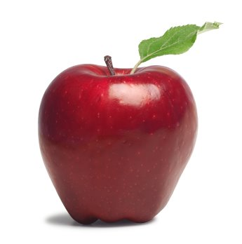

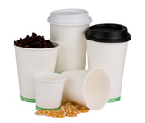

RecycleBoxBin, LLC
CAUTION: Printers default to print ALL pages! Select the pages you need and delete the others. We don’t want to waste your ink!
Set your printer setting for “borderless printing”. We highly suggest using photo or brochure paper for bright color and crisp images . Cut to black line.
compostables
hot & cold cups
food containers
plastic cutlery
napkins
food scraps OK
please do NOT contaminate this container with items not labeled compostable.
Graphic images are proprietary and may not be altered or used for any other use beyond RecycleBoxBin labels. You are free to move, shrink, enlarge, manipulate the images for use with our label system. Any other distribution, copying or disclosure is prohibited and may be unlawful. We accept no responsibility for changes made to this document or any alterations after transmission from our office.

Slide 53
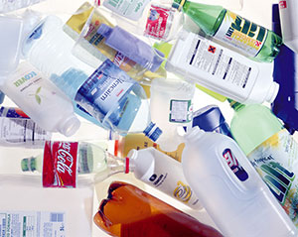
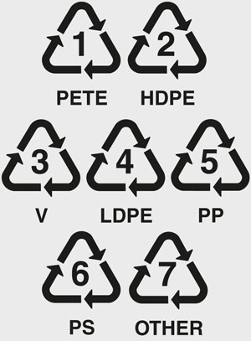
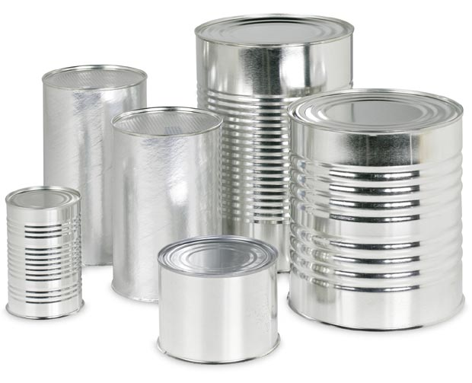
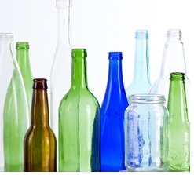
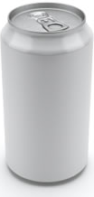
RecycleBoxBin, LLC
CAUTION: Printers default to print ALL pages! Select the pages you need and delete the others. We don’t want to waste your ink!
Set your printer setting for “borderless printing”. We highly suggest using photo or brochure paper for bright color and crisp images . Cut to black line.
plastic, metal & glass
all rinsed, clean, labeled
#1 through #7 plastics
aluminum & tin cans
glass – all colors
please do NOT contaminate with residue, rinse items before recycling
Graphic images are proprietary and may not be altered or used for any other use beyond RecycleBoxBin labels. You are free to move, shrink, enlarge, manipulate the images for use with our label system. Any other distribution, copying or disclosure is prohibited and may be unlawful. We accept no responsibility for changes made to this document or any alterations after transmission from our office.

Slide 54
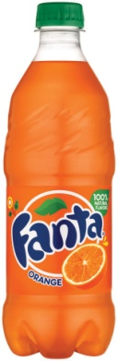
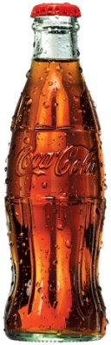
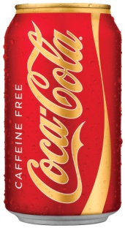
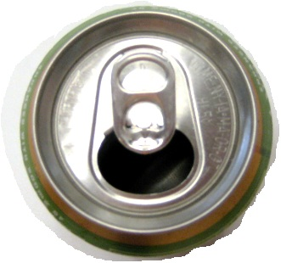
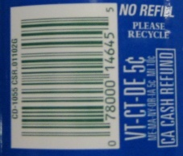
RecycleBoxBin, LLC
CAUTION: Printers default to print ALL pages! Select the pages you need and delete the others. We don’t want to waste your ink!
Set your printer setting for “borderless printing”. We highly suggest using photo or brochure paper for bright color and crisp images . Cut to black line.
returnable deposit
bottles/cans
State labeled aluminum cans
State labeled plastic bottles
State labeled glass bottles
please empty and rinse all State returnables
check for labels
Graphic images are proprietary and may not be altered or used for any other use beyond RecycleBoxBin labels. You are free to move, shrink, enlarge, manipulate the images for use with our label system. Any other distribution, copying or disclosure is prohibited and may be unlawful. We accept no responsibility for changes made to this document or any alterations after transmission from our office.

Slide 55
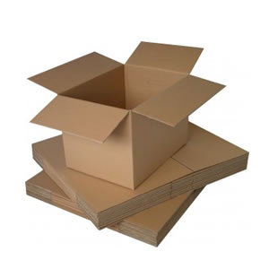
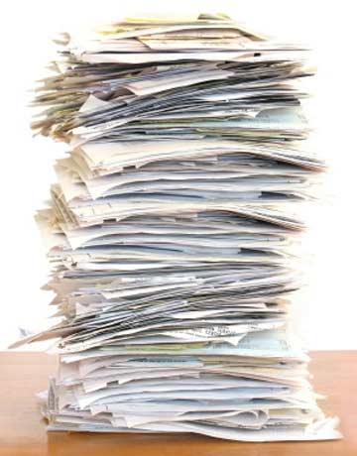


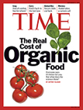

RecycleBoxBin, LLC
CAUTION: Printers default to print ALL pages! Select the pages you need and delete the others. We don’t want to waste your ink!
Set your printer setting for “borderless printing”. We highly suggest using photo or brochure paper for bright color and crisp images . Cut to black line.
office paper
business paper
mail, envelopes
magazines
cardboard
small staples are OK
Graphic images are proprietary and may not be altered or used for any other use beyond RecycleBoxBin labels. You are free to move, shrink, enlarge, manipulate the images for use with our label system. Any other distribution, copying or disclosure is prohibited and may be unlawful. We accept no responsibility for changes made to this document or any alterations after transmission from our office.

Slide 56
RecycleBoxBin, LLC
CAUTION: Printers default to print ALL pages! Select the pages you need and delete the others. We don’t want to waste your ink!
Set your printer setting for “borderless printing”. We highly suggest using photo or brochure paper for bright color and crisp images . Cut to black line.
landfill - trash
all other non-recyclables
all other non-compostables
contaminated recyclables
if in doubt, it is OK to trash rather than to
contaminate recyclables
Graphic images are proprietary and may not be altered or used for any other use beyond RecycleBoxBin labels. You are free to move, shrink, enlarge, manipulate the images for use with our label system. Any other distribution, copying or disclosure is prohibited and may be unlawful. We accept no responsibility for changes made to this document or any alterations after transmission from our office.

Slide 57
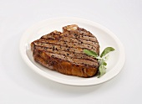
RecycleBoxBin, LLC
CAUTION: Printers default to print ALL pages! Select the pages you need and delete the others. We don’t want to waste your ink!
Set your printer setting for “borderless printing”. We highly suggest using photo or brochure paper for bright color and crisp images . Cut to black line.
compostables
hot & cold cups
food containers
plastic cutlery
napkins
food scraps OK
please do NOT contaminate this container with items not labeled compostable.
Graphic images are proprietary and may not be altered or used for any other use beyond RecycleBoxBin labels. You are free to move, shrink, enlarge, manipulate the images for use with our label system. Any other distribution, copying or disclosure is prohibited and may be unlawful. We accept no responsibility for changes made to this document or any alterations after transmission from our office.

Slide 58
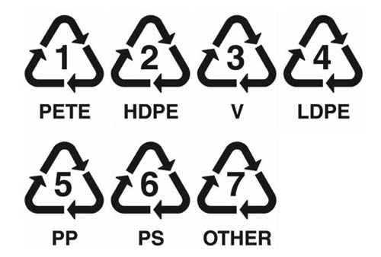
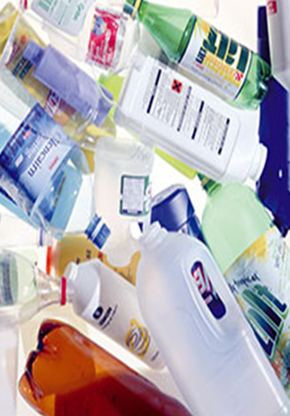
RecycleBoxBin, LLC
CAUTION: Printers default to print ALL pages! Select the pages you need and delete the others. We don’t want to waste your ink!
Set your printer setting for “borderless printing”. We highly suggest using photo or brochure paper for bright color and crisp images . Cut to black line.
plastic, metal & glass
#1 through
#7 plastics
aluminum
tin cans
glass
please do NOT contaminate with unclean plastics or items with residue
Graphic images are proprietary and may not be altered or used for any other use beyond RecycleBoxBin labels. You are free to move, shrink, enlarge, manipulate the images for use with our label system. Any other distribution, copying or disclosure is prohibited and may be unlawful. We accept no responsibility for changes made to this document or any alterations after transmission from our office.

Slide 59
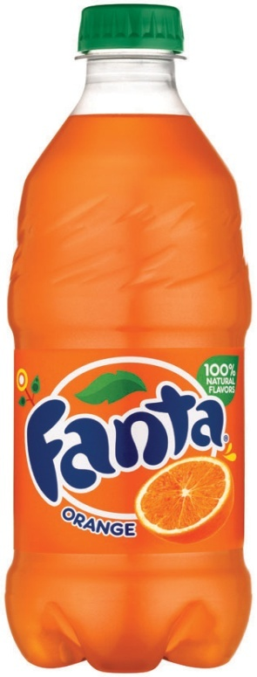
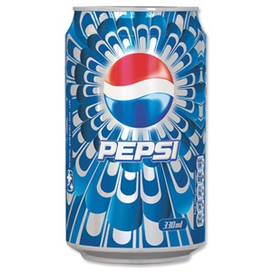

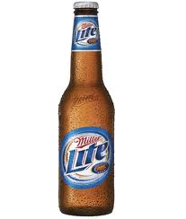
RecycleBoxBin, LLC
CAUTION: Printers default to print ALL pages! Select the pages you need and delete the others. We don’t want to waste your ink!
Set your printer setting for “borderless printing”. We highly suggest using photo or brochure paper for bright color and crisp images . Cut to black line.
state returnable
bottles/cans
check for labels
State labeled aluminum cans
State labeled plastic bottles
State labeled glass bottles
please empty and rinse all State returnables
Graphic images are proprietary and may not be altered or used for any other use beyond RecycleBoxBin labels. You are free to move, shrink, enlarge, manipulate the images for use with our label system. Any other distribution, copying or disclosure is prohibited and may be unlawful. We accept no responsibility for changes made to this document or any alterations after transmission from our office.

Slide 60
RecycleBoxBin, LLC
CAUTION: Printers default to print ALL pages! Select the pages you need and delete the others. We don’t want to waste your ink!
Set your printer setting for “borderless printing”. We highly suggest using photo or brochure paper for bright color and crisp images . Cut to black line.
office paper
business paper
mail, envelopes
magazines
cardboard
small staples are OK
Graphic images are proprietary and may not be altered or used for any other use beyond RecycleBoxBin labels. You are free to move, shrink, enlarge, manipulate the images for use with our label system. Any other distribution, copying or disclosure is prohibited and may be unlawful. We accept no responsibility for changes made to this document or any alterations after transmission from our office.

Slide 61
RecycleBoxBin, LLC
CAUTION: Printers default to print ALL pages! Select the pages you need and delete the others. We don’t want to waste your ink!
Set your printer setting for “borderless printing”. We highly suggest using photo or brochure paper for bright color and crisp images . Cut to black line.
landfill - trash
all other non-recyclables
all other non-compostables
contaminated recyclables
if in doubt, it is OK to trash rather than to
contaminate recyclables
Graphic images are proprietary and may not be altered or used for any other use beyond RecycleBoxBin labels. You are free to move, shrink, enlarge, manipulate the images for use with our label system. Any other distribution, copying or disclosure is prohibited and may be unlawful. We accept no responsibility for changes made to this document or any alterations after transmission from our office.

Slide 62

RecycleBoxBin, LLC
CAUTION: Printers default to print ALL pages! Select the pages you need and delete the others. We don’t want to waste your ink!
Set your printer setting for “borderless printing”. We highly suggest using photo or brochure paper for bright color and crisp images . Cut to black line.
Compost
Pizza boxes
Paper towels
Paper
Waxed paper
Cardboard
Soiled paper
Food waste
Wood
Leaves
Plants
Leftovers
Coffee grounds
All #0 Plastics
if in doubt, it is OK to trash rather than to contaminate recyclables
Graphic images are proprietary and may not be altered or used for any other use beyond RecycleBoxBin labels. You are free to move, shrink, enlarge, manipulate the images for use with our label system. Any other distribution, copying or disclosure is prohibited and may be unlawful. We accept no responsibility for changes made to this document or any alterations after transmission from our office.

Slide 63
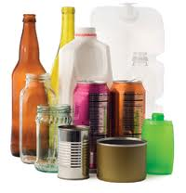

RecycleBoxBin, LLC
CAUTION: Printers default to print ALL pages! Select the pages you need and delete the others. We don’t want to waste your ink!
Set your printer setting for “borderless printing”. We highly suggest using photo or brochure paper for bright color and crisp images . Cut to black line.
Plastic, Metal, Glass, Paper
Plastic #1-7
Metal
Glass
Paper,
Magazines,
Cardboard
if in doubt, it is OK to trash rather than to contaminate recyclables
Graphic images are proprietary and may not be altered or used for any other use beyond RecycleBoxBin labels. You are free to move, shrink, enlarge, manipulate the images for use with our label system. Any other distribution, copying or disclosure is prohibited and may be unlawful. We accept no responsibility for changes made to this document or any alterations after transmission from our office.

Slide 64
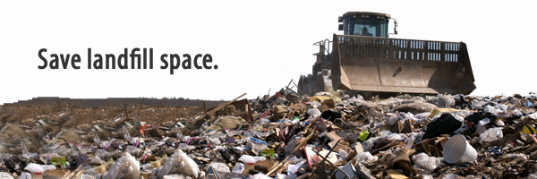
RecycleBoxBin, LLC
CAUTION: Printers default to print ALL pages! Select the pages you need and delete the others. We don’t want to waste your ink!
Set your printer setting for “borderless printing”. We highly suggest using photo or brochure paper for bright color and crisp images . Cut to black line.
Landfill
All other non-recycleable items
if in doubt, it is OK to trash rather than to contaminate recyclables
Graphic images are proprietary and may not be altered or used for any other use beyond RecycleBoxBin labels. You are free to move, shrink, enlarge, manipulate the images for use with our label system. Any other distribution, copying or disclosure is prohibited and may be unlawful. We accept no responsibility for changes made to this document or any alterations after transmission from our office.

Slide 65
RecycleBoxBin, LLC
CAUTION: Printers default to print ALL pages! Select the pages you need and delete the others. We don’t want to waste your ink!
Set your printer setting for “borderless printing”. We highly suggest using photo or brochure paper for bright color and crisp images . Cut to black line.
batteries
AAA, AA, C, D & 9V
all alkaline and carbon zinc
all mercuric-oxide (button)
silver-oxide and zinc-air (button)
all lithium
all rechargeable
Do not place leaking
batteries in container
Graphic images are proprietary and may not be altered or used for any other use beyond RecycleBoxBin labels. You are free to move, shrink, enlarge, manipulate the images for use with our label system. Any other distribution, copying or disclosure is prohibited and may be unlawful. We accept no responsibility for changes made to this document or any alterations after transmission from our office.

Slide 66
RecycleBoxBin, LLC
CAUTION: Printers default to print ALL pages! Select the pages you need and delete the others. We don’t want to waste your ink!
Set your printer setting for “borderless printing”. We highly suggest using photo or brochure paper for bright color and crisp images . Cut to black line.
ink cartridges
all cartridge types
black
color
Do not place leaking
cartridges in container
Graphic images are proprietary and may not be altered or used for any other use beyond RecycleBoxBin labels. You are free to move, shrink, enlarge, manipulate the images for use with our label system. Any other distribution, copying or disclosure is prohibited and may be unlawful. We accept no responsibility for changes made to this document or any alterations after transmission from our office.

Slide 67
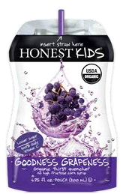

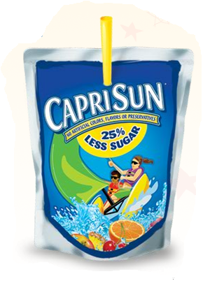
RecycleBoxBin, LLC
CAUTION: Printers default to print ALL pages! Select the pages you need and delete the others. We don’t want to waste your ink!
Set your printer setting for “borderless printing”. We highly suggest using photo or brochure paper for bright color and crisp images . Cut to black line.
TerraCycle
juice packs
Juice packs with
foil outer layer
Juice packs from CapriSun & Honest Kids
Graphic images are proprietary and may not be altered or used for any other use beyond RecycleBoxBin labels. You are free to move, shrink, enlarge, manipulate the images for use with our label system. Any other distribution, copying or disclosure is prohibited and may be unlawful. We accept no responsibility for changes made to this document or any alterations after transmission from our office.

