Slide 1


Welcome!
Programming Starts at 8:10am
Please help yourself to breakfast and beverages
at the back of the Ballroom.

Slide 2
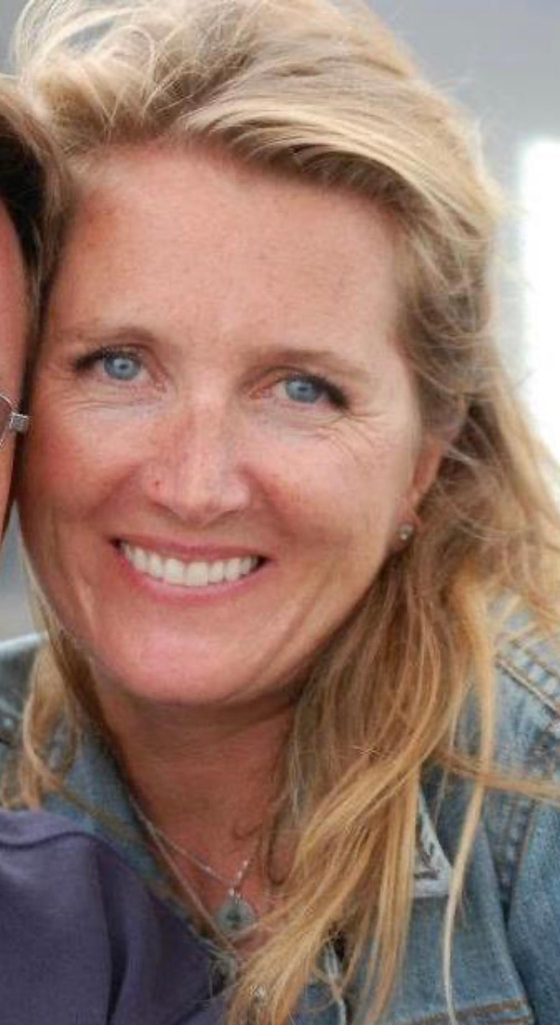

Melissa Parrott
Executive Director,
Renewable Energy Long Island &
Students for Climate Action
Harrison Bench
Deputy Executive Director,
Students for Climate Action &
Law Student, Pace University

Slide 3

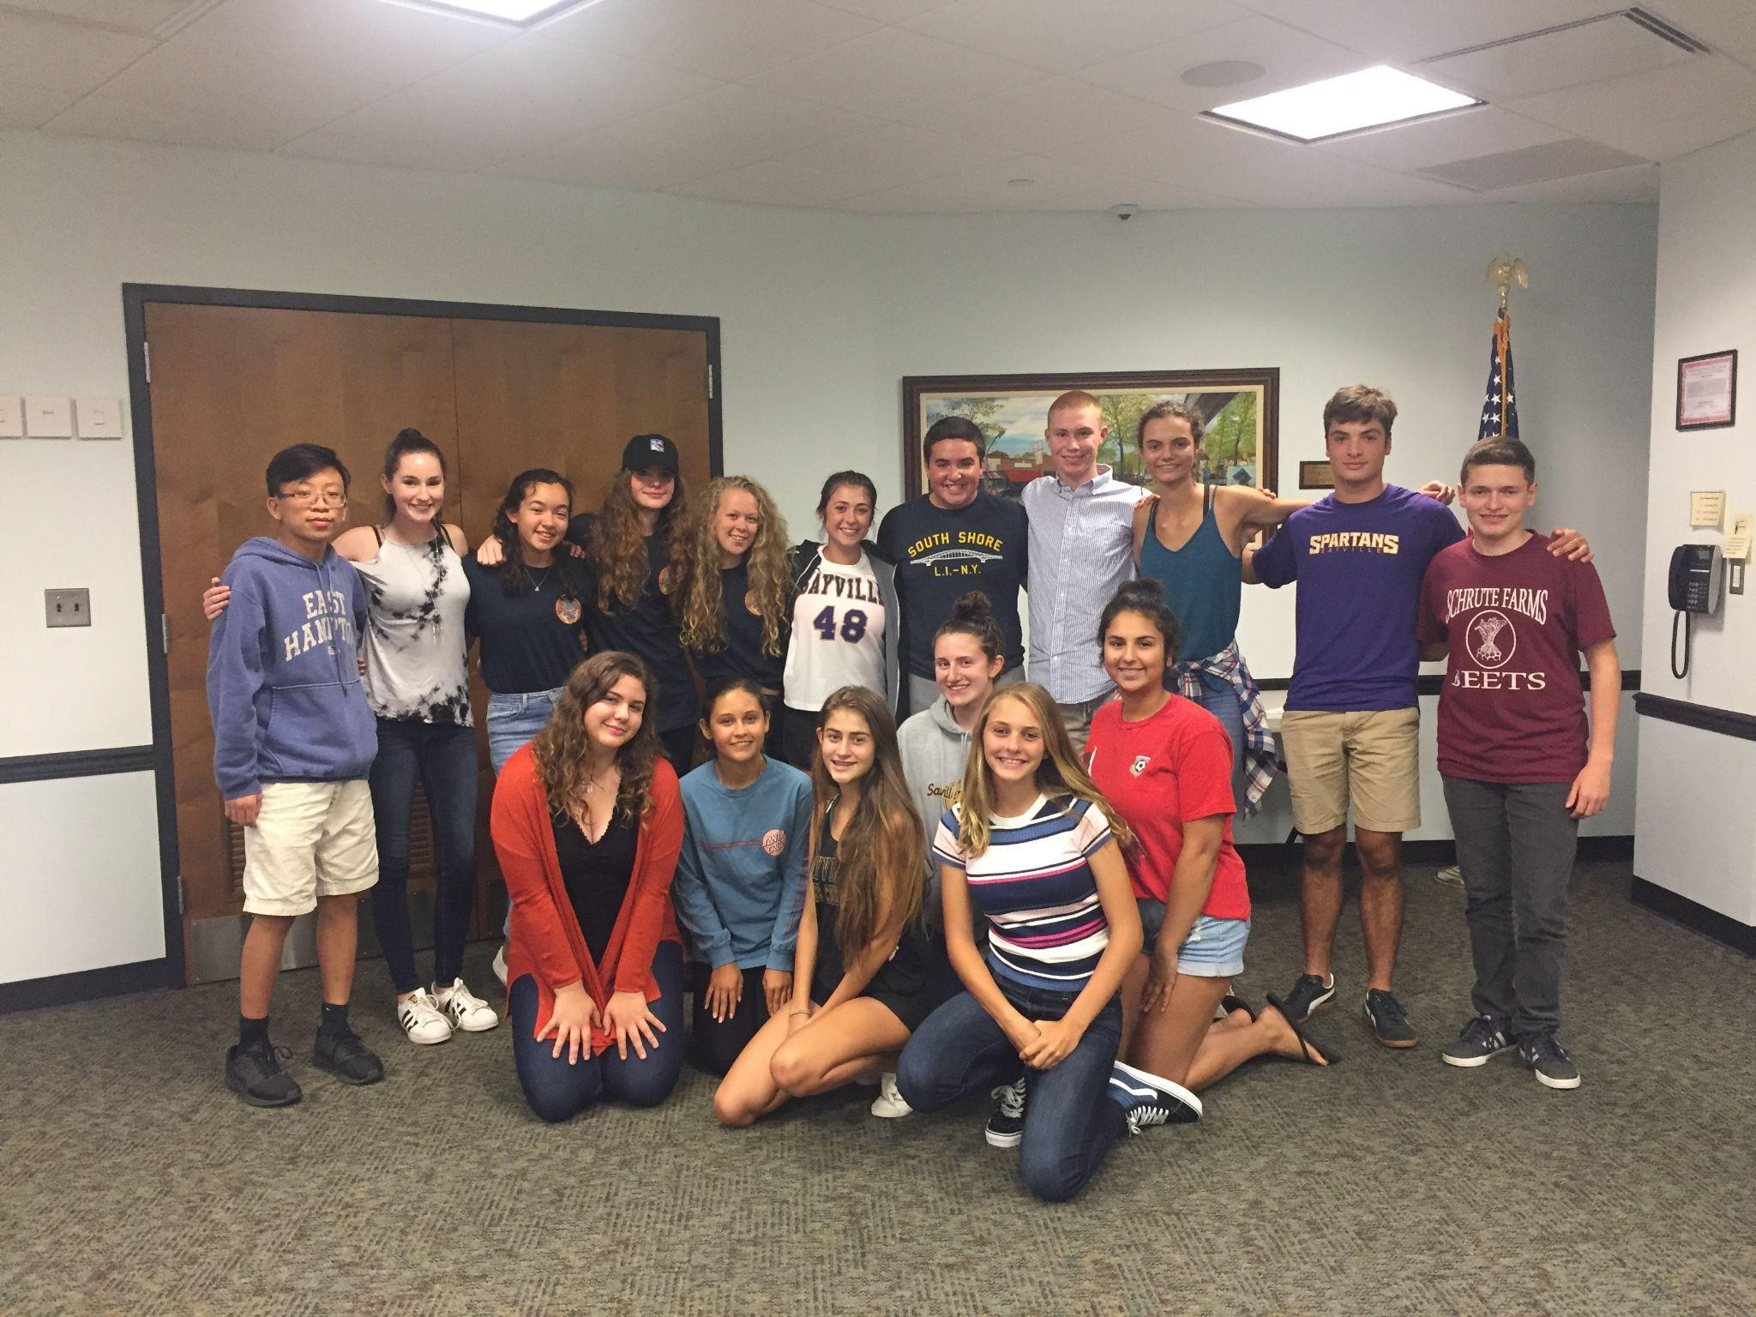
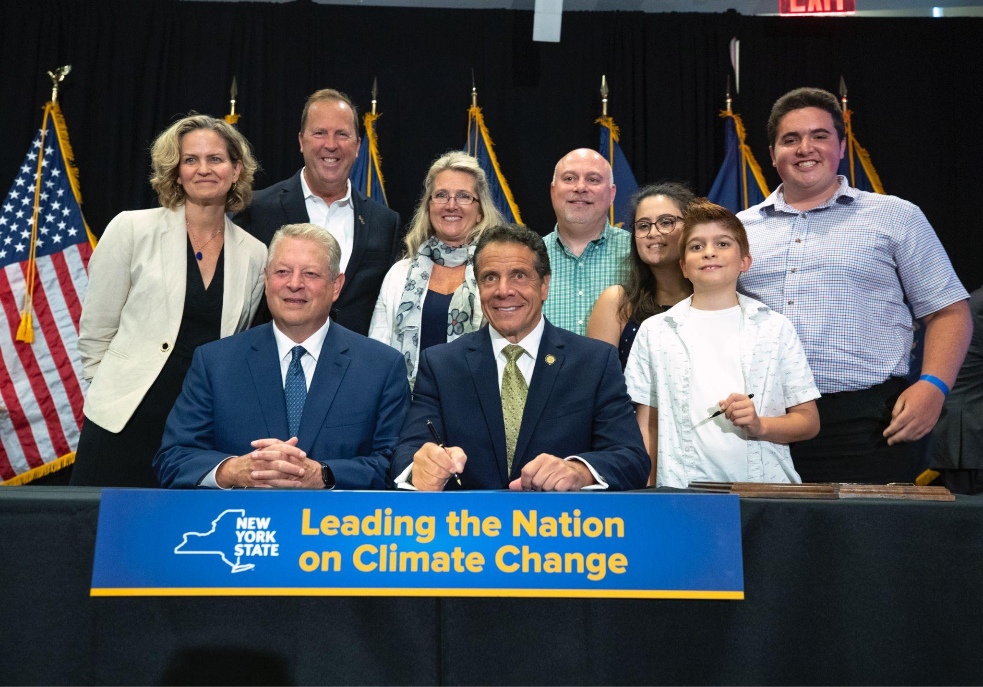
Students for Climate Action (S4CA)
www.s4ca.org | Instagram & FB @students4ca
S4CA is a non-profit, non-partisan organization that mobilizes students to lobby their elected officials for common sense climate policies and 100% renewable energy initiatives. Through education, public acts of engagement, and community involvement, the students have the power to help control local, state and federal policy.

Slide 4

Renewable Energy Long Island (ReLI)
https://www.renewableenergylongisland.org/ Instagram & FB @renewableenergylongisland
Renewable Energy Long Island (reLI), prompts clean, sustainable energy use and generation on Long Island. reLI is committed to accelerate the transition to a 100% renewable energy economy. We educate the public, work with local governments and partner with community interest groups to bring about the shifts necessary to enable widespread adoption of renewable energy.

Slide 5
Housekeeping & Run of Show
Keynote: Dr. Chris Gobbler, SBU
Session #1: Mirza Beg, SBU
Briefing #1: Adrienne Esposito, CCE
Short Restroom & Water Break
Session #2: The Power of Youth Engagement in Climate Policy
(Elected Officials Panel)
Briefing #2: Monique Fitzgerald, LIPC
Session #3: Careers and Degrees in Climate and Energy (Careers Panel)
Group Photo & Postcard Campaign
Lunch (1 Slice first) & Exhibitor Fair
Session #4: How to Craft a Successful Climate Campaign (Action Session)

Slide 6


















Thank You to our Sponsors, Underwriters, and Exhibitors!

Slide 7
Restroom & Water Break
Restrooms are located in the hallway, water is located at the back of the Ballroom.
Please return by 10:00am!

Slide 9

Postcard-Writing Campaign
First Action before you leave!
In your teacher packet is information on not only climate change, but offshore Wind.
You will also hear from speakers today on the facts and benefits of Offshore Wind for NY
Now is an opportunity to write your Congressional reps. to continue to support renewable energy, especially Offshore Wind.
Know the FACTS
Job Creation/Economic development
Reduces CO2 to fight climate change

Slide 10
NEW YORK IS LEADING ON OFFSHORE WIND
Renewable energy for our community, our environment, and our future- Let’s harness the Wind!
Do your research. Know your resources! (FACTS)
There is a Federal pause, we need our federal reps support! Now.
Write from your passion, education and future.
Turn them in before you leave.
Questions?

Slide 11
Lunch Break
We will dismiss you by school
Please also be sure to stop by our exhibitors’ tables to learn more about their work and opportunities!

Slide 12
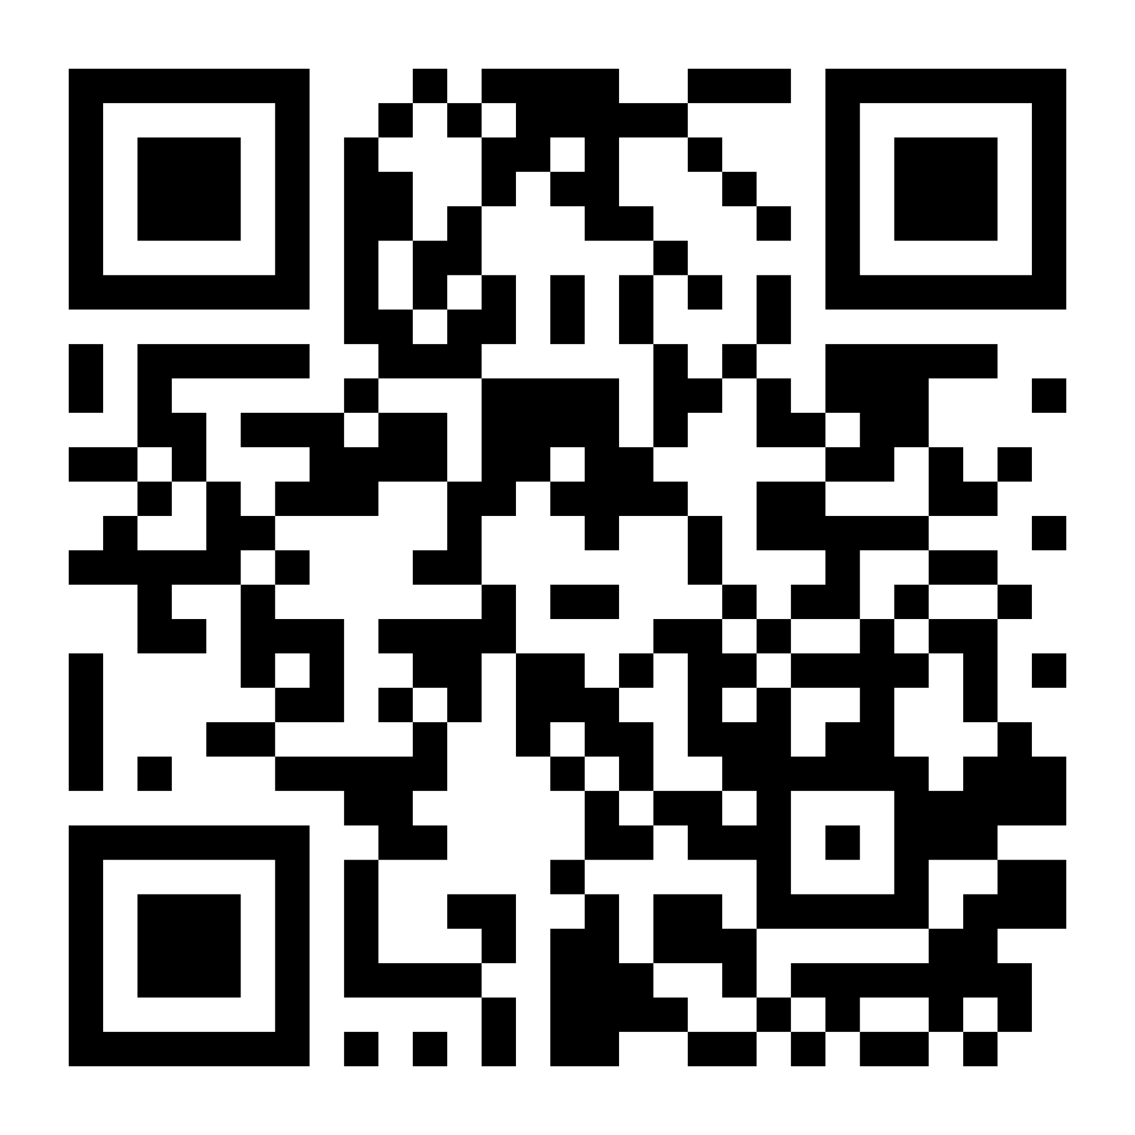
Benefits to Joining S4CA:
Join an existing S4CA chapter or start your own!
Join a group of like-minded peers
Meet with decision-makers
Trips to Town Halls, Albany, D.C.
Community engagement
Public speaking opportunities
Features in local TV & paper news
Career and networking events
Looks great on college applications
Field trips to cool places, conferences
Advocate for climate action, renewable energy, and sustainability!
Make a difference!

Slide 13
Session #4: How to Craft a
Successful Climate Campaign
Harrison Bench

Slide 14
What are some of the solutions we learned about today?

Slide 15
What can we do to advocate
for these solutions?

Slide 16

What is a Petition?
A petition is a formal request signed by a group of people to support a cause, policy, or action. It is a tool for advocacy and change that helps raise awareness, demonstrate public support, and pressure decision-makers to take action.
✅ Amplify Voices – Shows that many people care about an issue.
✅ Influence Decision-Makers – Encourages governments, businesses, school districts or other organizations to act.
✅ Builds Community & Momentum – Unites people around a shared cause.

Slide 17
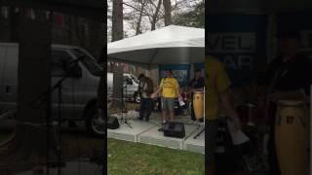
2017 Seatuck Eco-Carnival

Slide 18
STEP ONE: CREATING YOUR PETITION
Step 1A - What action item are you going to petition for?
Add a climate change elective at school
Increase renewable energy at school
Reduce energy consumption
Electrify the buses
Add EV chargers
Reduce food waste
Reduce plastic consumption
Green career days
Town-level action items
  100% RE goal
Community support for offshore wind
What else did you learn today?
Step 1B - What is the specific demand you’re making?
After you’ve chosen an action item, it’s important to be specific!
Outline how much change you want, over a specific period of time.
Make sure it is doable!
(And be adaptable!)
Step 1C - Why are you advocating for this action?
What’s your why? What are the benefits? How can you convince your skeptics?
Again, be specific:
Environmental
Public Health
Economic
Educational
Community

Slide 19
STEP TWO: OPERATIONALIZING YOUR PETITION
Step 2A - What is the group that will promote the petition?
A dedicated group (or club, or S4CA chapter) maintains identity and accountability!
Step 2B - What is the format of the petition?
Online, virtual (like a Google Form), or both! What will work for your group?
Step 2C - Who is the audience? Who should sign?
Students? Teachers? Parents? The Community?
Step 2D - Who is the recipient of the petition?
Who are the decision-makers that can say yes/no to your action?
Step 2E - What is the deadline for this petition?
Before the end of the year! Is there is a specific or important date in mind?
Step 2F - How will you collect signatures?
Think of time and place, both within and outside of school!

Slide 20

STEP THREE: PROMOTING YOUR PETITION
Step 3A - How can you use social media to promote?
Which apps? Existing accounts, or a new account for your group? Canva graphics?
Step 3B - How can you use news media to promote?
Letters to the editor, op-eds? Which newspapers? TV or online news sources?
Step 3C - How can you promote your petition in-person?
Information sessions? Printing flyers? How can you spread your message?
Step 3D - Are there other stakeholders that can support?
Who in the school or larger community can help promote your petition?

Slide 21

STEP FOUR: DELIVERING YOUR PETITION
Step 4A - When, where, and how will the petition be delivered?
Identify a date, time, and place (specific meeting?)
Step 4B - Who from the group can attend? Who can speak?
Less is sometimes more! Identify one or two speakers to keep your message on point.
Step 4C - What will the speaking points be?
Refer to Step 1C - what are the arguments in favor of your demand? Think of your audience!
Step 4D - What will happen after the petition is delivered?
Stay in touch with the decision-maker: what is the next step?

Slide 22
STEP FIVE: NEXT STEPS!
Step 5A - Identify a group leader or leader(s)
Everyone is equal, but delegation is an important skill to learn!
Who would make a good, respected group leader?
What are some other roles that could be distributed?
Step 5B - When and where will this group meet again? How will you keep in touch?
Accountability is key! Schedule a meeting RIGHT NOW - when are you all free next? What day works for most people?
Stay in touch! GroupMe, Group Chat, email chain, etc.
Step 5C - What will you do by the next meeting?
There’s a lot to do! Who does what?
Drafting petition
Signature collection schedule
Creating social media accounts/posts
Contacting local news and stakeholders
Contacting decision- makers
Holding events

Slide 23
Good luck! Youth to Power!

Slide 24
Name 5 takeaways from today!

Slide 25
Thank You! Next Steps:
Join an existing S4CA chapter or start your own!
Follow us on social media:
@students4ca
@renewableenergylongisland
Tag us in your posts with the hashtag #LIYCS
Email us so we can help with your petitions:
melissa@reli.org
hbench@s4ca.org
Tell your family and friends about what you learned today!

