Slide 1
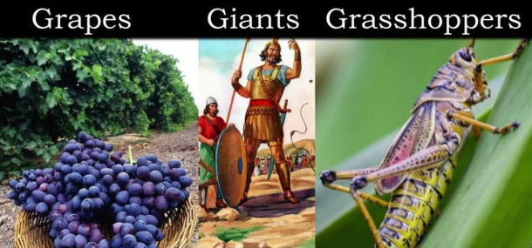
Consequences for the Faithless
Num 14:11-24

Slide 2
Key Concept
God is faithful both to forgive and to punish faithlessness.

Slide 3
Israel continues to grumble, complain, and rebel until the rebellious generation dies
(Num 15 – 36)
Moses sends 12 spies into the Promised land
(Num 13:1 – 20)
The people refuse to enter the promised land, threatening to stone their leaders
(Num 14:1 – 10)
The spies return, but 10 of the 12 spread a bad report
(Num 13:21 – 33)
Today’s Lesson
Moses intercedes before God, but there are consequences
(Num 14:11 – 38)

Slide 4
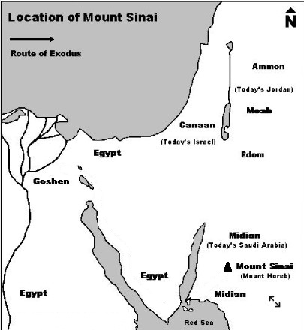
Wilderness
of Paran

Slide 5
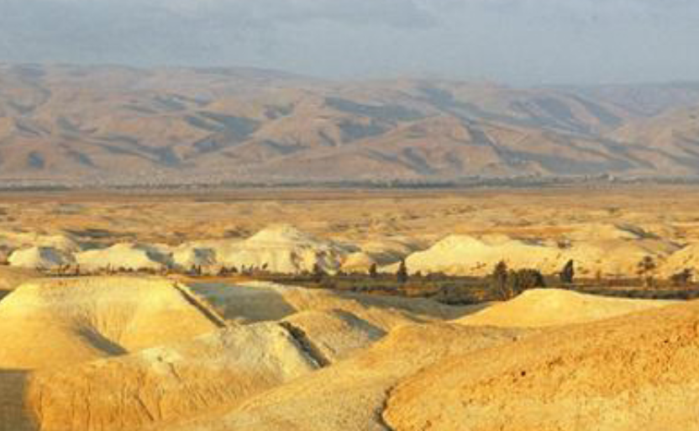
Land of Moab

Slide 6
Check on Learning
Why did God condemn the Israelites to 40 years wondering in the desert?
What happen to the ten men Moses sent to explore the land and then incited rebellion against the Lord?
1 year for every day the scouts explored the promised land
They were struck dead with a plague before the Lord

Slide 7
Check on Learning
T/F After hearing the Lord condemn the Israelites to wandering in the desert for 40 years, they rose early and returned to the wilderness?
False, Num 14:44
At what age of those included in the registration were condemned to death in the wilderness?
20yrs and older

Slide 8
Check on Learning
Which tribe was not represented by the 12 spies?
Levi
Moses changed whose name to the meaning of “God will save you” before the spies departed on their mission?
Joshua – originally was Hoshea
Moses tasked the spies with bringing back fruit and a report but, not what?
An assessment as to whether the people should enter the promised land

