Slide 1
Don’t run faster than you have strength
Emotional Resilience and mental well being

Slide 2
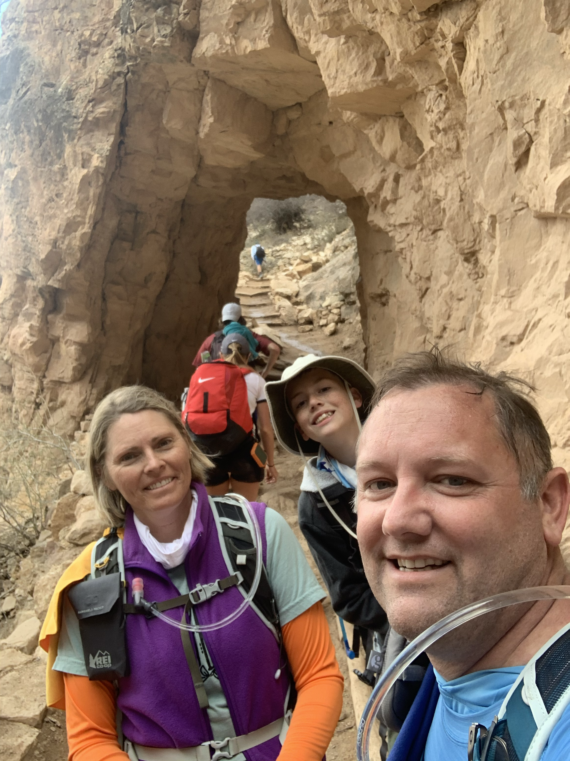
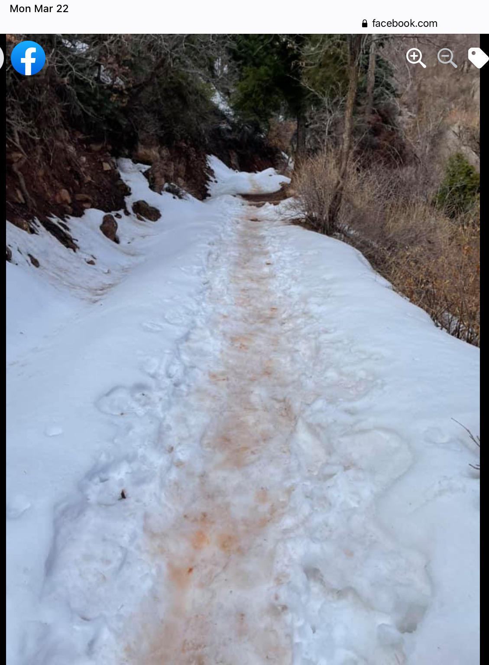
What Happens When We Go To Fast

Slide 3
Emotional resilience is:
Reliance on one's own powers and resources rather than those of others.
The ability to adapt to emotional challenges with courage and faith centered in Jesus Christ.
Helping yourself and others the best you can.
Reaching out for additional help when needed.

Slide 4
What is Happening to our Mental Health
According to an Oct 2021 Study by Boston University 1 in 3 Americans have depression
Same study showed 1 in 3 have an anxiety disorder
A culture of perfection and FOMO (Fear of Missing out)
Social Media and constantly connected
Messages of fear - Fear Sells – To much information for our brains to process

Slide 5
Protecting Your Wall
Boundaries
Say ”No”
Become proactive doing healthy not reacting to fix unhealthy
Accept the Journey with Christ – Don’t search so often for why search how to grow.
Curiosity and being cautiously dangerous
Act what you believe – Be Congruent
Daily gratitude
Hold the space to experience

Slide 6
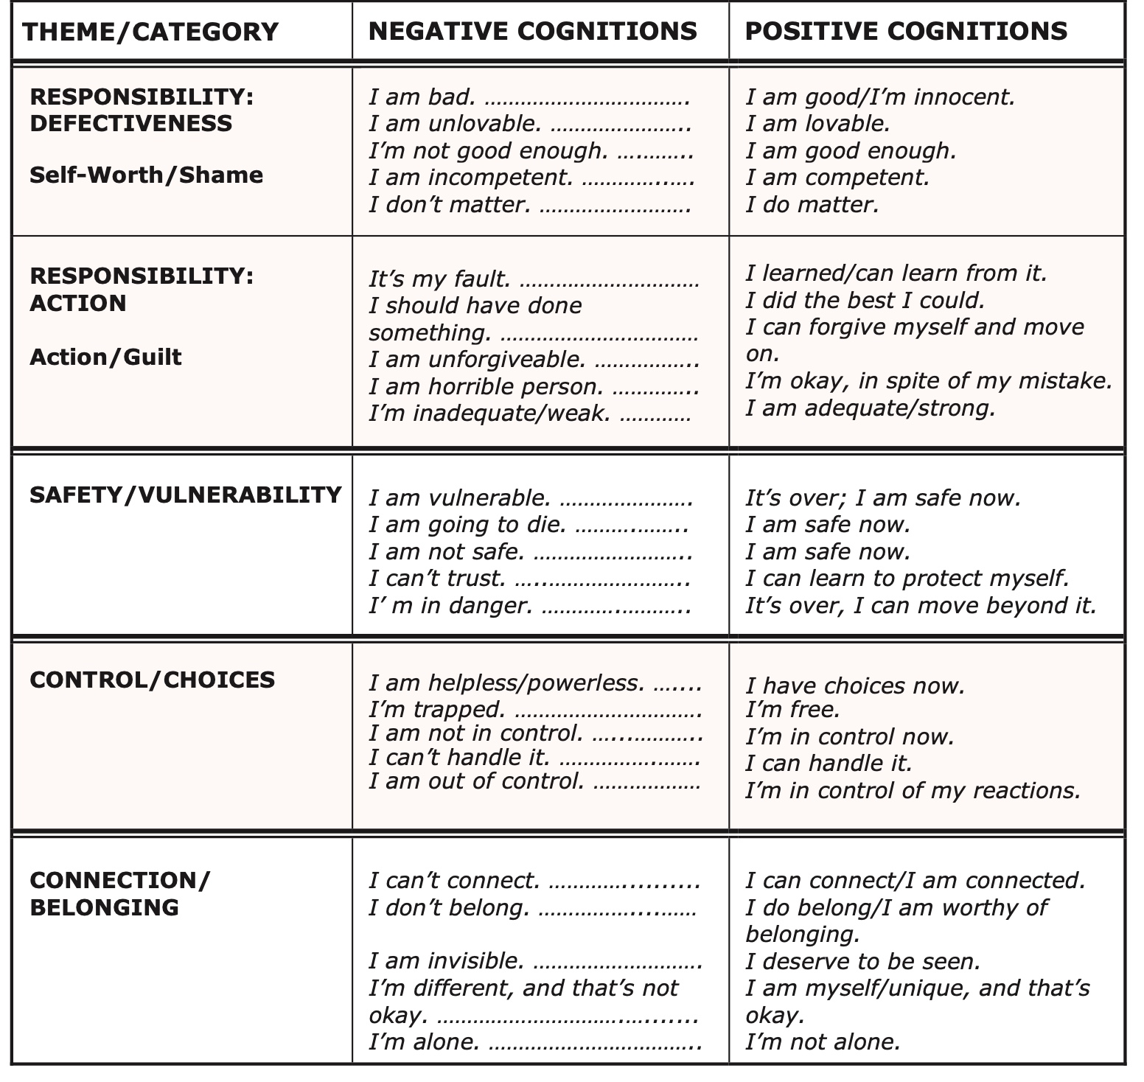

Slide 7
When do we need more assistance
Depression:
Prolonged moodiness & agitation
Difficulty sleeping
Physical symptoms aches pains
Feelings of guilt, hopelessness
Thoughts about not being here
Anxiety:
Having a sense of fear and doom
Feeling weak and tired
Difficulty thinking clearly
Desire to avoid situations
Change in social routines

Slide 8
“I testify you are beloved. The Lord knows how hard you are trying. You are making progress. Keep going. He sees all your hidden sacrifices and counts them to your good and the good of those you love. Your work is not in vain. You are not alone. His very name, Emmanuel, means ‘God with us.’ He is surely with you.” (Sharon Eubank, “Christ: The Light That Shines in Darkness,” Ensign or Liahona, May 2019)

Slide 9
“It isn’t as bad as you sometimes think it is. It all works out. Don’t worry. I say that to myself every morning. It will all work out. If you do your best, it will all work out. Put your trust in God, and move forward with faith and confidence in the future. The Lord will not forsake us. He will not forsake us.” (Gordon B. Hinckley, “Latter- day Counsel: Excerpts from Addresses of President Gordon B. Hinckley,” Ensign, Oct. 2000)

Slide 10
Resources
Books:
Dare: The New Way to End Anxiety and Stop Panic Attacks By Barry McDonagh
Mindfulness: An Eight-Week Plan for Finding Peace in a Frantic World By Mark Williams
Silent Souls Weeping: Depression-Sharing Stories, Finding Hope By Jane Johnson
Counseling:
EMDR
Mindfulness
Medications:
Family Dr.
Psychiatrist

