Slide 1
IDOL OF LOVE
Pastor Matt Hatzung
Trinity Bay City, MI

Slide 3
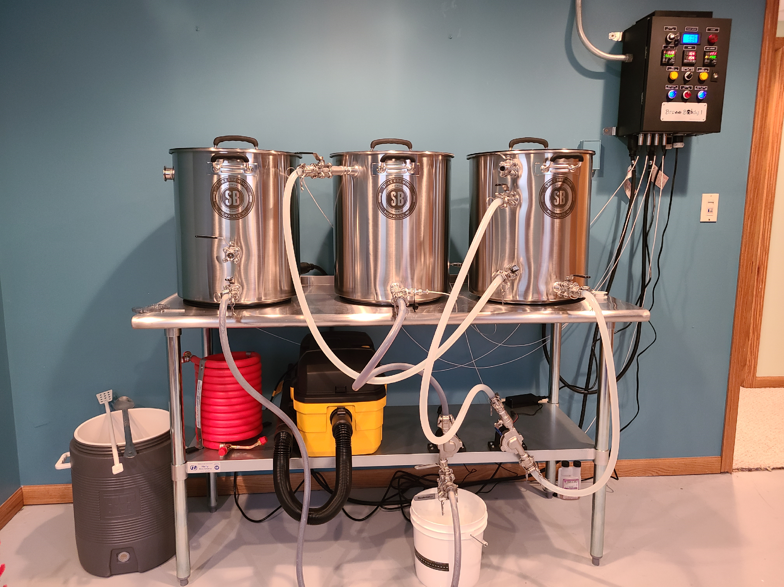

Slide 4
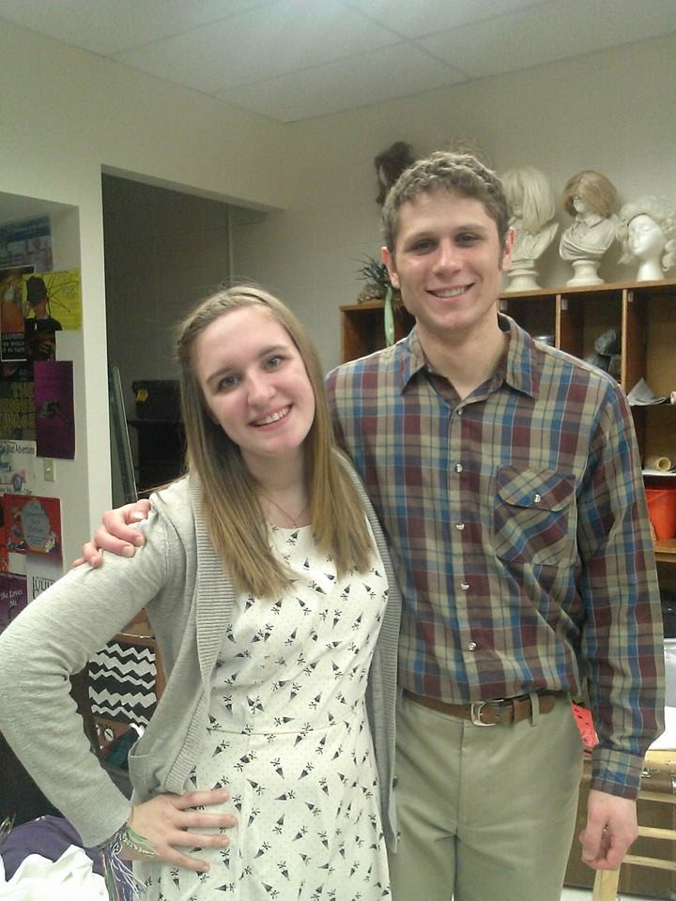
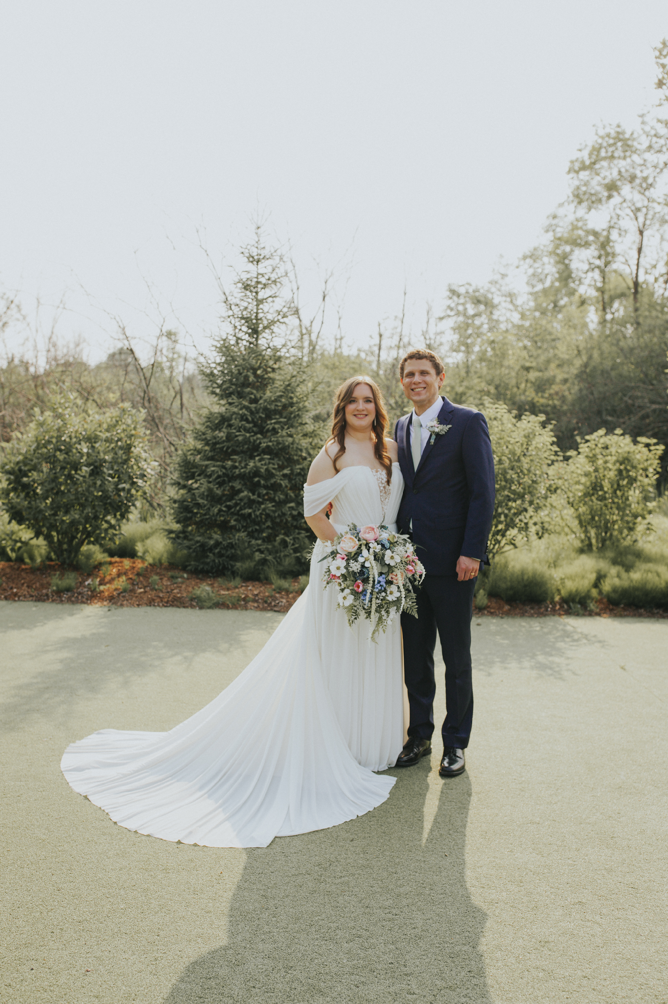

Slide 5
LOVE: WHAT DOES THIS MEAN?
English:
“Love your neighbor as yourself.”
“I love my wife.”
“I love bacon!”
Ancient Greece: 3+ Different words for “Love”
Eros: “Erotic”/Romantic Love
Philos: “Brotherly”/Friendship Love
Agape: Selfless Love
LUST
Notes:
When you think of love as an idol, what comes to mind?

Slide 6
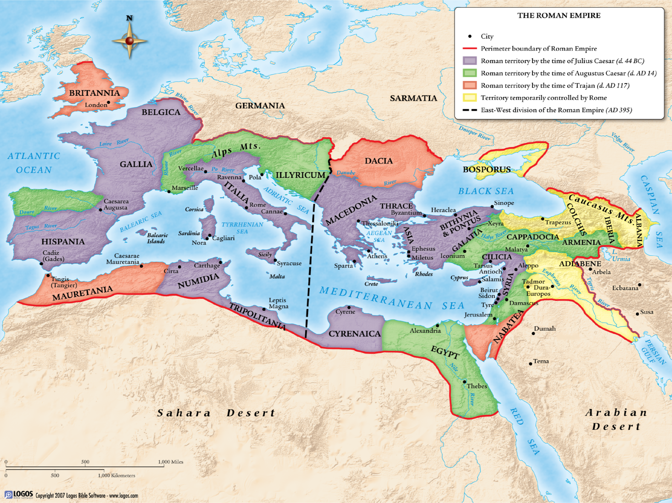
THE IDOL OF LOVE/LUST
“It’s never been this bad!”
...or has it?

Slide 7
SEXUALITY IN BIBLE TIMES
“I don’t care how promiscuous you think our modern culture is, let me assure you: it is nothing like first-century Rome. What we call pornography, the Romans simply called life. The junk you can find on HBO at 2:00 a.m. was plastered on bathhouse walls and inside homes as decoration.”
– Preston Sprinkle, People to Be Loved
Notes:
Things have been this bad, even worse. So what is different this time around? If we want to understand the idols of our age, we need to take a step back and realize that we literally do not think about sexuality in the same way as eras before us have. We probably don’t realize just how much the thinking of our time impacts the way think about sexuality. A fish doesn’t know it’s in water. So how is the thinking of our time different?

Slide 8
WHAT’S DIFFERENT? THE GREEKS
Greek Sexuality: The Pursuit of “Beauty”
The height of “beauty?”
Young men/boys

Slide 9
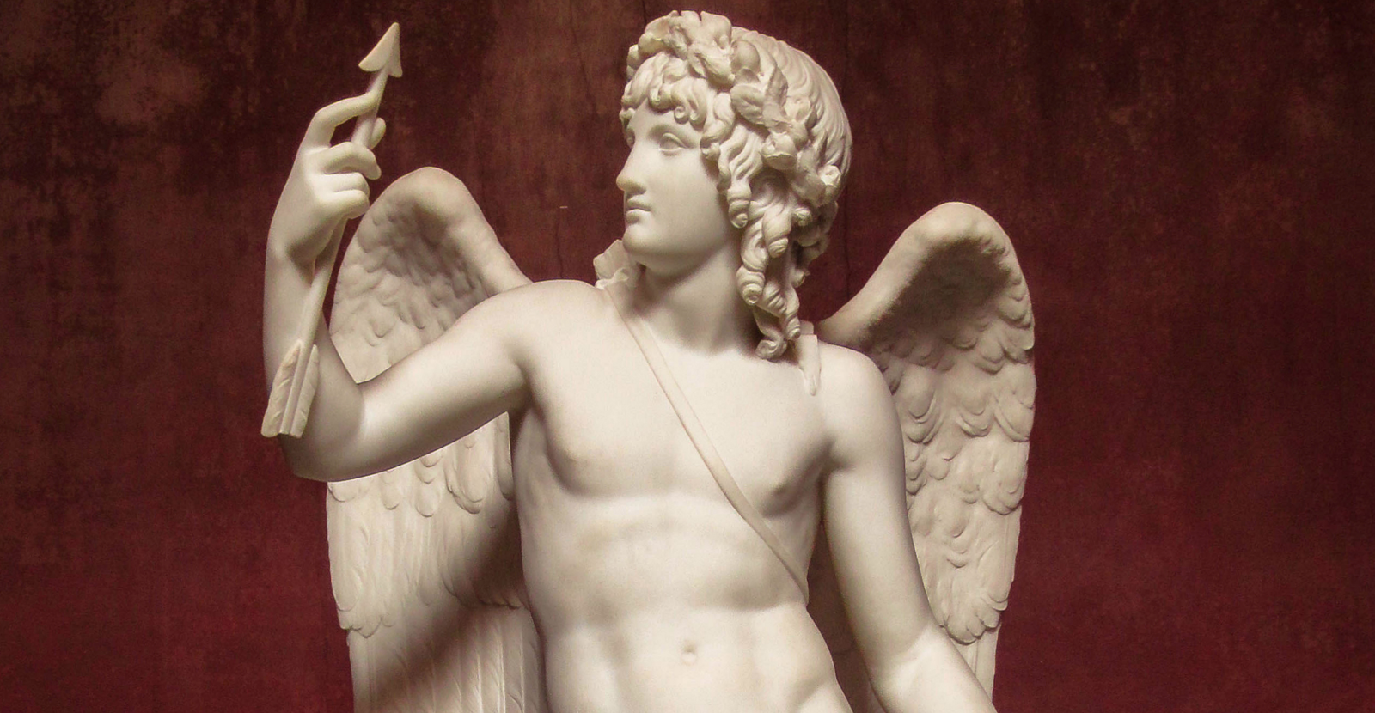
EROS, GREEK GOD OF EROTIC LOVE

Slide 10
WHAT’S DIFFERENT? THE ROMANS
Roman Sexuality: An expression of “manliness” vs. femininity
Actual sex/gender was mostly irrelevant (apart from having children)

Slide 11
WHAT’S DIFFERENT? TODAY
Sexuality
=
Identity

Slide 12
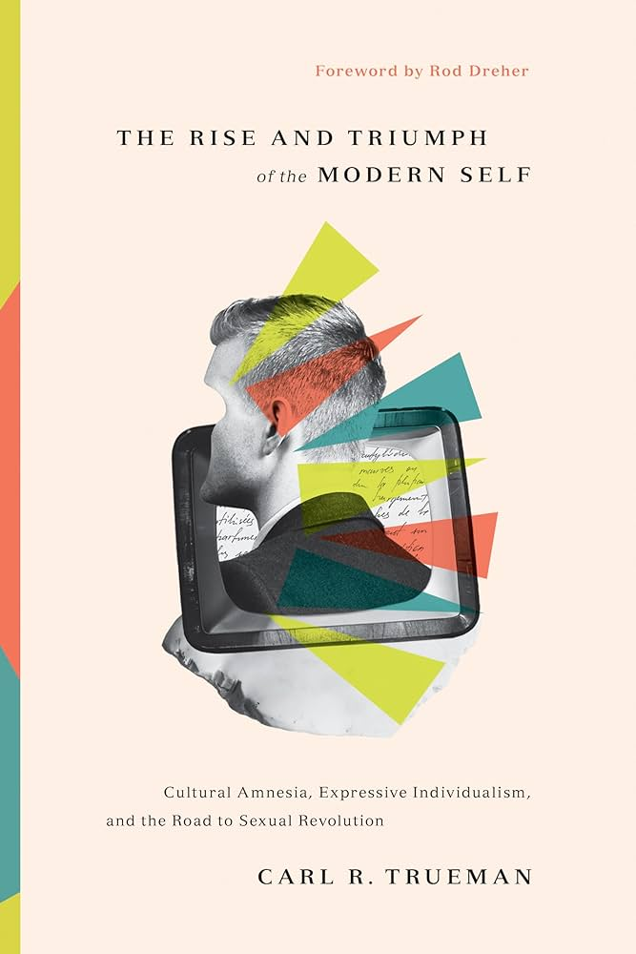
MODERN SEXUALITY
“While sex may be presented today as little more than a recreational activity, sexuality is presented as that which lies at the very heart of what it means to be an authentic person.”
– Carl Trueman,
The Rise and Triumph of the Modern Self

Slide 13
MODERN SEXUALITY
“People are taught to define themselves first and foremost as sexual beings.”
– Matthew Rueger,
Sexual Morality in a Christless World

Slide 14
IDOLS WE KNOW: HOMOSEXUALITY

Slide 15
HOMOSEXUALITY
“This is who I am!”
“Be true to who you are!”
Are people “born this way?”
Maybe, maybe not.
Does it matter?
Natural ≠ Good
Start with sin, not necessarily that sin.
Don’t expect sanctification before justification
Notes:
Perhaps clearest example of Sexuality=identity

Slide 16
HOMOSEXUALITY
Or do you not know that the unrighteous will not inherit the kingdom of God? Do not be deceived. Neither the sexually immoral, nor idolaters, nor adulterers, nor males who have sex with males, nor thieves, nor the greedy, nor drunkards, nor the verbally abusive, nor swindlers will inherit the kingdom of God.
-1 Corinthians 6:9-10

Slide 17
HOMOSEXUALITY
Or do you not know that the unrighteous will not inherit the kingdom of God? Do not be deceived. Neither the 1. sexually immoral, nor 2. idolaters, nor 3. adulterers, nor 4. males who have sex with males, nor 5. thieves, nor the 6. greedy, nor 7.drunkards, nor the 8. verbally abusive, nor 9. swindlers will inherit the kingdom of God.
-1 Corinthians 6:9-10
It’s not about this sin vs. that sin

