Slide 1
HOMOSEXUALITY
Or do you not know that the unrighteous will not inherit the kingdom of God? Do not be deceived. Neither the sexually immoral, nor idolaters, nor adulterers, nor males who have sex with males, nor thieves, nor the greedy, nor drunkards, nor the verbally abusive, nor swindlers will inherit the kingdom of God. And some of you were those types of people. But you were washed, you were sanctified, you were justified in the name of our Lord Jesus Christ and by the Spirit of our God.
-1 Corinthians 6:9-11
It’s about repentance
Notes:
Repentance isn’t a one time thing

Slide 2
IDOLS WE KNOW: PREMARITAL SEX
Notes:
Sex is fiery. A great blessing that makes us warm, brings us light if used properly.

Slide 3
PREMARITAL SEX
All the old temptations:
“If it feels good, do it.”, etc.
Now: Sexuality=Identity
“You’re an incomplete human if this is missing from your life”
Notes:
There’s a depth, meaning, and purpose behind
You need to experiment to find out who you truly are
Peer pressure on steroids. Not just what all your friends are doing, but what all of society is saying is an essential part of life

Slide 4
IDOLS WE KNOW: PORNOGRAPHY
Where to turn when it is “missing” from your life
Easy to access
Harmless? Maybe not.
Notes:
Similar addictiveness to drugs Rewires your brain to think of people as objects for your own pleasures and needs

Slide 5
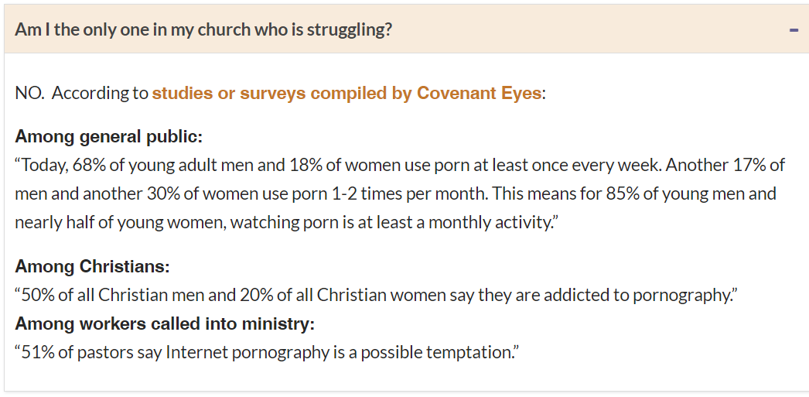
PORNOGRAPHY

Slide 6
IDOLS WE DIDN’T KNOW: MARRIAGE
When Solomon became old, his wives turned his heart after other gods, so that his heart was not fully devoted to the LORD as the heart of his father David had been. Then Solomon followed Ashtarte, the goddess of the Sidonians, and Milcom, the detestable god of the Ammonites. So Solomon did evil in the eyes of the LORD. He did not devote himself to the LORD as his father David had done. – 1 Kings 11:4–6.
Be aware of the impact your spouse is having on your faith

Slide 7
MARRIAGE VS. SINGLENESS
Avoiding the Catholic ditch of Luther’s day:
The LORD God said, “It is not good for the man to be alone. I will make a helper who is a suitable partner for him.” - Genesis 2:18.
God blessed them and said to them, “Be fruitful, multiply, fill the earth, and subdue it.” - Genesis 1:28.

Slide 8
MARRIAGE VS. SINGLENESS
Have we fallen into the ditch on the other side?
Pitting Genesis 2 against 1 Corinthians 7

Slide 9
MARRIAGE VS. SINGLENESS
“Now concerning the things you wrote: It is good for a man not to touch a woman… For I wish all people were like me, but each person has his own gift from God. One person is blessed in this way, another in a different way… I would like you to be free from concern. The unmarried man is concerned about the things of the Lord and thinks about how to please the Lord. But the married man is concerned about the things of the world and thinks about how to please his wife, and so he is divided. The unmarried woman and the virgin are concerned about the things of the Lord, so as to be holy both in body and in spirit. But the married woman is concerned about the things of the world and thinks about how to please her husband. I am saying this for your own benefit, not to impose a restriction, but to encourage honorable, undistracted devotion to the Lord.”
– 1 Corinthians 7:1,7,32-35

Slide 10
MARRIAGE VS. SINGLENESS
“His disciples said to him, “If this is the relationship of a man with his wife, it is better not to marry.”
But he said to them, “Not everyone can accept this saying, but only those to whom it has been given. For example, there are eunuchs who were born that way, and others who were castrated by people, and others who decided to remain unmarried because of the kingdom of heaven. The one who is able to accept this should accept it.”
-Matthew 19:10-12

Slide 11
MARRIAGE VS. SINGLENESS
Another expression of today’s mindset of sexuality=identity
Some examples:
Automatic desire to setup the new single pastor/teacher/vicar
“They’re still single at 40? What’s wrong with them?”
Singles getting the “Jacob” obsession
“A man’s life is not measured by how many possessions he has” his relationship status. – Luke 12:15

Slide 12
MARRIAGE VS. SINGLENESS ISSUES?
Opens the door to more obvious sins and idols
Makes it difficult for us to serve singles in our church
Both are blessings. How has the Lord uniquely called you?
Notes:
How we talk about those who aren’t driven to the opposite sex

Slide 13
THE COMMON THEME
Love = Eros: What pleasure will they bring me?
Sexuality = Identity

Slide 14
THE COMMON THEME
Love = Agape: What Christ has done for me
Christ = Identity

Slide 15
LOVE=AGAPE
For at the appointed time, while we were still helpless, Christ died for the ungodly. It is rare indeed that someone will die for a righteous person. Perhaps someone might actually go so far as to die for a person who has been good to him. But God shows his own love (agape) for us in this: While we were still sinners, Christ died for us. – Romans 5:6-8

Slide 16
CHRIST=IDENTITY
See the kind of love (agape) the Father has given us that we should be called children of God, and that is what we are! The world does not know us, because it did not know him. – 1 John 3:1
I have been crucified with Christ, and I no longer live, but Christ lives in me. The life I am now living in the flesh, I live by faith in the Son of God, who loved (agape) me and gave himself for me. – Galatians 2:20
Indeed, as many of you as were baptized into Christ have been clothed with Christ. – Galatians 3:27
We were therefore buried with him by this baptism into his death, so that just as he was raised from the dead through the glory of the Father, we too would also walk in a new life. For if we have been united with him in the likeness of his death, we will certainly also be united with him in the likeness of his resurrection. – Romans 6:4-5

Slide 17
AGAPE AT WORK
Husbands, love your wives, in the same way as Christ loved the church and gave himself up for her to make her holy, by cleansing her with the washing of water in connection with the Word… In the same way, husbands have an obligation to love their own wives as their own bodies. He who loves his wife loves himself. To be sure, no one has ever hated his own body, but nourishes and cherishes it, just as Christ does the church. – Ephesians 5:25-26,28-29
“A new commandment I give you: Love one another. Just as I have loved you, so also you are to love one another. By this everyone will know that you are my disciples, if you have love for one another.” – John 13:34-35

Slide 18
WHAT NOW?
Brothers, if a person is caught in some trespass, you who are spiritual should restore such a person in a spirit of humility, carefully watching yourself so that you are not also tempted. Bear one another’s burdens, and in this way fulfill the law of Christ. – Galatians 6:1-2
God’s people are struggling in the battle against lust
An opportunity to bear one another’s burdens
Be the one strong enough to confess
Be the one open to confession
We can’t afford not to talk about these things
“In this world you are going to have trouble. But be courageous! I have overcome the world.” – John 16:33.
Notes:
Open to confession: Overcoming the “yuk” factor
Can’t afford: Satan loves the chance to take us down alone.

Slide 19
QUESTIONS?
Pastor Matt Hatzung
matthatzung@gmail.com
612-386-6131

