Slide 1

Root Cause Analysis Executive Summary
[Enter Event Description Here]
[Enter Name and Date]

Slide 2
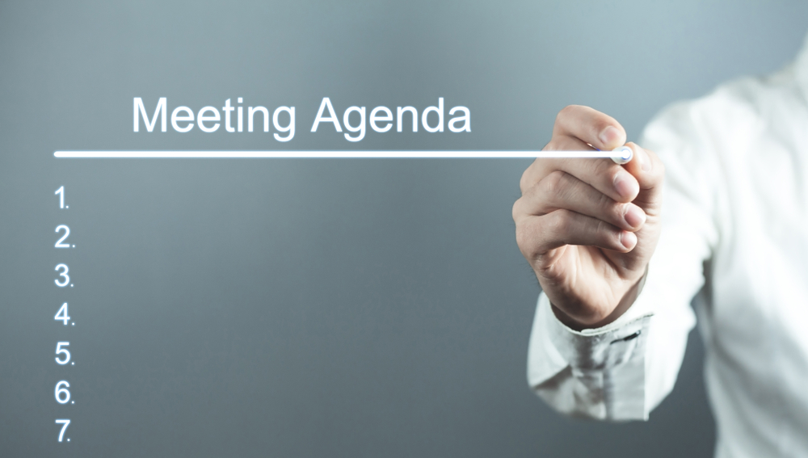
Agenda
Introduction & Summary of Analytical Process Used
Event Background
RCA Team and Methodology
Findings
Corrective Actions
Implementation/Execution Plan
Conclusion
Acknowledgments

Slide 3

Introduction
[Briefly introduce the presentation and its purpose. Summarize the Root Cause System Used]

Slide 4
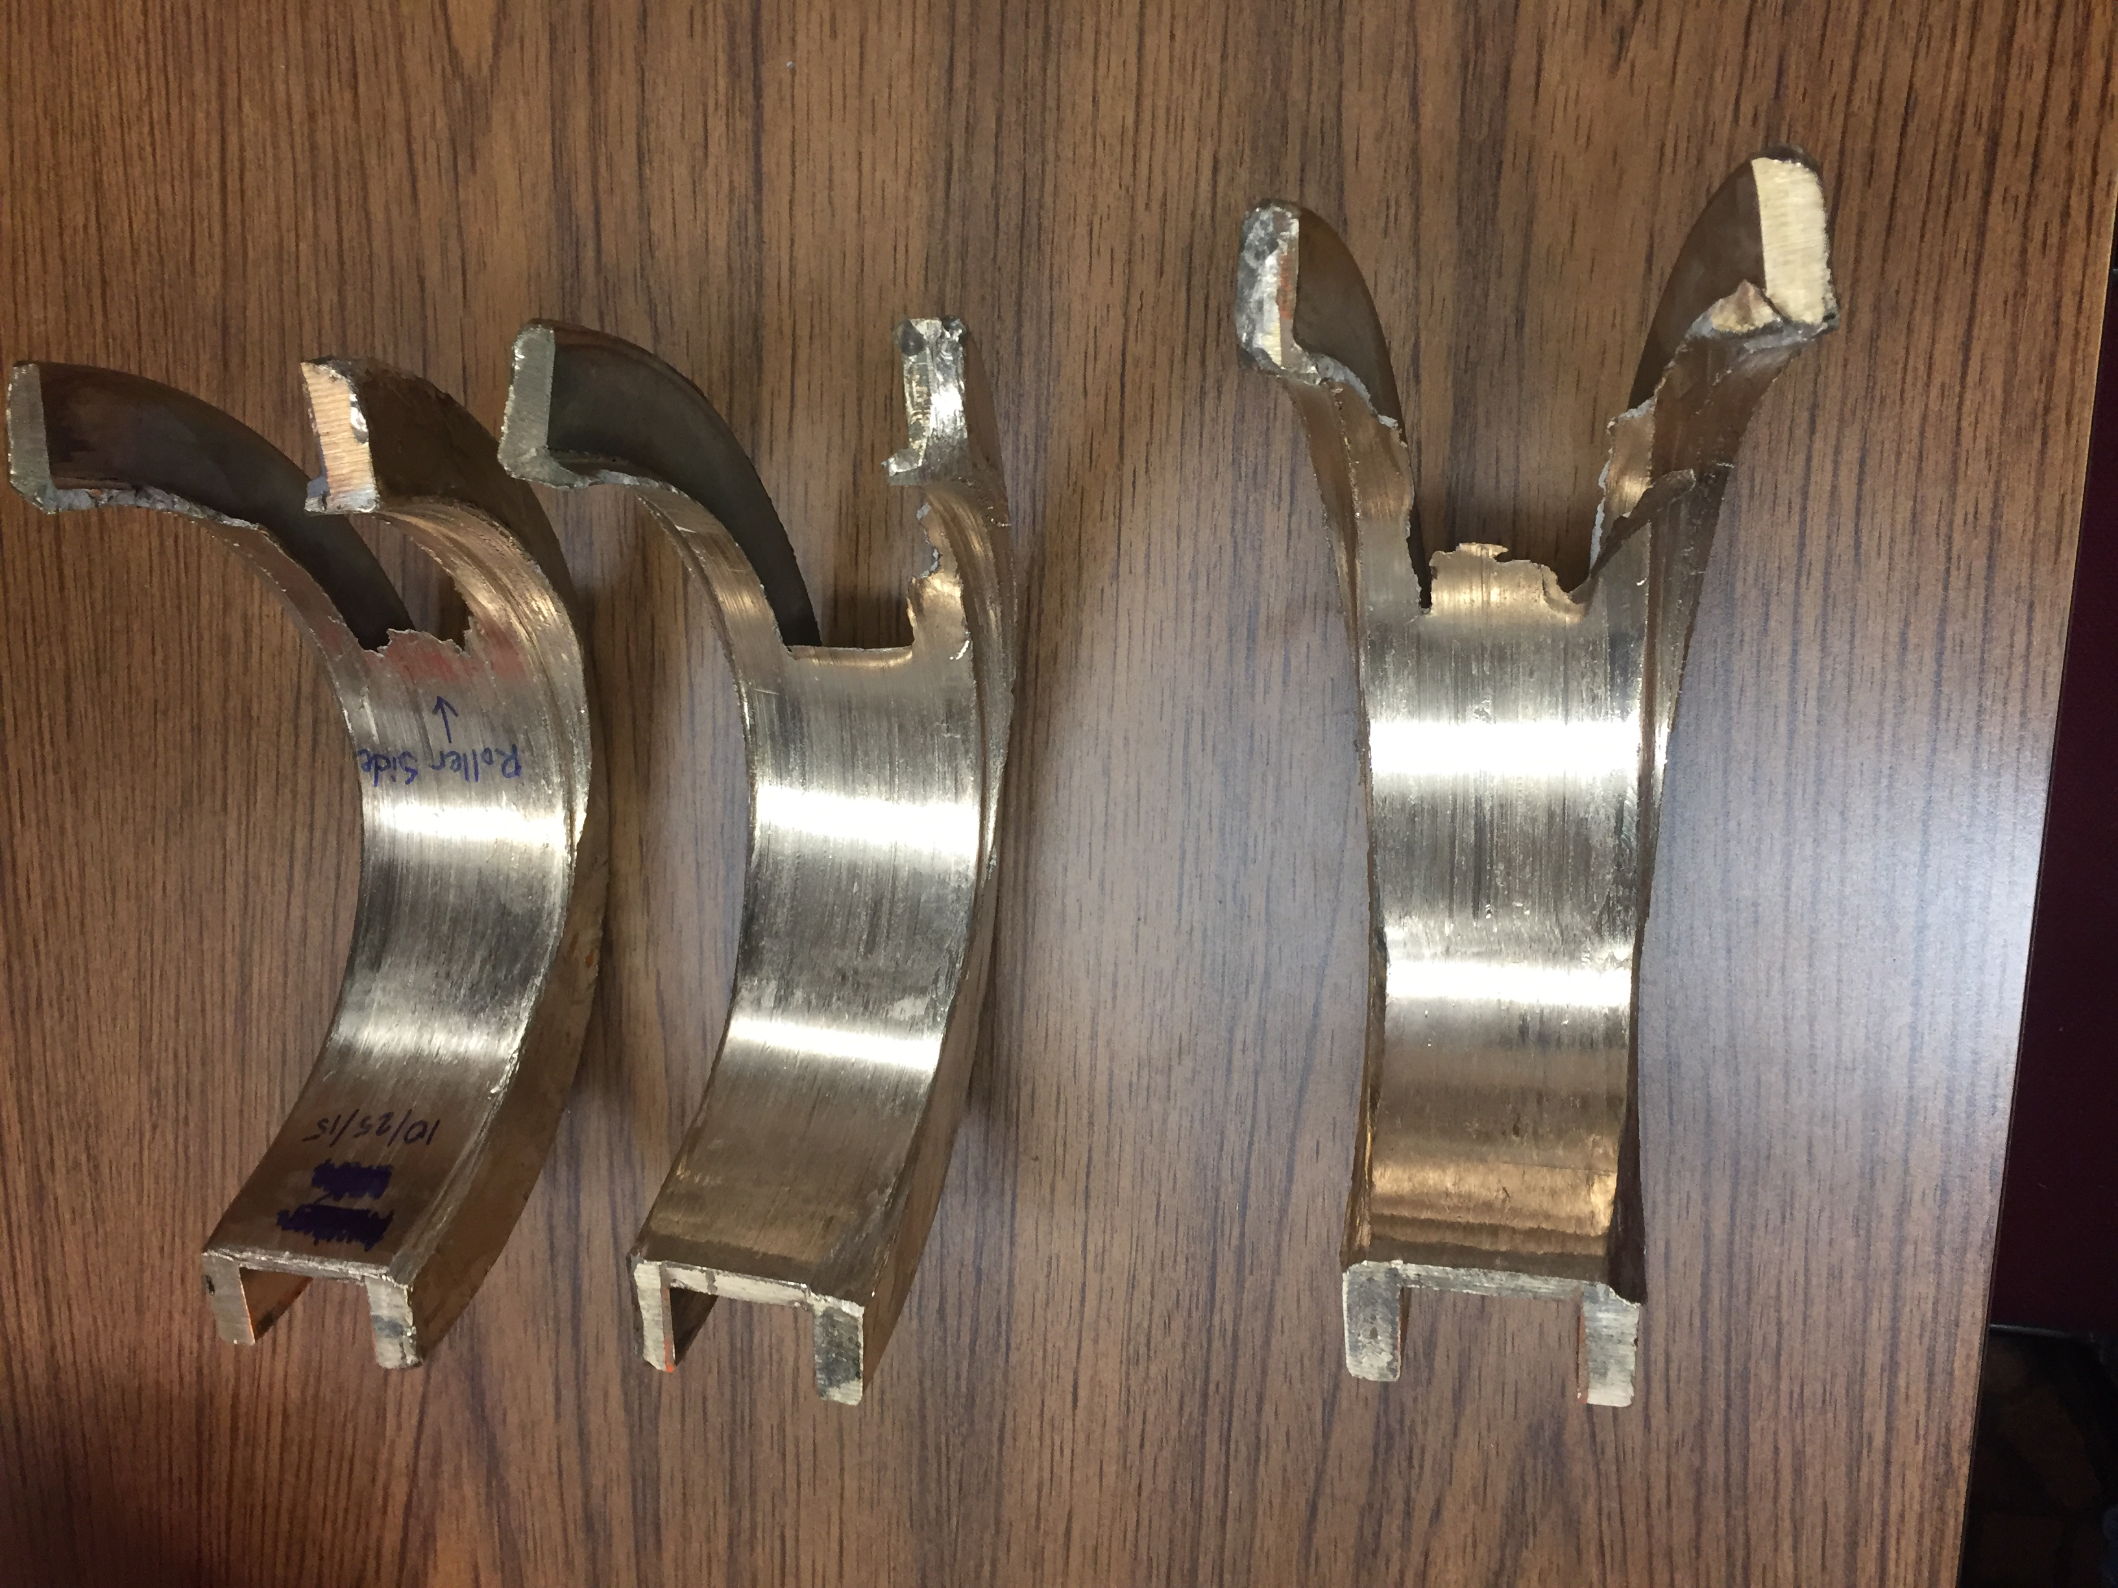
Event Background
Describe the event, including:
Date/Time/Location
Immediate Interim Actions Taken
Replace with Photo of the Event if Applicable

Slide 5

RCA Team and Process Used
Introduce the RCA team members and their roles
Explain the process used, such as data collection, timeline analysis, logic tree reconstruction, interviews, and identification of physical, human, and latent root causes

Slide 6

RCA Findings
Physical roots
Human roots
Latent/systemic roots
Contributing factors
Handout Verification Log (prior to tree presentation)
Present a single ‘Path to Failure’ leg of the logic tree
List the identified root causes identified.
Use visuals, props (i.e. –failed component) or diagrams to keep the audience engaged in the presentation

Slide 7
Corrective Actions
Identified Root Cause | P, H, or L* | Suggested Corrective Actions | Resp | Due Date | Completion Date
Corrective Action Presentation Tips
List specific actions to address each root cause.
Include responsible parties and deadlines.
Use as many different methods of visualization as possible with the audience (logic tree, pass failed parts around, videos, etc.)
*P,H, or L = Physical, Human, or Latent Root

Slide 8

Conclusion
Summarize the findings, recommendations, and the importance of the RCA.
Emphasize the need for continuous monitoring and improvement.

Slide 9

Acknowledgments
Express gratitude to individuals and departments that contributed to the analysis.

Slide 10

Questions
Open the floor for questions and discussion.
Commitment to ‘Next Steps’

Slide 11

Contact Information
Provide your contact information for follow-up questions or discussions.

Slide 12

Thank You
Express gratitude for the audience's time and attention.

