Slide 1
My prompt:
Using this voice and using humor, write a 50 word summary of a cozy mystery culinary book series that is about Jackie Norwood, a former celebrity chef that lost everything to alcholism and is now rebuilding her career by judging food festivals. Unfortunately, murder keeps happening at the festivals.

Slide 2
It came up with:
Jackie Norwood, the culinary world's fallen star, rises from the ashes of her booze-soaked past. Now a food festival judge, she's cooking up a comeback. But her plans are constantly seasoned with murder! With a dash of snark and a pinch of wit, Jackie chases killers between mouthwatering bites. Bon appétit, and watch out for the killer soufflé!
Jackie Norwood, a fallen culinary star, spices up her life as a festival judge in a deliciously funny cozy mystery series. Battling her demons and cooking up second chances, she finds herself knee-deep in saucy scandals and tantalizing homicides. Join Jackie in this murderously mouthwatering journey—where culinary prowess meets killer instincts! with murder!
Meet Jackie Norwood: a washed-up chef turned festival judge. She's cooking up a sizzling comeback, but there's a deadly secret ingredient. Murder! With each food festival she judges, she finds herself in a sticky situation, blending culinary expertise with amateur sleuthing. Can Jackie spice up her career while dodging the side dish of danger?

Slide 3
I combined them to:
In this deliciously funny cozy mystery series, Jackie Norwood, a former celebrity chef who lost everything due to alcoholism, has found a recipe for redemption. She's judging food festivals, but unfortunately, there's always a deadly secret ingredient. Murder! With each food festival, she finds herself in a sticky situation, blending culinary expertise with amateur sleuthing. Join Jackie in this murderously mouthwatering journey—where culinary prowess meets killer instincts.

Slide 4
And for the description for a novel
My prompt:
Now, using that voice, write a description for the first book in the series Claws of Death, under 300 words, using the AIDA model.
Jackie Norwood is in Texas, judging a crab festival. Unfortunately, her fellow judge is her biggest rival. Then, one of the chefs is her ex-boyfriend. Can it get worse? Yes, the rival dies.

Slide 5
Attention-grabbing Introduction: Join Jackie Norwood, the down-and-out celebrity chef on a comeback quest, as she navigates a treacherous crab festival in Texas. Brace yourself for a shell-shocking turn of events that will leave your taste buds tingling and your heart racing!
Captivating Interest: Jackie's crustacean adventure takes an unexpected twist when she discovers that her arch-nemesis, Chef Sabrina, is not only her co-judge but also a thorny thorn in her side. As if that weren't enough to stir the pot, she comes face-to-face with her long-lost ex-boyfriend, Chef Derek, stirring up old emotions and unresolved culinary clashes.
Creating Desire: As Jackie tries to maintain her cool amid the simmering tensions, disaster strikes. Chef Sabrina takes a fatal bite from a crab dish, leaving everyone in shock. With suspicion boiling over, Jackie becomes determined to clear her name and claw her way out of this culinary catastrophe.
Action-Packed Climax: Armed with her wit, culinary expertise, and a dash of luck, Jackie delves into the twisted world of crab claws and cutthroat rivalries. She interrogates quirky chefs, follows mouthwatering leads, and uncovers a crab pot full of secrets. As the heat in the kitchen rises, so does the danger lurking in the shadows.
Compelling Conclusion: In a thrilling climax that will keep you on the edge of your seat, Jackie uncovers the chilling truth behind Chef Sabrina's demise. But will she be able to bring the real killer to justice before becoming the next victim? With hearts pounding and crab shells cracking, prepare for a delectable ending that will leave you hungry for more.
Don't miss the first installment of this cozy culinary mystery series, where a spicy blend of murder, rivalry, and second chances will have you salivating for the next serving! Get ready for "Claws of Death" and embark on a culinary adventure you won't soon forget! 🕵️🍽️🔪

Slide 6
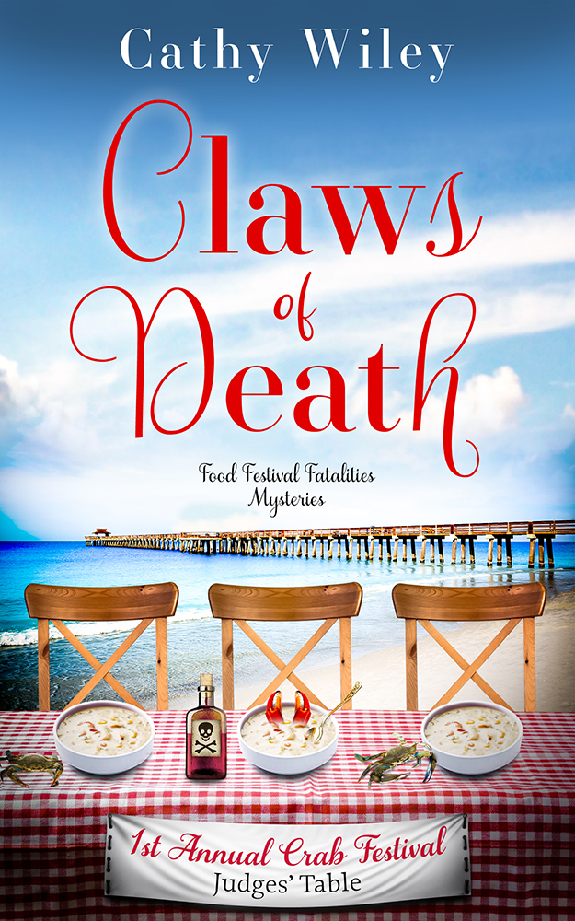
Join Jackie Norwood, a down-and-out celebrity chef, as she judges her first gig on her comeback quest: a Texas Crab Festival cooking contest. This new venture takes an unexpected twist when she discovers that her arch-nemesis, Heather Curtis, is her co-judge. As if that weren't enough to stir the pot, one of the competitors is Chef Benjy Hayes, her long-lost ex-boyfriend. Disaster strikes when Heather tastes Benjy's dish and meets a fatal end. Determined to clear Benjy's name -- and her own -- Jackie relies on her wit and the unique skills of her friends and family. But will she be able to bring the real killer to justice before becoming the next victim? Don't miss the first installment of this cozy culinary mystery series, where a spicy blend of murder, rivalry, and second chances will have you salivating for the next serving! Get ready for "Claws of Death" and embark on a culinary adventure you won't soon forget!

Slide 7
Translation
ChatGPT knows and supports more than 50 languages, including English, Spanish, French, German, Chinese, Japanese, Arabic, and many more.
This can be used for writing… or for regular life when needed.

Slide 8
Things it can do
Meal planning
Travel planning
Studying and homework help
Let’s go back to the Internet…

Slide 9
Writing emails or notes
My prompt:
Do a pun message about a hand mixer and marriage:
"If you want to whip up a successful marriage, you need to mix together love, trust, and a dash of humor. Oh, and a hand mixer can help too!"

Slide 10
What else can it do?
Write emails
Write code
Pros and Cons of anything
Play Dungeons and Dragons, ChatGPT can be the Dungeon Master
Prepare for interviews
Use it as a life coach for things going on in your life: lower stress, lose weight, start an exercise program, etc.
Party Planning Help
Entertainment Help
Creating Playlists

Slide 11
Ethics…

Slide 12
5 Cs
Consent - Consent asks questions around if we gave permission to use our content, if that permission was inadvertent due to generally worded terms of service and contracts, and if we should give consent going forward.
Copyright - Copyright deals with legal definitions as defined by the US Copyright Office. Copyright is a tricky subject as it's tied closely to both plagiarism and fair use.
Compensation - Compensation focuses on whether creatives should be paid for contributions, how compensation would work, and where the lines should be drawn.
Creativity - Creativity asks whether we should be replacing human work—specifically art—with machines capable of doing it faster and better than we can. What is sacred to humans, and what is okay to use AI for?
Capitalism - Capitalism ties commercial use of AI to morals and ethics. Is it greedy? Is it stealing? Is it like the Industrial Revolution in terms of how it affects the job landscape? Is it going to destroy our societal structures?
~ Monica Leonelle, The Author Analyst
https://authoranalyst.substack.com/

Slide 13
4 Ds
DIY
Difference
Derivative
Democratization

Slide 14
4 Ds
DIY
What percentage of the book did you do yourself vs. ChatGPT?

Slide 15
4 Ds
Difference:
What difference does it make if ChatGPT assisted you vs. another human?

Slide 16
All Writing is Derivative
"The ugly fact is books are made out of books."
~ Cormac McCarthy, Author of No Country for Old Men, All the Pretty Horses

Slide 17
Hollywood is already Derivative
“Endless reboots, remakes, sequels, next chapters, and prequels have replaced new stories. We've basically be doing AI by hand…”
~ Actress, Filmmaker, and Writer Justine Bateman, “AI in the Arts Is the Destruction of the Film Industry. We Can't Go Quietly.”
Opinion piece in Newsweek, May 15, 2023

Slide 18
4 Ds
Democratization:
For free, or for $20 a month…

Slide 19
Will ChatGPT replace fiction writers?
N
O
T
Y
E
T

Slide 20
What can we do?
As writers, we need to double down on our humanity…
~ Thank you to Joanna Penn
As readers/viewers, we need to let the decision makers know that we want creativity, that we want humans.

Slide 21
Most Controversial Thing I’ll Say Today
"AI won't take your job. It's somebody using AI that will take your job."
~ Economist and Professor Richard Baldwin
“While some worry that AI may take their jobs, someone who’s expert with AI will.” ~ Nvidia CEO Jensen Huang

Slide 22
Thank you all for your time…
Cathy Wiley
cathywileyauthor.com
cathymw@gmail.com

