Slide 1
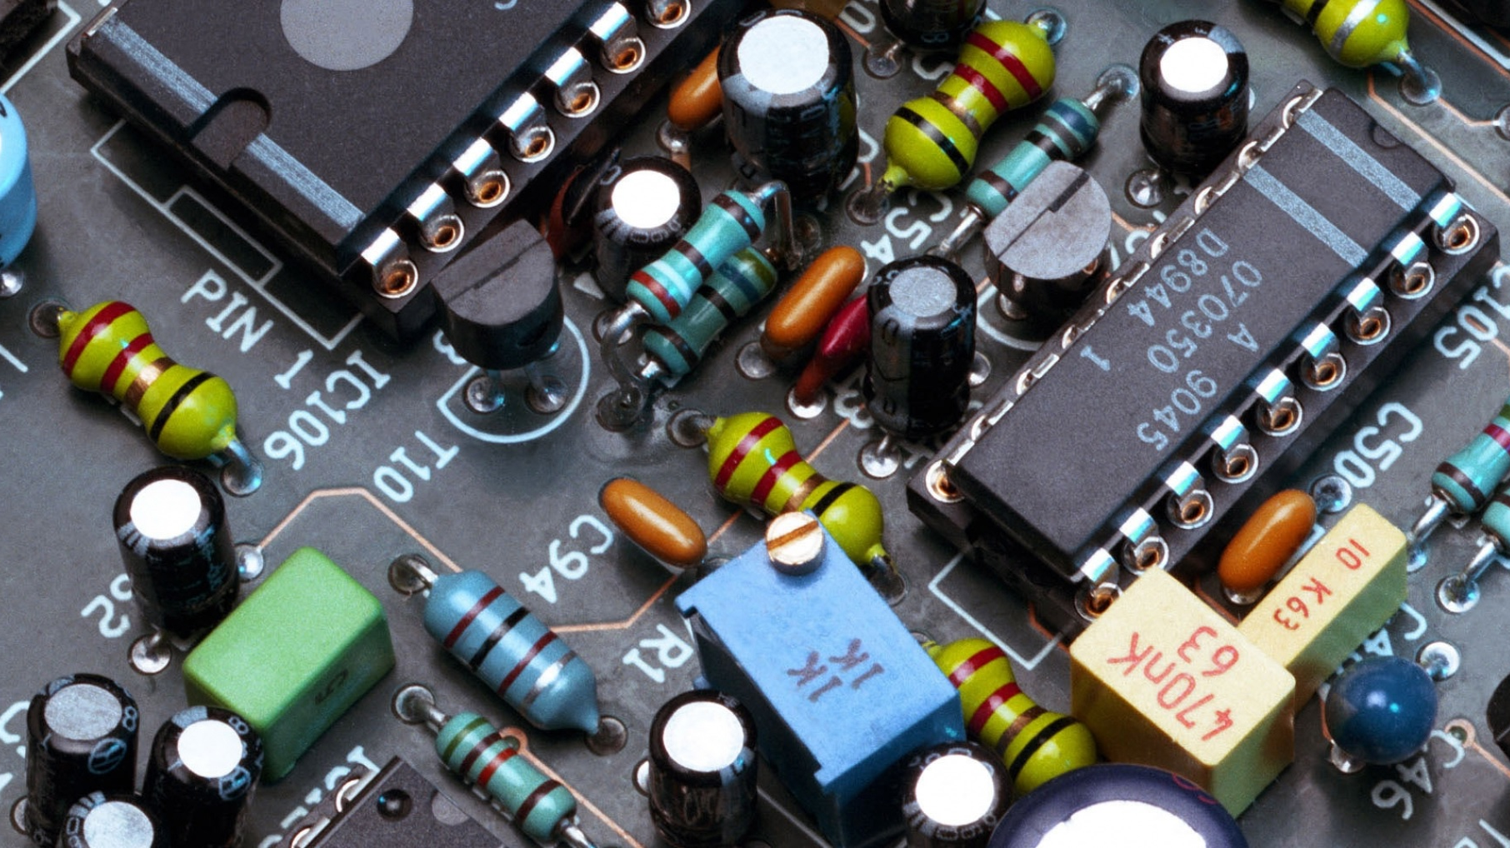
Unlocking the Power of ChatGPT:
Enhance Your Productivity for Writers and Everyone

Slide 2
The views expressed in this presentation on ChatGPT are solely those of the presenter and do not represent the views, opinions, or official stance of Sisters in Crime.

Slide 3
Any tool can be used for good or bad.
It’s really the ethics of the artist using it.
~ John Knoll, Chief creative officer of Industrial Light & Magic

Slide 4
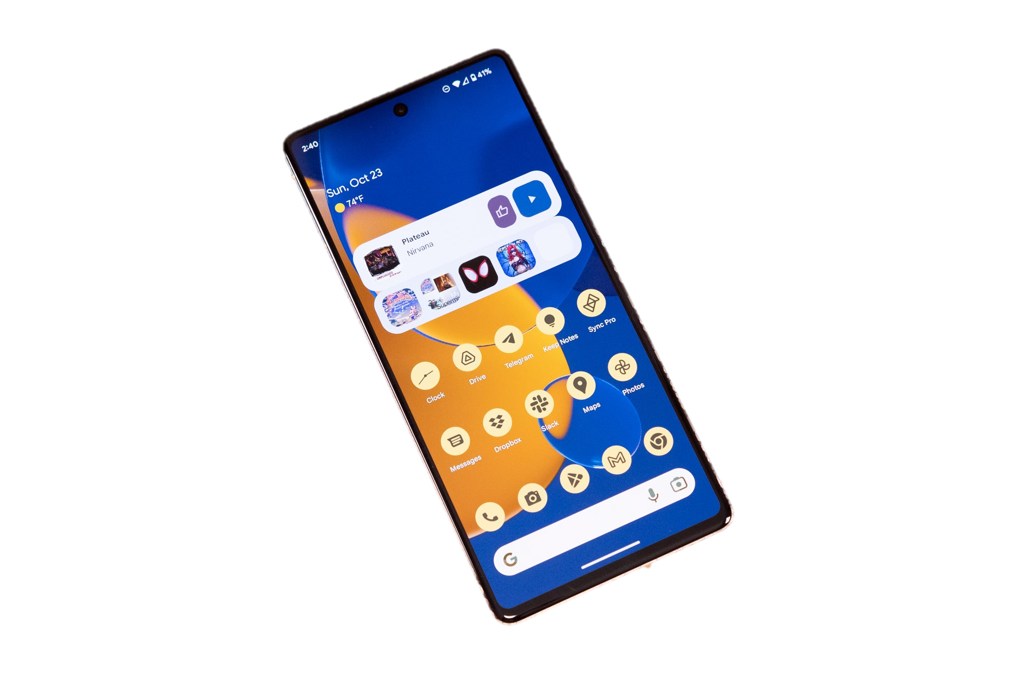
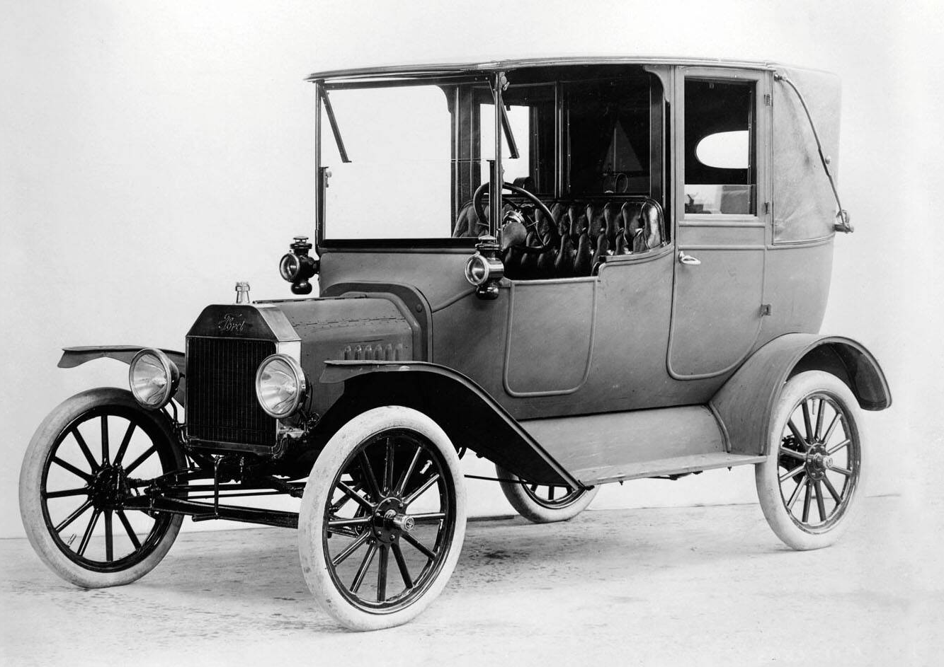
ChatGPT is a tool

Slide 5
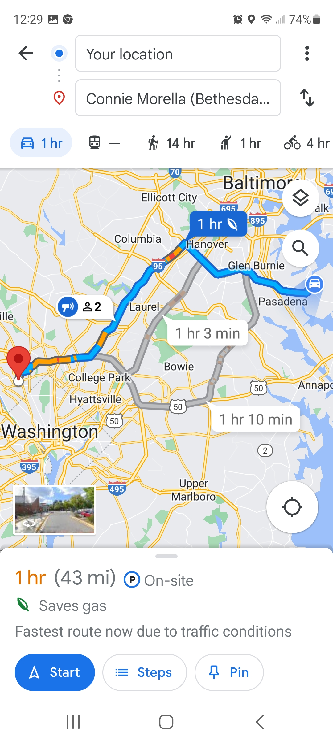
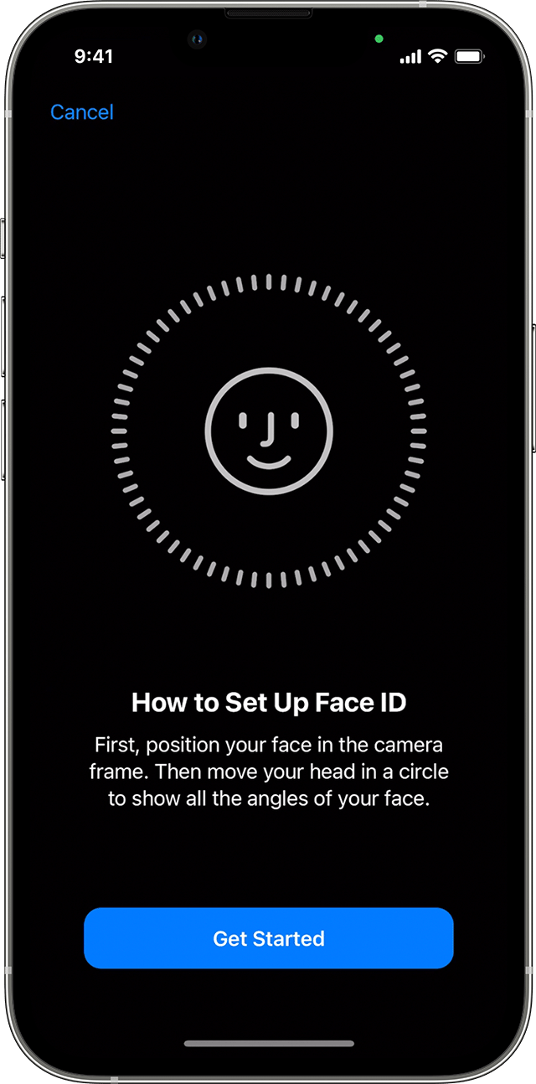
AI is already here

Slide 6
Mwah ha ha! That’s what you think…

Slide 7
AI is already here

Slide 8
What is ChatGPT ?
Chat Generative Pre-training Transformer
ChatGPT is an advanced artificial intelligence (AI) language model developed by OpenAI. It is designed to generate human-like text responses based on the prompts it receives.
Trained on a massive amount of diverse data from the internet, ChatGPT has the ability to understand and generate natural language in a conversational manner.

Slide 9
What isn’t ChatGPT?
It isn’t an AGI
It isn’t an AIP
Credit to Donna Andrews
It isn’t human
It doesn’t plagiarize
(intentionally)

Slide 10
Idea Generation
How can ChatGPT help authors?
Plot Development
Character Creation
Research
Writing Narrative & Dialogue
Well… what all does an author do?
Revision
Proofreading
Promotion
Editing
Revision
Promotion

Slide 11
And now…
Go to chat.openai.com, and log in or sign up.
There are two versions, a free version that uses ChatGPT 3.5, and a paid version, which currently costs $20 a month, where you can also use ChatGPT 4 up to 25 times every 3 hours.

Slide 12
Basic Prompt Structure
Give it a role/style (optional)
What action to perform
What format to output
If needed, give source/HTML

