Slide 1
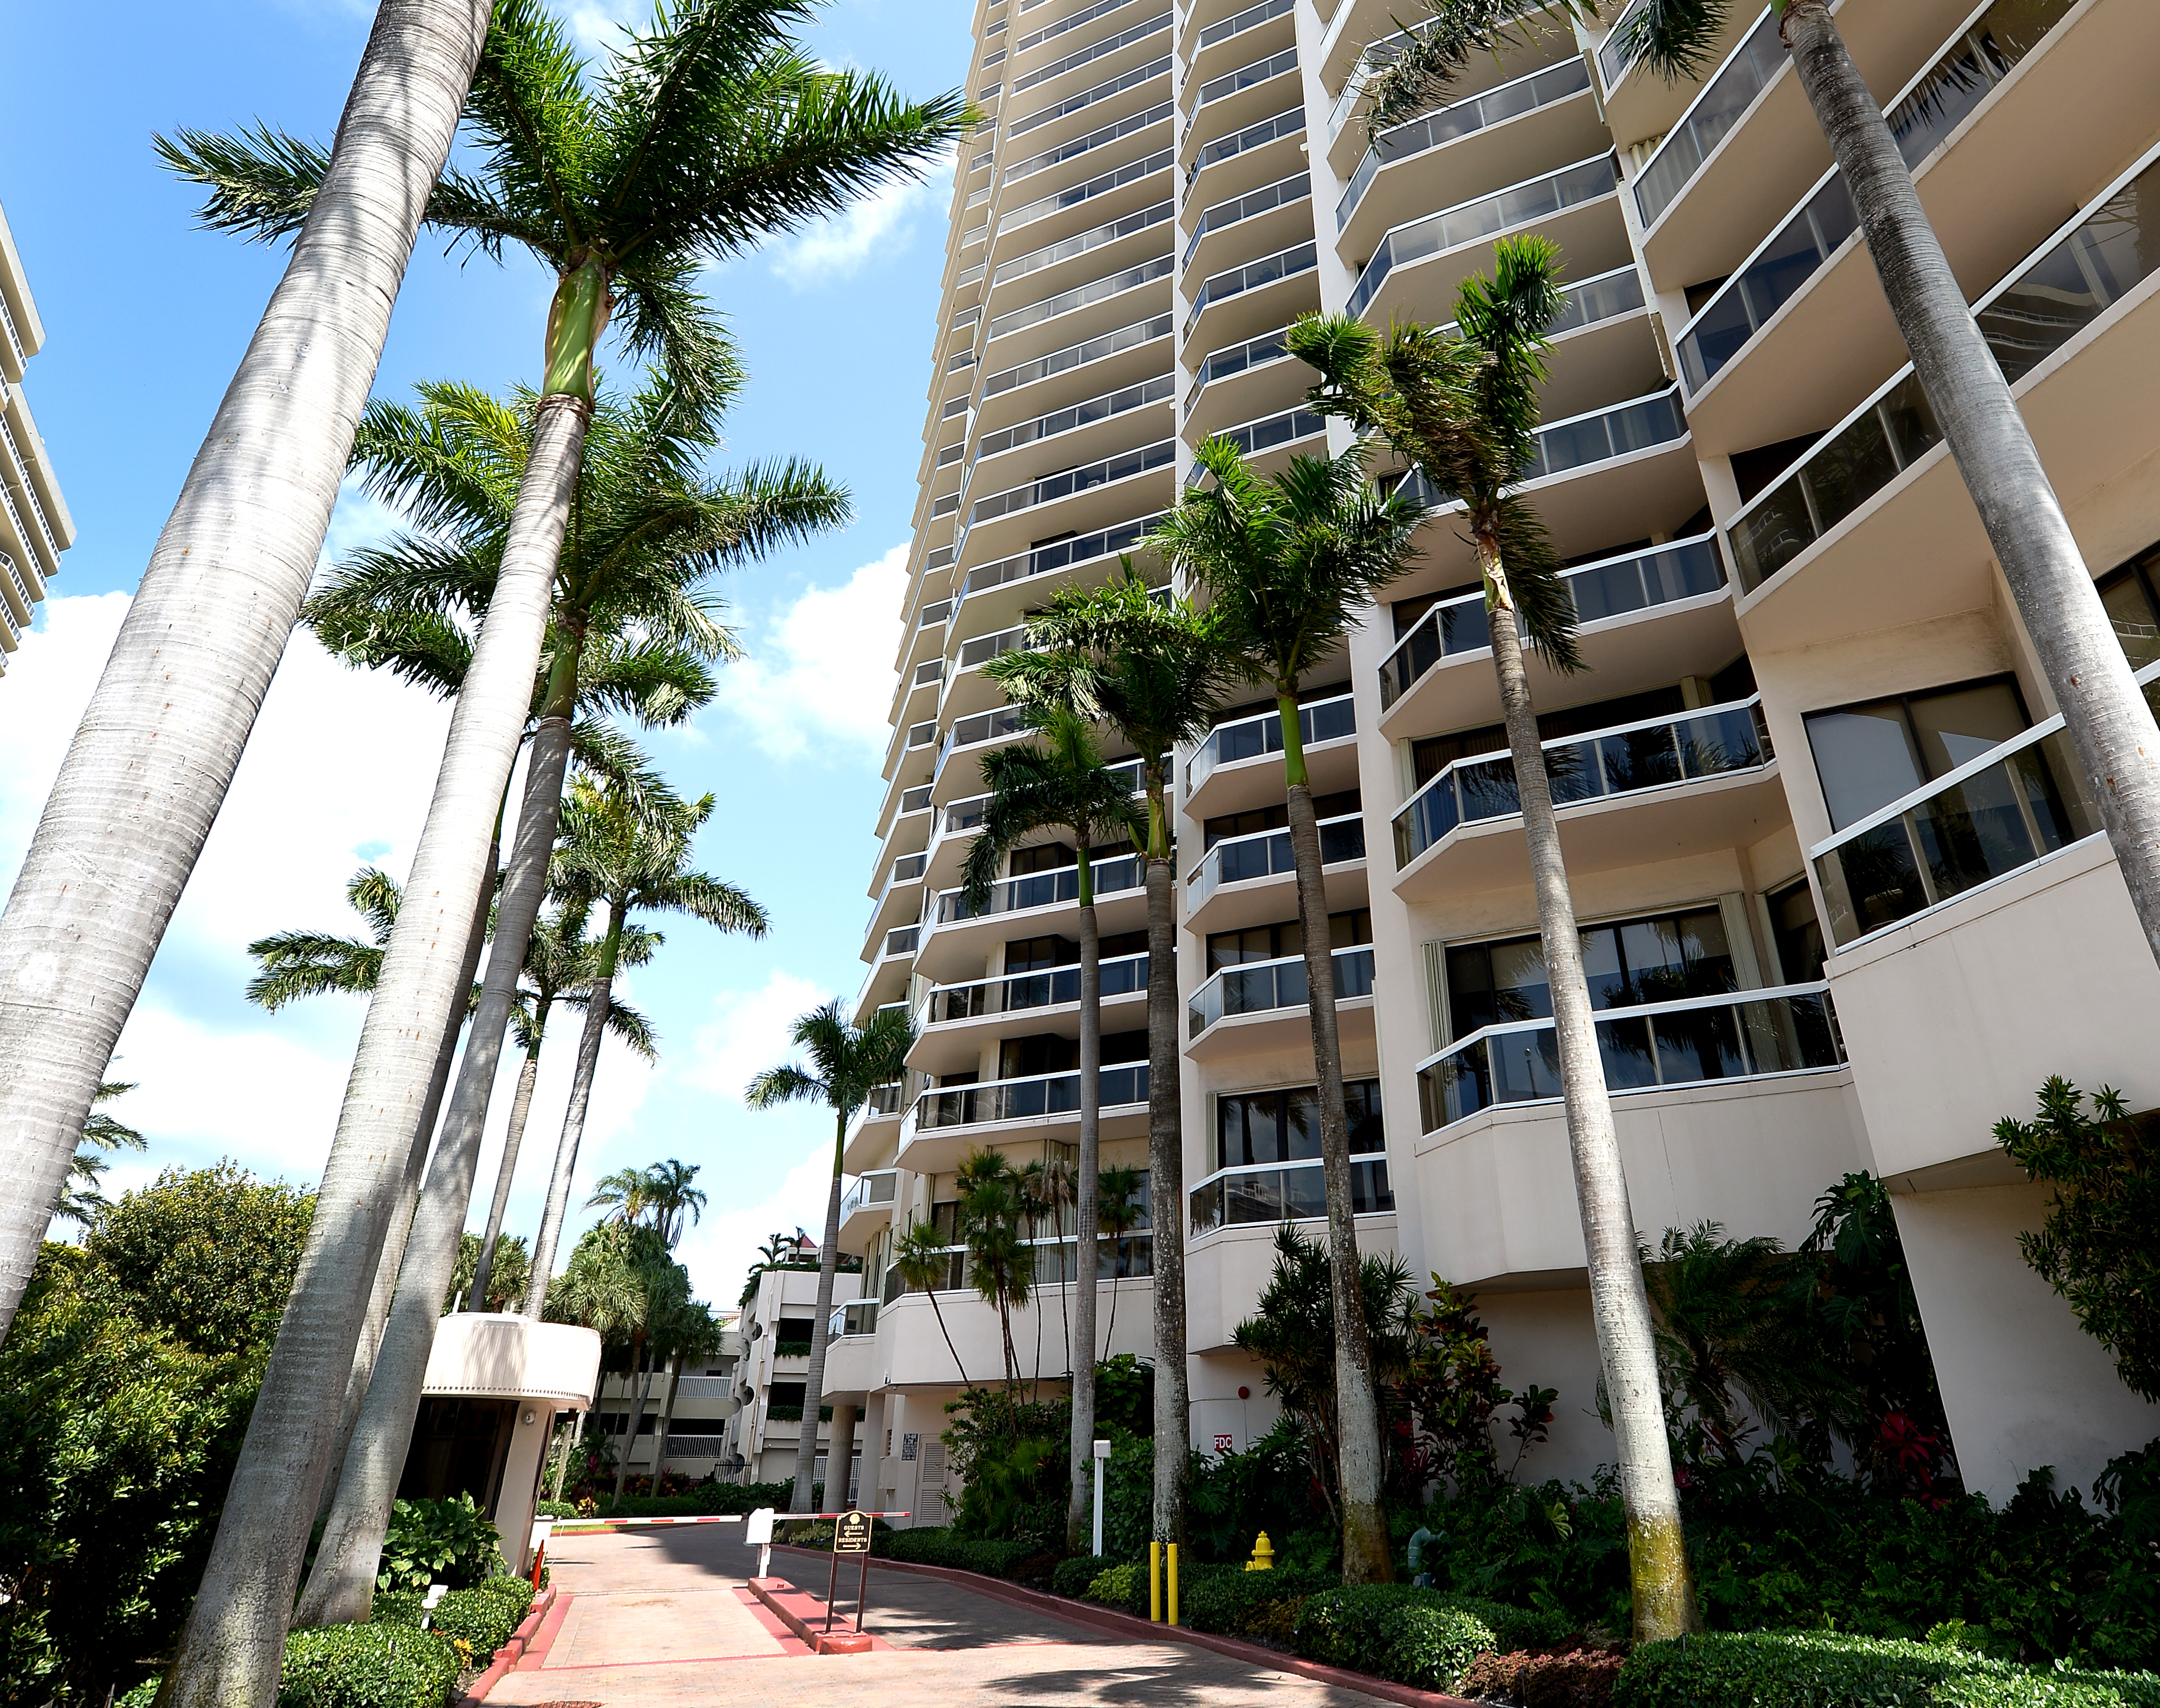
THE LANDMARK
CLUB CONDOMINIUM
BOARD OF DIRECTORS MEETING
September 16, 2025

Slide 2
TOPICS
• Treasurer’s Report
• Manager’s Update
• Ratification of approved proposals and agreements for the following:
• Repack Fire Pump, With Factory Packing
• Landmark Fitness Equipment: Replacement of the strength equipment
• 2025-2026 insurance policies including Flood Policy Renewal
• Tennis Court Repairs, Resurfacing and Painting Proposal
• Replacement of broken license plate reader – Gatehouse
• Main Drain Clean out - Annual Preventive Maintenance Service
• Receiving Arm Gate Repairs

Slide 3
TOPICS – Contd.
Discussion and Vote to Approve Proposals for Fire Rated Doors for the 3rd floor room doors.
Discussion and Vote to allow electronic voting per Florida Statute
§718.128
Owners Q & A
Adjournment

Slide 4
TREASURER'S REPORT UPDATE

Slide 5
Financial Report 8/31/2025
Monthly Maint per Budget 338,239.37
Actual Cash Received 361,787.94
+/- +23,548.57
Maintenance Due 20,308.47 4 late
2021 Spec Assess Due 5,761.50 5 late
2022 Spec Assess Due 1,067.63 3 late
2024 Spec Assess Due 817.14 2 late
Operating Bank Bal 137,426.77
Spec Assess Bank 250,488.42
2025 Insurance Savings 122,90628
Security Deposits Bank Bal 32,107.08

Slide 6
Manager’s Update

Slide 7
Manager Update Topics
Top Building Valve Replacement - June 17
First Service Residential- Inspections- SnapInspect (June 11) & 2025 Quality Assurance July (8)
Receiving Arm Gate - July
Dryer Vent Cleaning – August 12
Main Drain Clean Out – August 28
Pool: New Lounge Chair Covers - August / September
Summer Party outcome - August 10
Electrical Re-certification - In Progress
Bicycle Re- registration and Clean out / Painting Project – In Progress
Tennis Court Resurfacing and Painting - first week of October weather permitted
Gym: Strength Equipment - October

Slide 8
BUILDING VALVES UPDATE

Slide 9
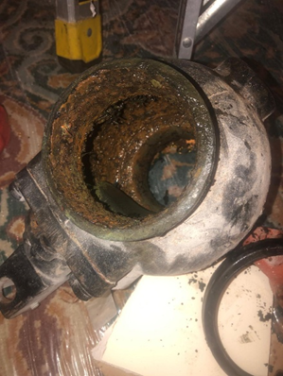
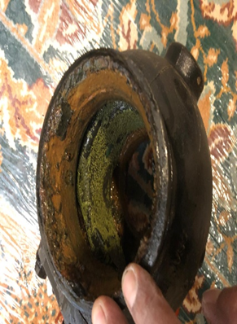
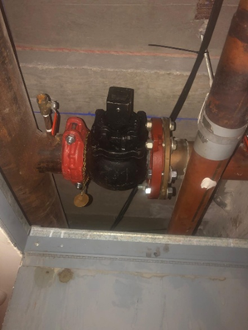
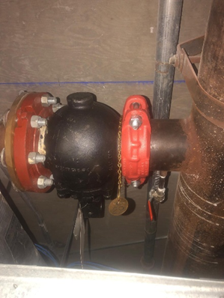
BUILDING VALVES UPDATE
REPLACED UPPER BUILDING VALVES – Scheduled on June 17, 2025
Before (Old Valves) New Valves

Slide 10


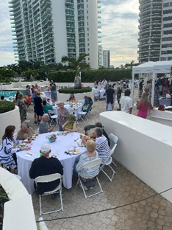
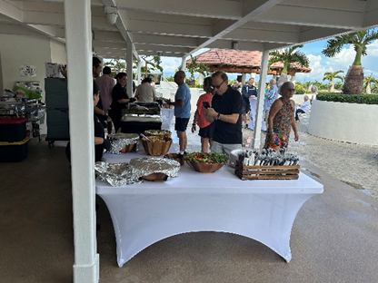
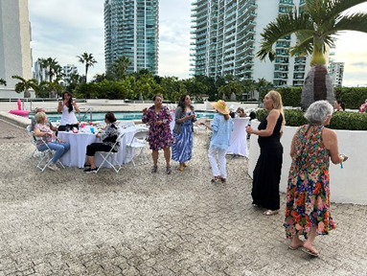
The Terraces and The Landmark Club Summer Party

Slide 11
First Service Residential Inspections
SnapInspect
2025 Quality Assurance

Slide 12
Ratification of approved proposals and agreements for the following:
• Repack Fire Pump, With Factory Packing
• Landmark Fitness Equipment: Replacement of the strength equipment
• 2025-2026 insurance policies including Flood Policy Renewal
• Tennis Court Repairs, Resurfacing and Painting Proposal
• Replacement of broken license plate reader – Gatehouse
• Main Drain Clean out - Annual Preventive Maintenance Service
• Receiving Arm Gate Repairs

Slide 13
Discussion and Vote to Approve Proposals for Fire Rated Doors for the 3rd floor room doors.

Slide 14
Discussion and Vote to allow electronic voting per Florida Statute §718.128

Slide 15
LANDMARK ELECTRONIC VOTING
Why we need to implement electronic voting
New Florida House Bill 913 amended Florida Statutes 718.128 regarding electronic voting.
Under current legal requirements, the Association now must either:
Implement statutory electronic voting or
Allow voting by e-mail.

Slide 16
LANDMARK ELECTRONIC VOTING
Electronic voting (via platform)
- Conducted through a certified third-party platform designed to comply with Florida Law.
- Protects voter secrecy, including in elections involving candidates.
- The platform provider assumes technical/procedural responsibility, reducing liability.
- Minimal cost involved. Peace of mind through legal compliance and reliability.
E-mail voting
- Technically permissible but requires extensive procedural oversight by Association.
- Process does not protect voter secrecy, particularly during elections.
- Each voter must sign a waiver of secrecy.
- The risk of procedural errors is high.
- The administrative burden and legal risk rest entirely on the Association.

Slide 17
LANDMARK ELECTRONIC VOTING
Requirements
- Board implements the electronic voting as a voting option.
- Select certified third-party vendor.
Next steps
- Board officially approved electronic voting.
- Board searches/select/approves vendor.
- Management Office coordinates necessary steps.
- 2026 Board election to simultaneously include paper ballot and electronic voting.

Slide 18
OWNERS Q & A

Slide 19
ADJOURNMENT

