Slide 1

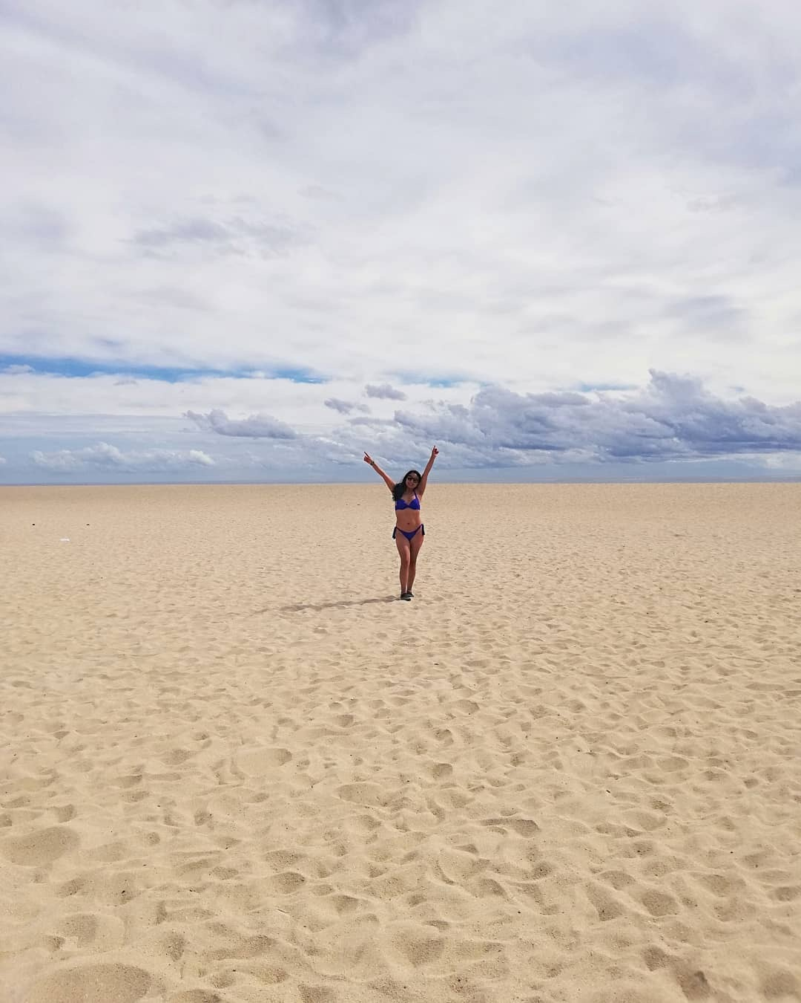
Breakthrough to Bliss
With Stephen & Sonji Millet

Slide 2

Married 12 Blissful, Honeymoon years & 5 adult children
Authors of the Best-Selling Book, TALK STRAIGHT DAMMIT
International Trainer
Licensed Ordained Minister & Comedian
Personal Communication Coach

Slide 3


BLISS
The freedom to love and be loved in abundance with complete forgiveness and without judgement.
Notes:
Stephen

Slide 4
B
L
I
S
S
Make a BOLD decison
LEVERAGE your past
Take INSPIRED actions
Put yourSELF first
START now

Slide 5


What they are saying about us.
“Since working with the Millets, I have graduated college, received a promotion, bought a house and got married. They have shown me how the words I speak really do attract the life I want and deserve. I recommend their courses and personal coaching to help you TALK STRAIGHT Dammit
- Candice, from Milwaukee
Notes:
Sonji

Slide 6
Rules of Engagement
We are HERE for YOU!
When we COACH 1, we coach many.
If you feel COMFORTABLE, SHARE your specifics.
Participate in all 3 days
You must DO THE WORK to have a BREAKTHROUGH!

Slide 7

Friday
How to Tell an Empowering Story of You.
Saturday
What's Holding You Back? With Special Guests Dr Wayne Swan and Francezia Campbell
Sunday
Step Into Bliss, Your New Story.

Slide 8

The most IMPORTANT story you will ever tell is the STORY of YOU!

Slide 9

Are you reinforcing VICTIMHOOD & POWERLESSNESS?

Slide 10

How to rewrite the STORY of You

Slide 11

Type Into Chat if you have any Questions.

Slide 12

HOMEWORK
List your pain points (hurts, disappointments, regrets)
List your successes (what went right, celebrations)

Slide 13

Type Into Chat
What was the VALUE of this for you today?

Slide 14

Join us
Tomorrow
Topic:
What’s Holding You Back?
Contact us at
www.myBlisstopia.com
www.Facebook.com/myBlisstopia.com
Available on Amazon
Notes:
Put text in follow up campaign

Slide 15
Breakthrough to Bliss
With Stephen & Sonji Millet

Slide 16
Married 12 Blissful, Honeymoon years & 5 adult children
Authors of the Best-Selling Book, TALK STRAIGHT DAMMIT
International Trainer
Licensed Ordained Minister & Comedian
Personal Communication Coach

Slide 17
Rules of Engagement
We are HERE for YOU!
When we COACH 1, we coach many.
If you feel COMFORTABLE, SHARE your specifics.
Participate, Participate, Participate
If you have a question type it into chat
You must DO THE WORK to have a BREAKTHROUGH!

Slide 18
Friday
How to Tell an Empowering Story of You.
Saturday
What's Holding You Back? With Special Guests Dr Wayne Swan and Francezia Campbell
Sunday
Step Into Bliss, Your New Story.

Slide 19
HOMEWORK
Review
List your pain points (hurts, disappointments, regrets)
List your successes (what went right, celebrations)

Slide 20
What’s Holding You Back?
What old beliefs do you have?
Are you bringing your past into the future?
Are you living in the past?

Slide 21

“True forgiveness is not wishing the past was any different than it was”
- Nelson Mandela
Notes:
Get out of the Land of Coulda, Woulda, Shoulda

Slide 22

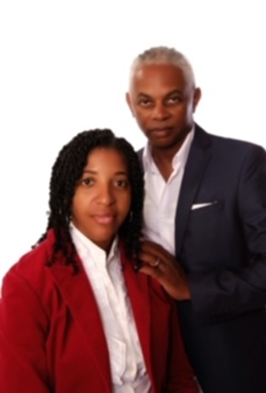
Welcome Dr. Wayne & Francezia
Co-Founders of ImpactOne International.
Internationally known Ordained Minister.
holds a PhD in Christian Leadership.
Author of The Mountain We Climb.
Divorce Coach and a transformational speaker.
Human Resources professional with over 10 years’ experience.
Life Strategy Coach and a Vision Board Facilitator.

Slide 23

Sign up on our website – www.impactoneinternational.com
Email – info@impactoneinternational.com
Facebook - @impactoneinternational or ImpactOne
Instagram - impactone.intl

Slide 24
Type Into Chat if you have any Questions.

Slide 25
HOMEWORK
Pick one of your pain points with yesterday's homework and List your beliefs
Think about how that belief shows up in your life today. How do they limit you
How would your life change if you were not limited by your beliefs?

Slide 26
Type Into Chat
What was the VALUE of this for you today?

Slide 27
Join us
Tomorrow
Topic:
Step Into Bliss
Your New Story
Contact us at
www.myBlisstopia.com
www.Facebook.com/myBlisstopia.com
Available on Amazon
Notes:
Put text in follow up campaign

Slide 28
Breakthrough to Bliss
With Stephen & Sonji Millet

Slide 29
Married 12 blissful honeymoon years, 5 adult children
Authors of the best-selling book, TALK STRAIGHT DAMMIT
International trainer
Licensed Ordained Minister & Comedian

Slide 30
Rules of Engagement
We are HERE for YOU!
When we COACH 1, we coach many.
If you feel COMFORTABLE, SHARE your specifics.
Participate, Turn ON your video
If you have a question, type it into chat
You must DO THE WORK to have a BREAKTHROUGH!

Slide 31
HOMEWORK
REVIEW
Pick one of your pain points with yesterday's homework and List your beliefs.
Think about how that belief shows up in your life today. How do they limit you?
How would your life change if you were not limited by your beliefs?

Slide 32
Friday
How to Tell an Empowering Story of You.
Saturday
What's Holding You Back? With Special Guests Dr Wayne Swan and Francezia Campbell
Sunday
Step Into Bliss, Your New Story.

Slide 33

Reconstruct the
STORY of
YOU
“Other people’s opinion of me is none of my business!”

Slide 34
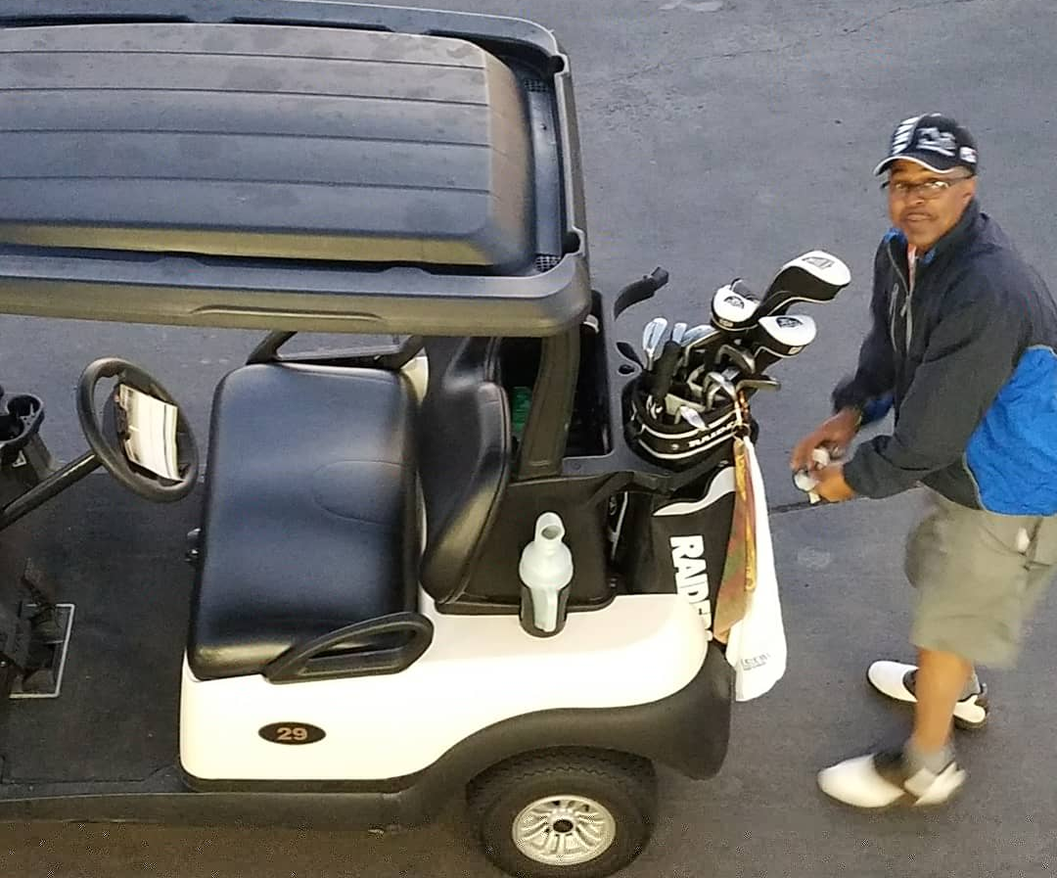
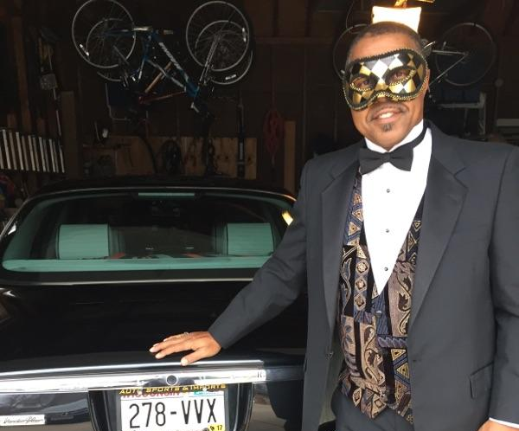
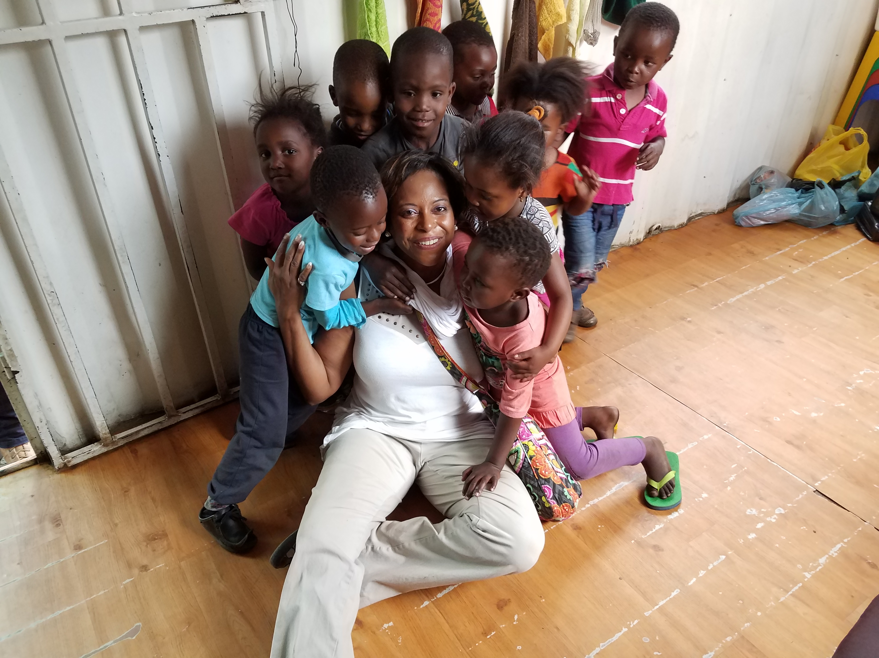
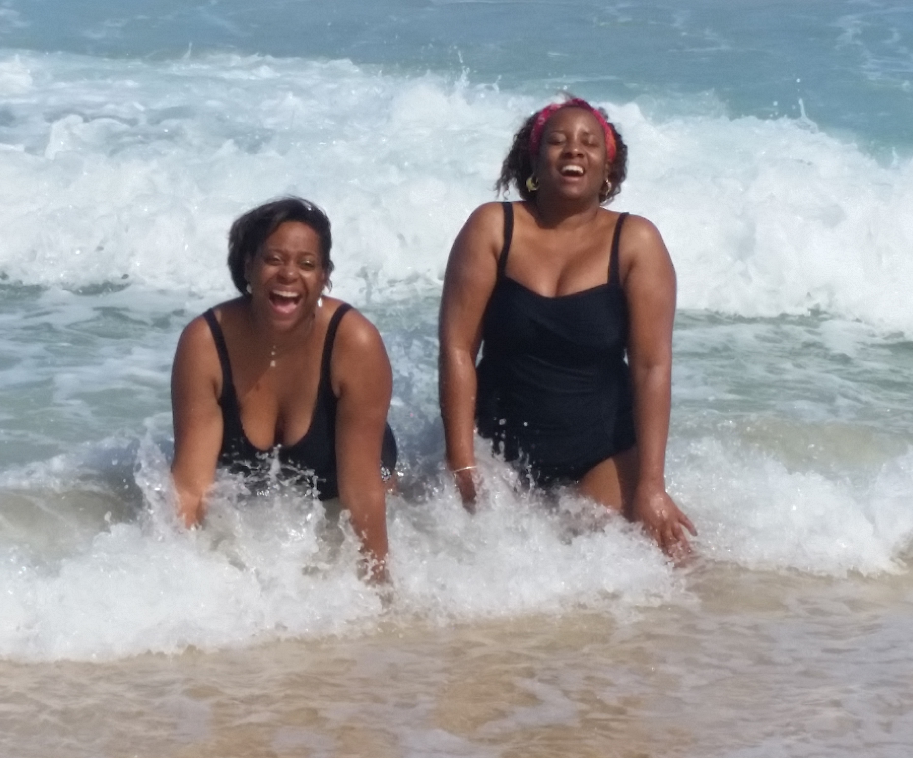
What Does BLISS look like for you?

Slide 35

Do you have a plan?
“The sooner you start planning your life, the sooner you will live the life you dream of.”
-Hans Glint

Slide 36
Welcome Back
Dr. Wayne & Francezia
Co-Founders of ImpactOne International.
Internationally known Ordained Minister.
holds a PhD in Christian Leadership.
Author of The Mountain We Climb.
Divorce Coach and a transformational speaker.
Human Resources professional with over 10 years’ experience.
Life Strategy Coach and a Vision Board Facilitator.

Slide 37
Five Strategies to Create a ‘Blissful Life’ Vision Board
Strategy 1: Be Open Minded and Give Gratitude
Strategy 2: Be Authentic
Strategy 3: Write Your Plan
Strategy 4: Be Intentional
Strategy 5: Share, Share, SHARE!

Slide 38

SUMMARY
Visualization
Possibilities
Being Intentional
Continued Motivation
Action
Manifestation
Manifestation
Purpose/Meaning

Slide 39

We want you to not only SEE but LIVE the LIFE planned for YOU!

Slide 40
Sign up on our website – www.impactoneinternational.com
Email – info@impactoneinternational.com
Facebook - @impactoneinternational or ImpactOne
Instagram - impactone.intl

Slide 41
HOMEWORK
Create an Action Plan to change your reality
Email us your action plan and we will give you a free 30-minute Action Plan Consultation with Stephen & Sonji ($500 value)

Slide 42
Here is What We Covered
Friday
How to Tell an Empowering Story of You.
Saturday
What's Holding You Back? With Special Guests Dr Wayne Swan and Francezia Campbell
Sunday
Step Into Bliss, Your New Story.

Slide 43
Type Into Chat
What was the VALUE of this for you today?

Slide 44
Want HELP Attracting the Life of Your Dreams?
TALK STRAIGHT DAMMIT
MASTER CLASS
Your Investment: $49.95 [valued at $4,000]
Includes:
six 30 min Videos
3 Mastermind Calls
The Talk Straight Dammit Workbook
Taught by 2 Personal Communication Coaches
Your BONUS for attending today
1 one-on-one coaching call
Contact Us at www.Myblisstopia.com for more information

Slide 45
Thank
You!
Contact us at
www.myBlisstopia.com
www.Facebook.com/myBlisstopia.com
Available on Amazon
Notes:
Put text in follow up campaign

