Slide 1
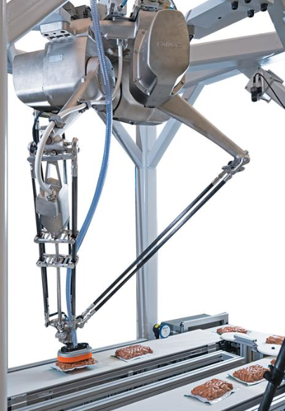
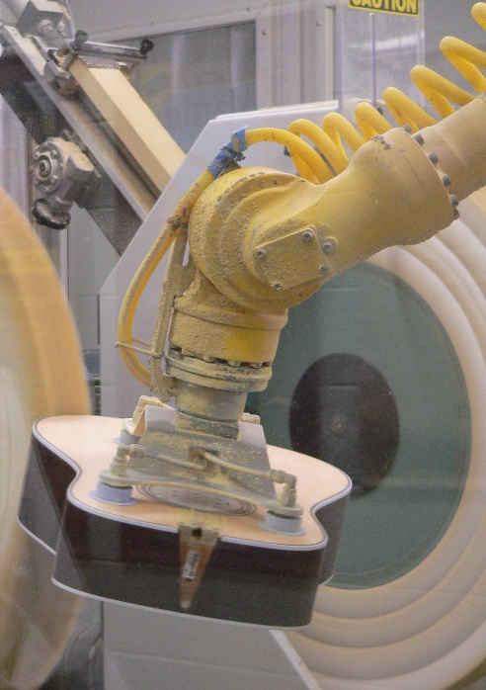
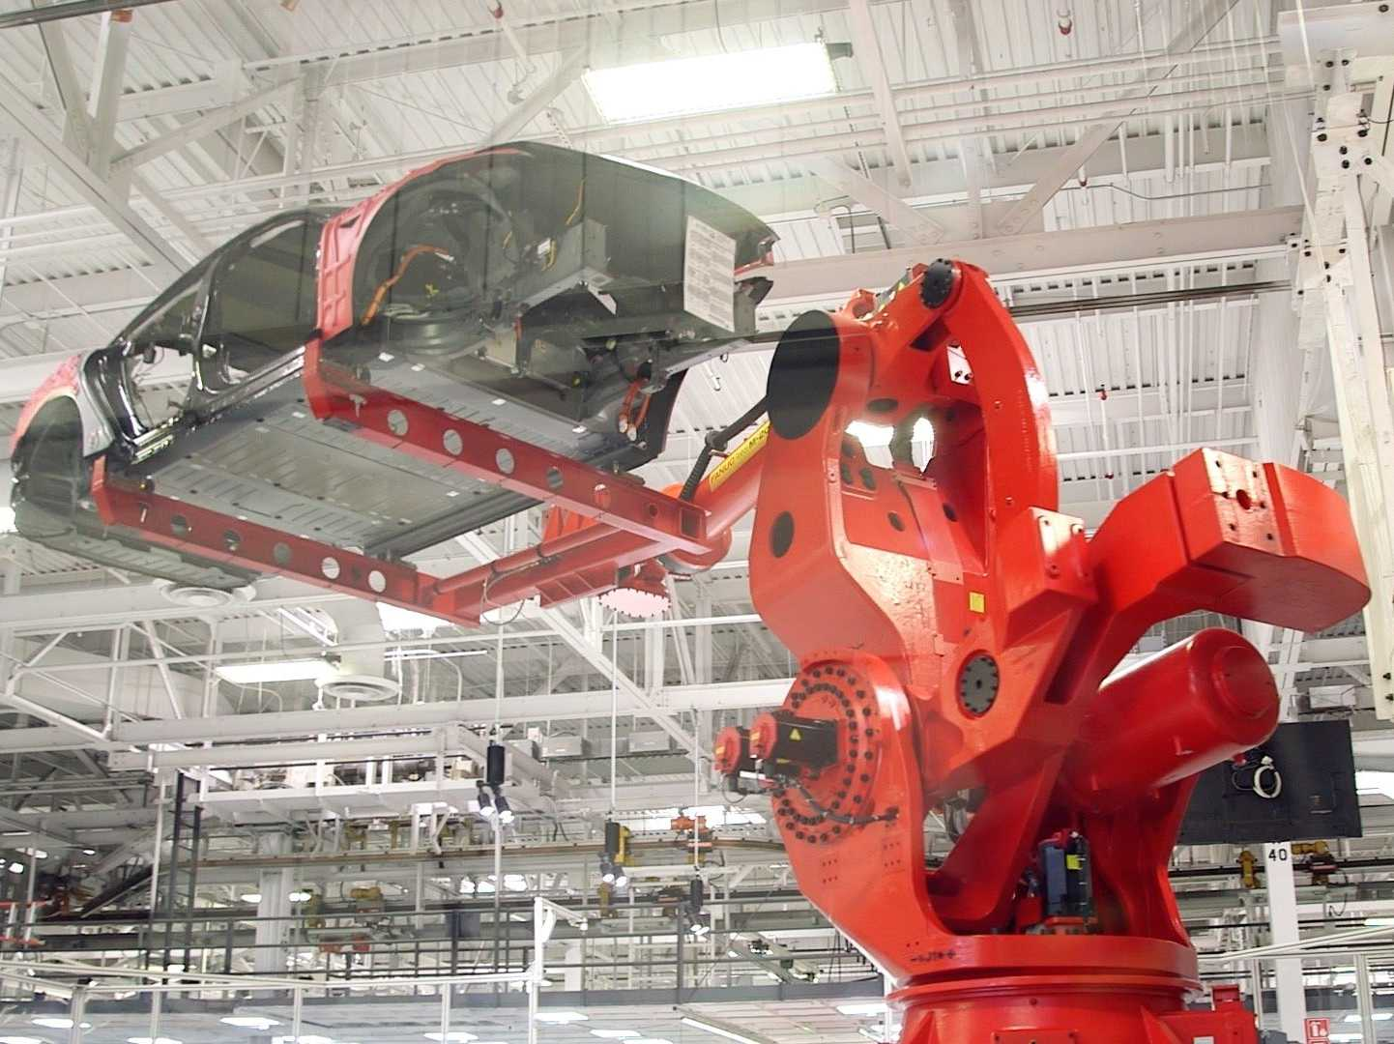
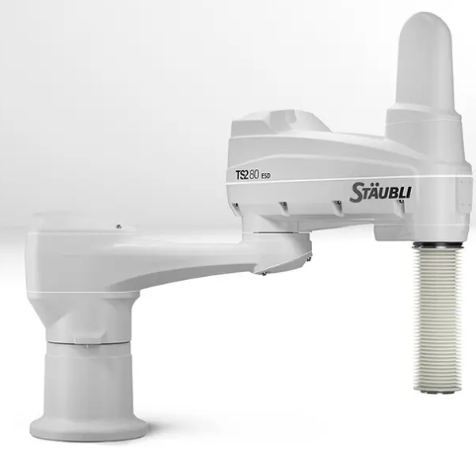
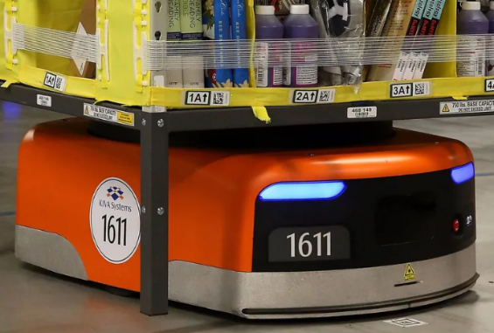
Industrial Robots
& VEX VRC Robots
3/25/2025 Steve Bolin
Bolinrobotics.com
Notes:
1

Slide 2
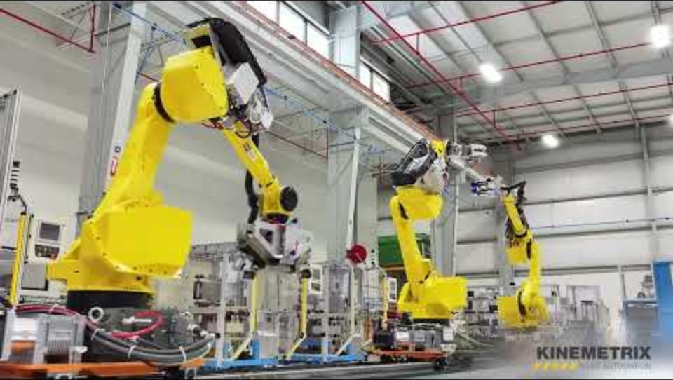
What robots do when no one is watching…
https://youtu.be/fFwrakDrYTc?si=WLQ8Q7bdj_31T11J

Slide 3
Topics
Introductions
Industrial robot technology
  Types of robots
  Size ranges
  Why so many choices?
Industrial robot systems – real world applications
Similarities between VEX and industrial robots
Background/skill requirements for robotics & automation
Hands-on time with an industrial robot
3
Notes:
3

Slide 4
Introductions
Steve Bolin
Bolin Robotics [Robotics & Automation Consulting]
Previous: Robotics and Vision Sales & Application Engineer at Kinemetrix [Custom Automation Builder]
Mentor for Covington Catholic VEX Robotics Teams (9257)
Matt Schroff
District/Account Manager
FANUC America Corp - Robotics Division
4
Notes:
4

Slide 5
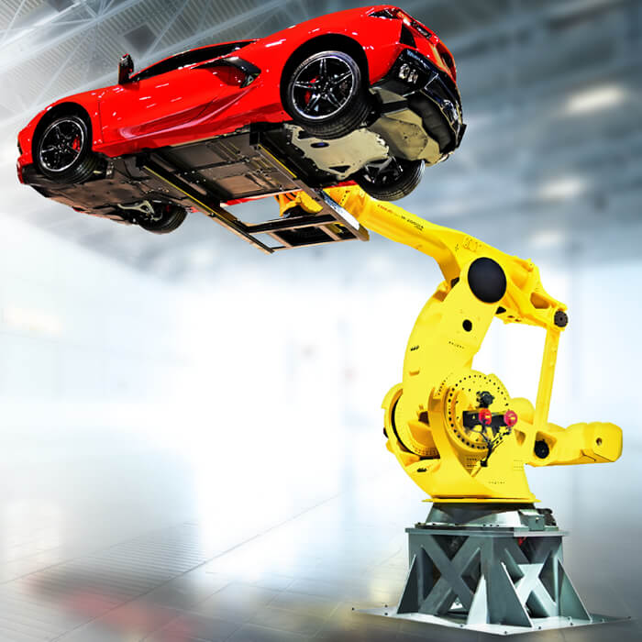
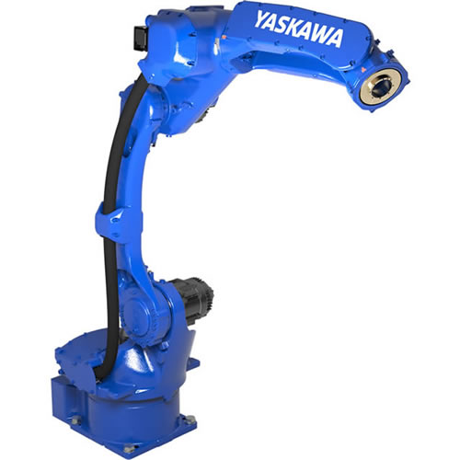
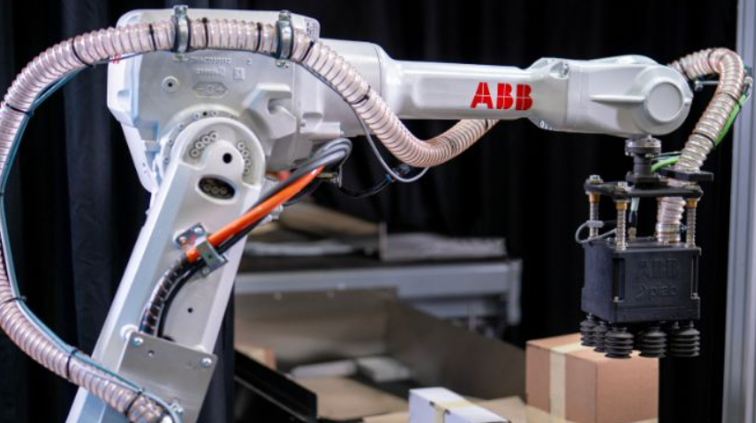
Industrial robot companies
Fanuc
Yaskawa Motoman
ABB
Kuka
Kawasaki
Epson
Yamaha
Denso
Omron
Mitsubishi
Nachi
And many more…

Slide 6
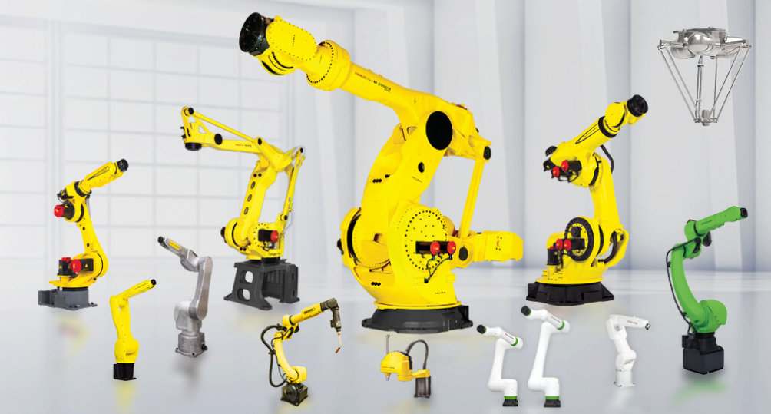
Many types and sizes of industrial robots

Slide 7
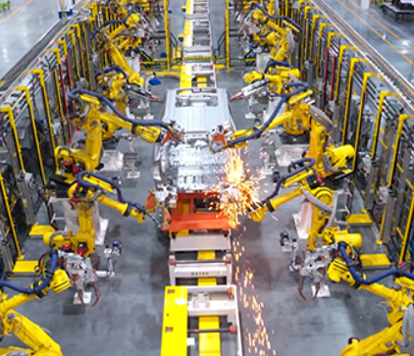
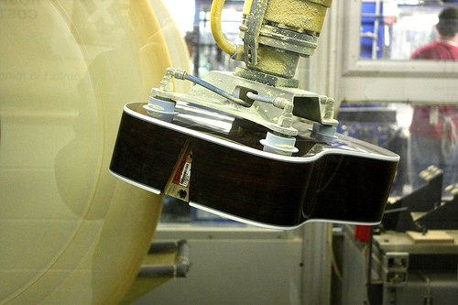
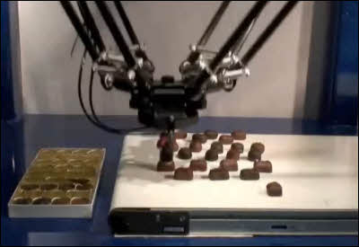
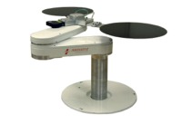
Industrial robot applications
Welding
Painting
Dispensing
Assembling
Polishing/Finishing
Material Handling
Packaging
Palletizing
Machine Loading

Slide 8
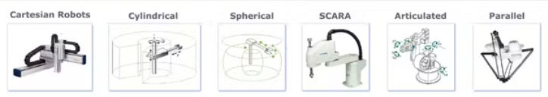
Industrial robot types
Articulated
Cylindrical
Spherical
SCARA
Parallel link / Delta / Spider
Cartesian / Linear / XYZ / Gantry
Collaborative [Cobots]
Wheeled / Mobile robots
  [AMR – autonomous mobile robots]

Slide 9
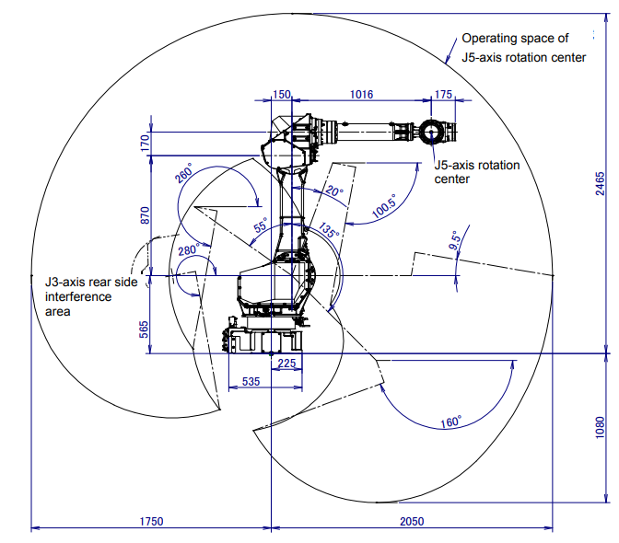
Industrial robot terms
Robotics terms:
Axes [degrees of freedom]
Payload [lifting capacity]
Working envelope / workspace [working volume]
Speed [axis speed, tool speed]
Accuracy
Repeatability

Slide 10
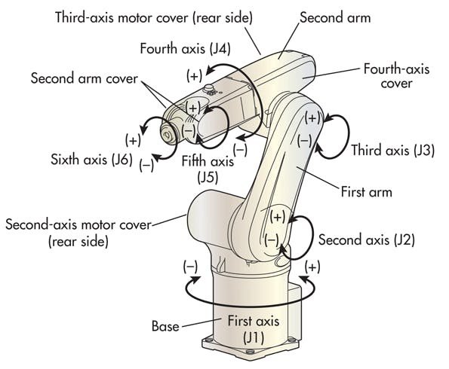
Industrial robot types
Articulated 4-6 axes

Slide 11
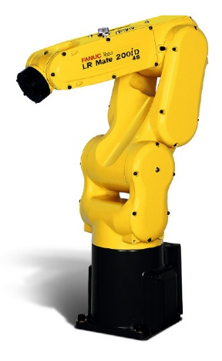
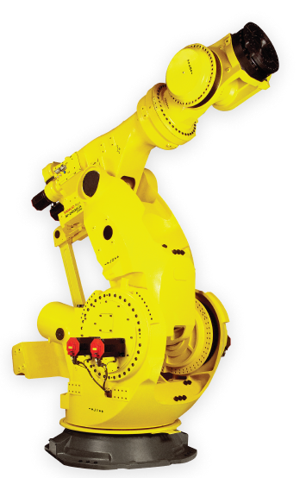
Industrial robot types
Articulated 4-6 axes
Small: 4 kg (8.8 lb)
Large: 2300 kg (~5000 lb)

Slide 12
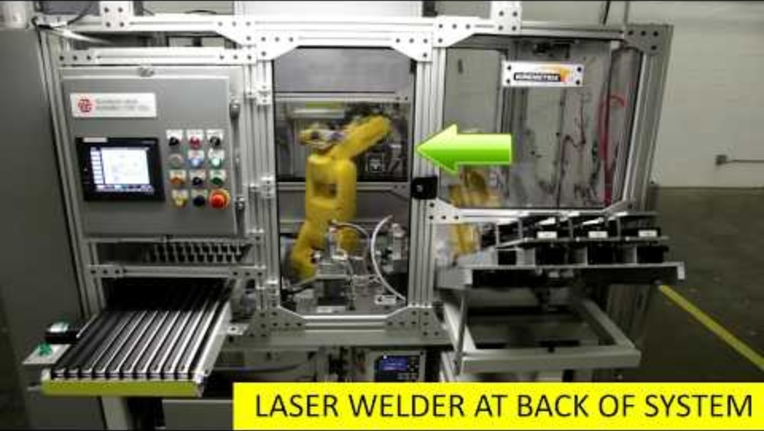
Industrial robotic systems
Small articulated robots – fuel valve assembly:

Slide 13
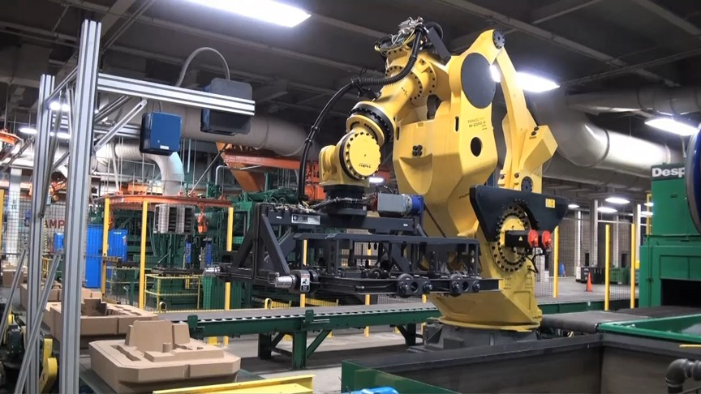
Industrial robotic systems
Large articulated robot - Diecast mold handling:

Slide 14
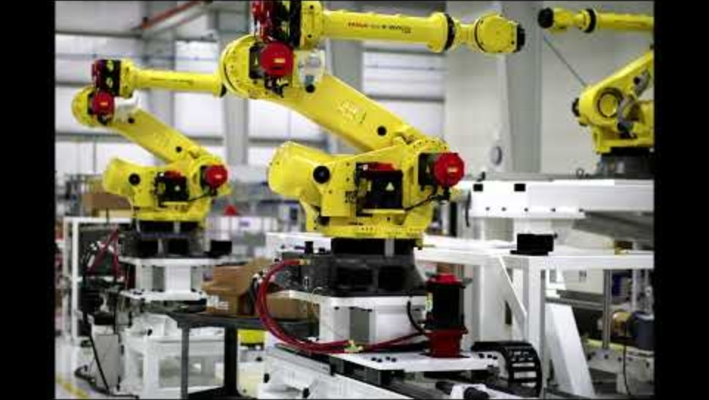
Industrial robotic systems
Large articulated robots – steel blank handling:

Slide 15
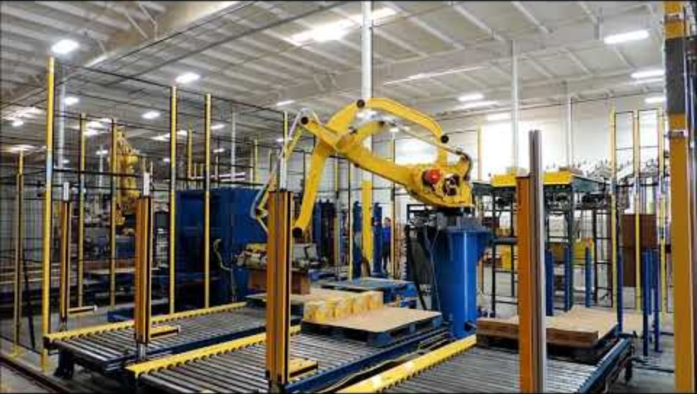
Industrial robotic systems
Large articulated robot – box palletizing:

Slide 16
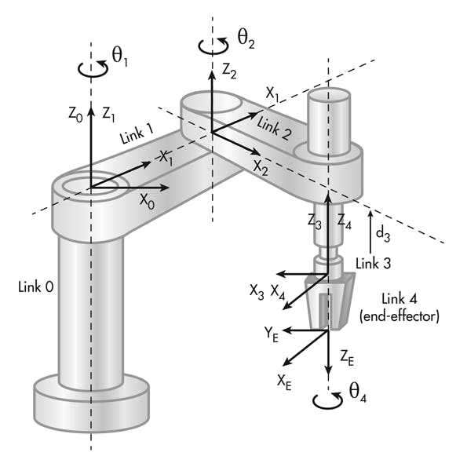
Industrial robot types
SCARA [Selective Compliance Articulated Robot Arm]
High-speed
High-precision assembly
Payload: 1-20 kg

Slide 17
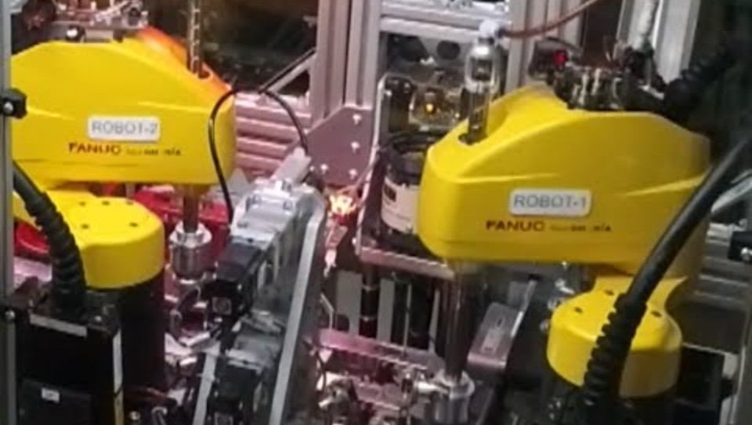
Industrial robot types
SCARA robots – high speed small part assembly:

Slide 18
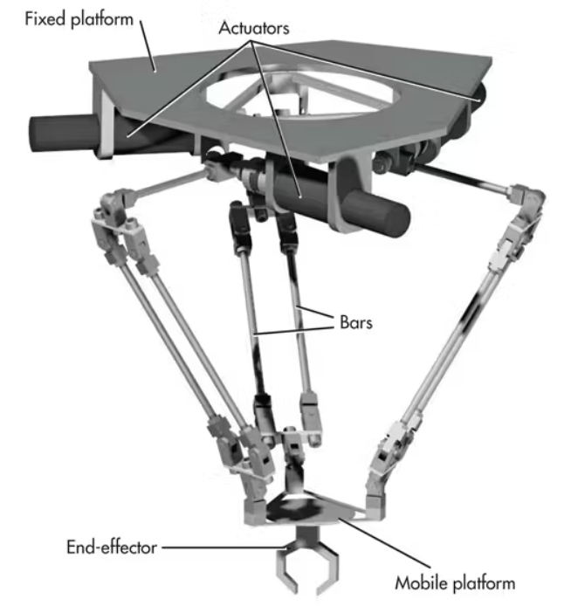
Industrial robot types
Parallel link / delta / spider robot
High-speed
Payload: 1-12 kg

Slide 19
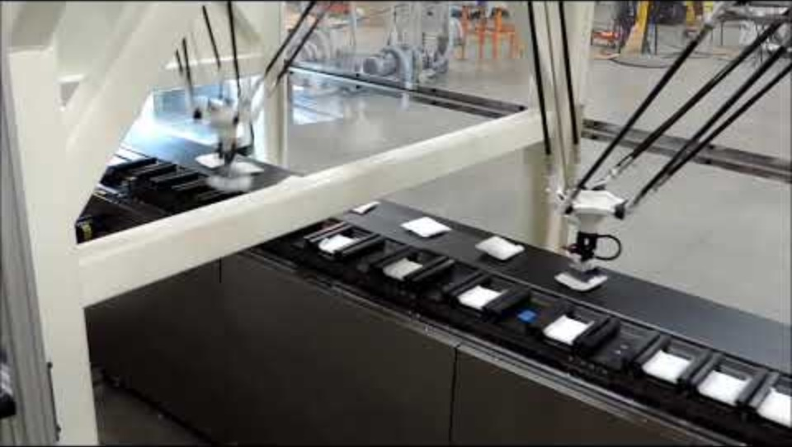
Industrial robot types
Delta robot application – high speed cartoner loading:

Slide 20
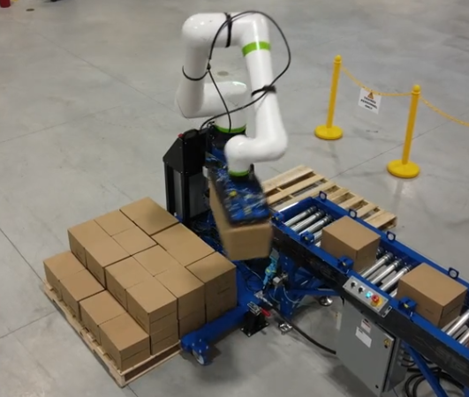
Industrial robot types
Collaborative [Cobot]
Intended for direct human-robot interaction within a shared space
Where humans and robots are in close proximity

Slide 21
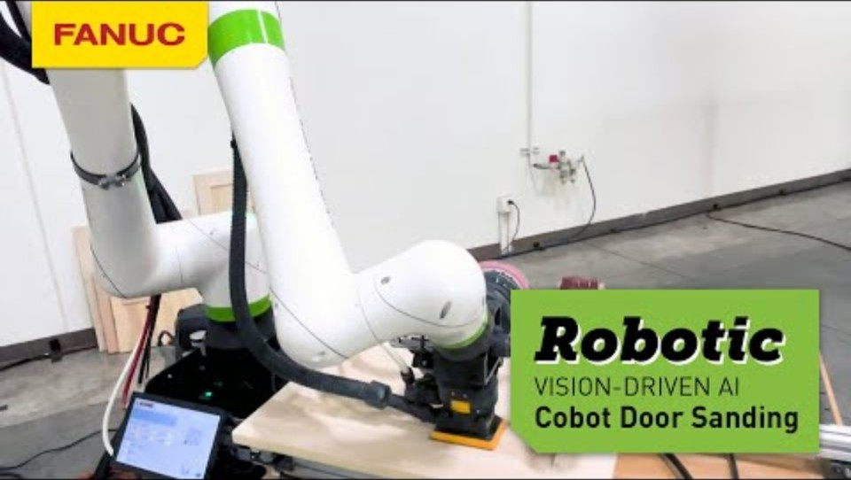
Industrial robot types
Cobot - AI Powered Door Sanding

Slide 22
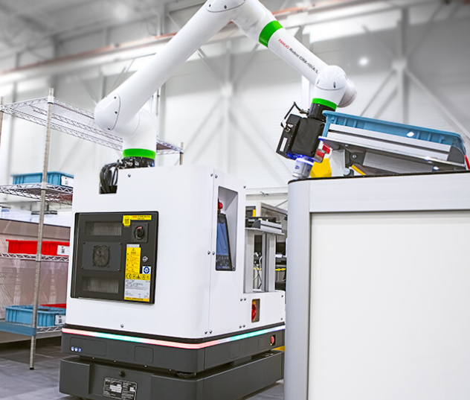
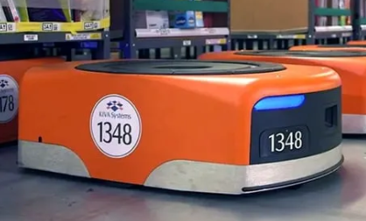
Industrial robot types
Mobile Robots
Autonomous mobile robot [AMR]
Can carry robot arm to create mobile manipulator

Slide 23
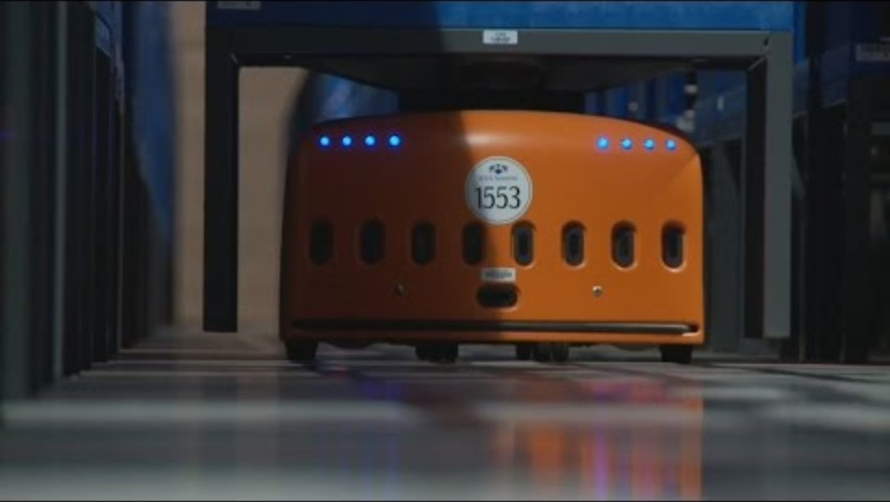
Industrial robot types
Mobile Robots in an Amazon warehouse

Slide 24
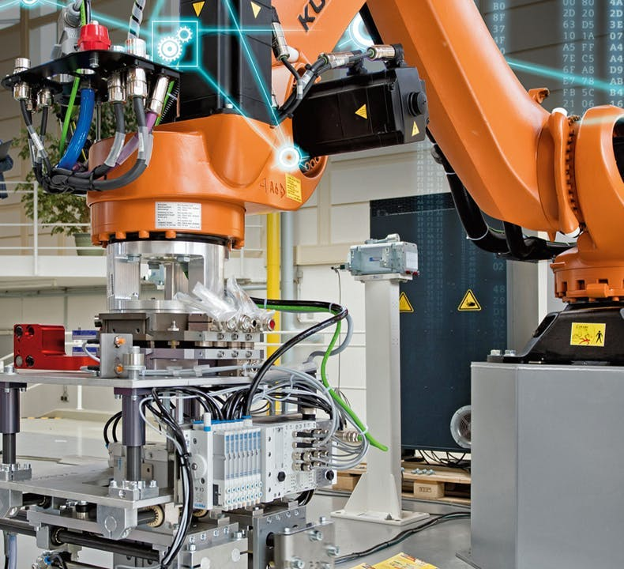
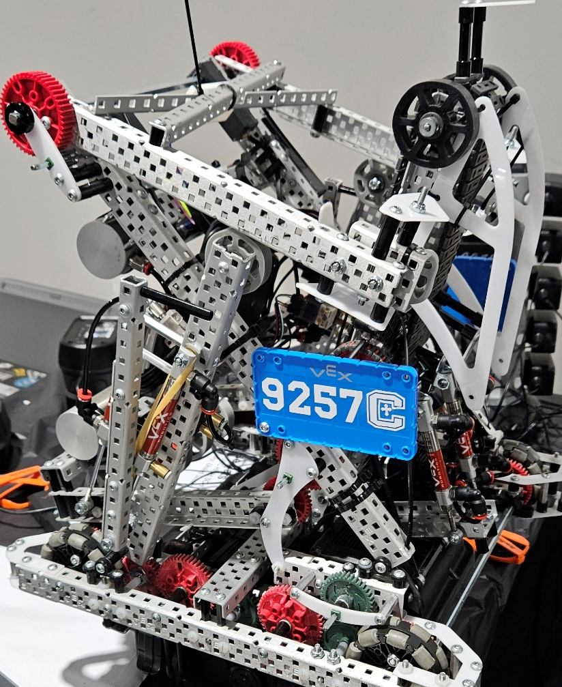
Industrial robots and VEX V5 use technologies that are more like each other than you might think!
24
Notes:
24

Slide 25
Industrial robot technology
Computer/controller
  Central controller (Motion planning, motor controllers, sensor interface)
Motors, gear reducers, encoders
Sensors (lasers, light, force)
Vision cameras
Lightweight materials
Tooling (grippers, vacuum, pneumatics, welding torches, etc.)
25
Notes:
25

Slide 26
VEX V5 robotic technology
Controller VEX V5 brain
Motors, gear reducers, encoders
Sensors (light, force, distance, rotation, GPS)
Cameras
Lightweight materials – aluminum, plastic
Tooling, mechanisms (grippers, intakes, flywheels/launchers)
26
Notes:
26

Slide 27
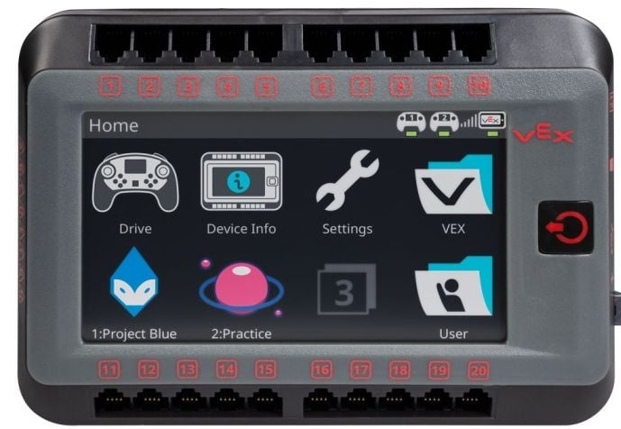
VEX V5 robotic technology
V5 Brain
27
Notes:
27

Slide 28
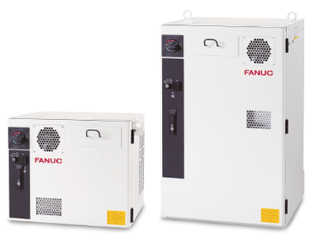
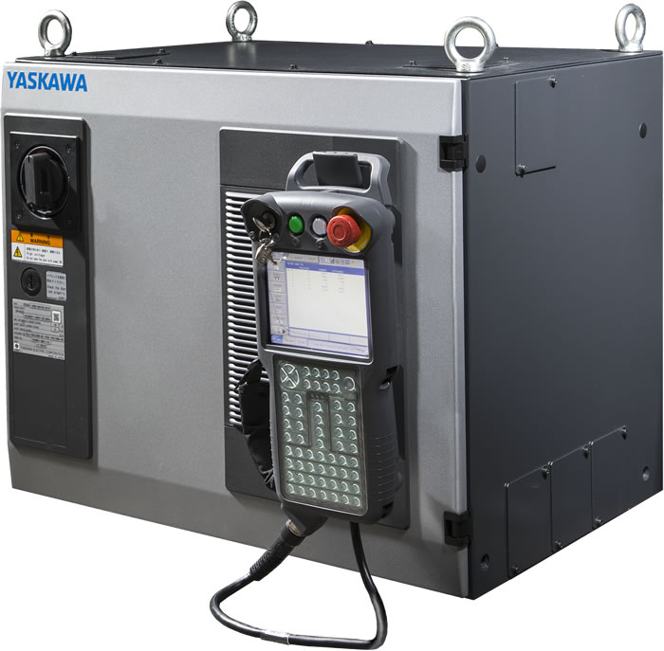
Industrial robot technology
Robot Controllers
28
Notes:
28

Slide 29
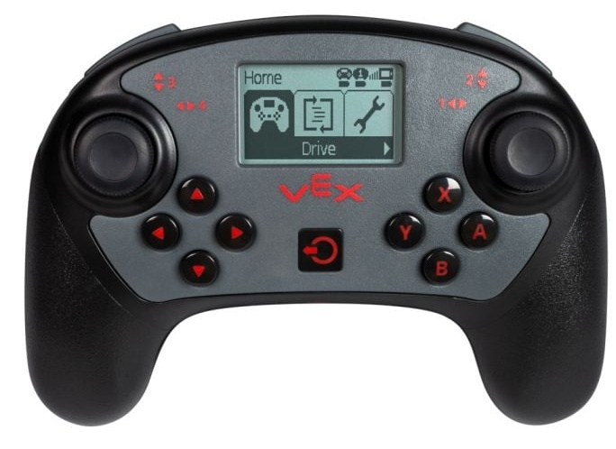
VEX V5 robotic technology
V5 Controller
29
Notes:
29

Slide 30
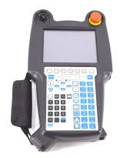
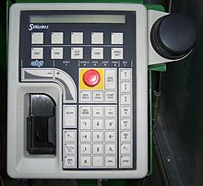
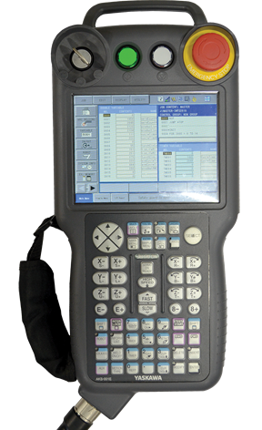
Industrial robot technology
Teach pendants
30
Notes:
30

Slide 31
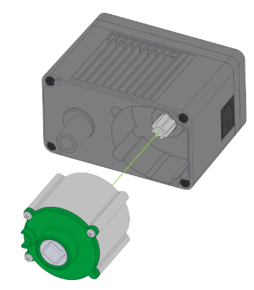
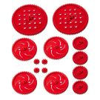
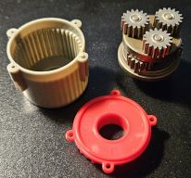

VEX V5 Robotic technology
V5 motors and gear reducers
Planetary gear reducer cartridges:
36:1 (100 RPM) - High torque, low speed. Great for robot arms and lifting heavy objects
18:1 (200 RPM) - Standard gear ratio for drive train applications
6:1 (600 RPM) - Low torque, high speed. Best used for intake rollers and flywheels
31
Notes:
31

Slide 32
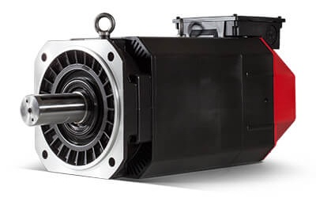
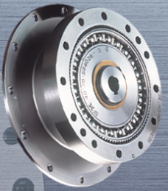
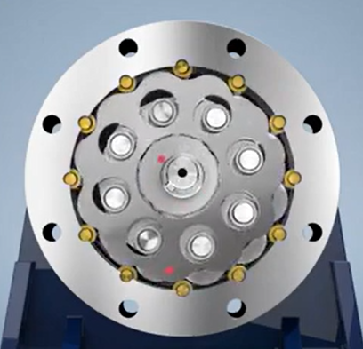
Industrial robot technology
Servomotors
Speeds up to 6000 RPM
High gear ratio reducers
Harmonic drives
  Ratio range from 30:1 up to 100:1
Cycloidal drives
  Ratio range from 6:1 up to 658,503:1
32
Notes:
32

Slide 33
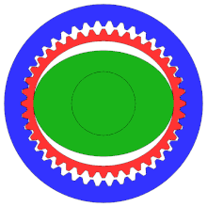
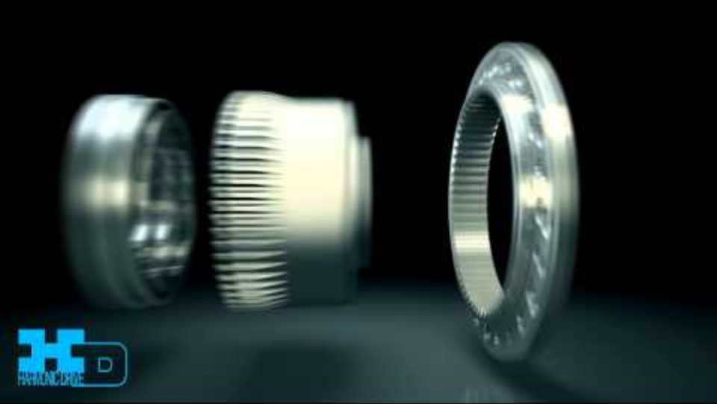
Harmonic (strain wave) drive

Slide 34
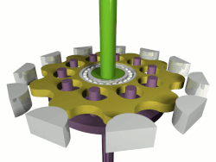

Cycloidal drive

Slide 35


VEX V5 Robotic technology
Optical Encoders (Internal)
Optical sensor with rotating slotted wheel
1800 ticks/rev with 36:1 gears (RED)
900 ticks/rev with 18:1 gears (GREEN)
300 ticks/rev with 6:1 gears (BLUE)
Rotation sensors
Resolution: 4096 ticks/revolution
Absolute encoder holds position with power off
Angle measurement is based on a magnetic field generated by 2 magnets
35
Notes:
35

Slide 36






VEX V5 Robotic technology
Sensors:
Touch switches (bumper, limit)
Laser distance
Light
Color/optical
GPS
36
Notes:
36

Slide 37


VEX V5 Robotic technology
Cameras / vision sensors
37
Notes:
37

Slide 38


VEX V5 Robotic technology
Lightweight materials:
Aluminum
Plastic
38
Notes:
38

Slide 39



VEX V5 Robotic technology
Tooling (EOAT):
Grippers/claws
Flywheels
Intakes
39
Notes:
39

Slide 40

Technical disciplines in robotics
Robotics merges many technical disciplines:
  Mechanical Engineering
  Electrical Engineering
  Control Systems
  Computer Science
MECHATRONICS
40
Notes:
40

Slide 41
Background & education
Associates degree (2 yr.) for Technician level
Bachelor of Science in engineering or computer science for most positions (4 yr.)
Masters or PhD for research or advanced development positions
  Masters - 2 years
  PhD – 2-4 years
41
Notes:
41

Slide 42
Robotics careers
Robot manufacturers
  Fanuc, Motoman
  Engineering development, Service, Sales
System builders / robot integrators
  Kinemetrix, Remtec, Bastian, Intelligrated
  Mech. Eng., Controls/Programming, System assembly, Sales
Companies that use robots [end users]
  Toyota, GE Appliances, Hitachi, Amazon
  Engineering, Maintenance
42
Notes:
42

Slide 43
Skills, talents & interests
Math
Algebra, geometry, trigonometry, calculus
Science
Physics – forces, motion control
Chemistry – materials
Computer Science
Programming languages, applications
Collaboration/teamwork, business, project management and leadership skills
Problem solving skills
43
Notes:
43

Slide 44

How to get technical experience while in school
Programming and technology classes
  C++, Python, Java
  iPhone/Android apps
  Free classes on Coursera
  Arduino controller projects
  Raspberry Pi computers
  3D CAD drawing packages
  Summer camps
44
Notes:
44

Slide 45
Job requirements
Research job postings for requirements:
Mechanical engineers
Electrical / Controls engineers
Software engineers
Fanuc https://www.fanucamerica.com/about-us/careers
ARM https://www.roboticscareer.org/
Toyota https://careers.toyota.com/us/en/c/manufacturing-production-engineering-jobs
https://www.automate.org/industry-insights/robotics-and-automation-career-paths

Slide 46
Steve Bolin’s background
Factory automation engineering
  Robotics integration
  Automated packaging
  Machine vision systems
  Material handling engineering
Project engineering/project management
Sales/application engineering
46
Notes:
46

Slide 47
Steve Bolin’s background
Manhattan College / University
BSME Machine design
Ohio State University
MSME Robot motion planning
Xavier University
MBA, concentration in Business intelligence/Data mining
47
Notes:
47

Slide 48
Matt Schroff’s background
Embry Riddle Aeronautical University
BS/MS Aeronautical Science, Minor in Education
US Air Force
Public Affairs Officer/Chief of Public Affairs
Professor of Aerospace Studies at the University of Dayton and Wright State University
Retired in 2023 as Lieutenant Colonel
Kroger Manufacturing
Maintenance Business Unit Leader
Operations Supervisor
Fanuc America Corp. – Robotics Division
District Sales Manager
48
Notes:
48

Slide 49

How did I get started in robotics?
Manhattan College
Senior project
Ohio State University
Robot kinematics / motion control
49
Notes:
49

Slide 50
Robotics judge/coach/mentor
FIRST Robotics
2008 - 2011 FLL/FTC Competition Judge/Inspector
2012 - 2016 FTC Coach St. Henry HS Erlanger
VEX Robotics
2016 - 2019 VRC Coach St. Henry HS
2016 - 2019 VEX IQ Coach St. Paul School Florence
2019 – 2025 VRC Mentor Covington Catholic
50
Notes:
50

Slide 51


VEX/RECF Sponsors
https://recf.org/about-us/our-partners/
51
Notes:
51

Slide 52

Fanuc CRX-5iA Robot Demo
Robot type: Cobot
Axes: 6
Reach: 994 mm (39”)
Payload: 5 kg (11 lb.)
Online basic training modules: https://crx.fanucamerica.com/training

Slide 53

Questions???
53
Notes:
53

Slide 54
Contact Information
Steve Bolin – Bolin Robotics
www.linkedin.com/in/stevebolin302
BolinRobotics.com
Matt Schroff - Fanuc Robotics
https://www.linkedin.com/in/mattschroff/
https://www.fanucamerica.com/products/robots

Slide 55


Slide 56
Application videos

Slide 57

Machine Load Unload Compilation
Remtec Automation

Slide 58

Picking and packing salami snacks
ABB Robotics

Slide 59

Grenade Fuze Clip Retrofit
Kinemetrix

