Slide 1
Reasons To Study
Church History
Helps Us Learn From The Mistakes Of The Past And Avoid Them
To Build Upon Their Successes, So We Can Grow From Them
Helps Us Appreciate The Lord’s Church

Slide 2
Overview Of Course
Before We Study The Restoration Movement, We Should Study:
The Church/Kingdom In Prophecy
The Church/Kingdom Established
The Church/Kingdom Apostate
The Church/Kingdom Restored

Slide 3
The Church/Kingdom In Prophecy
Daniel 2:32-35
Nebuchadnezzar’s Dream

Slide 4
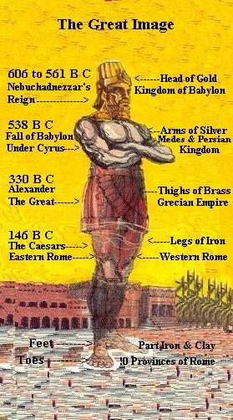
Nebuchadnezzar's Dream
#
Gentile Kingdom
Image Symbol
Reign over Israel
1
Babylon (a)
Head of GOLD
625 B.C. TO 539 B.C.
2
Medo-Persia (b)
Chest and Arms of SILVER
539 B.C. TO 331 B.C.
3
Greece
Waist and Thighs of BRONZE
331 B.C. TO 164 B.C. (c)
4
Rome
Legs of IRON
164 B.C. - 70 A.D.
Daniel 2:44 - "In The Days Of These Kings . . .

Slide 5
⁴⁴“And in the days of these kings the God of heaven will set up a kingdom which shall never be destroyed; and the kingdom shall not be left to other people; it shall break in pieces and consume all these kingdoms, and it shall stand forever. ⁴⁵“Inasmuch as you saw that the stone was cut out of the mountain without hands, and that it broke in pieces the iron, the bronze, the clay, the silver, and the gold—the great God has made known to the king what will come to pass after this. The dream is certain, and its interpretation is sure.” - Daniel 2:44,45 NKJV

Slide 6
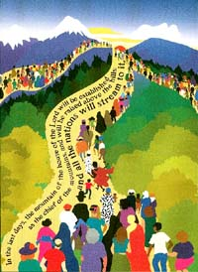
“²Now it shall come to pass in the latter days That the mountain of the Lord’s house Shall be established on the top of the mountains, And shall be exalted above the hills; And all nations shall flow to it. ³ Many people shall come and say, “Come, and let us go up to the mountain of the Lord, To the house of the God of Jacob; He will teach us His ways, And we shall walk in His paths.” For out of Zion shall go forth the law, And the word of the Lord from Jerusalem.” -Isaiah 2:2,3

Slide 7
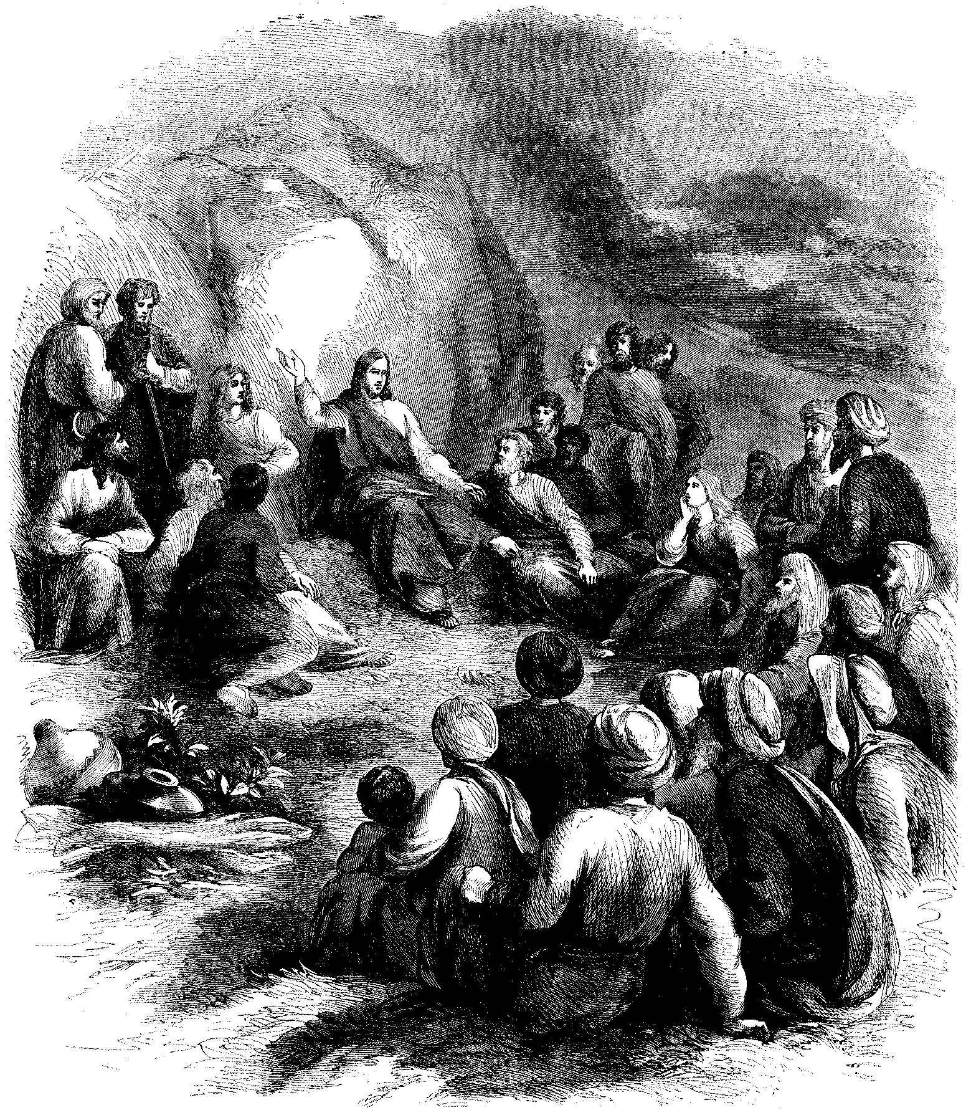
Jesus Taught:
Mark 9:1 – Some Standing Here Will Not Taste Death Before The Kingdom Comes
Matthew 16:13-19 – “Upon This Rock I Will Build My Church . . . And I Will Give Unto You The Keys Of The Kingdom Of Heaven”

Slide 8
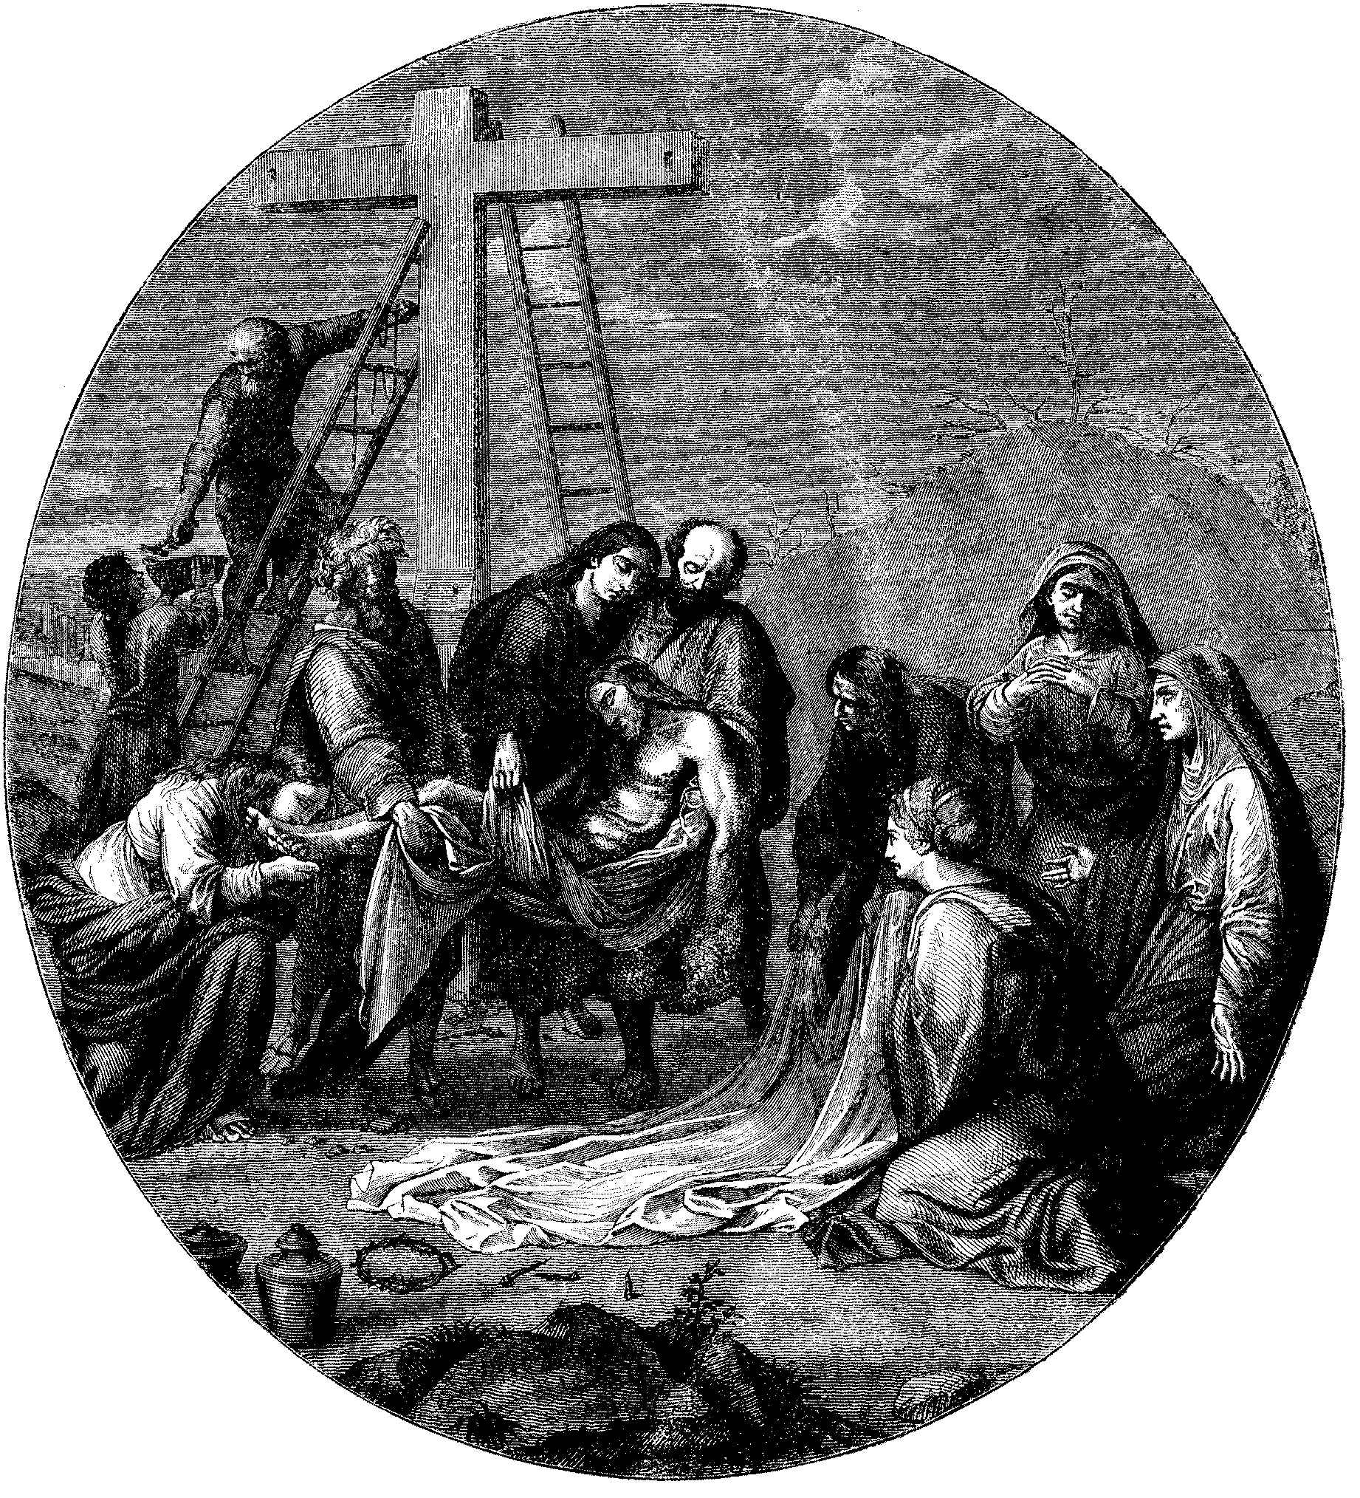
“⁵⁰Now behold, there was a man named Joseph, a council member, a good and just man. ⁵¹He had not consented to their decision and deed. He was from Arimathea, a city of the Jews, who himself was also waiting for the kingdom of God. ⁵²This man went to Pilate and asked for the body of Jesus. ⁵³Then he took it down, wrapped it in linen, and laid it in a tomb that was hewn out of the rock, where no one had ever lain before.”
Luke
23:50-53

Slide 9
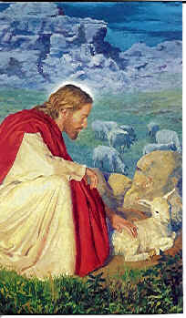
“⁴⁶Then He said to them, “Thus it is written, and thus it was necessary for the Christ to suffer and to rise from the dead the third day, ⁴⁷and that repentance and remission of sins should be preached in His name to all nations, beginning at Jerusalem. ⁴⁸And you are witnesses of these things. ⁴⁹Behold, I send the Promise of My Father upon you; but tarry in the city of Jerusalem until you are endued with power from on high.”
Luke
24:46-48

Slide 10
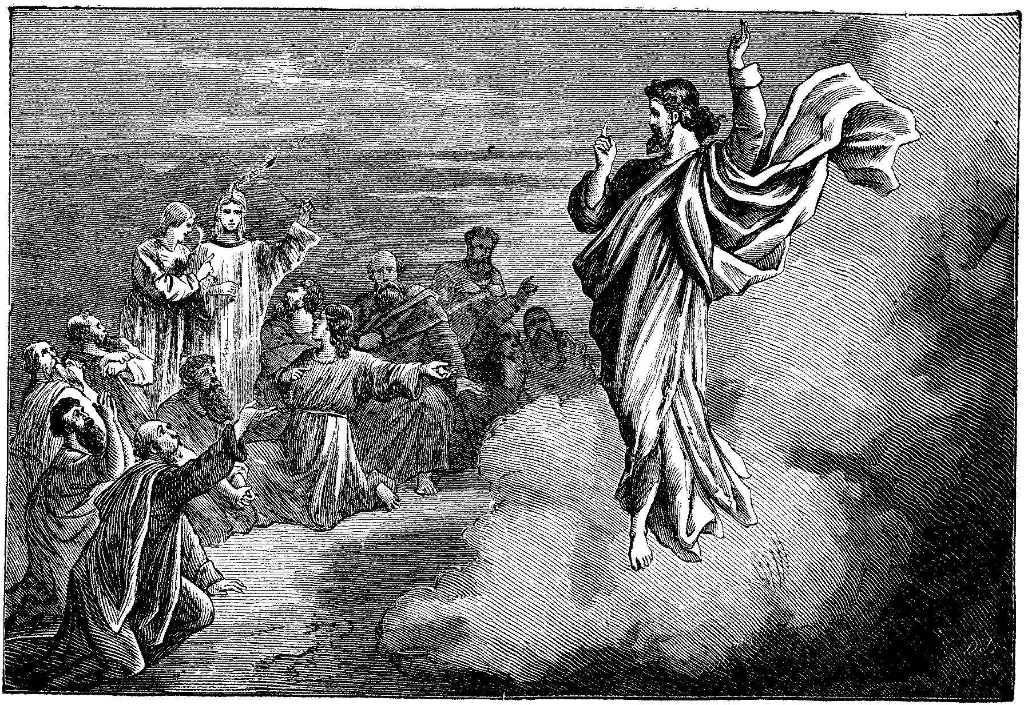
Acts 1:6-9:
“ ⁶Therefore, when they had come together, they asked Him, saying, “Lord, will You at this time restore the kingdom to Israel?” ⁷And He said
to them, “It is not for you to know times or seasons which the Father has put in His own authority. ⁸“But you shall receive power when the Holy Spirit has come upon you; and you shall be witnesses to Me in Jerusalem, and in all Judea and Samaria, and to the end of the earth.” ⁹Now when He had spoken these things, while they watched, He was taken up, and a cloud received Him out of their sight.”

Slide 11
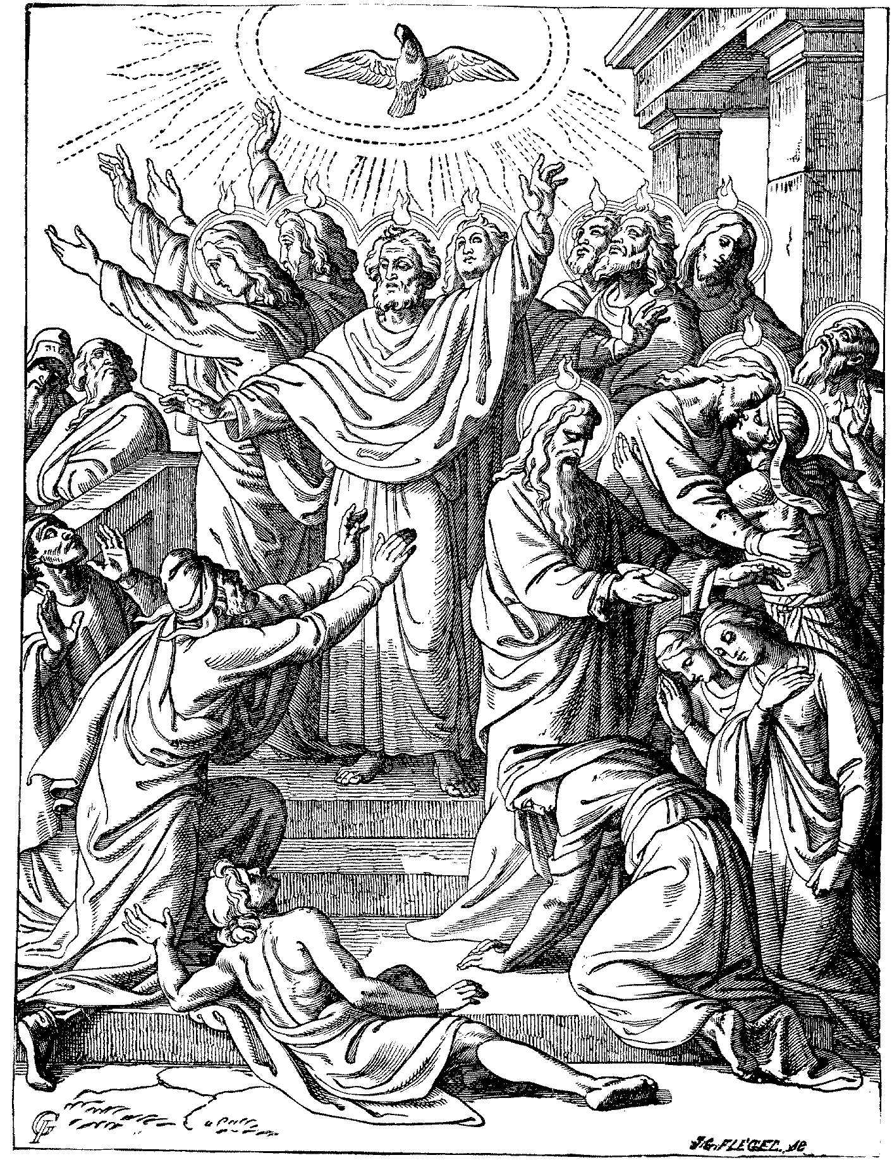
¹When the Day of Pentecost had fully come, they were all with one accord in one place. ²And suddenly there came a sound from heaven, as of a rushing mighty wind, and it filled the whole house where they were sitting. ³Then there appeared to them divided tongues, as of fire, and one sat upon each of them. ⁴And they were all filled with the Holy Spirit and began to speak with other tongues, as the Spirit gave them utterance.”
Acts 2:1-4ff:

Slide 12
On That Day Of Pentecost
Prophecy Fulfilled
  vv.16-21 – Joel 2 – God’s Great And Notable Day
  vv. 25-28 – Psalm 16:8-11 – David’s Prophecy
Church Starts – v.38-40
Kingdom Rule Begins Thru Apostles’ Binding Authority, cf. v.42-47 with Matthew 16:18,19

Slide 13
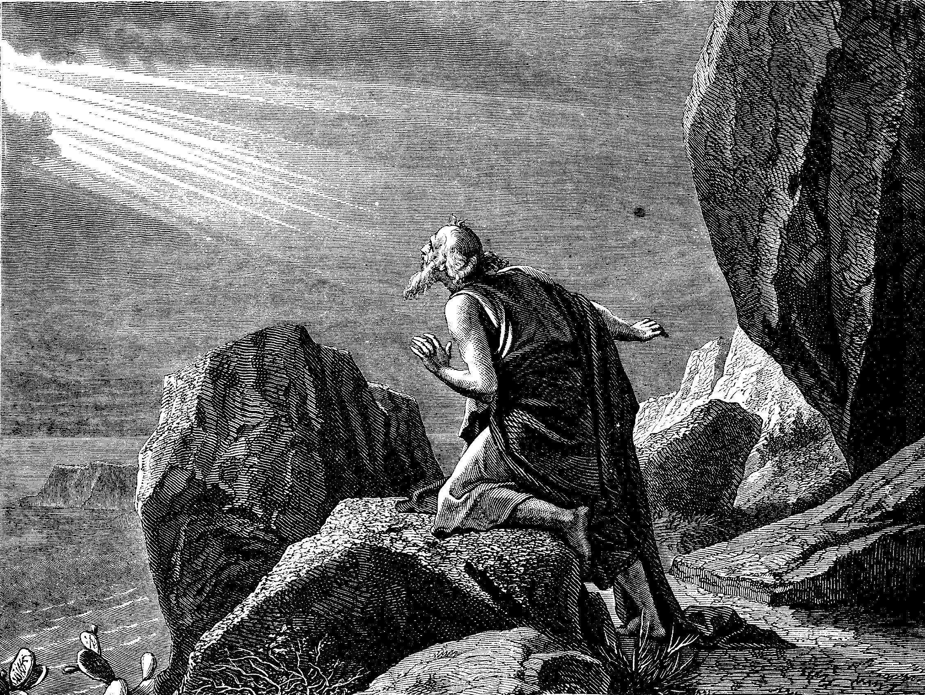
The Kingdom/Church Under Operation In The 1st Century
Colossians 1:12 – “¹³He has delivered us from the power of darkness and conveyed us into the kingdom of the Son of His love, ¹⁴in whom we have redemption through His blood.”
2 Thessalonians 1:5 – “⁵which is manifest evidence of the righteous judgment of God, that you may be counted worthy of the kingdom of God, for which you also suffer;”
Revelation 1:9 – “⁹I, John, both your brother and companion in the tribulation and kingdom and patience of Jesus Christ, was on the island that is called Patmos for the word of God and for the testimony of Jesus Christ.”

Slide 14
Next Lesson
What Happened To The Church Once It Was Established?
The End Of The First Century
Events In The 2nd & 3rd Centuries
4th –11th Centuries
1000A.D. – 1500 A.D.
Reformation
Restoration Movement

