Slide 1
Acts 2 To Luther
What Happened After The Church Was Established?
  3000 – Act 2:41
  5000 – Acts 4:4
  Disciples Multiplied – Acts 5:14
  Number Of The Disciples Multiplied – 6:1
  Word Of The Lord Increased – 6:7
  To Everyone Under Heaven – Colossians 1:23

Slide 2
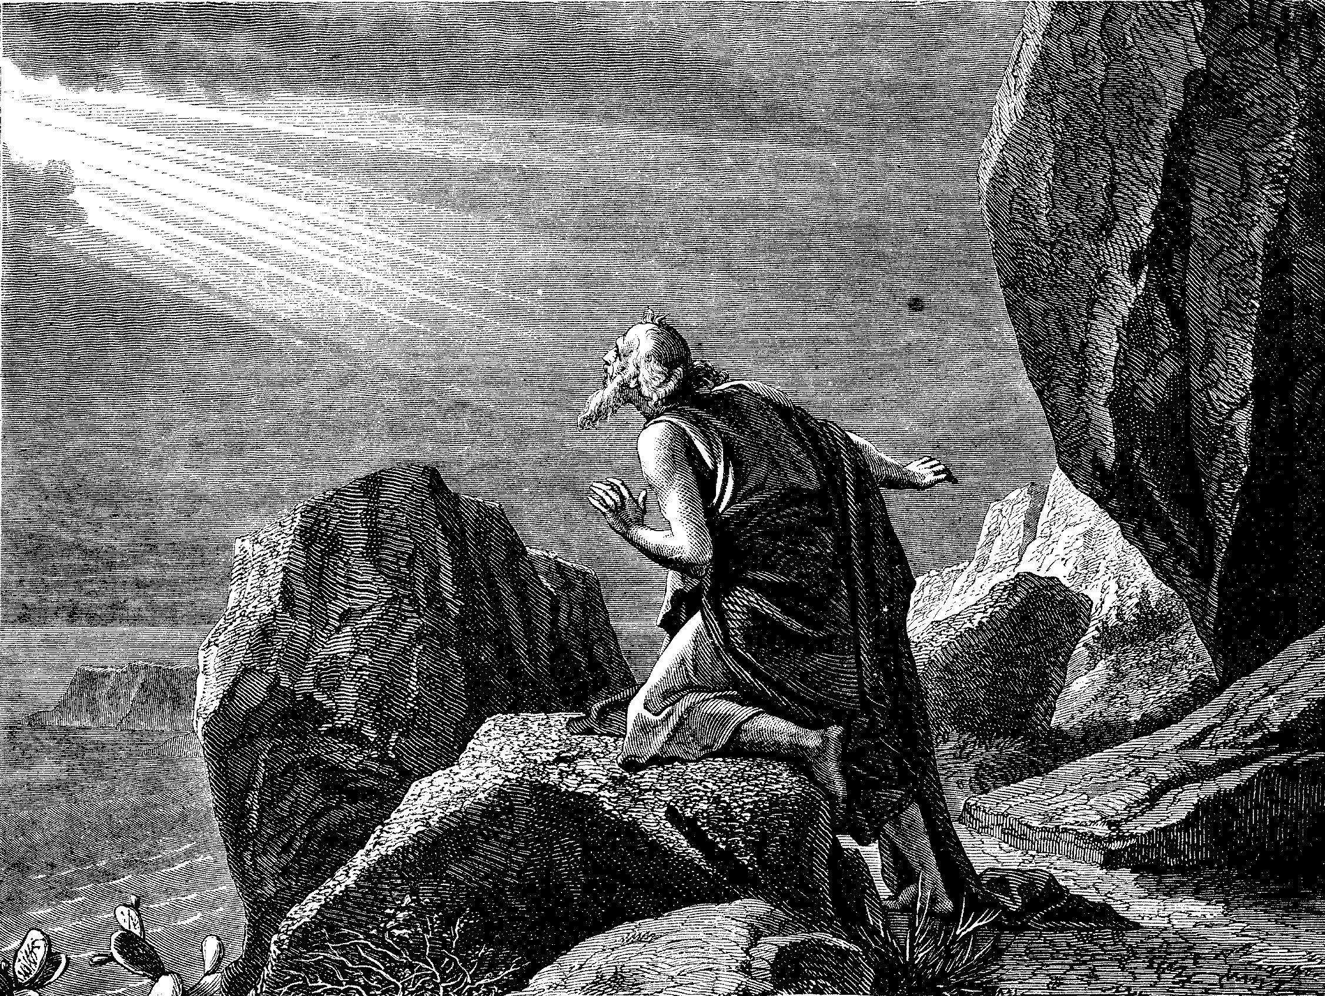
The Kingdom/Church Under Operation In The 1st Century
Colossians 1:12 – “¹³He has delivered us from the power of darkness and conveyed us into the kingdom of the Son of His love, ¹⁴in whom we have redemption through His blood.”
2 Thessalonians 1:5 – “⁵which is manifest evidence of the righteous judgment of God, that you may be counted worthy of the kingdom of God, for which you also suffer;”
Revelation 1:9 – “⁹I, John, both your brother and companion in the tribulation and kingdom and patience of Jesus Christ, was on the island that is called Patmos for the word of God and for the testimony of Jesus Christ.”

Slide 3
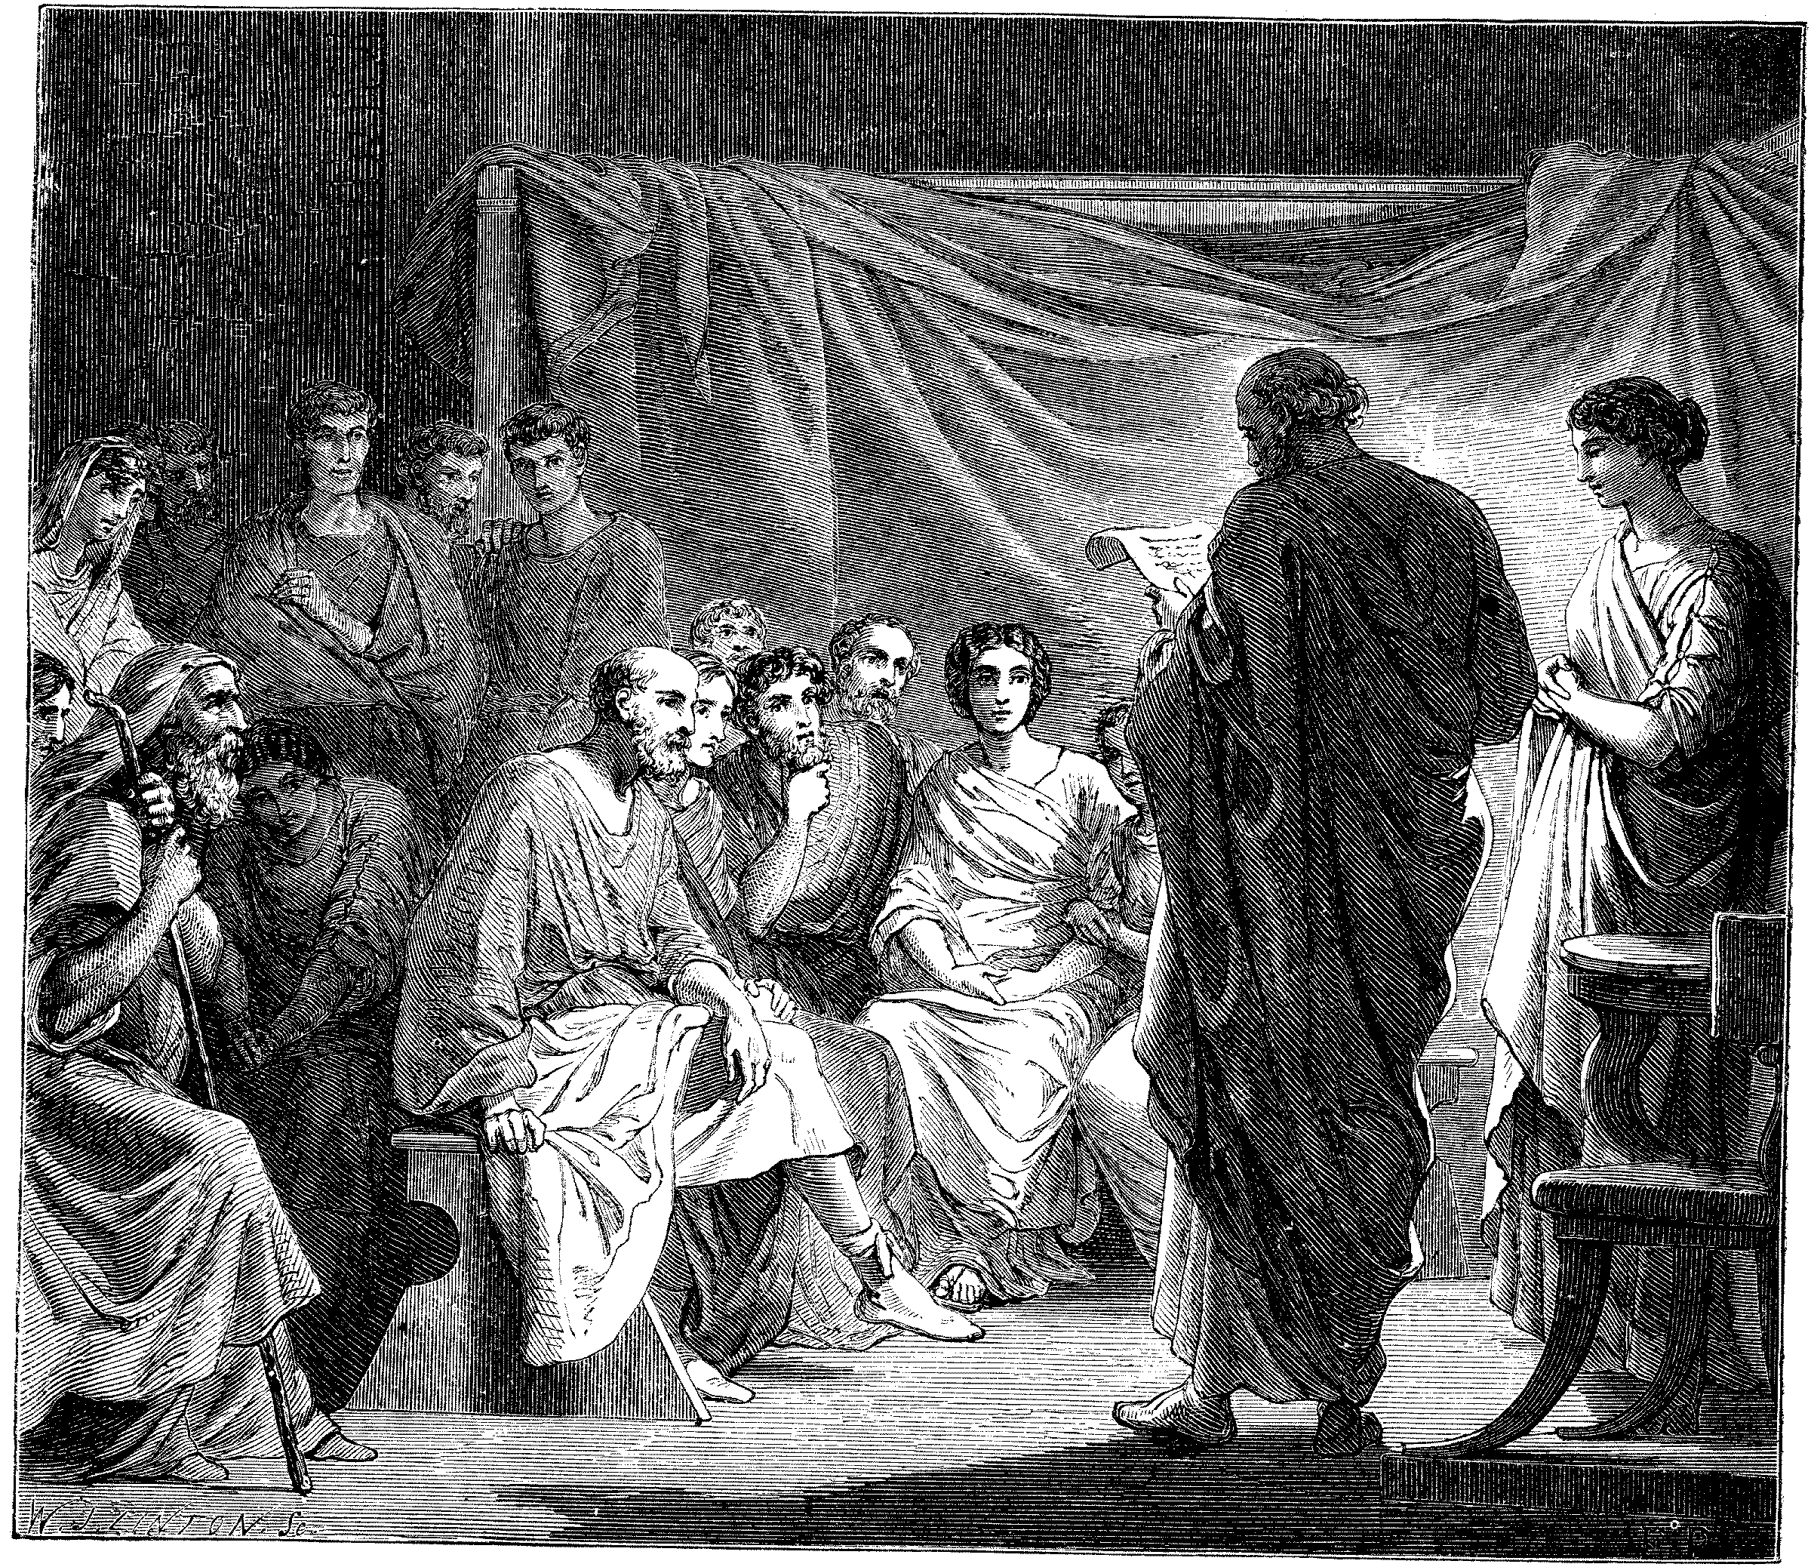
Problems In The Church Required Letters
1 & 2 Corinthians
  Disunity Through Partyism
  Taking Brothers To Law
  Incest
  Denial Of The Resurrection, etc.
Colossee – Mysticism, Gnosticism
Revelation – 7 Churches – All With Problems
Acts 20:28ff – Paul’s Warnings

Slide 4
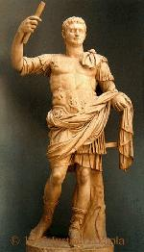
End Of The First Century
Ruler When John Was Exiled To Patmos.
Paranoid: Only Allowed One Servant In His Presence
Killed By His Own Servant, Stephanus While Taking A Bath - Seutonius, Historian
Perhaps, The Events Referred To In Revelation 1:3; 22:6 – “These Things Must Shortly Take Place”
Titus Flavius Domitianus
Emperor – 81-96 A.D.

Slide 5

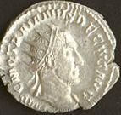
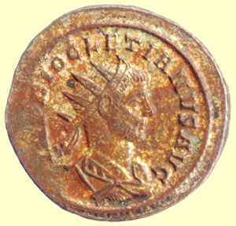
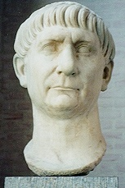
Second & Third Centuries
Trajan – 110-112 A.D.
  Persecuted Christians
  Allowed Provincial Governors To Persecute
Marcus Aurelius – 160-80 A.D.
  Allowed Persecution
Trajan Decius – 249-51 A.D.
  Another Persecution Arose
Diocletian – 284-305 A.D.
  In 286 A.D. Allowed Galerius to Kill Christians
  Worst Persecution Ever
  Thousands Killed

Slide 6
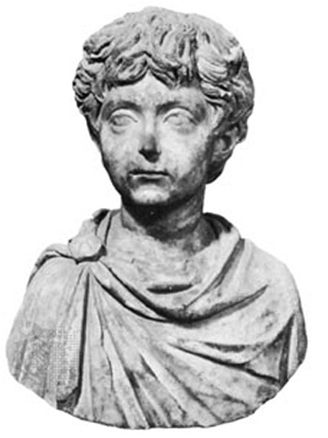
Fourth Century - Galerius
Thousands Of Christians Killed
  Throne To Lions
  Served As Torches On Roads
  Lighting Diocletian’s Gardens
311 A.D. Galerius, Emperor, Repented On Death Bed
Didn’t Believe In God, But Was Sorry For Martyrdom of Christians
Signed Law Ceasing Persecution Of Christians

Slide 7
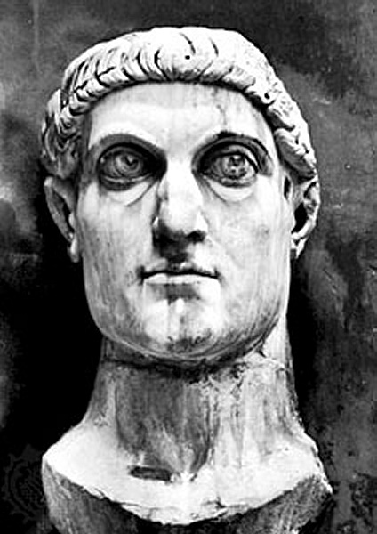
Constantine, The Great
313 A.D. Signed A Law That Christians Would Never Be Persecuted Again By Roman Government
Converted To Christianity On His Deathbed
Made Christianity The State Religion

Slide 8
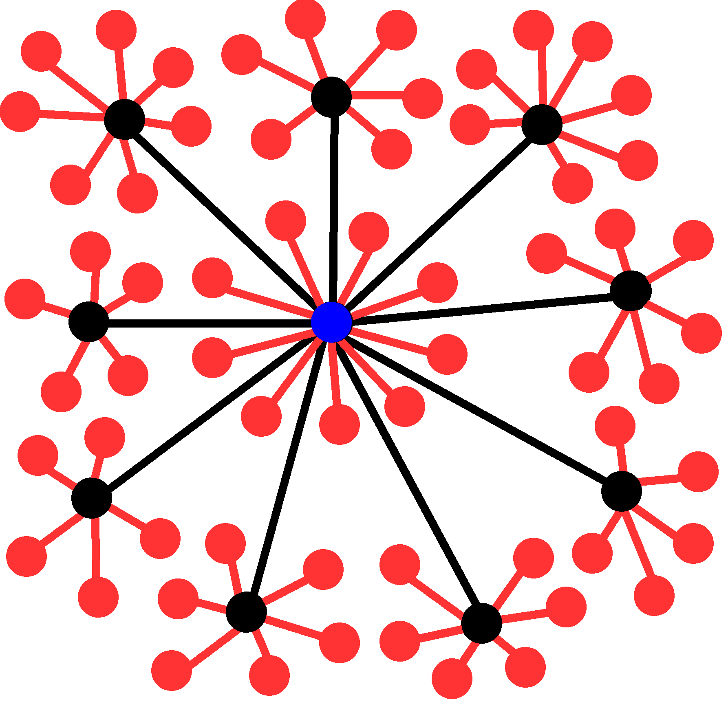
Roman Church Development

Slide 9
Departures
175 A.D. – It Was Written That A Bishop Was Different From An Elder, One Bishop Over Elders
250 A.D. – Development Of One Bishop Over Diocese
606 A.D. – Boniface III – First Universal Head – Pope
580 A.D. – Attempts To Add Instruments To Worship Were Rejected
660 A.D. – Pope Vitalian Introduced Organs In The Church, but not generally used at that point in time.
Pope
Cardinals
Archbishops
Bishops
Priests
Deacons
Notes:
Roman Catholic Church Hierarchy
The Catholic clergy is organized in a strict, sometimes overlapping hierarchy:
Pope: Head of the church, he is based at the Vatican. The pope is infallible in defining matters of faith and morals.
Cardinal: Appointed by the pope, 178 cardinals worldwide, including 13 in the U.S., make up the College of Cardinals. As a body, it advises the pope and, on his death, elects a new pope.
Archbishop: An archbishop is a bishop of a main or metropolitan diocese, also called an archdiocese. A cardinal can concurrently hold the title. The U.S. has 45 archbishops.
Bishop: A bishop, like a priest, is ordained to this station. He is a teacher of church doctrine, a priest of sacred worship, and a minister of church government. The U.S. has 290 active bishops, 194 head dioceses.
Priest: An ordained minister who can administer most of the sacraments, including the Eucharist, baptism, and marriage. He can be with a particular religious order or committed to serving a congregation.
Deacon: A transitional deacon is a seminarian studying for the priesthood. A permanent deacon can be married and assists a priest by performing some of the sacraments.

Slide 10
After 1000 A.D. – Dark Ages
By 1100 – Papal Customs, e.g. Holy Water Introduced
By 1200 – Baptism By Sprinkling
  A Few Years Later, Sprinkling Dead Infants
  A Few Years Later, Prayer Thru Mary
  She Was Deified In 1967
1290 A.D. – Marinus Sanutus Added Wind Organs Into Churches, - McClintock & Strong v.8, p.739
Only Papacy Had The Bible, No Personal Interpretation Allowed

