Slide 1
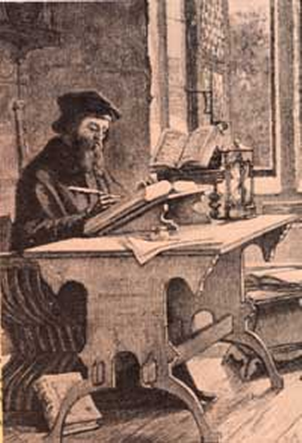
The Age Of Enlightenment
& The Reformation
John Wycliffe – English Reformer (1329-1384)
Teacher At Oxford University, England
Began Lollards, Followers Preaching His Reform Message

Slide 2
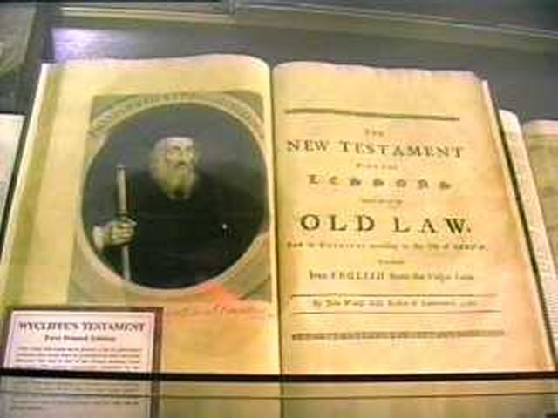
Teachings Of John Wycliffe
1376 Wrote Of Civil Dominion
  Should Be Moral Basis For Ecclesiastical Leadership
  Land Ownership – Root Problem
Result- King John Of Gaunt, Gladly “Purified The Priesthood” By Relieving It Of Some Land
After 1379 – Opposed Catholic Dogma
  Authority Of The Pope – Said Pope Was Not Head, But Christ Was, Called Pope – Anti-Christ
  The Bible, Not The Church Was Sole Authority Of Men
  Church Should Remodel Itself After The Pattern Of The New Testament
1382 – Opposed Transubstantiation, Private Mass, Extreme Unction & Purgatory
1382 – Translated The N.T. Into English

Slide 3
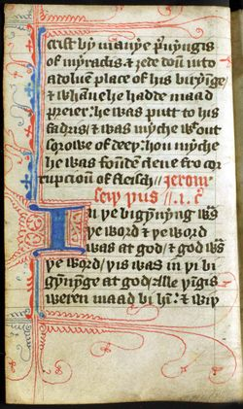
The Wycliffe Translation
Took 20 Years To Produce
Not Entirely Produced By Wycliffe, Others Helped With Different Books
Included The Old & New Testaments, & Apocrypha & Laodicensis
Translation From Jerome’s Latin Vulgate
About 250 Manuscripts Of It Are Extant
Books Are Broken Into Chapters And Verses
Took One Year To Produce A Hand-Written Copy
Copies Were Sold For £40
People Paid For The Privilege Of Reading It For An Hour – Sometimes Wagon Loads of Hay Were Paid
Beginning of the Gospel of John from a 14th century copy of Wycliffe's translation.

Slide 4
Result Of Wycliffe’s Work
1382 – Wycliffe’s Views Were Condemned In London
Was Forced To Retire To His Rectory At Lutterworth, England
Died Of Paralysis In 1384
Founded A Group Of Lay Preachers Called “Lollards”
  They Went Through England Teaching Wycliffe’s Ideas
  1401 – The Roman Church Forced The Statute:De Haeretico Comburendo Through English Parliament Making Lollard Teachings Punishable By Death
31 Years After His Death, Wycliffe Was Declared A Heretic, His Bones Were Dug Up And Burned And Through Into The Avon River

Slide 5
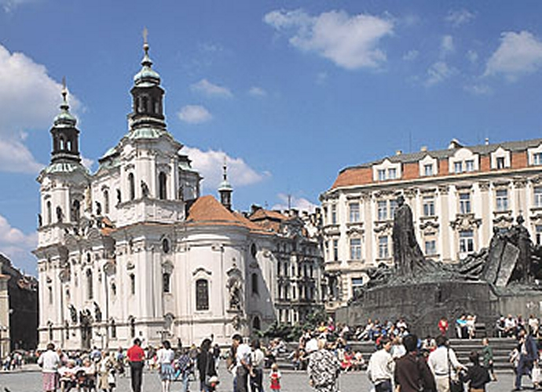
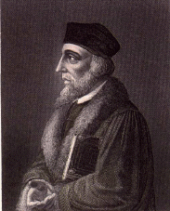
Jan Hus – 1373-1415 Prague, Czechoslovakia
Bohemian Pastor Of Bethlehem Chapel
1409 Rector Of University Of Prague
1409 Directed National Bohemian Party – Calling For Reform
Was Excommunicated As Heretic At Council Of Constance
St. Nicolas Church, Statue Of
Jan Hus, Prague

Slide 6
Jan Hus
Prague, Czechoslovakia
1413 – Wrote De Ecclesia = “About The Church”
  Neither Popes Nor Cardinals Could Establish Doctrine Contrary To Scripture
  Christians Should Not Obey Papacy When Contrary To Scripture
  Openly Criticized Papacy
  Condemned Image Worship
  Condemned Sales Of Indulgences
July 6, 1415, Burned At The Stake For Seeking To Reform The Church In Prague
Known As The “John The Baptist” Of The Reformation
St. Nicolas Church, Statue Of
Jan Hus, Prague

Slide 7
Taborites
Radical Followers Of Hus After His Death
Group That More Fully Withdrew From Catholicism
1450 – Some Of Taborites That Formed Unitas Fratrum (Unity Of Brethren, Unity Brethren) or Bohemian Brethren
By 1517 Had 200,000 Members & Two Printing Presses
Roots Of The Moravian Church of Today
U.S. Headquarters In Pennsylvania
St. Nicolas Church, Statue Of
Jan Hus, Prague

Slide 8
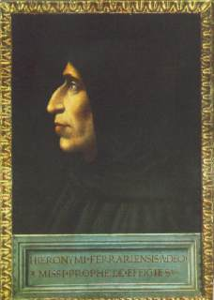
Girolamo Savonarola
1452-1498
1474 Dominican Monk
1490 Assigned To Florence
Tried To Reform Both State And Church
  Preached Against The Evil Life Of The Pope
  He Was Offered The Position Of Cardinal In Hopes That He Would Be Loyal To The Church, But He Refused
  Convinced Artists And Writers To Burn Paintings And Books In The Streets Of Florence As An Effort Toward Purification
Arrested And Tortured 6 Days
  Confessed To Doing Wrong Under Torture
  Retracted His Confession After Release
1498 – Was Hanged, Then Body Burned
Italian Priest

Slide 9
Troubles Existing In The Romish Church
Simony
  By "simony" is meant the purchase of an office in the church, the name and the offense coming from Simon Magus (the Sorcerer), who offered Peter money for the power to confer the Holy Spirit (Acts 8:9-24)
  Simony was reformed by Gregory VII.
  It had grown up in the church as the feudal system came into being.
    The ecclesiastical vacancies were sold to the highest bidder.
    The most unsuitable persons became bishops and abbots (Mediaeval and Modern History, Myers, p.115‑116)

Slide 10
The Sale Of Indulgences
The purchase of forgiveness, both now and after death.
John Tetzel's sale of Indulgences was the occasion for Martin Luther's break with Rome – 1517
According to Roman teaching, purgatory is very much the same as hell, only it does not last as long, but all have to pass through it.
The pope claimed to have the authority and power to lessen or remit these sufferings.
It began with Popes Pascal I (817‑824) and John VIII (872‑882)
  It was very profitable
  Soon came into general use
  They were offered as inducement to go on crusades or wars against heretics, etc.
This became a way of “selling the privilege of sin” (Halley's Bible Handbook, Halley, p.787)

Slide 11
The Unam Sanctum - 1302
Pope Boniface VIII and Philip IV, the Fair, (King of France) (1285‑1314) were in a mortal quarrel over taxation, and who receives it
Letters were exchanged, and all decencies of language on both sides were cast away.
In the end, the famous bull, called Unam Sanctam from the opening words, was published on Nov. 18, 1302.
  It declared that every human being was subject to the Roman Pontiff, which is necessary for salvation.
  Result: Philip was not terrified
    Philip led a band of lawless soldiers in an attack on Boniface and gained victory.

Slide 12
Note The Corruption Of The Papacy
French gained control of the papacy (1303‑1378)
  Benedict XI (1303‑1304)
  After his death, papal authority moved from Rome to Auignon, France
"Babylonian Captivity" of the papacy (1305‑1387)
  Burdensome taxes were imposed
  Church offices were sold for money
The Papal Schism (1377‑1417)
  Two sets of popes, one at Rome, one at Auignon
  Each set claimed to be "Vicar of Christ“
Renaissance Popes (1447‑1503) - Immoral Period
  Nicolas V (1447‑1455), authorized the king of Portugal to war on Africans, making slaves of them
  Paul II (1464‑1471) filled his house with concubines
  Innocent VIII (1484‑1492) had 16 children by various married women
  Alexander VI (1492‑1503) was called the most corrupt of the Renaissance popes (Halley's Bible Handbook, Halley, p.778‑779)

Slide 13
Corruption Brought About Through Councils

Slide 14
The Council Of Pisa, Italy (1409)
It purposed two main objects:
  The restoration of peace, by a restoration of unity of the church. Since 1378 two popes ruled: George XII in Rome, Italy and Benedict XIII in Avignon, France. The council of Pisa was to seek union of papal power, but failed.
  The second, the reformation of it in head and in members.
There were twenty three cardinals and either in person or by proxy, some two hundred bishops, nearly three hundred abbots, with doctors of theology and of the canon and the civil law, little short of five hundred, and others in assembly.
It lasted a little more than four months; from March 25 to August 7, 1409
The council became deserted by many of its principal members and was adjourned for three years.

Slide 15
The Council Of Constance 1414-1418
French control of the papacy (1303‑1378)
Far surpassed that of Council of Pisa, and any which followed.
The council proposed three objects:
  To bring Schism to an end
  To pass a judgment on the doctrines of Wycliffe and Hus
  To carry out that same reform, a reform of the church in head and in members, which for all that were true of heart had been long the dearest object of their desire; and which the mournful experience had not yet taught them was never through a council to be obtained.
The pope's aim was to bear the council in hand till a decent opportunity for getting rid of it shall arrive.

Slide 16
Planting The Seed Of Reform
The Rise Of Knowledge: Humanism
Petrarch (1304-1374)
  Known as the first of the Humanists
  Was the first to fully realize and appreciate the supreme excellence and beauty of classical literature and its value as a means of culture.
  He had great feelings for the material monuments of classical antiquity.
  He called into existence a school of ardent young humanists who looked up to him as master.

Slide 17
Planting The Seed Of Reform
The Rise Of Knowledge: Humanism
Humanism Develops.
  With mid‑fifteenth century invention of printing with movable type, popular education became widespread and new educational ideals arose.
  Luther favored widespread teaching
  The demand for books was great
  The great controversies brought many pamphlets, tracts, and brilliant works on classics, history, criticism, education and politics
  A study of the languages became common place for their aesthetic value – In the process leading to greater knowledge – Planting the seed for later revolt.

Slide 18
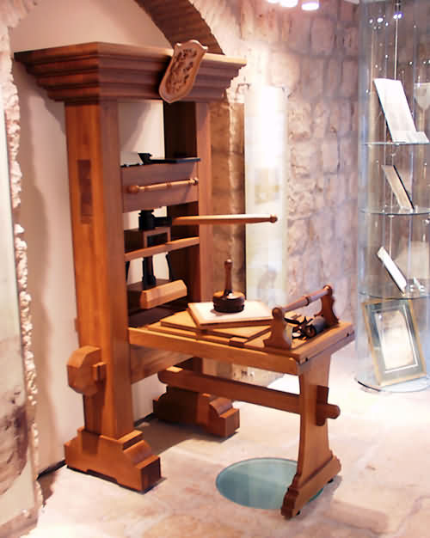
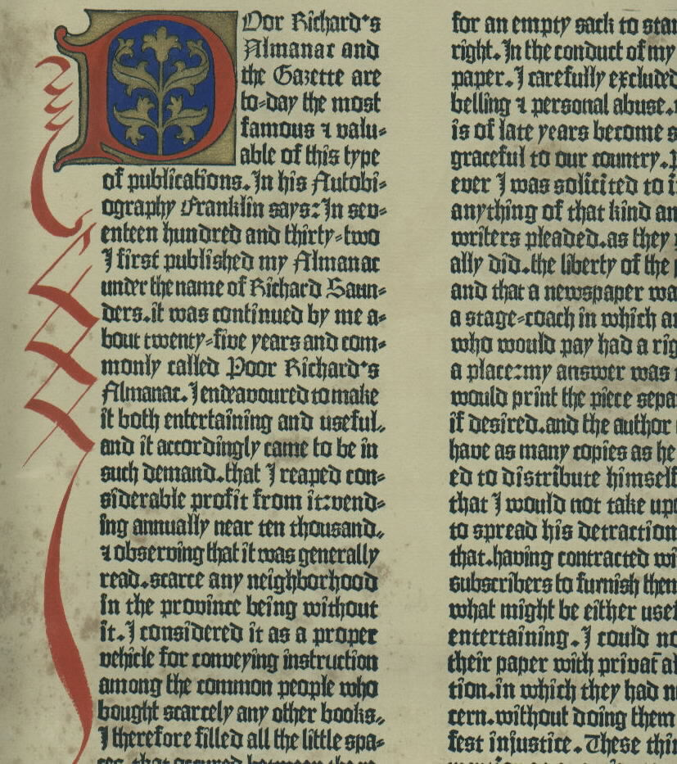
The Johannes Gutenberg Printing Press - 1454
Arguably History’s Greatest Invention
Produced
In Mainz, Germany
First
Produced Book: The Bible

Slide 19
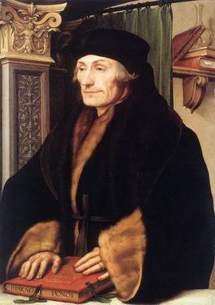
Planting The Seed Of Reform
The Rise Of Knowledge: Humanism
Erasmus
  One of the greatest humanists of the age was Erasmus of Rotterdam (1536)
  A scholar, promoter of classical erudition
  Editor of the Greek text of the Bible
  Author of The Praise of Folly - A renaissance satire looking at the frivolity of learning, but ending with the sharing of his concerns and beliefs of how Christians should act.

Slide 20
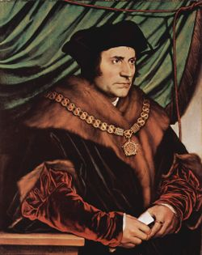
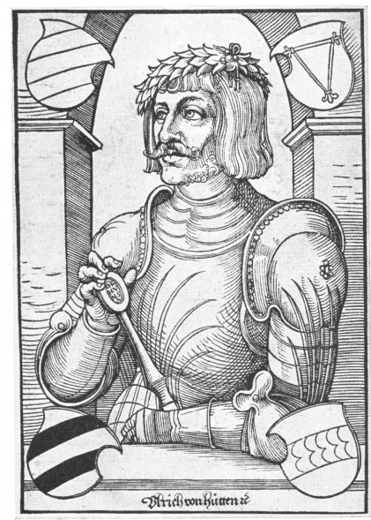
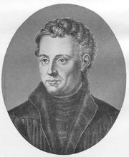
Planting The Seed Of Reform
The Rise Of Knowledge: Humanism
Other Leading Northern Humanists Of That Day:
  Thomas More (1478-1535) – English Author & Catholic Martyr
  Ulrich von Hutten – (1488-1523) – German Patriot, Poet, Knight, Classical Scholar, Satirist
  Johann Reuchlin (1455-1522) – German Humanist and Hebrew Scholar, Lexicographer
Ulrich von Hutten
Thomas More
Johann Reuchlin

Slide 21
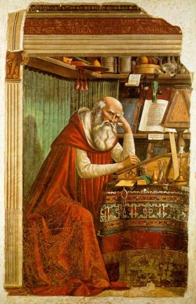
Planting The Seed Of Reform
The Rise Of Knowledge: Bible Translations
Practical reformation has never been possible without the average person having access to the scripture itself
Early attempts to translate it into English were made before 1000 A.D.
Wycliffe did not use the original Greek and Hebrew, but translated the Latin Vulgate of Jerome into English
  This translation was used extensively by the Lollards, the followers of Wycliffe
  It also influenced the Husite Reformation in Bohemia
Jerome – 5th Century Latin Bible Translator

Slide 22
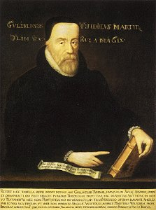
William Tyndale
1494-1536
  Desired To See The Bible In The Hand Of Every Plowman
  Between 1525 & 1535 Produced English Translation While In Exile In Cologne & Worms, Germany
  The first printed English New Testament was that of William Tyndale (1495‑1536); published part of the Old Testament also.
  15,000 Copies Of The N.T. Were Issued
  Secretly Imported Into England In Bales Of Cotton, Sacks Of Flour And Other Means

Slide 23
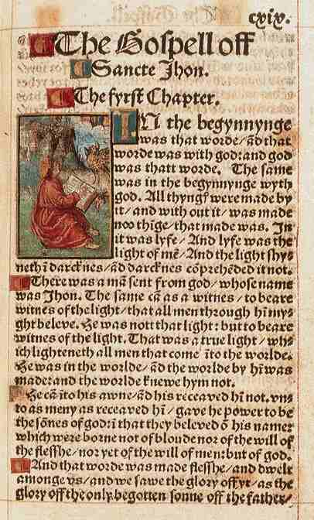
William Tyndale
1494-1536
  He used the original language.
  Translated the New Testament in 1525
  The Pentateuch in 1530
  Book of Jonah in 1531
  Psalms in 1534
  His work was so good that when the King James Version was done later, it was about 90% identical with that of Tyndale.
  In Less Than 10 Years The Same King Commissioned Miles Coverdale To Revise Tyndale’s Work
  About 12 or 13 Translations Precede The KJV

Slide 24
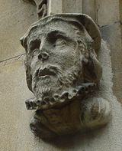
Tyndale’s Death
October 6, 1536 Tyndale Was Strangled And Burned At The Stake.
His Last Words Were, “Lord, Open The Eyes Of The King Of England.”
Today His Statue Stands On The River Thames In London Where He Was Not Allowed To Live During His Last Years Of Life
Sculpted Head Of William Tyndale from St Dunstan-in-the-West Church London

Slide 25
Planting The Seed Of Reform
The Rise Of Knowledge: Bible Translations
In 1535 the Miles Coverdale work began, which was taken mostly from Wycliffe and Tyndale.
In 1557 the Bible was divided into chapters and verses. There was also a prologue to each book with summaries and notes throughout.
By 1579 versions were so readily available that the average home was able to afford one.
The Bishop's Bible was published in 1586; it was a revision of the Great Bible.

Slide 26
Planting The Seed Of Reform
The Rise Of Knowledge: Bible Translations
From 1615 till 1769 there were many revisions of the King James Version.
A better English translation was published in 1881, due to the discoveries of the Codex Alexandrinus and Codex Sinaiticus
  There were advanced orders for almost two million copies
  Over three million copies were sold the first year
In 1901, the American Revision Committee brought out a version which was more in keeping with American usage than the English version (The Eternal Kingdom, Mattox, p.274‑278)

Slide 27
Causes Of The Reformation
16th & 17th Centuries
Long Range Causes
  The church had apostatized from New Testament purity, and was corrupt in the dark ages
    These abuses came from within the church itself
    This had destroyed the unity
  There were many false doctrines in the church
Immediate Causes
  The papacy had reached the zenith of its power and was using it to promote its selfish interests
  The entire church could be characterized as being morally bankrupt
  It was under these conditions that sincere reformers arose to work for a moral and spiritual regeneration
  (The Eternal Kingdom, Mattox, p. 219‑223)

Slide 28
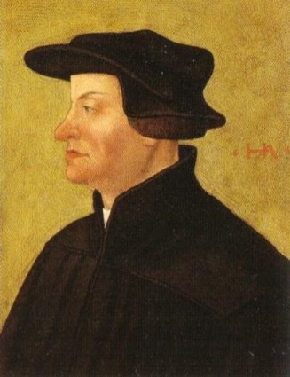
Ulrich Zwingli
(1484-1531)
Swiss Reformer
At Age 14 Went To Bern, Switzerland Studied Under Heinrich Wolfin
Studied 2 Years At University Of Vienna
1506 Ordained A Priest
1519 He Became The People’s Priest At Great Minster Church In Zurich
  Launched Reformation By Preaching Biblical Sermons From Pulpit
  Interpreted Scripture As Prohibiting What The Bible Did Not Specifically Prescribe
  Called For Return The Apostolic Order Of The New Testament
  Taught Memorial View Of The Lord’s Supper – Debated Luther Over It
Zwingli was killed in 1531, In Second Swiss Revolt Against Emperor Charles V

Slide 29
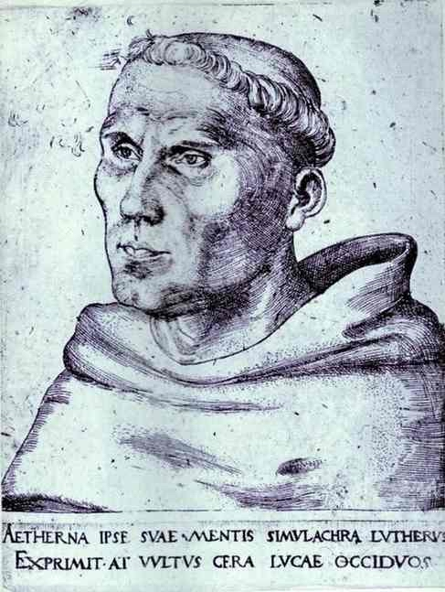
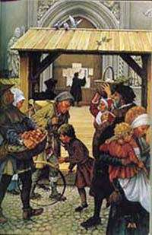
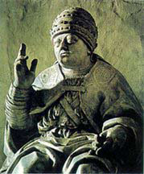
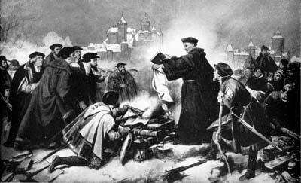
1500 – 1800 A.D.
Martin Luther: 1483-1546
  Rebelled Against Papacy After A Visit To Rome
  Oct. 31, 1517 – Nailed 95 Theses To The Door Of The Catholic Church At Wittenburg
  Pope Leo X Wrote And Told Luther To Recant, Or Excommunication
  John Tetzel’s Sale Of Indulgences
  Luther Burns The Papal Bull And Is Excommunicated In 1520
  Spends The Rest Of His Life In Seclusion At Wartburg

Slide 30
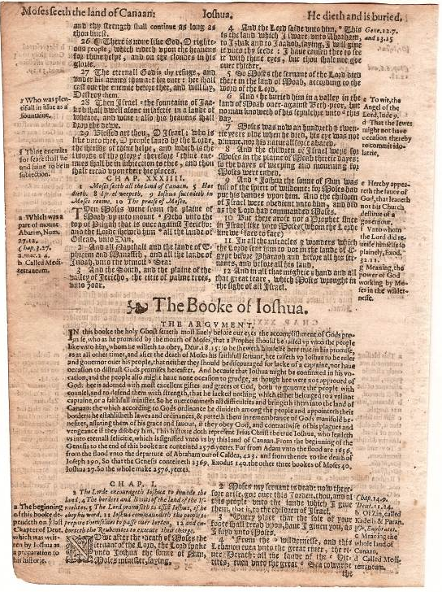
Geneva Bible – 1598
From The Book Of Joshua

Slide 31
Rise Of Protestantism:
Diet of Speyer (Germany) — 1526
As Protestantism advanced, the execution of the Edict of Worms (condemnations of Luther’s writings) became less and less practicable.
Many Catholics in the north had professed Luther’s ideas while people in the south were predominately Catholic.
This was highlighted at the Diet of Spier in 1526 under Archduke Ferdinand of Austria - (The Lutheran influence strong at this meeting)
The Diet came with the consent of Ferdinand to the unanimous conclusion Aug. 27, that a general or national council should be convened for the settlement of the church question concerning the Edict of Worms.
Also, each state was given the right to carry out their own justice as it had to do with violators of the teachings of the church, and not as the edict of Worms has determined as a role to be determined by the church and its officers.
As a result, the Protestant princes dared for the first time to profess their faith

Slide 32
Diet of Speyer II — 1529
The Second Diet (Assembly of Holy Roman Empire) at Speyer, Germany, convened in March, 1529 for action against the Ottoman Turks uprising, and against further progress of Protestantism
This meeting drew a majority of Catholics this time.
The Diet neutralized the recess of the preceding Diet of 1526
  It virtually condemned (without annulling) the innovations made
  It forbade any further reformation until the meeting of the council
The Lutheran members, under well‑founded impression that the prohibition of any future reformation meant death to the whole movement, entered in the legal form of appeal, a protest, on April 25,1529, against those measures of the Diet which were contrary to the word of God.
From this protest and appeal the Lutherans were called Protestants (History of the Christian Church, Schaff, vol.7, p.683‑686, 690‑693)

Slide 33
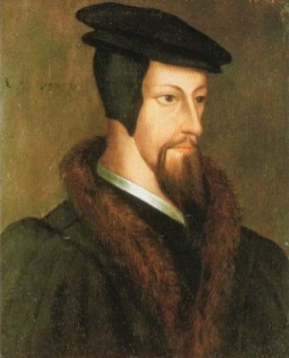
John Calvin
1509-1564
Born Noyon, France July 10, 1509
At Age 12 Presented To The Catholic Church At Noyon For Education
He Began Early Preaching Reformation
Organized Systematic Protestantism
Through Him Geneva Became The “Rome” Of Protestantism
“Calvinism” Is Used To Designate His System Of Theology
“Presbyterian” A Term To Designate The System Of Government He Adopted For Church In Switzerland
Established A College In Geneva, With Theodore Beza As Head – 1536
  Its Success Drew Students From All Over Europe, Inc. John Knox, And Other English & Scottish Theologians

Slide 34
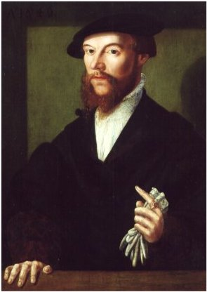
Teachings
Of Calvin
The Bible Is The Infallible Guide For The Church, But Must Be Interpreted By The Elect
Gave 10 Commandments An Important Place In Theology
Purpose Of Life Is Found In Glorifying God, Not Self Pleasure
Discipline, Excommunication To Those Not Conforming
Lord’s Supper Four Times Per Year For Elect
Tulip Doctrine – Augustinian Theology
  Total Hereditary Depravity (Sin Of Adam Inherited By All)
  Unconditional Election (God Chose You Irresistibly)
  Limited Atonement (Jesus Died For A Limited Amount Of People)
  Irresistible Grace (Given To Those Predestined, Irresistibly
  Perseverance Of The Saints (Once Saved, Always Saved)
Calvin Died 1564, Theodore Beza Then Led

Slide 35
Council Of Trent (1545-1563)
Convened by Paul III – The Greatest Catholic Church Council Since Council Of Nicea, 325 A.D.
Declared The Traditions Of The Church To Be Equal With The Bible
Reasserted The Divine Character Of The Papacy
Condemned Lutheran Doctrine Of Justification Of Faith Only
Clarified Doctrine & Demanded Moral Purity On The Part Of Priests & Bishops

Slide 36
16th Century Roman Counter-Revolution
Called the counter‑Reformation, during which time the old church underwent a spiritual revival and administrative renovation
  e.g. Ignatius of Loyola’s mission program–the Jesuits (1539)
  It failed to destroy the Protestant Reformation
  It was some time before it was generally realized how powerful a new religious inspiration had come into the world (The Reformation Crisis, Hurstfield, P.50)
The main characteristic of revised Catholicism was its effort to regain by force the territory lost to the Protestants
The history of this armed struggle which lasted nearly one hundred and fifty years falls into three periods
  The attack on the Calvinistic regions of Western Europe (1542‑98)
  The attack on the Lutheran regions of Central Europe (1618‑48)
  The struggle which led to English world supremacy
  (The Focal Points of Christian History, Dametz, p.121)

Slide 37

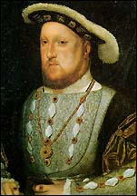


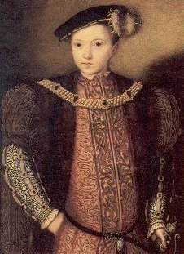
English Reform
Married Catherine Of Aragon 1509
  Youngest Daughter Of Ferdinand II & Isabella Of Spain
  Aunt Of Holy Roman Emperor, Charles V
  Had One Daughter, Mary
  Divorced 1533
  Broke With Roman Church
Married Anne Boleyn 1533
  Had One Daughter, Elizabeth
  Executed 1536
  Known As Anne Of The 1000 Days
  Was Out Deer Hunting While Anne’s Head Was Being Chopped Off In Tower Of London
Married Jane Seymour 1536
Had One Child, Edward VI, A Sickly Child
When Henry Died, 1547, Son Edward VI Only Served Five Years Before Dying.
King Henry VIII
1491-1547

Slide 38
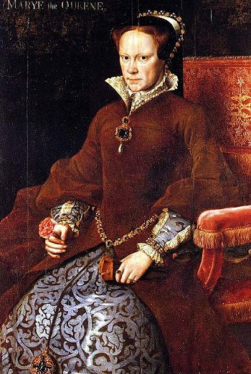
English Reform
With Mary’s Ascension To The Throne A Stir Among Church Leadership Took Place
  English Church Law Made King Head Of The Church
  With Mary On Throne, Archbishop Of Canterbury Became Head Of Church
  Therefore, Whatever Male Comes To Throne In England Is Also Head Of The Church
Mary, A Devout Catholic, Started A Restoration Movement Of Her Own
  Done In Revenge Against The Divorce Of Her Mother
  When Henry Booted Out All Catholic Priests, Confiscated All Churches & Land (About 25% Of All English Land, It Angered Catholics & Hence Mary
  Mary Caused Heads To Roll, Literally
  She Was Known As “Bloody Mary”
She Ruled From 1553 To Her Death In 1558
Queen Mary
1516-1558

Slide 39
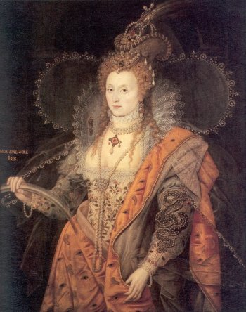
English Reform
With The Death Of Mary, Half Sister, Elizabeth I Came To Throne – 1558
Displayed Good Sense In Her Reign
Saw That Many In England Rebelled Against Both Catholicism And Anglicanism
She Gave Religious Freedom To The People, Seeds Of Restoration
She Allowed People To Study Their Bibles, Worship According To Their Own Preference.
Died In 1603
Queen Elizabeth I
1533-1603

Slide 40
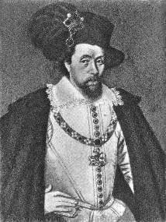
English Reform
Came To Throne After Death Of Elizabeth, Having Already Served 36 Years As King Of Scotland
Strong Protestant Urging Free Thinking Spirit Among Religious People
Desired To Merge Scottish & Anglican Church Under One Confession Of Faith
1611 – First Official English Translation Produced
1620 – December 21, He Established 1st English Colony In Americas At Plymouth Rock, Massechusetts
King James I Of England & VI Of Scotland
1566-1625

Slide 41
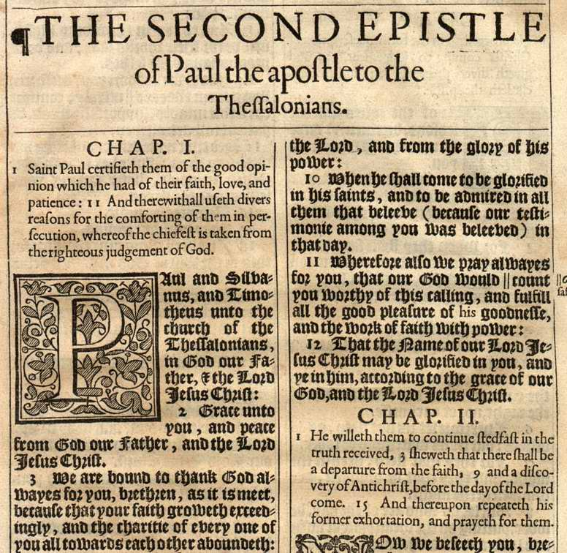
King James Bible

Slide 42
The Rise Of The Anabaptists
1500s — Radical reformers who differed widely among themselves, were generally known as Anabaptists
  This suggests the idea of one baptism on top of another
  Was applied to these because they rejected the validity of infant baptism, saying that for baptism to be valid, the person must voluntarily submit to it as a believer
They were persecuted by both Catholics and the followers of Luther and Zwingli
They were very close to the New Testament pattern
  Believed the church was composed of believers only
  Rejected infant baptism
  Church membership was based on faith and conscious submission to baptism
Problems: There were many leaders of this movement who became corrupt (1) One had seventeen wives (2) Polygamy was approved
The Catholics and Protestants united to stamp out the movement, and almost succeeded (1) One man was left (2) He studied the scripture and saved the movement from destruction (The Eternal Kingdom; Mattox, P. 262‑265)

Slide 43
Other Reform Movements
1550’s – John Knox – Development Of Presbyterianism In Scotland
1572 – Thomas Cartwright, Led A Puritan Movement In England, But Was Really The Presbyterian Church In England
1607 – John Smyth – Founded Baptist Church (Note, The First Baptist Church In England Was In 1611)

Slide 44
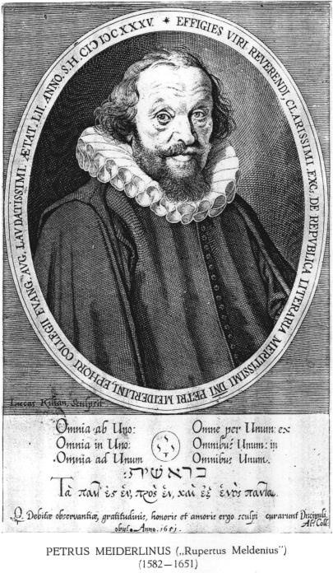
Peter Meiderlin
(Rupertus Meldenius) (1582-1681)
“In Essentials, Unity; in
Non-essentials, Liberty; in All Things, Charity”
—1626

Slide 45
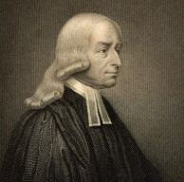
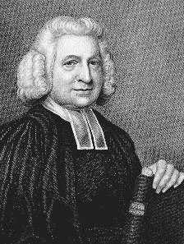
Methodist Episcopal Church
In 1727 John Wesley Began A Movement In The Anglican Church That Was Fully Established December 25, 1784 As The Methodist Episcopal Church
He Was An Ordained Priest In Episcopal (Anglican) Church
Lived And Died An Anglican
John, And His Brother Charles, With Whitefield And About A Dozen other Students At Oxford, Formed A Society For The Purpose Of Overcoming The Formalism And Ritualism Of The Episcopal Church To Stimulate Spirituality
John and his younger brother, Charles, arrived in America February 6, 1736 at Cockspur Island, Georgia.
Other Societies Were Organized And Because Of Their Methodical Manner Of Life They Were Called Methodists
Upon The Death Of Wesley, These Societies Banded Together Under A Conference And Became Known As The Methodist Episcopal Church
John Wesley
1703-1791
Charles Wesley
1707-1788

Slide 46
Other Efforts
Dates And Originators Of Denominations At This Time
  Dutch Reform – 1567 – Duke Of Alva Began A Persecution, Many Dutchmen Were Driven To England Where They Were Allowed To Worship As They Pleased, Began Dutch Reform Church
  Puritanism – 1570 – Thomas Cartwright – Believed Archbishops And Archdeacons Should Be Abolished; Church Officers Should Be Modeled After N.T. Order; Autonomous Churches; Ministers Responsible For One Church Only; No Man Should Solicit Church Appointment; Church Officers Should Be Chosen By Members, Not State
  Quakers – 1650 – George Fox & James Nailer
1669 – A Group Of Men Had Grown Tired Of All The Religious Division In The World – Tottlebank, Just North Of Liverpool, England, The Church Of Christ Was Established – Not Exactly The N.T. Church, More Like A Baptist Church
  Taught Local Church Autonomy
  With Elders To Shepherd Flock
  In 1824 A Group Pulled Away Becoming The Kirkby Church of Christ, After The N.T. Order, Still Meets Today – For 30 Years They Met Not Having Ever Heard Of Alexander Campbell Or Barton W. Stone

Slide 47
The Idea Of Restoration
1807 – When Thomas Campbell Comes To America There Are At Least Five Divisions Within Presbyterianism Alone.
By 1800s It Was Recognized Widely That Reformation Was Impossible
It Is Back To The Bible
Speak Where The Bible Speaks & Remain Silent Where The Bible Is Silent

