Slide 1
Scotland’s Influence On Restoration
Background
14th Century – John Wycliffe Led A Reform Movement In England
16th Century – Lutheranism Introduced In Scotland By Patrick Hamilton & George Wisehart
1559 – John Knox Introduces The Reform Church Into Scotland

Slide 2
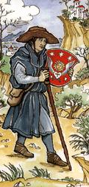
Early Plantings Of Reform In Scotland
1365 – One Year Prior To John Wyclif’s Resignation From Oxford, 81 Passports Were Granted To Scottish Students To Study At Oxford
1415 –Scottish Theologian, Jean Gerson (1363-1429), Complained About The Uprise Of Wyclif Ideas In Scotland
1525 – Luther’s Writings So Infiltrated Scotland That Scottish Parliament Banned Import Of Any Luther Material

Slide 3
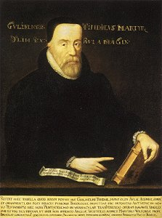
Early Plantings Of Reform In Scotland
By 1530 – Tyndale’s English Translation of 1525 Was Being Widely Used In Scotland

Slide 4
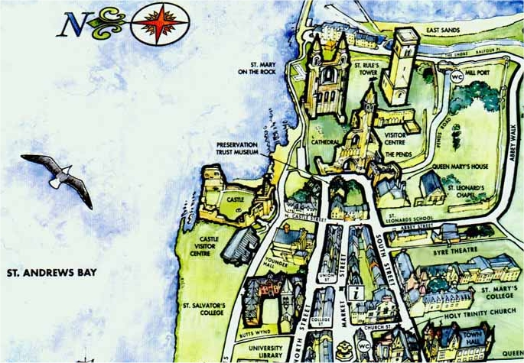
St. Andrews, Fife, Scotland

Slide 5
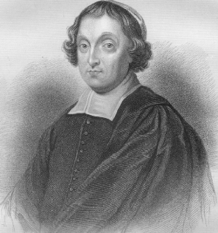
Cardinal David Beaton 1494-1548
Bishop and politician. Born in Balfour (Fife) and educated at St. Andrews and Glasgow Universities. He negotiated both marriages of King James V (1512 - 1542) with the French court. As Abbot of Arbroath, Beaton sat in the Scottish parliament from 1525.
Beaton was effectively the last Archbishop of St. Andrews, appointed to this position in 1539.
Opposed by John Knox, Beaton was murdered by Protestant reformers in the same year as he executed George Wishart.

Slide 6
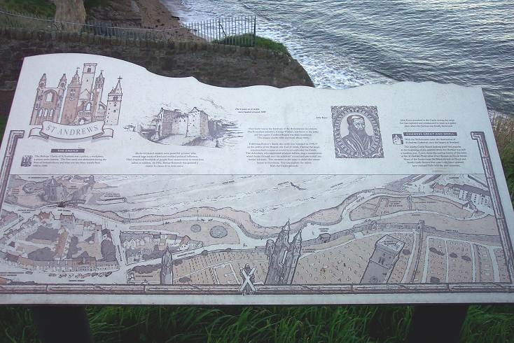
The Bishop’s Castle Of St. Andrews

Slide 7
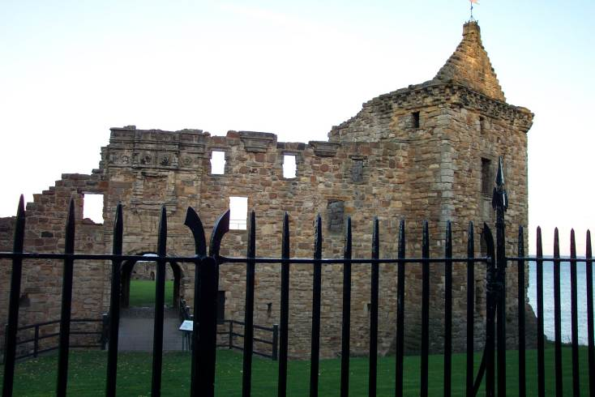
The Bishop’s Castle Of St. Andrews
These are ruins of the second castle, the first of which was destroyed during the wars of independence from 1400 to 1560.
During the Protestant Reformation, the forces of John Knox overtook the forces of Cardinal Beaton in late 1546

Slide 8
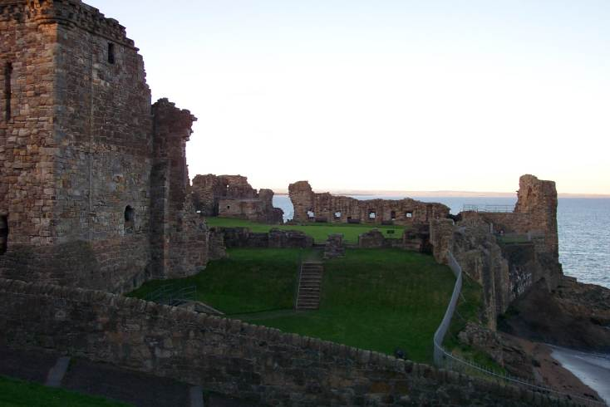
The Bishop’s Castle Of St. Andrews
For A Time John Knox Lived In The Castle, And It Served As A Church As Well As A Stronghold For The Protestants

Slide 9
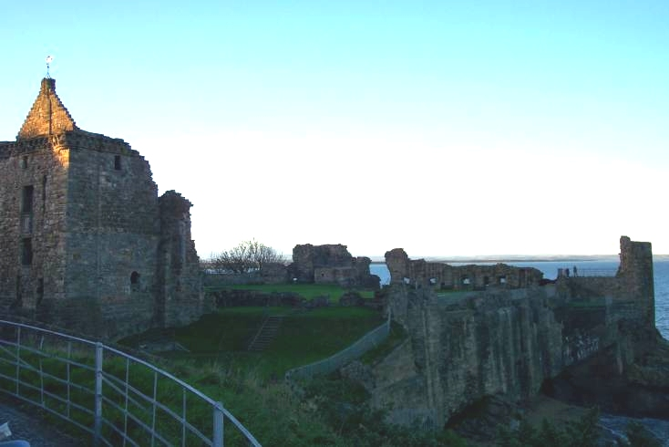
The Bishop’s Castle Of St. Andrews
Finally The Castle Was Destroyed Through Battles Between Protestants And Catholics

Slide 10
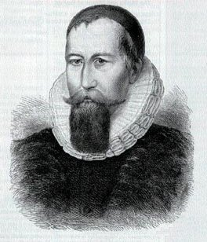
Early Reformers In Scotland
Patrick Hamilton (1504-1528)
Ordained Priest Who Led First Reformation
Spent 6 Months With Luther In Germany
Debated Alexander Alesius, Catholic Envoy Converting Him
Cardinal David Beaton, Archbishop Of St Andrews, Invited Him To Preach In Scotland. After A Week He Was Arrested For Heresy

Slide 11
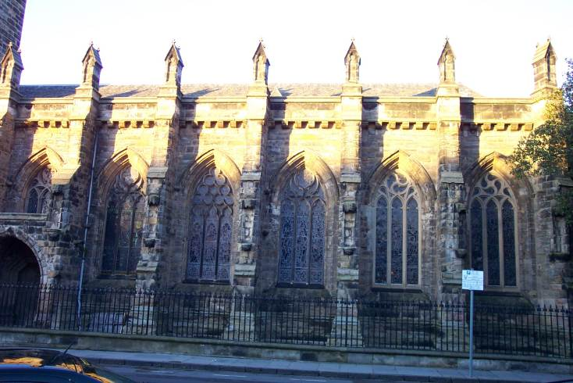
The St. Andrews Church
St. Andrews Church Is Located On The Campus Of St. Andrews College

Slide 12
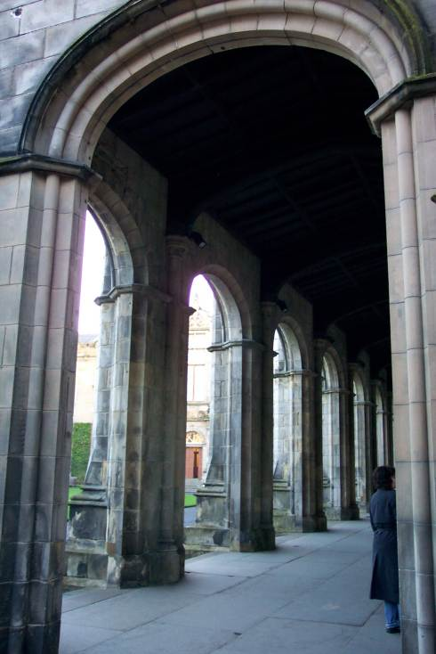
The St. Andrews Church Cloisters
The Old Church Is Open To The Public

Slide 13
Hamilton’s Demise
Taught Against Celibacy, Pressing The Point By Marrying
Accused Of Teaching Against Pilgrimages, Purgatory, Prayers To Saints, Prayers For The Dead
Burned At The Stake. It Was Gruesome, As It Took 6 Hours To Burn Him. The First Fire Went Out While He Writhed In Pain – February 29, 1528
Resulted With Deep Resentment & Resistance From Scottish People.

Slide 14
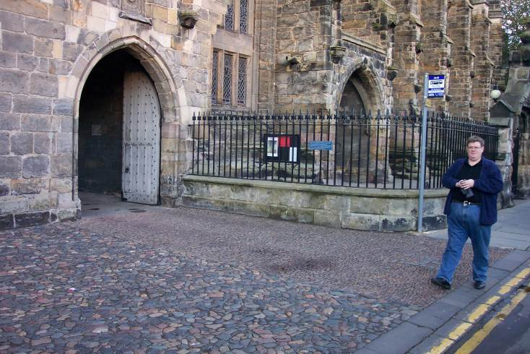
The Death Of Patrick Hamilton
Location Where Patrick Hamilton Was Burned At The Stake

Slide 15
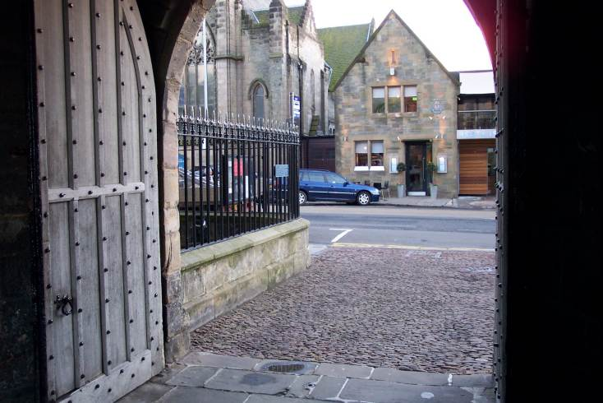
The Death Of Patrick Hamilton
A Marker Still Shows The Spot Where Hamilton Died

Slide 16
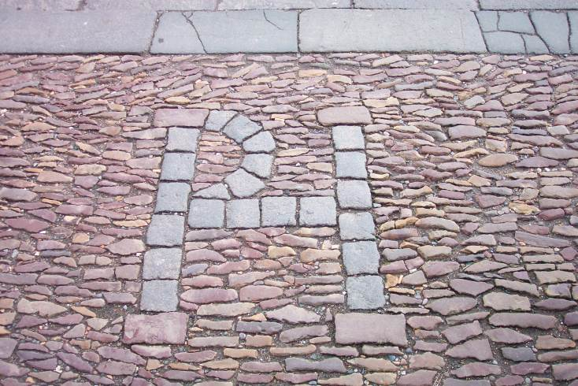
The Death Of Patrick Hamilton

Slide 17
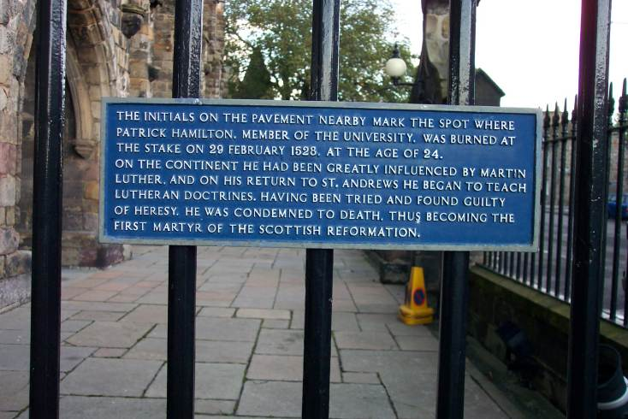
The Death Of Patrick Hamilton

Slide 18
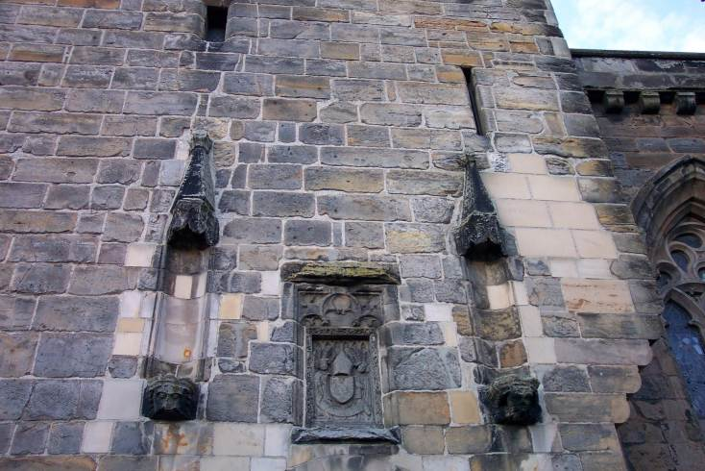
The Death Of Patrick Hamilton
The Heat Of The Fire That Burned Hamilton Was Said To Be So Hot That It Permanently Burned His Face Into The Stone Of The Church That Stood Closeby

Slide 19
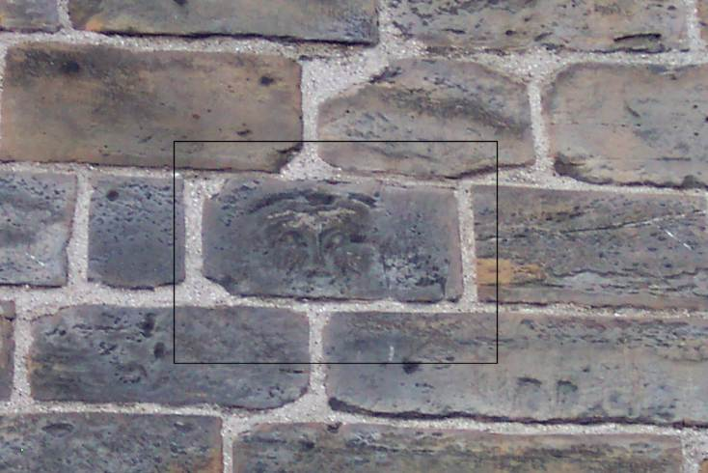
The Death Of Patrick Hamilton

Slide 20
George Wishart 1513-1546
1538 Forced Into Exile By Catholic Church: Fled To Strasbourg & On To Zurich - Influence By Swiss Reformers
Close Friend And Confidant Of John Knox
Held To Biblical Authority For Faith And Practice – Taught Greek – N.T. Was His Text
1544 - Returned To Scotland; Preached Protestantism; Calvinism; Authority Of The Scriptures; Presbyterian Form Of Church Government; Local Autonomy Of Congregations

Slide 21
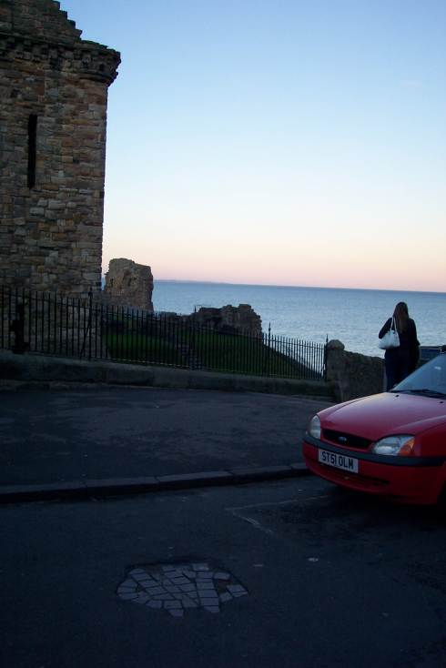
1544-1546 – Began Influencing John Knox – Was Present When Wishart Was Arrested Jan. 16, 1546
Wishart Defended Himself Before His Accusers As 18 Articles Were Read Against Him
He Was Against Purgatory, Mass, Transubstantiation, the Sacraments, Veneration Of Saints, & Celibacy
Burned At Stake In Front Of Bishops Castle, By Cardinal David Beaton.

Slide 22
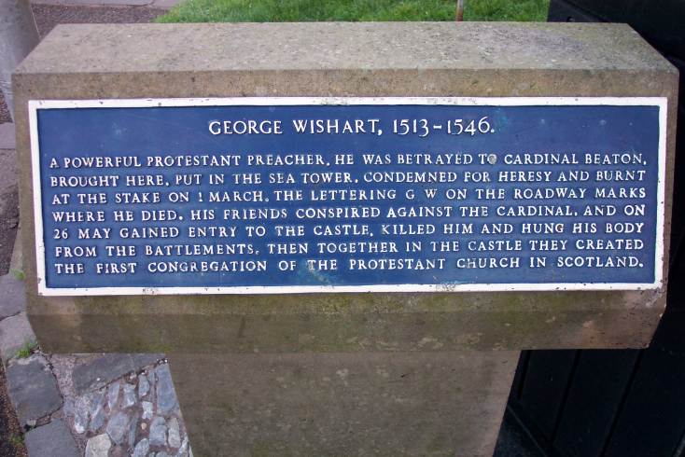
The Death Of George Wishart
Furious Response Of People - Beaton Was Hung By Wishart Loyalists May 28, 1546 In Retaliation
One Of The Earliest Congregations Of The Church Of Scotland Was In The Castle Where Wishart Was Martyred

Slide 23
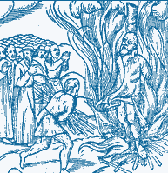
The Death Of George Wishart
Burning Religious Leaders At The Stake Only Fueled The Fire Of The Spirit Of Reformation In Scotland As In All Of Europe

Slide 24
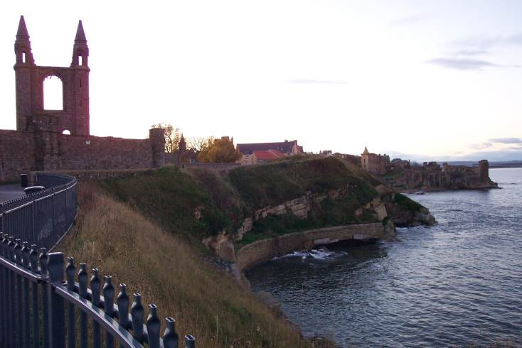
The St. Andrews Cathedral
Once The Largest Abbey In All Of Scotland

Slide 25
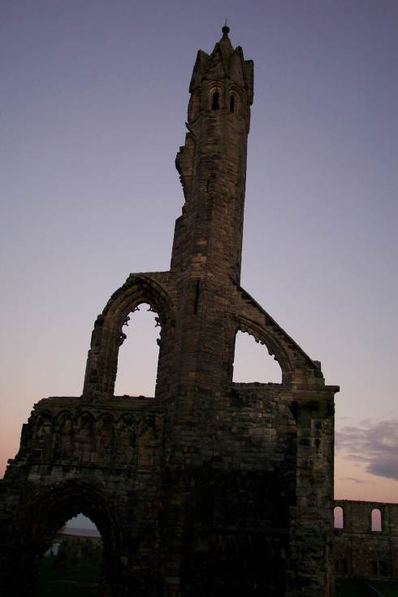
The St. Andrews Cathedral
Destoyed By Protestants When Seeking To Overtake The Catholic Stronghold

Slide 26
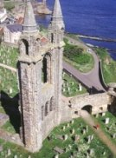
Scottish Catholicism: A Contributing Factor To Reform
Cardinal Beaton, Archbishop Of St. Andrews Had Nine Children
Bishop Hepburn Had 10 Children All By Different Mothers
1558 Catholic General Provincial Council Tried To Clean Up Their Act By Refusing To Pay For Illegitimate Children, Too Little Too Late
Catholic Leadership Was Immoral & Incompetent, Causing Many To Move Away From Catholicism Refusing To Attend Mass
The 1558 Council Passed Laws Of Punishment To Those Who Missed Mass
Internal Moral Decay In Scottish Catholic Leadership Brought On More Desire For Reform Than Anything
Cardinal David Beaton Archbishop Of St. Andrews Church, Scotland 1494-1546

Slide 27
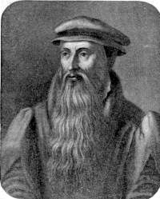
John Knox 1505-1572
Ordained Priest After Attending University of Glasgow & St. Andrews
Sat At Feet Of Swiss Reformers
1546 — Follower Of George Wisehart
1547 – Entered The Then Protestant Stronghold At St. Andrews After Death Of Cardinal Beaton
July, Captured By Catholics/ Spent 19 Months In The Galley Of A French Ship As Slave – Released In 1549
1549 – Received Protestant License To Preach From English King Edward VI, Son Of Henry VIII
1553 – Queen Mary Came To Throne And He Fled To Geneva, Influenced By Calvin – Close Friend Of Calvin Until Death In 1564
1559 – Returned To Scotland, With Elizabeth On The Throne In England

Slide 28
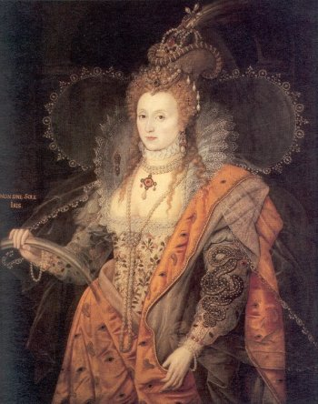
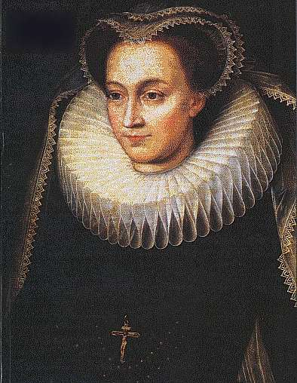
Political Setting At This Time
1558 Elizabeth Came English Throne
Mary, Queen Of Scots Had Recently Been Named Queen Of France
Catholic
She Was Believed To Be The Rightful Heir To The English Throne (Her Mother Was Sister To Henry VIII)
French/Catholics Were Planning To Use Scotland As A Base To Invade England
Protestants In Scotland Aided Elizabeth In Keeping Mary From Taking The Throne
Result: Elizabeth Rewarded Protestants For Their Faithfulness To The Throne

Slide 29
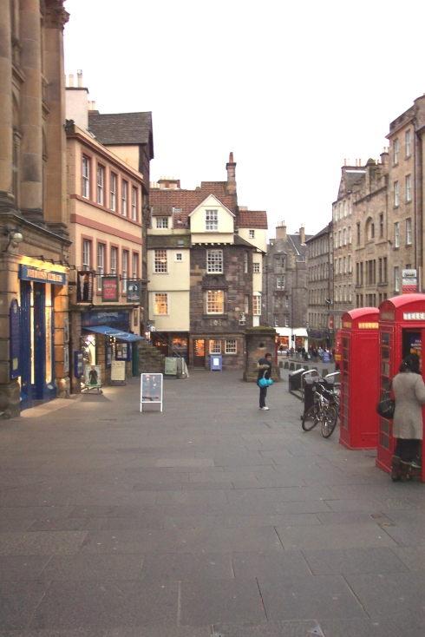
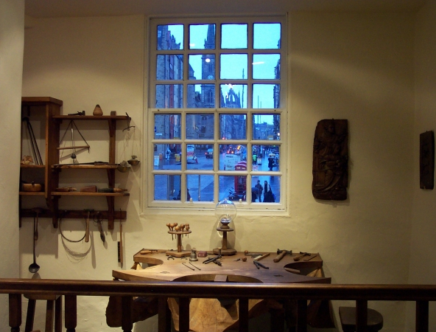
John Knox Home In Edinburgh

Slide 30
Knox & The Church Of Scotland
The True Church Had 3 Distinct Marks
True Preaching Of The Word Of God
Church Discipline To Be Administered According To The Bible
Correct Administration Of The Sacraments Of Christ
Reform Church Of Scotland Began – 1560
Abolished Papal Rule In Scotland
Abolished All Contrary To New Doctrine
Forbade Celebration Of Mass

Slide 31
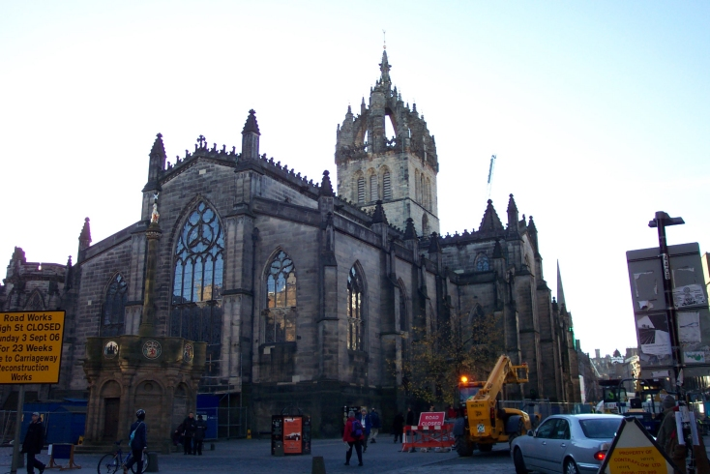
St. Giles Church: Home Of The Church Of Scotland

Slide 32
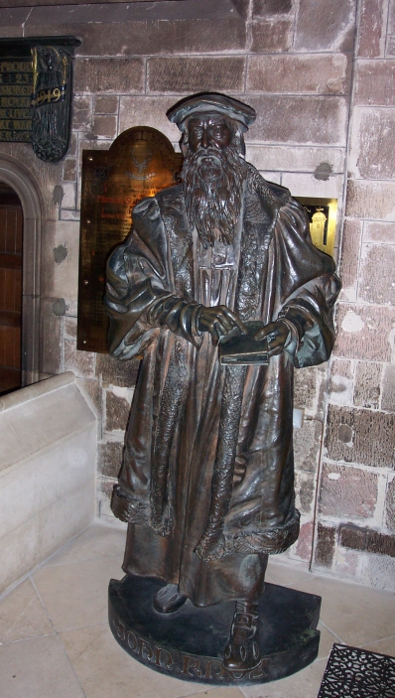
By End Of 1560 The General Assembly For The Reformed Church Of Scotland Was Formed
Wrote Two Disciplines
The Book Of Discipline – 1560: Teaching That Baptism And Lord’s Supper Could Be Administered Where The Word Of God Is Preached
The Second Book Of Discipline - 1575

Slide 33
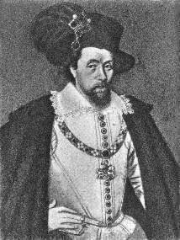
Reform After Knox
May, 1597, King James VI Of Scotland Became Involved In Reformed Church Affairs: John Knox Was A Dear Friend, Who Preached At His Coronation
1603 – Ascended To English Throne As King James I
Sought To Unite Scottish Reform With English Church
Authorized An English Version Of The Bible To Be Translated – King James Version - 1611
In August 1647 The General Assembly Of Edinburgh Adopted “Westminster Confession Of Faith”

