Slide 1
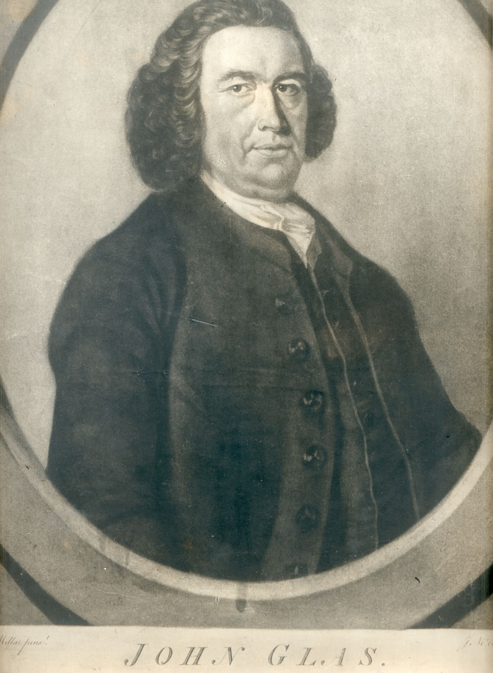
John
Glas
1695-1773
Born September 21, 1695
His Father, Thomas Was Minister Of The Church of Scotland
Attended Grammar School At Perth, Later Attending St. Leonard’s College at St. Andrews. Received M.A. May 6, 1713
Then Attended University Of Edinburgh
Received A Calvinistic Education Both At Home & University
Licensed As A Presbyterian Minister At Dunkeld Presbytery On May 20, 1718, Later At Tealing In Forfarshire May 6, 1719
At Tealing Presbyterian Church 5 Years

Slide 2
John
Glas
1695-1773
1727 – Wrote The Testimony Of The King Of Martyrs Concerning The Kingdom
  Against State Churches &
  Intervention Of Civil Authorities In Church Matters
Believed:
  The Church Is Made Up Of Those Who Experienced The Grace Of Christ
  Separated Themselves From The World
  Gathered Themselves In The Church
  Therefore, No Place For Civil Affairs
Separated From Tealing Church, July 13, 1725, Starting An Independent Church
  100 People Followed
  Agreed To Follow Christ As Lord
  Subjected Themselves To Glas’ Leadership
  Observed The Lord’s Supper Monthly (Not Quarterly Like Scottish Church)
  Followed Matthew 18 – Church Discipline
  Formed A Society Of Believers

Slide 3
John
Glas
1695-1773
Divisions Continue
  August 6, 1726 – At Strathmartine
  Taught John 18:36,37 – Christ’s Kingdom Is Not Of This World
  No Earthly Civil Designation Of Authority (Against Physical Kingdom Teaching In That Day)
  Close To Treason
Brought Before A Number Of Synods
  Aug. 1726 – Synod of Angus & Mearns
  Sept. 6, 1726 – Synod Of Dundee
  Oct. 1727 – Synod of Montrose
  April, 1728 – Synod Of Angus & Mearns
    Members Submitted 26 Questions To Glas And His Reply Was Discussed
    Glas Was Suspended As Presb. Minister
    Appeal To Gen. Assembly At Edinburgh May 2, 1728

Slide 4
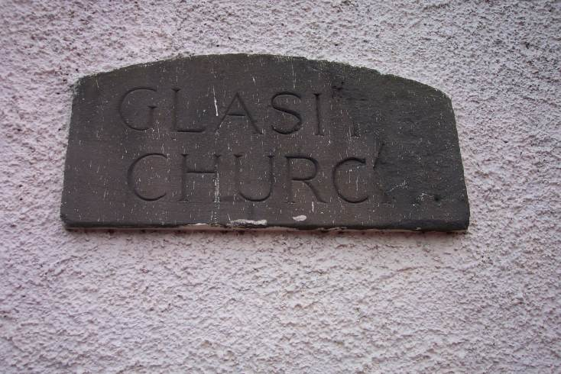
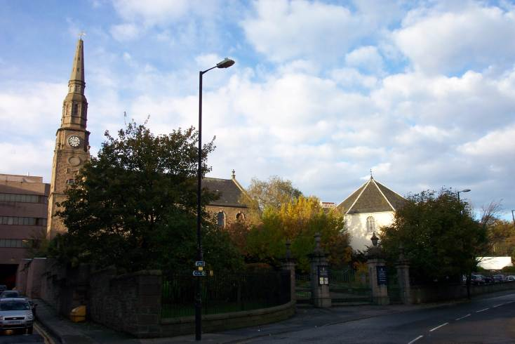
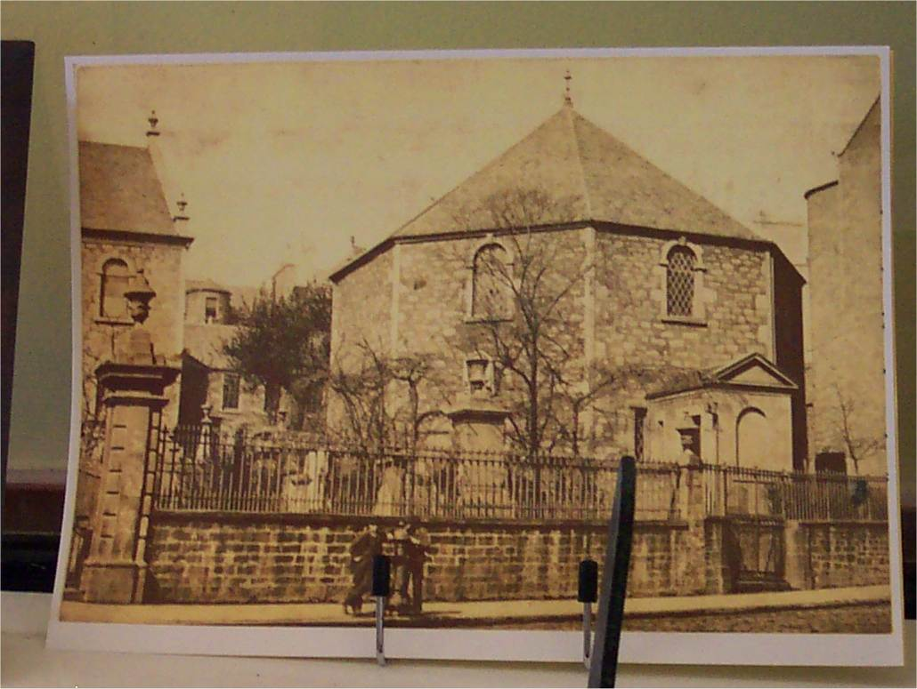
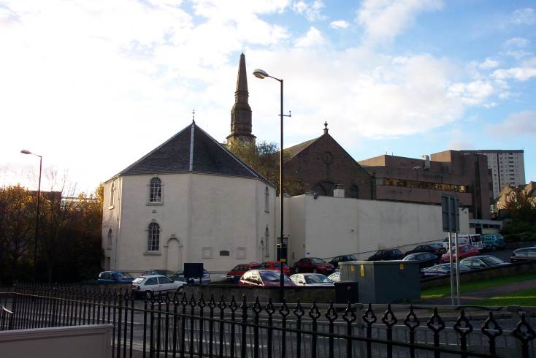
Glasite Church - Dundee

Slide 5
John
Glas
1695-1773
Still More Presbyterian Synods
  Oct. 17, 1728 – Synod Of Dundee
    Should They Suspend Or Depose Glas?
    He Was Deposed
  Mar. 12, 1730 – Appealed To Highest Presbyterian Court Who Confirmed The Sentence To Depose Him
  1739 The General Assembly Broke Precedence And Revoked The Sentence Of Deposition
    Though It Restored Glas As A Minister, It Did Not Restore Him As A Minister In The Church of Scotland
    Glas Never Requested This, But Its Happening Showed A Sign Of Softening Against Congregationalism

Slide 6
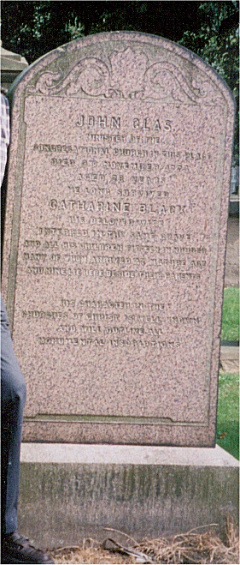
John Glas - 1695-1773
Last Years Of Ministry
  1730 – Continued To Minister To New Tealing Society
  Moved To Dundee To Support Himself By Opening A Bookstore
  Moved To Perth In 1733
    His Independent Reputation Was Not Quickly Accepted
    When Opening A New Meetinghouse There Some In Town Threw Mud At Attendees
    George Miller, The Town Clerk Intervened And Kept The Meetinghouse From Destruction
  1734 Established A Congregational Church in Edinburgh
    Met Robert Sandeman There
    Later Became His Son-In-Law
  Died November 2, 1773 – 78 Years Old
    Survived By 15 Children, Wife Died In 1749
    Most Of Family Buried At Dundee In “Old Howff” Cemetery

Slide 7
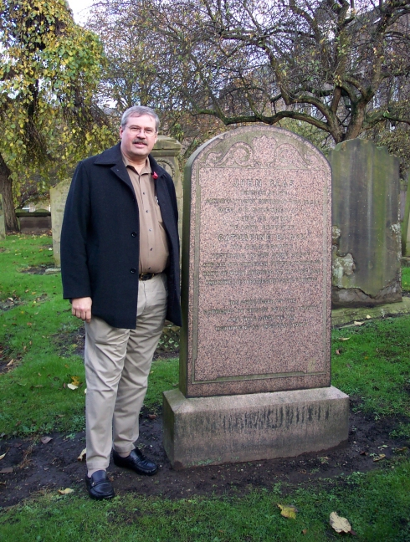
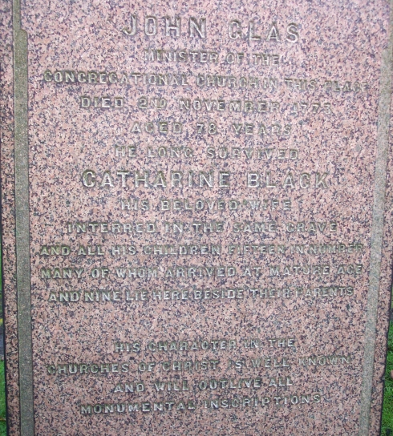
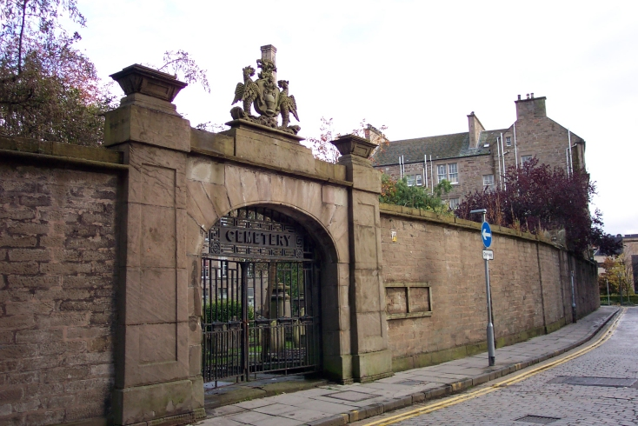
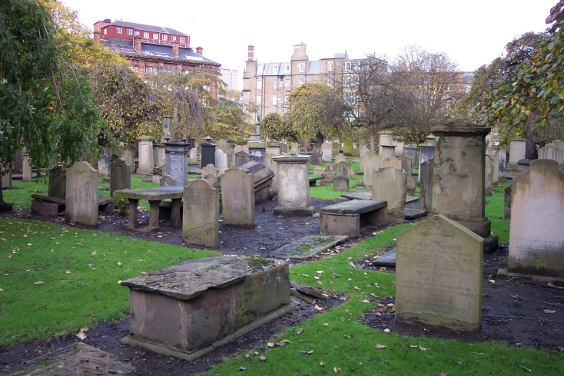
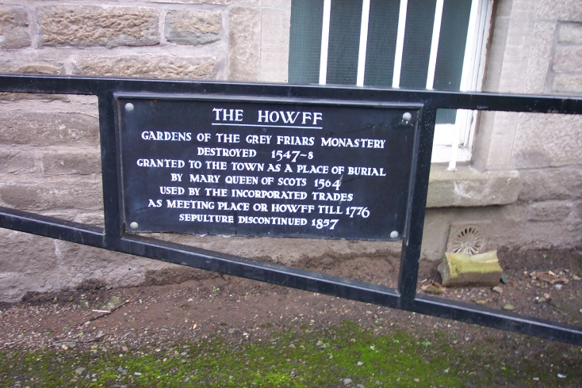
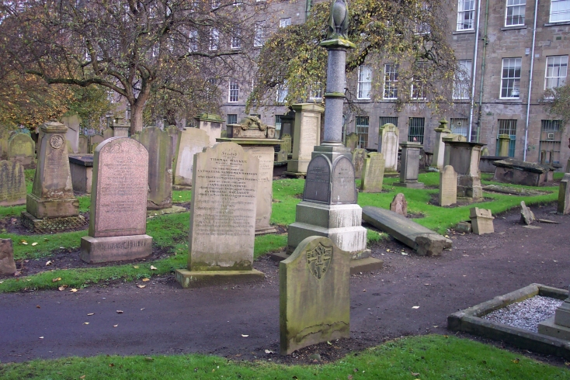
John Glas – Buried In Howff

Slide 8
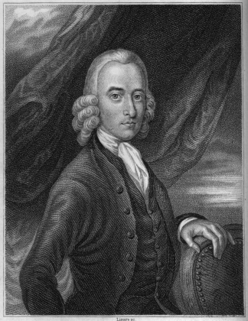
Robert
Sandeman
1718-1771
Born April 19, 1718
Father, David, A Linen Merchant And Magistrate In Perth
Attended University Of Edinburgh To Prepare For The Ministry In Church Of Scotland 0 1734
As A Youth He Became Acquainted With Glas Ideas
1735 Choosing To Give Up Ministry Idea, He Returned To Perth To Begin An Apprenticeship In Weaving Business
1737 He Married Katherine, Daughter Of John Glas
1740 Set Up A Weaving Business
1756 His Brother Married Another Of Glas’ Daughters

Slide 9
Robert
Sandeman
1718-1771
1744, Age 26 – Became Elder Of Perth Congregational Church
Preached For Next 16 Years At Perth, Dundee & Edinburgh
1757 – Wrote 2 Volume Work, Letters On Theron And Aspasio Against James Harvey’s Teachings On Calvinism
  James Hervey Had Written An Apologetic Of Calvinism Called Theron And Aspasio – 1755
  As A Result Of Letters On … Many English Congregational Churches Began Appearing
1761 – He And Brother William Went To London To Teach His Congregational Ideas
By 1766 Many Congregational Churches Are In England

Slide 10
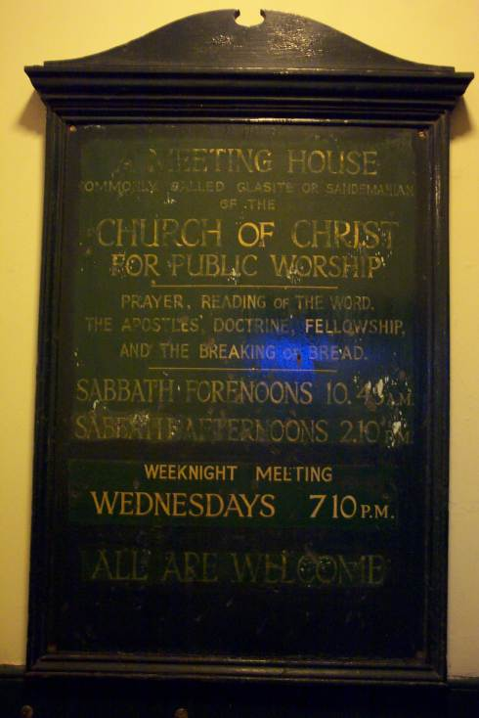
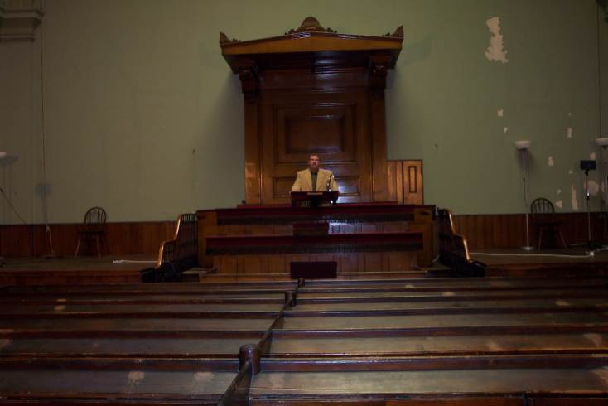
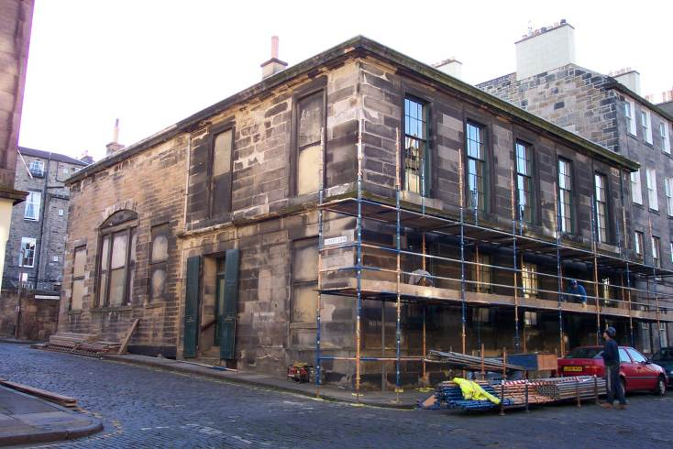
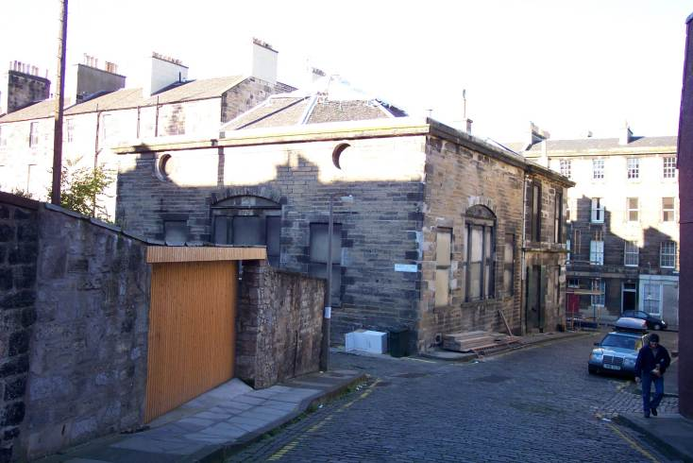
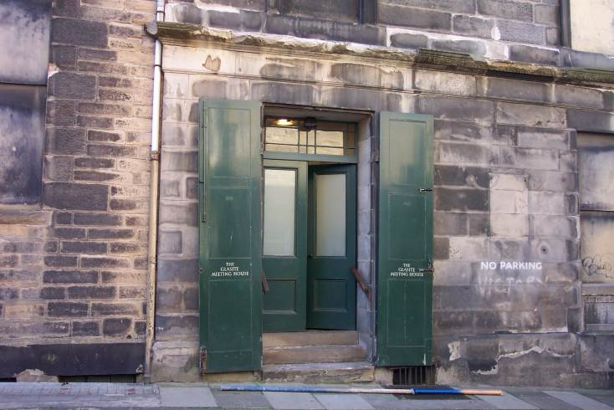
Glas Church In Edinburgh

Slide 11
Robert
Sandeman
1718-1771
American Influence
  1760 – Letters On Theron And Aspasio Appear In Colonies
  1763 – He Receives A Letter Urging A Visit To America
  August 30, 1764 Sandeman Departs Scotland Arriving In Boston Harbor, Oct. 18, 1764
  Glas/Sandemanian Churches Established In Connecticut, Rhode Island, Massachusetts, & Other New England States
Sandeman Died In Danbury, Connecticut, April 2, 1771 At 53 Years Of Age, Two Years Before Glas In Scotland

Slide 12
Some Beliefs Of The Glasites/Sandemanians
Believed They Could Reenact 1st Century Order In Christianity
Denied Tenets Of Calvinism
Had Lord’s Supper Every Sunday
Observed Love Feasts
Had Foot-Washings
Mutual Exhortations
Casting Lots, etc.

Slide 13
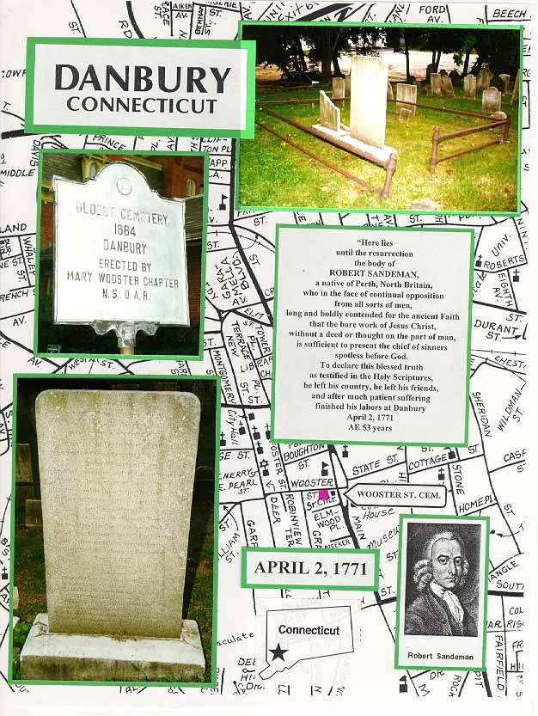
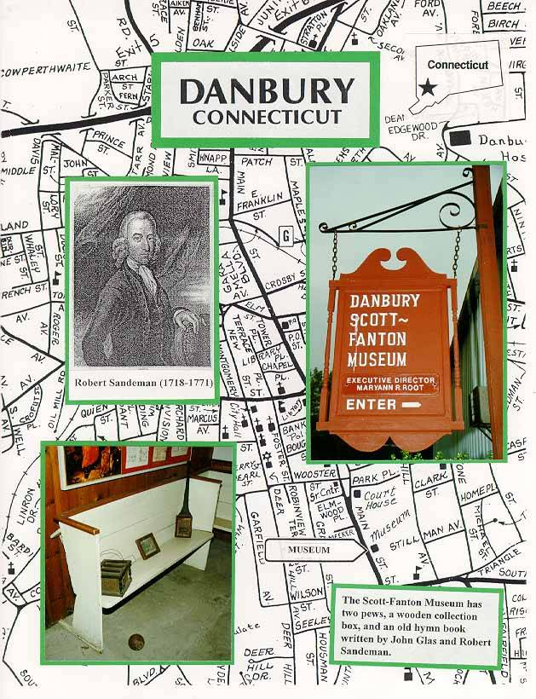
Robert Sandeman, Danbury, Conn.

Slide 14
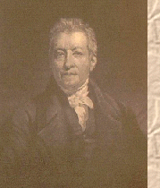
Robert & James Haldane
1798 – Started A Church In England After The Glas/Sandeman Order
The Tabernacle Church – Beg. 1799 With 310 People
L.S. Administered Every Sunday
Weekly Collections Taken
Operated Schools Throughout England
Close Associate To Greville Ewing
Associated With Baptists
James Haldane
1768-1851

Slide 15
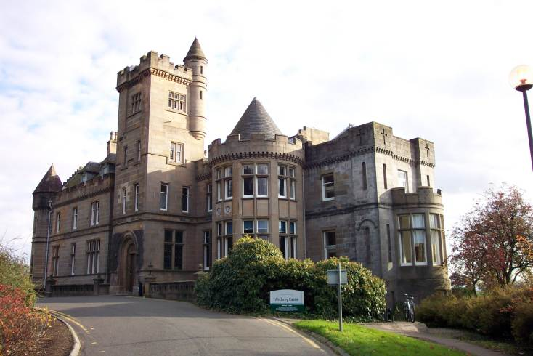
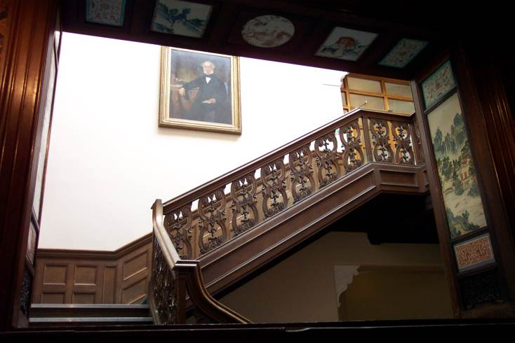
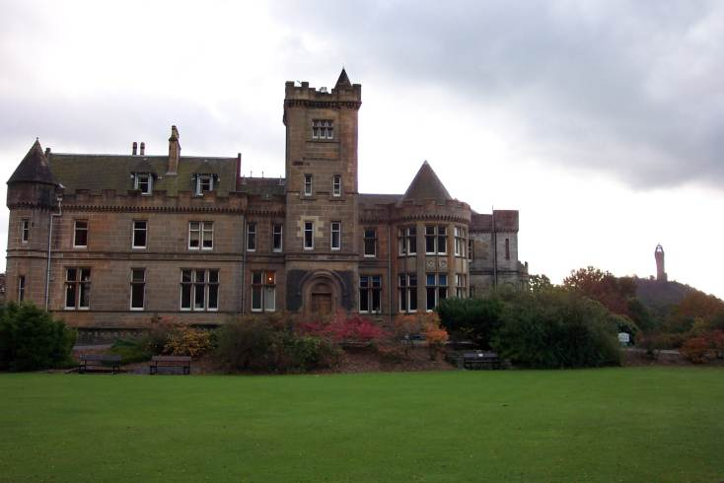
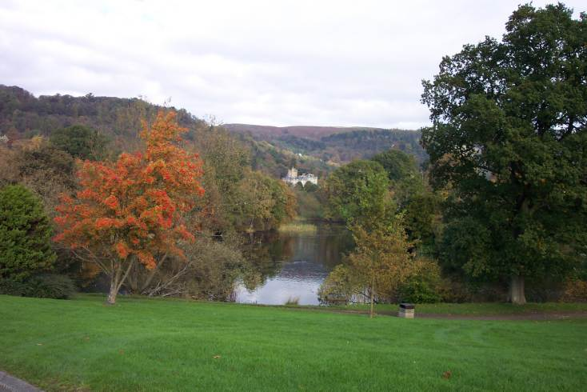
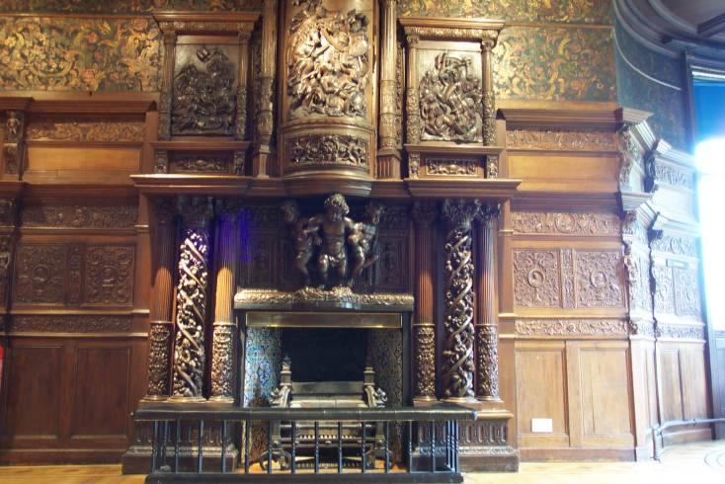
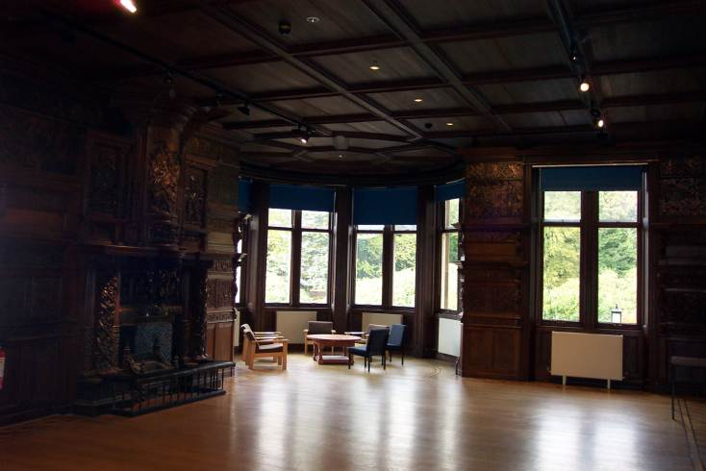
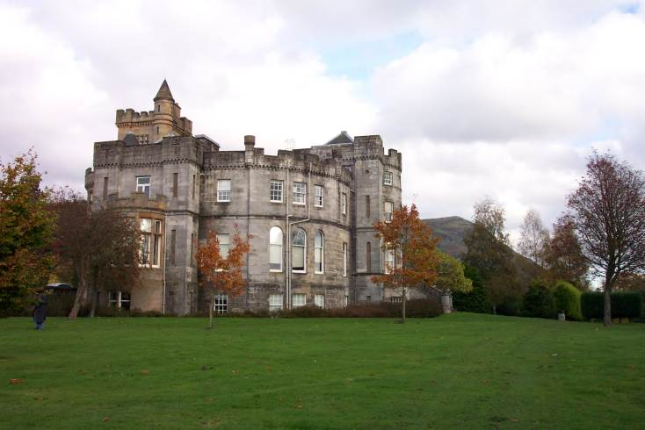
Haldane Home – Airthrey Castle, Sterling, Scotland

Slide 16
Tabernacle Church Teaching
N.T. Contained The Pattern For All Christian Service
Apostolic Church Model Provided Church Model For All Ages
Thus Teaching “Restoration” Or “Restitution”
Congregational Autonomy
Elders Served In Each Congregation, Teaching & Ruling
Each Church Had Its Own Deacons & Minister
Civil Authorities Had No Right In Church Matters
Weekly Observance Of The Lord’s Supper
By 1808 Both Haldanes Believed That Immersion Was The Only Proper Mode Of Baptism
Haldanes Differed With Glas Over Discipline, Took A More Loving Approach

Slide 17
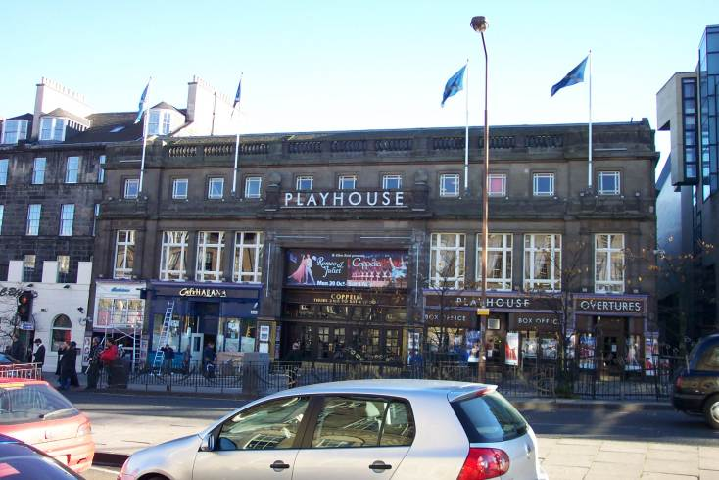
Haldane Tabernacle - Edinburgh

Slide 18
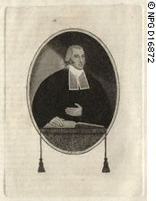
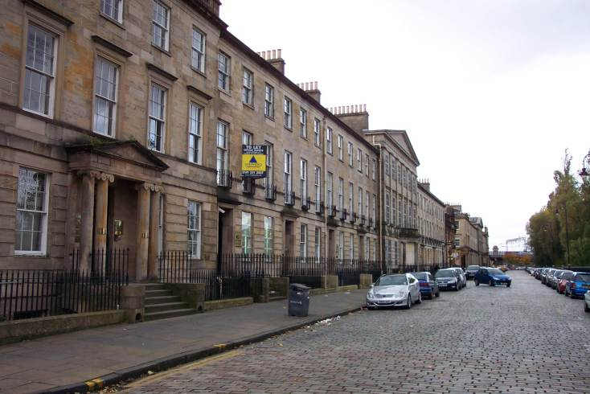
Greville Ewing
1767-1841- Born In Edinburgh, Scotland
Supported Mission & Congregationalism In Scotland
Founding Member & Secretary Of Edinburgh (Later Scotland) Missionary Society, March, 1796
Street Where Ewing Lived In Glasgow

Slide 19
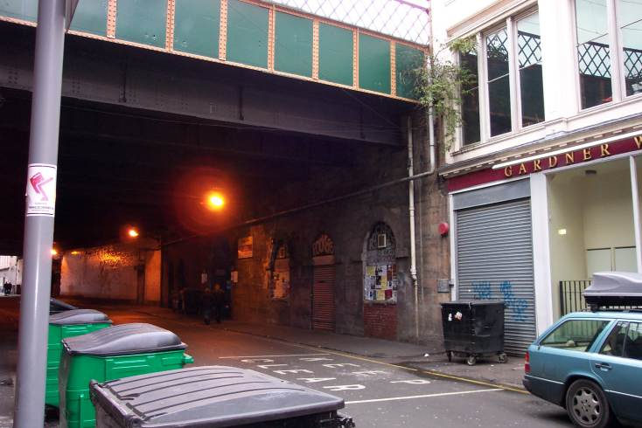
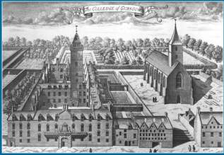
Influence Of Greville Ewing
Met And Worked With Haldane Brothers Until 1808 Teaching In Schools, Preaching
1800-1839 – Minister Of Mother Church of Scottish Congregationalism, Glasgow, Scotland
Instructed At University of Glasgow
One Of His Students 1808,1809 Year Was Alexander Campbell
Haldane Church Where Ewing Preached
In
Glasgow
Old Glasgow University

