Slide 1
Movements Independent Of Campbell & Stone
To Some Campbell & Stone Are Credited With Beginning Restoration
Some Predate These Men In Restoring New Testament Christianity
The Religious Freedom That This Country Was Built On Allowed Anyone With A Bible To Search The Scriptures And Obey Them

Slide 2
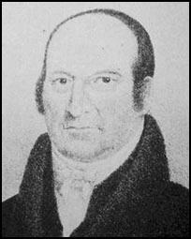
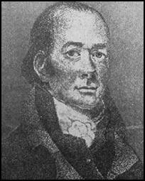
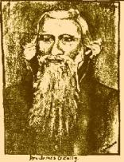
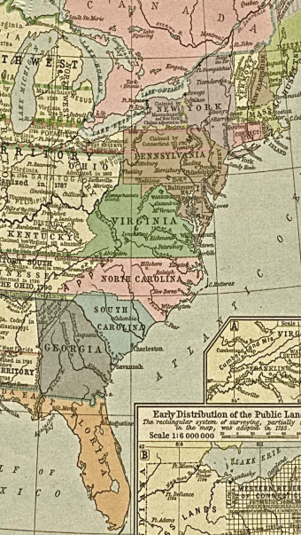
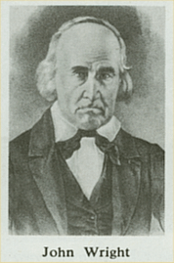
Earliest Restorers
Abner Jones
Elias Smith
1772-1841
1769-1846
John Wright
James O'Kelley
1738-1826
1785-1851

Slide 3
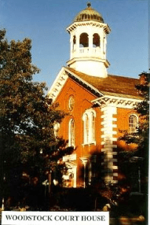
New England
Elias Smith
Broke With Sandamanian Congregationalists In New England
1789 Immersed A Baptist
Early Leanings Toward Universalism
Gave It Up By 1826
1802 – Taught That We Should Be Only Christians
1769-1846

Slide 4
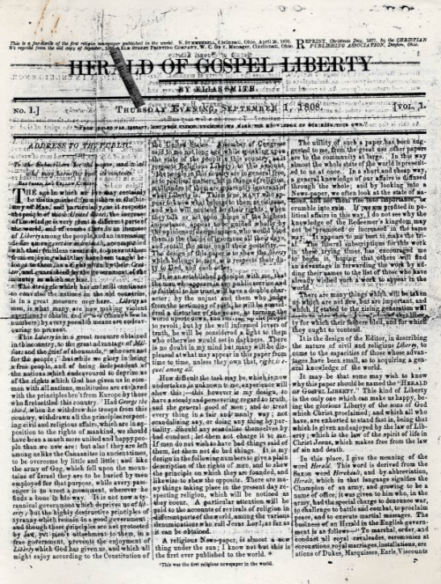
Elias Smith
Began Journal In 1808 –Herald Of Gospel Liberty, Later Called The Gospel Proclaimer
1810 – Started Christian Church Woodstock, VT
360 Baptisms Within A Short Time
Met In Woodstock Courthouse
Never Heard Of Campbell Or Stone

Slide 5
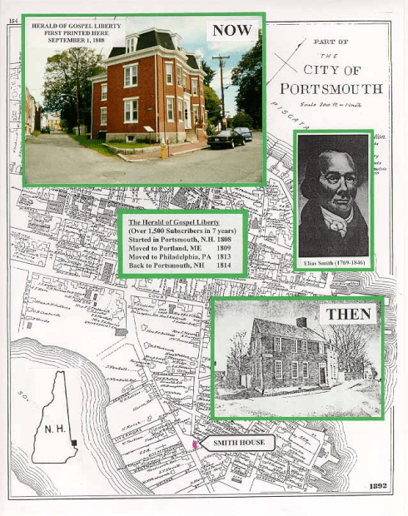
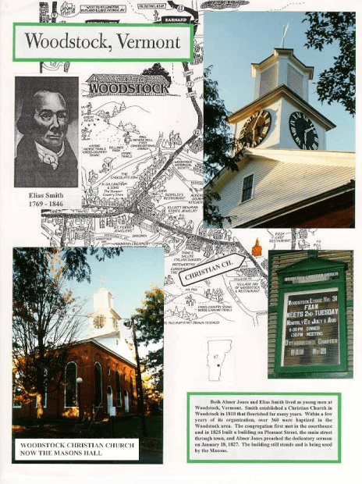
Elias Smith

Slide 6
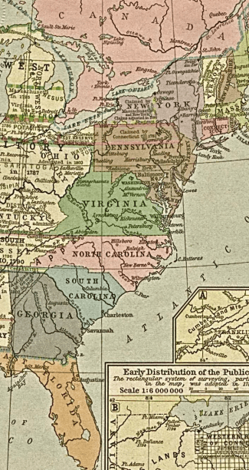
New England
Moved From Mass. When He Was 8 Yrs. Old To Vermont
1793 Baptized Into Baptist Church, Woodstock, VT
Began To Preach 1801, Age 29
  Began Planning At 21
  Studied His Bible On His Own
  Found Baptist To Be Unauthorized Name
  Should Be A Christian Only
Organized 1st Free Christian Church In New England
Denied Calvinism And Branded As Heretic By Free-Will Baptists
Abner Jones
1772-1841
Studied And Practiced Medicine For Many Years
Mastered Hebrew, Latin & Greek Grammars
Started Christian Churches In Vermont, New Hampshire & Salem, Massachusetts

Slide 7
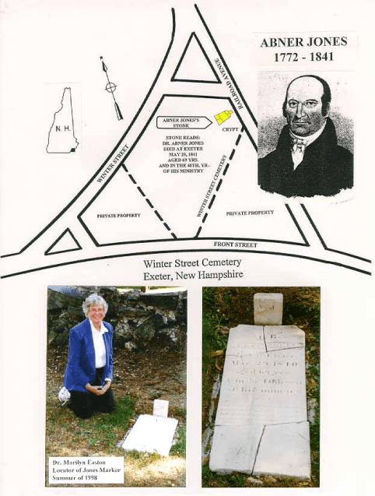
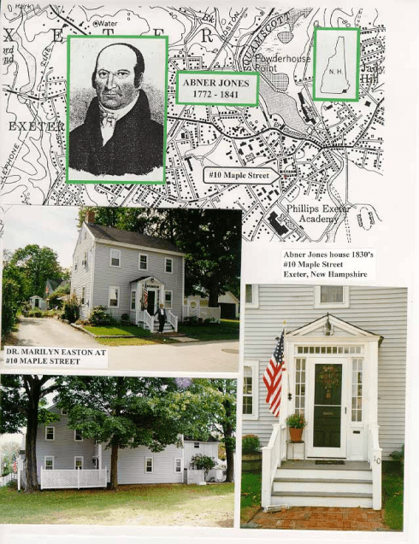
Abner Jones (1772-1841)

