Slide 1
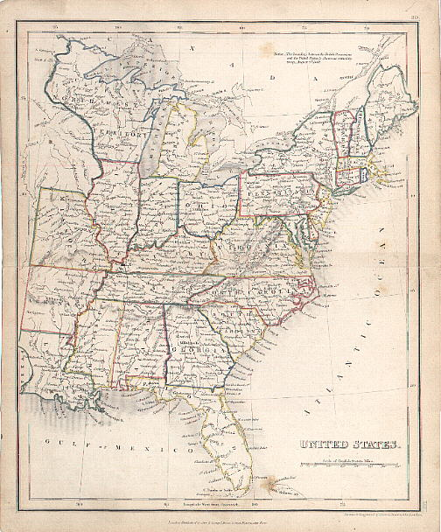
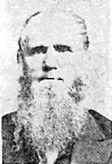
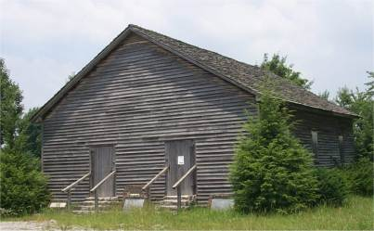
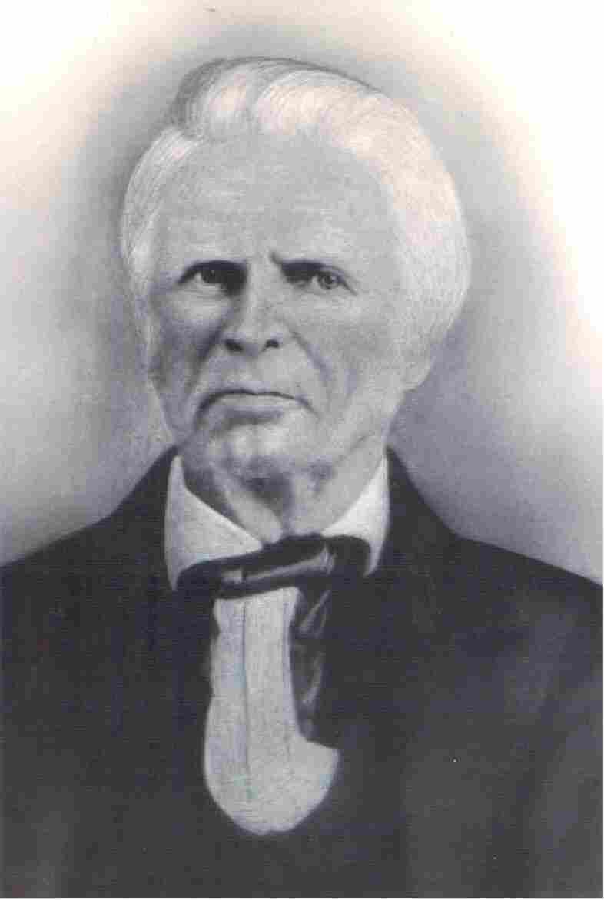
Movements Independent Of Stone & Campbell Part II
Old Philadelphia
Warren Cty. TN
Dr. Chester Bullard
1809-1893
1805
John Taylor
Christian H. Dasher
1807-1895
1789-1866

Slide 2
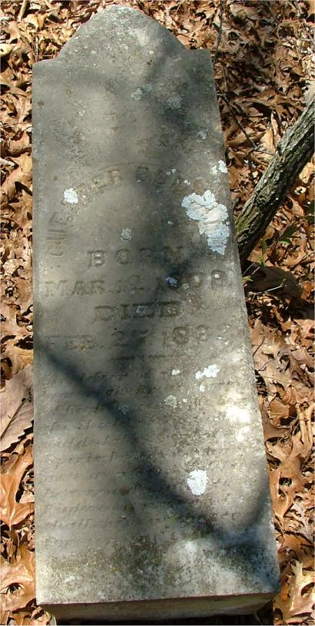
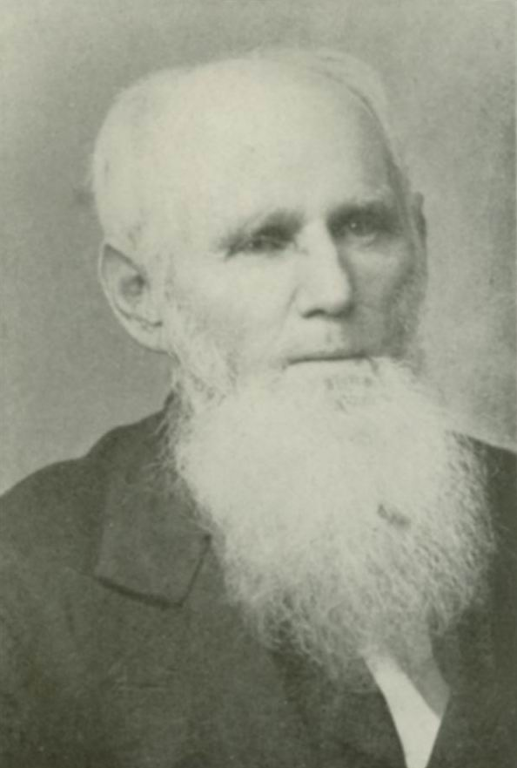
A Virginia Movement
Born In Massachusetts In 1809
Early Influence Of Methodists Who Taught One Must Have A Holy Spirit Experience
His Study Found H. Sp. Worked Only Through The Word Of God
Baptized By Landon Duncan Dec. 11, 1830
1831 Medical Studied, Became Doctor
Preached His 1st Sermon On Baptism
Organized A Church After The Ancient Order In Catawba, Craig County, 1833
By 1836 He Had Planted Six Churches
Followers Called Bullardites
Moved to Snowville, Montgomery County, Snowville Church Became Known As “Little Jerusalem” Of S.W. Virginia
Never Heard Of The Campbells Until 1839 Finding Their Teaching Similar To His
Preached 60 Years & Baptized 8000-10,000
Dr. Chester Bullard
1809-1893

Slide 3
A Georgia Movement
In 1734, A Group Of Salzburg, Austrian Lutherans Came To Settle About 30 Miles Northwest Of Savannah In Ebenezer
Around 1819, Christian Herman Dasher Began To See The Need For Immersion
He Was Introduced To Sheldon C. Dunning In Savannah Who Immersed Him
In 1825, Dasher & 30 More Left, Moving To Lowndes County And Establishing N.T. Christianity
He Never Had Heard Of Campbells Or Stones
Christian H. Dasher
1789-1866

Slide 4
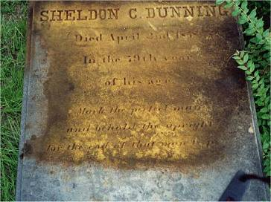
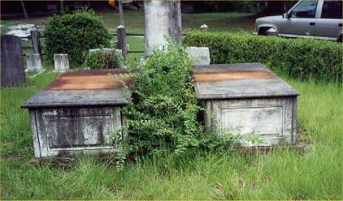
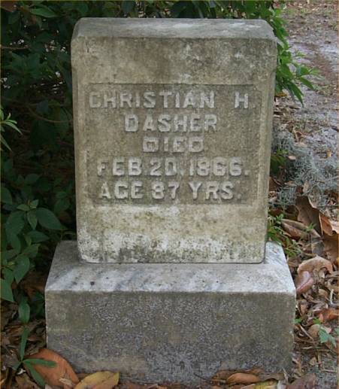
Dunning & Dasher, Perhaps The First N.T. Christians In Georgia
Christian H. Dasher
Sheldon C. Dunning
Died April 2, 1858
In The 79th Year Of His Age Mark The Perfect Man And Behold The Upright For The End Of That Man Is Peace
-Psalm 37:37
1789-1866
Dasher Is Buried At Sunset Hill Cemetery, Valdosta, GA
S.C. Dunning Is Buried At Laurel Grove Cemetery, Savannah, Georgia

Slide 5
An Alabama Movement Before 1826
Alabama Became A State In 1819
Reared In The Baptist Faith
Had Trouble With Scripture & Baptist Doctrine
He Wanted To Be Baptized For Remission Of Sins
Found A Baptist Minister Who Nervously Consenting To Baptize Him For Rem. Of Sin
Was To Meet Late At Night
Preacher Didn’t Show/Cold Feet
Later He Was Encouraged To Meet With Taylor, Then He Was Baptized
Began Preaching After The Ancient Order In Lauderdale/Colbert /Franklin Counties, Alabama
Never Heard Of Alexander Campbell
Said He Found His Doctrine From The Word Of God
John Taylor
1807-1895

Slide 6
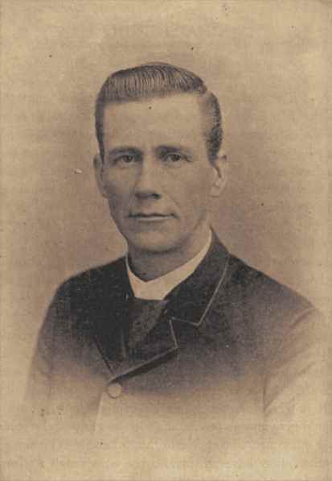
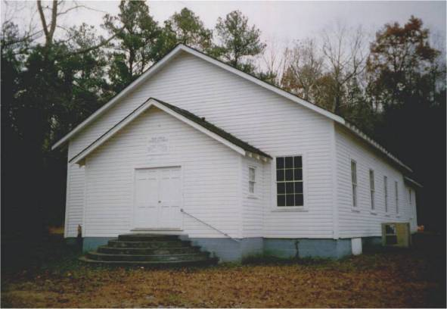
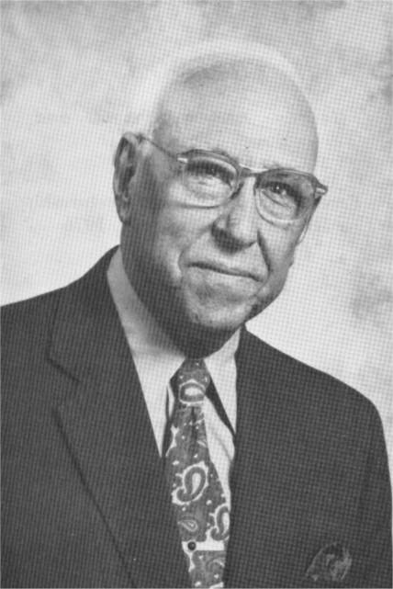
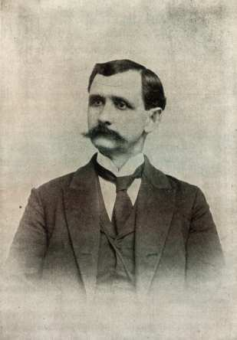
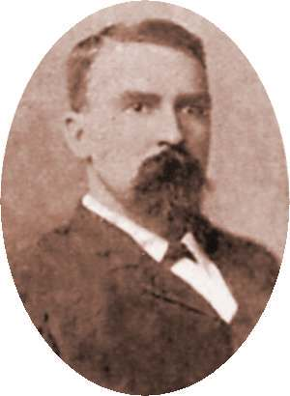
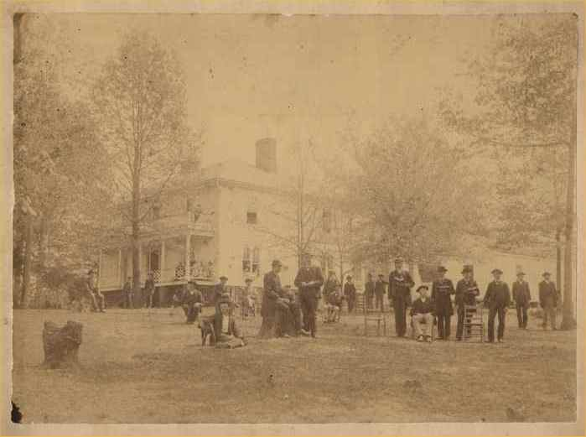
The Influence Of John Taylor
Rock Creek Church Of Christ
Gus Nichols
T.B. Larimore
Near Russellville, Alabama
1892-1975
1843-1929
Mars Hill Bible College
F.D. Srygley
F.B. Srygley
1859-1940
1856-1900
Florence, Alabama 1871-1887

Slide 7
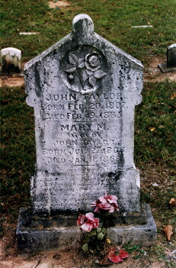
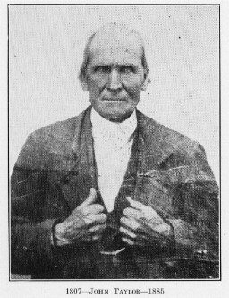
John Taylor Born: Feb. 20, 1807 Died Feb. 19, 1885 Mary M. wife of John Taylor Born Jul. 27, 1808 Died Jan. 11, 1868 In great poverty and through bitter persecution John Taylor Preached the Gospel in Ala. and Miss. from 1830 to the time of his death. This stone is erected by his brethren of the Lord as a token of their appreciate ion of his labors as a Father and Minister in the Church of Christ

Slide 8
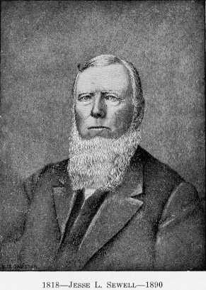
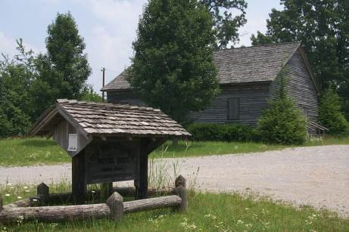
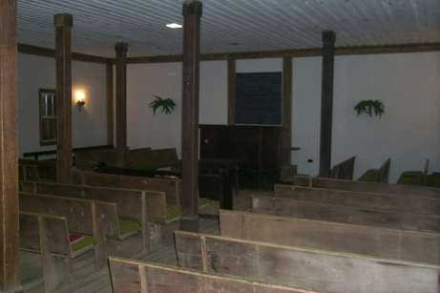
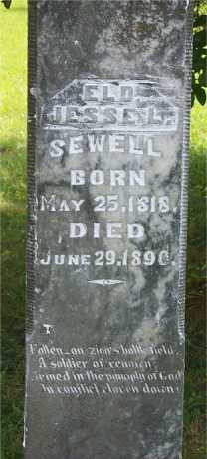
Old Philadelphia, Viola, Tennessee
Jesse L. Sewell
1818-1890

Slide 9
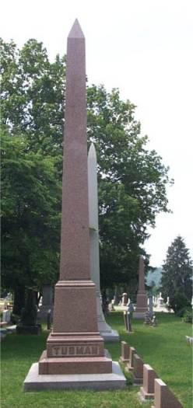
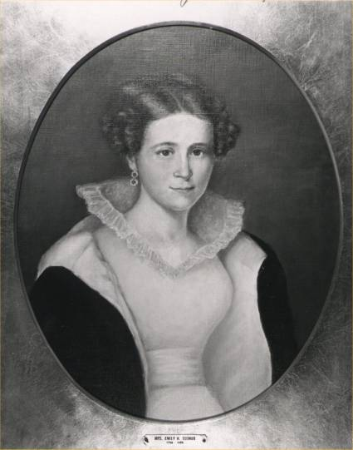
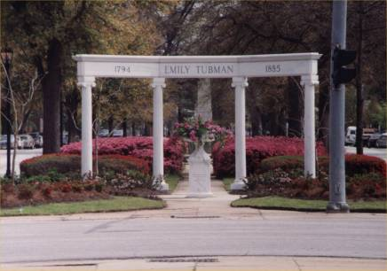
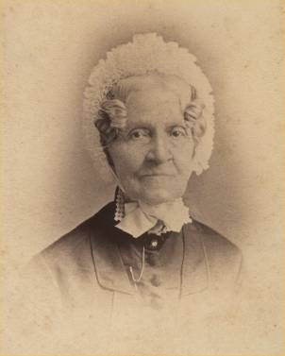
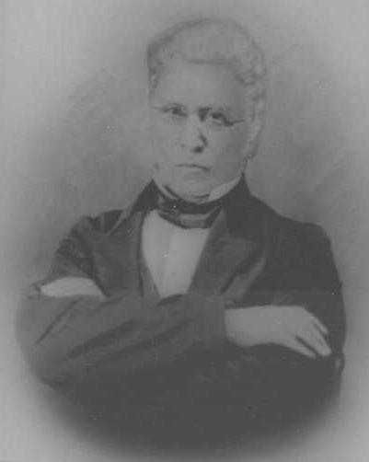
Other Work In Georgia
Emily H. Tubman
Dr. Daniel Hook

