Slide 1
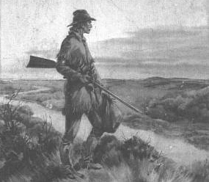
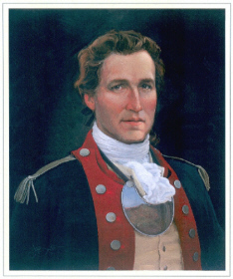
The History Of Benjamin Lynn
  Born In Chester County, Penn.
  4th Child Of Irish Parents, Andrew Lynn, His Father
  Was A Slender, Dark-Skinned Man, With Blue Eyes, His Height Was 5’10”
  Very Fine Marksman, Lived Among The Shawna & Delaware, Maumee and Kickapoo Indians Four Years – Learned Their Languages
  As A Trapper He Became Aware Of All The French Settlements East And West Of The Mississippi
  Went To Fort Pitt, (Now Pittsburgh) And Became Good Friends With George Rogers Clark
  Served Clark As Spy For His Army Until Clark Came To The Falls Of The Ohio, Where Lynn Was Given The Rank Of Captain.

Slide 2
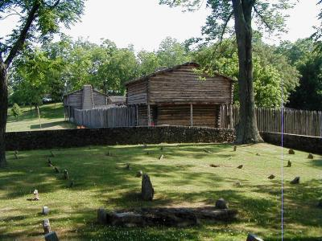

The History Of Benjamin Lynn
  Seventeen Men Placed Under Him, And He Was Sent To Fort Harrod, Kentucky - 1772
  During Revolution Helped The Settlers At Ft. Harrodsburg Against The Indians
  1779 Married Hannah Soverigns, Then Learned To Read – His Text Was The Bible At Harrod’s Station
  To Bardstown, KY, In 1780
Ft. Harrod
Harrodsburg, Kentucky

Slide 3
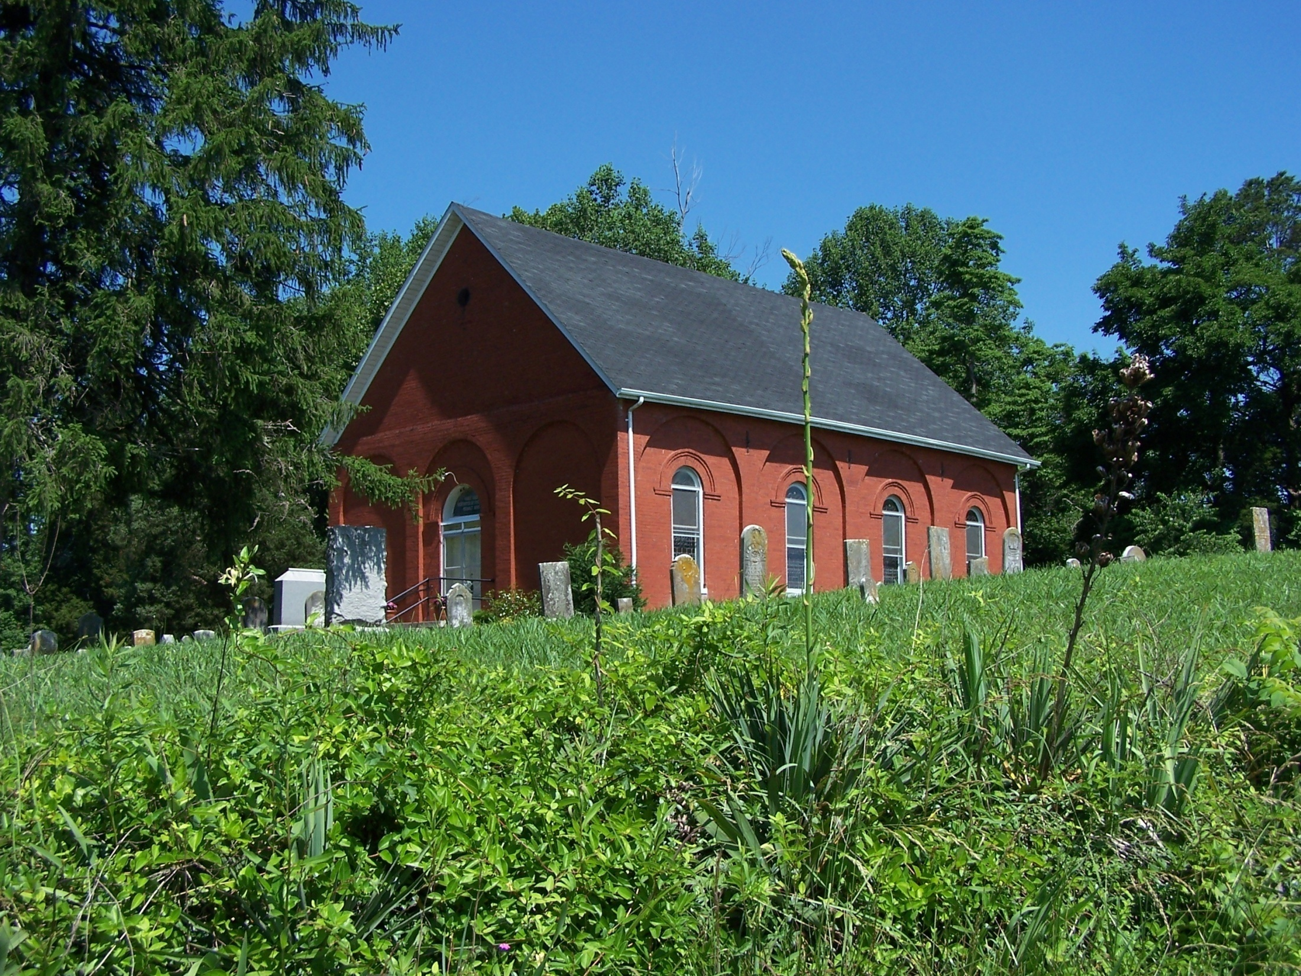
  1782 Lynn Formed A Separate Baptist Group - Baptized Seven People In Nolin Creek, Believed To Be The First Baptisms In Kentucky

Slide 4
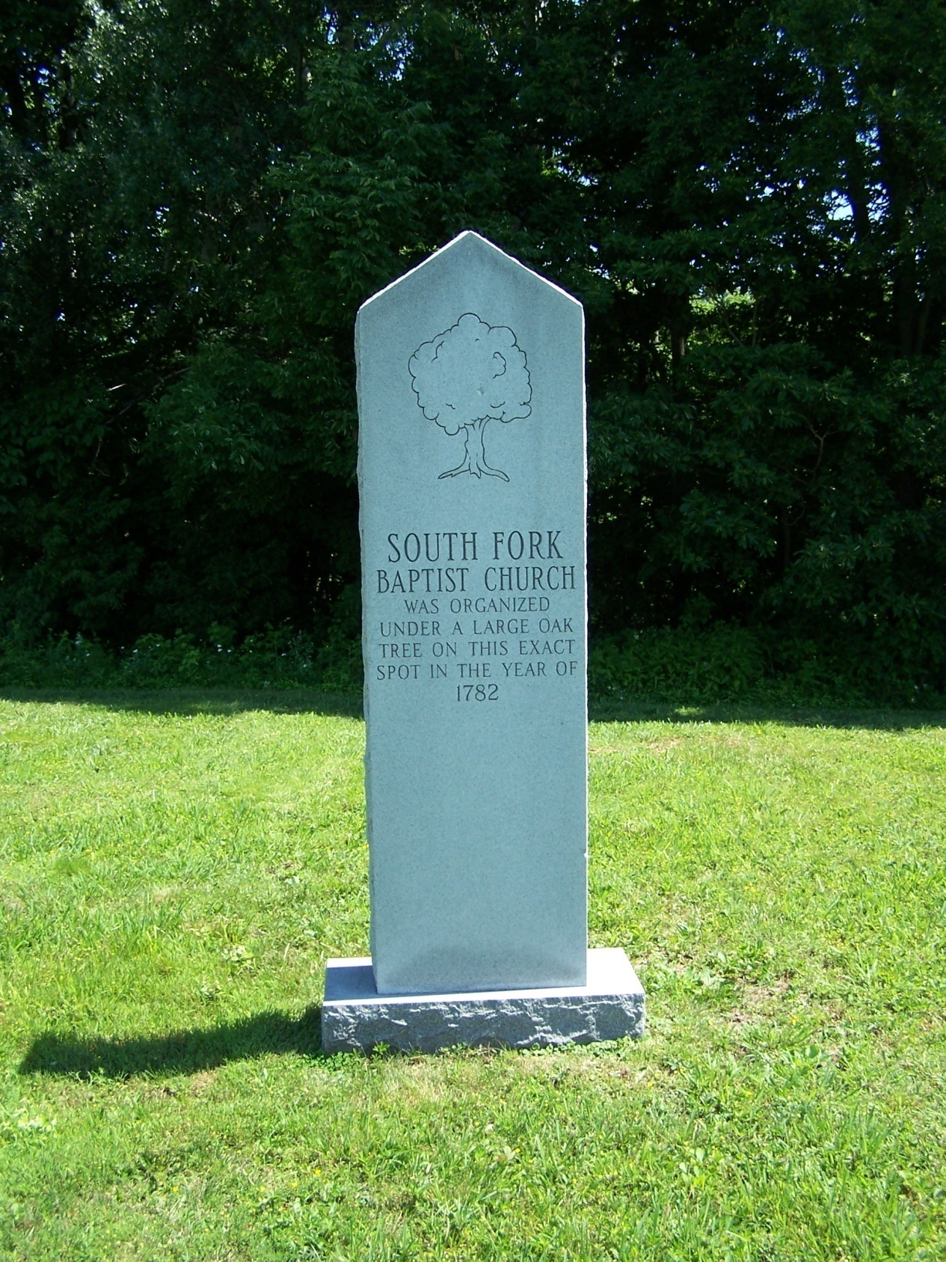
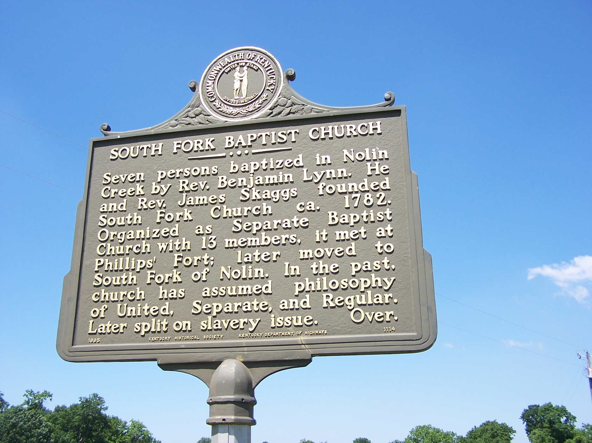

Slide 5
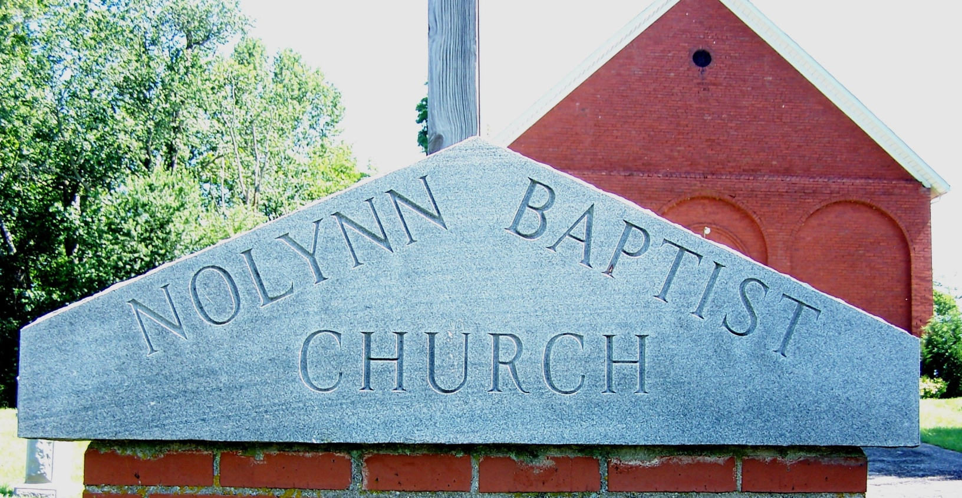
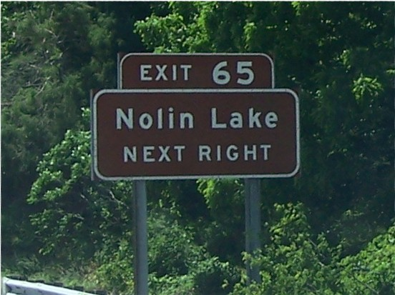

Slide 6
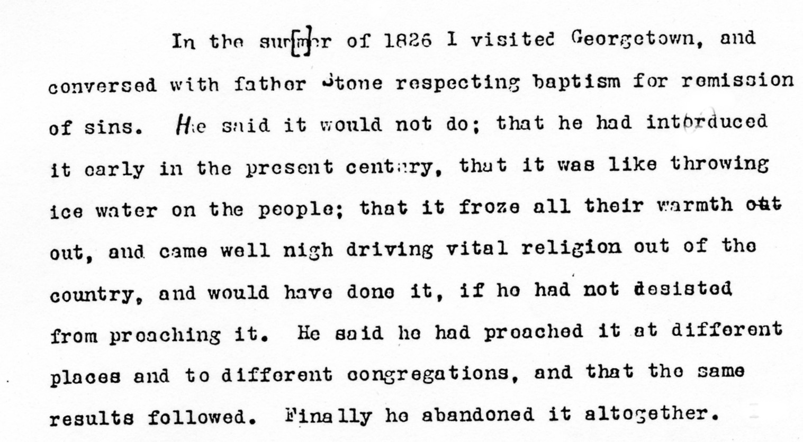
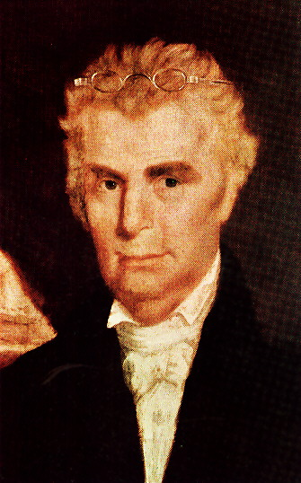
In 1805 Lynn learned of Barton Stone and his work at Cane Ridge.
i. Stone was immersing and he was
not a Baptist.
ii. Lynn traveled to Cane Ridge at
Stone baptized him.
iii. B.F. Hall reflected in his journal.

Slide 7
The History Of Benjamin Lynn
Moved To North Alabama With Family – About 1810
He Was Alabama’s First Located Preacher
That Year Organized A Church In North Part Of What Is Now Huntsville, Alabama
Wife Died in May, 1814, Huntsville, Alabama
Died December 23, 1814 – In The Home Of John & Esther (Lynn, 2nd Dau.) Chisholm, Buried On Church Cemetery Ground, Present Location Unmarked On The Campus Of Alabama A&M.

Slide 8
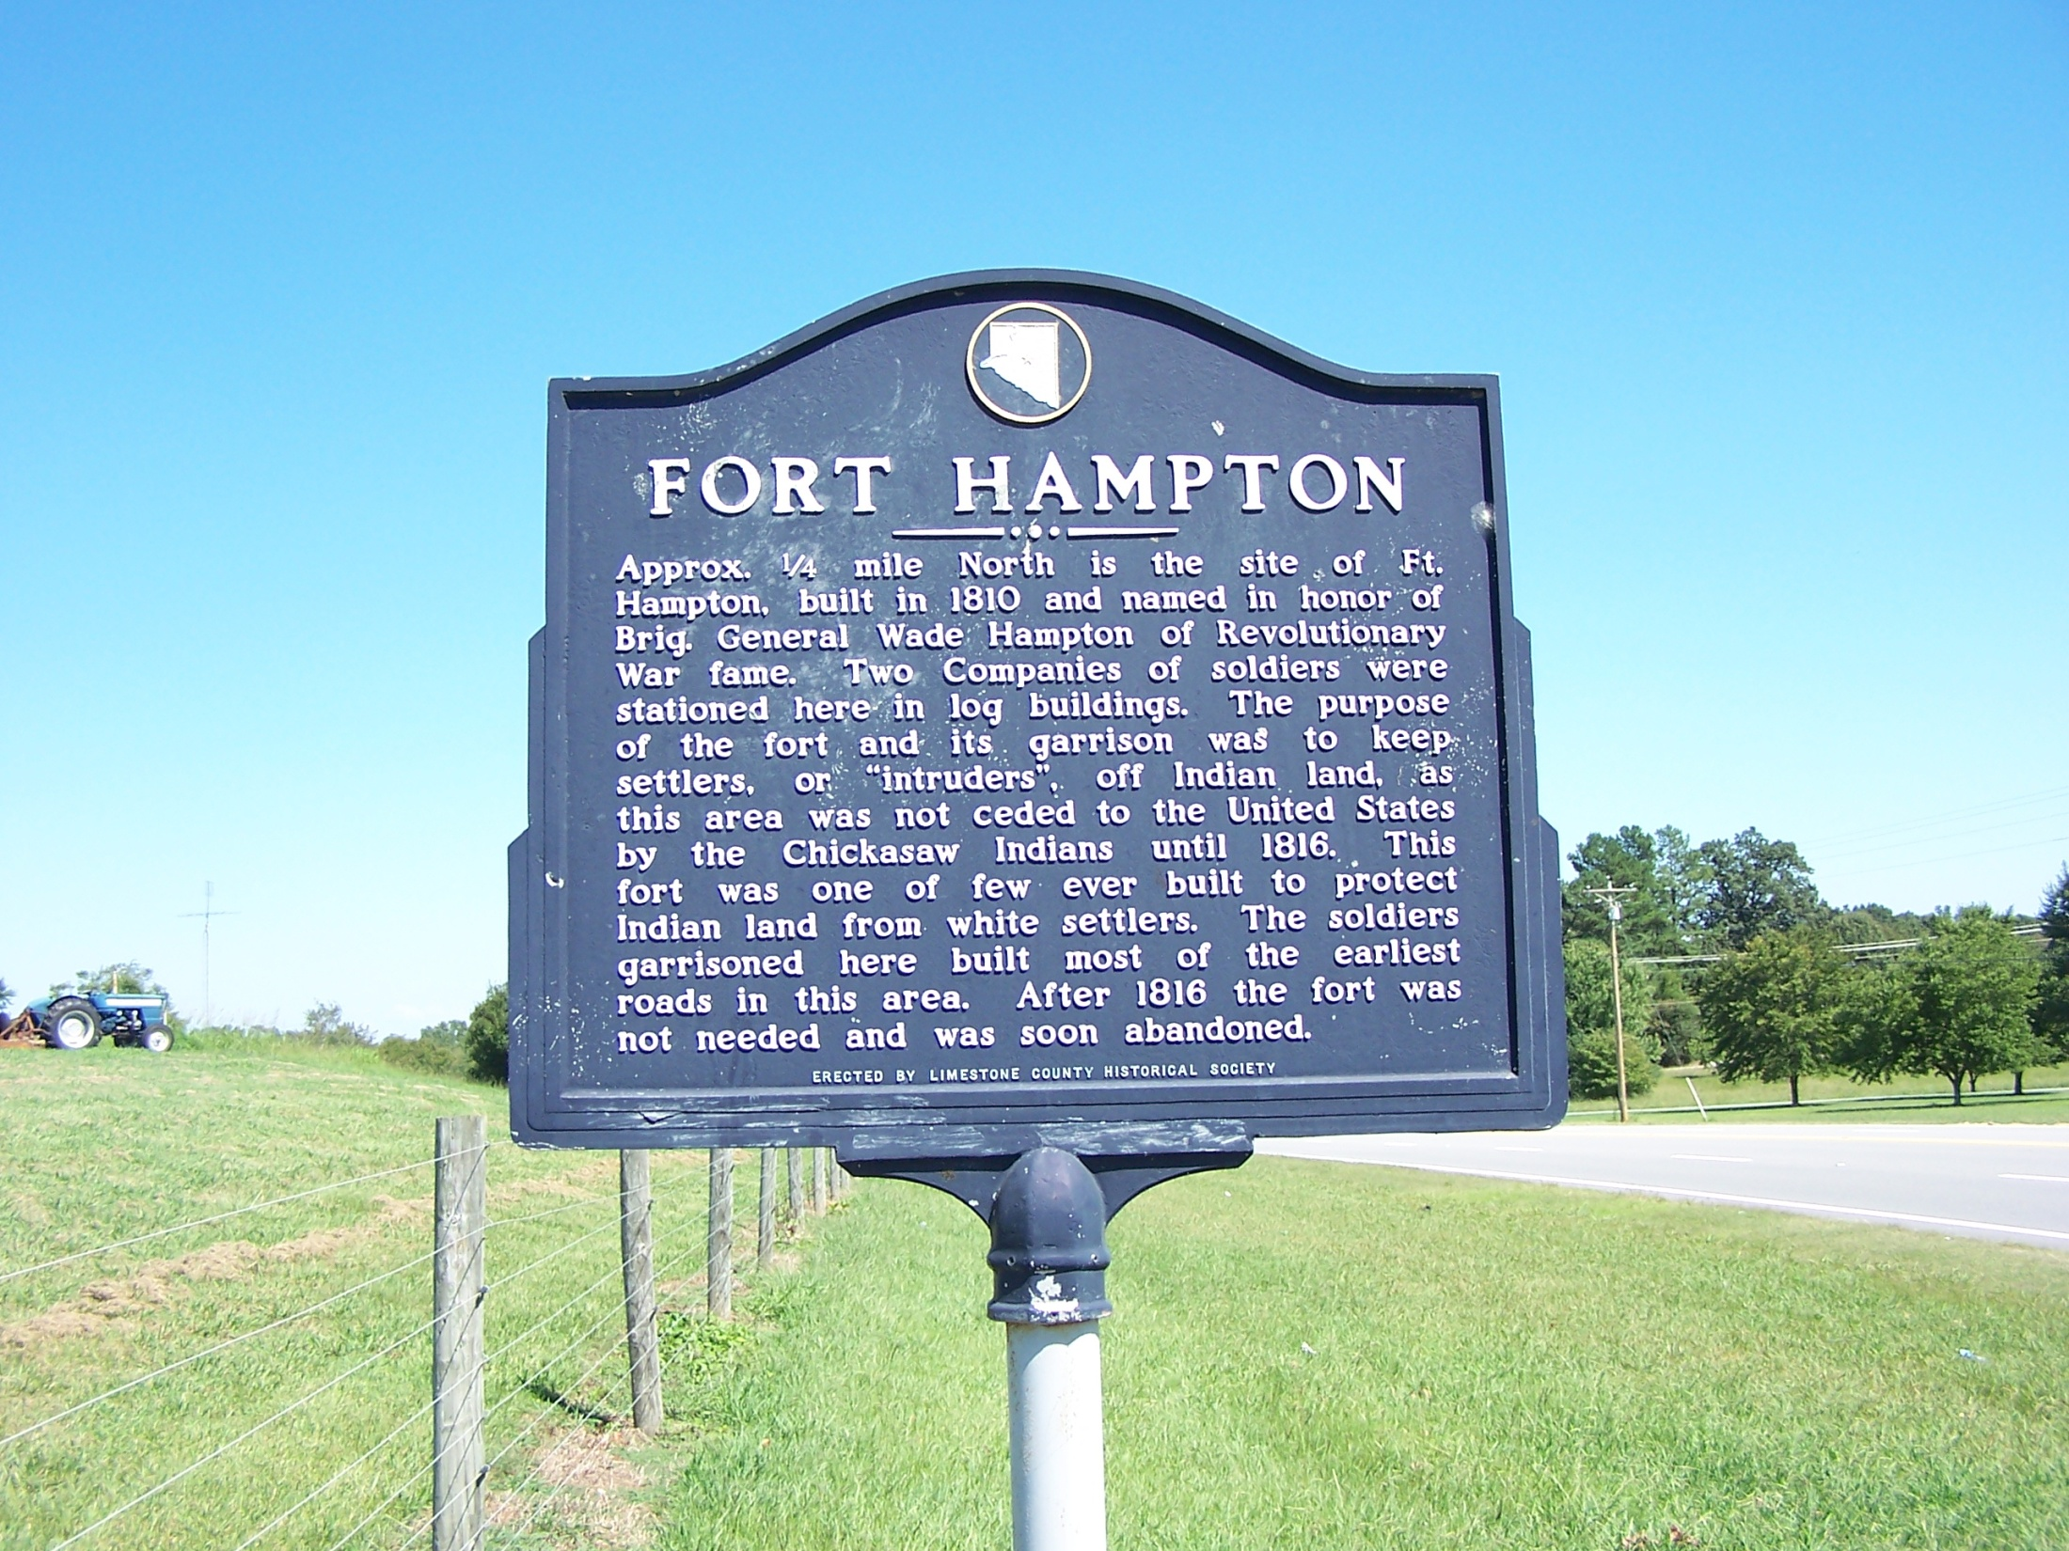

Slide 9
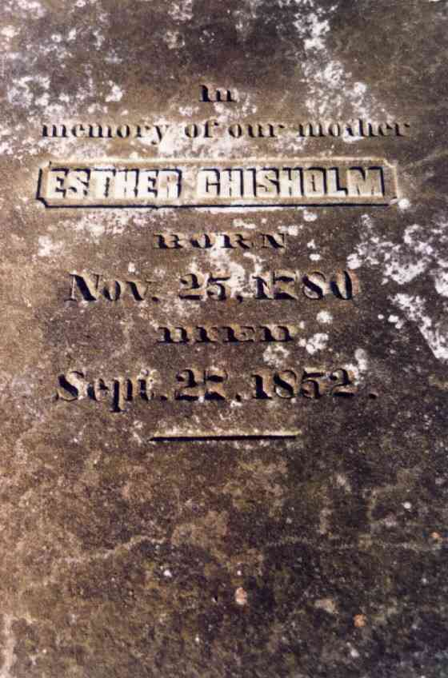
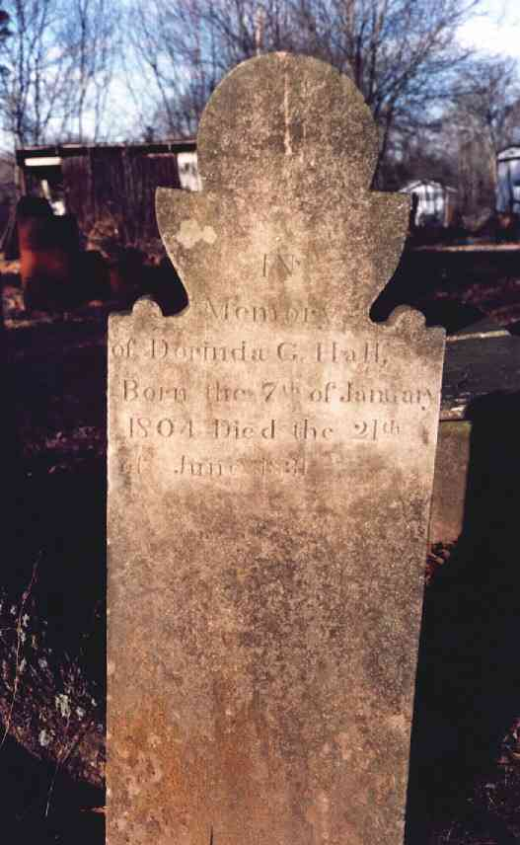
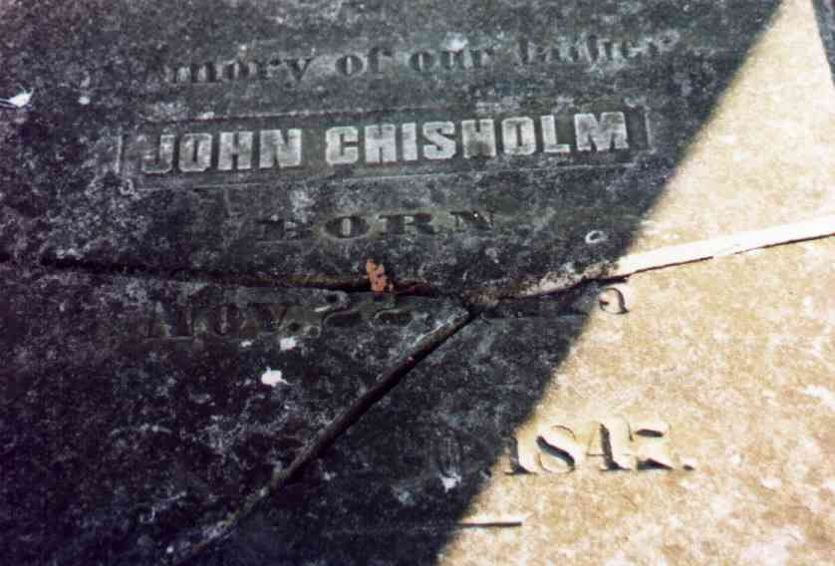
The History Of Benjamin Lynn
The Family Without Lynn
When Legalization Of Settlement In Northwest Alabama Came Open, in 1816, The Chisholms Moved To About Seven Miles North Of Florence & Began Worshipping In Their Home
By 1824 A Congregation Was Planted On Cypress Creek – Called Old Republican. Today, The Oldest Continuous Church of Christ In N.W. Alabama, Now The Stoney Point Church Of Christ
The Chisholm Graveyard Is The Oldest Cemetery In N.W. Alabama
Grave Of Dorinda Chisholm Hall, Wife Of B.F. Hall

Slide 10
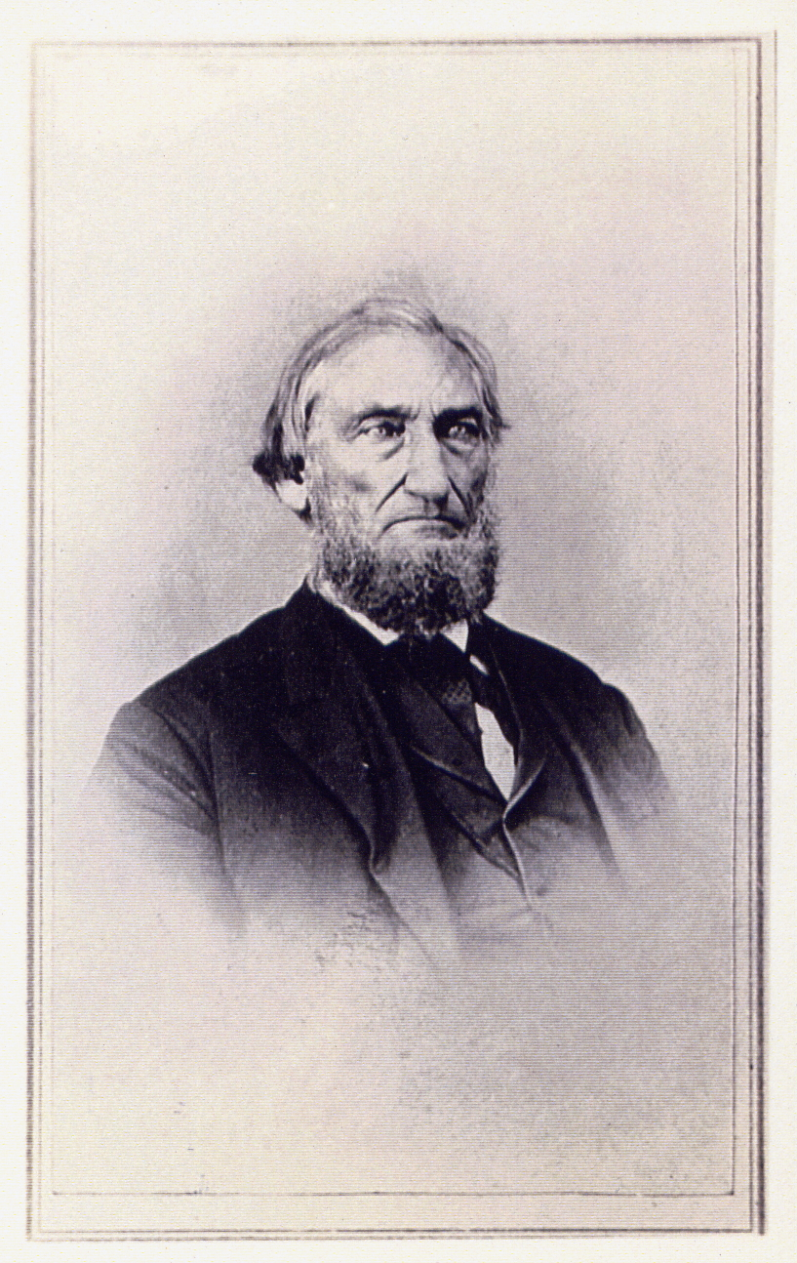

Slide 11
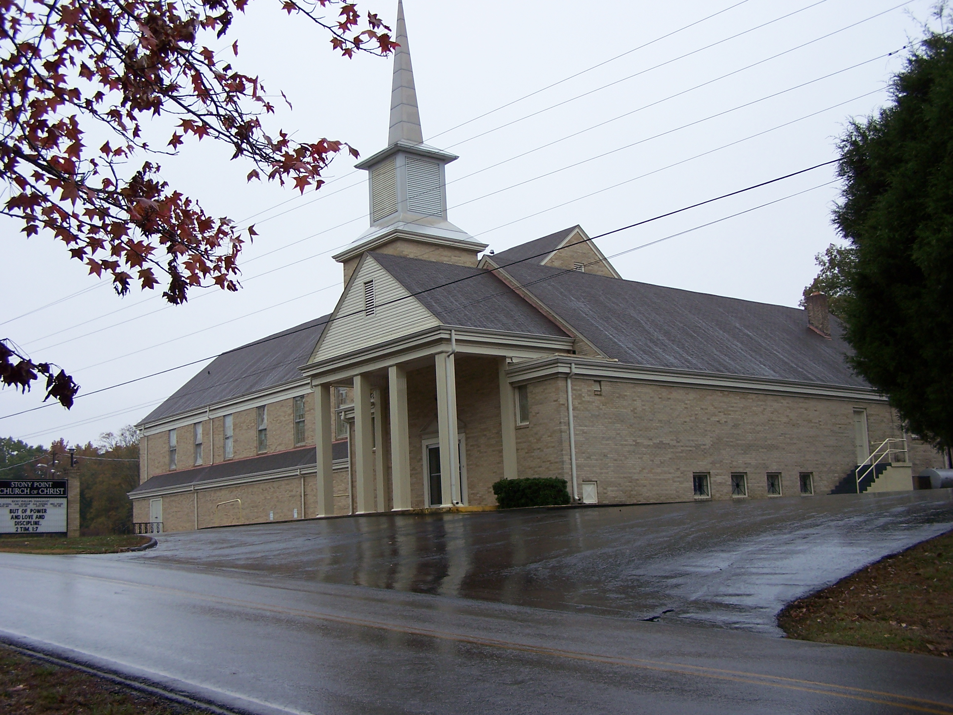

Slide 12
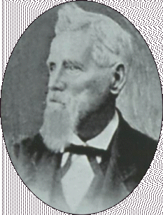
Church In Waterloo, Alabama Grows
Another Of Lynn’s Daughters, Rachel Married Marshall DeSpain & Moved To Waterloo, Alabama
In 1826, The Church Of Christ At Waterloo Was Established.
While In Waterloo, A School Teacher In The Community, Mansil W. Matthews, Taught The Daughter Of The DeSpains, Hetty.
The DeSpains Taught Him The Gospel & He Was Baptized For The Remission of His Sins, Very Soon Thereafter Began Preaching (brother James preached at Old Republican)
Matthews And Lynn DeSpain, Son Of Marshall & Rachel, Were The Preachers For The Congregation
Dr. Mansil W. Matthews
1806-1891
Buried At
Paradise, Texas
Notes:
During the battle of San Jacinto, General Sam Houston was injured. The doctor that treated him was Dr. Mansil W. Matthews.
Served in the 1st and 7th congresses of the of the Republic of Texas.
During the war he was a firm unionist, and barely escaped a vigilanty attempt on his life by some southern sympathizers.

Slide 13
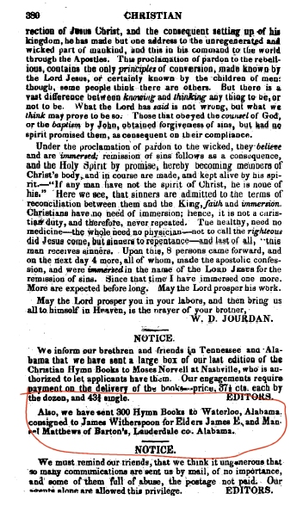
Lynn’s Influence In NW Alabama
1830 The Church Ordered 300 Songbooks From Barton W. Stone’s Publishing House. Mentioned In Christian Messenger Vol. 6 #12 Dec. 1832 page. 380
Marshall Died, And Is Buried In Waterloo, Ala.

Slide 14
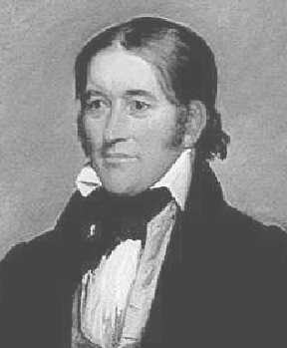
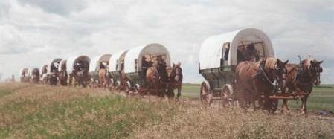
N.T. Christianity Comes To Texas
According To 1936 Document Prepared By Jewell Matthews, Descendant of Dr. Mansil Matthews, Cheap Land In Texas Prompted Nearly The Whole Town To Desire To Move To Texas
The Church Left Waterloo In 1835
It Was A Church On Foot, On Wheels, & On Horseback
Leading Them Was David Crockett
Slow Travel, With Sundays Set Aside For Worship, Crockett Left The Group At The Mississippi River
Crocket Passed Among The Campers, Greeting Each Man, Woman And Child; Left With Them And Affectionate Farewell, Mounted His Noble Bay Charger, Accoutered For Battle, And Waved His Cap, Halloed, ‘Hurrah For Texas,’ As He Galloped Away At The Head Of Some Sixty Volunteers For The Texas Army! Off They Went To The Alamo
David "Davy" Crockett
(1786-1836)

Slide 15
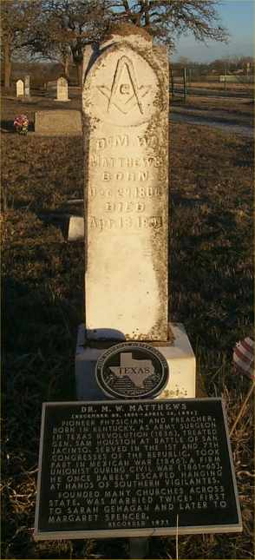
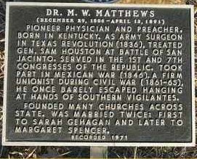
The Church of Christ In Texas
Later Dr. Mansil Matthews Would Take Part In The Fight For Texas
He Joined Sam Houston’s Fighters As A Doctor, Administering Medical Aid To Houston When Santa Ana Was Captured at Battle of San Jacinto.
Still Later, Matthews Served As Member Of The First Congress Of The Republic Of Texas, October, 1836
The Church Was Established In Clarksville, Texas January 17, 1836
After A Year The Group Moved South To Nacogdoches County And Planted A Church – 1837
Here Joseph Addison Clark Met Hetty DeSpain And Found New Testament Christianity As Well.
Dr. Mansil Walter Matthews Died At Paradise, Texas, Apr. 13, 1891, 86yrs., Having Preached The Day He Died
Dr. Mansil W. Matthews
1806-1891
Buried At
Paradise, Texas

Slide 16
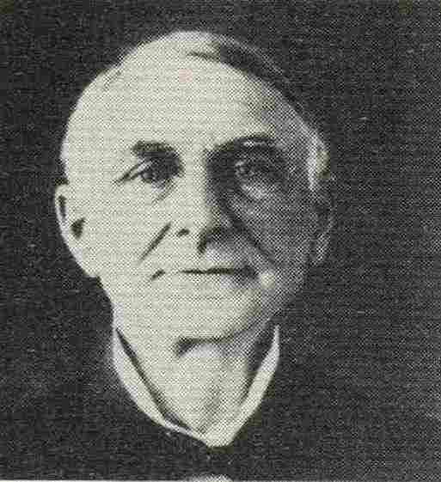
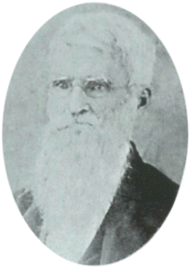
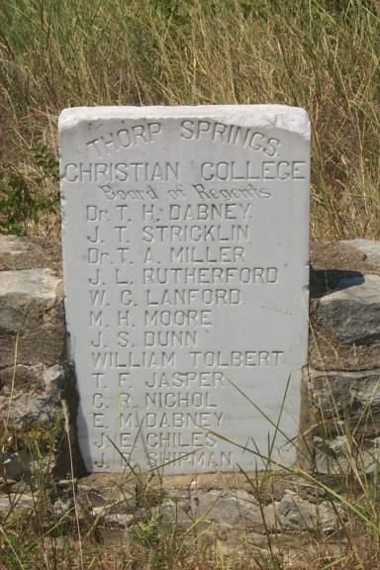
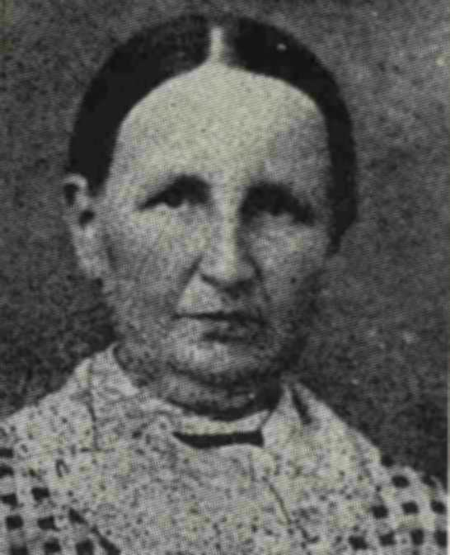
Work Of Joseph & Hetty Clark
Joseph Addison Clark
Moved To Thorpe Spring And Started The Church Of Christ
Had Two Sons, Addison & Randolph
Started A School At Thorpe Spring Called AddRan College
Later Became Known As Texas Christian University
1815-1901
Hetty Clark
1824-1924

Slide 17
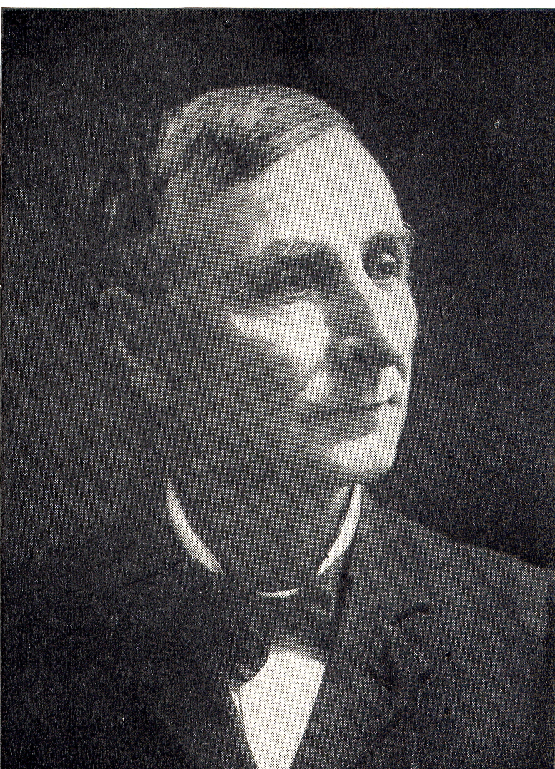
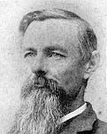
Addison Clark
Randolph Clark

Slide 18
Incident At Thorpe Spring
The Instrument Of Music Began Entering Worships Assemblies Around 1860
1894, The Sons Of Clark Desired To Bring It In At Thorpe Spring Much To The Strong Reservations Of Joseph Clark
Tuesday Night, February 20, 1894, B.B. Sanders, A Minister Who Favored The Instrument Was Involved In A Gospel Meeting.
A Petition Was Signed By 139 Members Of The Congregation Saying They Did Not Want It, Even Having The List Read
Before Meeting Began Joseph Clark Stood And Prayed A Prayer For Unity
As Addison Clark, Directing The Worship, Said The Students Had Been Promised Instruments And They Were Going To Have Them, Turning He Looked At Miss Bertha Mason, The Pianist, And Said, “Play On, Miss Bertha!”
When It Was Introduced Brother Clark, Now In His 80s Departed The Assembly With 2/3 Of The Congregation
The Church Of Christ Was Re-established Across The Street.

Slide 19
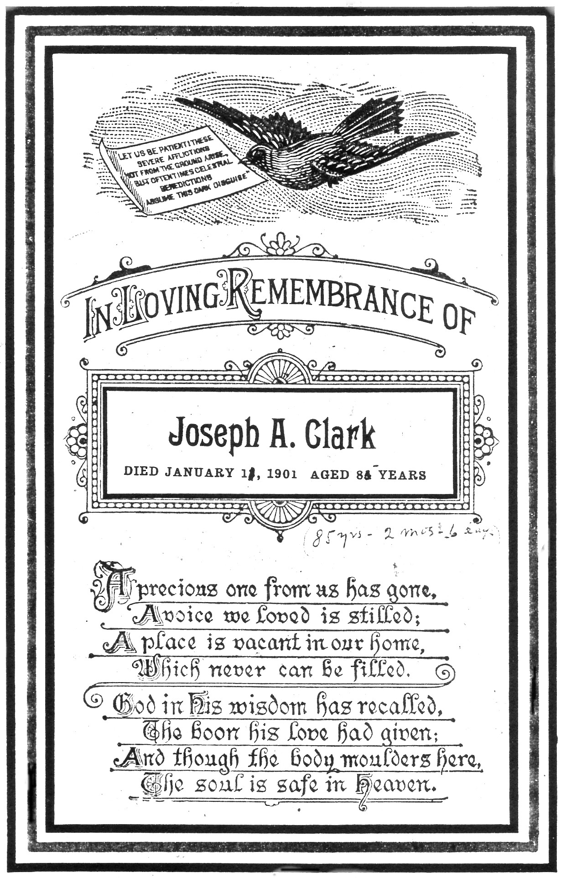
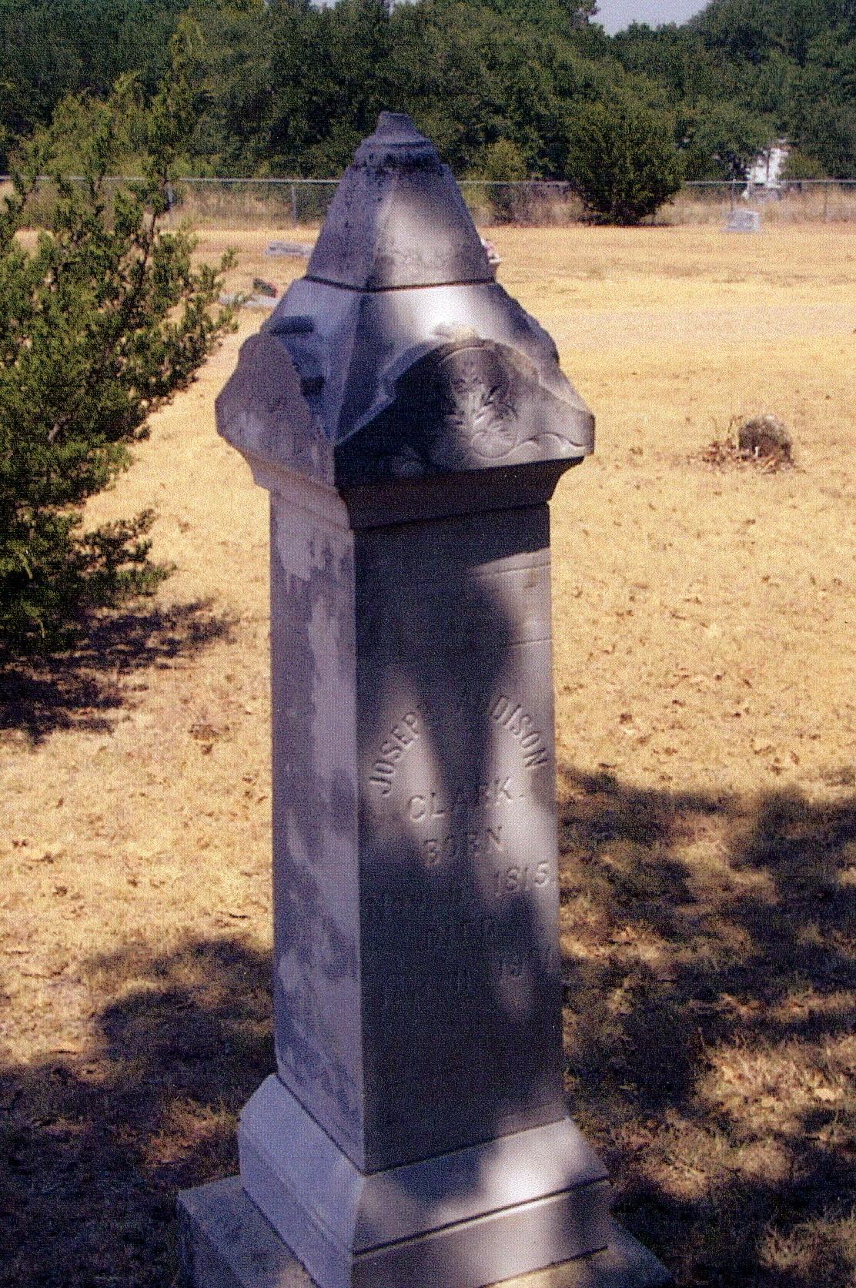

Slide 20
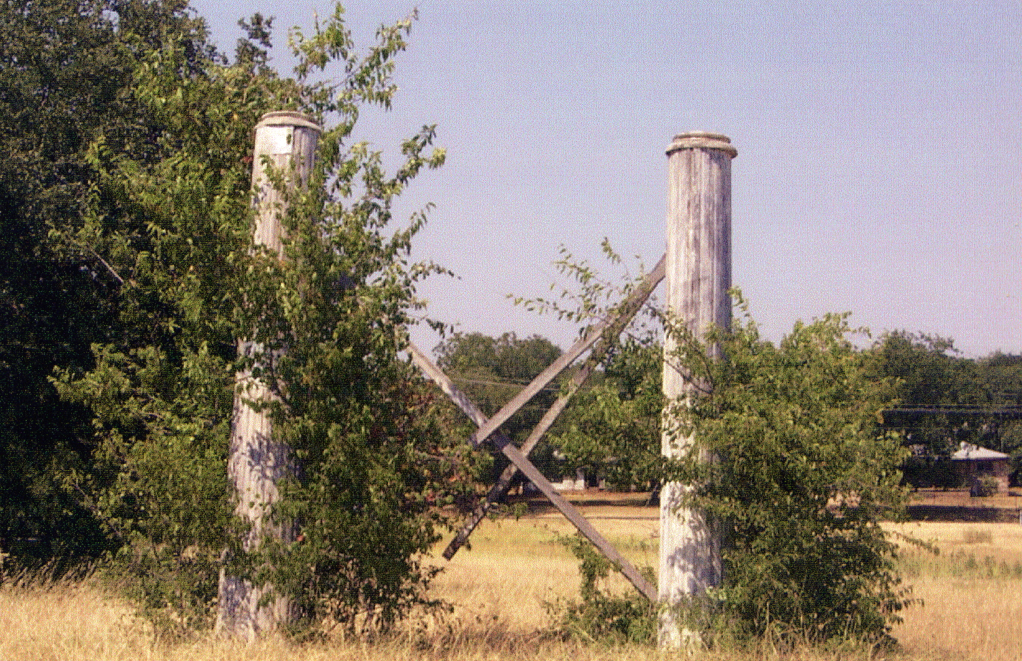

Slide 21
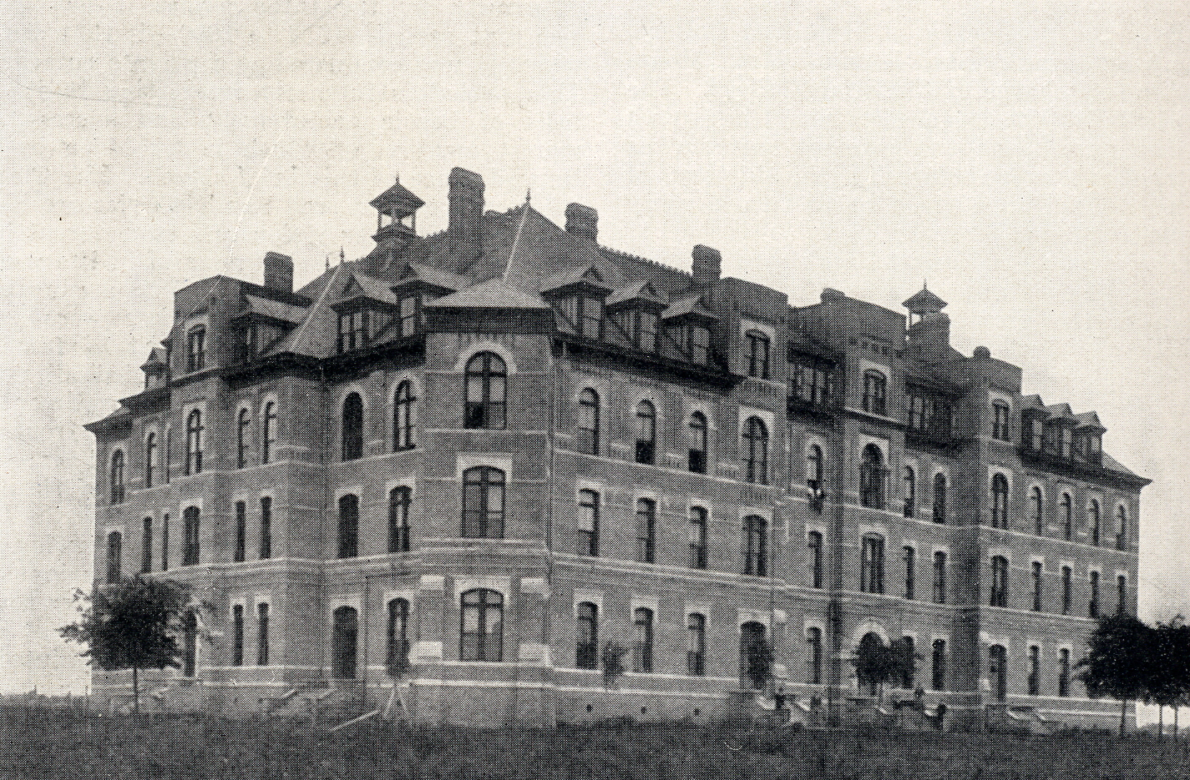
Notes:
TCI in Waco, Texas

Slide 22
