Slide 1
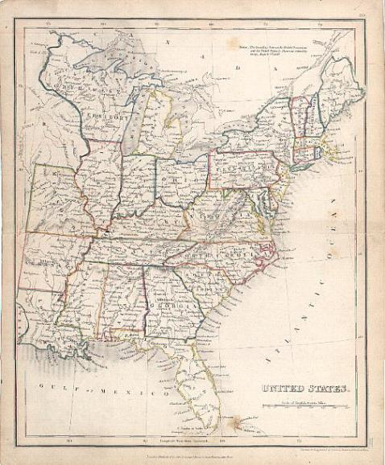
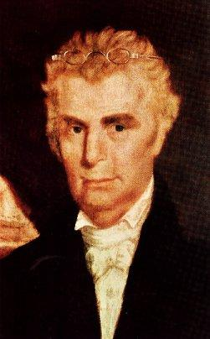
The Work And Influence Of Barton W. Stone

Slide 2
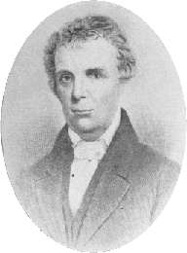
Barton Warren Stone
Born In 1772 – Port Tobacco, Maryland
Father Died When He Was Young
Moved South During His Youth
During Revolutionary War, He Lived In Alamance County, North Carolina When Cornwallis Met General Green At The Battle Of Guilford Courthouse, Though 30 Miles Away Could Hear The Sounds Of Artillery Causing Great Fear
At The Age Of 15 or 16 He Decided He Wanted To Be Educated To Become An Attorney
Feb 1, 1790, Age 18, Attends Doctor David Caldwell’s Guilford Academy

Slide 3
David Caldwell 1725-1821
Born In Lancaster County, Pennsylvania, March 22nd, 1725
Graduated from Princeton in 1761
Licensed To Preach By The Presbytery Of New Brunswick, June 8th, 1763
1765 While Doing Mission Work In North Carolina, He Started A Log Cabin School In Guilford County
1766 Married Rachel Craighead, Daughter of Presbyterian Minister, Alexander Craighead
1768, He Was Installed As Minister Of The Two Presbyterian Churches In Buffalo and Alamance Settlements
1769 Began His Academy At Greensboro, N.C.
During Revolutionary War, Gen. Cornwallis offered a £200 Reward For His Capture For Speaking Out Against The Crown – Home Destroyed By Fire, Including Library By British
1776, Member Of The Convention That Formed The Constitution Of The State Of North Carolina
1789 When University of N.C. Was Chartered Caldwell Was Offered The Presidency

Slide 4
David Caldwell 1725-1821
His School Sent Out Over 50 Preachers, 5 Governors, Congressmen, Physicians, Lawyers & Judges
1790 – 65 Years Of Age When B.W. Stone Became Student
Continued To Preach In His Two Churches Till The Year 1820
Preached Often At Hawfields Church Where B.W. Stone Was Later Ordained Into Orange Presbytery
He died August 28th, 1824

Slide 5
Barton Warren Stone
Studied The Languages – Believed That The Hebrew & Greek Languages Were The Choices Of God To Deliver His Message To Man, Therefore His Honor To Study
Got Religion
Upon Arrival, Not Interested In Religion, Just Wanted To Study Law
Just Before Arriving Most Of Student Body Had Been Converted To Presbyterianism At The Preaching Of William Hodge
1791, February — Heard James McGready, Who Left Him Cold And Religiously Detached
In The Spring, Got Religion At The Milder Preaching Of William Hodge, (Graduate of Caldwell’s School) At Hawfields Presbyterian Church - Sprinkled

Slide 6
Barton Warren Stone
After Graduation, Though Leaning To The Ministry, He Rejected It Initially Choosing To Visit His Brother In Washington, Georgia
Offered To Taught At Succoth Academy, In Washington, Georgia For One Year
Influenced By Principal, Hope Hull, A Methodist Influenced By O’Kelley In 1795
Was Professor Of Languages
His Notoriety As A Linguist Nearly Caused Him To Turn Away From Religion
1796 Return To N.C. Stone Was Licensed In The Orange Presbytery At Hawfields Church, To Preach
At Ordination William Hodge Took The Bible In Hand And Said Their Greatest Obligation Was To It
Stone Noted That Such Focus Was Not On The Confession Of Faith, But The Bible

Slide 7
Background To The Kentucky Revival
In 1796, 97 Many Denominational Preachers Questioned Their Backgrounds
One Preacher Wrote That His Sin Was Greatest Among Sinners Deserving God’s Wrath
Another Wrote, “If People Are Spotted With Sin, I’m Spotted All Over.”
One Preacher Thought The World Was Doomed Waiting On The Wrath Of God To Be Revealed
Others Thought Themselves Unworthy Of Any Blessing From God
Everyone Was Doomed And There Was Nothing That Could Be Done About It
These Were The Result Of Calvinism In Presbyterian Teaching In Kentucky In Late 18th Century

Slide 8
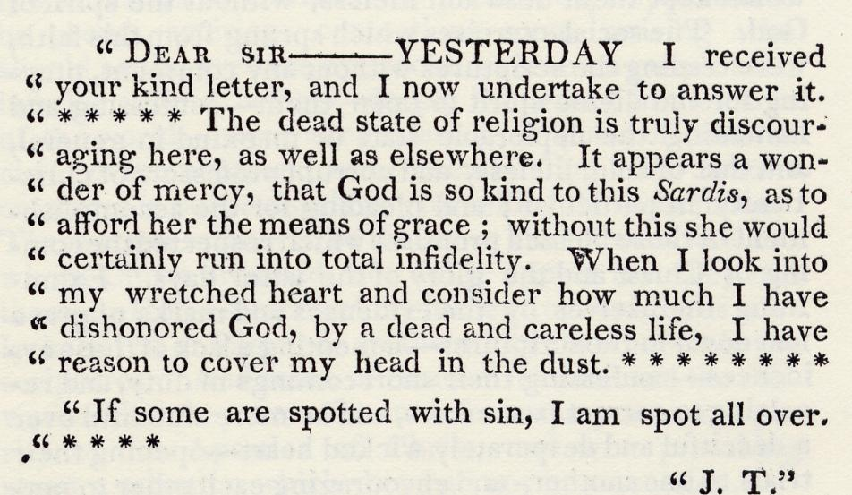
Background To The Kentucky Revival

Slide 9
Background To The Kentucky Revival
Spiritual Conditions Prior to the Cane Ridge Revival
William Dorchester said that it was… “the darkest period spiritually and morally in the history of the United States.”
Letter To Richard McNemar

Slide 10
Kentucky Revival & James McGready (1760-1817)
A Different Kind Of Presbyterian Minister
Born In Pennsylvania, Moved To Guilford County, N.C. After Revolutionary War
Attended David Caldwell’s School
Very Dramatic In His Preaching
Moved To Logan County, Kentucky, 1796
At Meetinghouses On Gasper & Red Rivers
Peter Cartwright, A Methodist Minister Called It “The Devil’s Den”
Outcasts From Society Moved There For Its Location – Good Hiding Places, Escape Law In Tennessee
His Preaching
Repentance, Not Baptism For Remission Of Sins
If All Can Repent, Then Calvinism’s Predestination Fails
People Responded!!!!!
Mainline Presbyterians Rejected Him
Fall Of 1800 – Revival Brought Many Onlookers – One A Young Presbyterian Minister Named Barton W. Stone.

Slide 11
Red River Meetinghouse Logan County, Kentucky Birthplace Of The Kentucky Revival

Slide 12
Barton Warren Stone
Moved To Cane Ridge, Kentucky In 1797 Where He Accepted Positions Of Pastor For Concord & Cane Ridge Churches
Concerning His Ordination Into The Transylvania Presbytery, He Was To Swear Allegiance To The Westminster Confession Of Faith
Stone Said, “I Do In As Far As It Agrees With The Bible”
Heard Of And Visited The McGready Revival In Logan County, Fall, 1800
Returned To Cane Ridge And Preached A Lesson On John 3:16
July 2, 1801 – Married Elizabeth Campbell At Greenville, Ky.

Slide 13
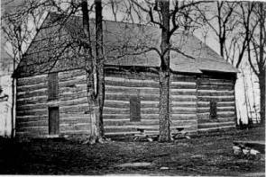
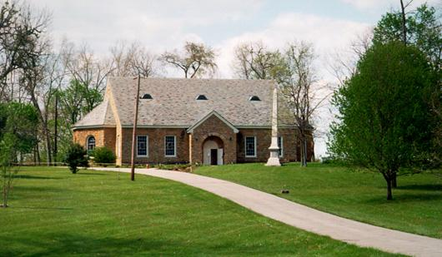
Cane Ridge Revival August 14-19, 1801
Area Settled In The Mid 1700s By Daniel Boone And Group From North Carolina
1791 – Built Largest One–Room Log Cabin In America
Between 15 & 25,000 People Gathered From All Denominations
Many Got Religion, Repented Of Sin And Confessed The Lord
Different Preachers Would Get Up On The Back Of Wagons And Speak To Groups In Their Area
People Left When Food Ran Out At The End Of Six Days

Slide 14
B.W. Stone Battle With Calvinism
Continued On Next Slide

Slide 15
B.W. Stone Battle With Calvinism

Slide 16
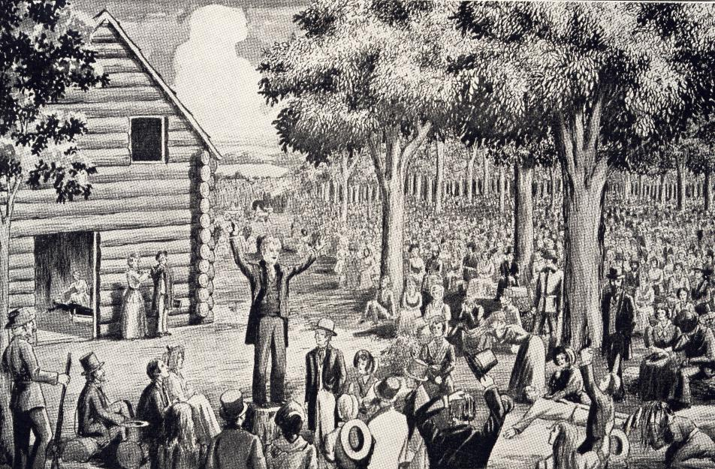
Cane Ridge Revival

Slide 17
The Focus Of The Revival
Some Falsely Claim That The Focus Of The Cane Ridge Revival Was To Achieve A Religious Experience. See Stone’s Purpose In The Revival From His Autobiography
Bodily Functions Among Some In Attendance, Called “Exercises” Included Uncontrollable Dancing, Jerking, Running, Barking, Laughing, Etc.,
Stone Found Them Strange And Unexplainable. He Gave God The Praise And Pressed Forward With His Anti-Calvinistic Mission Of Preaching & Teaching The Gospel That Must Be Responded To In Order To Receive Its Blessings

Slide 18
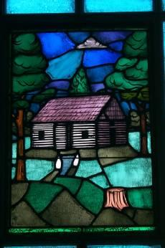
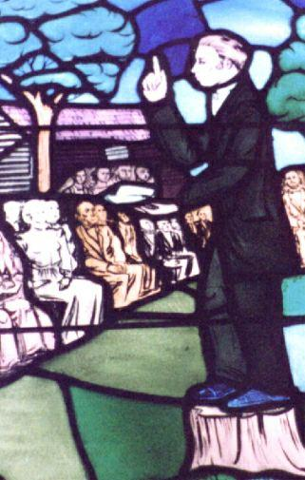
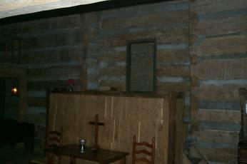
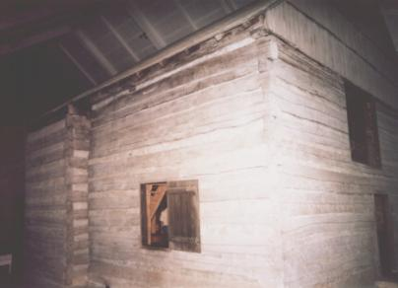
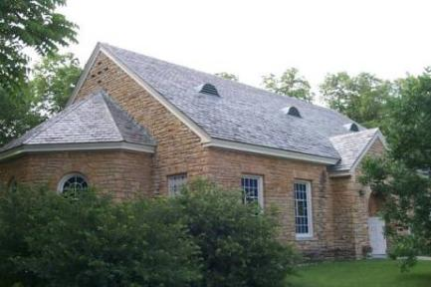
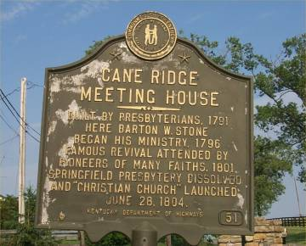
Cane Ridge Meetinghouse

Slide 19
Aftermath Of The Revival
3000 People “Got Religion” At The Revival
Preachers From The Methodist, Presbyterian, and Baptist All Spoke At Cane Ridge
This Brought Old Calvinistic Religion To A Crisis
The Baptists Divided Into Free-Will And Calvinists
The Presbyterians Divided Into New Lights and Old Lights
The Cumberland Presbyterian Church Began In 1810 As A New Light Congregation
This Was What Brought Barton Stone To A Crossroad In His Own Religion, And Caused Him To Begin Searching For New Testament Christianity

Slide 20
Rejection & Restructuring
Rejection
By 1803 Revival Had Died Down Some
Presbyterian Church Put Pressure On Stone To Quit What He Was Preaching
Other Preachers He Influenced: John Dunlavy; David Purviance; John Marshall; Richard McNemar; Malcolm Worley; John Thompson
Either He Was To Preach Presbyterian Doctrine Or Be Excommunicated
Restructuring
These Men Resigned Both Orange And Washington Presbyteries
They Formed The Springfield Presbytery
They Vowed To Preach The Bible Only
In 1804 They Disbanded The Springfield Presbytery

Slide 21
Restoration
June 28, 1804 – The Signing Of The Last Will & Testament Of The Springfield Presbytery
A Call To Preach The Bible Only
A Call To Reject The Westminster Confession Of Faith And All Document Designed By Man
At The Insistence Of Rice Haggard, The Name “Christian” Only Be Used To Designate What They Would Be Called.

