Slide 1
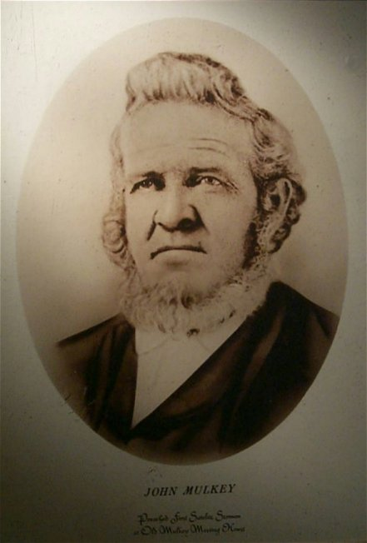
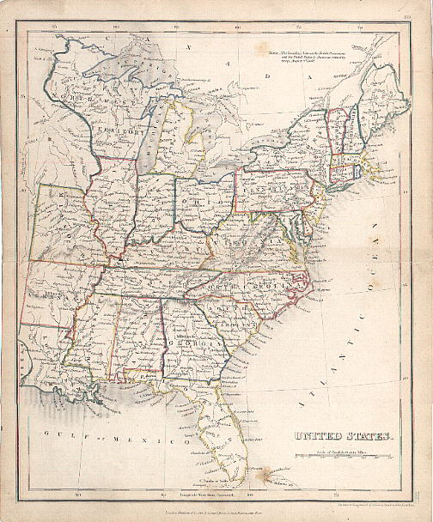
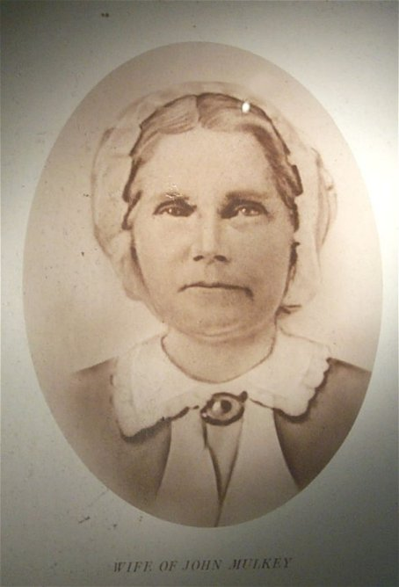
The Work And Influence Of
John & Elizabeth Mulkey
Tompkinsville, Kentucky

Slide 2
John Mulkey
Tompkinsville, KY
1809
Mill Creek Baptist Church, Near Tompkinsville.
John Mulkey, From A Family Of Baptist Preachers, Father Jonathon, Brother Philip
While Preaching From John 10:28 Closed His Bible And Said He Could No Longer Preach Calvinism
He Went Out One Door Of The Building Into The Snow, 2/3 Of Congregation Followed
He Did Not Originally Intend To Restore N.T. Christianity When He Walked Out.
Later He Joined Forces With Barton W. Stone & Others In The “Christian” Movement
Said That In The 53 Years Of His Ministry He Preached 10,000 Sermons And Baptized As Many People

Slide 3
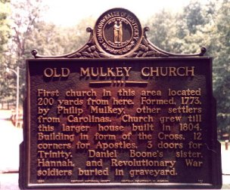
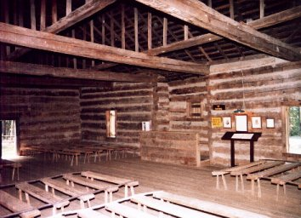
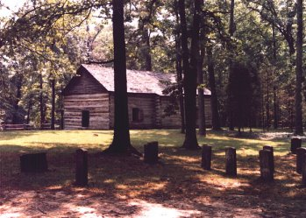
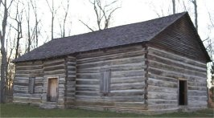
Mulkey Meetinghouse, Tompkinsville, Kentucky

Slide 4
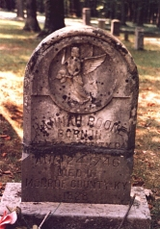
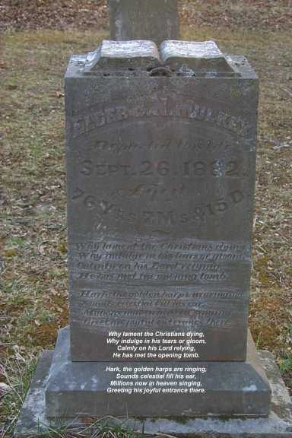
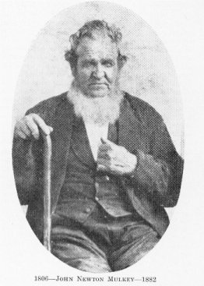
Mulkey Meetinghouse Cemetery

Slide 5
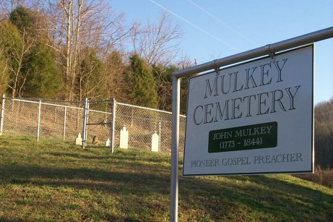
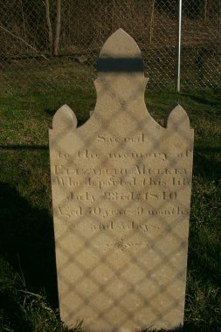
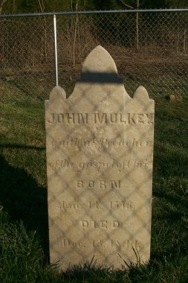
Mulkey Graveyard
Near Tompkinsville,
Kentucky

