Slide 1
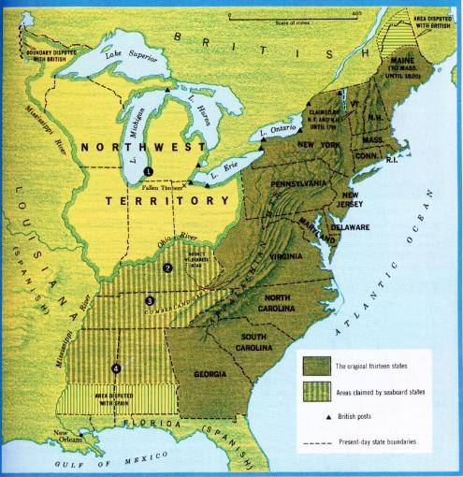
The Influence Of Thomas & Alexander Campbell
1809, Thomas & Alexander Campbell, Bethany, Virginia

Slide 2
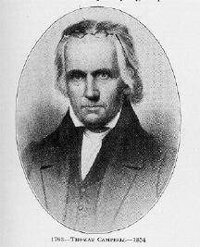
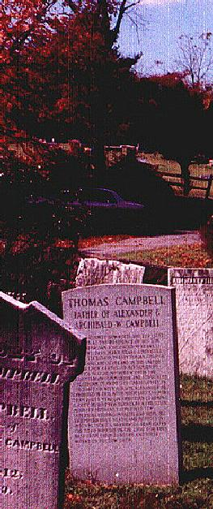
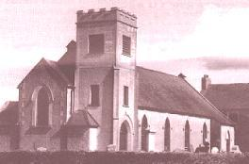
Thomas Campbell 1763 - 1854
The Presbyterian Church in Ahorey, Northern Ireland where Thomas Campbell preached before moving to the United States. The bell tower is not original.
Thomas Campbell born February 1, 1763 in Newry, County Down, Ireland. Arrived here May 13, 1807. A Presbyterian preacher who through study of the Bible saw the need to preach it and live wholly under its authority. Now buried at God’s Acre, Bethany, West Virginia next to his son, Alexander.

Slide 3
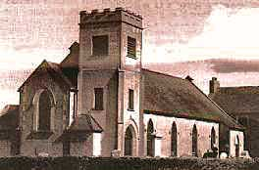
Alexander Campbell Is Born In Ballymena, County Antrim, Ireland, September 12, 1788
Receives A Classical Education From His Father
1807 Teaches School Takes Charge Of His Father's School At Rich Hill, Ireland, His Father Departs For America
1808 Prepares To Depart To America To Join Thomas Campbell
Presbyterian Church In Ahory, North Ireland Where Thomas Campbell Preached

Slide 4
Campbell To Glasgow
Departed For America September 28, 1808 On The Sailing-Vessel Hybernia.
Ship-Wreck Off Scotland Coast October 7, 1807

Slide 5
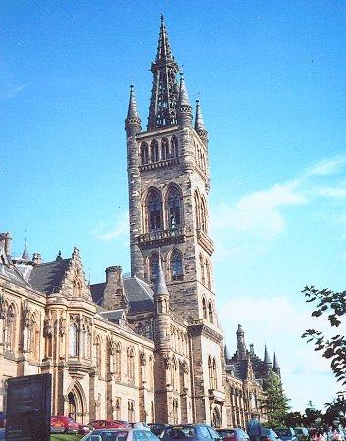
November 9, 1808 Attends Glasgow University, Scotland
Note Later Resemblance To Bethany College

Slide 6
Influences Of Greville Ewing
1767-1841- Born In Edinburgh, Scotland
Taught In Haldane Schools Until 1808
Began Teaching At Glasgow University, One Of His First Students, A. Campbell
Campbell’s Essays On Leadership & Lord’s Supper Led Him To Give Up Presbyterianism

Slide 7
October, 1809 Reaches Washington, Pennsylvania
Reads Proof-Sheets Of The "Declaration And Address"
Devotes His Life To The Plea For Christian Union. "Declaration And Address" Published
1810 Preaches First Sermon, July 15, From Matthew 7: 24-27

Slide 8
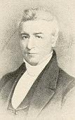
March 12, 1811 Marries Margaret Brown.
May 4, 1811, Christian Association Of Washington Becomes Church At Brush Run
Began To Celebrate The Lord's Supper weekly
June 16, 1st Meeting In New Brush Run Building
1812, Jan. 1st — Ordained To The Work Of The Ministry
1812, March 13th — His Daughter Jane Born
1811, Age 23

Slide 9
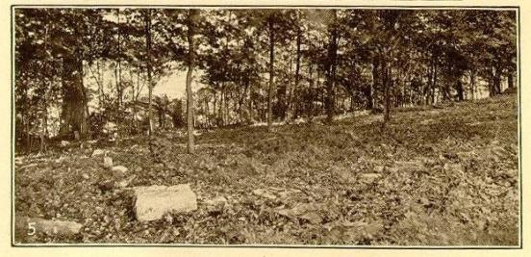
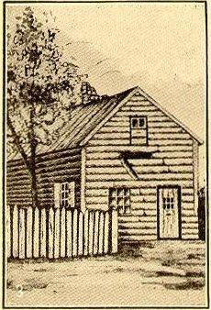
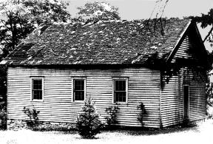
Brush Run 1811-1823

Slide 10
Begins A New Study Of The Subject Of Baptism
June 12, 1812 Immersed By Elder Matthias Luce, Of The Baptist Church, On The Confession Of Faith In Christ As The Son Of God.
Thomas Campbell, Concedes To Him The Leadership Of The Movement At Age 24
Matthias Luce

Slide 11
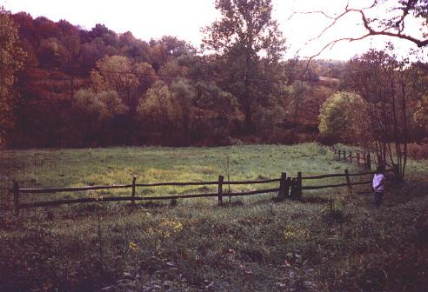
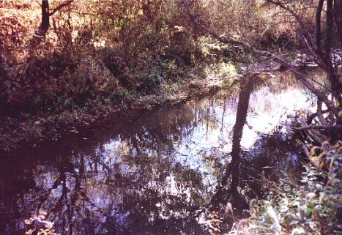
Campbell Baptism In Buffalo Creek June 12, 1812

Slide 12
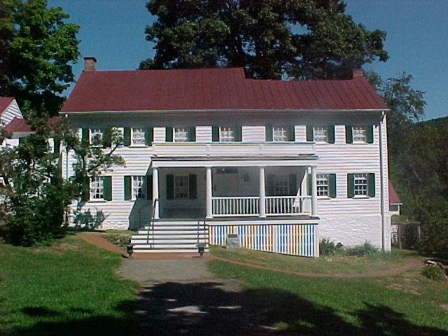
1813 John Brown, His Father-In-Law Gives Alexander Campbell His Farm.

Slide 13
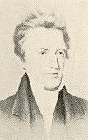
1814 - Campbell At Age 26

Slide 14
1815 Campbell Goes East, To Philadelphia, New York And Washington, D. C., To Solicit Funds To Build A Meeting-House At Wellsburg, Securing $1,000.

Slide 15
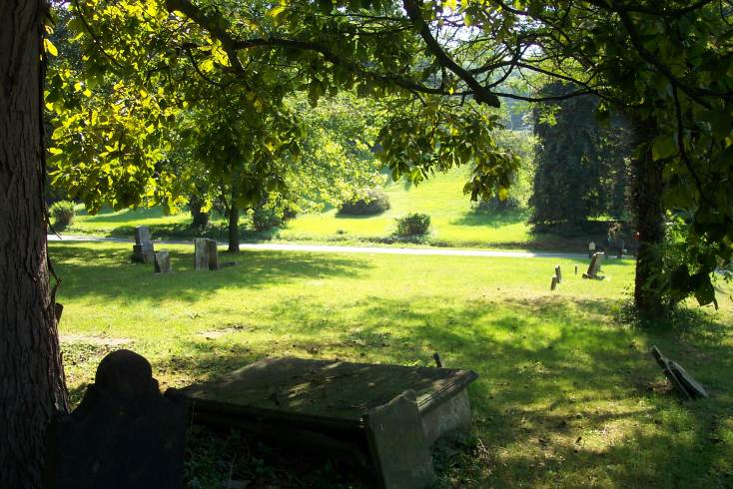
1816 Sermon On The Law
Brush Run Joins Redstone Association of Washington
August 30, 1816 – Cross Creek Baptist Church – Elder Pritchard, preacher there.
Another preacher was appointed to preach, but could not as he was sick. Campbell volunteered
Later referred to the message as “rather extemporaneous”
Alexander Campbell Preaches The "Sermon on The Law”
Sermon Content – Rightly Dividing Truth
It Marks The Beginning Of The Separation From The Baptists

Slide 16
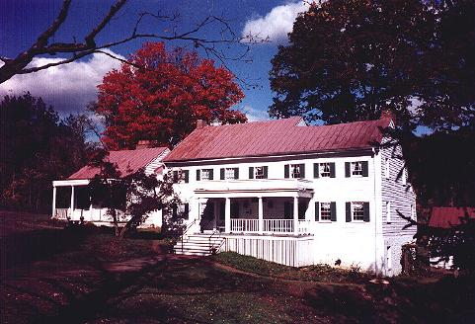
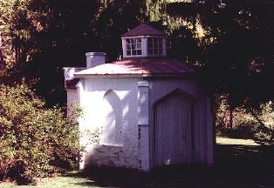
1818 Issues His First Challenge To Religious Discussion
Opens Buffalo Seminary, Boarding Young Men In His Home
Hours Each Day Spent In Study Only With Light From Above
Second Edition Added For Seminary

Slide 17
1823, July 4, First Issue Of The Christian Baptist
August, Buffalo Seminary Closes Due To Overwork & Little Attendance
October, 300 Mile Horseback Visit To Kentucky, Accompanied by Sidney Rigdon

Slide 18
1820 Campbell Debates John Walker at Mt. Pleasant, Ohio On The Subject And Action Of Baptism
August 30—Mahoning Association Formed
1821 Adamson Bentley and Sidney Rigdon Visit Campbell At His Home, Remaining Two Days
They Embrace The Restoration Plea Through Campbell's Influence
Sidney Rigdon Becomes Preacher For The Church At Pittsburg

Slide 19
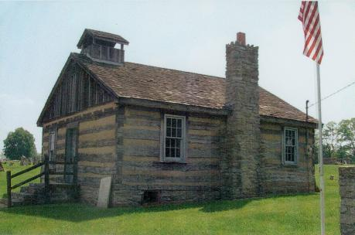
Preparation For: Campbell/McCalla Debate Of 1823
William L. McCalla, Presbyterian
According To Campbell, McCalla Was “Smoke In Their Eyes And A Thorn In Their Sides” Among The Baptist Community
October 15-21, 1823 In Washington, Mason Cty. Kentucky
Subject: Christian Baptism
Preparation Was A Joint Effort With Thomas Campbell & Walter Scott
Alexander Campbell Prints Debate

Slide 20
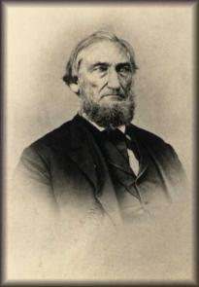
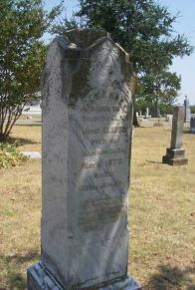
Influence Of The Campbell/McCalla Debate Of 1823
Buried At VanAlstyne, TX
His Stone Says:
He Was Ordained To The Ministry, May 1st, 1828 And Was The 1st In Ky. To Preach Salvation Through Obedience To The Gospel.
B.F. Hall
In The Discussion Campbell Argued That Baptism Was For The Remission Of Sin
Spring of 1826, B.F. Hall Found A Copy Of The Debate And Read It
In His Preaching Many Had Come To The Mourner’s Bench And Found No Relief
When Reading The Debate, He Noted Campbell’s Teaching On Baptism For Remission Of Sins, At Which Point, He Raised His Hands And Said, “Eureka! Eureka! I Found It! I Found It!
With This Discovery The Purpose Of Baptism Quickly Spread Throughout The Church

Slide 21
1824 Redstone Association Ready To Expel Wellsburg Church
They Withdrew Before The Action Is Taken.
Wellsburg Church Received Into Mahoning Association.
Tour Of Kentucky, Meets John Smith And Leading Baptists.
Introduced To Barton W. Stone
Began The Series "Restoration Of The Ancient Order of Things."
Raccoon John Smith
Barton W. Stone

Slide 22
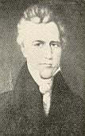
October 22, 1827 Death of Margaret Campbell.
Publishes "Living Oracles."
The Sacred Writings of the Apostles and Evangelists of Jesus Christ, Commonly Styled the New Testament. Translated from the Original Greek, by Doctors George Campbell, James Macknight, and Philip Doddridge
Walter Scott Elected Evangelist Of Mahoning Association.
At Age - 39

Slide 23
1828 Walter Scott Begins Work In Mahoning Association.
Second Edition Of "Living Oracles.”
Publishes First Hymn-Book
Marries Selena H. Bakewell of Wellsburg, July 31, 1828 – Nine Months After Death Of Margaret
Walter Scott

Slide 24
Accepts Robert Owen's Challenge To Debate The Claims Of Infidelity As Opposed To Religion.
Robert Owen

Slide 25
1829 – Campbell / Owen Debate
April 13-21, Debate On Existence Of God Conducted In The Methodist Church At Cincinnati, Ohio
Campbell Spoke For 12 Hours
The Principles Of The Reformation Spread To England And Ireland.
Robert Owen
Notes:
In the Robert Owen debate, Mr. Campbell felt that he had met a worthy opponent. Mr. Owen was a Scotch freethinker, who came to America to establish a community in accordance with his social views; all religion was to be excluded. He preached a crusade against Christianity. He challenged any clergyman to meet him in debate, and was [449] about to sail for Europe announcing that no minister in the New World dared to meet him in debate. The challenge fell under the eye of Alexander Campbell, and he promptly accepted it. The debate was held at Cincinnati. Men went hundreds of miles to attend it. The debate was afterwards published. While it was preparing for publication, Mr. Owen was the guest of Mr. Campbell at Bethany. One day, while walking in the fields together, Mr. Owen turned and said to Mr. Campbell: "I have one advantage over the Christian." "What is that, sir?" "I am not afraid of death," responded Mr. Owen; "if I had a few business affairs arranged, I could lie down and die without a fear." "Have you any hope in death?" asked Mr. Campbell. "No, sir; I think that death is the end, and I am without hope or fear in death." "Do you see that ox?" said Mr. Campbell. "It has filled itself with the grass of the meadow, and now stands in the shade of the tree, without fear and without hope in death. Tell me, what does infidelity do to elevate a man above the beasts?"
During the debate Mr. Owen read his theses, nearly two hundred pages of folio. To this manuscript he adhered throughout the discussion. He laid down twelve laws of human nature, upon which he built a "Social System." Nothing Mr. Campbell could say could divert him from his manuscript, and his twelve laws of human nature. He had his say; the "gems" from "his casket" were shown for the eight days of this debate.
The debate seemed to be proceeding upon parallel lines which never would meet. When Mr. Owen had finished his manuscript, he sat down and gave the time to Mr. Campbell. He, without an opponent to reply, spoke for twelve hours on Christian evidences, the longest speech on record.
- Benjamin Lyon Smith, The Millennial Harbinger Abridged, (1902) pages 447-450

Slide 26
Elected As Delegate And Attends The Constitutional Convention of Virginia.

Slide 27
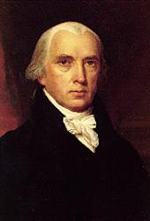
What Some Said Of Campbell
4th President of the U.S., James Madison said: “It was my pleasure to hear him very often as a preacher of the gospel, and I regard him as the ablest and most original expounder of the Scriptures I have ever heard.”

Slide 28
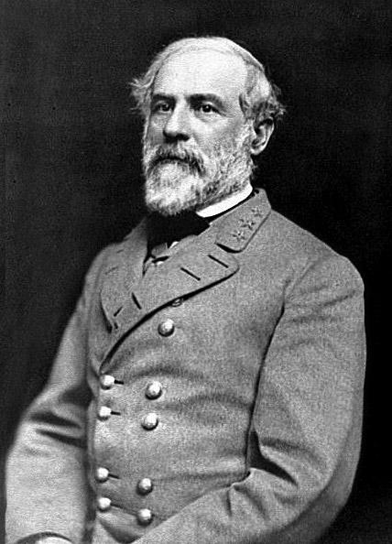
What Some Said Of Him
Robert E. Lee, Civil War General, “He was a man in whom were illustriously combined all the qualities that could adorn or elevate the nature to which he belonged; knowledge the most varied and extended, virtue that never loitered in her career nor deviated from her course. A man who, if he had been delegated as a representative of his species to one of the many superior worlds, would have suggested a grand idea of the human race.”

Slide 29
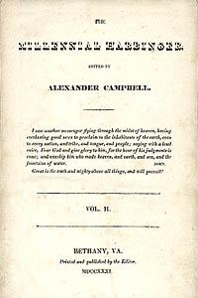
January 4, Millennial Harbinger Begins
1830
July 5, Last Issue Of The Christian Baptist Produced

Slide 30
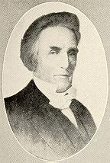
1830 Mahoning And Stillwater Associations, Ohio, Dissolve Resolving To Meet As Annual Meetings, Without Authority
Debates Obadiah Jennings, a Presbyterian Minister, at Nashville, Tennessee “Debate On Campbellism”
Sidney Rigdon Espouses Mormonism
Obadiah Jennings
1830, Age 42

Slide 31
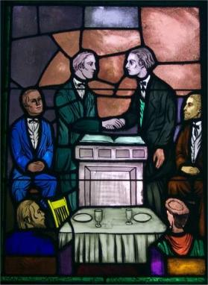
1831 Union Of The Reformers (Disciples of Christ) and Christians Under The Leadership of Barton W. Stone in Kentucky. This United Body Had 10,000 Members In The State.
Hill Street Church Lexington, KY

Slide 32
1832 Separation From Baptists Takes Place In Richmond
Reformation (Restoration) Becomes A Distinct Religious Body
Bethany Congregation Established, Building Built
Second Building On Same Foundation - 1852

Slide 33
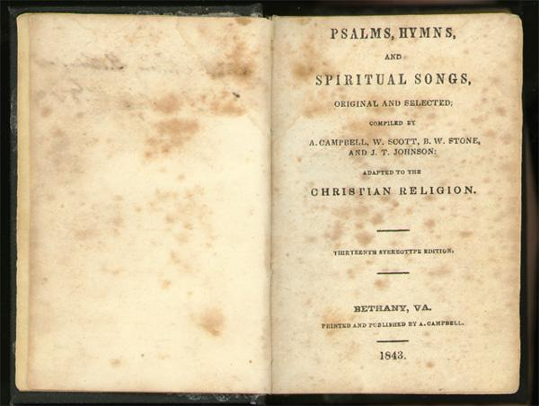
1835 Tour of Tennessee And Central Kentucky
Enlarges Hymn-Book
Barton W. Stone’s Name Is Added To The List Of Editors To Help Increase Unity In The Movement

Slide 34
1836 Robert Richardson Becomes Co-Editor Of The Harbinger
Tours New England States, 90 Day Trip
Meets Bishop John B. Purcell In Cincinnati
They Clash Concerning The Use Of The Bible In The Public School, And The Results Of Protestantism
The Campbell-Purcell Debate Is Arranged

Slide 35
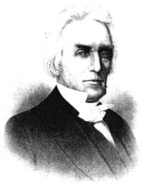
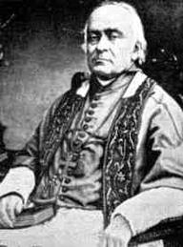
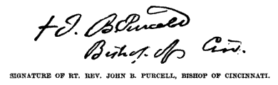
1837 The Campbell- Purcell Debate
On Catholicism vs. Protestantism
Held In January 13-21, 1837, Cincinnati, Ohio
John Baptist Purcell (1800-1883) was the 37 yr. old Bishop Of Cincinnati,
Campbell was 48
Notes:
Concerning the debate with Bishop Purcell, the Harbinger published, in 1837, the following from the Cincinnati Daily Gazette:
THE GRAND DEBATE.
As my opinion of the late discussion of the respective merits of Protestantism and Catholicism has been solicited by friends whose wishes I ought to respect, the following brief statement is submitted, with the hope that it will give no just cause of offense to any man or to any party.
Having attended throughout the discussion, with as much regularity as I conveniently could, I retired at the close, with increased confidence in the character of both Mr. Campbell and Bishop Purcell; being convinced that if the debate should be faithfully published, it would, in several ways, have a good influence upon society.
Mr. Campbell, I think, sustained the cause of Protestantism with candor, and with great ability; his documentary proofs were abundant and decisive, and his arguments were incontrovertible; and it is difficult to conceive how any impartial mind can hesitate to admit, that he deserves to be respected by Protestant Christians of all denominations, for this magnanimous effort to diffuse light upon a subject which we believe essential to the best interests of all mankind.
The Bishop also exhibited a degree of mildness and liberality of sentiment, that was not anticipated. His addresses, taken altogether, were calculated to make a good impression, both upon Protestants and upon Catholics: from the former they would remove prejudice, and incline to exercise more charity towards our Roman Catholic brethren; and on the latter, they tended to make the impression, that the spirit of persecution ought not to be indulged, and that the practice of it ought never to be adopted in these United States of America.
The Bishop has defended his cause with considerable ingenuity, and sometimes with striking displays of eloquence. We were pleased to notice his efforts to modify the Papal system, and to abandon the dark foundation of his predecessors; and we rejoice in the hope, that the Roman Catholic religion is not so infallible as to be incapable of improvement in the sunshine of American liberty.
Such of Mr. Campbell's positions as could be encountered with apparent plausibility, were promptly met by the Bishop; others, more [448] formidable, were passed by in silence. The ingenuity of this learned advocate of clerical power, in removing the impression made by the arguments of his antagonist, were sometimes very striking; insomuch, that some Protestants who were in attendance, were probably not without their fears that their cause would suffer loss by the controversy. Mr. Campbell, however, returned to the charge with a composed dignity, and with a freedom from all signs of intimidation, which evinced to all spectators that he had no misgivings of mind, and that he knew well the solidity of the ground on which he had taken his stand.
There was no point at which the Bishop appeared to falter more, than in his weak attempt to set aside Mr. Campbell's arguments, founded upon the prophecies of Daniel, the Apocalypse, and the Apostle Paul. Here, it is presumed, intelligent Catholics began to tremble for their champion. Mr. Campbell constantly saw his advantage, and improved it with a promptness and skill not often equalled, and perhaps never surpassed.
If the whole of this debate be faithfully published, I can not help thinking it will furnish a mental feast to the intelligent public, and that it will have a tendency no less to promote charity, than to disperse the mists of delusion, and to place the truth in a clear light before a rising and inquiring posterity.
In regard to Mr. Campbell's peculiar sentiments, I have not had the means of knowing precisely what they are. Whatever they be, they were not brought into this debate; for he took his stand, and kept it, on that firm ground which was occupied by the original Reformers, and on which Protestants of all denominations will readily agree with him. If he holds peculiar opinions which are injurious to this great cause, it is truly to be lamented; and we may hope that a good Providence will yet lead him out of such dangerous mistakes; for a mind like his ought always to be public property, as it was in the late famous discussion in the city of Cincinnati.
In conclusion, I will take the liberty to say, that I have no other feeling than that of affection and good will; both for Mr. Campbell and his learned and ingenious opponent, and while my faith in Protestantism is confirmed, my charity for the Catholic communion is considerably enlarged.
A. SHINN.
There is no abler defense of Protestantism in the English language than the Campbell-Purcell debate.
- Benjamin Lyon Smith, The Millennial Harbinger Abridged, (1902) pages 447-450

Slide 36
1837 – Other Events
A Running Debate In Harbinger On Relation Of The Pious Un-immersed To The Christian
Strong Support For Bacon College In The December Issue Of The Millennial Harbinger
Calls It A Literary Institution
Clarifies That The Only Good Literary Institution Is Built On Good Morals
Expresses His Gladness To Know Bacon Falls Into This Category

Slide 37
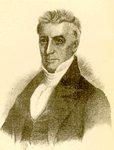
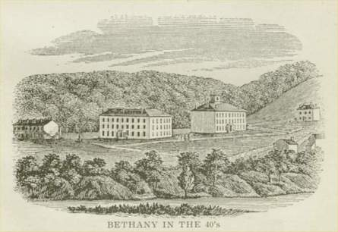
1839 Plans For Bethany College.
1840 Bethany College Chartered And Organized, Campbell Elected President
Donated Land Plus $10,000.00

Slide 38
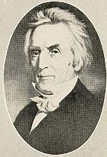
1843 Campbell-Rice Debate, Campbell's Last Public Debate Lasted Sixteen Days
1843 – 55 Years Old

Slide 39
Publishes Revised Hymnbook

Slide 40
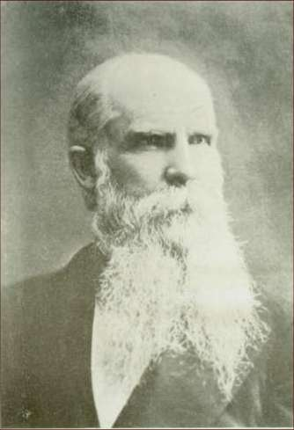
1844 Expresses Views On Slavery
1846 The Harbinger Increased From Forty-Eight To Sixty Pages
W. K. Pendleton Becomes Co-editor
W.K. Pendleton 1817-1899
Notes:
1846 The Harbinger Increased From Forty-Eight To Sixty Pages – Memoirs p.540

Slide 41
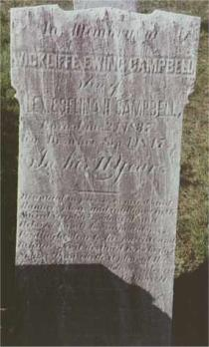
1847 Alexander Campbell Tours Through England, Scotland And Ireland
Illegally Arrested
Gravely Ill
During His Absence His Son Wickliffe Had Drowned, Not Informed Until His Return Home
Invited To Speak Before Congress.

Slide 42
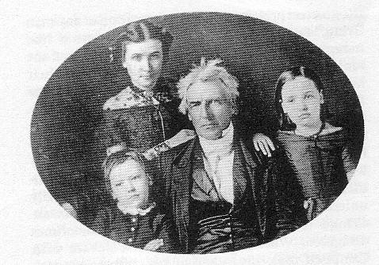
Rare Picture Of Campbell & Children
L2R Willie, Virginia, A.C. & Decima, c.1849

Slide 43
1849 National Convention Meets In Cincinnati, Organizes The American Christian Missionary Society
Alexander Campbell Elected President Fills This Position The Rest Of His Life
1849 Campbell Published His Extra On "Life And Death"

Slide 44
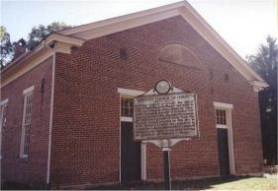
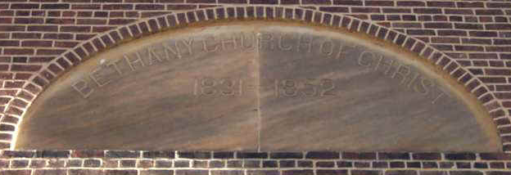
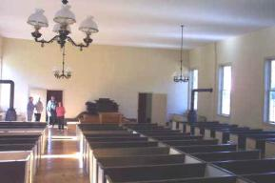
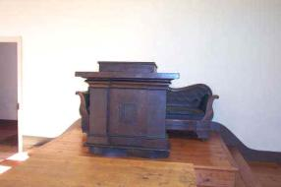
1852 — Bethany Church Of Christ

Slide 45
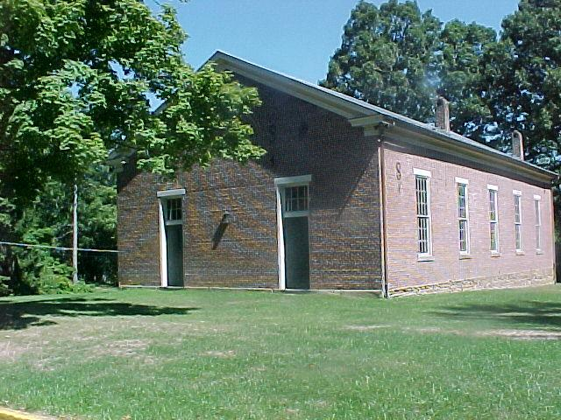
Built To The Specification Of A.C.

Slide 46
1852 Tours Missouri To Secure Endowment For A Chair In Bethany College
Delivers Two Addresses To State Legislature
Takes An Indian Boy, With Consent Of His Parents, To Educate

Slide 47
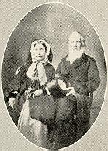
At Home In Bethany
Alexander & Selina Campbell

Slide 48
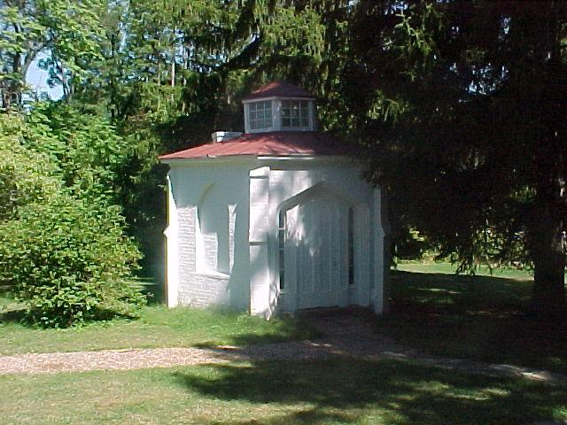
Campbell Spent Many Hours In This Study

Slide 49
“The Bishop In His Study
“He Is A Living Wonder . . . A New Man Every Time You Meet Him, For His Mind Seems To Be Taking A Sweep Through The Universe And Enlightening New Objects At Every Inch Of Its Orbit” —J. A. Garfield, 1853

Slide 50
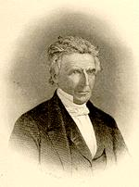
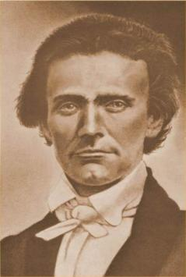
1853 Jesse B. Ferguson in Nashville Teaches Post-Mortem Gospel
Campbell Exposed The False Teaching, Going To Nashville For This Purpose.
1853, Age 65
Jesse B. Ferguson

Slide 51
1854 Thomas Campbell Died January 4 At Age Of Eighty-Three.

Slide 52
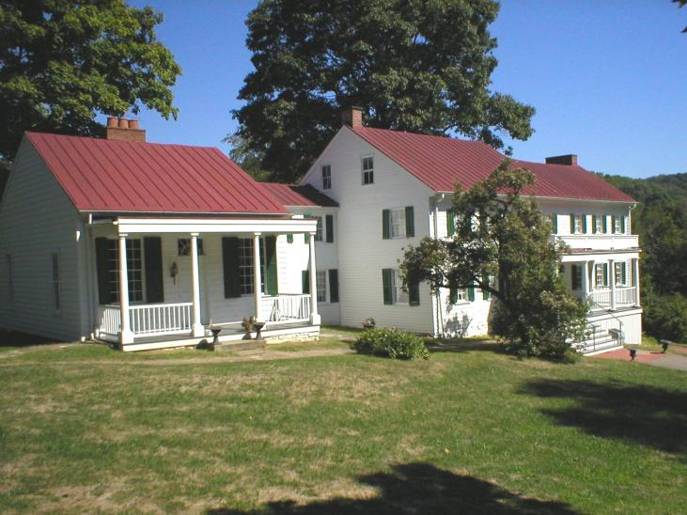
House Completed In 1793
Second Section Added To House Buffalo Seminary In 1819; Brick Dining Area Added In 1836; Stranger’s Hall Added In 1840

Slide 53
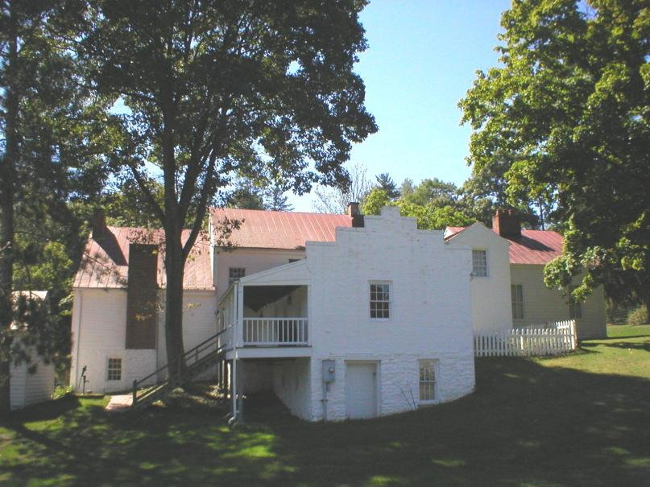
Back Of Campbell Mansion
The Campbell Mansion Is Listed On The National Register Of Historic Homes

Slide 54
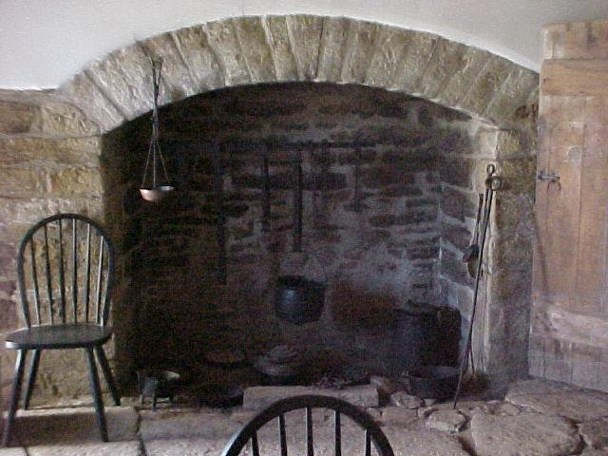
Basement Of Campbell Mansion
During The Time The Buffalo Seminary Was Being Run In The Home The Campbells Lived In The Basement. The Mildew And Damp Environment Led To The Deaths Of Two Children & Sickness Among All

Slide 55
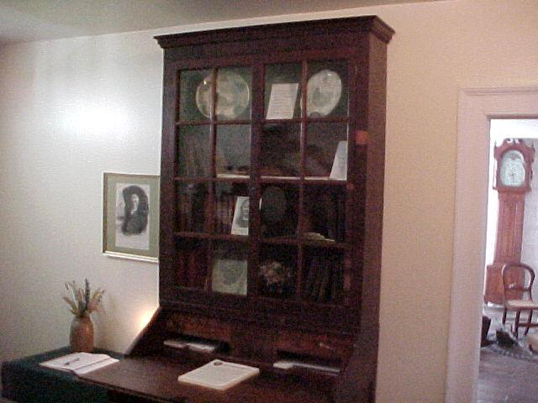
Inside The Mansion

Slide 56
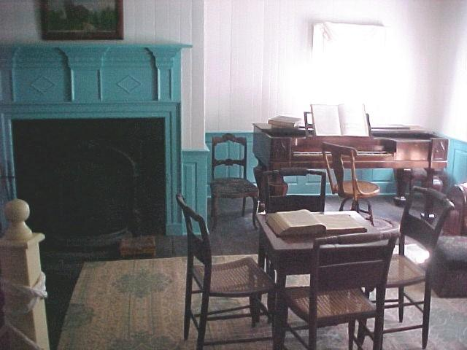
Sitting Room

Slide 57
Actors Pose Showing How Life Would Have Been In The Campbell Home

Slide 58
Bedroom Of A. Campbell

Slide 59
Bedroom Of Alexander Campbell

Slide 60
Death Bed Of Alexander Campbell

Slide 61
Dining Hall, Added In 1836

Slide 62
Death Bed Of Thomas Campbell

Slide 63
Travelers Lodge

Slide 64
Well Known Dignitaries Stayed In Stranger’s Hall
Included Were Henry Clay, John C. Calhoun, Jefferson Davis, Daniel Webster & James A. Garfield

Slide 65
Stranger’s Hall
The Wall Paper In Stranger’s Hall Came From Italy. While Visiting In Nashville, Tennessee, Campbell Saw This Paper While Visiting Andrew Jackson At His Hermitage Home

Slide 66
1855 Campbell Completes The Task Of Revision Of The Acts Of Apostles Assigned Him By The Bible Union
Dr. J. B. Jeter, Richmond, Va., Publishes His Book, "Campbellism Examined."
Campbell Reviews It In The Harbinger, Vol. 1855, page 512. May
Moses Lard Was Selected To Respond In Print
His Friends Noticed That His Memory Became Defective

Slide 67
The Elderly Alexander Campbell

Slide 68
1856 He Visits, St. Catharine's Springs, Canada With His Wife And Daughter Decima & Made Another Tour Through Virginia
1857 Tour Through South For Endowment Funds
School Building At Bethany Burned
1858 Campbell, Nearly Seventy Years Old, Started Resolutely To Secure Funds To Restore The College

Slide 69
At Washington He Spoke In The Baptist Church Building. President Buchanan And Several Members Of His Cabinet Being Present.
The Corner-Stone Of New College Building Was Laid
President James Buchanan 1791-1868 Served 1857-1861

Slide 70
Bethany College

Slide 71
1860 "Lectures and Addresses" Published
Campbell Publishes His "Life of Thomas Campbell"
Addition Of Instrument At Midway, Kentucky — Campbell Had Written In The M.H. That The Addition Of An Instrument In Worship Would Be Like Adding A Cow Bell To A Concert.

Slide 72
1861 The Sage Of Bethany

Slide 73
1862 Writes His Will
The Harbinger Reduced From Sixty To Forty-Eight Pages

Slide 74
1864 Campbell Attended The General Convention For The Last Time
He Gives The Copyright Of The Hymn-Book To The American Christian Missionary Society

Slide 75
1865 Hymn Book

Slide 76
1865 Campbell Relinquished The Editorship Of The Harbinger to W. K. Pendleton
W.K. Pendleton 1817-1899

Slide 77
Campbell’s Declining Health
November, Campbell's Last Article In The Millennial Harbinger Is Published
1866 He Is Confined To The House By A Heavy Cold
Assisted In Ordaining Elders At The Church At Bethany
February 25 He Was Confined To His Bed, And Never Arose From It

Slide 78
March 4 At 11:45 P.M Campbell Finishes His Course
His Selina Comforted Him With "The Blessed Savior Will Go With You Through The Valley Of The Shadow Of Death." He replied: "That He Will! That He Will!" These Were His Last Words.

Slide 79
Chair Where Campbell Studied
For Five Summers After Campbell Died, Selina Campbell Had His Study Chair Placed In The Cemetery At The Grave Where Students And Other Visitors To The Grave Could Sit And Contemplate The Life Of This Great Champion

Slide 80
What Some Have Said
Jacob Creath said: "I do claim that he shall stand in the front rank of the most illustrious benefactors of his race since the death of the apostles. He will compare favorably with any of the apostolic fathers in point of learning, talents, purity, and usefulness."
John T. Johnson said: "The debt of gratitude I owe that man of God no language can tell."

Slide 81
Access To God’s Acre

Slide 82
God’s Acre

Slide 83
Buried Among His Parents, Wives & Children

Slide 84
Buried Among His Parents, Wives & Children
In Memoriam Alexander Campbell Defender Of The Faith Once Delivered To The Saints Founder Of Bethany College Who Being Dead Yet Speaketh By His Numerous Writing And Holy Example Born In County Of Antrim, Ireland Sept. 12, 1788 Died At Bethany, Va March 4, 1866

Slide 85
Margaret Campbell Wife Of Alex Campbell Died Oct. 22, 1827 In The 37 Yr Of Her Age _____________ Selina H. Campbell Wife Of Alex Campbell Born In Litchfield, England Nov. 12, 1802 Died At Bethany, W. Va. June 28, 1897

