Slide 1
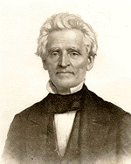
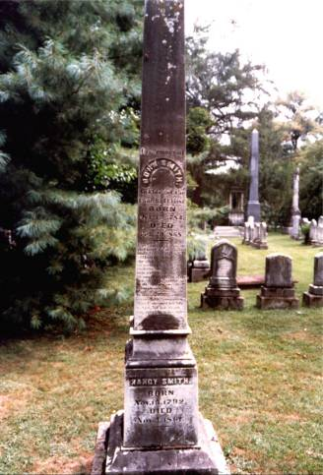
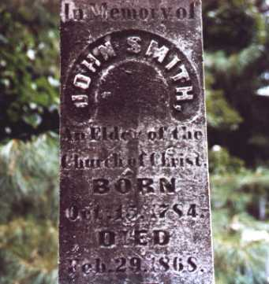
“Raccoon” John Smith 1784-1868

Slide 2
“Raccoon” John Smith 1784-1868
Born on October 15, 1784 in East Tennessee’s Sullivan County
Education: Alexander Campbell Said, “John Smith is the only man that I ever knew who would have been spoiled by a college education.”
Calvinistic Baptist Background
Greatly Frustrated Awaiting The “Call” Of God – No Religious Experience
Memorized Much Of The Scriptures And Used Them During His Preaching, Amazing Many
He Came Across A Copy Of “The Christian Baptist” Was Amazed At Alexander Campbell’s Teaching
First Heard Him Speak. After He Expressed Disappointment Having Ridden His Horse 50 Miles To Hear Him Speak For 30 Minutes. He Was Told That He Needed To Look At His Watch As Campbell Had Spoken For Over 2 ½ Hours.

Slide 3
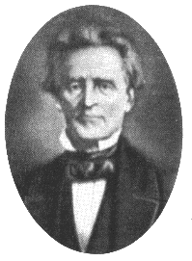
“Raccoon” John Smith 1784-1868
He Turned His Back On The Baptist Faith, Sacrificing The Relationships He Had With His Family
He Became A Christian Preacher, Teaching N.T. Christianity
He Converted Entire Baptist Churches To Accept The Ancient Order
Was Called “Raccoon” Because He Once Said, “I am John Smith, from Stockton’s Valley. In more recent years, I have lived in Wayne, among the rocks and hills of Cumberland. Down there, saltpeter cave abound, and raccoons make their homes. On that wild frontier we never had good schools, nor many books; consequently, I stand before you to-day a man without an education. But, my brethren, even in that ill-favored region, the Lord, in good time, found me. He showed me his wondrous grace, and called me to preach the everlasting Gospel of his Son.” Life of Elder John Smith. p.115

Slide 4
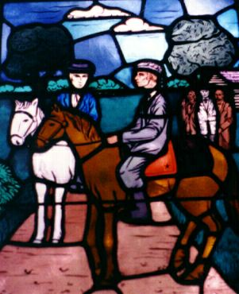
“Raccoon” John Smith 1784-1868
In 1827 Baptized 2000 People In Kentucky, Nearly That Many In 1828.
In January, 1832 When The Stone/Campbell Movement Came Together, It Was Smith, Representing The Disciples, Who Extended The “Right Hand Of Fellowship” With Stone.
Was Selected To Ride With John Rogers To Go Throughout The Region To Tell Of The Coming Together Of The Stone/Campbell Movement – The Merged Movement Exceeded 10,000 In Kentucky

Slide 5
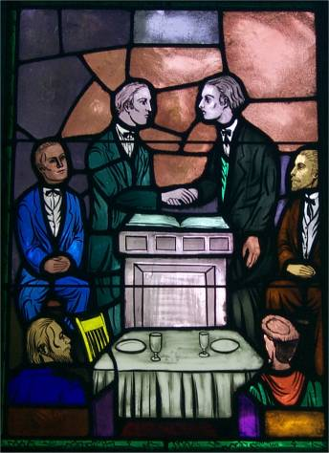
Campbell & Stone Come Together – New Years Day, 1832
“Let us, then my brethren, be no longer Campbellites or Stoneites, New Lights or Old Lights, or any other kind of lights, but let us come to the Bible, and to the Bible alone, as the only book in the world that can give us all the light we need.” -Raccoon John Smith

Slide 6
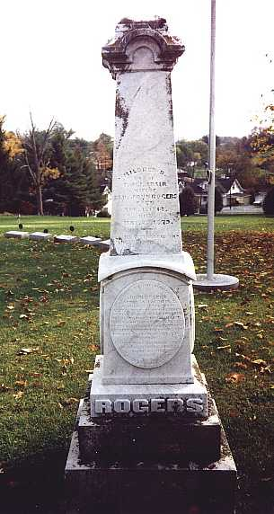
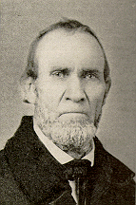
John Rogers 1800-1867
Grave Inscription
Sacred to the memory of John Rogers After A Faithful Advocacy of the truth as it is in Jesus for 49 years. He fell asleep while engaged In the work at Dover, Mason Co, KY, Jan. 5, 1867 in the 67 year Of his age. His abundant and Successful labors had earned for him the esteem of all the Churches They that turn many to righteousness shall shine as the stars forever & ever.
Represented Christians After 1832 Traveling With Raccoon John Smith
Minister At Carlisle, Kentucky
Biographer On The Life Of B.W. Stone

Slide 7
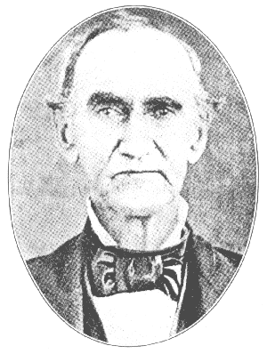
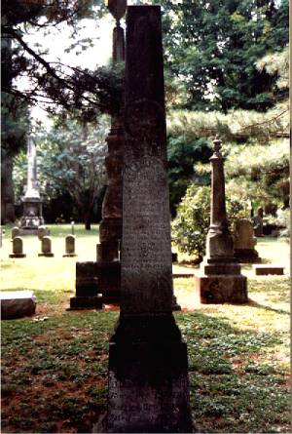
John T. Johnson 1788-1856
Born on November 5, 1788, in Scott County, Ky
Studied Law With His Brother, Richard M. Johnson, Who Was A Distinguished Politician And Lawyer, And Martin Van Buren’s V.P.
1811 Married
1813 he was honored with the place of volunteer aide on the staff of General Wainson at Fort Meigs
1814 He Began The Practice Of Law And Was Elected To Represent His County (S. Elkhorn) In the State Legislature–Re-Elected A Number Of Times
1820 He Was Elected To Congress, And Was Re‑Elected In 1822

Slide 8
John T. Johnson 1788-1856
1821, At 33, Professed Faith, Baptist Church, Campbell Influence
1824 Met Barton Stone
1827 Co-Edited Christian Messenger With B.W. Stone
1832 Great Part In Organized The Disciples & Christians Into One Movement, Held Purse To Support Rogers & Smith In Their Mission
1834 Started The Gospel Advocate With B.F. Hall As Co-Editor, Tolbert Fanning Assisted
1856, While In A Meeting At Lexington, Mo., He Fell Sick Of Pneumonia, And Passed Away,Evening Of December 24th

Slide 9
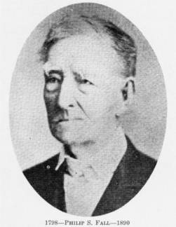
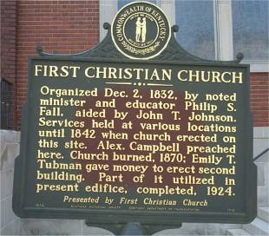
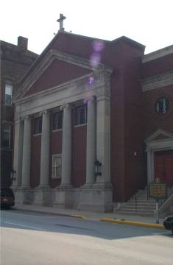
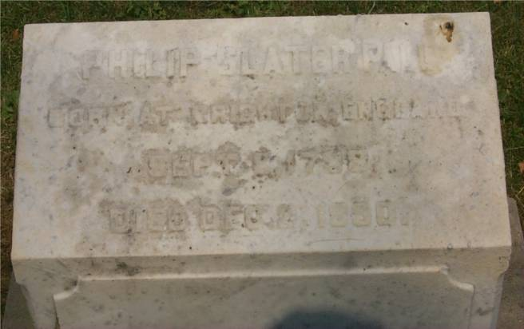
Philip Slater Fall 1798-1890

Slide 10
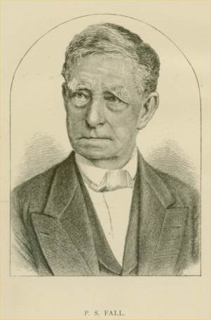
Philip Slater Fall 1798-1890
Born at Keloedon, England, in September, 1798
Eldest Of 12 Children
1817 Came To US And Located Near Russellville, Kentucky With Is Father
1818, Parents Died – He Became Father & Provider To Eleven Siblings
His Good Education In England Help Prepare Him For The Burdens Thrown Upon Him
1818 Established An Academy In Louisville, KY
Became A Baptist That Year As Well
1819 Ordained A Baptist Preacher
1821 Married Anne Bacon, From A Distinguished Kentucky Family
1823 Moved To Louisville, Preached And Operated A School
1824 After Reading The Writings Of A. Campbell, He Adopted The Cause Converting The Whole Church Where He Preached

Slide 11
Philip Slater Fall 1798-1890
1825 Moved To Nashville, Tennessee
1826-1831 Accepted The Invitation To Preach For Baptist Church There With Stipulation That He Could Preach His Own Convictions, Resulting In The Established Church of Christ In Nashville, Tennessee
While In Nashville Occupied A Chair At The Nashville Female Academy
1823 Delivered A Powerful Discourse To A Large Group At Frankfort, Kentucky On The Difference Between The Old & New Law
1831 Returned To Kentucky To Preach For Frankfort Church – Operated A Female Academy
1837 His Sister Charlotte (Who Taught Him Hebrew & Greek) Marries Tolbert Fanning
1858 Returned To Nashville To Help The Struggling Church There – Church Grew From 25 To Over 600 Before Leaving In 1877 To Retire In Frankfort, Kentucky
December 3, 1890, Died In His 93rd Year

Slide 12
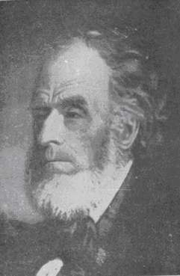
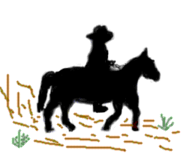
Samuel Rogers 1789-1887
Born in Charlotte County, Va., on November 6, 1789
Baptized By B.W. Stone
Circuit Evangelist
One Of The First Preachers In Missouri
Baptized Benjamin Franklin (Evangelist of Indiana – Editor Of American Christian Review
Sons W.C. Rogers & John I. Rogers Preached
Grave Inscription

Slide 13
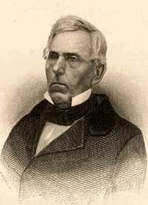
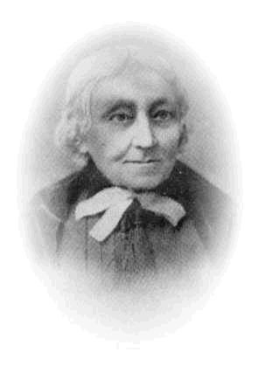
Tolbert Fanning 1810-1874
Born in Cannon County, Tennessee, May 10, 1810
Baptized For Remission Of Sins, October, 1826 by James Matthews
November, 1831, Entered Nashville University, And Graduated In 1835
1836 Spent The Spring And Summer In A Preaching Tour With Alexander Campbell
1836 Married Sarah Shreve (Soon Died)
Teaching Staff Of Bacon College, Georgetown, Kentucky
1837 Married Charlotte Fall, Sister Of Philip Fall
1840-1842 Conducted A Female College Near Nashville, Tennessee With Wife Charlotte
1842 Nearly A Year Preaching In Alabama & Mississippi
President of Franklin College from 1846 to 1865
Began the Christian Review in 1844

Slide 14
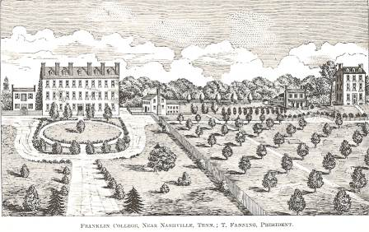
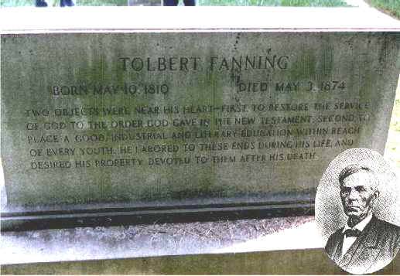
Tolbert Fanning 1810-1874
Franklin College
Began Gospel Advocate in 1855 With William Lipscomb
1865 Franklin College Was Destroyed By Fire
Hope Institute Was Started Afterwards, Later Called Fanning Orphan Home For Girls
1874, May 3, Died From Injuries Suffered As A Result Of Being Gored By A Bull

Slide 15
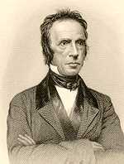
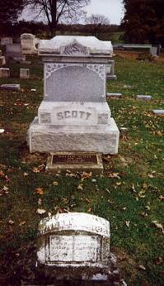
Walter Scott 1796-1861
Born On The Last Day of October, 1796, in Moffat, Scotland
1818 Came To America And Was A Latin Tutor In A Long Island, New York Academy
1819 Went To Pittsburg, PA And Met George Forrester, A Haldanian Preacher Who Ran An Academy
Baptized By Forrester
Early 1820s Met T & A Campbell, Began Writing For Christian Baptist
1823 Help Campbell Prepare For McCalla Debate
1826 Married, Moved To Steubenville, Ohio
1827 Elected Evangelist For The Western Reserve By Mahoning Baptist Association
1827, November Baptized The First Person In The Campbell Movement For The Remission Of Sins
Coined “Five Finger Steps” To Salvation Phrase: Belief, Repentance, Baptism, Forgiveness Of Sin, Gift Of The Holy Spirit
1861, April 23 Died – Having Spent The Remainder Of His Life In Mays Lick, Kentucky

Slide 16
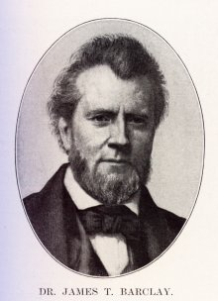
James T. Barclay 1807-1874
Born in Scottsville, Albemarle County, Virginia
Graduate Of University Of Virginia And Medical College Of The University Of Pennsylvania
Married Julia Sowers (1813-1908)
Presbyterian Background/Became A Disciple
Helped To Plant The National City Christian Church In Washington D.C.
1851-1854 – First Missionary From ACMS Went To Palestine
Received Much Resistance From Arab/Christian/ Jewish People In Palestine
Treated Over 2000 Cases Of Malaria While There
1858 Archaeological Work In Palestine Caused Him To Write The City Of The Great King
1863 His Son Judson Married A. Campbell’s Youngest Daughter, Decima
1866-1868 Professor Of Natural History At Bethany
1874 – Died At Courtland, Alabama While Living With His Son & Family
Re-Interred At Bethany’s God’s Acre

Slide 17
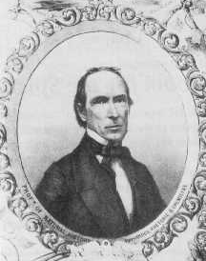
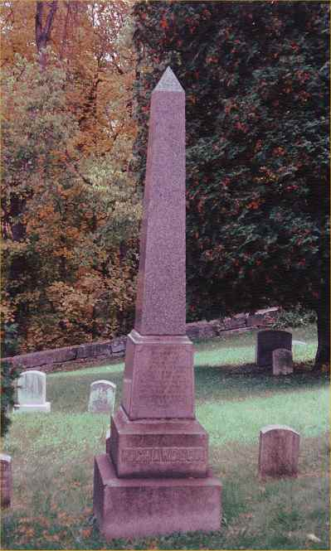
Robert Richardson 1806-1876
Born in Pittsburgh, Pennsylvania And Raised In The Episcopal (Anglican) Church
Studied Chemistry At The University Of Pittsburgh
1827 Medical Degree From The University Of Pennsylvania In Philadelphia
1829 Influenced By Campbells & Walter Scott Baptized Him For The Remission Of His Sins
Moved To Wellsburg, Virginia For A Short Time To Set Up A Medical Practice
1836 Moved To Bethany, Virginia To Assist A.C. With Millennial Harbinger
1841 At New Bethany College He Was Professor Of Chemistry & College Bursar
1866 When A. Campbell Died He Was Charged With The Work Of Editing The Memoirs – Released In 1868 In A Two Volume Set
1876 Died And Is Buried Near His Life-Long Friend Alexander Campbell, In God’s Acre

Slide 18
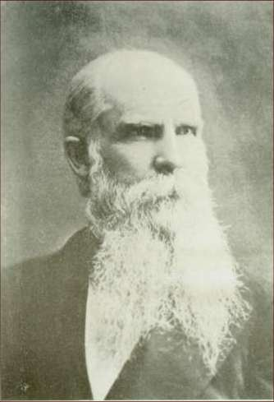
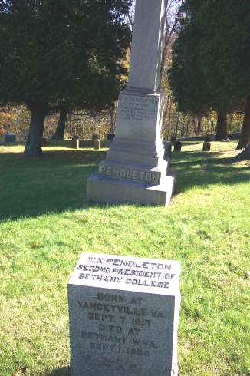
W.K. Pendleton 1817-1899
1817 Born William Kimbrough Pendleton, From A Family Of Old Virginia Aristocrats
Mother Was Episcopalian
At Age 16 He Began Reading The Writings Of A.C.
1840 Baptized Into Christ By Alexander Campbell
1840 Married Lavinia Campbell, Daughter Of A.C.
1841 Became Professor Of Physical Science At The New Bethany College
1841, September 2, First Daughter Named Campbellina
1846, May 29 Lavinia Dies Of Tuberculosis, Age 29
1845, August 13 He Became V.P. Of Bethany College & Co-Editor Of The Millennial Harbinger
1847 While A.C. Was In Scotland He Ran College & Paper – Also Assisted In Helping To Revive Wycliffe When He Drowned (Six-Hour Ordeal)
1848 Remarried, Lavinia’s Sister Clarinda Campbell
1850 Clarinda Dies Of Tuberculosis
1855 Marries Catherine Huntington King Of Ohio
1866 Upon Death Of A.C. Became President Of Bethany And Editor Of M.H. – He Was Controversial
1886 Moved To Deland, Florida To Retire – d.1899

Slide 19
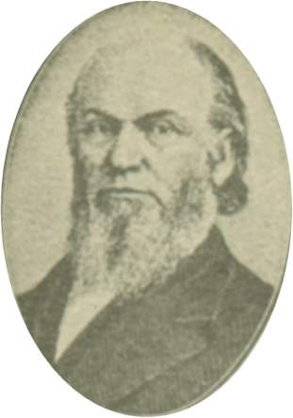
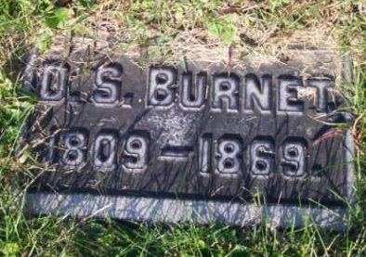
D.S. Burnett 1808-1867
David Staats Burnett Was Born In Ohio And Raised As A Presbyterian
As A Teenager He Came Across The Writings Of A.C.
Accepted The Faith & Very Soon Became A Powerful Force For New Testament Christianity
1835 Edited A Revised Edition Of Christian Baptist
1837 Followed Walter Scott As Second President Of Bacon College – Until 1839
1845 Organized The American Christian Bible Society, The First National Organization of The RM
1849 Helped Organize The ACMS, Cincinnati, Ohio
Spent His Last Years As A Leader Among Churches In Cincinnati, Ohio
Buried At Spring Grove Cemetery, Cincinnati, Ohio

Slide 20
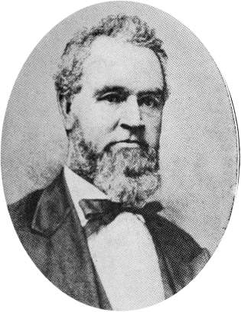
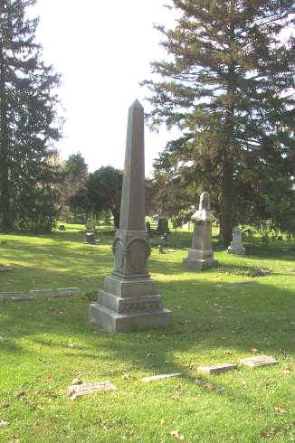
Isaac Errett 1820-1888
Spent First Five Years Of His Life In New York
1825 His Father Died & Family Moved To N.J.
1832 Family Moved To Frontier, Pittsburgh, PA
1832 He Was Baptized Along With Brother Russell
1839 Began Preaching
1857-1860 Corresponding Secretary Of ACMS
1861,1862 Co-Editor Of The Millennial Harbinger & Fundraised For Bethany College
1861, October Represented A.C. At The Annual ACMS Meeting – Pushed For Condemnation Of The South For Pulling Out Of The Union
1862 Moved To Detroit, Michigan Preaching For The Jefferson Avenue and Beaubien Street Church – Increased Membership To Over 2000
Wrote A Tract, “A Synopsis of the Faith and Practice of the Church of Christ.” Bringing Strong Challenge As Being A Creed Statement – Received Strong Condemnation From Benjamin Franklin’s American Christian Review & Lard’s Quarterly

Slide 21
Isaac Errett 1820-1888
Further Condemnation Came When He Began To Be Referred To As “Reverend” Errett After He Accepted An Inscribed Silver Doorknocker From A Church Member – Others Began To Follow
1865 Met With Some Concerned That There Was Not A Progressive Paper Among The Disciples
Only B. Franklin’s American Christian Review In Indiana & T. Fanning’s Gospel Advocate In Nashville – Both Very Conservative
1866 Errett Was Given Editorship Of The New Christian Standard
Errett Later Explained To David Lipscomb That It Was Started Because Of Franklin’s Unwillingness To Allow Pro-Unionist Articles In The American Christian Review
Christian Standard Still In Print Today As The Main Paper Of The Disciples Of Christ
When Campbell Died Many Thought Errett Would Take Over The Movement
1888, December 19, Died At His Home In Terrace Park, Ohio – Buried At Spring Grove Cem

