Slide 1
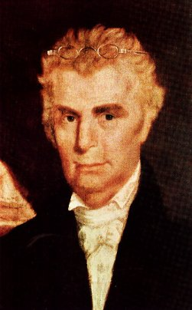
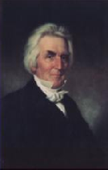
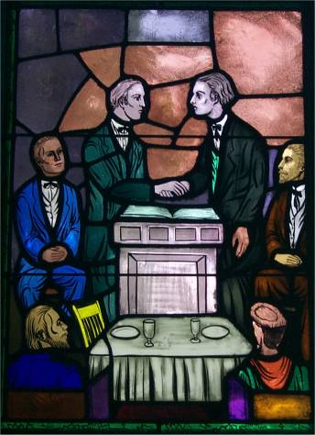
Growth And Departures
Christians & Disciples Come Together January, 1832

Slide 2
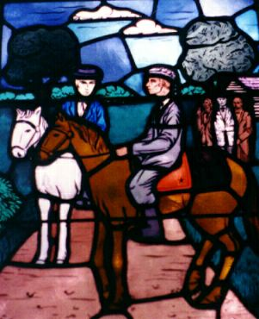
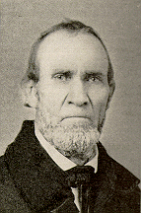
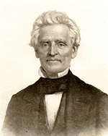
The Good New Spreads
During The Years 1832 & 1833 John Rogers & Raccoon John Smith Were Selected To Travel Throughout The Region To Make People Aware That Union Had Taken Place

Slide 3
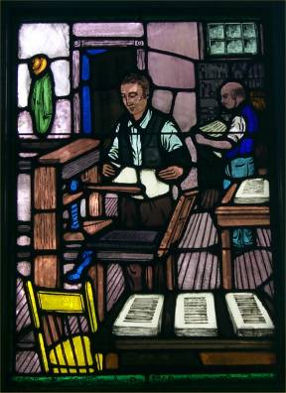
The Printing Press
Contributed To Union
B.W. Stone’s
Christian Messenger &
A. Campbell’s
Millennial Harbinger Distributed The Message Of Union Among Christians, Later Others Like
Firm Foundation &
Gospel Advocate Continued The Unity Call

Slide 4
Some Highlights Over The Next Few Years
1835 The “Disciple’s Hymn Book” Is Distributed Bearing The Names Of B.W. Stone, Alexander Campbell, Walter Scott & John T. Johnson
1836 – Bacon College Begins With Walter Scott As First President, Georgetown, Kentucky
1841 – Bethany College Begins
1844 – Nov. 9, B.W. Stone Dies In Hannibal, Missouri, Later Re-Interred At Caneridge, Kentucky, Christian Messenger Ceases Publication
1845 – January 1, Franklin College, Nashville, Tennessee Begins
1858 – Bacon College Becomes The University Of Kentucky At Harrodsburg, Kentucky, Moved To Lexington In 1865

Slide 5
Changes Causing Digression
1849 – Development Of The American Christian Missionary Society
1860 – Introduction Of Instrumental Music At Midway
The Pastoral System In Congregations
Alternative Ways Of Raising Money

Slide 6
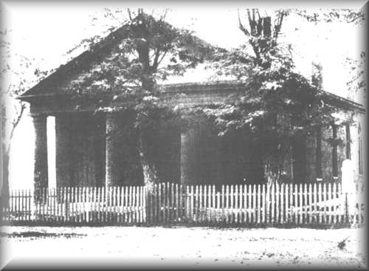
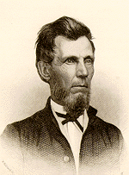
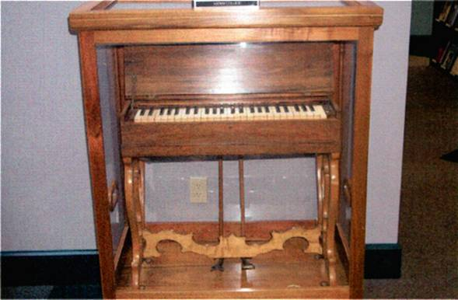
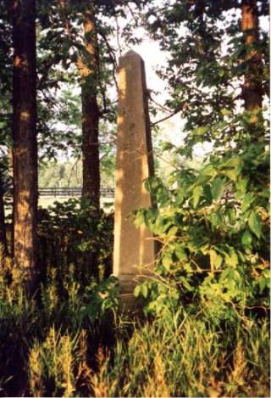
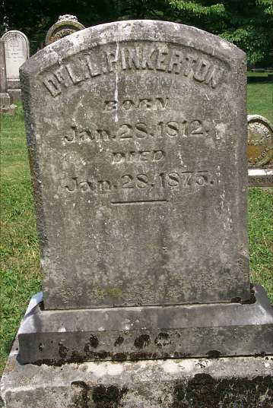
The Incident At Midway, Kentucky
Adam Hibler
Grave
L.L. Pinkerton
Grave

Slide 7
The Church During The Civil War
Leading Up To The War Discussion Of The Slavery Issue Was Discussed In Journals
Some Like James Shannon In Missouri Were Strong Activists For Slavery
Others Like Pardee Butler Of Kansas Was Equally Strong Activist Against Slavery
Mississippi Preacher, T.W. Caskey Was Involved In Preparation Of The Document Leading To Secession In That State, 1861
During War Many Lost Their Faith
Many Enlisted In The Military, Preachers Became Chaplains
  Fanning Visited Atlanta. Dr. A.G. Thomas, A Preacher, Wore A Feather In His Hat And A Glittering Sword In His Right Hand. Fanning Said He Doubted If Thomas Would Be Able To Hold The Word Of Georgia In One Hand And The Sword Of The Spirit In The Other – GA Vol VII, No. 2, Feb. 1861 p.39
  W.H. Hopson Resigned His Post At Main Street Church Of Christ Lexington, Kentucky Because Of His Disposition Toward The South. J.W. McGarvey Took His Place, 1862

Slide 8
The Church During The Civil War
  250 Boys From Hiram College Joined The Union Forces
  James A Garfield Was A Union Acquiring Rank Of Brigadier-General
  T.B. Larimore Served With The Southern Forces
  B.F. Hall Was Chaplain With The Texas Rangers
Colleges & Publications Sought To Ignore The War Refusing Anti-War Articles To Be Printed
  W.D. Carnes Sought To Keep It Out Of Franklin College, But When War Was Began The Entire Student Body Left, Joining The South
  1860, Fall Arkansas College Began At Fayetteville, William Baxter President, Battles At Pea Ridge And Prairie Grove Was Fought Nearby. School Burned
Preachers Avoided It In Their Preaching
Many Journals Ceased Publication For Economic Reasons
Biggest Wedge Was When The Missionary Society Condemned The South, Southern Brethren Were Appalled, 1862
Officially The Churches Of Christ Was The Only Church In The US Not To Split During The Civil War

Slide 9
After The Civil War
Many Issues That Were Before The War Started Up Again
  ACMS & The Instrument Of Music In Worship – Next 40 Years Takes Its Toll
  Can Christians Fight In War Or Participate In Governmental Activities – e.g. President Garfield
Alexander Campbell Dies March 4, 1866
1866 Christian Standard Begins With Isaac Errett As Editor – Devoted To A More Progressive Approach To Christianity
1866 The Gospel Advocate Restarts With Tolbert Fanning And A Young David Lipscomb As Co-Editors
1869 Henderson, Tennessee, Henderson Male & Female Institute Begins, Root School Out Of Which Would Later Come Freed-Hardeman University

Slide 10
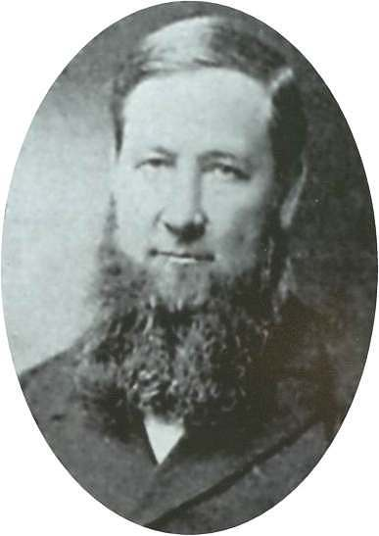
Sand Creek Meeting
August 18, 1889, Shelby County, Illinois
An annual gathering place of
conservative Disciples since 1871
Above 6000 in attendance
Daniel Sommer (1850-1940) presented the gospel in two speeches
  Speech one outlined the differences that took place within the disciples movement
  Speech two, in the afternoon, was an evangelistic sermon
  A formal signing of a written declaration to separate from liberal Disciples was signed

Slide 11
Sand Creek Meeting
Sommer discussed the intention
of the “Declaration and Address” of
September 7, 1809 by T. Campbell
He reviewed the distinctive position of Disciples between faith and opinion, and between testimony and inference
He then discussed the effect it had on the Disciples - - Two Different Approaches Since 1832
  Men who held that the plea for unity at all costs was paramount
  Men who regarded the restoration principle as paramount
Lastly, a bold charge that the former had abandoned soundness, and through innovation had “produced evils plaguing the brotherhood”

Slide 12
Sand Creek Meeting
Sommer Charged — Disciples
Innovation Included:
  One-Man Pastorates
  Missionary Societies
  Modern Methods of Raising Money
    Ladies Festival in one Ohio church to raise money for curtains and carpet for the meetinghouse
    Children with “brown jugs on begging expeditions”
    Box Suppers and Pound Parties
  Instrumental Music In Worship
Claimed That Urban Churches Were The Main Culprits In This Departure

Slide 13
Breakdown Of Movement
Class | Conservatives | Liberals
Religious Authority | Faith/Testimony | Opinion/Inference
Church Government | Plurality Of Bishops | One-Man Pastorate
Preaching The Gospel | Through The Church | Through Missionary Society
Finances | Giving Through Simplicity | Fairs, Festivals & Begging
Music | Congregational Singing | Instrumental Music
Character of Members | Poor, pious, simple, humble, peace-loving, honest | Rich, shameless, arrogant, divisive, “usurpers of other men’s labors”

Slide 14
Seven Signs The Brought Separation
Tears Shed By Loyal Christians
Angry and unchristian words and
actions from liberals
Strifes and alienations
Divisions
Lost opportunities to save souls
Expenditures of time, money and strength
Feuds, “heartburning and heartbreaking”

Slide 15
After The Civil War
1874 – Tolbert Fanning Dies At Elm Crag, Nashville, Tennessee
1884 – Firm Foundation Begins In Austin, Texas, Austin McGary Editor
1891 – Nashville Bible School Begins, Later Lipscomb University
In The 1906 U.S. Census The Church of Christ And The Christian Church Was Recognized As Different Entities

Slide 16
Splintering Continues In The
20th Century
March, 1917 Major Controversy In The College Of The Bible Exists Over The Subject Of Higher Criticism, Leading To A Major Split Among Christians, Enter: The Disciples Of Christ
1920s Controversies With R.H. Boll Over Premillennialism
1930s & 40s Relative Quietness Due To Economic Depression & War
1950s To 1970s Battles Over Support Of Institutions/Sunday School/Located Preachers/Christian Colleges/etc.
1980 To Today – The Change Movement – New Hermeneutics/Worship Styles etc.

