Slide 1
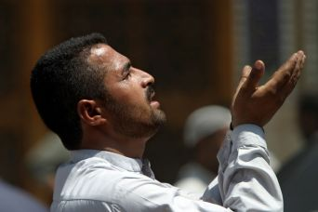
The Beliefs and Practices of Islam

Slide 2
Keeping an Open Mind Toward “Truth”
“What is truth?” Pilate – Jn. 18:38
  Jesus’ response – John 14:6; 8:32; 16:13
  A confirmed truth – Heb. 2:3-4
  We are to “test the spirits” 1 Jn. 4:1
We invite investigation of “the faith”
1 Thes 5:21
Zeal does not establish truth
Violence does not establish truth
Truth is “knowable” Jn. 8:32; Eph. 3:4
Note claims of Islam

Slide 3
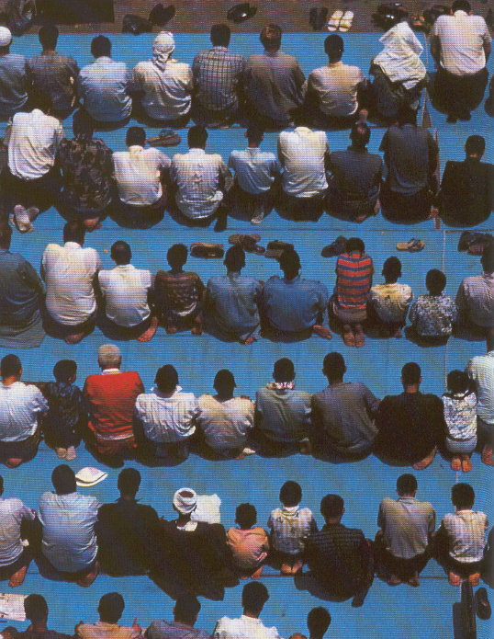
Beliefs of Islam
❖ Core Beliefs
− Monotheistic
− Mohammed is the
last prophet
− The Koran is the last revelation from God

Slide 4
The Koran - Sura 1
Praise be to God, Lord of the worlds!
The Compassionate, the Merciful!
King on the Day of Reckoning!
Thee only do we worship, and to Thee do we cry for help.
Guide Thou us on the straight path,
The path of those to whom Thou has
been gracious; with whom Thou art not angry, and who go not astray.

Slide 5
The Koran - Sura 26:190
Verily from the Lord of the Worlds, hath this Book come down;
The faithful spirit hath come down with it
Upon thy heart, that thou mightest
become a warner -

Slide 6
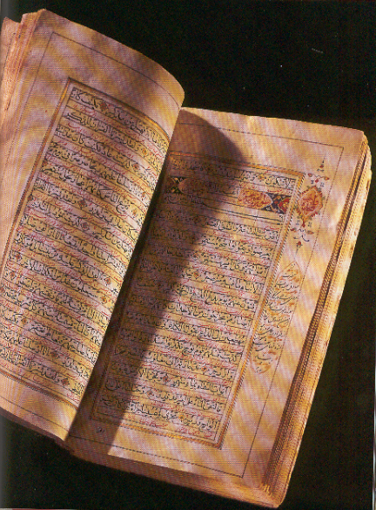
Koran (Qu’ran)
- Organized into “suras”
- Repeated themes:
•Existence of only one God
•Praises to God
•Condemnation of unbelievers
•Reminders of judgment, Paradise, and hell

Slide 7
The Koran - Sura 33:64-68
Verily, God hath cursed the infidels,
and hath got ready for them the Flame:…
On the day when their faces shall be rolled in the Fire, they shall cry:”Oh! Would that we had obeyed God, and obeyed the Apostle!”…
O our Lord! give them a double chastisement, and curse them with a heavy curse.

Slide 8
Muslims teach…
Moses, David, Isaiah, Jesus, Paul, etc. were all prophets of God
The texts of the Old and New Testaments have been altered and thus contain inaccuracies
− also teach that the Qu’ran is without flaw or corruption

Slide 9
- Literary characteristics:
Absence of narrative
Repeated themes
Lack of direction, cohesiveness
Muslims teach…
One cannot receive the full benefit and experience the true power of the Koran unless one reads it in Arabic

Slide 10
Other sources of authority
Hadith in religious use is often translated as 'tradition', meaning a report of the teachings, deeds and sayings of the Islamic prophet Muhammad. The hadith literature was compiled from oral reports that were present in society around the time of their compilation after the death of Muhammad. Bukhari’s collection is considered by many traditional religious scholars as the most reliable, it was compiled two centuries after the death of the Prophet.

Slide 11
Other sources of authority
Sharia - legal and moral guidance compiled by Muslim scholars; civil law is based upon it in some Muslim countries
Muslims prefer this legal system even while living in non-Muslim countries
It assumes a sub-culture that is not amenable to national legal systems, e.g. US Constitution.
This keeps Muslims from integrating into local customs and neighborhoods.

Slide 12
The Sunni / Shi'a Division
Controversy over the leadership after Mohammed’s death involving Ali, his son- in-law and cousin
Ali becomes fourth caliph but then is assassinated
A civil war and a schism occurs:
  - Party of Ali or “Shi’a”
- “Sunni” (tradition) becomes the name for the mainstream

Slide 13
The initial difference was political
The are a few variations in practice
Bad blood between the two groups developed because of violent power struggles
Government rule is seen as the protector of religious faithfulness thus, there is a religious zeal that fuels this division
It is not unusual to see Muslim kill Muslim due to sectarian violence (Note: Isis)

Slide 14
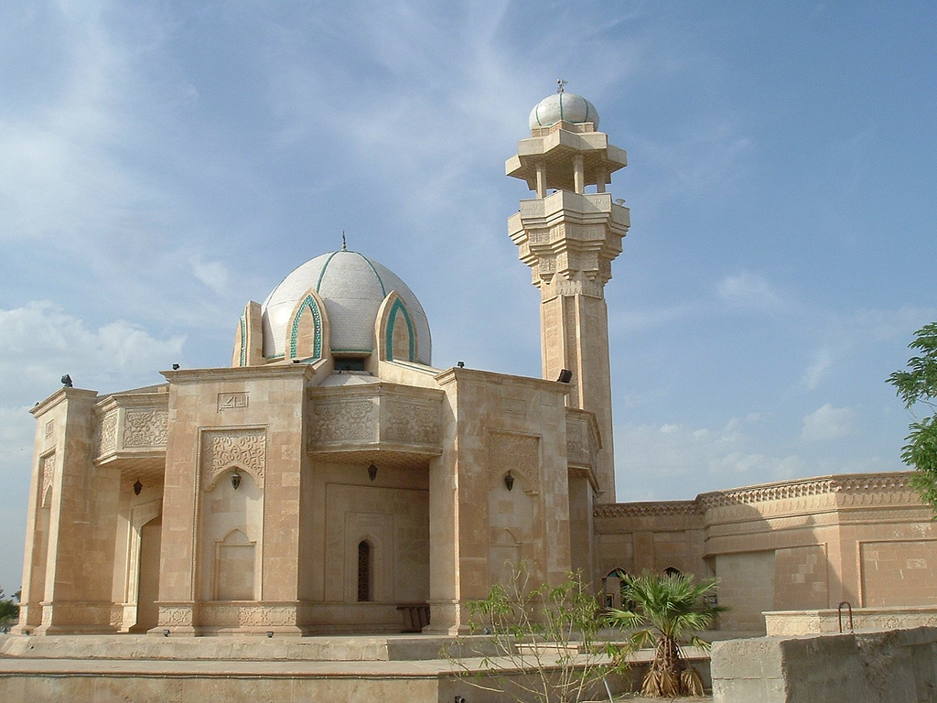
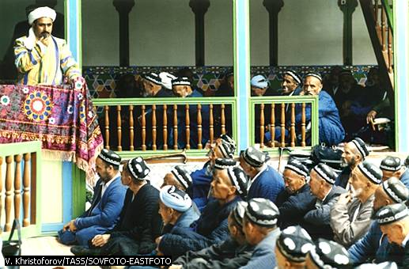
Practices of Islam
The Mosque
Friday meetings:
Prayers
Readings
Preaching

Slide 15
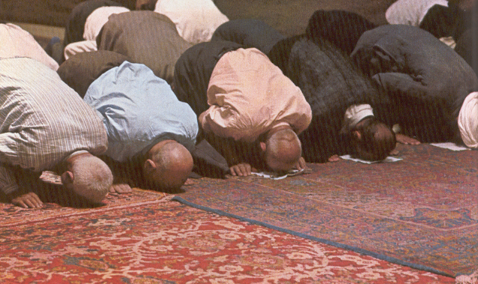
The Five Pillars of Islam
Confession – “There is no God but one God (Allah) and Mohammed is His prophet”
Prayer
- 5 times a day
- Toward Mecca

Slide 16
Alms
- 2% of worth annually
Fasting
- During the month of Ramadan (ninth month of their calendar)
- During daylight hours only
Pilgrimage - The Hajj
- Once in a lifetime if possible

Slide 17
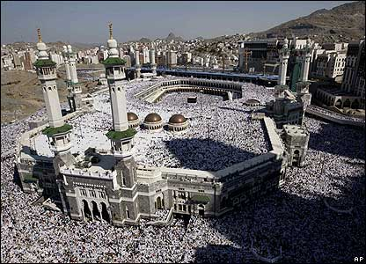
The Grand Mosque

Slide 18
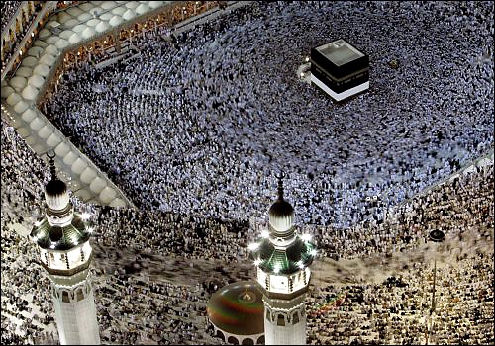

Slide 19
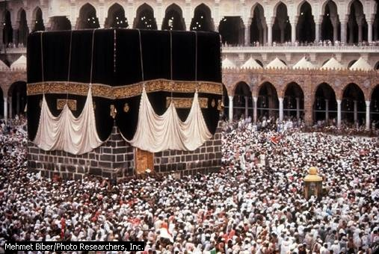

Slide 20
According to the Qu’ran the Ka'aba was built by the prophet Abraham and his son Ishmael as a house of monotheistic worship. However, by the time of Muhammad, the Ka'aba had been taken over by pagan Arabs to house their numerous tribal gods. In 630 A.D., Muhammad and his followers took over leadership of Mecca after years of persecution. Muhammad destroyed the idols inside the Ka'aba and re-dedicated it as a house of monotheistic worship.

Slide 21
It should be noted that Muslims do not worship the Ka'aba and its environs. Rather, it serves as a focal and unifying point among the Muslim people. During daily prayers, Muslims face toward the Ka'aba from wherever they are in the world (this is known as "facing the qiblah"). During the annual pilgrimage (“Hajj”), Muslims walk around around the Ka'aba in a counter-clockwise direction (a ritual known as "tawaf").

Slide 22
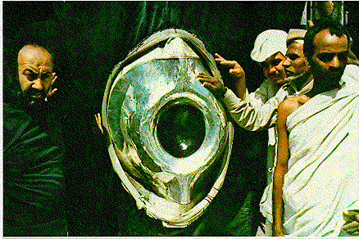

Slide 23
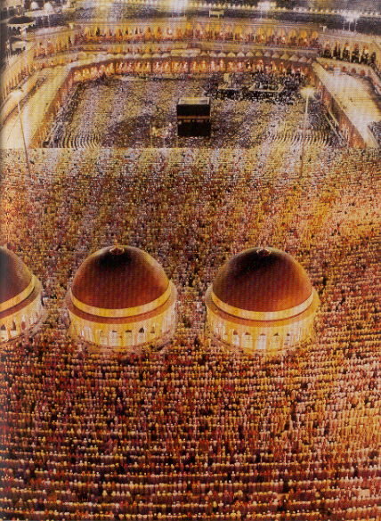
Muslims only are allowed
Approximately 2 million within one month
Many deaths
(old age, sickness,
tramplings)

Slide 24
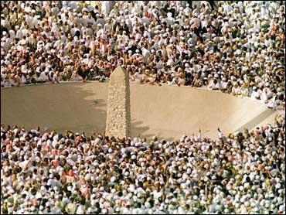

Slide 25
Muslims Believe in Salvation By Works
Generally speaking, there are only two methods of salvation in all the religions of the world: grace and works. Christianity is a religion of salvation by grace: "For by grace through faith you have been saved, not of works . . . " (Eph. 2:8-9). All other systems rely totally or in part on the works of the believer to merit salvation. On the Day of Judgment, if a Muslim's good works outweigh his bad ones and if Allah so wills it, he may be forgiven of all his sins and then enter into Paradise. Therefore, Islam is a religion of salvation by works because it combines man's works with Allah's grace. Consider the following verses from the Qur'an. (All quotes from the Qur'an are from The Holy Qur'an, Mushaf Al-Madinah An-Nabawiyah, Revised and Edited by THE PRESIDENCY OF ISLAMIC RESEARCH, IFTA, Call and Guidance, the Custodian of the Two Holy Mosques King Fahd Complex, for the Printing of the Holy Qur-an).

Slide 26
Muslims Believe in Salvation By Works
"To those who believe and do deeds of righteousness hath Allah promised forgiveness and a great reward," (Surah 5:9).
"And He answers those who believe and do good deeds, and gives them more out of His grace; and (as for) the unbelievers, they shall have a severe punishment," (42:26, trans. by M.H. Shakir).
"O you who believe! If you are careful of (your duty to) Allah, He will grant you a distinction and do away with your evils and forgive you; and Allah is the Lord of mighty grace," (8:29, trans. by M.H. Shakir).

Slide 27
Muslims Believe in Salvation By Works
"O you who believe! be careful of (your duty to) Allah and speak the right word, He will put your deeds into a right state for you, and forgive you your faults; and whoever obeys Allah and His Apostle, he indeed achieves a mighty success," (33:70-71, trans. by M.H. Shakir).
". . . If you obey GOD and His messenger, He will not put any of your works to waste. GOD is Forgiver, Most Merciful," (49:14).

Slide 28
Muslims Believe in Salvation By Works
"Then those whose balance (of good deeds) is heavy, they will be successful. But those whose balance is light, will be those who have lost their souls; in hell will they abide," (23:102-103).
"And We set a just balance for the Day of Resurrection so that no soul is wronged in aught. Though it be of the weight of a grain of mustard seed, We bring it. And We suffice for reckoners," (21:47).

Slide 29
The Bible: Justification by Faith
Eph 2:8-9 “By grace through faith…”
God’s Grace – John 3:16; Rom. 5:8-9
Man’s Faith – in Jesus Christ – John 8:24; 8:58
Means of forgiveness – blood of Christ –
Heb. 9:11-14; 1 John 1:7
Reach blood in baptism – Rom. 6:1-7; Acts 22:16

Slide 30
Other Beliefs: ANGELS OF ALLAH
The word ‘angel’ means ‘messenger’. Angels are a special creation of Allah. They are made of divine light (nur) to carry out specific jobs. Although angels have been given important qualities and powers, they do not have the freedom of choice as man does. They are the innocent servants of Allah, who always obey His commands, because they don’t have the power to disobey Him. Unlike mankind, they won’t be judged on the Day of Judgement.
Angels don’t need sleep and they don’t require the things a human being would need. Angels never get tired, therefore they are always at work. Their duty is to praise Allah and help mankind in carrying out the decisions they make throughout their lives. We can not see the angels, unless they take a human form. Angels can take any form, which is suitable for their job. When ever a person prays to Allah, thinks or talks about Allah, the angels gather round and join in. Their presence helps to build up an atmosphere of worship.

Slide 31
JIHAD Although Allah doesn’t force us into doing anything, He has told us that we must follow Islam if we want to succeed in this life and the Hereafter. In order to become good people, we must form a united effort in trying to obey Allah. This unity is called Jihad, which means "to try one’s utmost best/ striving" to see truth prevail and falsehood vanish. The aim of Jihad is to please Allah. At first, a Muslim must learn to control his/her own bad desires and intentions. This is called Jihad within ourselves, which is the basis of implementing right (Ma’ruf) and removing evil (Munkar) from society. In order to achieve Jihad within ourselves, we must perform basic Islamic duties. After Jihad within ourselves, we may have to give up our lives for Islam. A person who dies in a war for Islam is called a ‘Shahid’ which means martyr. - By Fazeela Hanif

Slide 32
Central Doctrines of Christianity
(This will be covered more fully later)
Matthew 16:
16 Simon Peter answered and said, "You are the Christ, the Son of the living God."
17 Jesus answered and said to him, "Blessed are you, Simon Bar-Jonah, for flesh and blood has not revealed this to you, but My Father who is in heaven.
Jesus is the Christ, the SON of GOD

Slide 33
Central Doctrines of Christianity
Romans 5:
8 But God demonstrates His own love toward us, in that while we were still sinners, Christ died for us.
9 Much more then, having now been justified by His blood, we shall be saved from wrath through Him.
Jesus died on the cross as a sacrifice for man’s sins

Slide 34
Central Doctrines of Christianity
Acts 10:
39 "And we are witnesses of all things which He did both in the land of the Jews and in Jerusalem, whom they killed by hanging on a tree.
40 "Him God raised up on the third day, and showed Him openly,
Jesus was raised from the dead

Slide 35
The Koran Denies Jesus’ Deity
Sura 4:169
The Messiah, Jesus, son of Mary, is only an apostle of God, and His word which He conveyed into Mary, and a spirit proceeding from Himself….God is only one God! Far be it from His glory that He should have a son!

Slide 36
The Koran
Sura 4:156
And for their saying, “We have slain the Messiah, Jesus the Son of Mary, an apostle of God.” Yet they slew him not, and they crucified him not, but they had only his likeness…but God took him up to himself.

Slide 37
Islam’s teaching on Jesus
The Koran denies…
Jesus was crucified
Jesus was resurrected
Jesus was the Son of God
These are at the very heart of what Christianity is all about!

