Slide 1
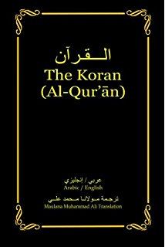
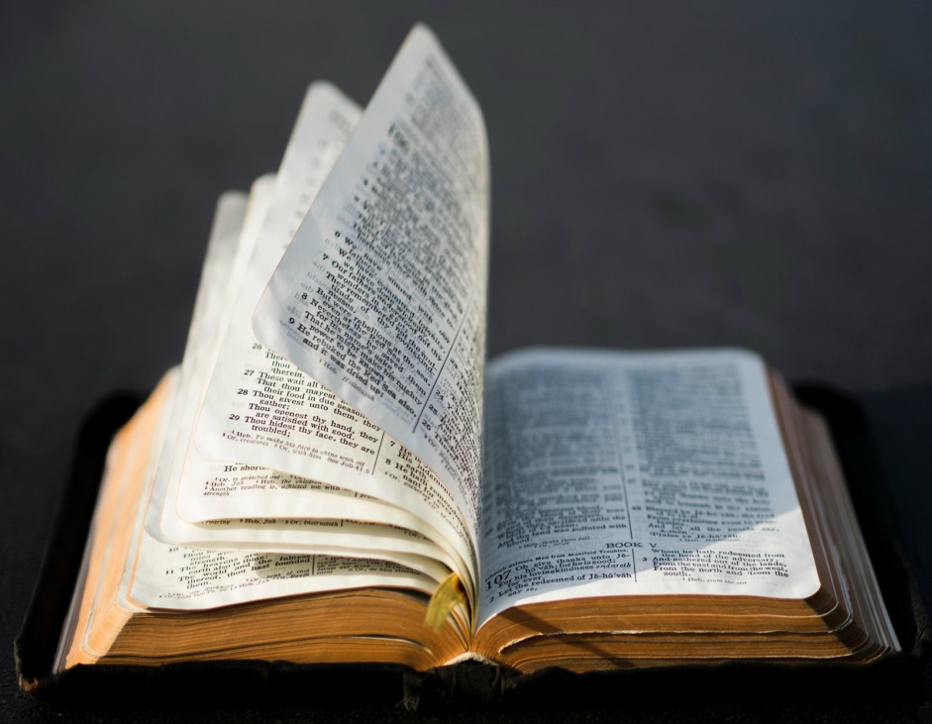
A look at the Bible and the Koran: Side by Side

Slide 2
Is the Bible Inspired of God? - 2 Timothy 3:16-17
16 Every scripture inspired of God is also profitable for teaching, for reproof, for correction, for instruction which is in righteousness: 17 that the man of God may be complete, furnished completely unto every good work.

Slide 3
Is the Bible Inspired of God? - I Cor. 2:12-13
¹² But we received, not the spirit of the ^{[a]}world, but the spirit which is from God; that we might know the things that were freely given to us of God. ¹³ Which things also we speak, not in words which man’s wisdom teacheth, but which the Spirit teacheth; ^{[b]}combining spiritual things with spiritual words.

Slide 4
Is the Bible Inspired of God ? - 2 Pet. 1:21
²¹ For no prophecy ever ^{[a]}came by the will of man: but men spake from God, being moved by the Holy Spirit.

Slide 5
Is the Bible Authoritative ? - 2 Jn. 9
⁹ Whosoever ^{[a]}goeth onward and abideth not in the teaching of Christ, hath not God: he that abideth in the teaching, the same hath both the Father and the Son.

Slide 6
Is the Bible Authoritative ? - I Cor. 4:6
⁶ Now these things, brethren, I have in a figure transferred to myself and Apollos for your sakes; that in us ye might learn not to go beyond the things which are written; that no one of you be puffed up for the one against the other.

Slide 7
Has the Bible Been Changed?
5,600 manuscripts…100 years from original
Fragment of John 18:31-33; 37-38
Most of the N.T. within 200 years of original
Entire N.T. within 300 years
Over 86,000 Quotations from early church fathers
Dead Sea Scrolls discovery and Study – 250 B.C. to A.D. 68

Slide 8
Are our Scriptures Inspired of God?
He has sent down upon you, [O Muhammad], the Book in truth, confirming what was before it. And He revealed the Torah and the Gospel.
Before, as guidance for the people. And He revealed the Qur'an. Indeed, those who disbelieve in the verses of Allah will have a severe punishment, and Allah is exalted in Might, the Owner of Retribution.
Surah 3:3-4

Slide 9
Are our Scriptures Inspired of God?
“Those who follow the Messenger, the unlettered prophet, whom they find written in what they have of the Torah and the Gospel, who enjoins upon them what is right and forbids them what is wrong and makes lawful for them the good things and prohibits for them the evil and relieves them of their burden and the shackles which were upon them…”
Surah 7:157

Slide 10
Are our Scriptures Inspired of God?
…So they who have believed in him, honored him, supported him and followed the light which was sent down with him - it is those who will be the successful.
Surah 7:157

Slide 11
Can Allah’s Words Be Altered ?
[Say], "Then is it other than Allah I should seek as judge while it is He who has revealed to you the Book explained in detail?" And those to whom We [previously] gave the Scripture know that it is sent down from your Lord in truth, so never be among the doubters.
Surah 6:114

Slide 12
Can Allah’s Words Be Altered ?
And the word of your Lord has been fulfilled in truth and in justice. None can alter His words, and He is the Hearing, the Knowing.
Surah 6:114

Slide 13
Say, "O People of the Scripture, you are [standing] on nothing until you uphold [the law of] the Torah, the Gospel, and what has been revealed to you from your Lord." And that which has been revealed to you from your Lord will surely increase many of them in transgression and disbelief. So do not grieve over the disbelieving people.
Your Scriptures Have Been Corrupted???
But how is it that they come to you for judgement while they have the Torah, in which is the judgement of Allah ? Then they turn away, [even] after that; but those are not [in fact] believers.
Surah 5:43

Slide 14
Say, "O People of the Scripture, you are [standing] on nothing until you uphold [the law of] the Torah, the Gospel, and what has been revealed to you from your Lord." And that which has been revealed to you from your Lord will surely increase many of them in transgression and disbelief. So do not grieve over the disbelieving people.
Your Scriptures Have Been Corrupted???
And let the People of the Gospel judge by what Allah has revealed therein. And whoever does not judge by what Allah has revealed - then it is those who are the defiantly disobedient.
Surah 5:47

Slide 15
Say, "O People of the Scripture, you are [standing] on nothing until you uphold [the law of] the Torah, the Gospel, and what has been revealed to you from your Lord." And that which has been revealed to you from your Lord will surely increase many of them in transgression and disbelief. So do not grieve over the disbelieving people.
Your Scriptures Have Been Corrupted???
Say, "O People of the Scripture, you are [standing] on nothing until you uphold [the law of] the Torah, the Gospel, and what has been revealed to you from your Lord." And that which has been revealed to you from your Lord will surely increase many of them in transgression and disbelief. So do not grieve over the disbelieving people.
Surah 5:68

Slide 16
Say, "O People of the Scripture, you are [standing] on nothing until you uphold [the law of] the Torah, the Gospel, and what has been revealed to you from your Lord." And that which has been revealed to you from your Lord will surely increase many of them in transgression and disbelief. So do not grieve over the disbelieving people.
Were the early Korans burnt?
"Send us the manuscripts of the Qur'an so that we may compile the Qur'anic materials in perfect copies and return the manuscripts to you." Hafsah sent copies to Uthman.
Sahih Bukhari – Vol. 6, Book 61; Number 510

Slide 17
Say, "O People of the Scripture, you are [standing] on nothing until you uphold [the law of] the Torah, the Gospel, and what has been revealed to you from your Lord." And that which has been revealed to you from your Lord will surely increase many of them in transgression and disbelief. So do not grieve over the disbelieving people.
Were the early Korans burnt?
Uthman then ordered four men to rewrite the manuscripts in perfect copies. After this had been done, the Hafsah codex was returned to her. "Uthman returned the original manuscripts to Hafsah."
Sahih Bukhari – Vol. 6, Book 61; Number 510

Slide 18
Say, "O People of the Scripture, you are [standing] on nothing until you uphold [the law of] the Torah, the Gospel, and what has been revealed to you from your Lord." And that which has been revealed to you from your Lord will surely increase many of them in transgression and disbelief. So do not grieve over the disbelieving people.
Were the early Korans burnt?
Uthman sent to every Muslim province one copy of what they had copied, and ordered that all the other Qur'anic materials, whether written in fragmentary manuscripts or whole copies, be burnt.
Sahih Bukhari – Vol. 6, Book 61; Number 510

Slide 19
Say, "O People of the Scripture, you are [standing] on nothing until you uphold [the law of] the Torah, the Gospel, and what has been revealed to you from your Lord." And that which has been revealed to you from your Lord will surely increase many of them in transgression and disbelief. So do not grieve over the disbelieving people.
Abdullah Mas’ud
"How can you order me to recite the reading of Zaid, when I recited from the very mouth of the Prophet some seventy Surahs?" "Am I," asks Abdullah, "to abandon what I acquired from the very lips of the Prophet?" (Masahif" by Ibn abi Dawood, 824-897 AD, pp. 12, 14).
Sahih Bukhari – Vol. 5, Book 58; Number 150

