Slide 1
NIDHI WORKS MODULE PRESENTATION
ON 29-01-2024

Slide 2
EVOLUTION OF WORK BILL SUBMISSION TO PAO ORGANISATION FOR ARRANGING PAYMENT
AT FIRST INSTANCE WORK BILLS OF IRRIGATION DEPARTMENT(NOW WRD), R&B DEPARTMENTS WERE ARRANGING FOR PAYMENT AT PAO ORGANISATION MANNUALY.
LATER ALL ENGINEERING DEPARTMENTS SUCH AS PRED,RWS,PH&MED,FOREST DEPARTMENTS WERE BROUGHT IN TO PURVIEW OF PAO ORGANISATION FOR ARRANGING PAYMENT OF WORK BILLS.
THE FINANCE WORKS ACCOUNTS DEPARTMENT ORGANISATION DURING 2012 INTRODUCED A WEB APPLICATION NAMELY “BMS- BILLS MONITORING SYSTEM” FOR PROCESSING OF WORK BILLS OF ALL ENGINEERING DEPARTMENTS AND SUBMISSION OF MONTHLY ACCOUNTS, REMITTANCE OF STATUTORY RECOVERIES etc.,
LATER APCFSS INTRODUCED “COMPREHENSIVE FINANCIAL MANAGEMENT SYSTEM - CFMS” PHASE-I WEBSITE ON SAP PLATFORM DURING 2018 FOR PROCESSING OF WORK BILLS OF ALL ENGINEERING DEPARTMENTS AND ARRANGING PAYMENT THROUGH RBI PLATFORM

Slide 3
EVOLUTION OF WORK BILL SUBMISSION TO PAO ORGANISATION FOR ARRANGING PAYMENT
UPON SUCCESS OF CFMS PHASE-I TO EASE OF ACCESS AND TO PROVIDE END TO END DIGITALISATION PROCESS, APCFSS UPGRADED CFMS PHASE-II FROM 2021 ONWARDS IN RESPECT OF ALL WORKS MODULES I.e., AS,TS,AGREEMENT,DIGITAL M-BOOK,BILLING.
TO BRING EFFECTIVENESS IN THE SYSTEM WITH ENHANCED FEATURES,BASED ON THE FEED BACK RECEIVED FROM END USERS, NIDHI WORKS MODULE IS DEVELOPED SUBSEQUENTLY TO MAKE IT MORE USER FRIENDLY.
NIDHI MODULE DEVLOPED IN JAVA PLATFORM BEING LAUNCHED RECENTLY DURING 8-11-2023 ON PILOT PROJECT BASIS TO 13 IDENTIFIED DIVISIONS OF PRED ACROSS THE STATE.

Slide 4
ENHANCEMENTS/ADDITIONS INTRODUCED IN NIDHI MODULE:
I. ADMINISTRATIVE SANCTION:
MIGRATION PROCESS:
ADMINISTRATIVE SANCTION CREATION AT HOD LEVEL FOR CAPITAL/REVENUE WORKS.
DISTRICT COLLECTOR OR ANY OTHER DISTRICT AUTHORITIES SANCTIONS ENTRY AT CONCERNED SUPERINTENDING ENGINEERS.
PD AUTHORITIES AS SANCTION ENTRIES AT RESPECTIVE PD ADMINISTRATORS LOGINS.
ALREADY ENTERED AND APPROVED AS IN CFMS PHASE-II WILL BE AUTOMATICALLY MIGRATED TO NIDHI WORKS MODULE.
FREE WORK FLOW IS MAINTAINED IN RESPECT OF CONCERNED HOD/CIRCLE/PD OFFICES.

Slide 5
NEW AS CREATION PROCESS IN DIGITAL MODE:
AS PROPOSAL IN NIDHI MODULE CAN BE CREATED BY RESPECTIVE DEPARTMENT AEE/AE IN DIGITAL MODE DULY ENCLOSING LINE/DETAILED ESTIMATE .
THIS PROPOSAL WILL BE SUBMITTED TO HOD/GOVERNMENT THROUGH PROPER AUTHORITIES AND THEREAFTER TO CONCERNED SANCTION DEPARTMENT SECRETARIAT/HOD/PD AUTHORITIES FOR SCRUTINY AND ACCORDING AS IN DIGITAL MODE.
BEFORE ACCORDING AS BY CONCERNED DEPARTMENTS FINANCE CONCURRANCE WILL BE OBTAINED IN DIGITAL MODE.
DUE TO THIS GOVERNMENT/SANCTION AUTHORITIES CAN ACCORD SANCTIONS TO THE EXTENT OF BUDGET AVAILABILITY DULY FOLLOWING FRBM NORMS.
A FACILITY WAS PROVIDED TO R&B DEPARTMENT, TO CREATE CIVIL AND ELECTRIC ESTIMATES SEPARATELY AND BUNDLING AT E-IN-C LEVEL WITH PARALLEL APPROVAL FLOW UP TO CE LEVEL.

Slide 6
ENHANCEMENTS/ADDITIONS IN NIDHI MODULE:
WORK WISE DATA CAPTURING ALONG WITH LOCATION,HOA,DDO AND AMOUNT ALLOCATION IN AS .
SO THAT CONCERNED DDO CAN ACCORD TECHNICAL SANCTION AGAINST THE ALLOCATED AS AMOUNT TO THEIR RESPECTIVE DIVISION.
THIS REDUCES REDUNDANCY WORK BY MULTIPLE EXECUTING ORGANISATIONS AND PROPER UTILISATION OF GO/PROCEEDING AMOUNT.
END-TO-END DIGITAL PROCESS.

Slide 7
II. TECHNICAL SANCTION/DETAILED ESTIMATE:
MIGRATION PROCESS:
TECHNICAL SANCTION CREATION WILL BE ENABLED TO CONCERNED EXECUTING DEPARTMENT AUTHORITIES AT DIVISION/SUB-DIVISION LEVEL.
ALREADY ENTERED AND APPROVED TS ALONG WITH LATEST VERSION OF ESTIMATE IN CFMS PHASE-II WILL BE AUTOMATICALLY MIGRATED TO NIDHI WORKS MODULE.
FREE WORKFLOW MAINTAINED AT DIVISION LEVEL BY CONCERNED EXECUTIVE ENGINEER.
NEW DIGITAL TS PROCESS:
GENERATION OF TS NEED TO BE DONE BY CONCERNED DDO ONLY WHO ARE MENTIONED IN AS WORK.
THIS WILL STOP THE USING OF OTHER DDOs WORKS AND THEIR AMOUNTS.
NEW DETAILED ESTIMATE WITH DERIVED SOR SPECIFICATIONS CAN BE PREPARED BY USERS.

Slide 8
ENHANCEMENTS/ADDITIONS IN NIDHI MODULE:
A PROVISION OF STANDARD SAMPLE ESTIMATE/TEMPLATES MADE AVAILABLE BASED ON NATURE OF WORK AND DEPARTMENT SPECIFIC.
A PROVISION WAS ENABLED FOR REPLACEMENT OF SPECIFICATION IN AN ORDER.
AN OPTION FOR ENTRY OF DEPARTMENT SPECIFICATION DESCRIPTION IN ADDITION TO SOR WAS PROVIDED FOR USER COMPATIBILITY.
A PROVISION BEING MADE FOR UPLOADING EXCEL PREPARED LINE ESTIMATE.

Slide 9
III. AGREEMENT:
MIGRATION /NEW PROCESS:
AGREEMENTS ALREADY CREATED AND APPROVED IN CFMS PHASE-II WERE SHOWN IN CONCERNED DDOs LOGIN.
ONE TIME CONFIRMATION OF AVAILABLE DATA, WITH ALREADY PAID QUANTITIES AND AMOUNTS ARE TO BE CONFIRMED BY CONCERNED USER.
THIS WILL ENABLE FOR SMOOTH PROCESS OF FURTHER FLOW IN NIDHI MODULE.
MILESTONES, DETAILS OF EMD CHALLAN/BGs ARE TO BE CONFIRMED.
FIXED WORK FLOW MAINTAINED FOR MAKER,CHECKER AND APPROVER FOR APPROVAL PROCESS OF AGREEMENT DATA.

Slide 10
ENHANCEMENTS/ADDITIONS IN NIDHI MODULE:
EXTENSION OF AGREEMENT TIME(EOAT) ENTRY PROVIDED IN A SEPARATE TILE WITHOUT AMENDING AGREEMENT.
PENALTY/LDs OPTION CAN BE ENABLED IN EOAT SCREEN.
SUPPLEMENTARY AGREEMENTS WITH COMPREHENSIVE OVERVIEW i.e., ADD,DELETE AND CHANGED SPECIFICATION WITH DIFFERENT COLOUR PATTERN PROVIDED FOR EASY IDENTIFICATION TO USER.
IN EPC UP TO 32 SUB-LEVELS(MAIN/SUB COMPONENTS) CAN BE CAPTURED DULY PROVIDING RELATIONSHIP BETWEEN PARENT AND CHILD SPECIFICATIONS IN A SINGLE VIEW.
IN EPC AGREEMENTS WHILE ENTERING PAYMENT, SCHEDULE PERCENTAGES UP TO SEVEN DECIMALS CAN BE CAPTURED.

Slide 11
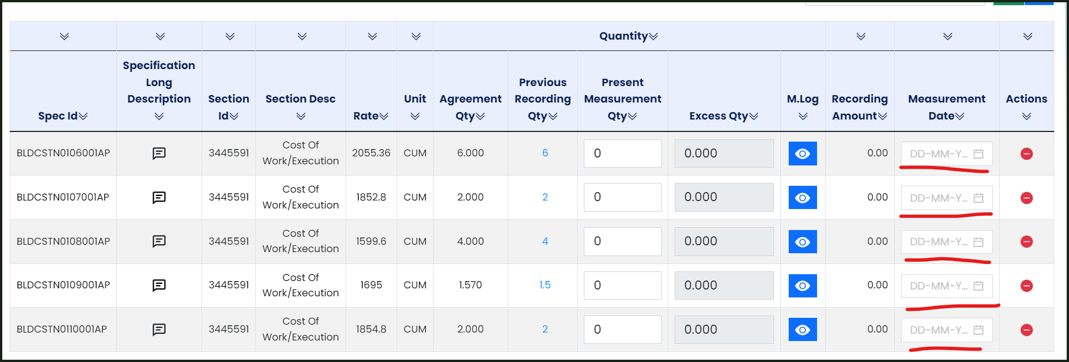
IV. DIGITAL M-BOOK:
THE DIGITAL MBOOK WORK FLOW IS CAPTURED AS PER THE AGREEMENT NO. THIS REDUCES THE CONFUSION AND PAIN OF WORKFLOW CONFIGURATION AS IN SAP MODULE.
WORK FLOW FOR MBOOK CAN BE DEFINED UP TO SECTION LEVEL IN THE AGREEMENT. THIS FACILITATES THE USER TO CREATE MULTIPLE MAKERS AND CHECKERS AGAINST THE SINGLE AGREEMENT.
IN RESPECT OF MIGRATION ABSTRACT QUANTIES AFTER DERIVING SPECIFICATION FROM TS USER CAN ENTER DATES AT A STRETCH IN ONE PAGE AS PER PHYSICL M BOOK WITHOUT CREATION OF MULTIPLE PAGES.

Slide 12
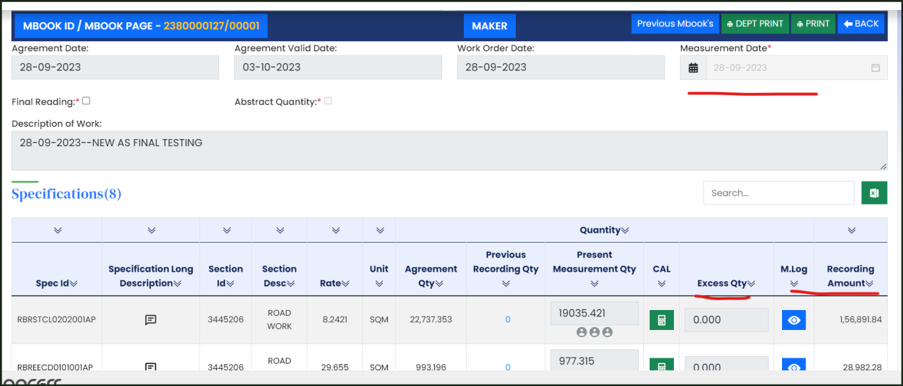
IV. DIGITAL M-BOOK:
IN RESPECT OF NEW WORKS DETAILED MEASUREMENTS TO BE RECORDED. FOR EACH DATE SEPARATE PAGE IS TO BE CREATED. SYSTEM WILL DERIVE SPECIFICATIONS AND RATES FOR THE EXECUTED QUANTITIES. AMOUNT OF THAT PAGE WILL BE AUTO GENERATED.

Slide 13
ENHANCEMENTS/ADDITIONS IN NIDHI MODULE:
IN SAP SINGLE SPECIFICATION RECORDING ONLY AVAILABLE, USER SHOULD COME BACK AND NEED TO LOAD ANOTHER SPECIFICATION. FURTHER SPECIFICATIONS VISIBILITY IN SAP IS HORIZONTAL VIEW.
IN NIDHI MODULE THE SPECIFICATIONS CAN BE SELECTED IN A SINGLE STRETCH AND ALL ARE VISIBLE IN A VERTICAL COMPREHENSIBLE VIEW. THIS WILL REDUCES THE TIME DURING MEASUREMENT OF QUANTITIES.
SPECIFICATION WISE RECORDING DATES ARE PROVIDED WHICH IN TURN REDUCES THE CANCELLATION AND RE-PROCESS OF M BOOK.
WORK FLOW IS TO MAINTAIN AEE/DEE/EE/QC/SE.
QC IS MANDATORY FOR THE WORKS ABOVE 2CRORES.
MOBILE APPLICATION IS DEVELOPED FOR RECORDING OF MEASUREMENTS FROM FIELD LEVEL.

Slide 14
V. BILLING:
THERE ARE NO MAJOR CHANGES IN BILLING PROCESS BETWEEN SAP & NIDHI MODULE.
WITHOUT DIGITAL M BOOK BILLING WILL NOT BE POSSIBLE IN NIDHI MODULE.
AFTER APPROVAL OF BILL BY CONCERNED PAO, PAYMENT WILL BE PROCESSED IN SAP MODULE THROUGH INTERFACE.

Slide 15
OTHER ENHANCEMENTS/ADDITIONS:
PS AUDIT, PRE-AUDIT, PD AUDIT ORGANISATIONS MAPPING ENABLED TO DOWA.
IN RESPECT OF EPC WORKS VENDOR CREATION DELEGATED TO SE LEVEL.
SOR SPECIFICATIONS CREATION, UPLOADING OF MATERIAL RATES,ADDING OF NEW MATERIALS,MAPPING OF SPECIFICATIONS WILL BE ENABLED TO HODs.
DDO-HOA MAPPING TOOL ENABLED TO DOWA.
IN TS ADDING OF GST UNDER LS PROVISIONS MADE MANDATORY FOR WORKS COSTING Rs 2.50 LAKHS AND ABOVE.
PULL BACK OPTION FOR ALL THE DOCUMENTS LIKE AS,TS,AG AND MB IS AVAILABLE IN CASE THE DOCUMENT IS SENT TO WRONG PERSON BY MISTAKE.

Slide 16
USER GUIDANCE TIPS
USER SHOULD ADDRESS A LETTER TO DIRECTOR OF WORKS ACCOUNTS FOR DDO & HOA MAPPING AND TO SUBMIT THROUGH MAIL ID dwa-finance@ap.gov.in AND sreenivasvendra@apcfss.in
IF THE “APPROVER BUTTON” IS NOT DISPLAYED, POST RELEVANT INFORMATION IN PRED NIDHI 13 PILOT PROJECT DIVISIONS WATSAPP IN GROUP WITH CONCERNED EMPLOYEE POSITION ID AND CFMS ID.
IF ANY ISSUE FACED DURING ENTRY PROCESS IN NIDHI MODULE, PLEASE RAISE AN “SRT “ UNDER “NIDHI” MODULE TAB DULY ATTACHING A LETTER WITH EE’S SIGNATURE LETTER WITH PROPER EXPLANATION.
ONLY ONE “AS” SHOULD BE CREATED FOR “ONE G.O”.
SYSTEM WILL NOT CALCULATE “SEIGNIORAGE” VALUE FOR “NONSOR” ITEMS. USE MANUAL OPTION FOR SUCH SPECIFICATIONS TO CALCULATE SEIGNIORAGE CHARGES.
THE LATEST DOCUMENT INFORMATION SHOULD BE POSTED WHILE DOING THE MIGRATION WORK.

Slide 17
USER GUIDANCE TIPS
CHOOSE LS PROVISIONS LISTED FROM 1 TO 16 AS THEY ARE LINKED TO OTHER APPLICATIONS OF WORK.
OPT LS FLEXIBLE PROVISIONS, FOR OTHER THAN LISTED FROM 1TO16 ITEMS TO CLAIM WORK OTHER CHARGES BILL.
IN TS ESTIMATE “PRICE ADJUSTMENT” AND “TENDER PERCENTAGE” FIELDS GIVEN ONLY VALUES INSTEAD OF PERCENTAGES.
IF THE ESTIMATE CONTAINS “HTTC” CHARGES, OPT “LS024” ITEM.
CROSS CHECK THE VENDOR DETAILS, AGREEMENT DETAILS, CHALLAN/BG INFORMATION BEFORE SUBMITTING THE AGREEMENT.
SRTS WITH COURT CASES SHOULD BE INFORMED TO THE WORKS TEAM BEFORE 7 WORKING DAYS.

Slide 18
USER GUIDANCE TIPS
CHALLANS WHICH ARE NOT BROUGHT INTO “CFMS”, RAISE SRT UNDER “RECEIPTS & CHALLANS CATEGORY” WITH “TREASURY APPROVAL LETTER” DULY ADDRESSING A SEPARATE LETTER TO DOWA (THROUGH PAO/APAO).
BEFORE SAVING THE BILL, PLEASE ENTER “GROSS AMOUNT IN COST DISTRIBUTION FIELD” IN ORDER TO AVOID “GROSS AMOUNT DOESN’T MATCH WITH COST DISTRIBUTION”.
ALL REIMBURSABLE ITEMS ARE LINKED WITH “LS PROVISION” IN APPROVED “TS ESTIMATE”.
BILL ABSTRACT HYPERLINK : USEFUL TO VERIFY THE AGMT QUANTITIES, RECORDED QUANTITIES, BALANCE QUANTITIES ETC..,
USERS ARE ADVISED TO CHECK ALL THE “HOAS OF THE DEDUCTIONS” IN THE BILL BEFORE APPROVAL.
USER ALWAYS ADVISED TO CHECK ALL THE FIELDS ONCE/TWICE BEFORE APPROVAL. ANY UNUSUAL ISSUES MAY BE TIMELY BROUGHT TO CFMS TEAM NOTICE.

Slide 19
USER GUIDANCE TIPS
IF THERE IS A CHANGE OF “MAKER/CHECKER” THEN BEFORE RELIEVING TO THEIR DUTIES IT IS MANDATORY TO MAKE A “SUBSTITUTE” TO THAT EMPLOYEE OR OTHERWISE THE DOCUMENTS IN THEIR LOGINS WILL NOT APPEAR. IN CASE OF CHANGE OF “APPROVER” IT IS BETTER TO RETURN ALL THE DOCUMENTS IN HIS LOGIN I.E., AS, TS, AGREEMENT, MBOOK, BILLING OR OTHERWISE HE WOULD HAVE TO APPROVE THE EXISTING DOCUMENTS IN HIS LOGIN.
WHILE ENTERING MIGRATION DETAILS IN THE “AGREEMENT” APPLICATION CAREFULLY ENTER ALL THE “PREVIOUS PAID PAYMENT DETAILS” AGAINST TO THE FIELDS, AS THIS IS LINKED TO THE BILLING.
ALL THE USERS ARE REQUESTED TO NOTE THAT SYSTEM WILL NOT ALLOW TO REDUCE THE “QUANTITIES” IN “WORKING ESTIMATE” WHICH IS ALREADY RECORDED IN THE DIGITAL MBOOK.
WEBSITE LINK :- https://nidhi.apcfss.in/

Slide 20
THANK YOU

