Slide 1

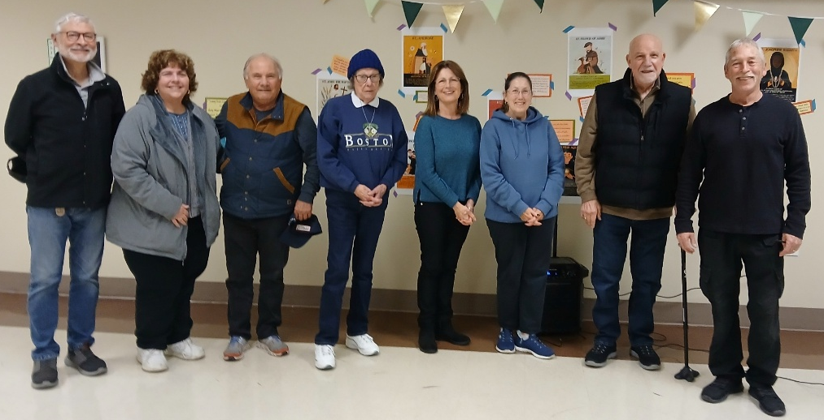
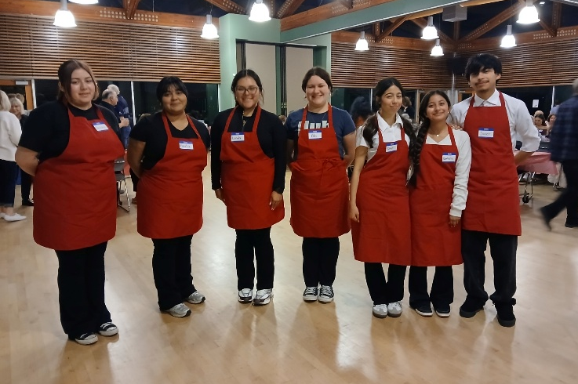
Italian American Citizens Club of South San Francisco
IL CITTADINO
March 2026
Founded 1916
I.A.C.C. ELECTION RESULTS
On Tuesday, January 20 the IACC members gathered to fill six Board positions and two Officer positions. Since only five members were nominated for the Board of Directors, motions were made at the November General Meeting to retain one of three current Board Members for a new term. During the voting process Armando Altamirano, Debbie Cushman, Norm Faria, Rosemarie Garcia and Lin Keller were elected and Rich Garbarino was retained for another term. Barbara Guevara was voted in for a new term as Treasurer and since there were no nominations for President, a motion was made to retain Leo Pierini for an additional term as President. Rich Garbarino was also elected as Trustee.
Board Members and Officers for 2026-2027 (Left to Right) Armando Altamirano, Rosemarie Garcia, Norm Faria, Barbara Guevara, Debbie Cushman, Lin Keller, Rich Garbarino and Leo Pierini
PRESIDENT’S MESSAGE
CRAB FEED FUNDRAISER 2026
South San Francisco High School Italian Class students volunteered to assist in the serving at the annual IACC Crab Feed Fundraiser under the direction of instructor Julianne Franceschi. Their efforts and work are always appreciated and helps the event go off without a hitch. And, of course, they were treated to a crab dinner.
More Crab Feed photos on pages 7 - 10
Dear IACC Members & Friends:
I’d like to thank all those that supported retaining me for an additional term as President of the IACC for 2026-2027.
While we had some unusual situations dictate how the elections were held on January 20, I am happy to welcome the new faces to the Board of Directors with Debbie Cushman, Norm Faria and Lin Keller while Rosemarie Garcia was elected to her second term and Armando Altamirano was also elected. As you may remember, Armando was selected to the Board to fill the last year of Manny Garcia’s term when he was elected Vice President in 2025.
Rich Garbarino was also retained for an additional term for the Board of Director and was elected as the new Trustee, while Barbara Guevara was elected as Treasurer in a special election to align her position with the revised bylaws.
I congratulate Sandra Lencioni for navigating the complex circumstances of these elections, which was no easy task.
In addition to the elections, 2026 kicked off with as bang as
- Continued on page 4
BOARD OF DIRECTOR’S MEETING
IACC Clubhouse
Tuesday, March 3, 2026, 4 pm
GENERAL MEETING
IACC Clubhouse
Tuesday, March 17, 2026, 6:00 pm

Slide 2
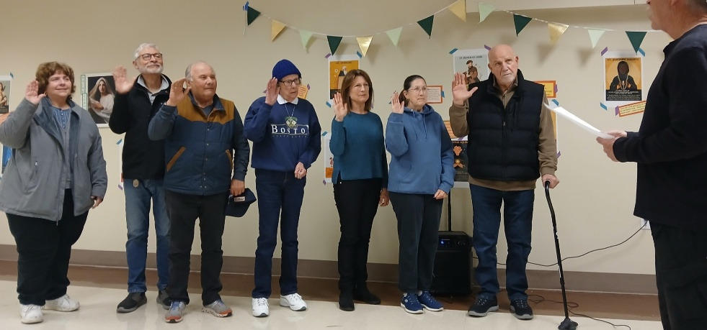
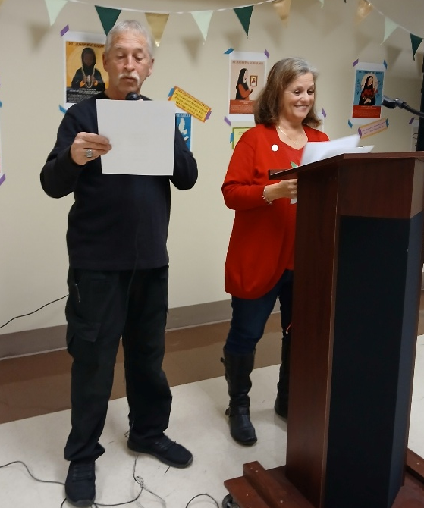
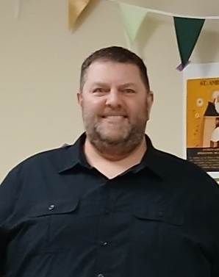
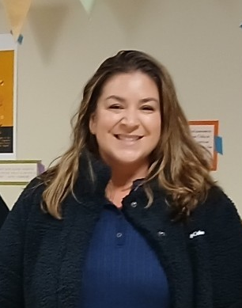
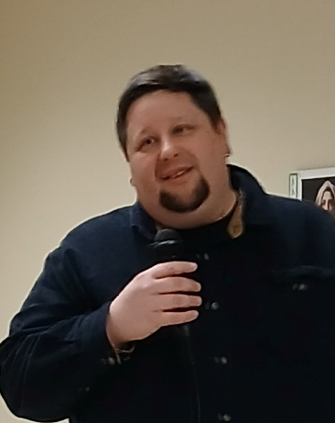
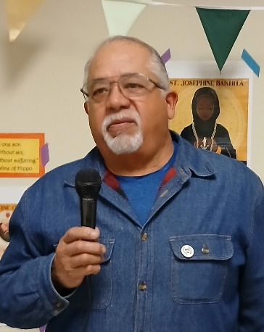
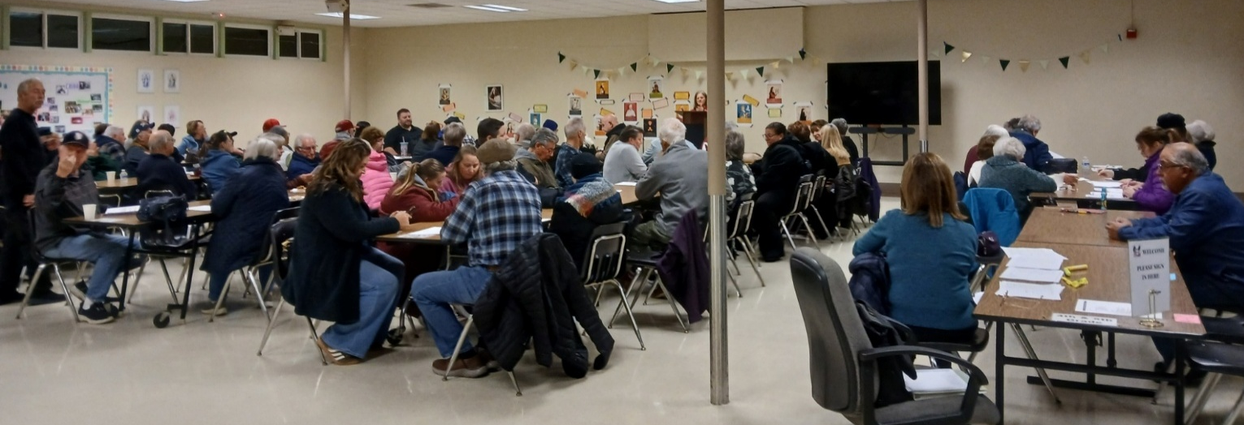
JANUARY GENERAL MEETING
ELECTIONS * NEW MEMBERS
LEFT: President Leo Pierini receives the election results from Election Committee Chair Sandra Lencioni. RIGHT: President Pierini, having been sworn in by Board Chair Rich Garbarino, swears in the Board Members and Officers for their 2026-2027 terms. At a Special Board Meeting on January 29, Garbarino was once again selected as Board Chair.
NEW MEMBERS
Robert Newman Brian Morris Amber Moala Pablo Matos Jr.

Slide 3

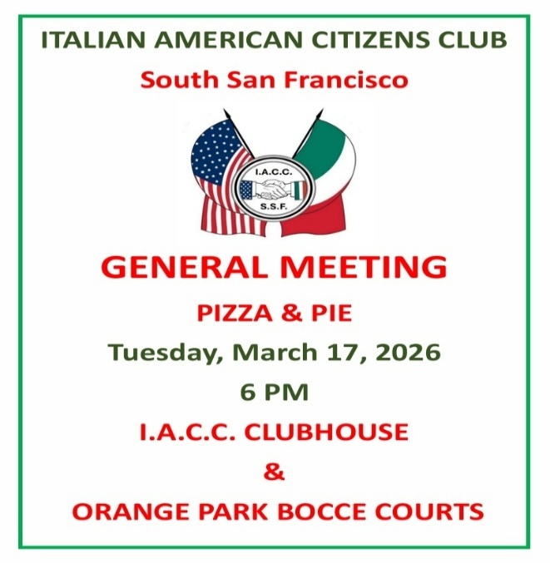


IACC SSF – OFFICERS & BOARD MEMBERS
2026
(Terms Serving)
A TOAST TO ST. PATRICK
By Diana Stanton Minsky
A tribute to Saint Patrick
Be sure to wear your Green
Leprechauns dancing in the field
of four-leaf clovers
Or a pot of gold at the end of the rainbow
A typical Irish scene
Make your toast to Saint Patrick
With your favorite whiskey
But remember, Not too much
As it may make you frisky
EXECUTIVE OFFICERS
Leo Pierini, President (26-27)
IACC.LEO@YAHOO.COM 415-716-6813
Manny Garcia, Vice President (25-26) 650-892-0391
Barbara Guevara, Treasurer (26-27) 650-259-9981
Dee Delorio, Secretary (25-26) 650-740-3205
BOARD OF DIRECTORS
Rich Garbarino, Chairperson (26-27) 650-438-7309
Debbie Cushman (26-27) * Armando Altamirano (26-27) Rosemarie Garcia (26-27) * Norm Faria (26-27) * Lin Keller (26-27) * Helen Birkeland (25-26) * Judy Dianos (25-26) * Janae Morales (25-26) * Bill Green (25-26) * Sandy Lencioni (25-26)
TRUSTEES
Steve Hawthorne (25-26) Rich Garbarino (26-27)
SPORTS / BOCCE COMMITTEE DIRECTOR: Manny Garcia
650-892-0391 MANNY3630@YAHOO.COM
IACC COMMITTEE CONTACTS
EMAIL: IACC.SSF@YAHOO.COM
WEBSITE: HTTPS://SSFIACC.ORG
COMMUNICATIONS DIRECTOR: Janae Morales
EMAILS: Rosemarie Garcia ROSEMARIEROCKS@ATT.NET
NEWSLETTER: IACC.SSF@YAHOO.COM
WEBSITE CONTRIBUTIONS: IACC.SSF@YAHOO.COM
COURT MAINTENANCE: Taco Morales 650-755-5366
HOSPITIALITY: Judy Dianos JDBREW52@AOL.COM
MAINTENANCE: Ken Hartje
IACC.MAINTENANCE@YAHOO.COM
EVENTS: Winnie Girard, Celeste Giuliani
IACC.EVENTS@YAHOO.COM
MEMBERSHIP: Sandy Lencioni SKAARMOM@GMAIL.COM
SUNSHINE: Chris Babcock 650-873-8730
CHRISBABCOCK179@GMAIL.COM
RECYCLE PROGRAM: Barbara Guevara (Recycle Queen)
TISBARB@SBCGLOBAL.NET
NOTE LOCATION CHANGE
Sunshine Corner
Manny Garcia
Winnie Gerard
Patty Cabano
Donna O’Balle
Joan Vina
Sandra Lencioni
If you would like a Club member to receive a card, contact Chris Babcock 650-873-8730

Slide 4
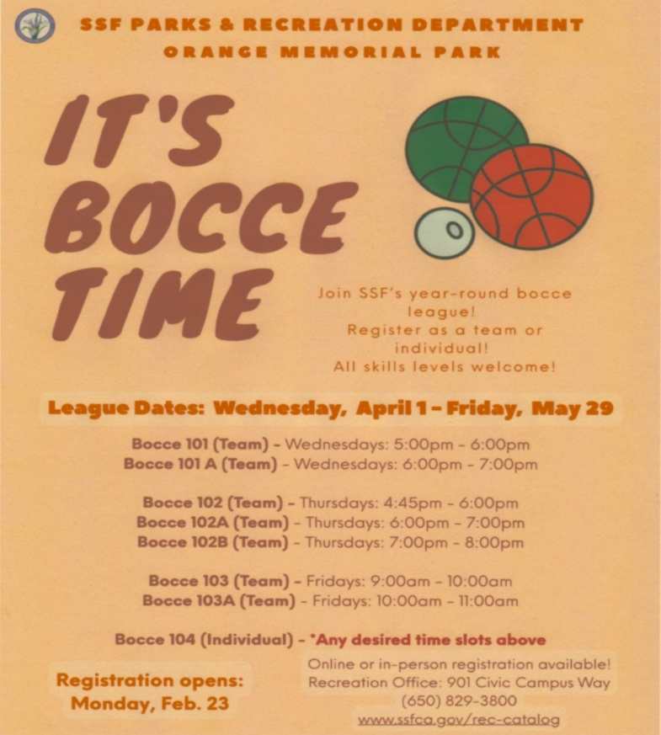


SAVE THE DATES
Tuesday, March 3 – IACC Board Meeting
Tuesday, March 17 – IACC General Meeting
Sunday, April 26 – Lasagna Challenge & Bingo
GET INVOLVED
VOLUNTEERS ALWAYS NEEDED
Help is always needed for the various events, tournaments and other activities at the Club. We encourage all those that can assist in a number of roles, big or small, to sign up. The IACC is only as good as we make it. Tasks include set-up and clean-up or helping with the planning and execution of a particular event. The Maintenance Committee has an endless task during the year as does the Events Committee. A list of the various committees, their Chairs and their emails are listed on page 3. More hands-on deck always makes the process easier and smoother and is well appreciated.
President’s Message
-Continued from page 1
our members enjoyed a White Elephant Gift Exchange and an afternoon of bingo in early January.
Under the guidance and coordination of Robert Lasher our annual Crab Feed Fundraiser was a great success and, while not all the numbers are in, it looks like we managed to tally enough funds to supplement next year’s scholarship and charity program.
Without skipping a beat, we plan on holding the annual Lasagna Challenge with an afternoon of bingo on Sunday, April 26. We also plan to hold the annual IACC Italian Festival on Sunday, May 31.
The Member’s Appreciation BBQ is scheduled for Sunday, July 19. The San Francisco Giant’s Italian Heritage Night will be held on Tuesday, July 28 and we’ve already locked in a group of tickets.
In coordination with the city, the Festa Italiana – SSF 2026 has been rescheduled for Saturday, September 19 and will once again feature wonderful Italian vendors, food and music.
More details on all these events will go out as we get closer to the dates.
I am very excited that we will be hosting members of the Special Olympics to the courts beginning in March. It is a pleasure to support and expose these young men and women to the sport of bocce with plans to expand the program in 2027.
With all the events mentioned, keep in mind that all our committee chairs give their time and work on a volunteer basis and can always use the assistance of additional members.
Last, but not least, the renovated patio area project is coming to a close as new planter boxes have been moved in to supplement the barbeque and serving area.
Leo Pierini
President
Italian American Citizens Club of SSF
VOTED BEST S.S.F. DELI 2025 BY GOOGLE REVIEWS

Slide 5



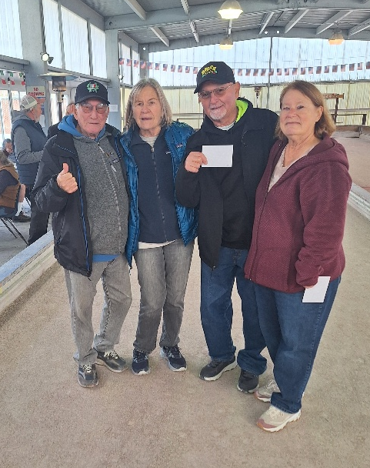
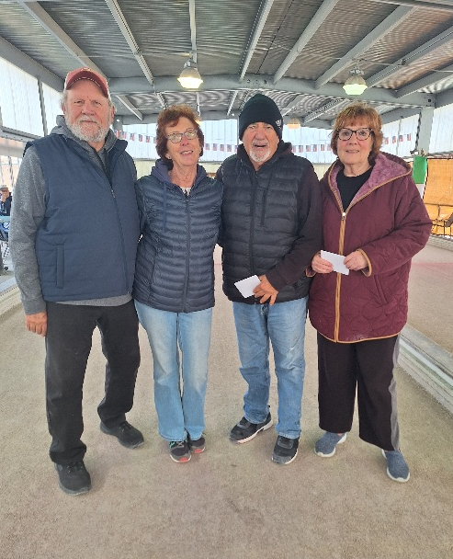
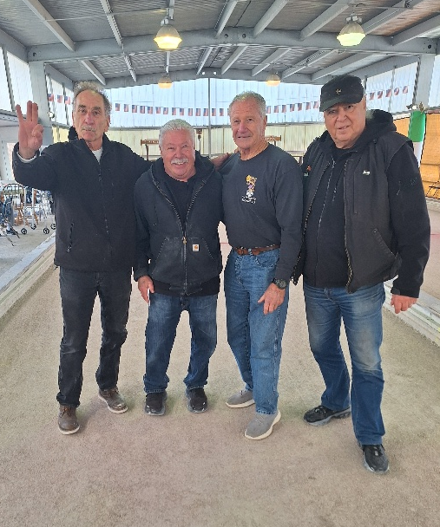
BOCCE NEWS
As we enter March, Spring bocce play begins with Monday night, Tuesday and Wednesday mornings, Wednesday night Raffa and Thursday morning leagues. Winter league bocce action will finish up on March 9.
We are very excited that beginning on Saturday, March 7 and every Saturday through April we will be hosting Special Olympics athletes (ages 20 to 40 years old with Special Needs) on courts 5 and 6 from 1 to 3 pm. I encourage our members to come out and interact with the players and cheer them on as they learn bocce play. The initial group will be playing for enjoyment and 2027 is slated to host more players from Northern California Special Olympics in a competitive atmosphere.
Once again, April is Free Bocce Lessons month on Thursdays with morning classes, taught by Taco Morales, going from 10 am to 11:30 am and evening classes from 6:30 pm to 8 pm. We are still looking for two or more Club members to volunteer for the evening classes to teach the basics of bocce. If interested, contact me at 650-892-0391 or at manny3630@yahoo.com. Unfortunately, due to health reasons I will not be able to teach this year and would really appreciate some of our members stepping up. Each year the people that attend the classes are eager to learn the basics and are very appreciative.
The SSF Parks & Recreation leagues will begin in April.
As for our annual Bocce Tournaments, the Women’s Al Sacco is scheduled for Sunday, May 17 and the Men’s Al Sacco Tournament is set for Saturday, June 13. More information will be sent out as we get closer to those dates and we will be looking for volunteers to help with both events.
Overall, 2026 is shaping up to be a very busy year with the many bocce leagues and tournaments in addition to other organizations scheduling their own tournaments and private parties. As always, please be conscious of the courts and our Clubhouse whenever your activity is finished and clean up after yourselves and make sure the lights are out and the complex is locked up.
Manny Garcia
Sports & Activities Director
IACC Vice President
THURSDAY MORNING LEAGUE
FIRST PLACE: Team B – Germano Colombana, Charlene Colombana, John Dianos, Judy Dianos
Second Place: Team A – Rich Vaznaugh, Jamaica Nally, Larry Fioranelli, Carroll Meek
Third Place: Team E – Tommy Balestreri, Mark Radovich, Steve Hawthorne, Frank Scafani

Slide 6
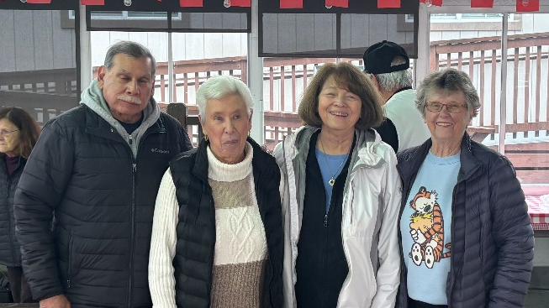
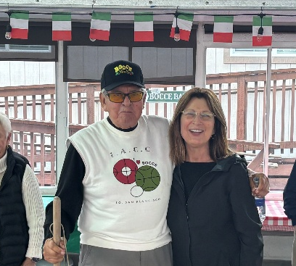
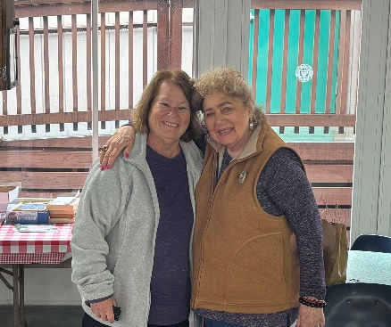
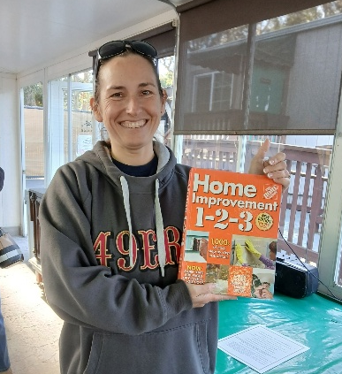
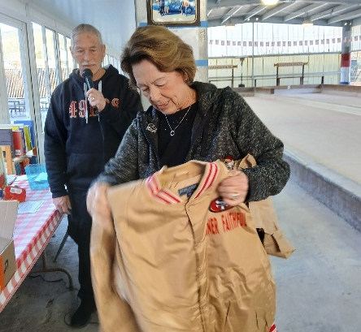
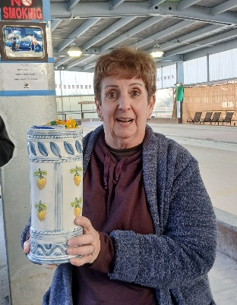
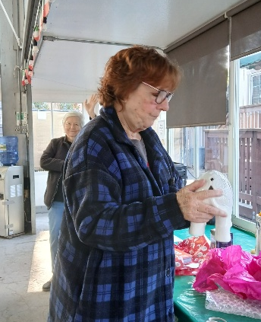
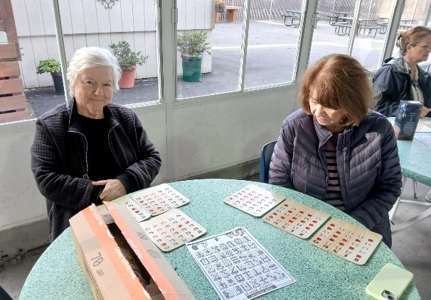
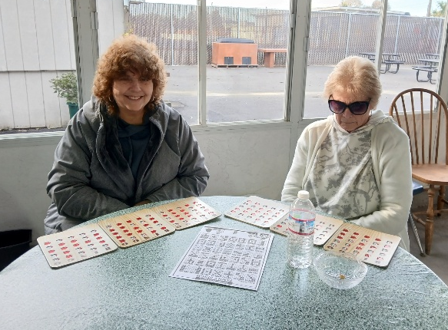
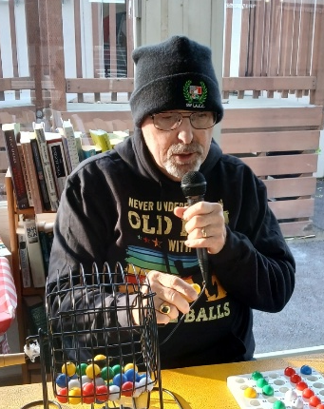
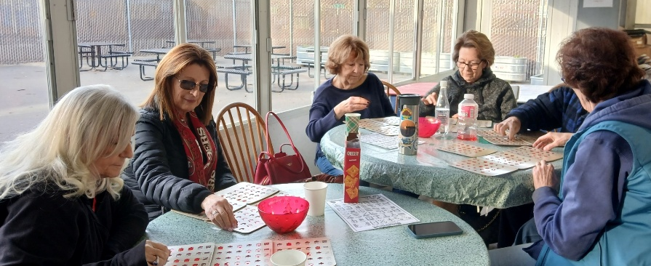
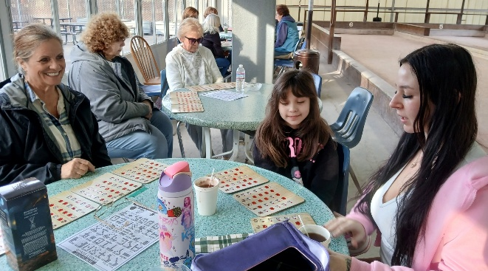
WEDNESDAY MORNING LEAGUE
1st Place: Richard Fierro, Pat Hatch,
Erica Baxter & Captain Joan Daly
2nd Place: Andy Ynostroza & Captain Debbie Cushman. Missing – Mike Keller & Ann Koenig
3rd Place: Judy Dianos & Diana Minsky. Missing – John Dianos & Patty Sarracino
WHITE ELEPHANT GIFT EXCHANGE & BINGO

Slide 7
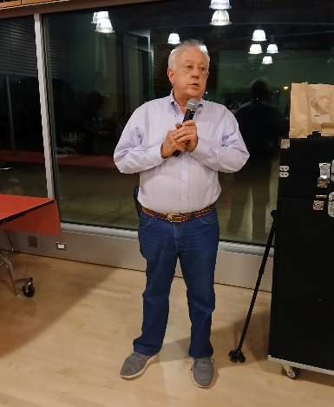
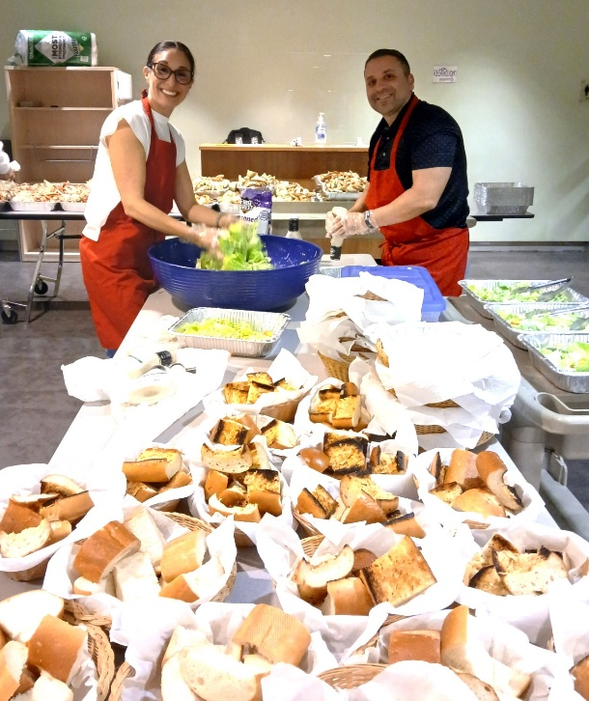
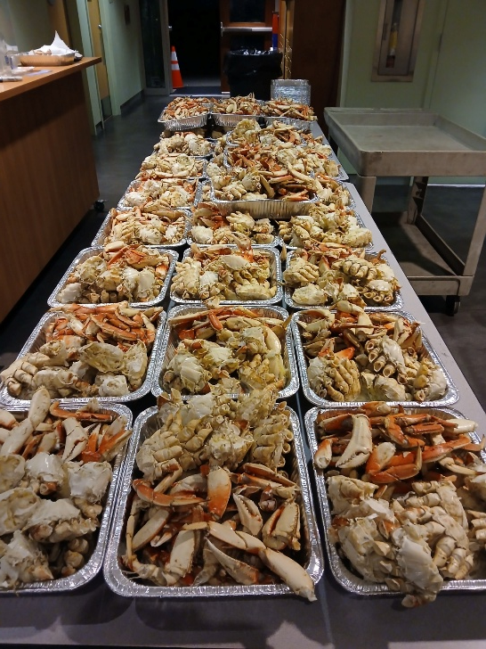
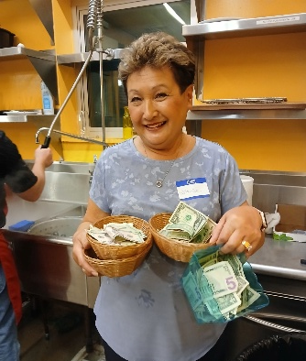
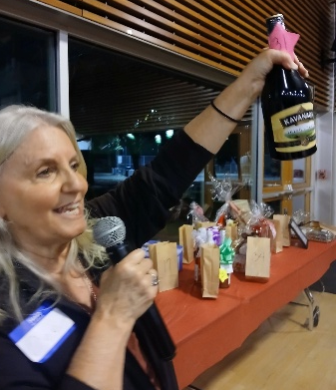
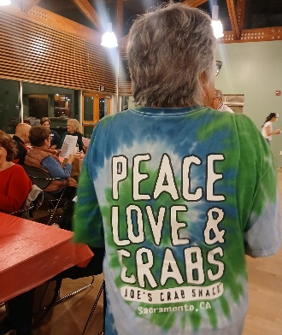
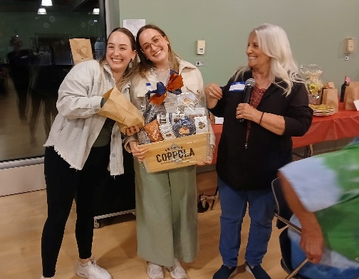
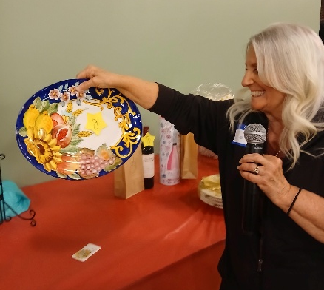
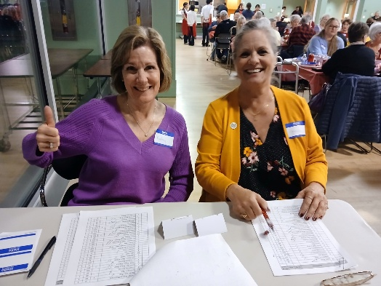
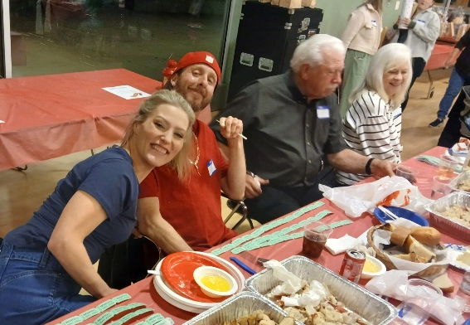
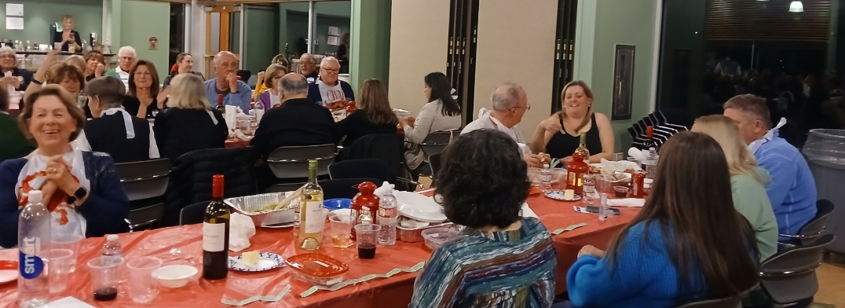
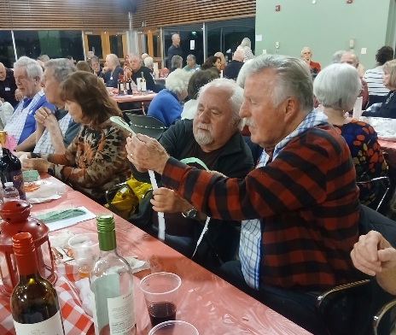
CRAB FEED FUNDRAISER
Robert Lasher, Coordinator of the Crab Feed Fundraiser, acknowledges the many club volunteers and the South San Francisco High School Italian Class students who did the serving for the event.

Slide 8
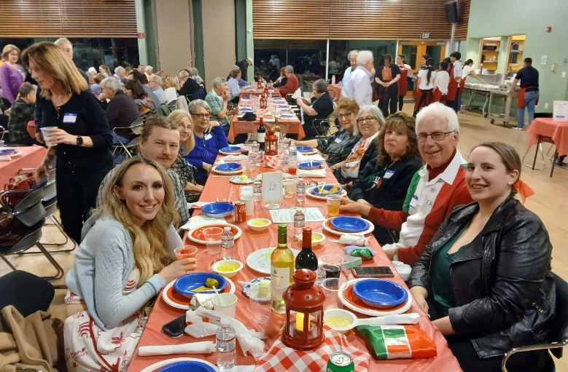
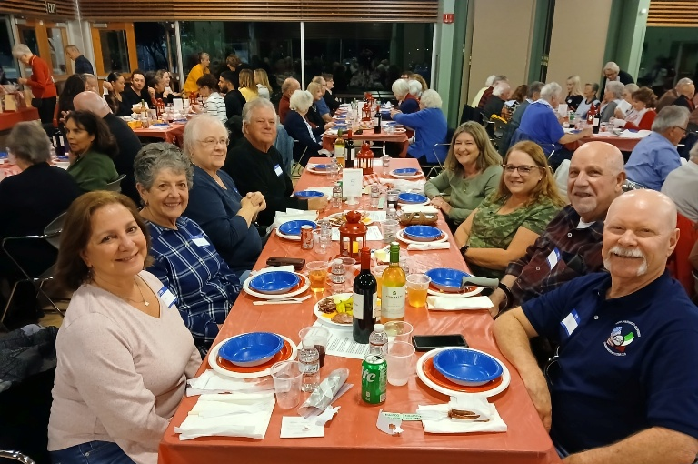
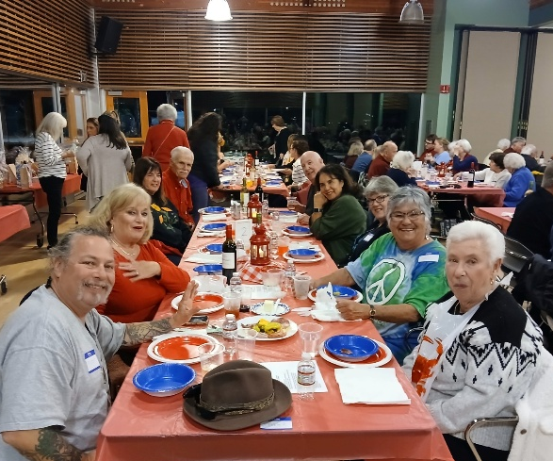
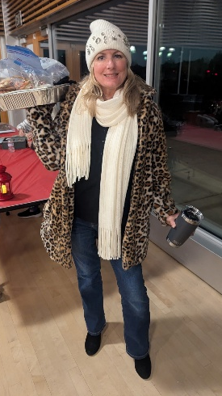
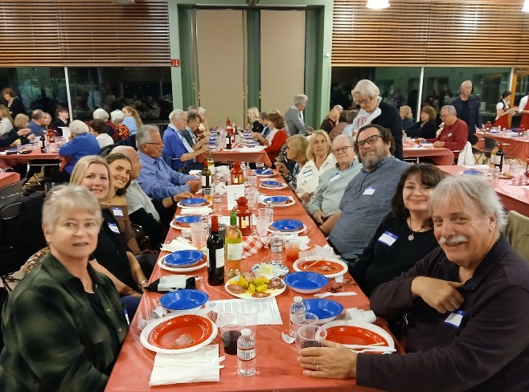
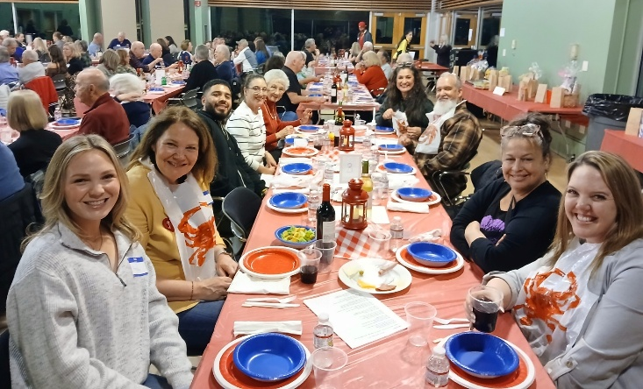
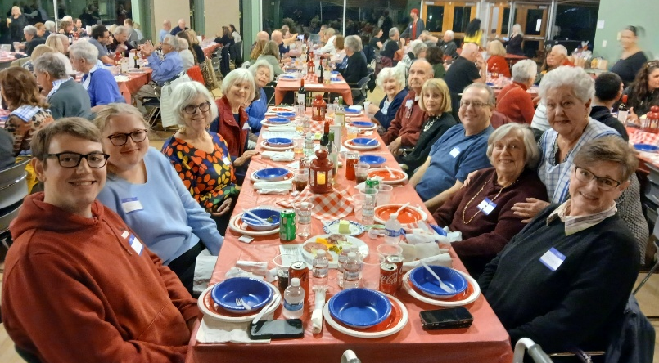
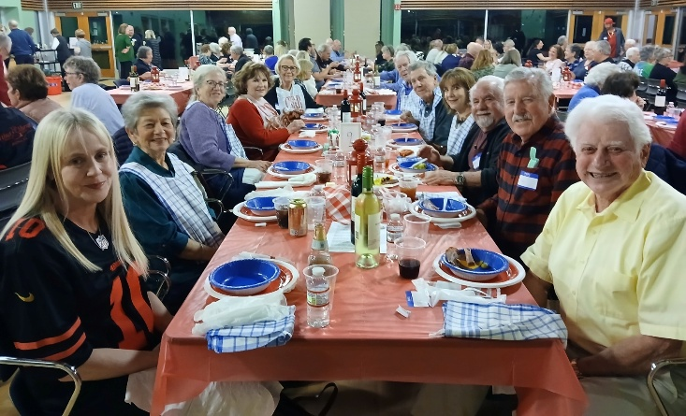
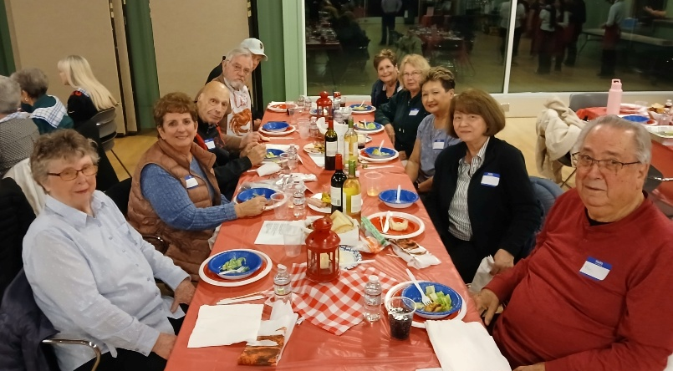
CRAB FEED FUNDRAISER

Slide 9
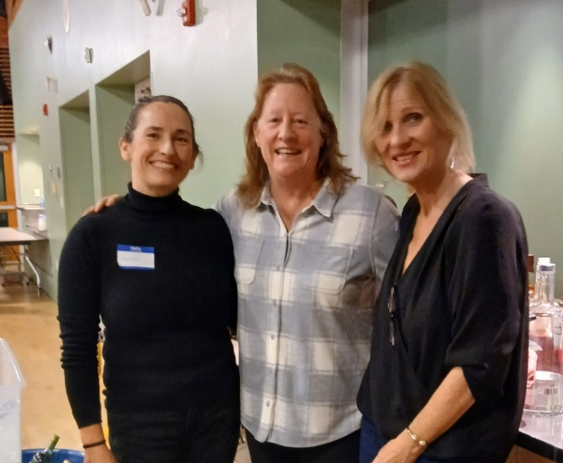
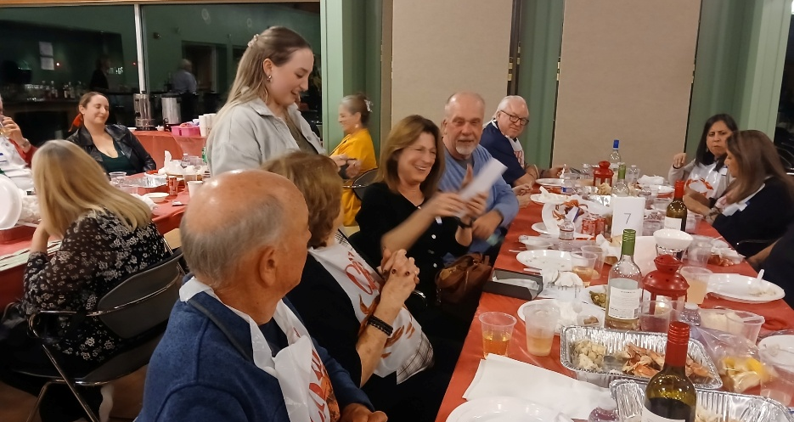
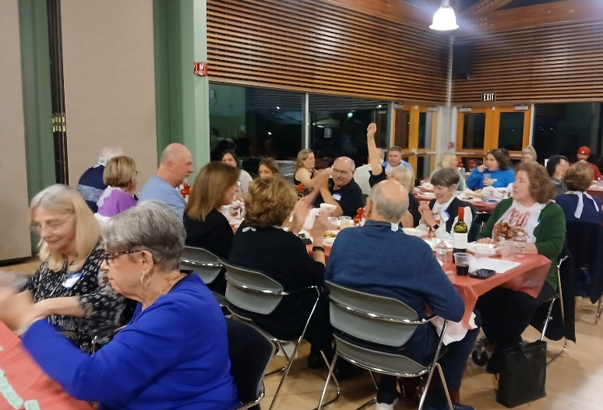










CRAB FEED FUNDRAISER

Slide 10












CRAB FEED FUNDRAISER
OUR MEMBERS MAKE A DIFFERENCE
The efforts of all our members during the holiday season should be commended for their generosity as indicated below:
From Nancy Balestreri: Today (January 29) we concluded our annual warm clothing drive. Once again, our IACC members have been very generous. Over the past two months IACC donated over 400 warm clothing items to Hearts for Humanity Bay Area. As in prior years, all clothing is distributed locally.
From Catherine Ithurburn, Chief Executive Officer of Ronald McDonald House Charities (Northern California): Thank you for your gift supporting Ronald McDonald House Charities Northern California. Studies show sick children who are receiving critical medical care recover quicker and go home sooner when family is nearby. At the Sacramento Ronald McDonald House, donors like you help provide a ‘home-away-from-home’ and make a difference in the lives of those who need it most. Each year, the House serves about 1,200 sick children and their families. Each family stays in a private bedroom with access to their own kitchens, food, washers and dryers and even a fitness center to relieve stress. An added benefit is that families often bond with other families going through similar circumstances and create friendships that continue long after going home. Thank you again for your gift of 30 lbs. of pull tabs and supporting children and families in need. We appreciate your generosity.
From Bill Green: He advised that our monetary and non-perishable food donations to the YMI Food Basket Drive provided 300 Food Baskets and an age-appropriate toy for each child to families. He also wanted to thank the many members who showed up to help sort, pack and deliver these baskets.
SUPPORT OUR GENEROUS SPONSORS

Slide 11


IACC CALENDAR
DATES AND TIMES SUBJECT TO CHANGE
MARCH 2026
APRIL 2026
All photos in this newsletter and more are on the IACC website:
WWW.SSFIACC.ORG

Slide 12





Italian American Citizens Club of South San Francisco
P.O. Box 5674
South San Francisco, CA 94083-5674
I.A.C.C. General Meeting
Tuesday, March 17, 2026
6:00 pm
IACC CLUBHOUSE

