Slide 1
The Main Categories of CECs in Global Groundwater
Malcolm J. Gander, Ph.D.
17 January 2023/17:15 CET

Slide 2
(Main Points)
1) CECs are: Toxic – the nature & severity of the toxicity is variably undefined
Unregulated – no environmental laws
CECs are not monitored – periodic sampling & lab testing needed
2) A literature review indicates there are 6 main categories of CECs in groundwater:
1)Pharmaceuticals, 2) personal care or household cleaning products, 3) industrial chemicals, 4) flame retardants, 5) cyanotoxins, and 6) nanomaterials.
3) Of all CECs, PFAS has the highest certainty of causing human health problems. Countries need to take immediate action to control the release and dispersal of PFAS.
Countries should follow the European Commission: Identify & control sources of PFAS; finalize legislation to eliminate the widespread release of PFAS compounds in biosolids (from WWTPs) that are used as soil amendments for agricultural areas, as the PFAS compounds currently continue to leach into underlying groundwater.
4) Aside from PFAS, more sustained groundwater monitoring is needed for certain toxic pharmaceuticals & common toxic compounds in cosmetics/personal care products

Slide 3
How PFAS Moves in the Environment

Slide 4
PFAS: Ubiquitous, Carcinogenic; the best candidate for immediate action
PFAS are in the CEC categories of Industrial Chemicals AND Cosmetics/Personal Care Products
Examples of PFAS-bearing products are:
non-stick coatings (Teflon),
textiles (Gore-Tex),
stain-resistant carpets and sofas, and
aqueous firefighting foams to engulf flames (AFFF).
PFAS water pollution has been confirmed in the European Union (EU), Asia, Australia, the Middle East, Canada, and the United States,

Slide 5
Examples of other Industrial Chemicals
Pesticides and their metabolites/breakdown products
1,4 – Dioxane: Used in pharmaceutical purification, and plastics production
Explosives:
Explosives compounds contamination in groundwater is very poorly known and assumed present in areas coincident w/ unexploded ordnance (UXO) in Cambodia, Laos, Vietnam, North Korea, South Korea, Afghanistan, Yemen, various South African countries, Iraq, Angola and Chechnya
20% of the land area of Cambodia, Laos and Vietnam have unexploded ordnance

Slide 6
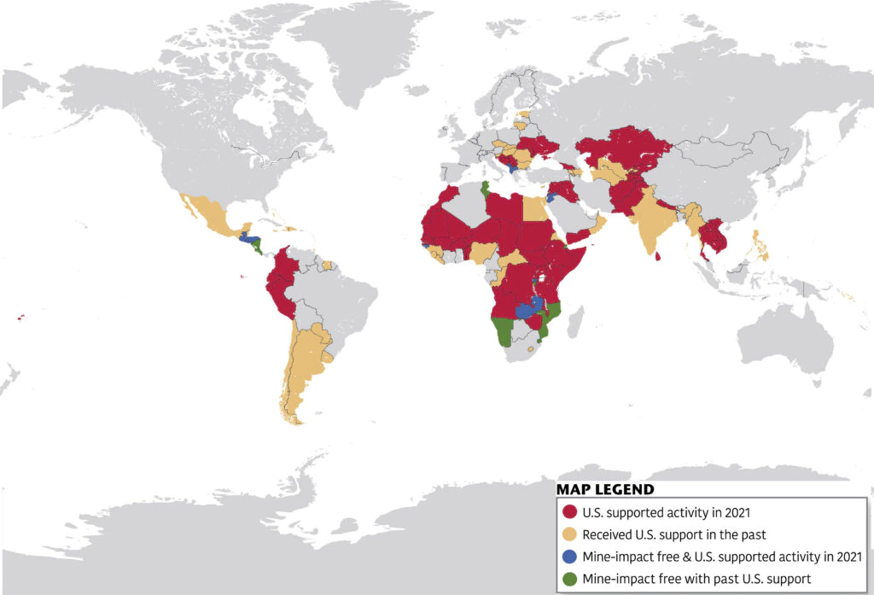
Countries with Unexploded Ordnance as of 2021

Slide 7
Pharmaceuticals: Another Major Category of CECS
Antibiotics anti-inflammatories analgesics/pain relievers antiepileptics antidiabetics beta-blockers (for heart disease and high blood pressure) lipid regulators (lipids are fats and vitamins that store energy)
Monitoring (sampling and lab testing to define concentrations) in groundwater is not occurring
Concentrations in groundwater above which adverse health effects may occur not established

Slide 8
Personal Care & Household Cleaning Products: Another CEC Category
These include cosmetics, deodorants, cleansers (soap, shampoo, toothpaste), moisturizers, perfumes, sunscreens, hair styling sprays and foams, and shaving creams.
Here are examples of toxic compounds in cosmetics:
Formaldehyde (carcinogenic)
Mercury (damages kidneys and nervous system)
Dibutyl & diethylhexl phthalates (disrupt hormones, damage reproductive system
M- & O- phenylenediamine in hair dyes (carcinogenic – damage DNA)
PFAS

Slide 9
Flame Retardants: Another CEC Category
Brominated flame retardants (BFRs) are an enormous category of CECs, used to reduce flammability in computers, plastics, furniture and clothing.
Polybrominated diphenyl ethers (PBDE) are a common class of flame retardant compounds
Many flame retardant compounds, as well as pharmaceuticals, personal care products, and industrial chemicals such as PFAS, act as so-called endocrine disruptors (EDCs).
EDCs are compounds that adversely alter the normal functions of hormones.

Slide 10
Cyanotoxins: Another CEC Category
Cyanotoxins are toxic chemicals released from bacterial blooms
Cyanobacteria are commonly referred to as blue-green algae, although not scientifically classified as algae
They can proliferate in groundwater as a result of additions of nitrogen and phosphorus from fertilizer runoff and detergents in urban areas.
The toxins are generally poorly documented; they reduce water quality and can adversely affect wildlife and humans.

Slide 11
Cyanobacteria

Slide 12
Nanomaterials: another CEC Category
Also referred to as nanoparticles
Used in hundreds of consumer products and biomedical applications
They are typically 1-100 nanometers (a nanometer is one-millionth of a meter)
Examples are carbon fiber, and metals such as aluminum or silver
Relatively few toxicity studies have been conducted on these nascent or established materials

Slide 13
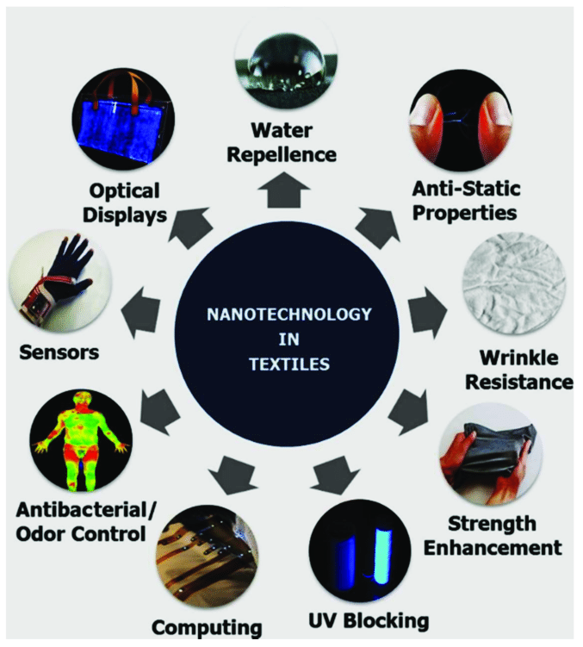
Nanomaterials

Slide 14
Summation
1) CECs are: Toxic – the nature & severity of the toxicity is variably undefined
Unregulated – no environmental laws
CECs are not monitored – periodic sampling & lab testing needed
2) There are 6 main categories of CECs in groundwater:
1)Pharmaceuticals, 2) personal care or household cleaning products, 3) industrial chemicals, 4) flame retardants, 5) cyanotoxins, and 6) nanomaterials.
3) Of all CECs, PFAS has the highest certainty of causing human health problems. Countries need to take immediate action to control the release and dispersal of PFAS.
Countries should follow the European Commission: Identify & control sources of PFAS; finalize legislation to eliminate the widespread release of PFAS compounds in biosolids that are used as soil amendments for agricultural areas, as the PFAS compounds currently continue to leach into underlying groundwater.
4) Aside from PFAS, more sustained groundwater monitoring is needed for certain toxic pharmaceuticals & common toxic compounds in cosmetics/personal care products

