Slide 1
Curry County, Oregon
Brookings Police Department and Curry County
Emergency Operations Center
13Nov2024
Coos County, Del Norte County, Linn County,
Lake County, Douglas County
Information and Open-Source Intel (OSINT) Gathering,
Local Government Engagement,
Entity Engagement,
and
Substantive Commentary with Government Entities
Doyel Shamley

Slide 2
Natural Resource Users Law & Policy Center (NRULPC)
University of Arizona’s James E. Rogers College of Law and Cooperative Extension
25Jan2024
Information and Open-Source Intel (OSINT) Gathering,
Local Government Engagement,
Entity Engagement,
and
Substantive Commentary with Government Entities
Doyel Shamley
doyel@vrcltd.us
928-245-5722

Slide 3


Slide 4
A Fundamental Point
Engage early in the process, substantively, adhering to the prime responsibilities of state and local elected office;
Protection of Health, Safety and Welfare of the citizens being represented.

Slide 5
Intel early and often
Utilize the predominant public notification process systems to increase lead time, offer better ability to prepare a substantive comment, and allow for more time to request additional documentation as needed.
Do not be afraid to request a ”comment period extension” from the lead agency of the proposal – caveat; must be requested in writing, at a point in the comment timeframe, of under the 50% mark in the calendar.

Slide 6
Intel early and often
Federal Register:
https://www.govinfo.gov/app/collection/FR/
USDA-USFS – Schedule of Proposed Action (SOPA)
https://www.fs.usda.gov/sopa/index.php
USDOI-BLM - Planning Documents or “Plans in Development”
https://www.blm.gov/programs/planning-and-nepa
Arizona Department of Environmental Quality (ADEQ)
https://azdeq.gov/PublicNotices
Arizona Administrative Register
https://apps.azsos.gov/public_services/register/2023/contents.htm

Slide 7
Federal Register
Depository for “all” actions from agencies within the federal government.
Caveat; Due to the CAA and CWA, the EPA will publish in the Friday edition of the Federal Register,
“Environmental Impact Statements; Notice of Availability”
The notice on Friday can give you significant extra time to prepare.

Slide 8

Federal Register

Slide 9
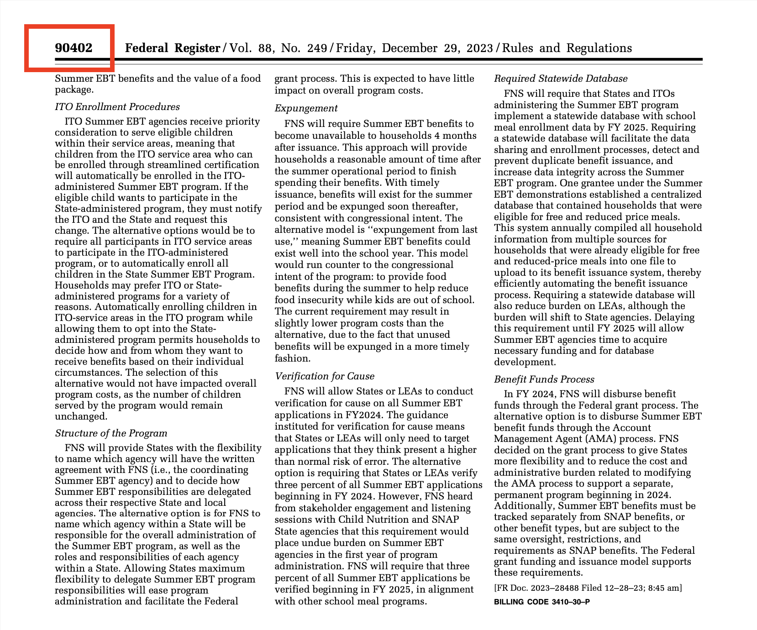
Federal Register

Slide 10
Federal Register
The cost of government extends well beyond what Washington taxes. Federal regulations add another $1.939 trillion annually to be burdened by Americans’. Federal environmental, safety and health, social, and economic interventions grip the economy. Many crisis regulations become permanent regulations, or last far longer than is warranted. The COVID-19 episode was the third major economic shock of the century, after the September 11, 2001, attacks and the 2008 financial crisis.
There have been no large-scale tax hikes, but the hidden tax of regulation has proved appealing to lawmakers. Unlike on-budget spending, many regulations are hard to quantify. Budgetary pressures can incentivize off-budget regulations requiring private outlays and adjustments rather than adding more unpopular deficit spending. Mandates like family leave, child care, and job training initiatives could involve either increased observable government spend- ing or new regulations on business. Just as consumers wind up shouldering much of the corporate income tax,2 the regulatory compliance costs and mandates borne by businesses will percolate throughout the economy, sneaking their way into consumer prices.
When the U.S. federal administrative state began its march over a century ago, few imagined the tangle of hundreds of thousands of rules and guidance documents it would produce, and the way those would envelop society.

Slide 11
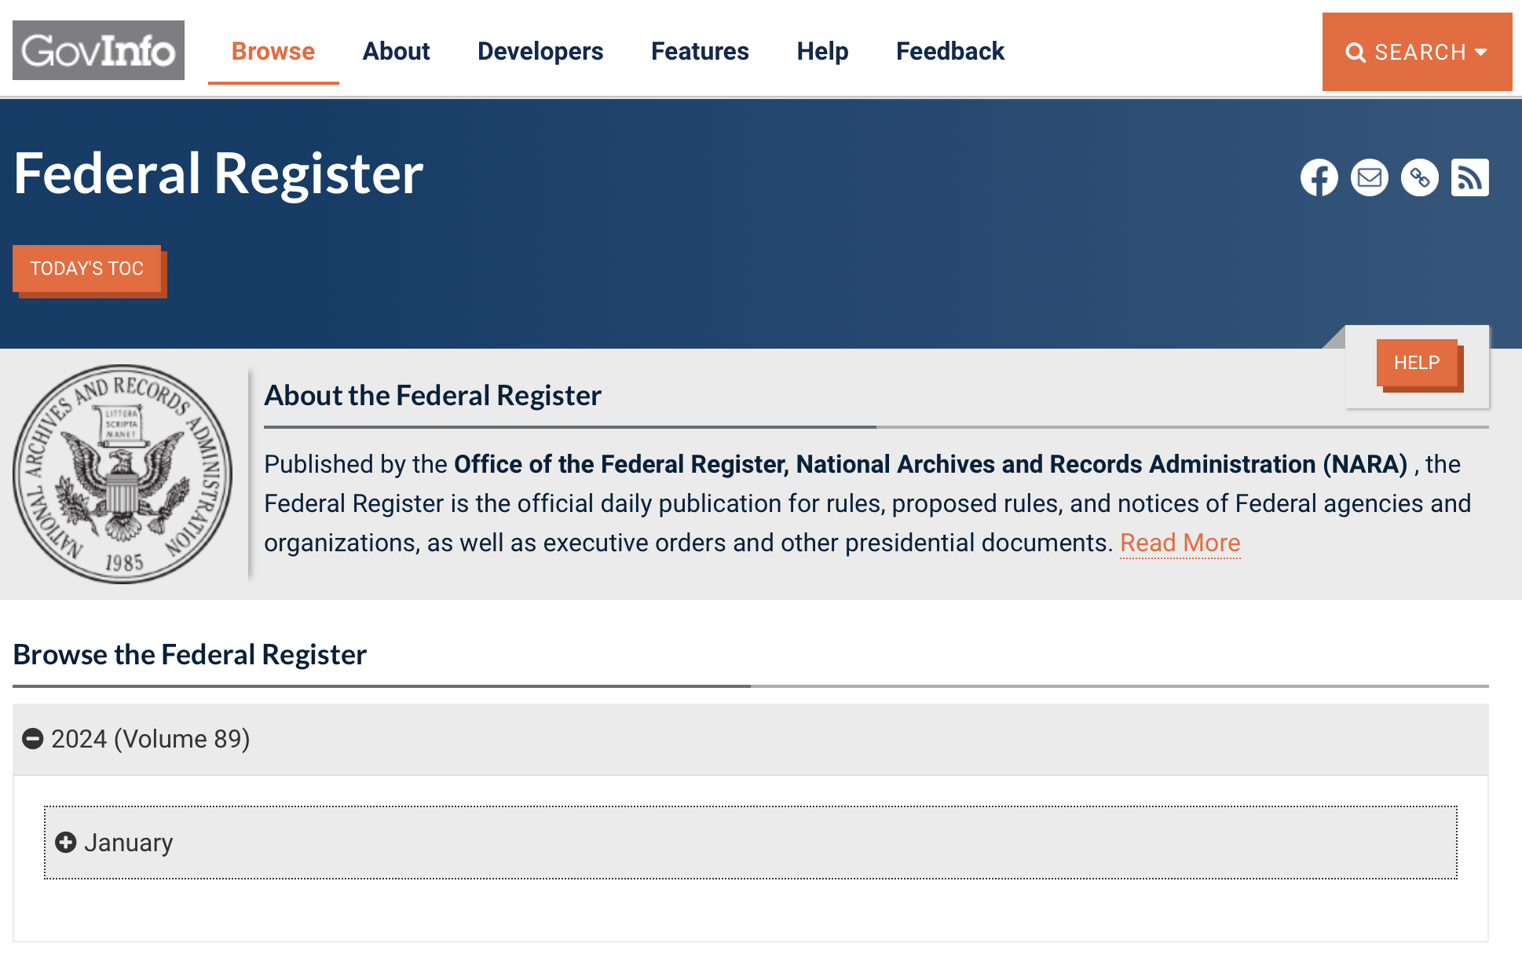
Federal Register

Slide 12
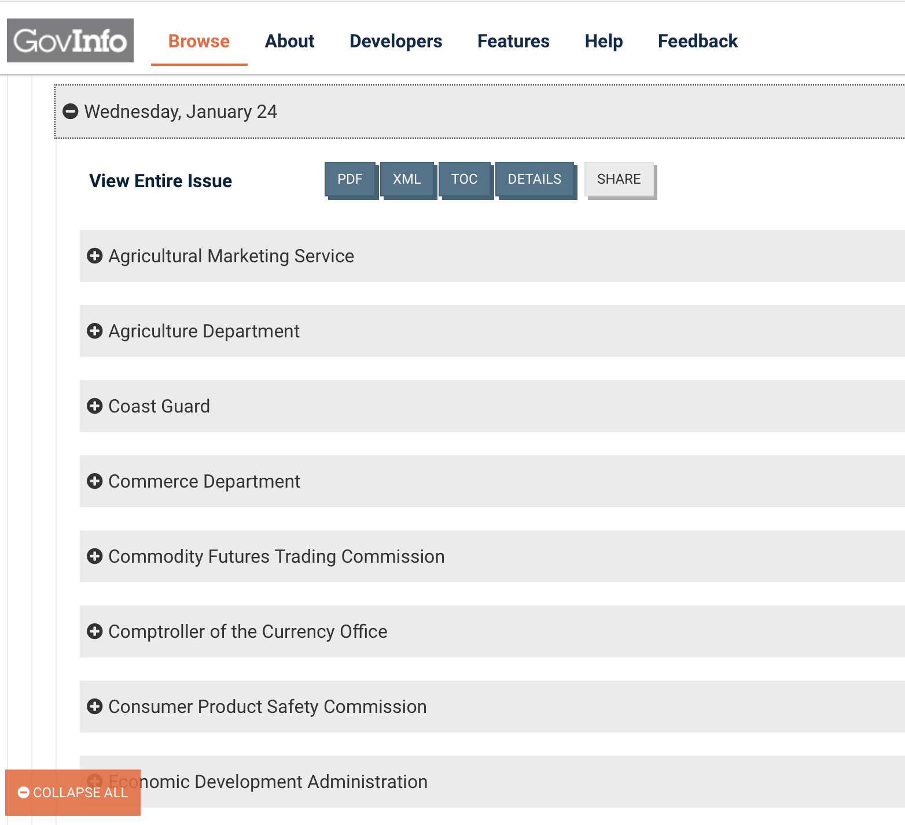
Federal Register

Slide 13
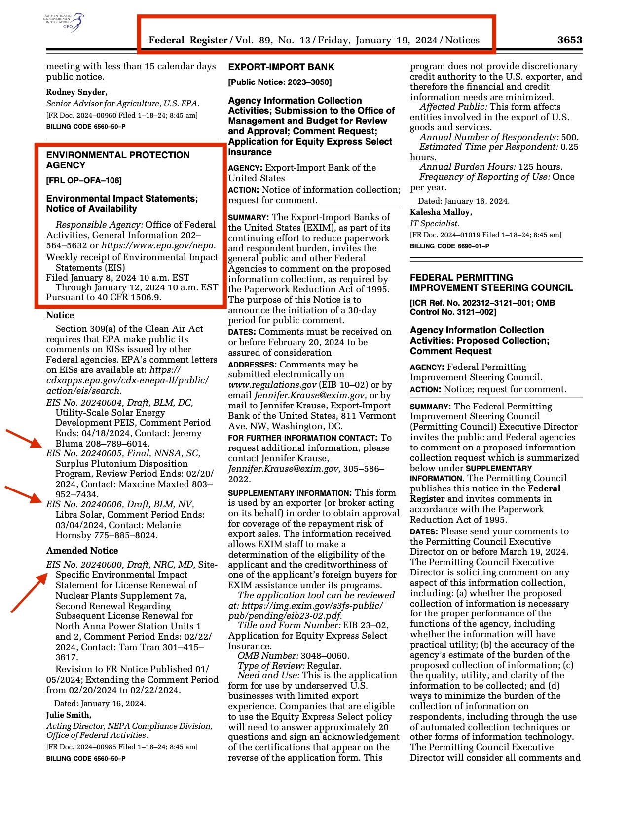
Federal Register

Slide 14
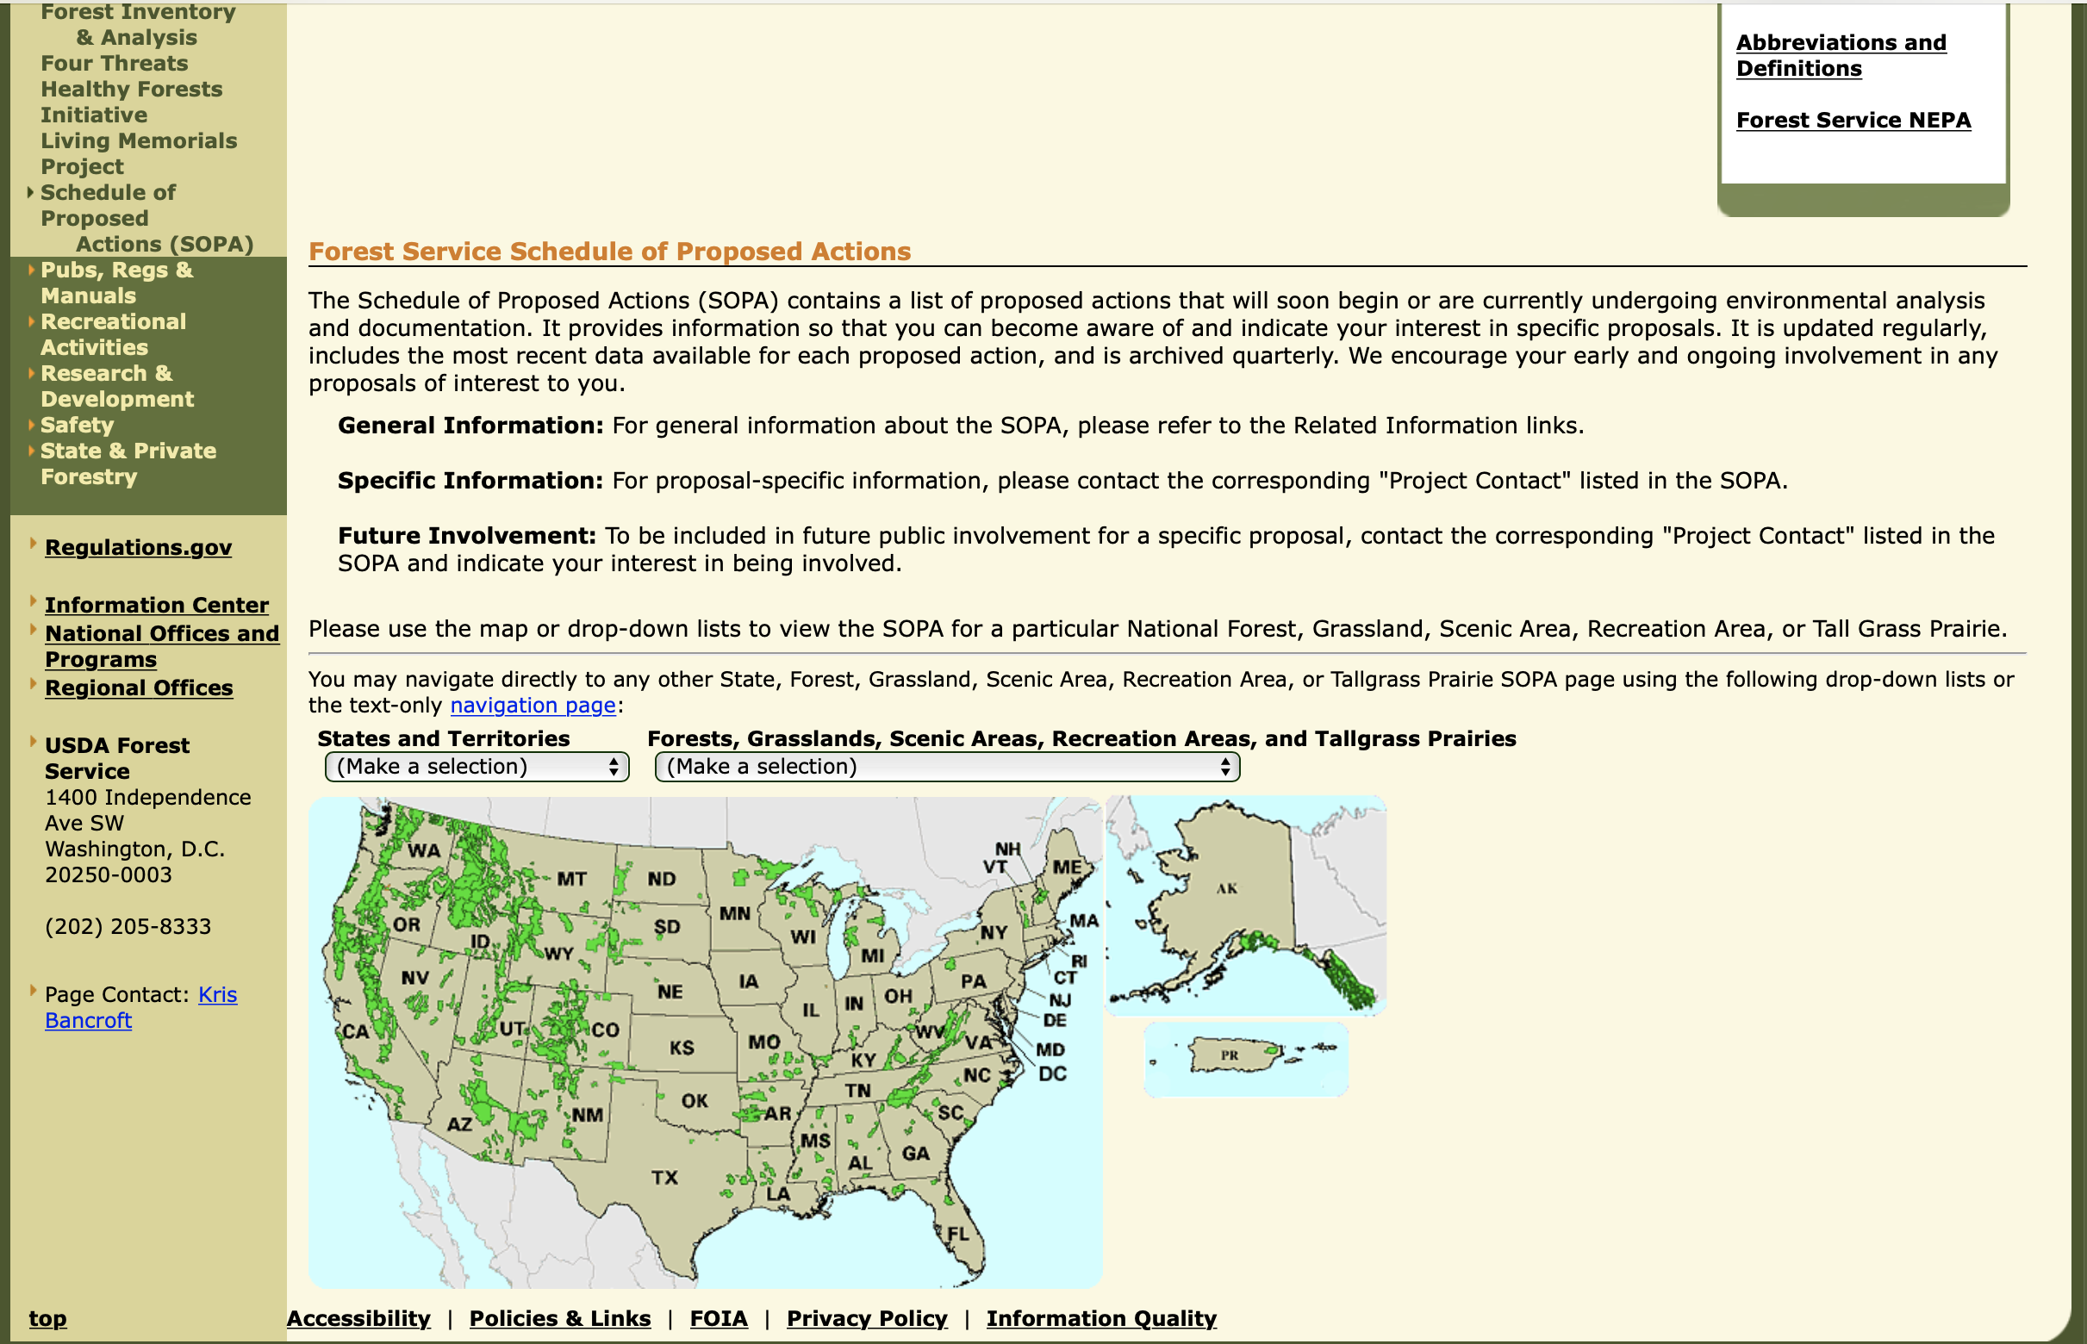
USFS – Schedule of Proposed Action (SOPA)

Slide 15
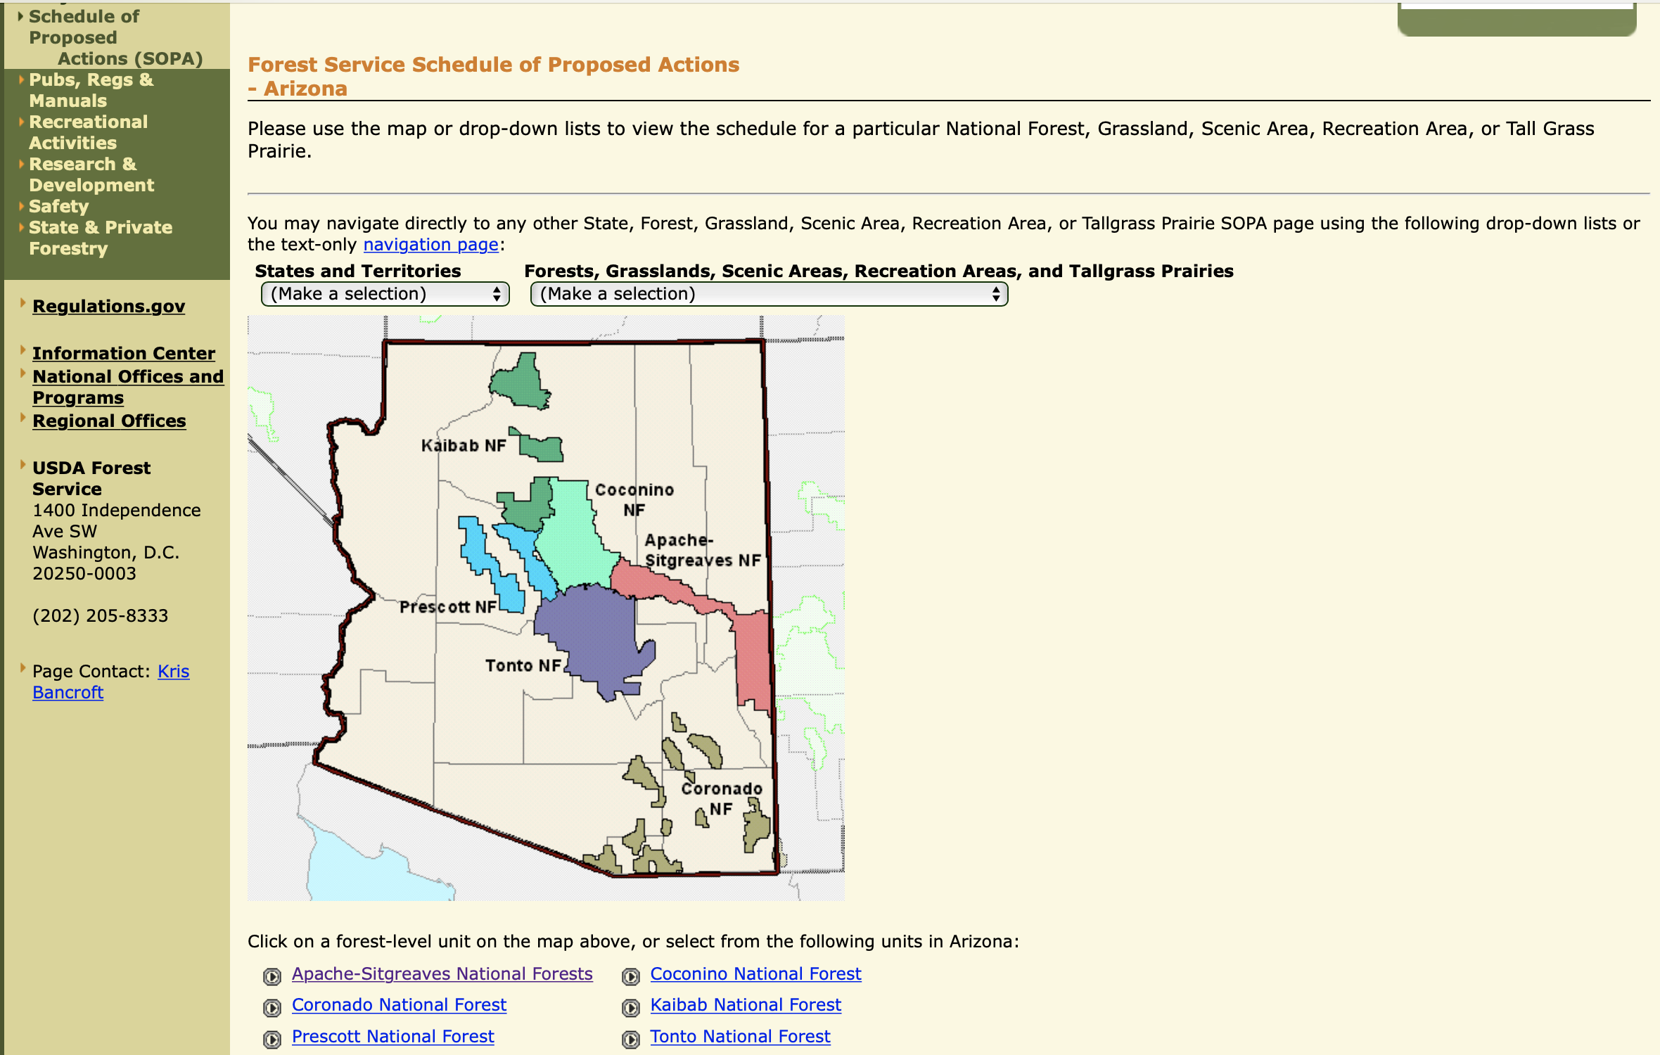
USFS – Schedule of Proposed Action (SOPA)

Slide 16
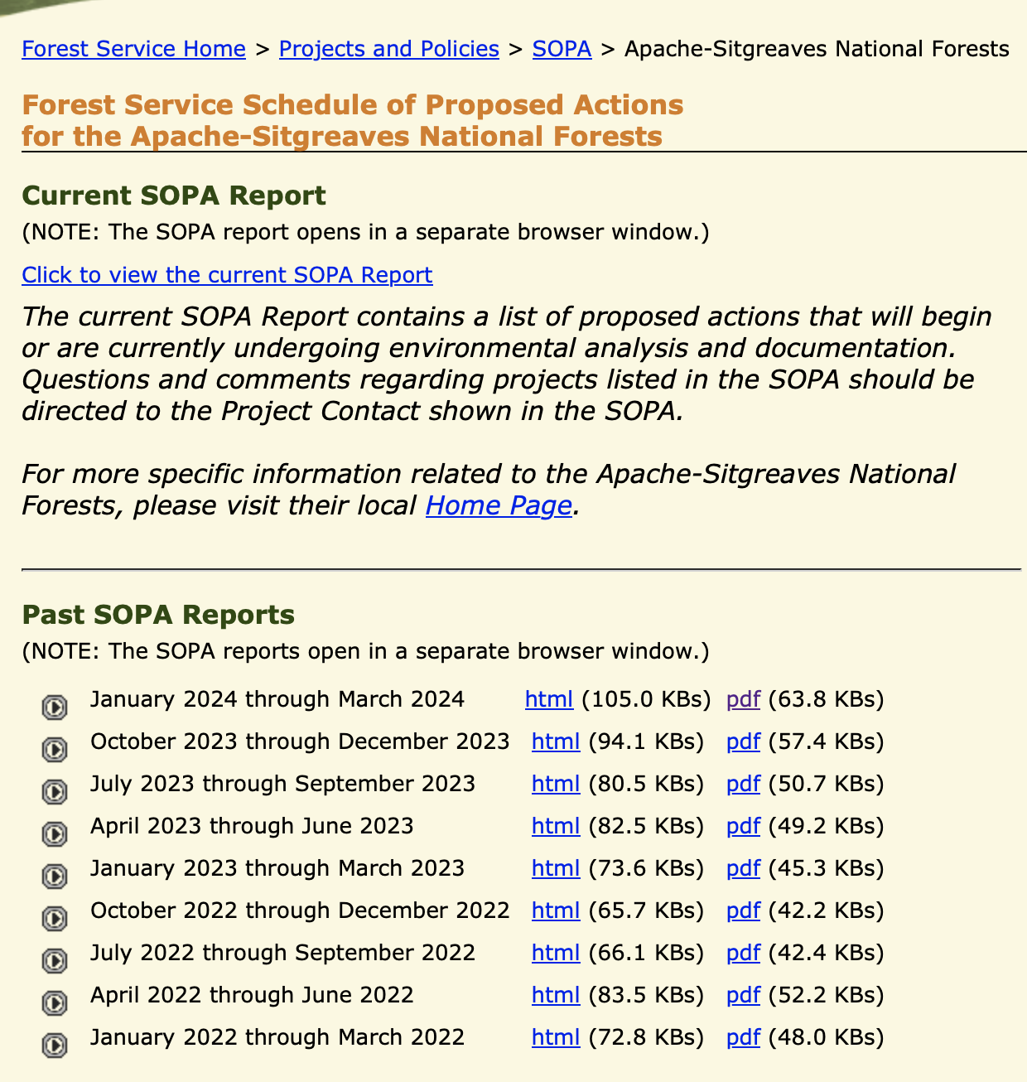
USFS – Schedule of Proposed Action (SOPA)

Slide 17
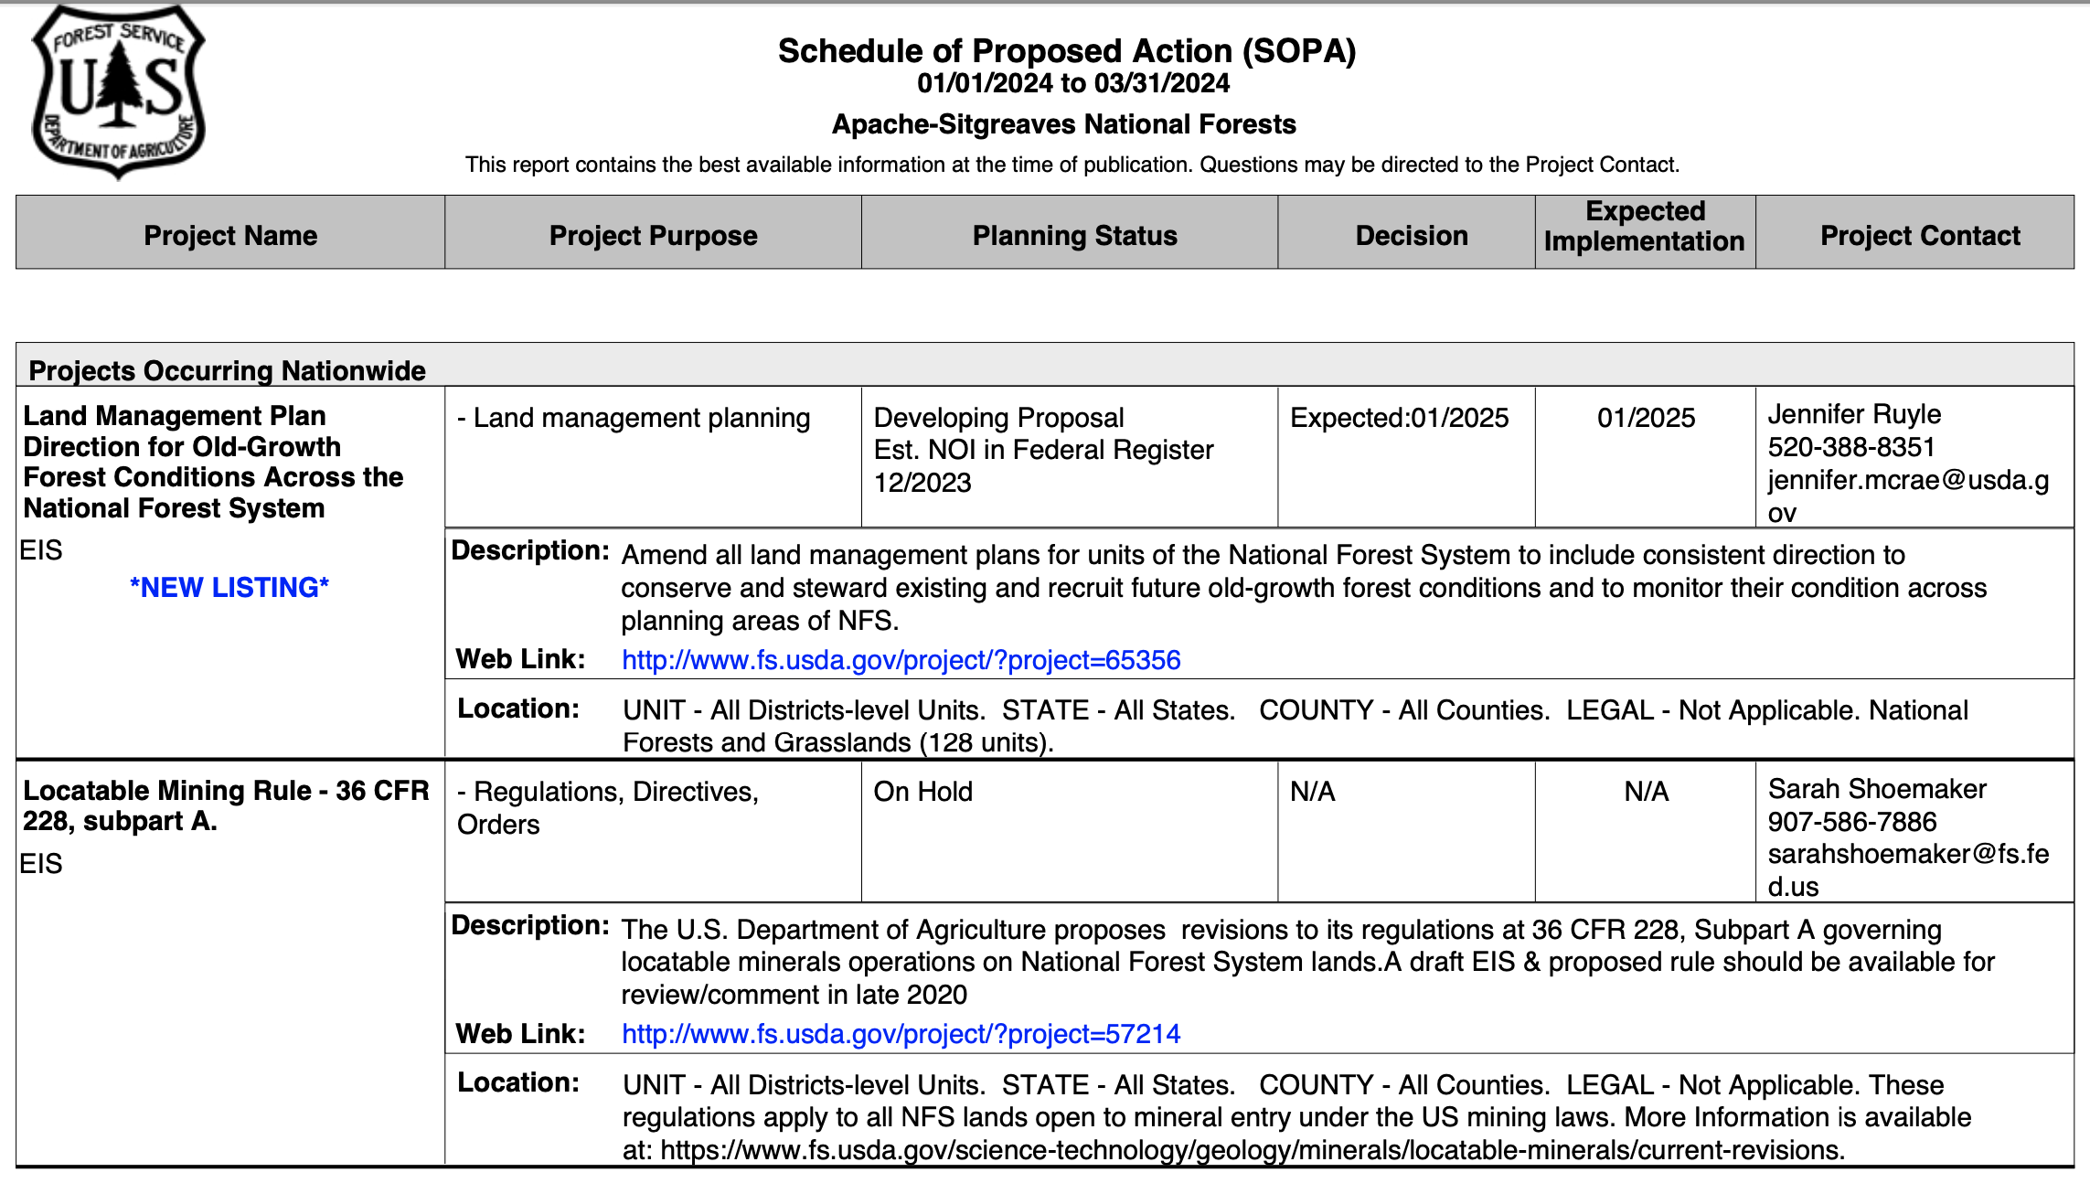
USFS – Schedule of Proposed Action (SOPA)

Slide 18
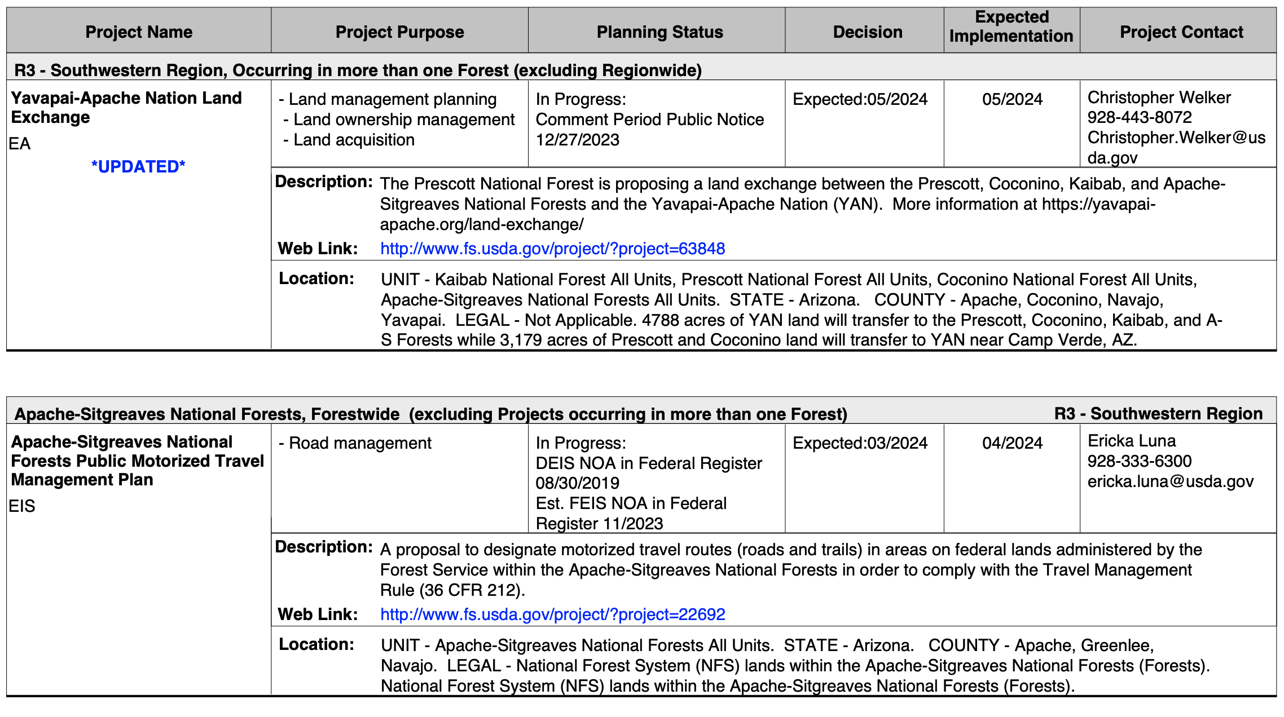
USFS – Schedule of Proposed Action (SOPA)

Slide 19
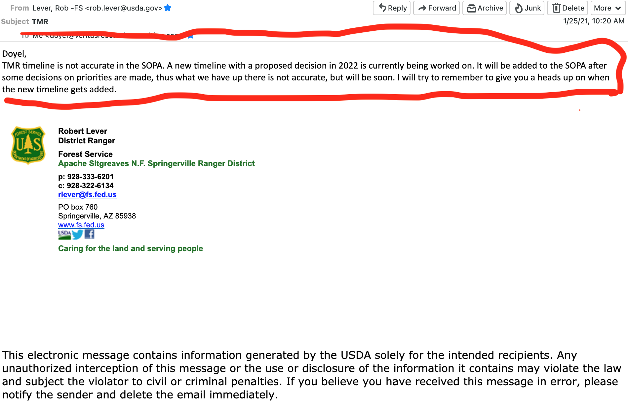
USFS – Schedule of Proposed Action (SOPA)

Slide 20
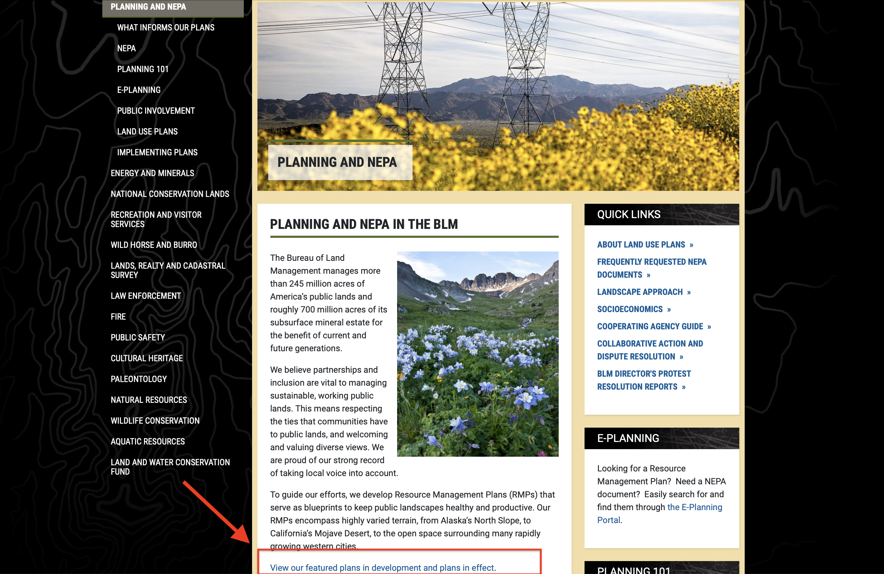
BLM – Planning Documents

Slide 21
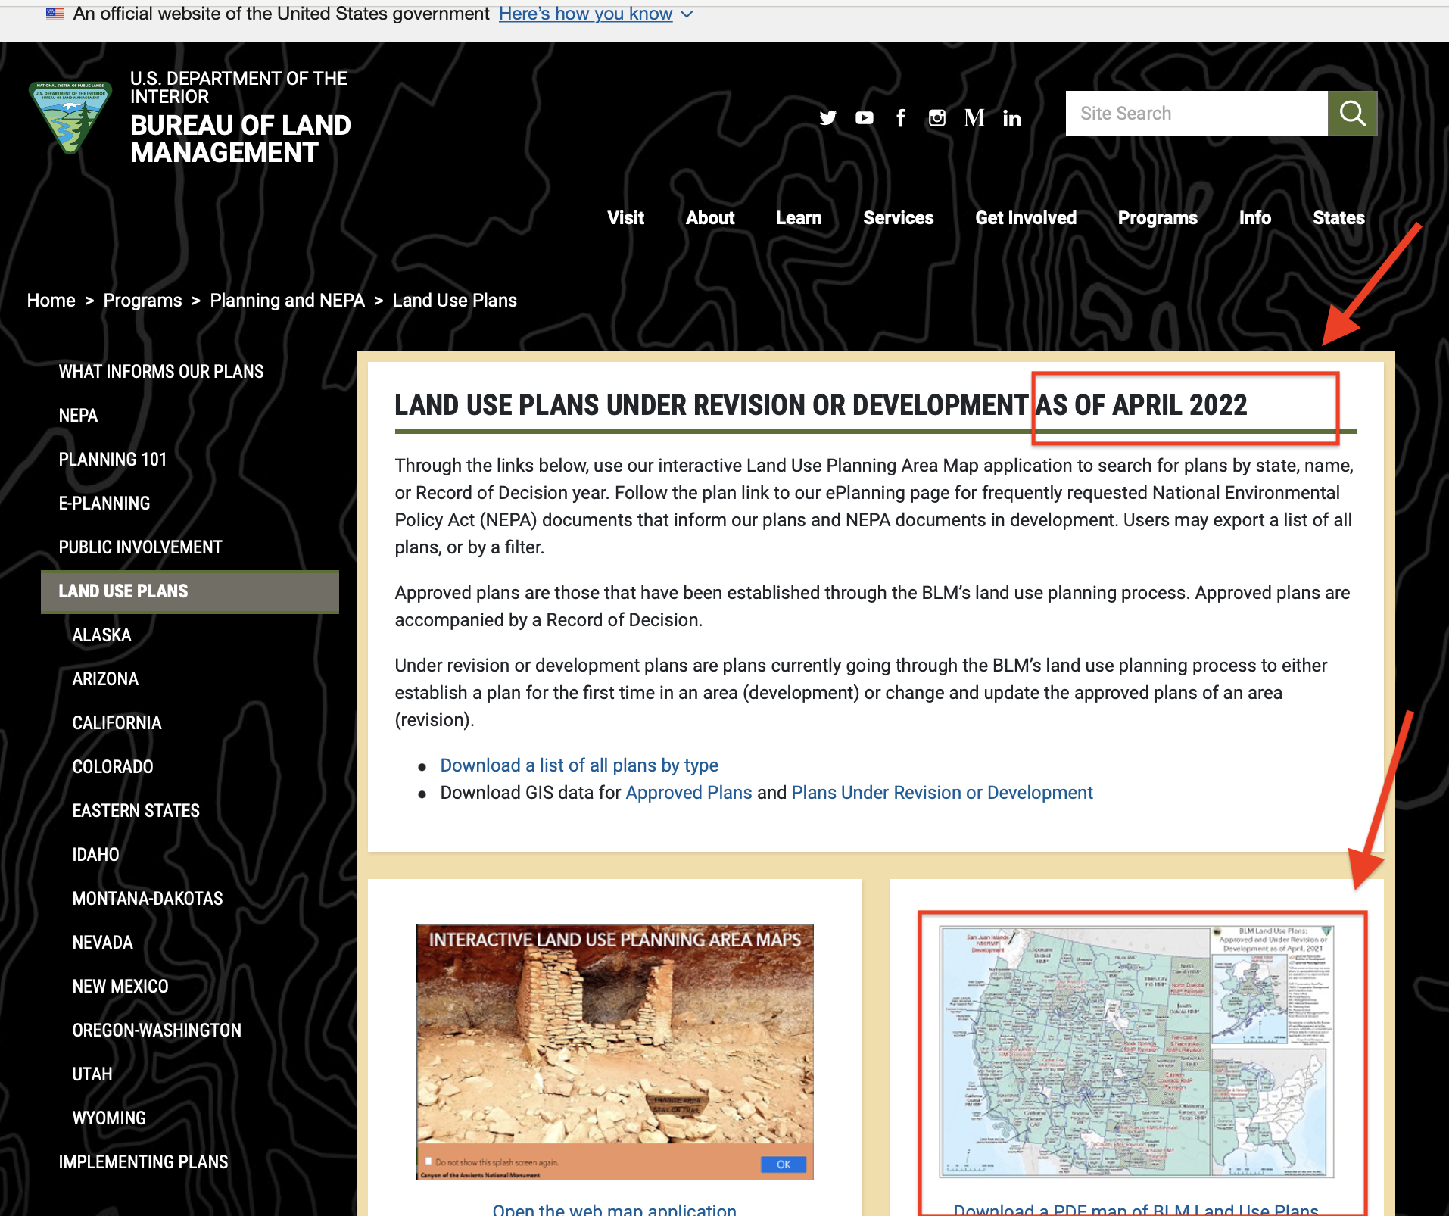
BLM – Planning Documents

Slide 22
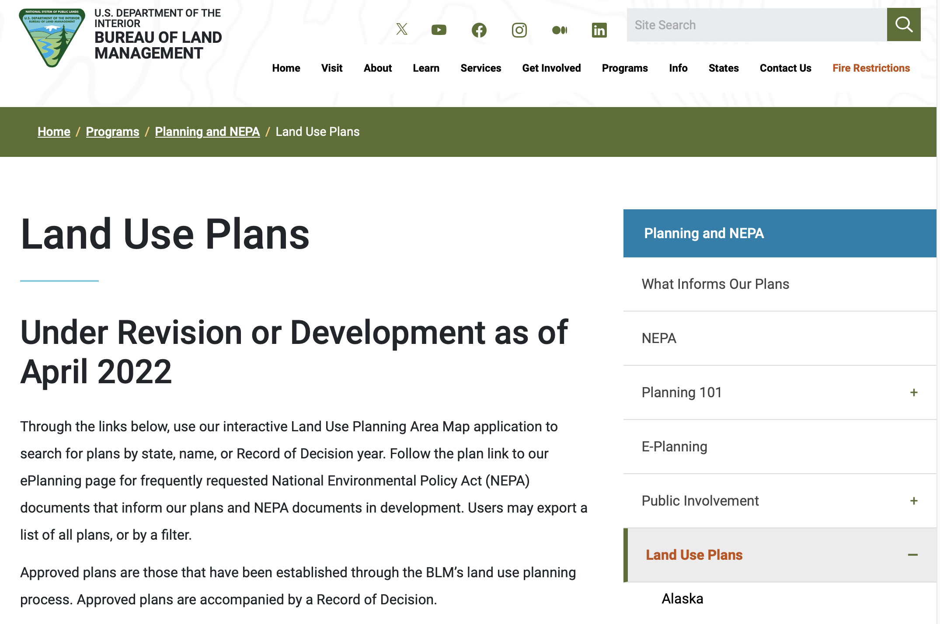
BLM – Planning Documents

Slide 23
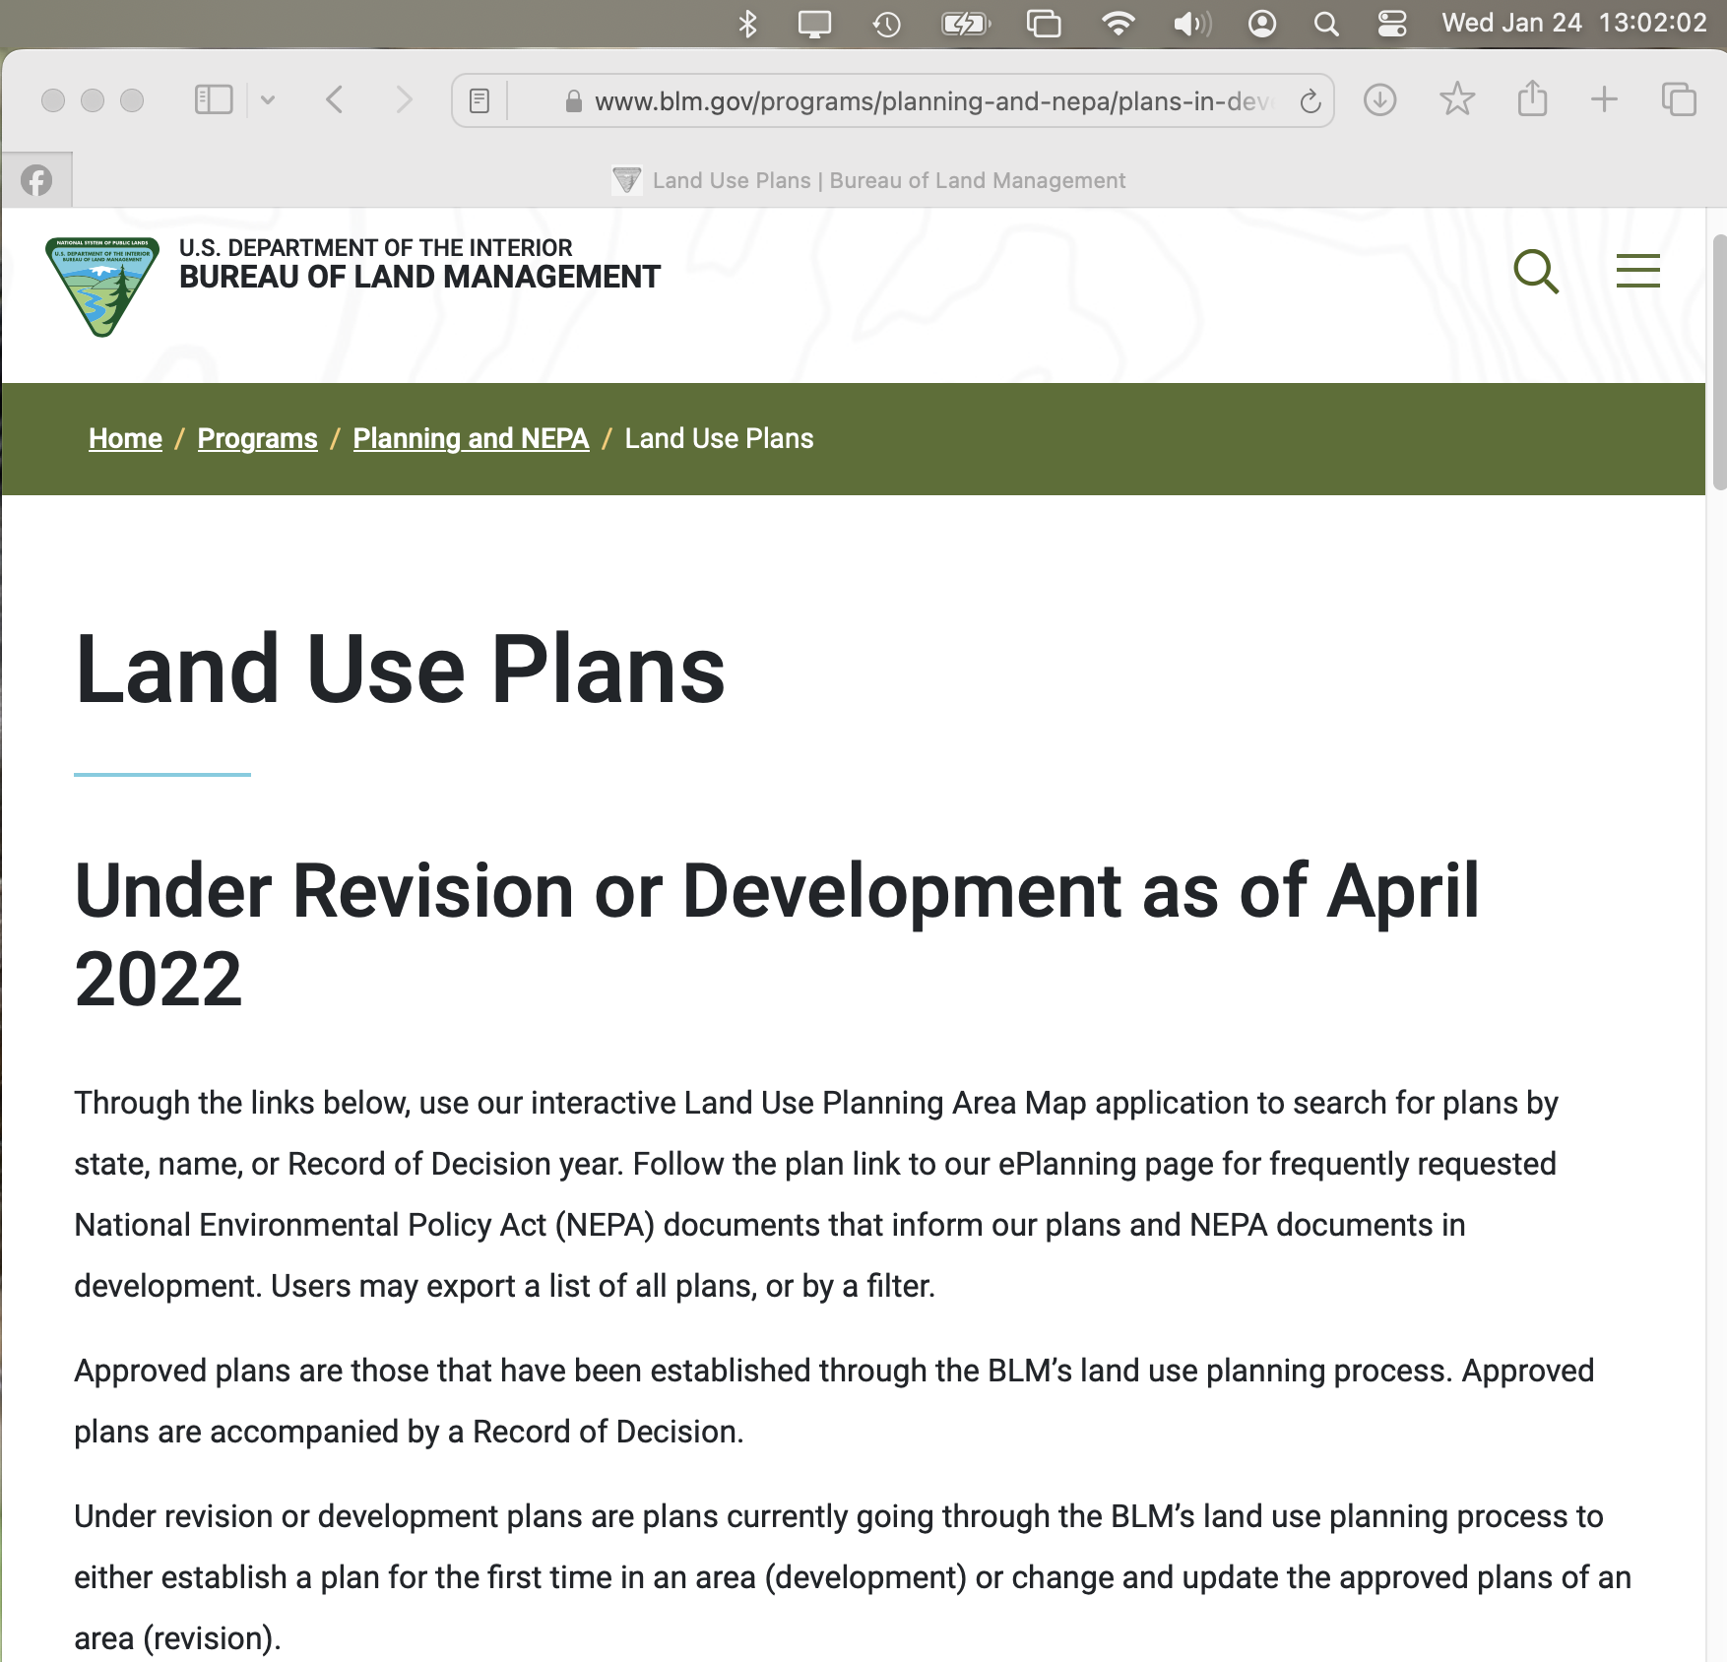
BLM – Planning Documents

Slide 24
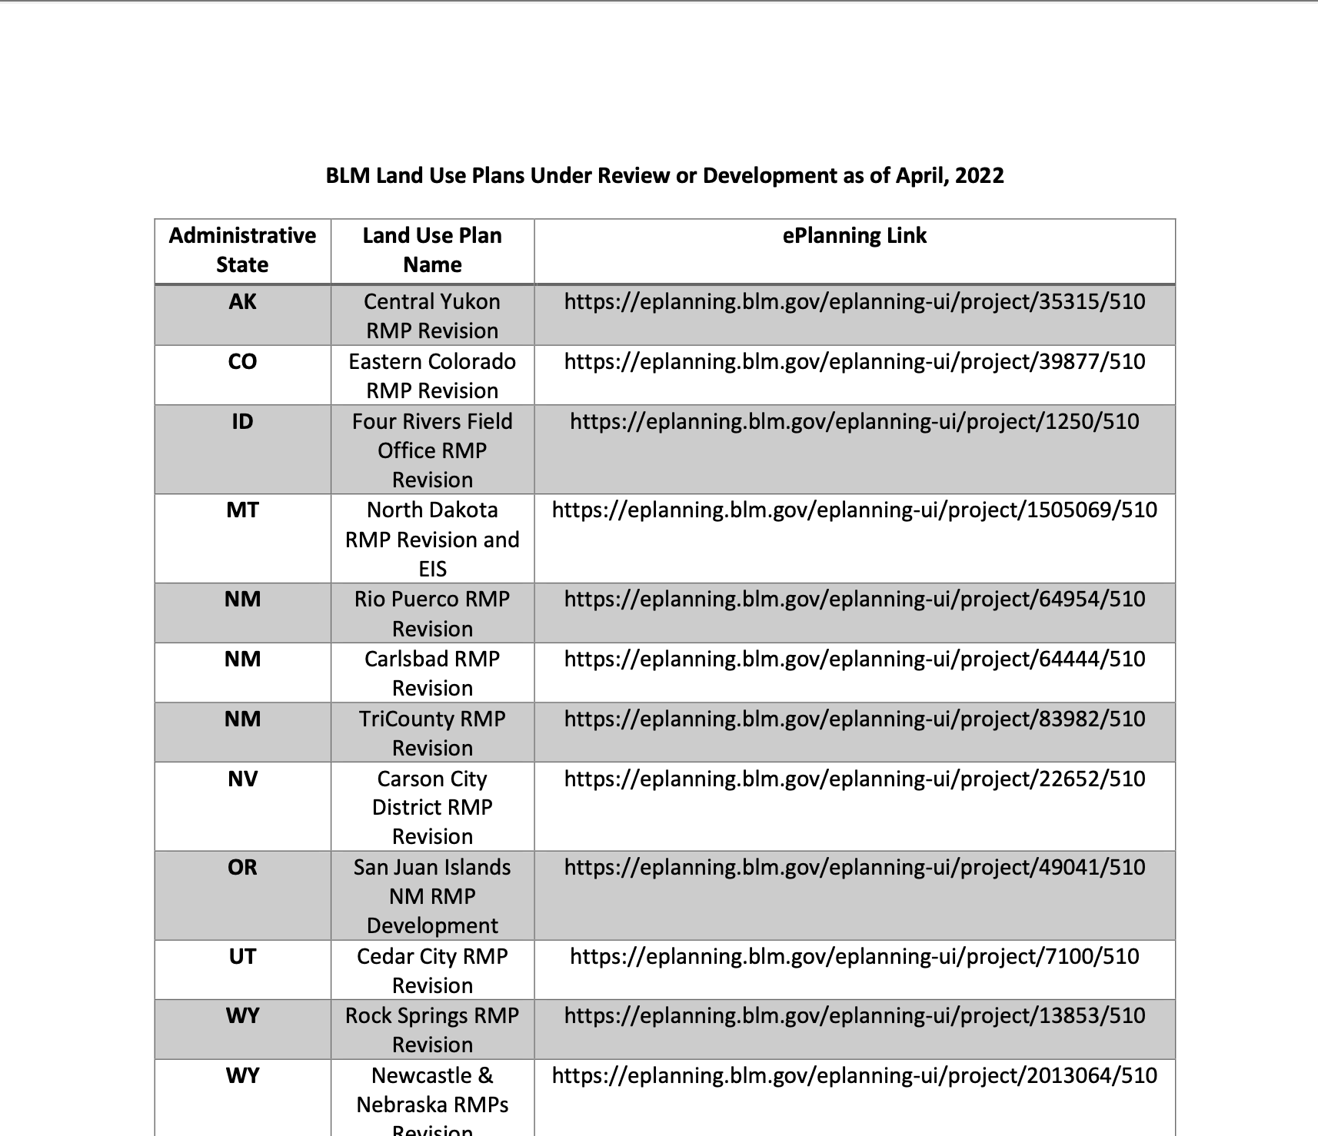
BLM – Planning Documents

Slide 25
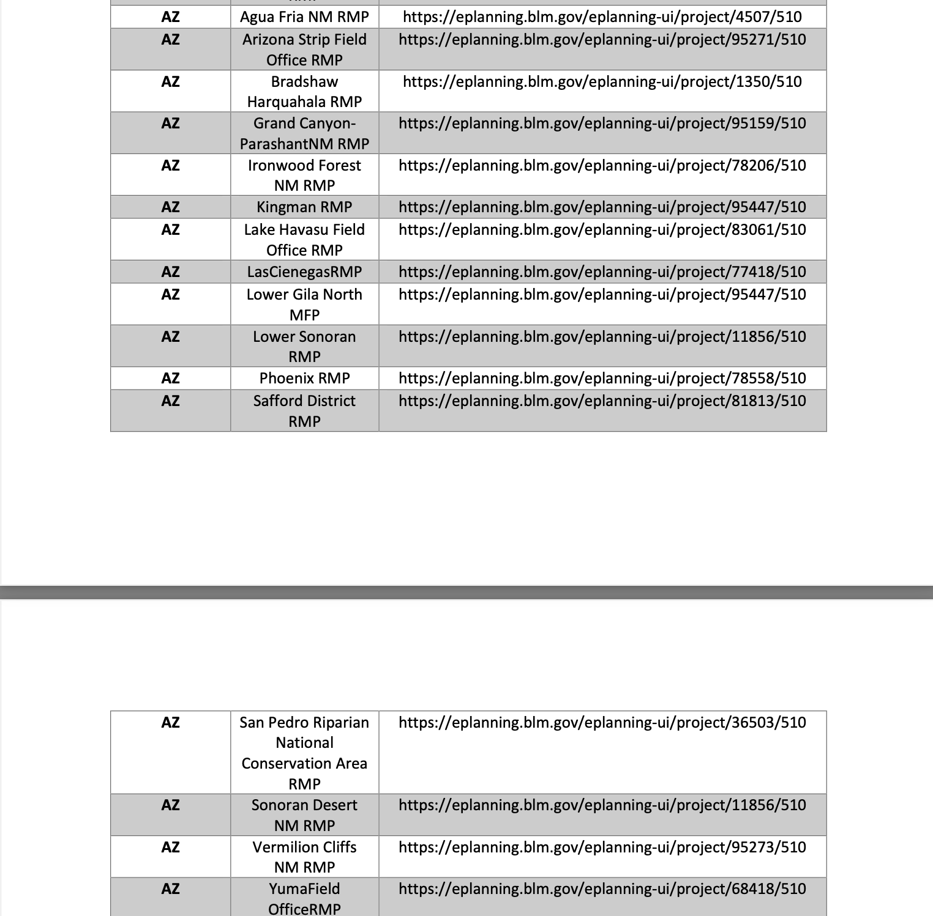
BLM – Planning Documents

Slide 26
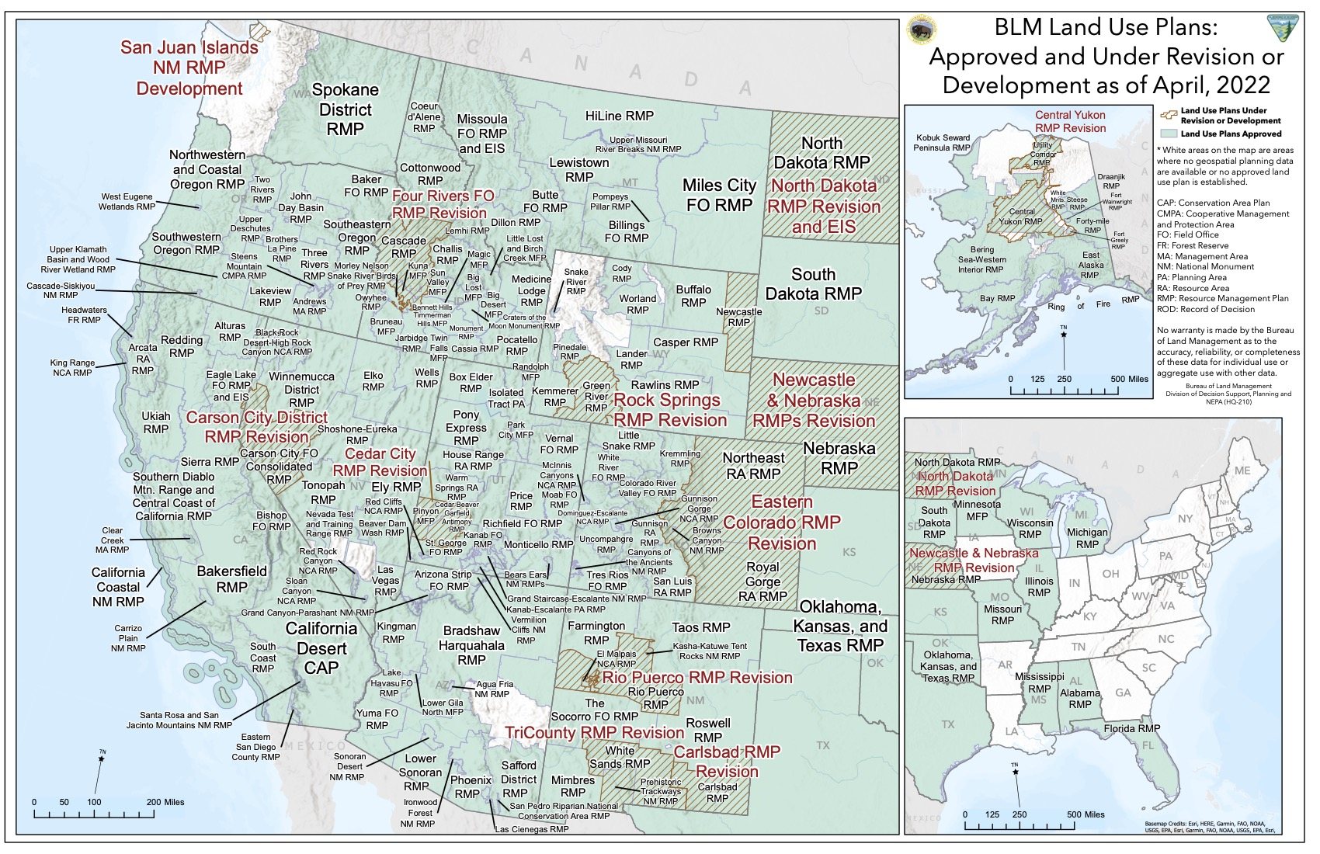
BLM – Planning Documents

Slide 27
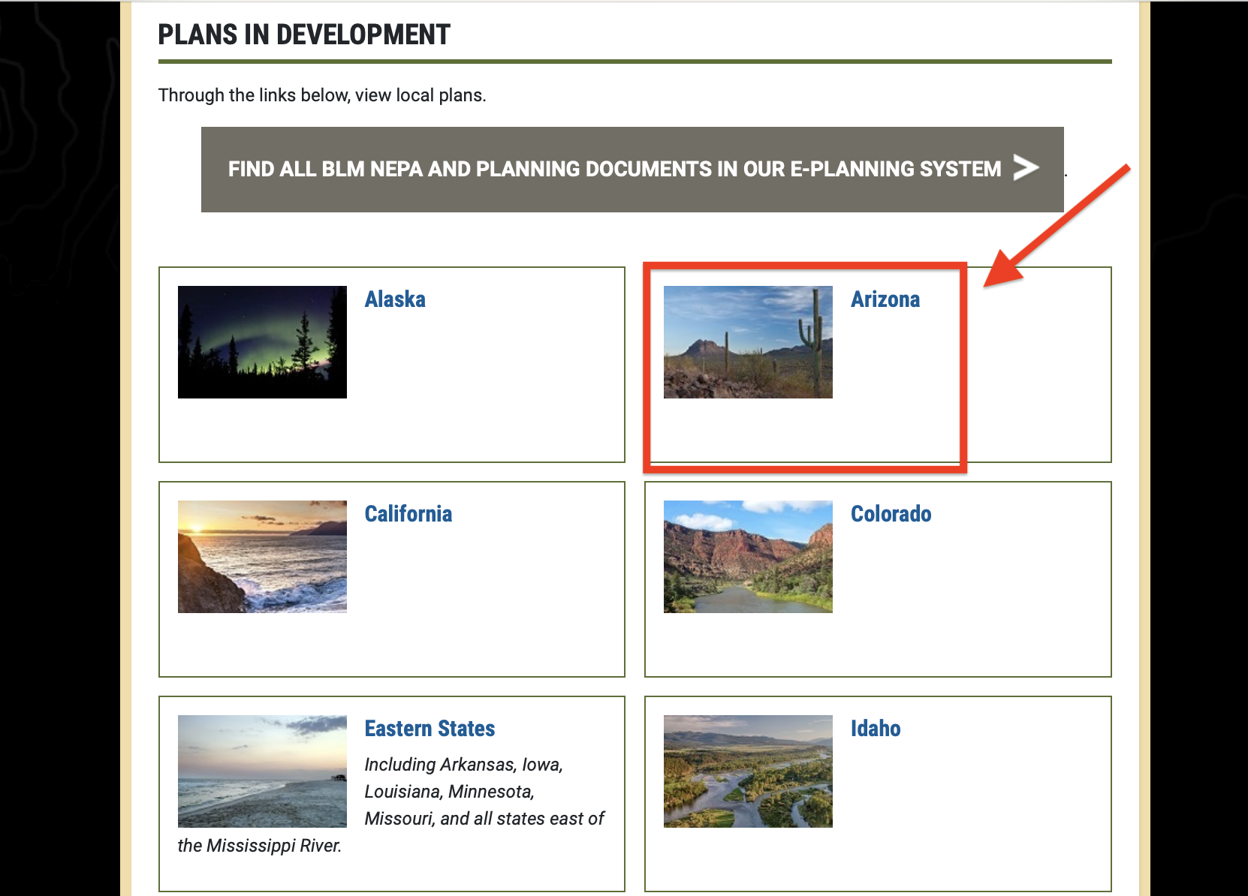
BLM – Planning Documents

Slide 28
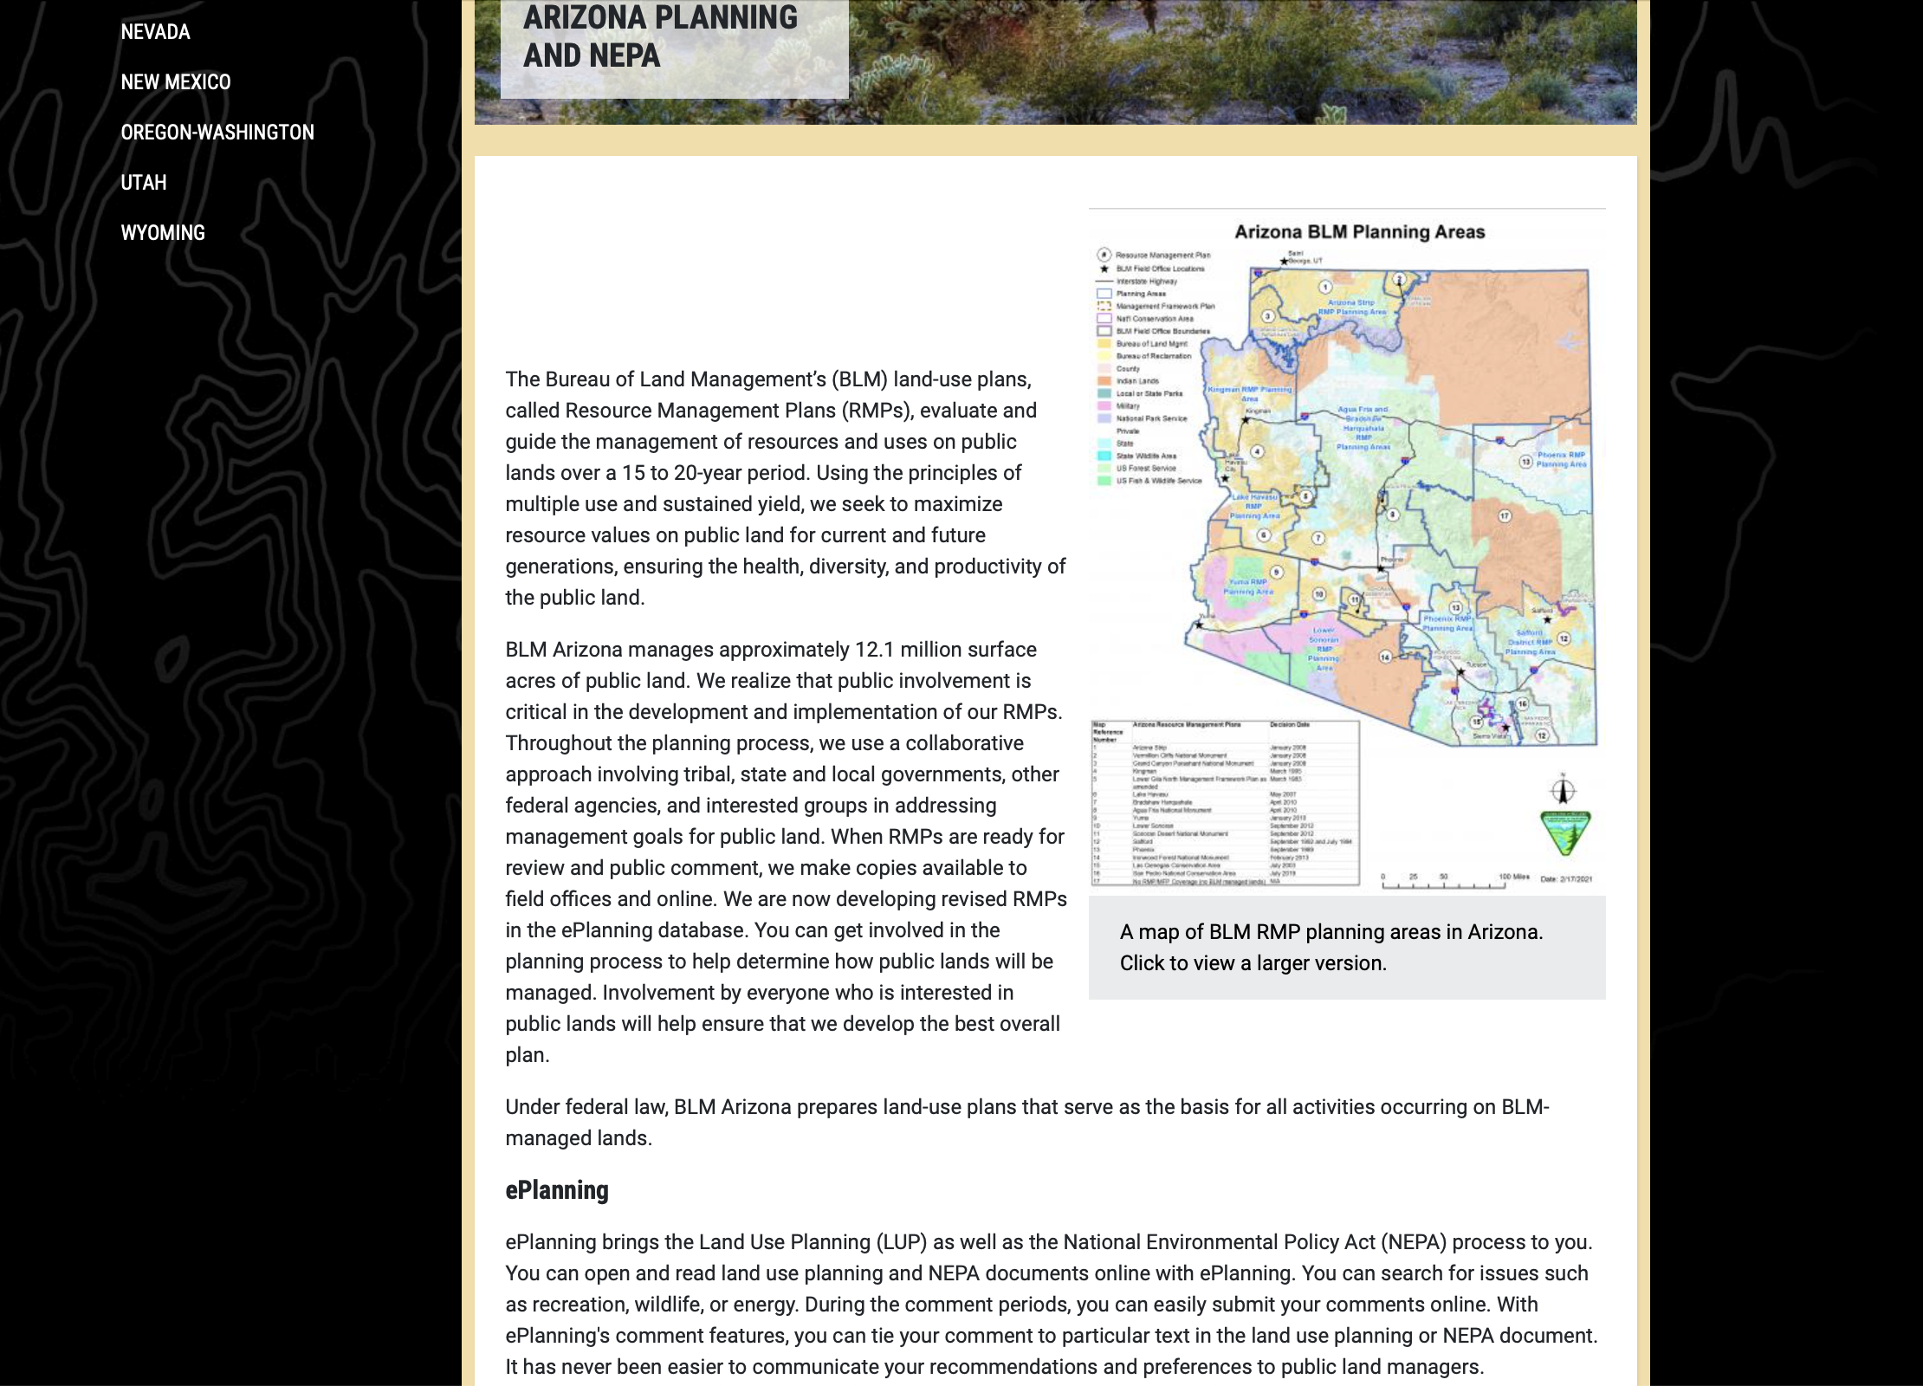
BLM – Planning Documents

Slide 29
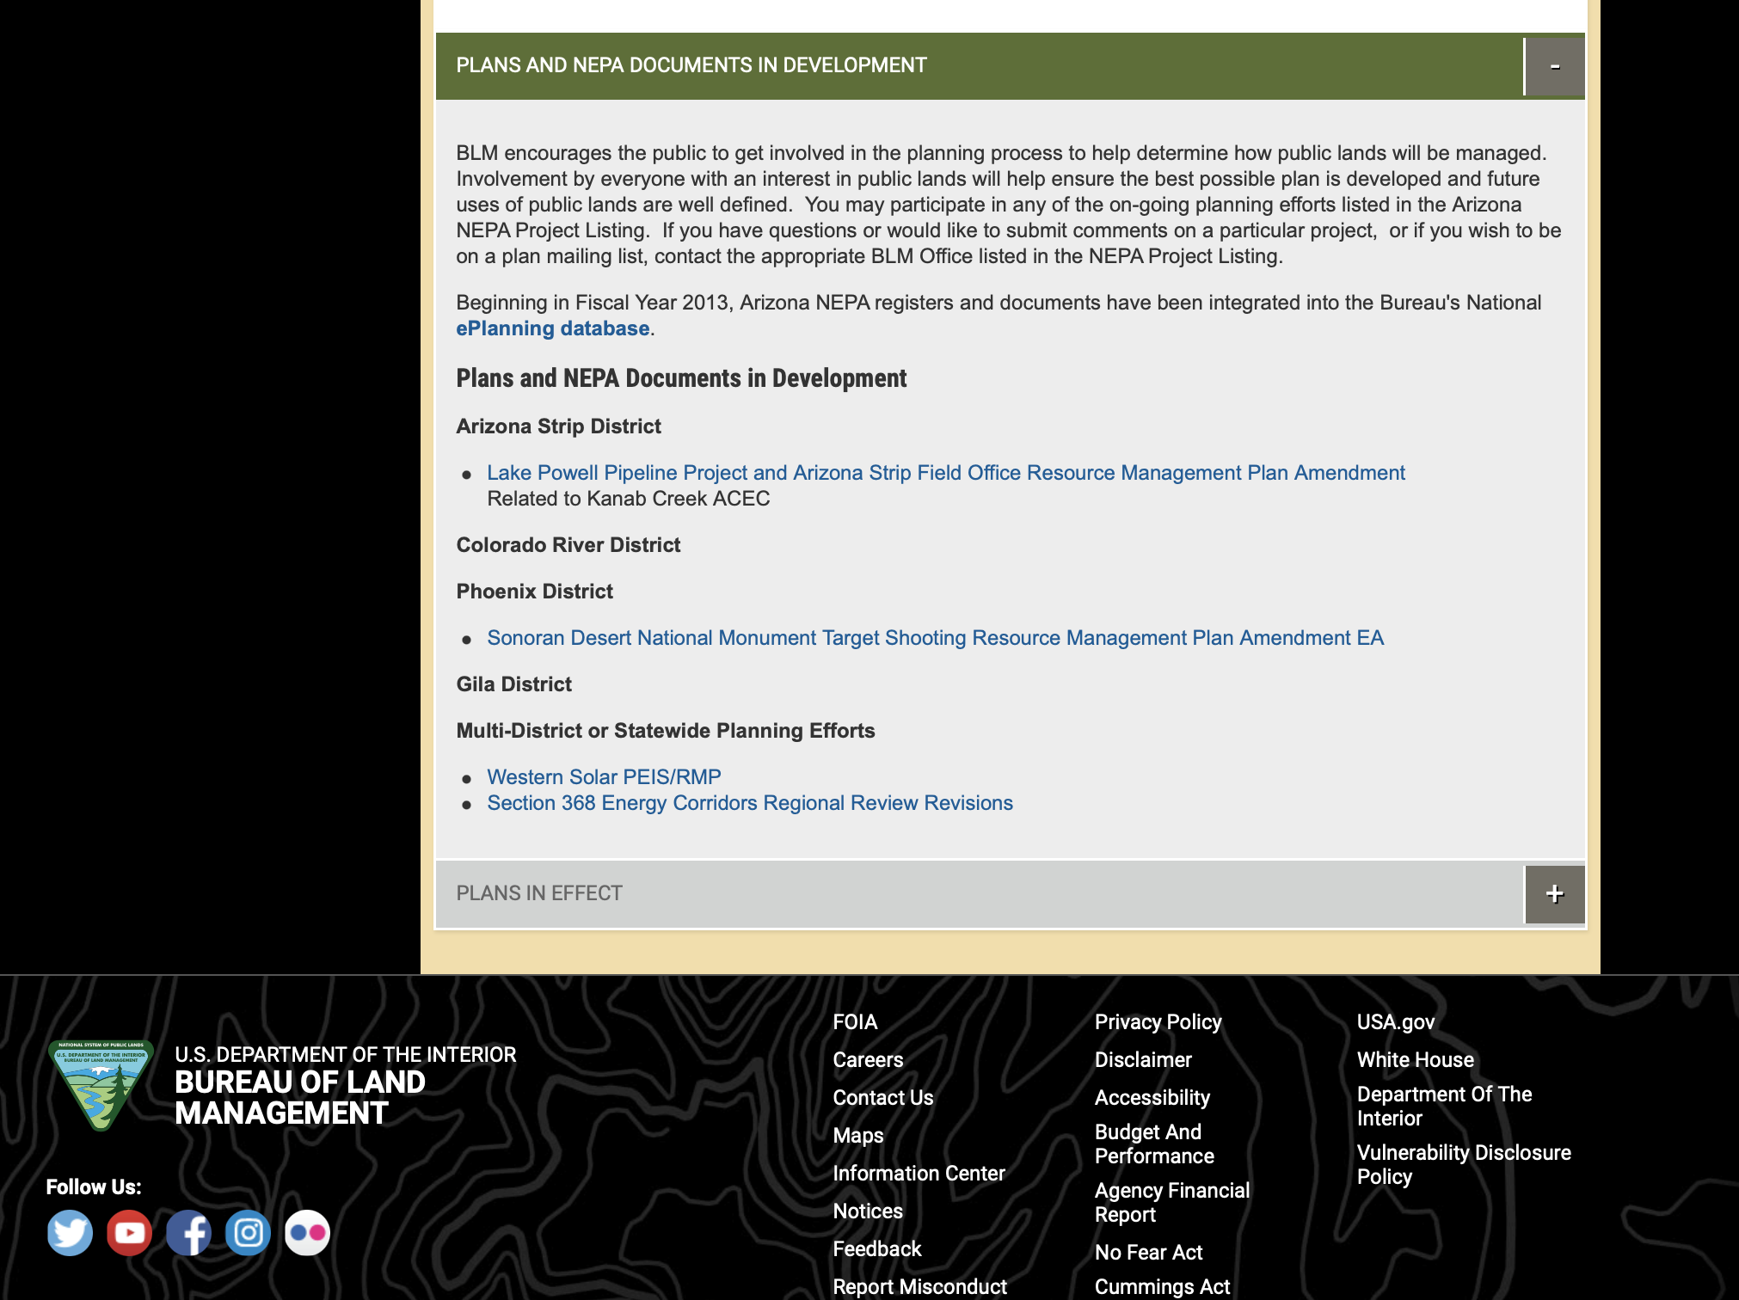
BLM – Planning Documents

Slide 30
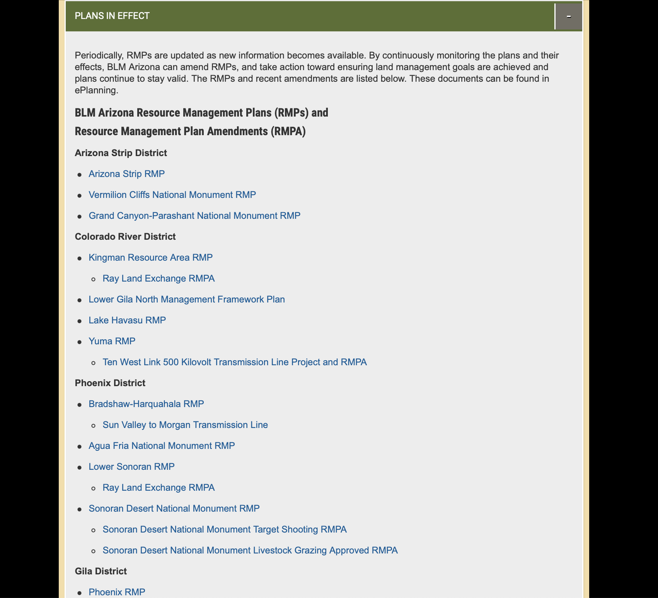
BLM – Planning Documents

Slide 31
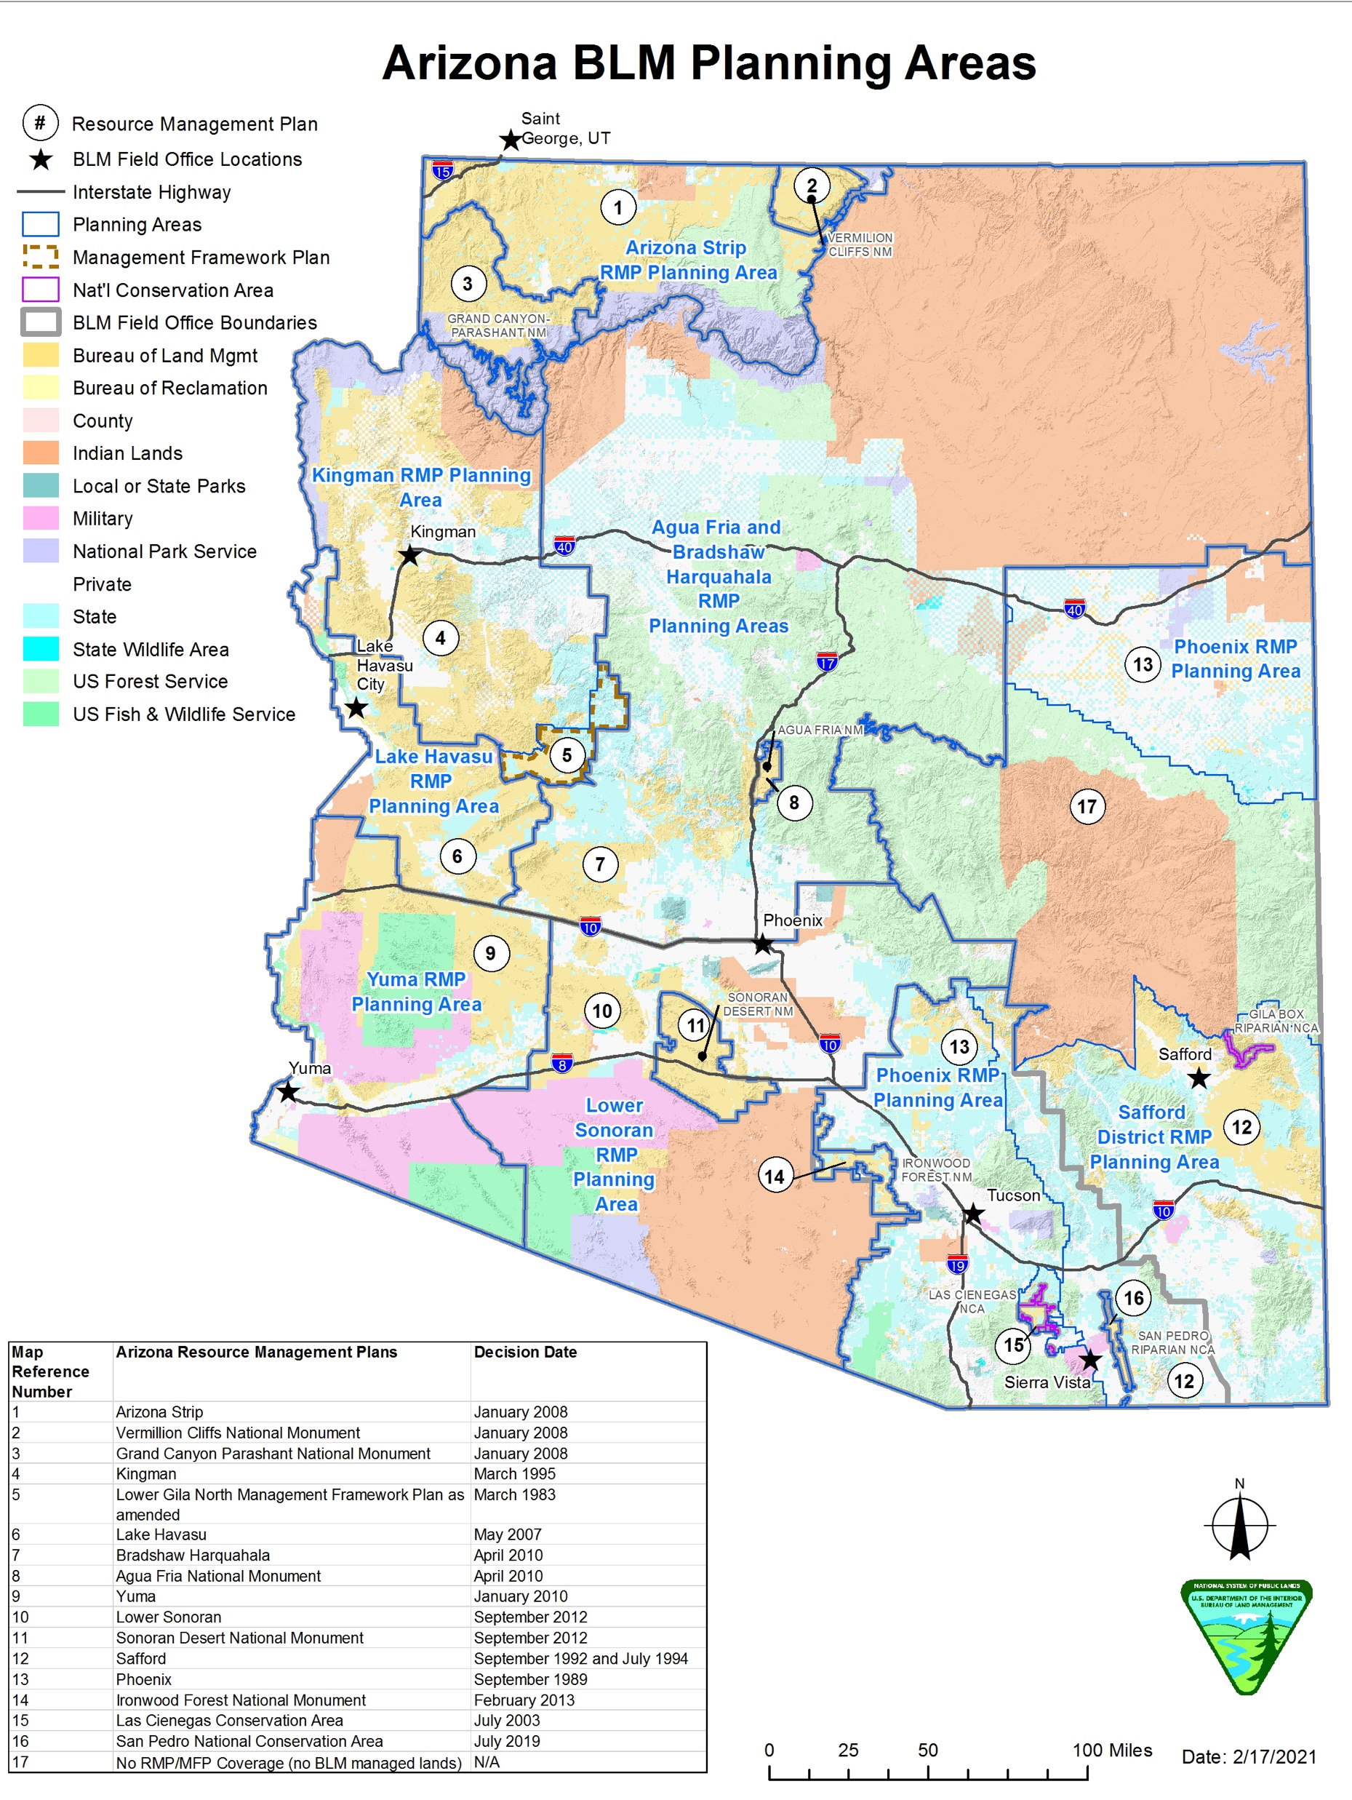
BLM – Planning Documents

Slide 32
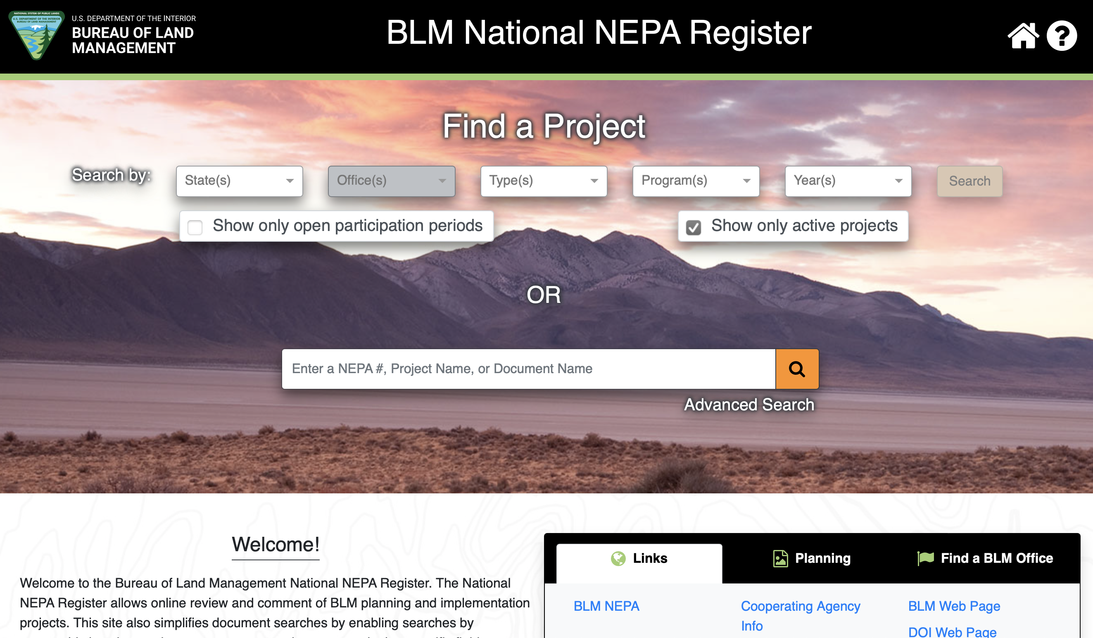
BLM – Planning Documents

Slide 33
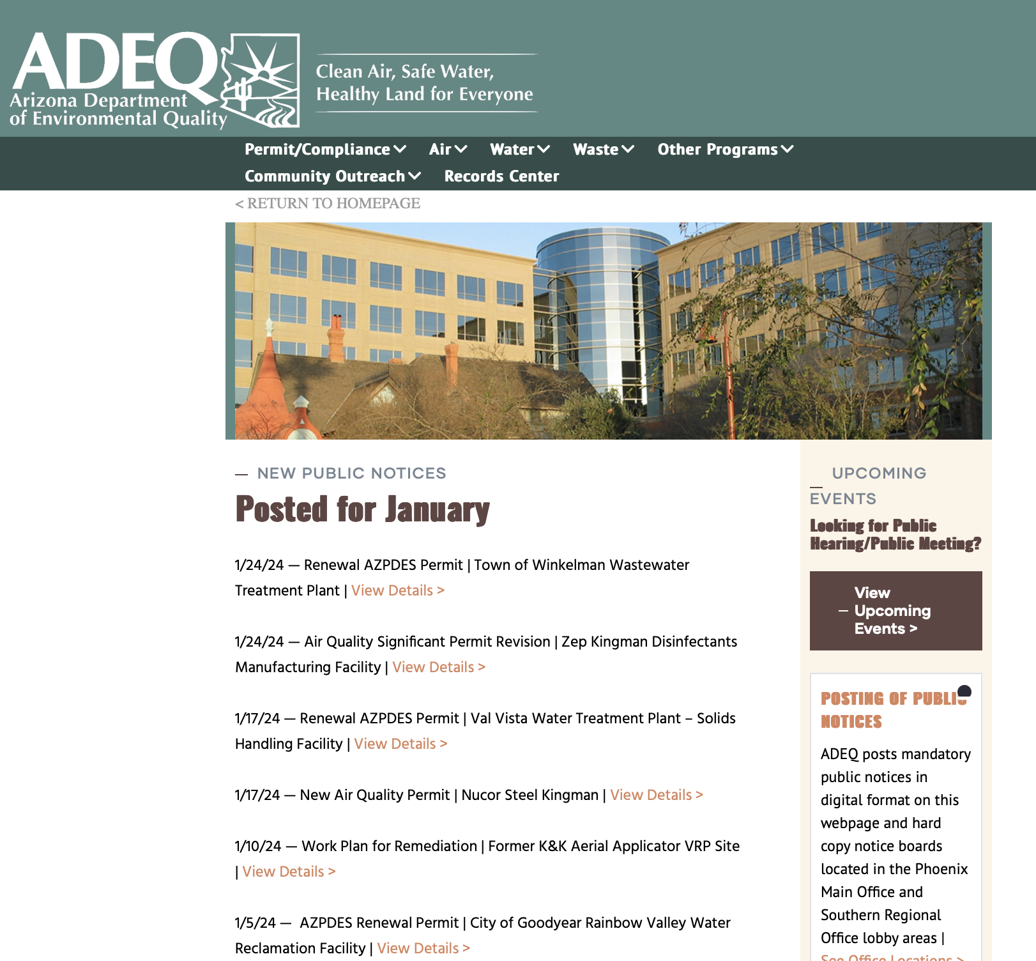
ADEQ – Arizona Department of Environmental Quality

Slide 34
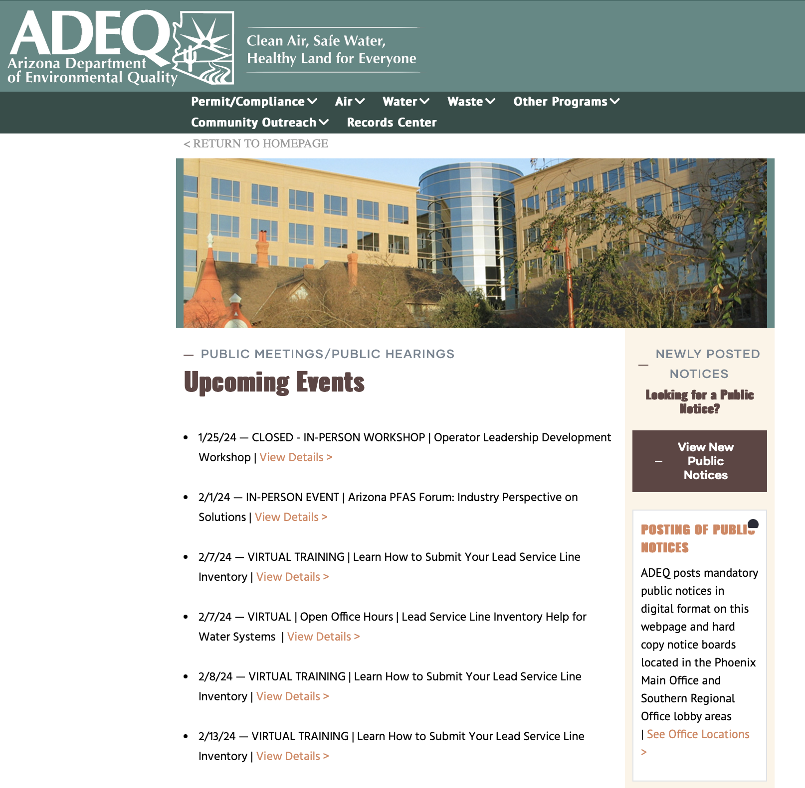
ADEQ – Arizona Department of Environmental Quality

Slide 35
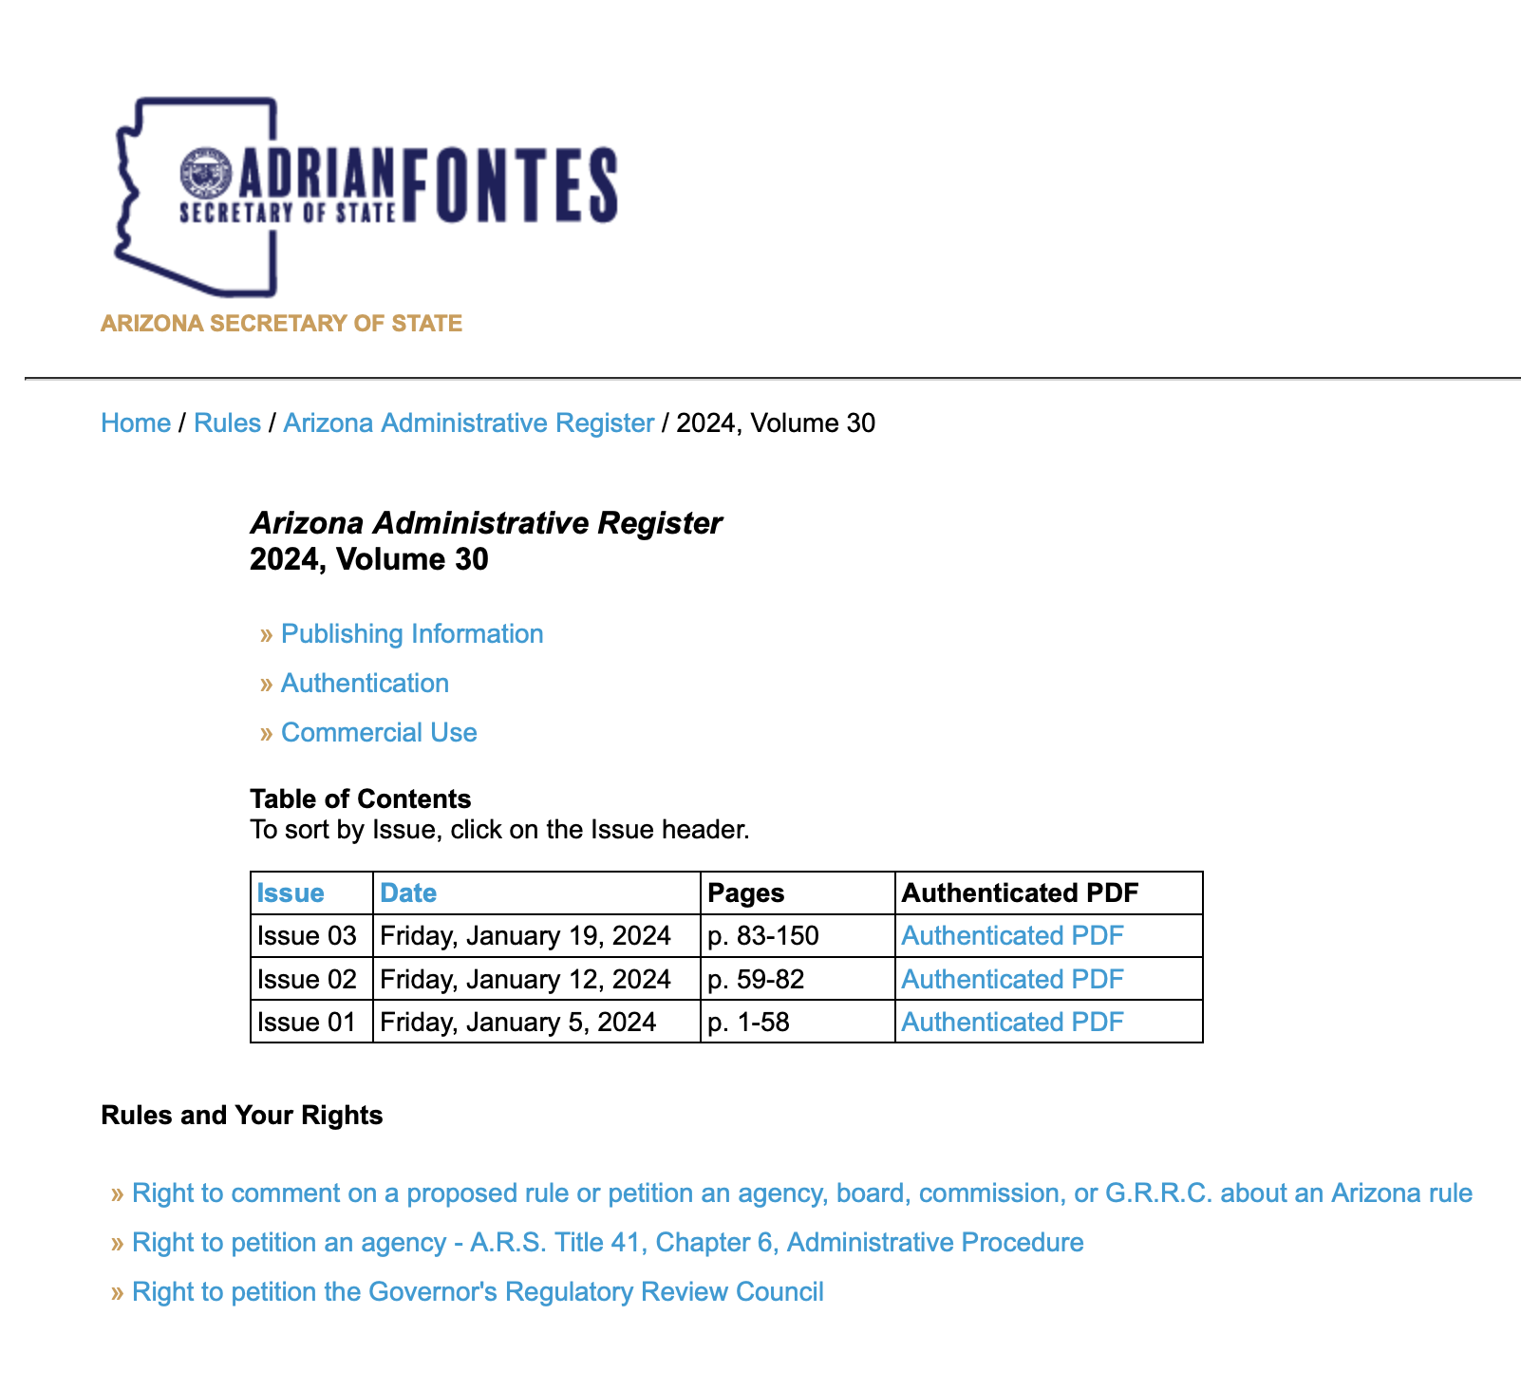
AZ Notice of Final Rule Making (NFRM) and the
Arizona Administrative Register

Slide 36
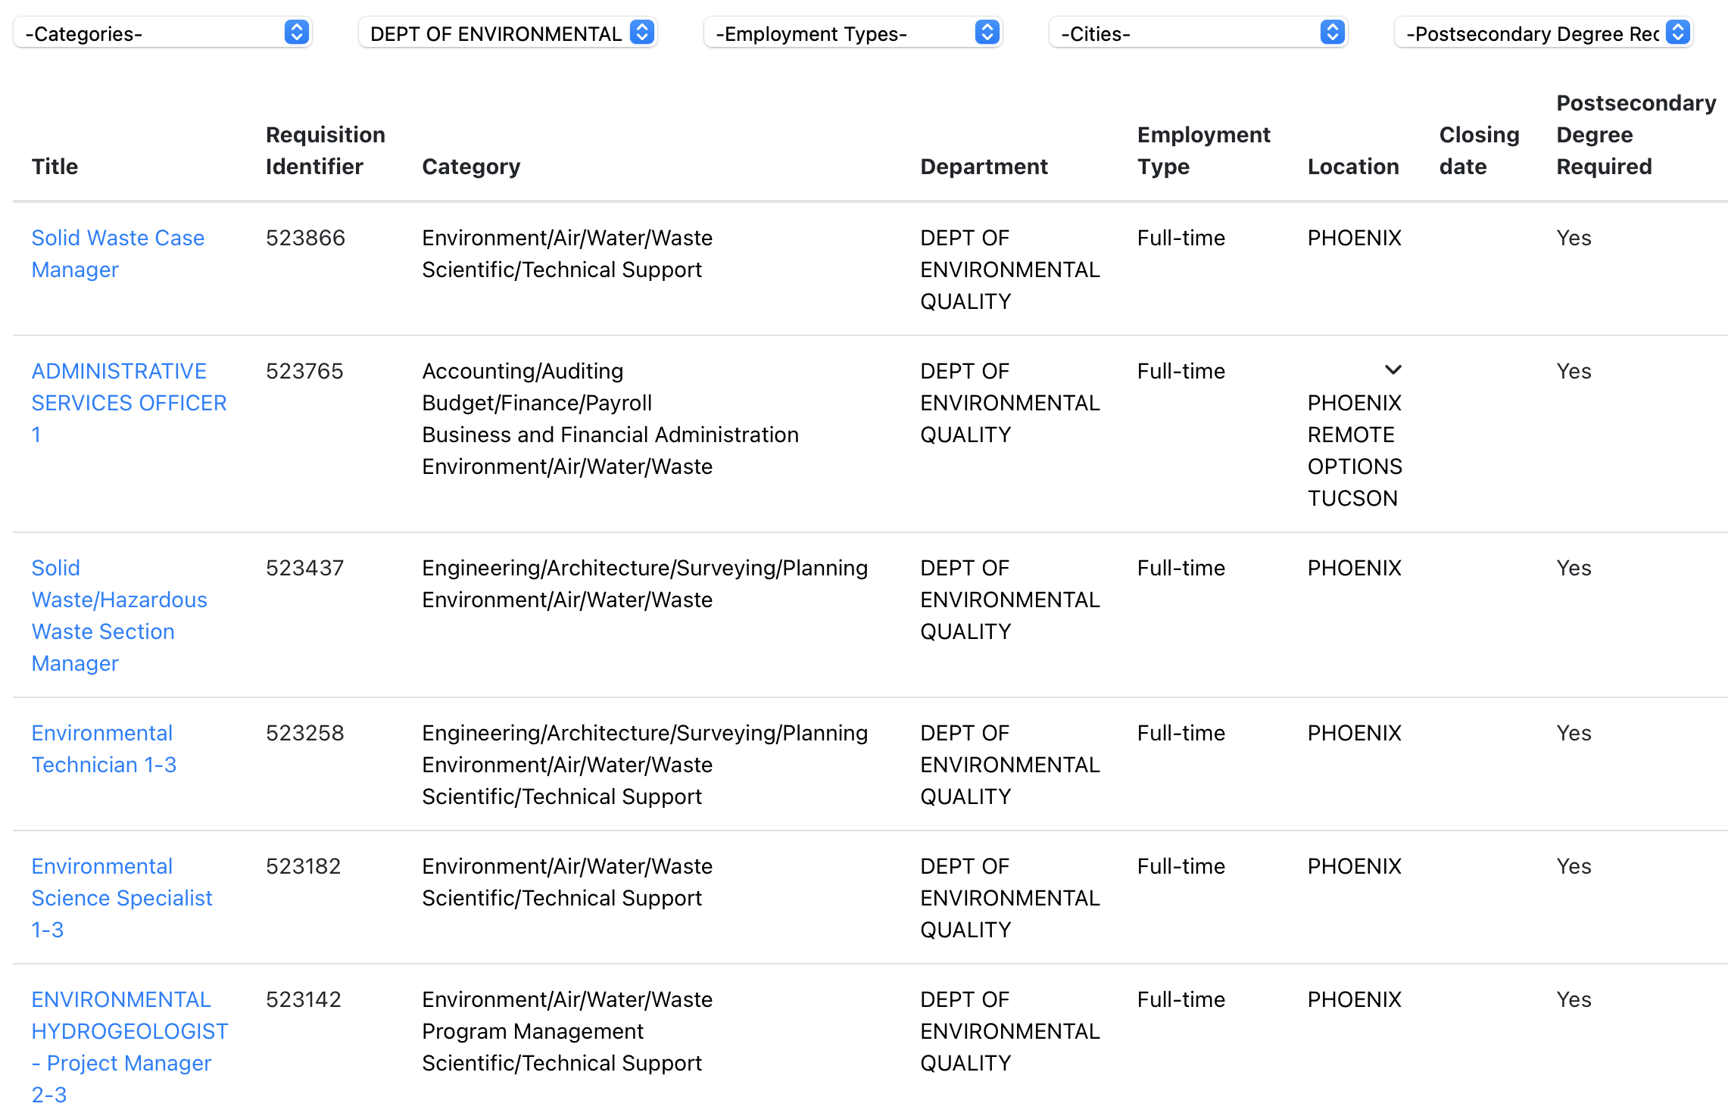
ADEQ – Arizona Department of Environmental Quality

Slide 37
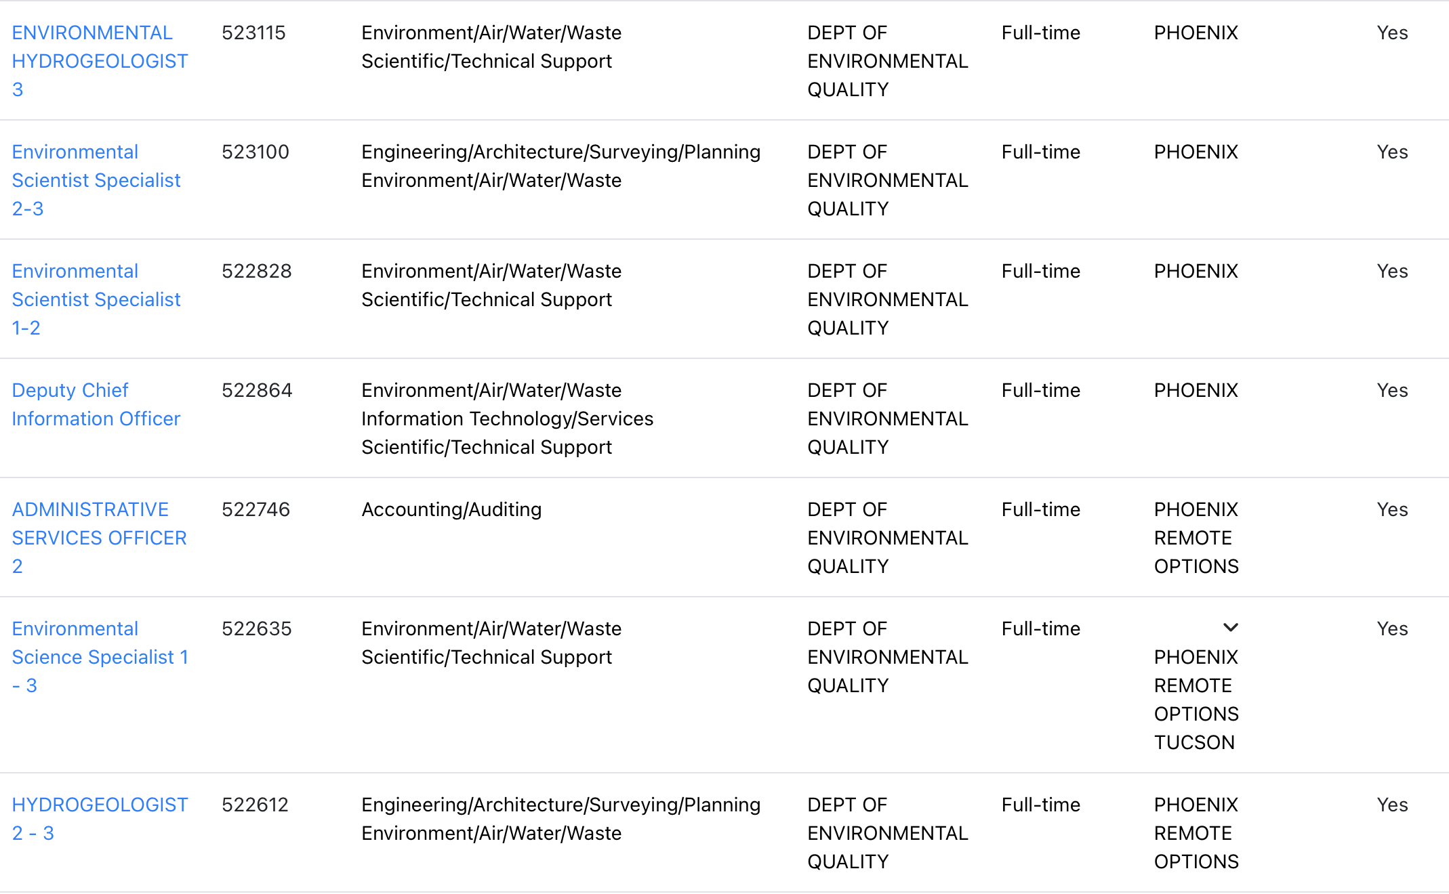
ADEQ – Arizona Department of Environmental Quality

Slide 38
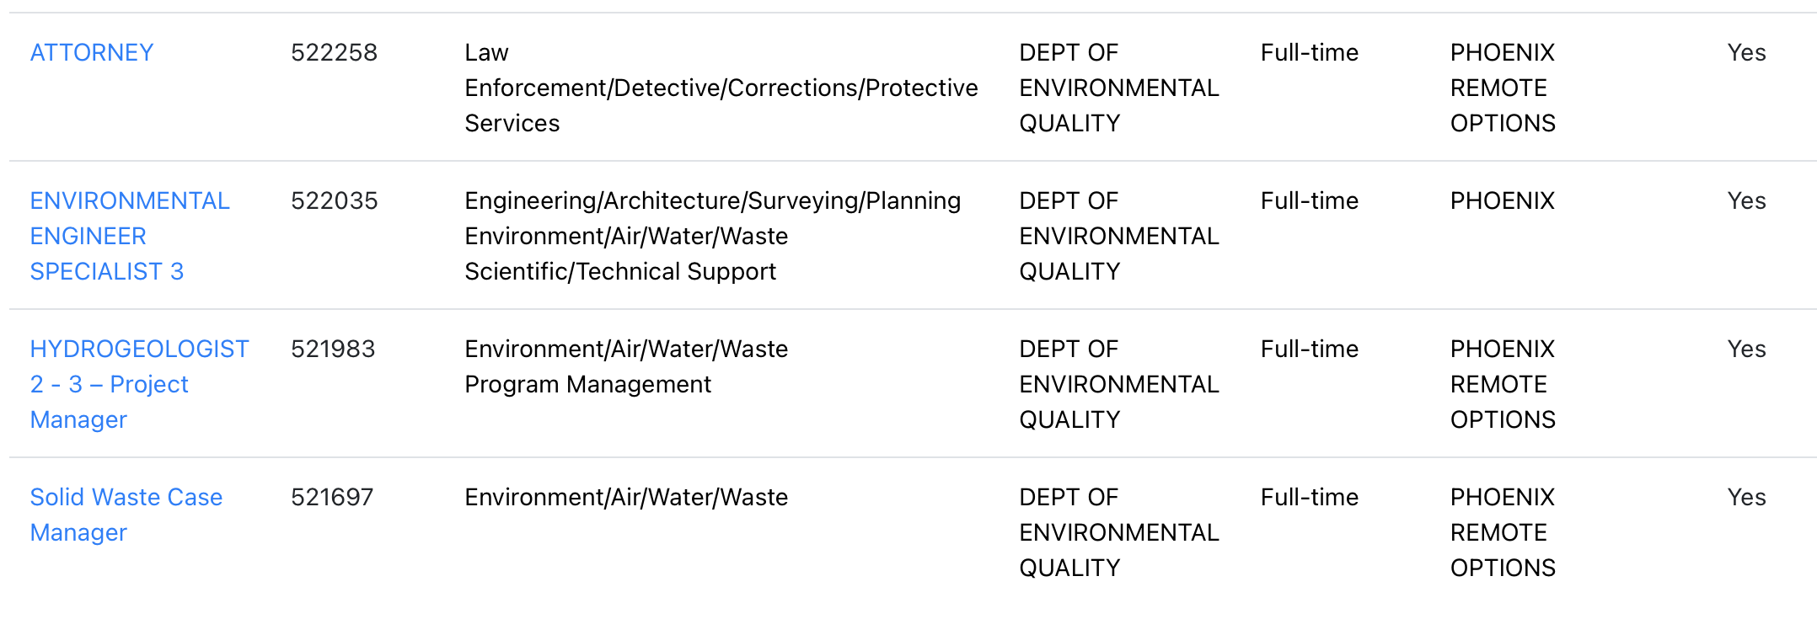
ADEQ – Arizona Department of Environmental Quality

Slide 39
Substantive Commentary
Example of agency statement in an EIS, NEPA, CE, etc.;
“The agency has found the proposed project and critical habitat designation addresses the needs of habitat enhancement and meets the objectives of the habitat conservation plan”

Slide 40
Substantive Commentary
Not a substantive comment;
“I don’t like this plan because you’re changing the area where my family goes camping”
“Can you please show the habitat plan?”

Slide 41
Substantive Commentary
Substantive comment;
“In the Threatened and Endangered, Soils, Riparian, and Vegetation specialist reports, the agency failed to identify the type of habitat enhancement needed, shortfalls of the current habitat conditions, and the goals of the referenced habitat conservation plan.”

Slide 42
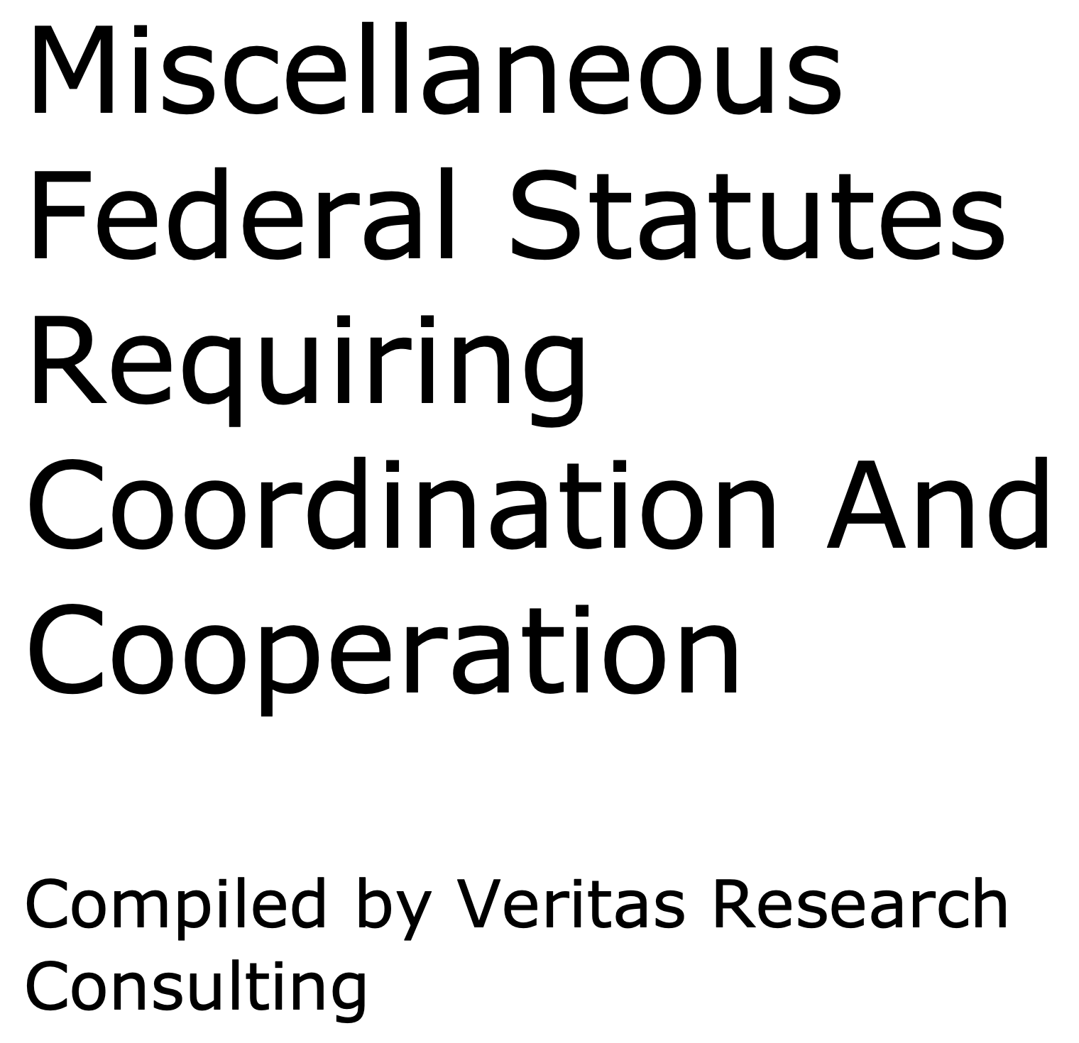
Coordination, Cooperation, Consultation http://www.veritasresearchconsulting.com/NRULPC/Misc_Fed_Stat_Req_Coord.pdf

