Slide 1
Veritas Research Consulting
Curry County
13Nov2024-14Nov2024

Slide 2
Preface
This .pdf is taken from a much larger Powerpoint presentation, which included much verbal commentary, illustration, expansion and explanatory highlights.

Slide 3

Background and Overview

Slide 4
Nixon E.O. 11647
President Nixon, on March 27, 1969, through the Government
Reorganization Act divided the United States into 10 Regions. To
further implement this Regional Governance over the U.S.A., President
Nixon signed Executive Order 11647 and entered it in the Federal
Register February 12, 1972. (Vol .37, No.30) Through the authority
vested in him as President of the United States, President Nixon
established a Federal Regional Council for each of the 10 standard
regions. It stated that, the President shall designate one member of
each Council as Chairman of the Council and such Chairman shall
serve at the pleasure of the President.

Slide 5
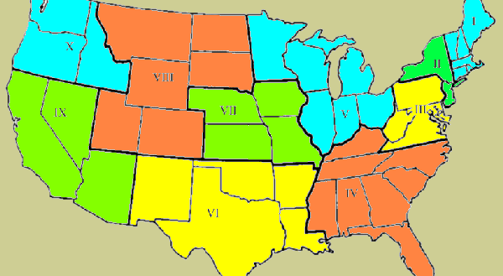
Nixon E.O. 11647

Slide 6
United States Constitution-Art. IV, Sec.3, Par. 1
"New States may be admitted by the Congress into this Union; but no new State shall be formed or erected within the jurisdiction of two or more States.; or parts of States without the consent of the Legislatures of the States concerned as well as the Congress."

Slide 7
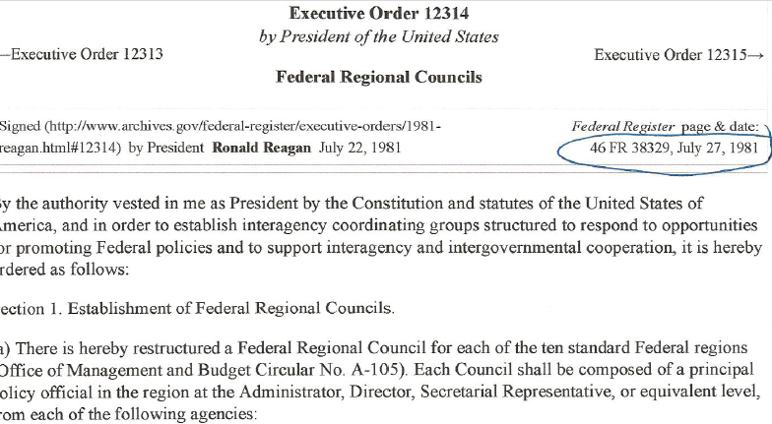
Reagan – E.O. 12313

Slide 8
Nixon E.O. 11644
Executive Order 11644--Use of off-road vehicles on the public lands
The provisions of Executive Order 11644 of Feb. 8, 1972, appear at 37 FR 2877, 3 CFR, 1971-1975 Comp., p. 666, unless otherwise noted.

Slide 9
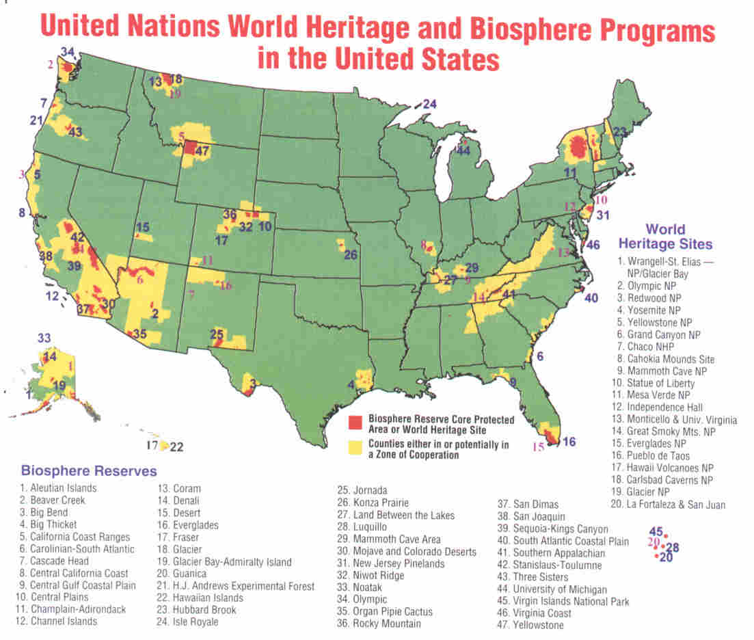
UN World Heritage and Biosphere Program in the United States

Slide 10
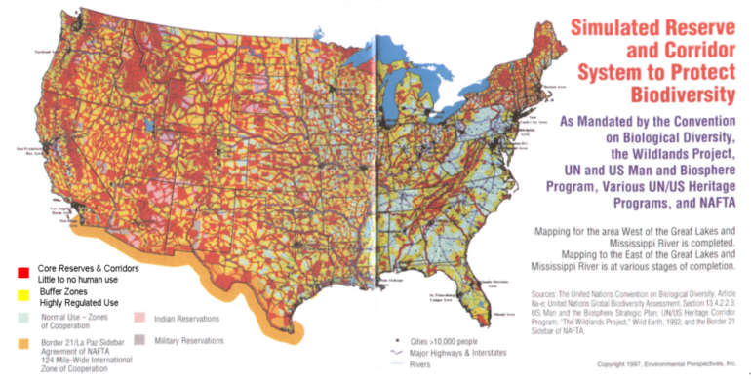
Bio-Diversity Corridor

Slide 11
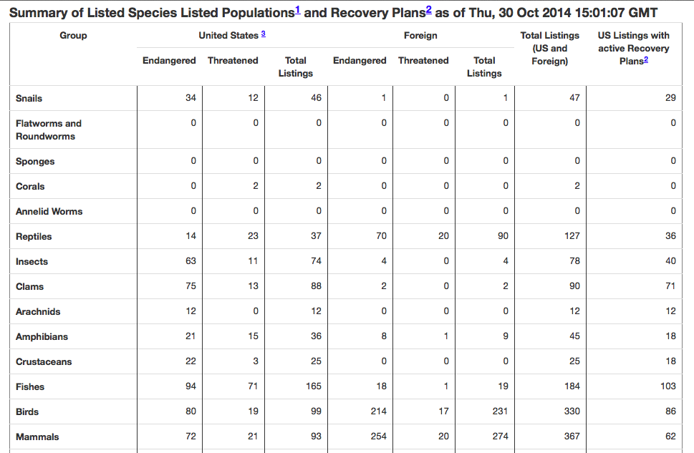
Summary of T&E under ESA
30 recovered since 1966
1.9% success rate in U.S.
1.4 % U.S. and International

Slide 12
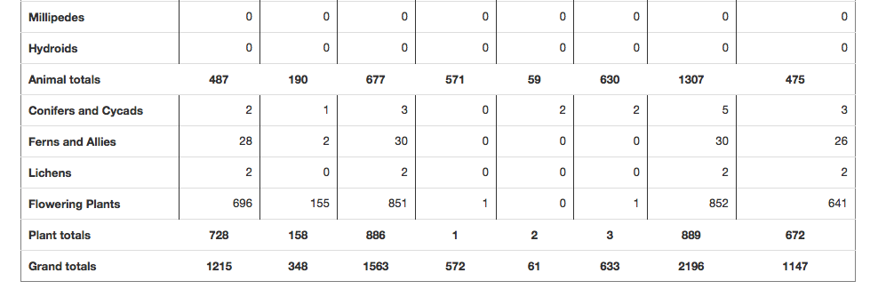
Summary of T&E under ESA
30 recovered since 1966
1.9% success rate in U.S.
1.4 % U.S. and International

Slide 13
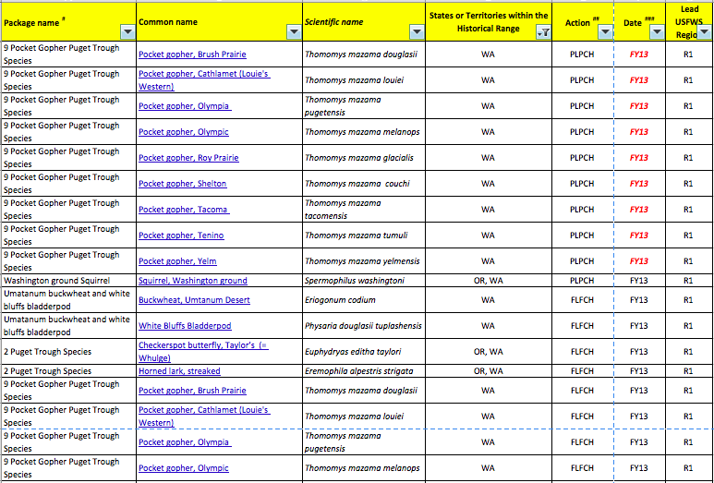
ID, MT, WA, OR – MDL Settlement Species

Slide 14
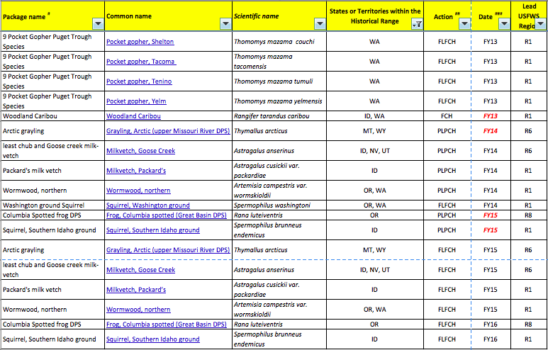
ID, MT, WA, OR – MDL Settlement Species

Slide 15
Other Endangered
The next list of endangered entities is perhaps the most alarming yet least spoken of in society.

Slide 16
The Most Impactful Endangered list
Prosperity
Liberty
Private Property Rights
Secure Future for Children
Personal Freedoms
Industry
Jobs
World Manufacturing Leadership Role
World Leading Exporter

Slide 17

World Economic Forum (WEF)
Green Growth Alliance (GGA)

Slide 18

World Economic Forum
- Outlook on the Global Agenda

Slide 19

World Economic Forum
– Mining and Metals

Slide 20
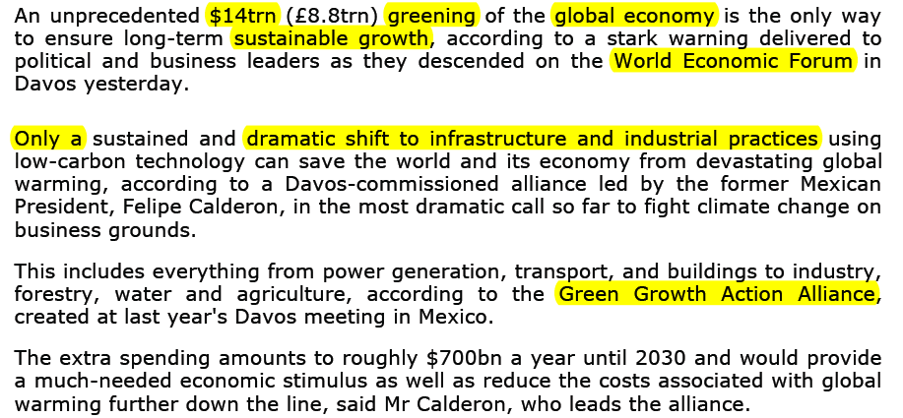
Davos Calls for $14 Trillion Greening of Global Economy

Slide 21
World Economic Forum 2013
“The Global Agenda Outlook 2013 is a publication of the Network of Global Agenda Councils, a unique network…All these discussions have been supplemented with updated data based on the opinions of Members of the Network of Global Agenda Councils, gathered before and during the Summit on the Global Agenda 2012 in Dubai”…

Slide 22
World Economic Forum 2013
Kevin Rudd: “The spreading of wealth is the key benefit in my view: globalization.
The worst thing is the disconnect between the volume of activity that now requires regulation at a global level and national political systems incapable of agreeing on global forms of governance to do that.”

Slide 23

World Economic Forum
- Green Investments

Slide 24
World Economic Forum 2013
“The Green Growth Action Alliance was created to accelerate this agenda at the 2012 G20 Summit in Los Cabos, Mexico…to thank, in particular, Bloomberg New Energy Finance, the Climate Policy Initiative, the Global Green Growth Institute, the International Energy Agency, the OECD, the United Nations Environment Programme, the World Bank Group and the World Resources Institute for providing data”…

Slide 25
World Economic Forum
Innovative partnerships can be created through targeted government support.
Government Subsidies can help push commercially unproven technologies into a more competitive market.
Funds raised through taxing fossil fuels can be used to leverage additional finance.

Slide 26

UNEP - 21

Slide 27
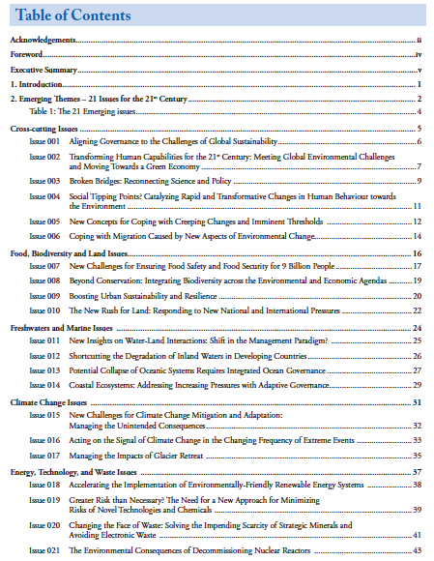
UNEP - 21

Slide 28
Map - 21
Improve connectivity among habitats disrupted by roads.
Pick corridors across multiple states.
Mitigate damage to wildlife, aquatic organism passage, habitat and ecosystem connectivity.
The plan may encompass multiple environmental resources within a defined geographic area or may focus on a specified resource, such as aquatic resources, parkland, or wildlife habitat.

Slide 29
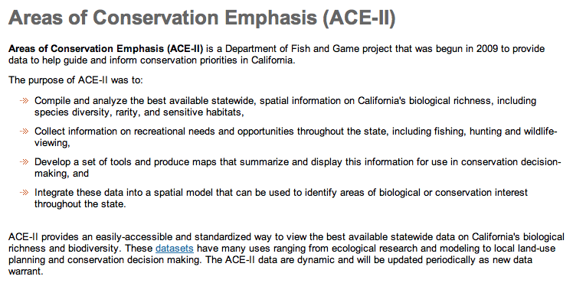
Crucial Habitat Assessment Tool (CHAT) and Areas of Conservation Emphasis (ACE-II)

Slide 30
UNEP Objectives – foundational Principles from 1972-1973 formation
Redraw land maps to differentiate biological characteristics rather than political (state, counties, etc.) jurisdictions.
Regroup human population into self-sustaining settlements that minimize impact on biodiversity.
Create a new system of governance within a framework of international agreements based on Bioregions and governed by “Bio-regional Councils”.

Slide 31
Some Notable Quotes
Richard Gardner, from The Hard Road To World Order…“In short, the "house of world order" will have to be built from the bottom up rather than from the top down. It will look like a great "booming, buzzing confusion," to use William James’ famous description of reality, but an end run around national sovereignty, eroding it piece by piece, will accomplish much more than the old-fashioned frontal assault.”

Slide 32
Some Notable Quotes
“The next few years should see a continued strengthening of the new global and regional agencies charged with protecting the world's environment. In addition to comprehensive monitoring of the earth's air, water and soil and of the effects of pollutants on human health, we can look forward to new procedures to implement the principle of state responsibility for national actions that have transnational environmental consequences, probably including some kind of "international environmental impact statement”…”

Slide 33
Some Notable Quotes
Robert Weaver, Chief, Department of Housing and Urban Development, 1966, “Regional Government means absolute Federal control over all property and its development regardless of location, anywhere in the United States, to be administered on the Federal Official’s determination. It would supersede state and local laws…through the authority we seek to recapture control of the use of land, most of which has already been given to the people”

Slide 34
Some Notable Quotes
Dr. Reed F. Noss, The Wildlands Project, “The collective needs of non-human species must take precedence over the needs and desires of humans”
Peter Berle, when President of the National Audubon Society, “We reject the idea of private property.”
Prince Phillip, Founder, World Wildlife Fund, “If I were reincarnated I would wish to be returned to Earth as a killer virus to lower human population levels.”

Slide 35
Some Notable Quotes
Pete Singer, “father of animal rights”, “Christianity is our foe. If animal rights is to succeed, we just destroy the Judeo-Christian religious tradition.”

Slide 36
Some Notable Quotes
Gus Hall, leading US Communist, eventual National Chairman of the US Communist Party, Ecology Magazine, 1972; “This is true in the struggle to save the environment, we must be the organizers, the leaders of the movement.”
Carl Boice, US Communist Party Officer, in MIA, March 1995; “The environmental movement promises to bring greater numbers into our orbit than the peace movement ever did.”

Slide 37
Water
The large tracts us federally managed lands are responsible for 2/3 of our fresh water supply and are suffering to a great extent due to mismanagement. This lack of management directly impacts our water supply through evapotranspiration, massive changes in timing of snowpack melt and runoff, massive post-fire sediment runoff, pollutant injection into watersheds and massive changes in surface water trends.

Slide 38
Water
Evapotranspiration – Vegetation moves water from the soil to the atmosphere, or traps higher than normal amounts in the upper tiers or the canopy, reducing surface flow and downstream yield.
In the winter period, a portion of the snow caught in the branches evaporates or sublimates and reenters the atmosphere without ever melting
Open tree stands and reduced understory vegetation protect snowpack from solar radiation, versus entrapment in the branches.

Slide 39
Water
An active management system by the states can significantly improve our stressed and strained fresh water supply.
Studies have show that if active management were to occur, which is best done at a more manageable state-level of landscape, that water demands and needs can be met.

Slide 40
Water
Forest treatments to reduce forest cover by 40% can yield an increase in water yields by 9%.
A treatment area of just 4100 acres wherein a 24% reduction of vegetation occurred showed a significant water yield increase of 3 inches.
Sustained, ongoing treatments in our overly dense forests can increase yield by 16%.
Forest management which has a well-established link to water can be altered to meet water resource goals and priorities.

Slide 41
Water
Regional water planning and budgets have show that as much as 70% of total precipitation is evapotranspired by native vegetation (overly dense tree stands, ladder-fuel buildup, abnormally high undergrowth and vegetation loads).
Delays in peak snowpack runoff can move from days into weeks, better distributing and utilizing the water afforded from winter storage.

Slide 42
Water
With the recent release of the WOUS (Waters of the US) proposal from the EPA to the OMB for review, we can look forward to another aggressive water curtailment from the federally mismanaged lands. In fact, with the Orwellian Swap occurring in the language of jurisdiction and other definitions, this will be the biggest curtailment in history.

Slide 43
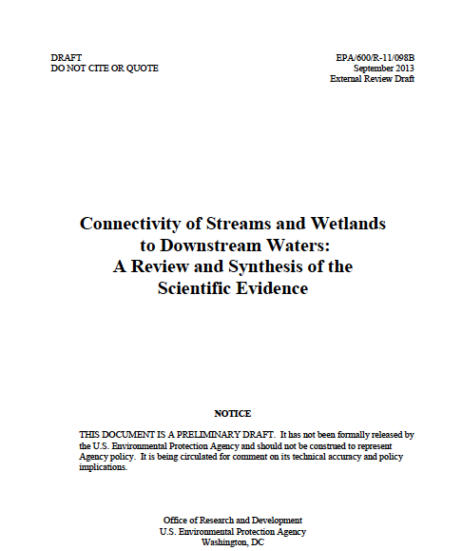
Waters of the U.S. - WOUS

Slide 44
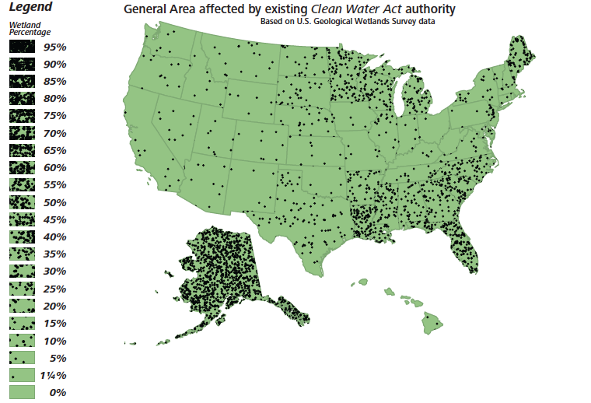

Slide 45
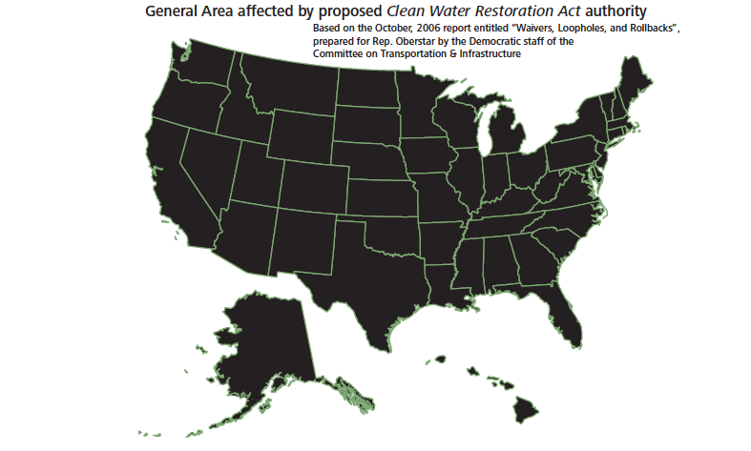

Slide 46
Wildfire
According to the National Institute of Standards and Technologies (NIST), wildfires in the 1970’s destroyed about 400 homes nationwide.
Since 2000, wildfires have destroyed about 3000 homes per year.

Slide 47
Wildfire
Insurance claims due to wildfires on federally mismanaged lands have resulted in insurance claims in the billions of dollars.
For instance, in 2012-2013, insurance claims in just Colorado have exceeded $1 Billion dollars.
1000’s of properties and 100,000’s of acres of land have become underinsured or uninsurable due to necessary policy changes of insurance carriers due to mismanagement of adjacent property.

Slide 48
Wildfire – Social impact received 02Oct13
“During the handling of your fire claim on the above property it has come to State Farm’s attention that your property is at a high risk for sustaining another fire claim due to the remaining stand of charred trees that were burned during the major fire last year on the lot adjoining yours. While we understand that you do not have any control over these trees, they are an increased hazard to your home and potentially other homes in the area and should be removed. If the charred trees are not removed it may result in your policy not being renewed. Obtaining a new policy with another carrier may be difficult at the least if not substantially more costly due to the existing increased fire hazard”

Slide 49
Wildfire
Loss of resources due to catastrophic events, stemming from federal mismanagement have resulted in billions of dollars of lost revenue.
One event alone caused the destruction of enough timber in 3 weeks to run a full-scale mill of 300 workers, 24/7 for 21 years.
Loss of habitat, wildlife, soil, increased sedimentation, water supplies and quality, air quality, property tax available to local governments.

Slide 50
Wildfire
In a well documented study in AZ, a single wildfire incident, the Rodeo-Chediski, resulted in over $1 billion in losses due to cost of restoration, opportunity costs of values lost and rebuilding of infrastructure for tourism.
Analysis showed this incident caused a long-term asset value loss in timber of over $1 trillion.

Slide 51
Wildfire and Timber
In the west, it was found that the benefits of treating medium and high risk stands exceeded costs by $1000 - $2000 per acre.
A treatment area in Apache County with a cost of $41,000 was estimated by fire management teams and state forestry to have avoided suppression costs of $250,000…if suppression could even have occurred due to the extreme danger the landscape offered.

Slide 52
Wildfire and Timber
The tree density rates in the average western forest are 10-30 fold a naturally healthy and sustainable level.
Growth rates exceed extraction rates by 400%.
The most recent studies and reports on forest areas show that the U.S. forests are adding 938,600 acres of growth per year. In other words, 19,019,000 acres in the last measurable decade. Yet…

Slide 53
Wildfire and Timber
“it (the U.S.) still contributes to deforestation as an importer of forest products”.

Slide 54
Wildfire and Timber
In just the Southwestern forests, the annual growth is equal to the quantity necessary to build an 1,900 square foot home for 90,000 families. Remember, that is the per year new fiber in just the forests of AZ and NM.

Slide 55
Wildfire and Timber
Treatments - Although federal policies stipulate that significant resources should be invested in the WUI, it has been found that only 3% of the area treated was within the WUI.
Often Wildfire Hazardous Fuels Reduction is cited by federal agencies as a positive aspect of their “management” ability…yet on average only 14% of total appropriated funds actually goes towards these efforts.

Slide 56
Wildfire and Timber
Southwestern forests can have an average value of $176.66 per thousand board feet (mbf).
A minimum operable acre of 2 mbf in the southwest would equate to $353.32
Wallow Fire burned 540,000 acres.
Direct Timber Loss - $192,792,800.00
Opportunity Costs and restoration will exceed $2 Billion
Long-term Asset Value Loss to exceed $1.5 Trillion

Slide 57
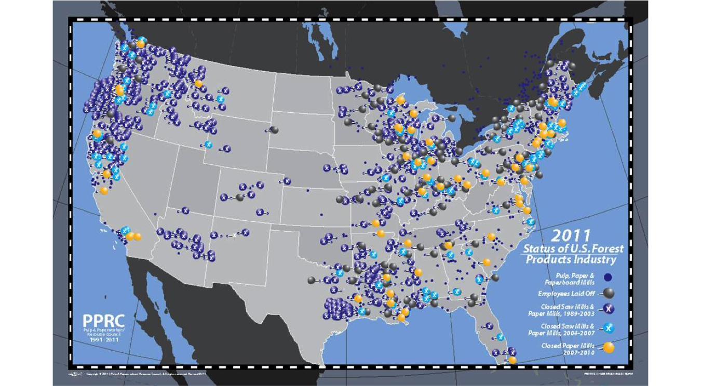
U.S. Mill Closures 1991-2010

Slide 58
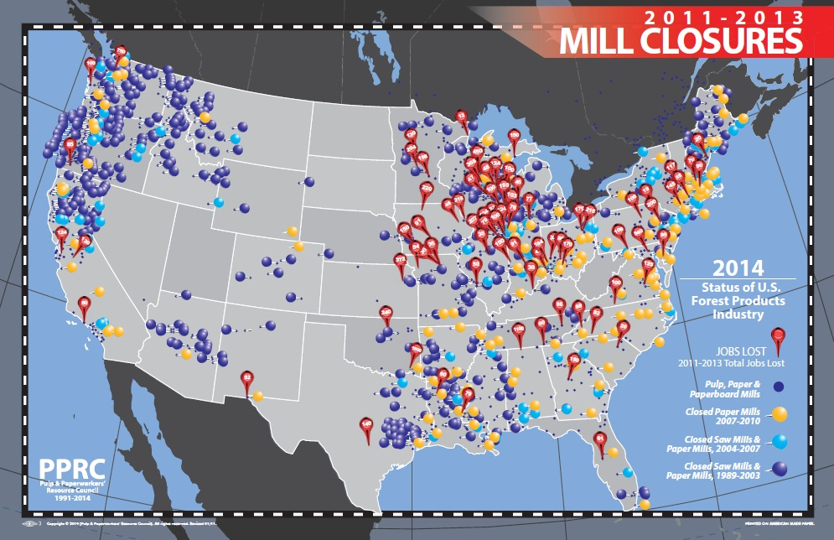
U.S. Mill Closures 2011-2013

Slide 59
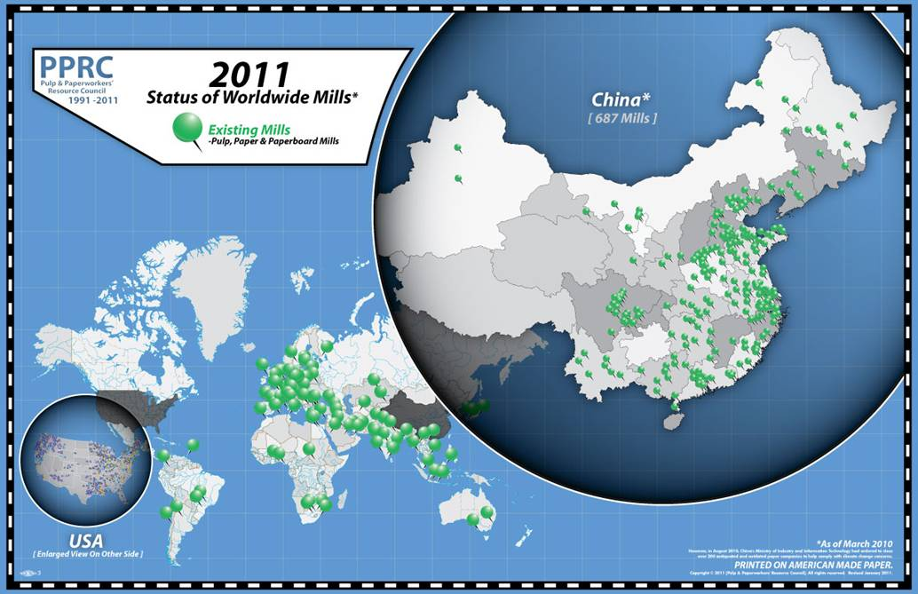
China Mill Expansions

Slide 60
Minerals-Gas-Oil
Over $150 Trillion dollars in technically recoverable oil and gas resides in the federally mismanaged lands, locked-up due to policies and pencil-whipping.
Oil, gas and coal leasing, royalties and additional tax revenues to state and local governments in the 10’s of billions are being lost due to this mismanagement.

Slide 61
Wildlife
Federally mismanaged lands are destroying habitat at an ever escalating rate. Direct losses of habitat in the form of wildfires, loss of habitat due to misguided and nonscientific policies and cumulative losses due to degradation of habitat.
In a recent case study, over one million animals were lost in a single wildfire event. This is repeated over and over again every fire season.

Slide 62
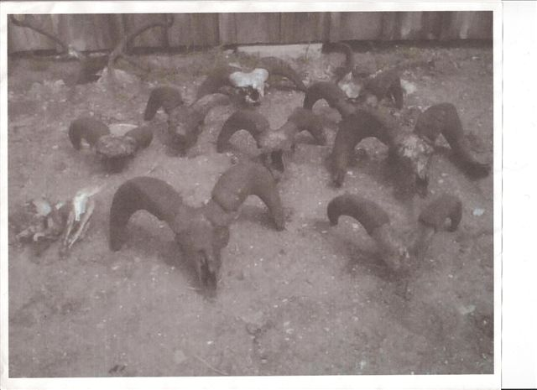

Slide 63
Wildlife
In a case concerning the Wallow Fire, the causes for most of the catastrophic fuel conditions were driven by protectionist measures on wildlife. Those very same measures resulted in causing the very species being protected to suffer an 86% destruction rate. Watersheds were destroyed 7 counties and a state away, by the post-fire sediment runoff, with just 3 days of rain after containment.

Slide 64
Wildlife
“management” plans of federal agencies often do not use accurate or “best available science” and run contrary to the intent of the program. An example is the decreases in birthing rates and propagation of birds, where it was proven that in the areas managed for the “ideal conditions” for rehabilitation, the populations often dropped.
Another example is less than 3% of all species of plants, insect and wildlife listed under federal management have ever recovered.

Slide 65
Disease
Disease outbreaks and spread due to federal mismanagement have led to increases in disease spread. Much of this is due to an apathetic response to changes and a direct result in many cases of federal programs inducing and introducing deadly diseases.

Slide 66
Disease
The following list of diseases carried by wolves, predatory mammals and other managed species, while not totally comprehensive, represents over 30 infections. Those that can infect humans are followed by an (H); those that affect other animals are followed by an (OA).

Slide 67
Disease
1. Rabies (H) (OA)
2. Brucellosis (H) (OA)
Hydatid Disease (2):
3. Echinococcus granulosis (H) (OA)
4. Echinococcus multilocularis (H) (OA)
5. Anthrax (H) (OA)
6. Encephalitis (H) (OA)
7. Great Lakes Fish Tapeworm (H) (OA)
8. Smallpox (H) (OA)
9. Mad Cow Disease(BSE) (OA) (H)
10. Chronic Wasting Disease (OA)

Slide 68
Disease
From Ticks (10) Carried by wolves and other mismanaged mammals:
11. Anemia (H)
12. Dermatosis (H)
13. Tick paralysis (H)
14. Babesiosis (H)
15. Anaplasmosis (H)
16. Erlichia (H)
17. E. Coast Fever (H)
18. Relapsing Fever (H)
19. Rocky Mtn. Spotted Fever (H)
20. Lyme Disease (H)

Slide 69
Disease
From Fleas (4) Carried by wolves and other mismanaged mammals:
21. Plague (H)
22. Bubonic Plague (H)
23. Pneumonic Plague (H)
24. Flea-Borne Typhus (H)
25. Distemper (OA)
26. Neospora caninum (OA)
27. 2 Types of Mange (H) (OA)
28. GID (a disease of wild and domestic sheep) (OA)
29. Foot-and –Mouth (OA)
30. Parvo (OA)

Slide 70
Air
Carbon, uranium, “greenhouse gas” emissions, particulate matter, heavy metals, etc. are released at alarming rates due to federal mismanagement of the lands via wildfires.
For an overcrowded, higher than healthy tree density, which is the norm today in the western forests the figures are alarming.

Slide 71
Air
Using Forest Carbon Emission Models, it has been discovered that an acre of land consumed in wildfire can emit 126 tons of “greenhouse gas”. This is based on an acre stand of 700 trees, where much of the western forests contain substantially higher stand densities.
In a more understandable form, 4 wildfires in CA emitted the equivalent of 7,000,000 cars ran for 24/7 for an entire year.

Slide 72
Some other economic factors
The USFS spends on average 5 times the amount as the comparative state agency on management.
The BLM spends on average 2 times the amount as the comparative state agency on management.
Often federal agencies indicate poor quality assets as the reasoning for differentials, while most often it is a fact of overly high management costs and lack of any incentive towards a profitable or at least cost-effective operation.

Slide 73
Some other economic factors
Number of agency personnel per acre is one of the major contributors to these losses.
The States average 36 employees per million acres.
The BLM averages 45 employees per million acres.
The USFS averages 210 employees per million acres.

Slide 74
Some other economic factors
States earn average annual revenues from land management of about $425,000 per full-time employee.
The BLM earns close to $110,000 per full-time employee.
The USFS earns less than $24,000- per full-time employee.

Slide 75
Positive economics facing dire impacts
If the land is not divested, a massive sector of our economy, one of the largest economies in the western states, is at risk of being lost.
Although we possess 2010-2014 data for most of the U.S., we will focus on ID, MT, WA, OR and AZ as examples.

Slide 76
Positive economics facing dire impacts
Outdoor recreation is the third largest sector of spending in America.
Nationally it is in excess of $645 Billion.
In the western states, it is in excess of $256 Billion.
While most sectors of the economy have shrunk, this sector increased by 5% annually between 2005-2012 with a cumulative impact of $1.6 Trillion and 12 million jobs, while suffering from massive curtailment via policies derived from litigation and sue-and-settle tactics. Divestiture of the land to the states could significantly increase this sector of the economy.

Slide 77
Positive economics facing dire impacts
On an Idaho scale:
$6.3 Billion in consumer spending
77,000 Direct Idaho Jobs (does not include indirect, implied, multiplier or ripple effects)
$1.8 Billion in wages and salaries
$461 million in state and local tax revenue

Slide 78
Positive economics facing dire impacts
On a Montana scale:
$5.8 Billion in consumer spending
64,000 Direct Montana jobs (does not include indirect, implied, multiplier or ripple effects)
$1.5 Billion in wages and salaries
$403 Million in state and local tax revenue

Slide 79
Positive economics facing dire impacts
On a Washington scale:
$22.5 Billion in consumer spending
227 Direct Washington jobs (does not include indirect, implied, multiplier or ripple effects)
$7.1 Billion in wages and salaries
$1.6 Billion in state and local tax revenue

Slide 80
Positive economics facing dire impacts
On an Oregon Scale
$12.8 Billion in consumer spending
141,000 Direct Oregon Jobs (does not include indirect, implied, multiplier or ripple effects)
$4.0 Billion in wages and salaries
$955 Million in state and local tax revenue

Slide 81
Divestiture is a necessary role
The States and their political subdivisions, the counties, have the authority and duty under the 10th Amendment of the U.S. Constitution to protect the Health, Safety, Welfare and Morals of the citizenry.

Slide 82
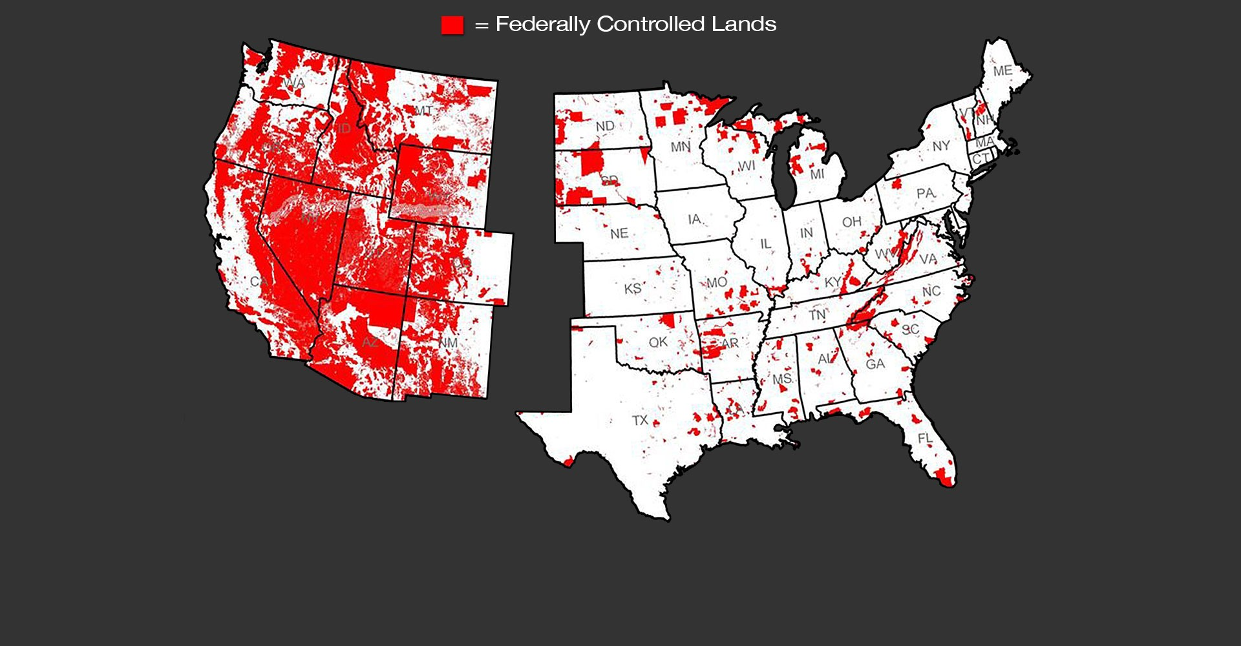
Transfer of Public Lands
American Lands Council

Slide 83

Break Time

Slide 84
Information and Data
Some sources and techniques for harnessing data, information and upcoming policies, along with disposition of open planning efforts and changes.

Slide 85
Freedom of Information Act – FOIA
TITLE 5 > PART I > CHAPTER 5 > SUBCHAPTER II > § 552.
Public information; agency rules, opinions, orders, records, and proceedings

Slide 86
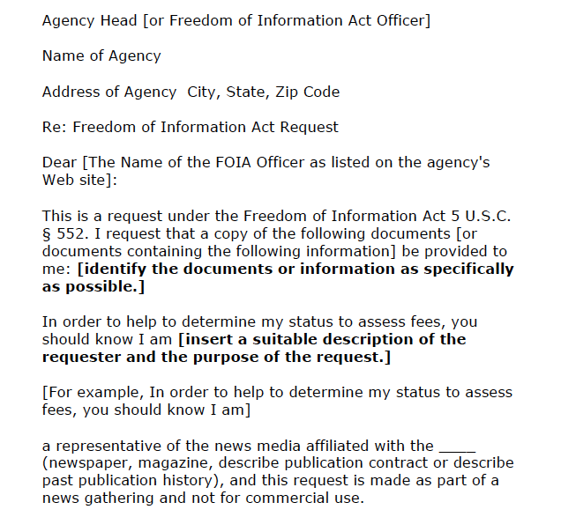
Freedom of Information Act – FOIA
(The following is from the U.S. DOJ on filing a FOIA-page 1 of 3)

Slide 87
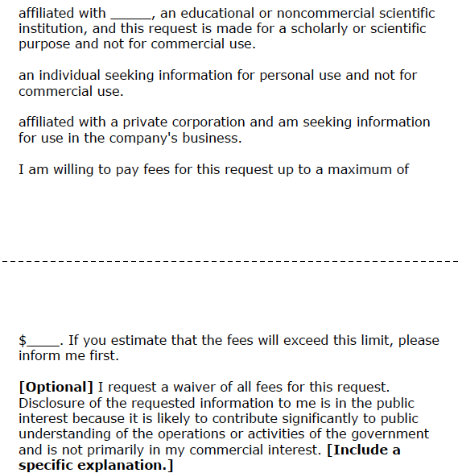
Freedom of Information Act – FOIA
(The following is from the U.S. DOJ on filing a FOIA-page 2 of 3)

Slide 88
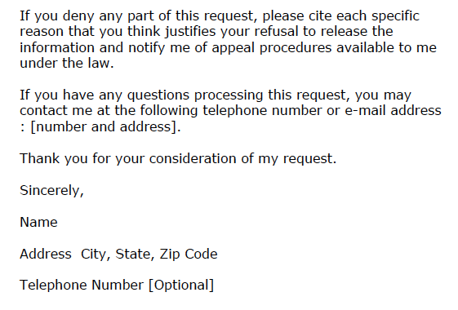
Freedom of Information Act – FOIA
(The following is from the U.S. DOJ on filing a FOIA-page 3 of 3)

Slide 89

Federal Register

Slide 90
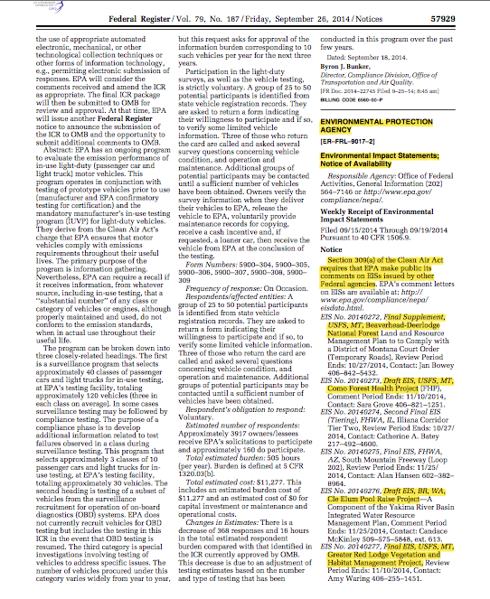
Federal Register

Slide 91
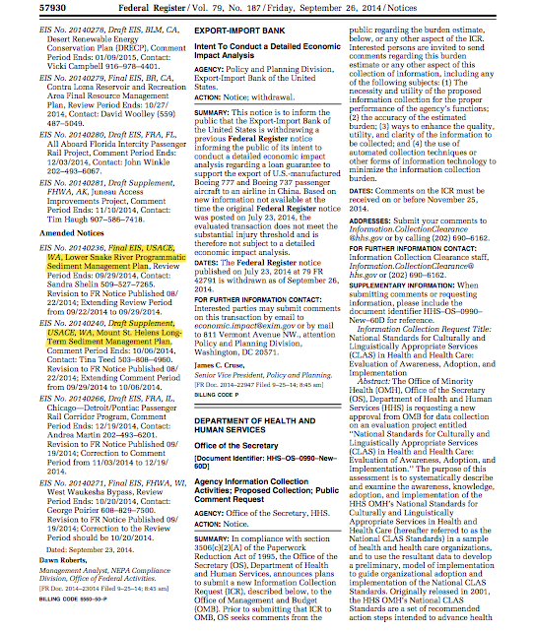
Federal Register

Slide 92
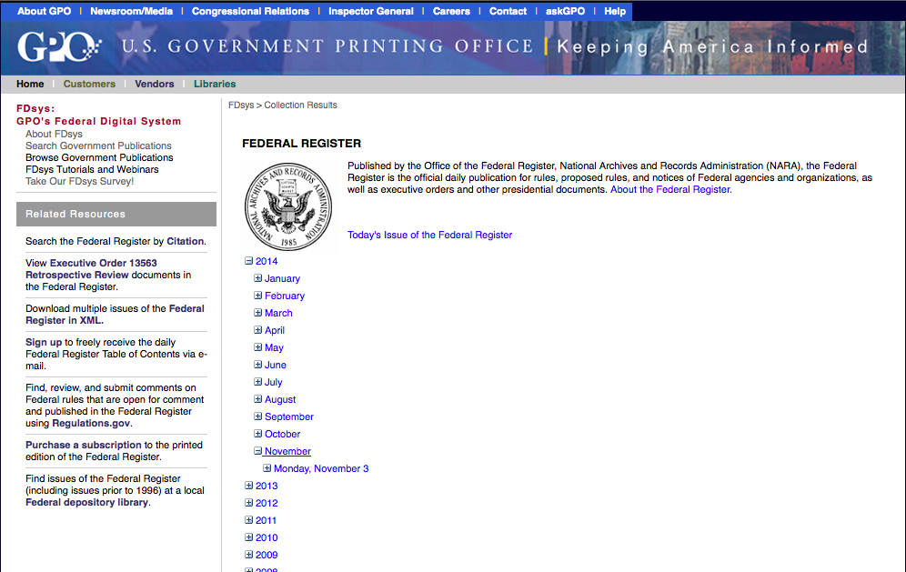
Federal Register Site http://www.gpo.gov/fdsys/browse/collection.action?collectionCode=FR

Slide 93
Areas of Jurisdiction and Delegation of Authority

Slide 94
US Attorneys – USAM – Title 9 – Sec. 665
“Determining Federal Jurisdiction”
“The United States has jurisdiction only if the land or building is within the special territorial jurisdiction of the United States.”

Slide 95
US Attorneys – USAM – Title 9 – Sec. 665
“Determining Federal Jurisdiction”
“If the land is other than a military base, the regional counsel's office of the General Services Administration usually has the complete roster of all Federal lands and buildings in its region and can frequently provide a definitive answer to jurisdiction.”

Slide 96
US Attorneys – USAM – Title 9 – Sec. 665
“Determining Federal Jurisdiction”
“Each United States Attorney would be well advised to request from each agency within the district a report on the jurisdictional status claimed for each of its facilities and assurance that documentation is available.”

Slide 97
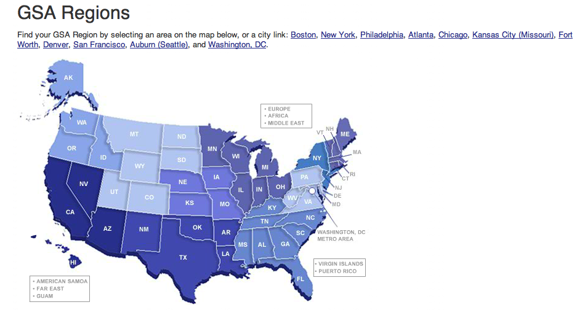
General Services Administration (GSA)

Slide 98
General Services Administration (GSA)
GSA Region 10 – Northwest/Artic Region
Alaska
Idaho
Oregon
Washington
Regional Counsel – Elizabeth Krueger
(253) 931-7007
betsy.kruger@gsa.gov

Slide 99
General Services Administration (GSA)
Type of Legislative Jurisdiction
Code 4 – Proprietorial Interest Only
“This term is applied to those instances wherein the Federal Government has acquired some right or title to an area in a State, but has not obtained any measure of the State’s authority over the area.”

Slide 100
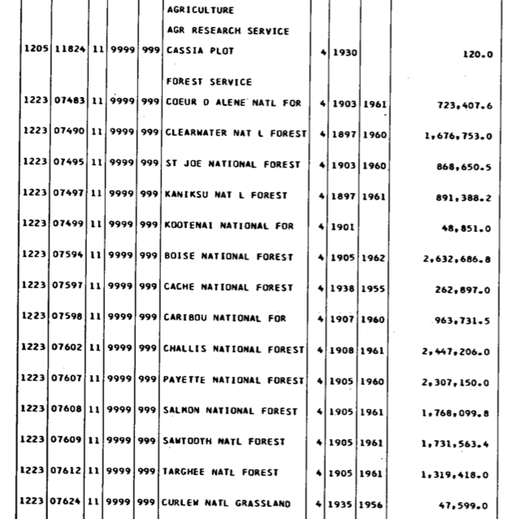
General Services Administration (GSA)

Slide 101
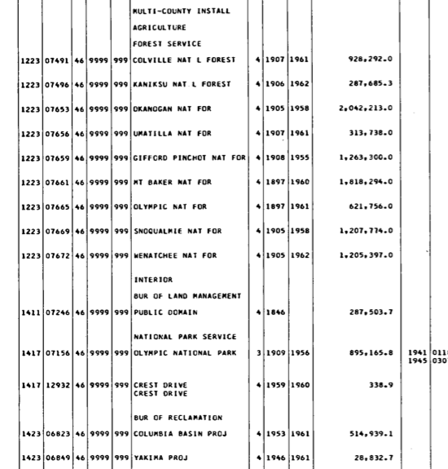
General Services Administration (GSA)

Slide 102
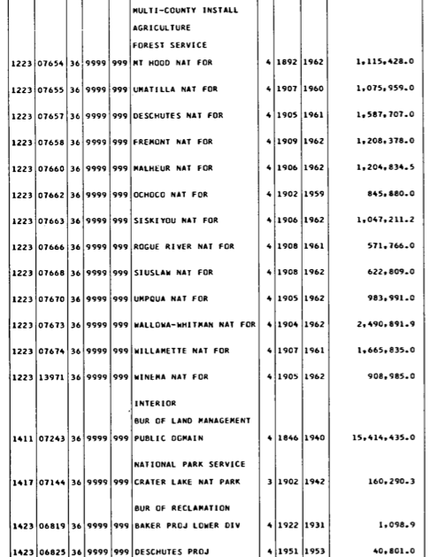
General Services Administration (GSA)

Slide 103
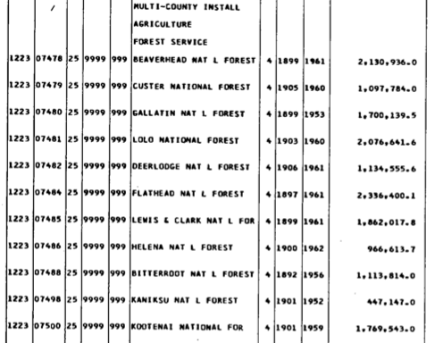
General Services Administration (GSA)

Slide 104
Congressional Acts and cases
“Needful Buildings” clause of Article 1, Sec. 8, Clause 17 of the Constitution for the United States does not include Forests and Parklands.
Collins vs. Yosemite Park and Curry Co.

Slide 105
Congressional Acts and cases
Organic Act of 1897 and the Weeks Forestry Act of 1911
States shall not by reasons of the establishment of a National Forest, lose it’s jurisdiction, nor the inhabitants thereof their rights and privileges.

Slide 106
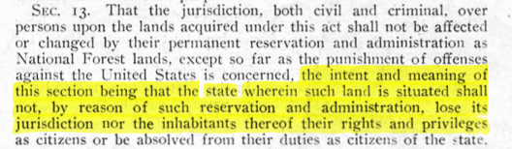
Congressional Acts and cases
Weeks Forestry Act

Slide 107
Congressional Acts and cases
The Act of May 9, 1941, 55 Stat. 183, codified at 43 U.S.C. 931a, authorized the Attorney General to retrocede jurisdiction over roads across federal properties.
The Act of October 23, 1962, 76 Stat. 1129, codified at 40 U.S.C. 319, extended this power to executive agency heads generally (Secretary’s).

Slide 108
Congressional Acts and cases
In 1976 the Secretary of the Interior obtained retrocession authority with respect to National Parks.
In 1978 the Secretary of Agriculture was added as well.

Slide 109
Jurisdiction
Retrocession
1941 - 43 USC Authorized Attorney General to retrocede jurisdiction over roads across federal property.
1973 - 38 USC – Retrocession authority given to Administrator of Veteran’s Affairs.
1976 – 16 USC – Secretary of Interior – National Parks
1978 – 7 USC 2268 - Secretary of Agriculture – forest and timber lands

Slide 110
Congressional Acts and cases
Congress has made all federal property, including federal enclaves, subject to State environmental requirements and the power to enforce State environmental laws includes the power to enforce criminal provision of those laws.
133 Mil. L. Rev. 249, 278 (1991)
United States v. Pennsylvania Environmental Hearing Board

Slide 111
Congressional Acts and cases
The Supreme Court has stated that “ it has never been the case that “the national forests were . . . to be ‘set aside for nonuse.’”
United States v. New Mexico, 438 U.S. 696, 716 n.23

Slide 112
Congressional Acts and cases
A federal officer who is outside his jurisdiction loses his law enforcement authority and can make only a “citizens arrest”.
People vs. Crusilla, 77 Cal. App.4th 141, 91 (1999)

Slide 113
Congressional Acts and cases
Hazardous Materials Transportation Act
Federal Water Pollution Control Act
Hazardous substance Act
Comprehensive Environmental Compensation and Liability Act
Resource Conservation and Recovery Act

Slide 114
Some other areas of jurisdiction
Omaechevarria v. State of Idaho, 246 U.S. 343, 346, 38 S.Ct. 323 (1918):
Idaho law with penal provisions regulating grazing held applicable to federal rangelands.
"[T]he police power of the state extends over the federal public domain, at least when there is no legislation by Congress on the subject."

Slide 115
Some other areas of jurisdiction
Chicago, R. I. & P. Ry. Co. v. McGlinn, 114 U.S. 542, 5 S.Ct. 1005 (1885):
Railroad company's train passing through Fort Leavenworth enclave struck and killed McGlinn's cow. State law at time of cession required railroads to fence rights-of-way. Court held state law in existence at time of cession applied to enclave.

Slide 116
Some other areas of jurisdiction
Wilson v. Cook, 327 U.S. 474, 66 S.Ct. 663 (1946):
Wilson's partnership had contract to cut timber off U.S. lands and state sought to impose a severance or license tax. Some of federal lands had no cession of state jurisdiction; other lands were subject of state cession of "concurrent jurisdiction". Court upheld the tax, stating the state had territorial jurisdiction to impose it.

Slide 117
Some other areas of jurisdiction
California Coastal Comm. v. Granite Rock Company, 480 U.S. 572, 107 S.Ct. 1419 (1987):
Question of where federal mining regulations applied and who had authority to require permit. State held to have authority over federal lands.

Slide 118
Some other areas of jurisdiction
Palmer v. Barrett, 162 U.S. 399, 16 S.Ct. 837 (1896):
The U.S. had jurisdiction over Brooklyn Navy Yard, but leased part thereof to New York City for a market. City subleased market spaces and there was state court action regarding dispute between two tenants. Court held state court had subject matter jurisdiction since act of cession applied only as long as the U.S. used property for government purposes, and the U.S. lease to city caused reversion of state jurisdiction.

Slide 119
Some other areas of jurisdiction
Harcourt v. Gaillard, 25 U.S. (12 Wheat.) 523, 526, 527 (1827), where the Supreme Court stated:
"There was no territory within the United States that was claimed in any other right than that of some one of the confederated states; therefore, there could be no acquisition of territory made by the United States distinct from, or independent of some one of the states.

Slide 120
Some other areas of jurisdiction
"Each declared itself sovereign and independent, according to the limits of its territory.
"[T]he soil and sovereignty within their acknowledged limits were as much theirs at the declaration of independence as at this hour.

Slide 121
Some other areas of jurisdiction
Lambert v. Yellowly, 272 U.S. 581, 598, 47 S.Ct. 210 (1926): “It is important also to bear in mind that ‘direct control of medical practice in the States is beyond the power of the Federal Government.’
Linder v. United States, 268 U.S. 5, 18. Congress, therefore, cannot directly restrict the professional judgment of the physician or interfere with its free exercise in the treatment of disease. Whatever power exists in that respect belongs to the states exclusively.”

Slide 122
Some other areas of jurisdiction
Linder v. United States, 268 U.S. 5, 18, 45 S. Ct. 446 (1925):
"Obviously, direct control of medical practice in the states is beyond the power of the federal government.”

Slide 123
Some other areas of jurisdiction
Conant v. Walters, 309 F.3d 629, 639 (9th Cir. 2002) (quoting Linder).
United States v. Anthony et al., 15 F. Supp. 553 (S.D.Cal. 1936) (June 23 1936) Nos. 12069-12072. United States District Court, S.D. California, Central Division

Slide 124
Some other areas of jurisdiction
"The Linder Case (Linder v. United States [1925] 268 U.S. 5, 45 S.Ct. 446, 449, 69 L.Ed. 819, 39 A.L.R. 229) is very important. We all seem to agree, whether we read it alike or not, that it determines this case, so far as the law is concerned. I wish to refer to it for the present only for the purpose of pointing out that the moment we assume that this act regulates the sale within the state of narcotics and that it aims to regulate the practice of medicine, we must hold it unconstitutional.”

Slide 125
Substantive NEPA Commentary Highlights
This section is much abbreviated and only an overview of highlights from a 6-hour course. As a result, much continuity and supporting data is lost in such an abbreviated display.

Slide 126
Substantive NEPA Commentary Highlights
Substantive commentary:
It is new information or finding a flawed analysis that will substantially change the outcome.
What NEPA is, And What NEPA is not
WHAT NEPA IS NOT:
NEGOTIATION: Personal relationships are of little use.
A LEGAL PROCEEDING: You don’t need a lawyer.
VOTING: It only takes one substantive comment to completely change a plan.
WHAT NEPA IS:
A Procedural Requirement for disclosing the environmental effects of agency decision making, requiring public participation.

Slide 127
Substantive NEPA Commentary Highlights
“substantive comments” can be offered ONLY during the COMMENT PERIOD after the DEIS is available – ranging from 30 to a 90 day period.
Why? Because this is the only part of the PUBLIC PARTICIPATION PERIOD where you have the LEGAL STATUS to actually make them change the document.
It is different than scoping, in other words,
Scoping period = no legal obligations
Comment period = legal obligations
The NEPA Schedule:
-Notice of Intent (NOI)
-Scoping (determining the "scope" of the analysis)
-Doing the Analysis (Silence)
-Publishing a Draft Environmental Impact Statement (DEIS)
-Taking Public Comment on the DEIS
-Writing the Final Environmental Statement (FEIS)
-Publishing the Record of Decision (ROD)

Slide 128
Substantive NEPA Commentary Highlights
NATIONAL ENVIRONMENTAL POLICY ACT
THE NEPA HIERARCHY:
The NEPA HAS two parts-the intent of Congress, AND the creation of the COUNCIL ON ENVIRONMENTAL QUALITY (CEQ)
The CEQ WRITES THE REGULATIONS THAT FEDERAL AGENCIES MUST FOLLOW WHEN THEY CONDUCT A NEPA ANALYSIS.
These regulations provide the specific instructions on how to comply with the NEPA.
CEQ regulations apply to all Executive Branch agencies
CEQ regulations are found in the CODE OF FEDERAL REGULATIONS (CFR) Title 40 Part 1500 thru 1508.
Then the agencies take the CEQ’s regulations, and develop their own regulations for implementing the CEQ regulations (how the agencies conduct their own NEPA-compliant analysis).
Why is this important? Because: the legality of the DEIS relies entirely upon the legality of the agency-created regulations.

Slide 129
Substantive NEPA Commentary Highlights
NEPA does not require that environmental, or purely natural values be placed above all other values.
It only requires that agencies take a "hard look" at the environmental consequences of their actions.
WHAT IS THE OBJECTIVE OF YOUR COMMENT REGARDLESS OF ITS SUBJECT MATTER?
Your goal is to get the agency to produce an accurate, professional, and CEQ-compliant analysis.

Slide 130
Substantive NEPA Commentary Highlights
The legal goal is to "identify the agency action that affects him or her and must show he or she has suffered a legal wrong because of the agency action or is adversely affected by that action within the meaning of a relevant statute. To be "adversely affected within the meaning of a statute," a plaintiff must be within the "zone of interests" sought to be protected by the statutory provision that forms the basis of a complaint."
Lujan v. National Wildlife Federation, 497 U.S. 871, 110 S. Ct. 3177 (1990).

Slide 131
Substantive NEPA Commentary Highlights
Chapter 1: Purpose and Need Statement (the P&N)
This is where they tell us why they are doing the EIS.
It often includes elaborate background discussion.
This chapter is where we should find the "authorities" that the agency is using to give itself the authority to make these changes (new regulations).
Chapter 2: The Alternatives.
This chapter is required to describe in detail each proposed alternative. There must be a diverse enough range of alternatives that we can see a clear difference between them.
Chapter 3: Affected Environment and Environmental Consequences.
The Affected Environment is where they describe the way things are at the present time. This is the source of many clues and often the beginning of multiple story changes.
The Environmental Consequences is where they estimate the effects of each alternative, and compare the effects of each alternative to the other alternatives. This is where the "cumulative effects" are estimated.

Slide 132
Substantive NEPA Commentary Highlights
Chapter 3 (Environmental Consequences),
where the "Cumulative Effects" are estimated, is where the Forest Service frequently loses in court on their poor cumulative effects analyses.
Chapter 4 is the List of Preparers, Consultation & Coordination.
The Appendices vary from DEIS to DEIS. They should include the methodologies used for analysis. Most include specifics about mitigation, site-specific data, Biological Evaluations (USF&W Consultations) and some include a listing of all road & trail numbers analyzed.

Slide 133
Substantive NEPA Commentary Highlights
1. Summarize your evidence according to your questions. Then you will be able to see if the evidence does lawfully support the proposed action.
2. If it does not, you will see a pattern. The pattern will reveal that the evidence either doesn't have any rational connection to the proposed action, won't answer the P&N, or, the agency is proposing to take action that it doesn't have the authority to do.
3. You can also sort your evidence according to subject, or even better, according to the CEQ regulations and the laws they are using to give themselves the authority to make these proposed changes.

Slide 134
Substantive NEPA Commentary Highlights
They can change the document.
That is the ONLY thing they can do.
In telling them what to change, make it something they have to change in the Final EIS.
Do not ever ask them "to provide" anything in the FEIS that isn't already in the DEIS.
That’s the mousetrap you set to catch them up in. Why?
Because when the agency is irrationally hostile toward motor access, livestock, timber harvest, multiple-use, etc. in their response to your request to add, delete or revise parts of the document, they will generate a new set of violations, and it will be in the record, and published.
In other words, if they are following an irrational course of action in the published DEIS, let them continue to dig in

Slide 135
Substantive NEPA Commentary Highlights
Example instruction from you: "If there is no evidence of [...] but the agency wishes to keep these claims in the analysis, please add the following conclusion at the end of the discussion: "However, no evidence has been uncovered to support this claim.“
Another example: Conclude your comment with the header, "Changes that will resolve this concern:" and then list what you want them to change in the document that would correct the problem that you have found. You can tell them to add information, delete information, or make corrections.

Slide 136
Substantive NEPA Commentary Highlights
How to figure out whether you can get
everything you want from this DEIS
1. Find the alternative that has everything you want.
2. If you find such an alternative, you know the agency has a position to fall back to when your comments force them to give up their own proposal.
3. If there is no alternative with everything in it, then you cannot get everything you want regardless of how good your comments are. Why? Because if it's not in any alternative, at this point in the process it is off the table ---OUTSIDE THE SCOPE OF THE ANALYSIS.
4. If there is no such alternative, then you must force them to ditch this DEIS as it is

Slide 137
Substantive NEPA Commentary Highlights
Neither the Appeal Deciding Officer OR the judiciary can reverse a bad decision, unless the Decision was not arrived at within the legal process, i.e. it must meet the standards for properly following the NEPA process as set forth in CEQ regulations, and comply with the controlling law for the agency.
APA (Title 5 USC) is the law which gives citizens the right to a judicial review of agency decisions, after you’ve exhausted all the available administrative remedies.
This is when you need the lawyer.
The most common enforcement requested is a “Preliminary Injunction.”

Slide 138
Substantive NEPA Commentary Highlights
APA Title 5 § 706. Scope of review
To the extent necessary to decision and when presented, the reviewing court shall decide all relevant questions of law, interpret constitutional and statutory provisions, and determine the meaning or applicability of the terms of an agency action. The reviewing court shall—
(1) compel agency action unlawfully withheld or unreasonably delayed; and
(2) hold unlawful and set aside agency action, findings, and conclusions found to be—
(A) arbitrary, capricious, an abuse of discretion, or otherwise not in accordance with law;
(B) contrary to constitutional right, power, privilege, or immunity;
(C) in excess of statutory jurisdiction, authority, or limitations, or short of statutory right;
(D) without observance of procedure required by law;
(E) unsupported by substantial evidence in a case subject to sections 556 and 557 of this title or otherwise reviewed on the record of an agency hearing provided by statute; or
(F) unwarranted by the facts to the extent that the facts are subject to trial de novo by the reviewing court.

Slide 139
Substantive NEPA Commentary Highlights
A judicial review of an agency determination (its final administrative appeal decision) as to whether the appellant was likely to prevail on the merits of its NEPA and NFMA claims will necessarily incorporate the APA’s arbitrary and capricious standard—because the APA is how we enter the judicial system.
We must establish our standing to sue. The first big step is that we have exhausted all our administrative remedies (comment and appeal). Then we "identify the agency action that affects him or her and shows that he or she has suffered a legal wrong because of the agency action or is adversely affected by that action within the meaning of a relevant statute. To be "adversely affected within the meaning of a statute," a plaintiff must be within the "zone of interests" sought to be protected by the statutory provision that forms the basis of a complaint."
Lujan v. National Wildlife Federation, 497 U.S. 871, 110 S. Ct. 3177 (1990).

Slide 140
Substantive NEPA Commentary Highlights
About the "arbitrary and capricious" standard:
Agency action is arbitrary and capricious “if the agency has relied on factors which Congress has not intended it to consider, entirely failed to consider an important aspect of the problem, offered an explanation for its decision that runs counter to the evidence before the agency, or is so implausible that it cannot be attributed to agency expertise.” SEC v. Chenery Corp., 332 U. S. 194, 332 U. S. 196 (1947).

Slide 141
Substantive NEPA Commentary Highlights
“The scope of review under the ‘arbitrary and capricious’ standard is narrow and a court is not to substitute its judgment for that of the agency. Nevertheless, the agency must examine the relevant data and articulate a satisfactory explanation for its action including a ‘rational connection between the facts found and the choice made.’”
This standard has been cited in Burlington Truck Lines, Inc. v. United States, 371 U. S. 156, 371 U. S. 168 (1962).
and cited again in Motor Veh. Mfrs. Ass'n v. State Farm Ins., 463 U.S. 29 No. 82-354 (1983)
and cited again in AMERICAN TRUCKING ASSOCIATIONS INC v. ENVIRONMENTAL PROTECTION AGENCY No. 09-1090. Argued Oct. 2, 2009. -- April 02, 2010

Slide 142
Substantive NEPA Commentary Highlights
A preliminary injunction is appropriate when a plaintiff demonstrates either:
a likelihood of success on the merits and the possibility of irreparable injury; or
that serious questions going to the merits were raised and the balance of hardships tips sharply in [the plaintiff’s] favor.’ ” LandsCouncil v. Martin (Lands Council II), 479 F.3d 636, 639 (9th Cir. 2007) (quoting Clear Channel Outdoor Inc. v. City of Los Angeles, 340 F.3d 810, 813 (9th Cir. 2003)).
These two options represent extremes on a single continuum: “ ‘the less certain the district court is of the likelihood of success on the merits, the more plaintiffs must convince the district court that the public interest and balance of hardships tip in their favor.’ ” (quoting Sw. Voter Registration Educ. Project, 344 F.3d at 918).

Slide 143
Substantive NEPA Commentary Highlights
Success on the Merits
"meriting a legal victory; the elements of a claim; the substantive considerations to be taken into account; a judgment based on the evidence." From Black's Law Dictionary 9th ed.
Review under the arbitrary and capricious standard “is narrow, and [we do] not substitute [our] judgment for that of the agency.” Earth Island Inst. II, 442 F.3d at 1156 (citing U.S.Postal Serv. v. Gregory, 534 U.S. 1, 6-7 (2001)). Rather, we will reverse a decision as arbitrary and capricious (as noted above) only if the agency relied on factors Congress did not intend it to consider, “entirely failed to consider an important aspect of the problem,” or offered an explanation “that runs counter to the evidence before the agency or is so implausible that it could not be ascribed to a difference in view or the product of agency expertise.” (citing Sierra Club v. U.S. Envtl. Prot. Agency, 346 F.3d 955, 961 (9th Cir. 2003), amended by 352 F.3d 1186 (9th Cir. 2003)).

