Slide 1
Forest Stewardship
AICPA
Government Performance and Accountability Committee
25Sep17
Tempe, AZ

Slide 2
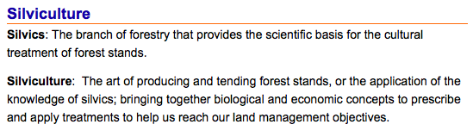
What is Silvaculture?

Slide 3
What is Fire Ecology?
Fire ecology is a scientific discipline concerned with natural processes involving fire in an ecosystem and the ecological effects, the interactions between fire and the abiotic and biotic components of an ecosystem, and the role of fire as an ecosystem process.

Slide 4
What is Stewardship?
An ethic that embodies the responsible planning and management of resources.
The careful and responsible management of something entrusted to one’s care.
Natural Resource Stewardship is the scientifically and economically based management to meet current and future needs of Multiple-Use, coordinating consumptive and “non-consumptive” uses for most beneficial use.

Slide 5
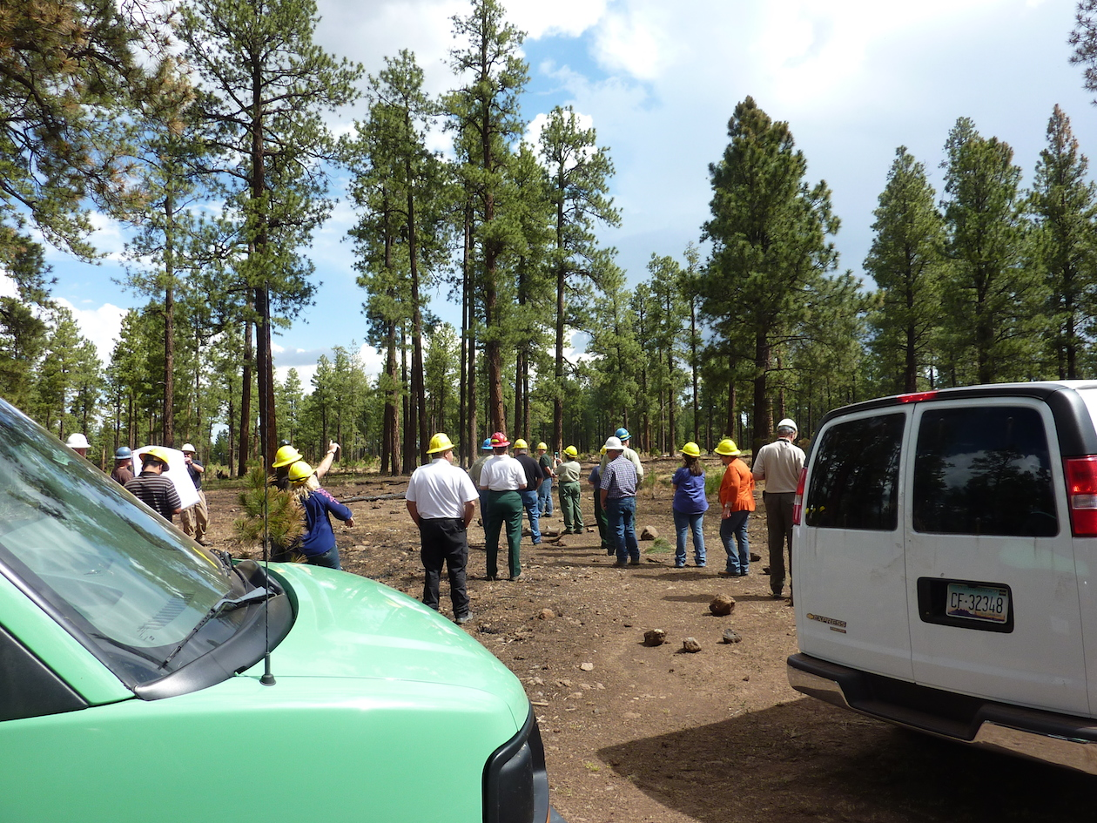

Slide 6
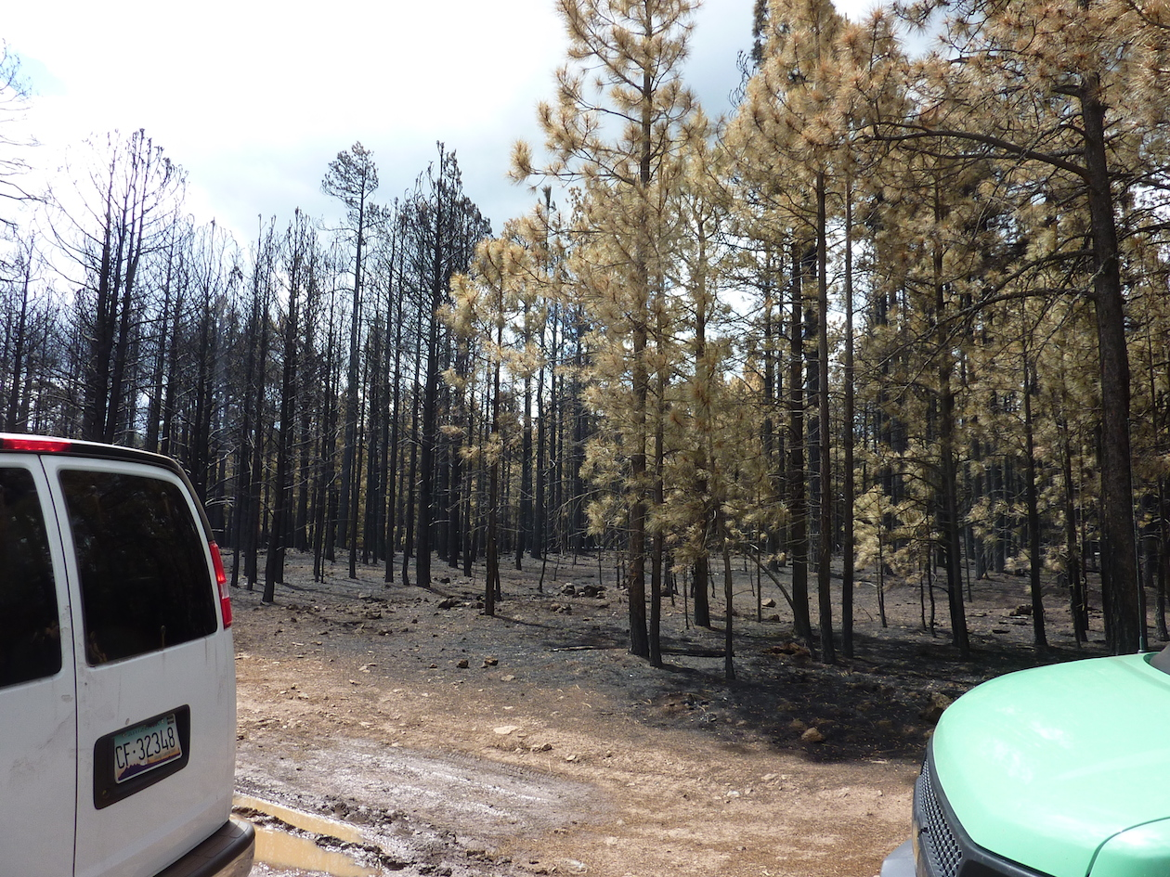

Slide 7
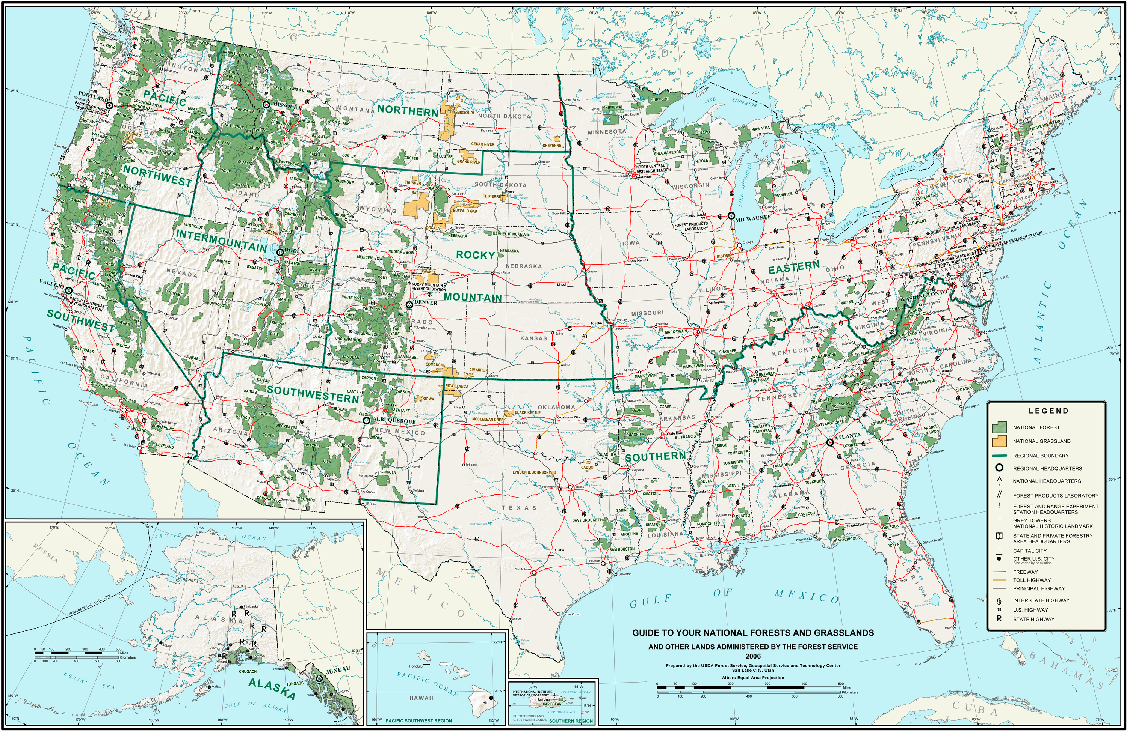

Slide 8
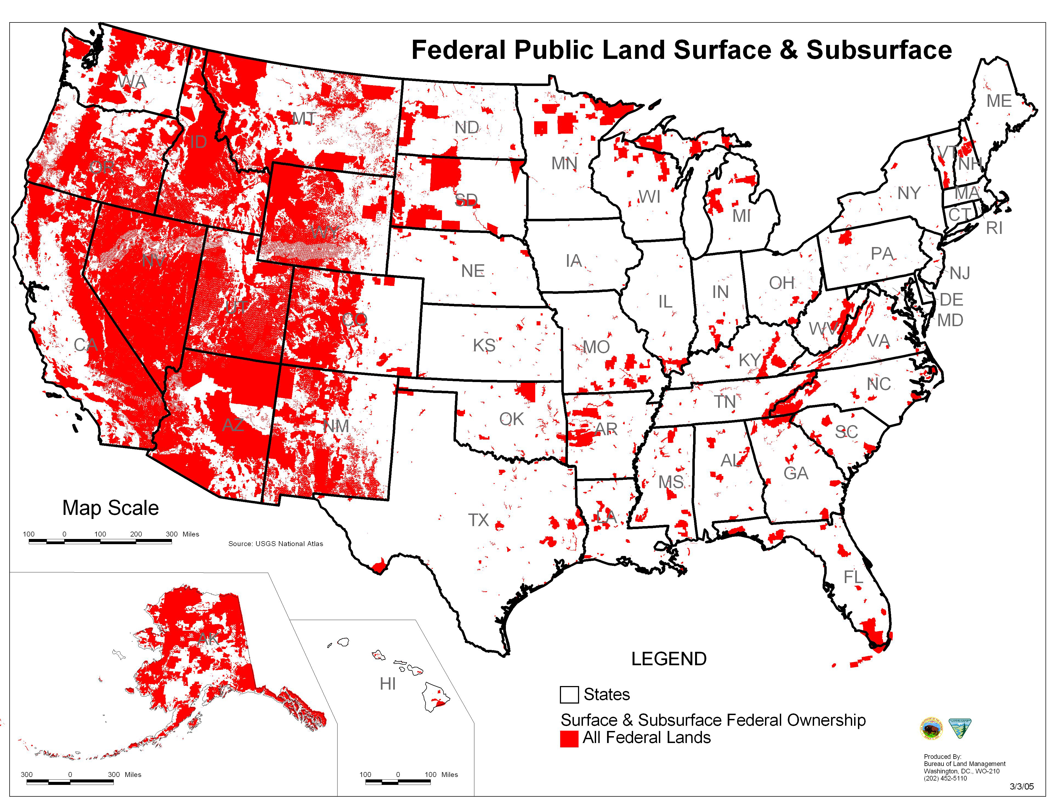

Slide 9
Water
The large tracts us federally managed lands are responsible for 2/3 of our fresh water supply and are suffering to a great extent due to mismanagement. This lack of management directly impacts our water supply through evapotranspiration, massive changes in timing of snowpack melt and runoff, massive post-fire sediment runoff, pollutant injection into watersheds and massive changes in surface water trends.

Slide 10
Water
Evapotranspiration – Vegetation moves water from the soil to the atmosphere, or traps higher than normal amounts in the upper tiers or the canopy, reducing surface flow and downstream yield.
In the winter period, a portion of the snow caught in the branches evaporates or sublimates and reenters the atmosphere without ever melting
Open tree stands and reduced understory vegetation protect snowpack from solar radiation, versus entrapment in the branches.

Slide 11
Water
An active management system by the states can significantly improve our stressed and strained fresh water supply.
Studies have show that if active management were to occur, which is best done at a more manageable state-level of landscape, that water demands and needs can be met.

Slide 12
Water
Forest treatments to reduce forest cover by 40% can yield an increase in water yields by 9%.
A treatment area of just 4100 acres wherein a 24% reduction of vegetation occurred showed a significant water yield increase of 3 inches.
Sustained, ongoing treatments in our overly dense forests can increase yield by 16%.
Forest management which has a well-established link to water can be altered to meet water resource goals and priorities.

Slide 13
Water
Regional water planning and budgets have show that as much as 70% of total precipitation is evapotranspired by native vegetation (overly dense tree stands, ladder-fuel buildup, abnormally high undergrowth and vegetation loads).
Delays in peak snowpack runoff can move from days into weeks, better distributing and utilizing the water afforded from winter storage.

Slide 14
Wildfire
According to the National Institute of Standards and Technologies (NIST), wildfires in the 1970’s destroyed about 400 homes nationwide.
Since 2000, wildfires have destroyed about 3000 homes per year.

Slide 15
Wildfire
Insurance claims due to wildfires on federally mismanaged lands have resulted in insurance claims in the billions of dollars.
For instance, in 2012-2013, insurance claims in just Colorado have exceeded $1 Billion dollars.
1000’s of properties and 100,000’s of acres of land have become underinsured or uninsurable due to necessary policy changes of insurance carriers due to mismanagement of adjacent property.

Slide 16
Wildfire – Social impact
“During the handling of your fire claim on the above property it has come to State Farm’s attention that your property is at a high risk for sustaining another fire claim due to the remaining stand of charred trees that were burned during the major fire last year on the lot adjoining yours. While we understand that you do not have any control over these trees, they are an increased hazard to your home and potentially other homes in the area and should be removed. If the charred trees are not removed it may result in your policy not being renewed. Obtaining a new policy with another carrier may be difficult at the least if not substantially more costly due to the existing increased fire hazard”

Slide 17
Wildfire
Loss of resources due to catastrophic events, stemming from federal mismanagement have resulted in billions of dollars of lost revenue.
One event alone caused the destruction of enough timber in 3 weeks to run a full-scale mill of 300 workers, 24/7 for 21 years.
Loss of habitat, wildlife, soil, increased sedimentation, water supplies and quality, air quality, property tax available to local governments.

Slide 18
Wildfire
In a well documented study in AZ, a single wildfire incident, the Rodeo-Chediski, resulted in over $1 billion in losses due to cost of restoration, opportunity costs of values lost and rebuilding of infrastructure for tourism.
Analysis showed this incident caused a long-term asset value loss in timber of over $1 trillion.

Slide 19
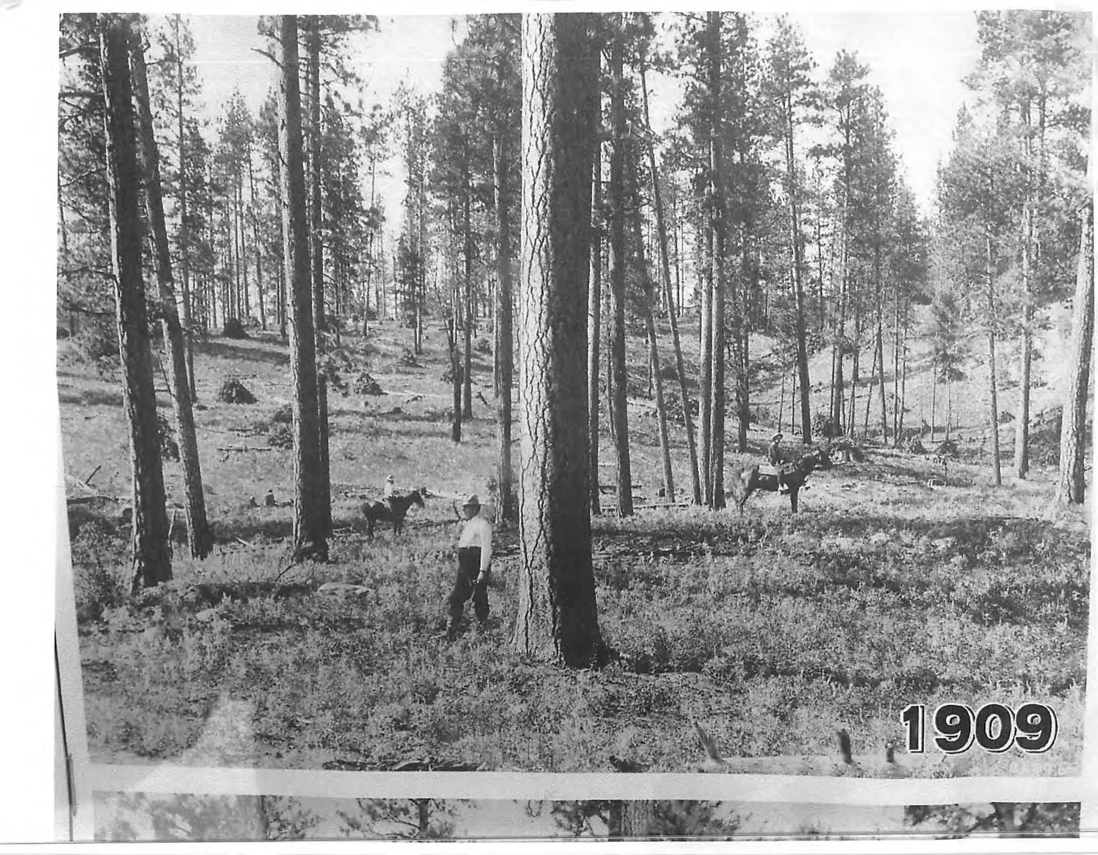

Slide 20
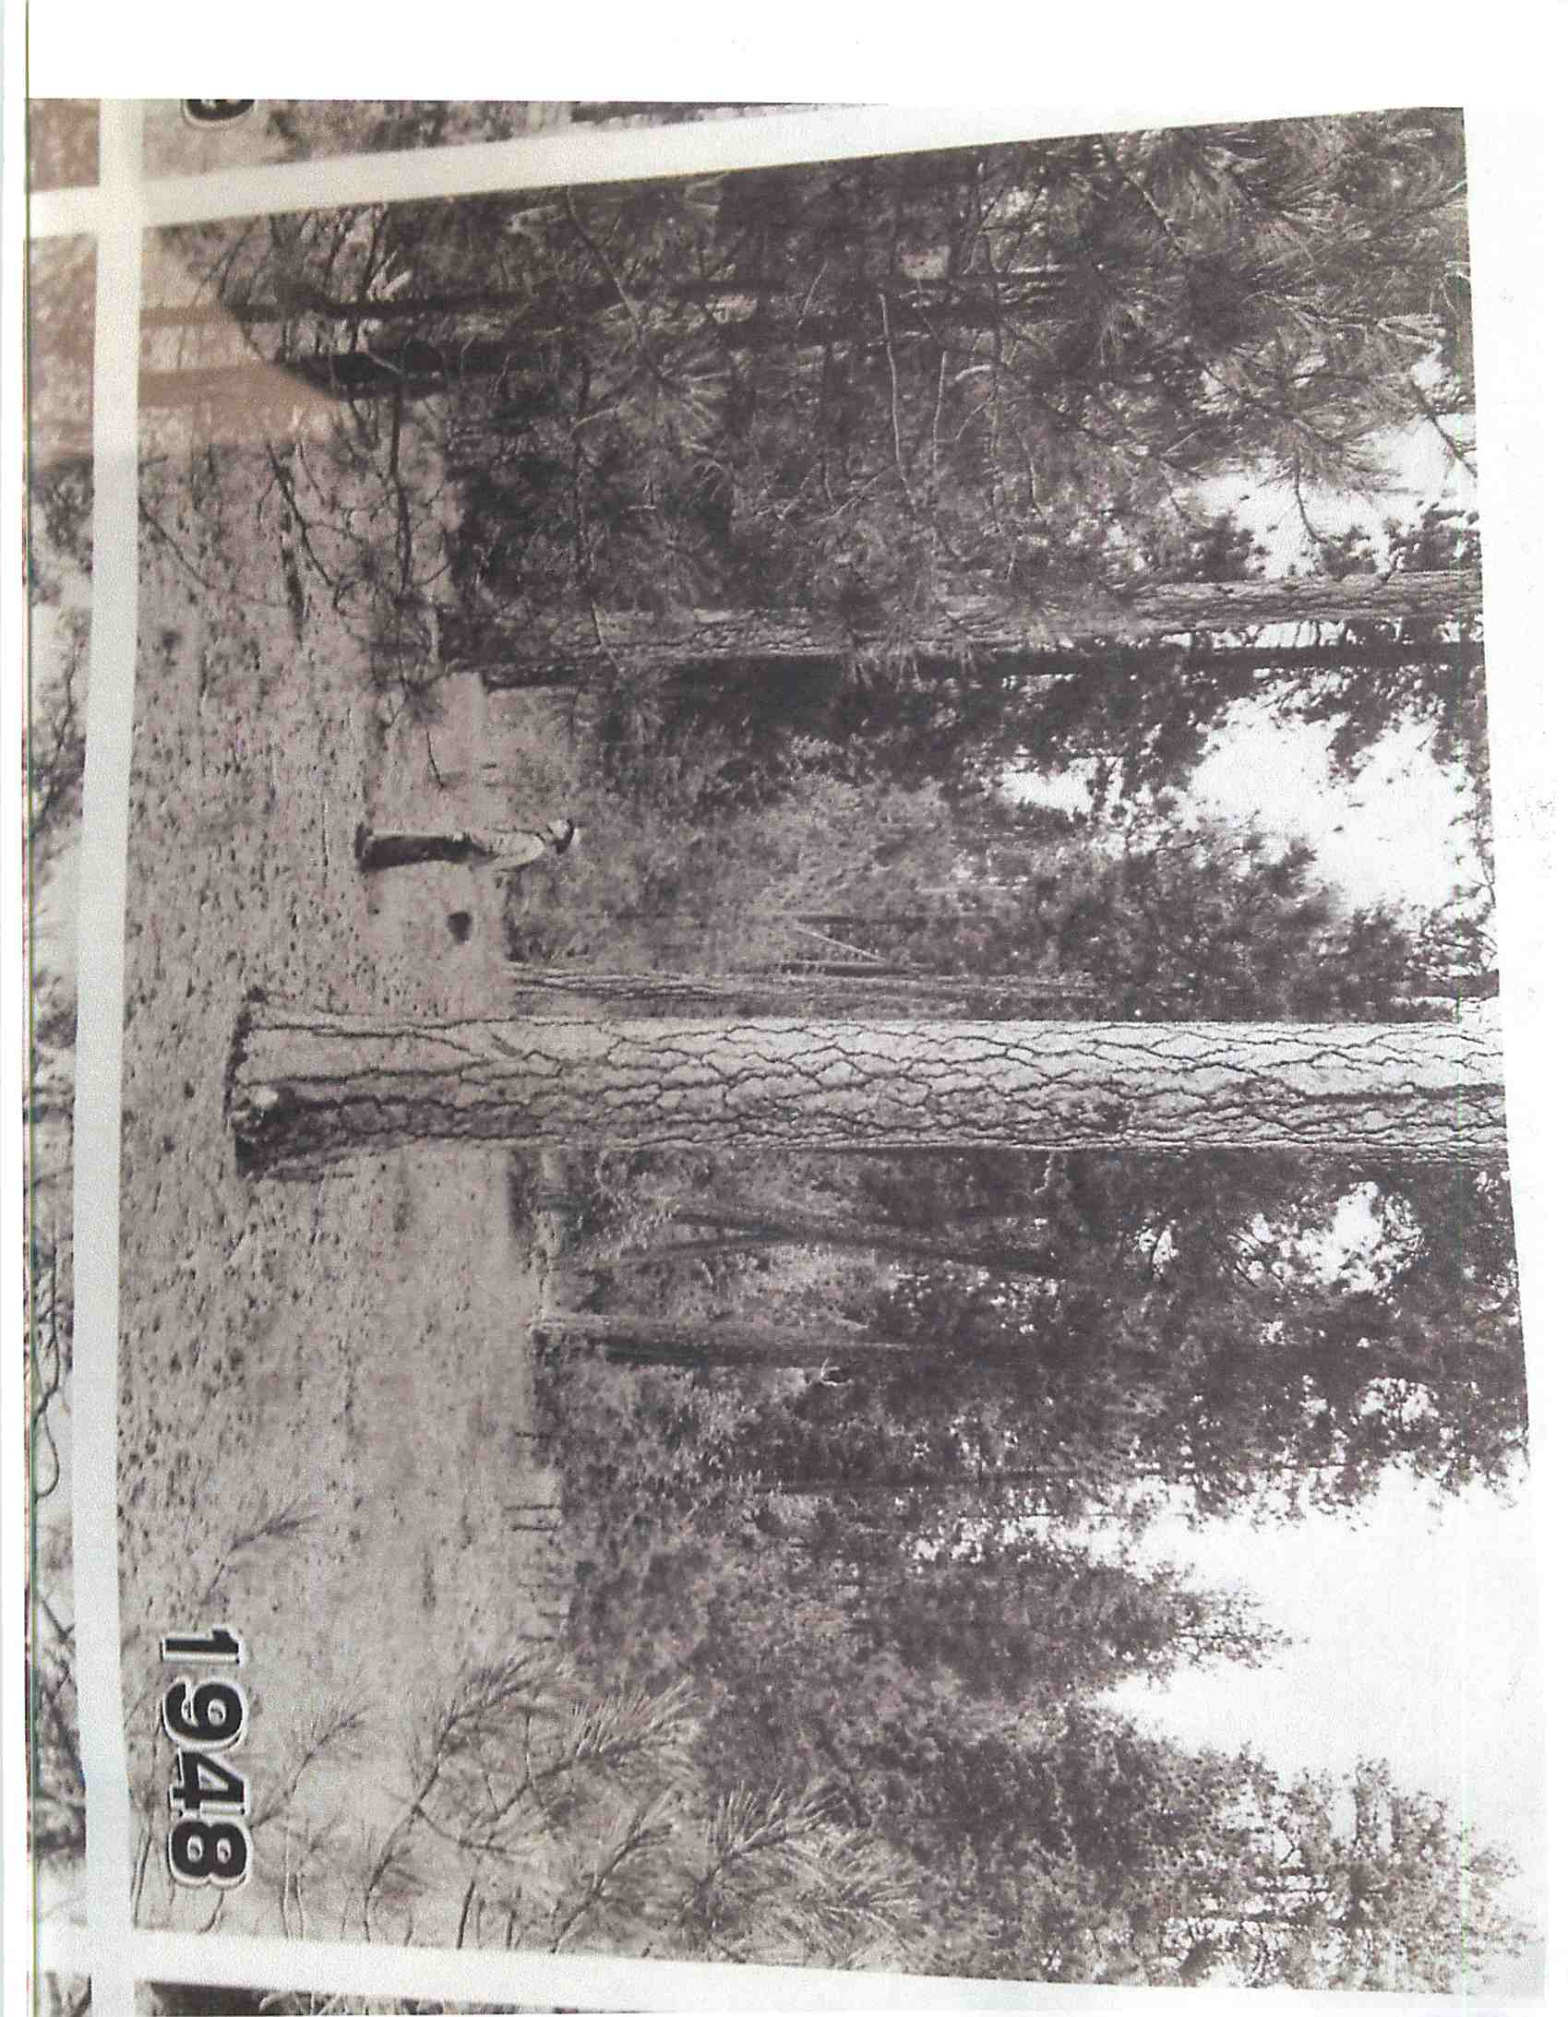

Slide 21
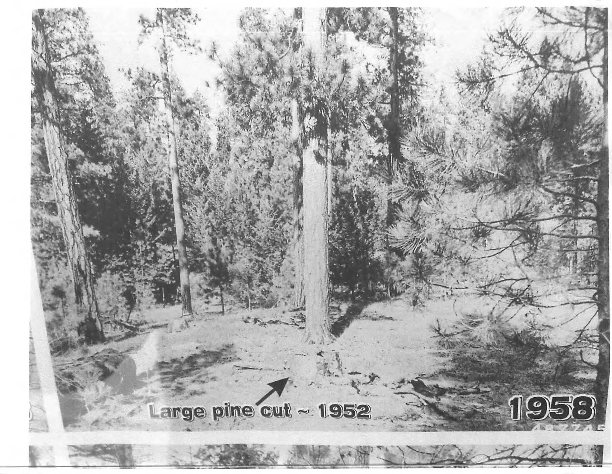

Slide 22
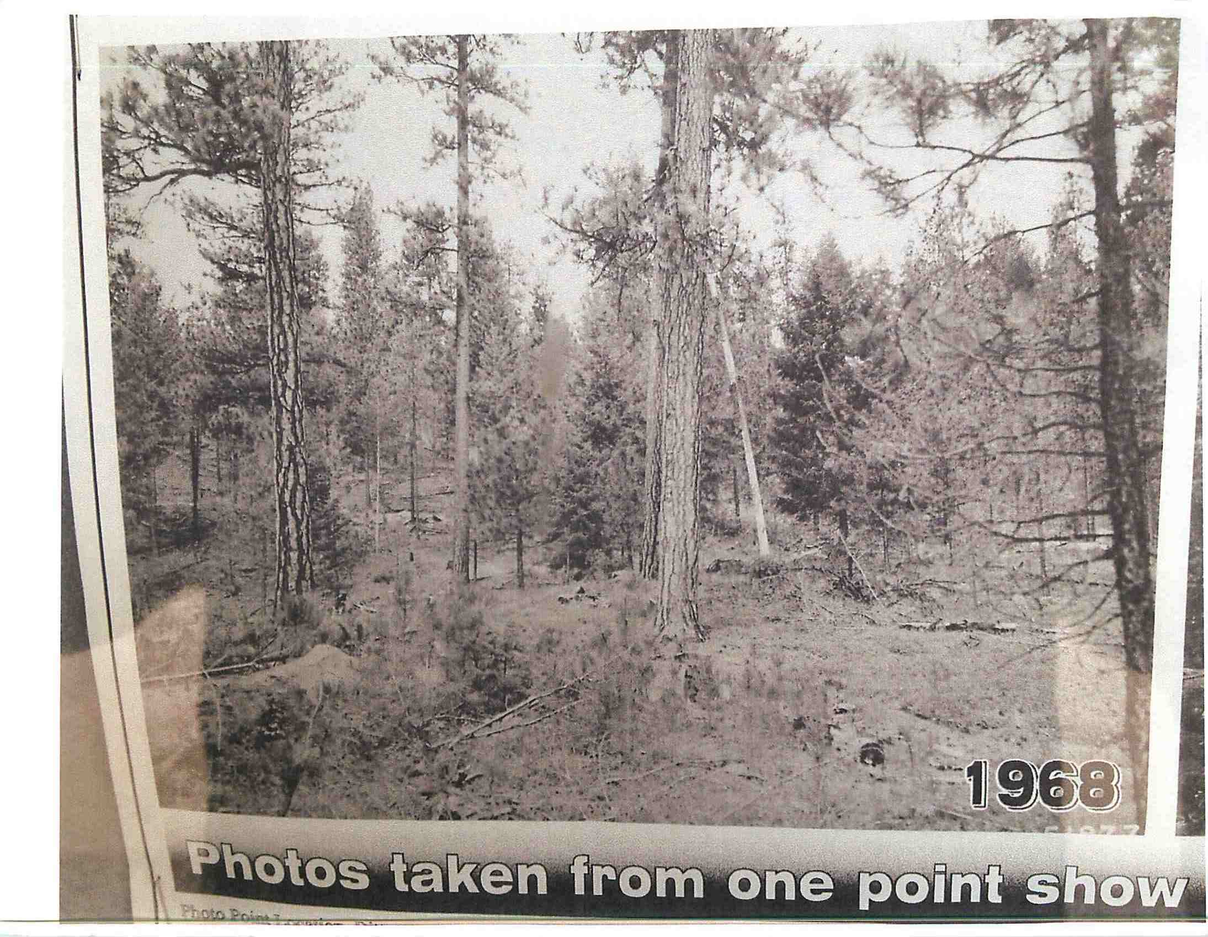

Slide 23
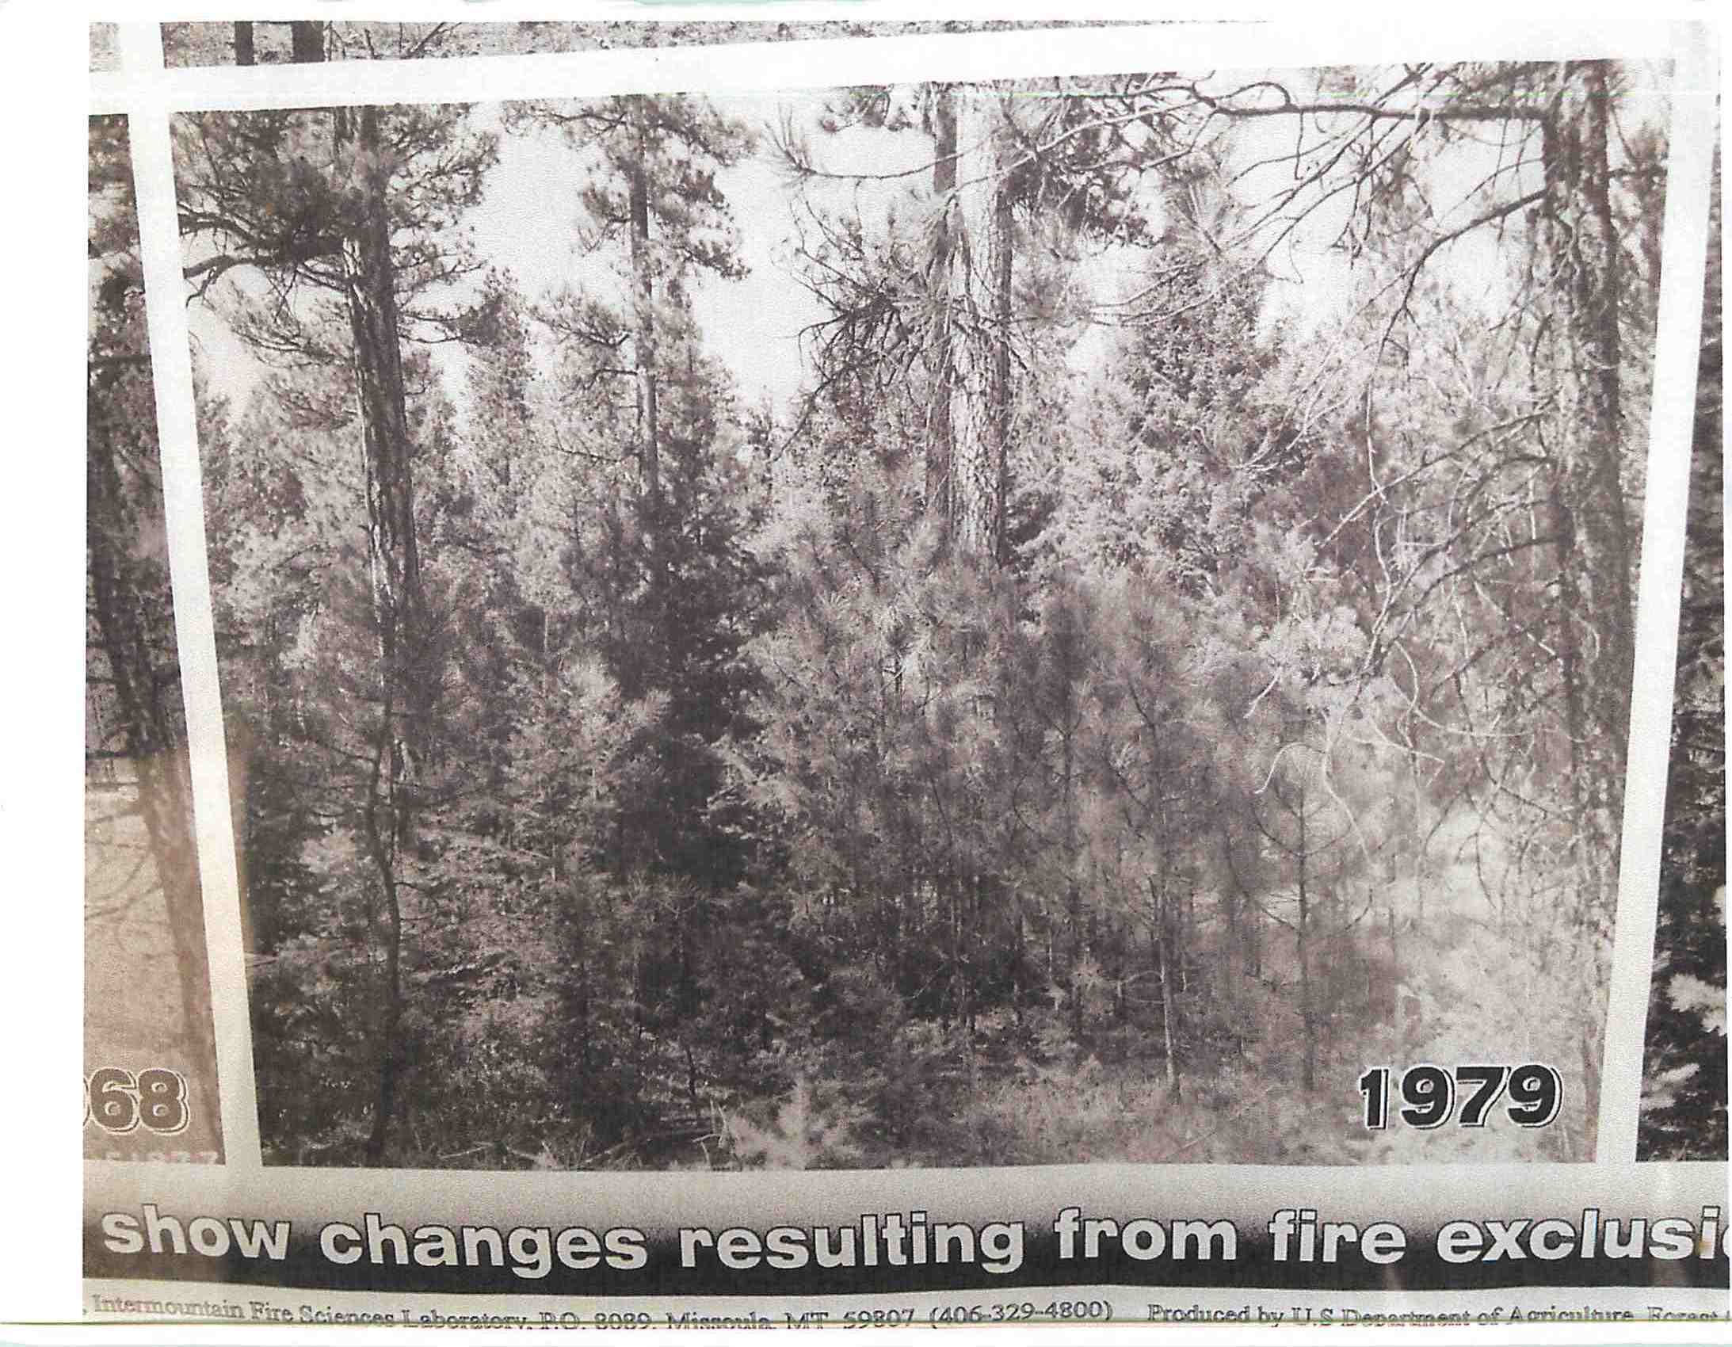

Slide 24
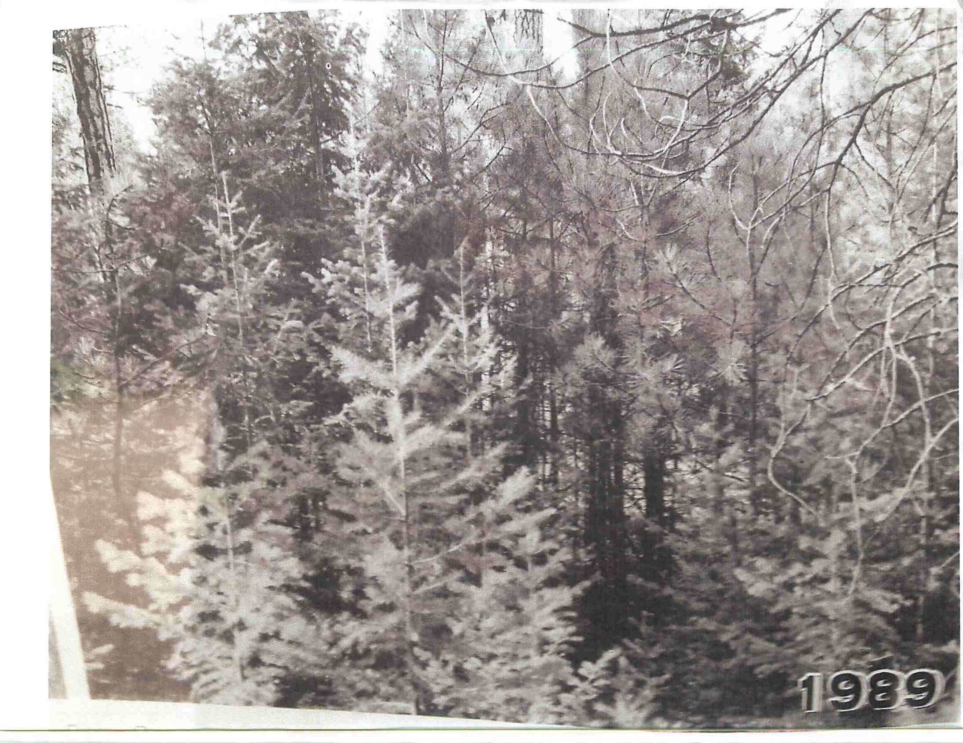

Slide 25
Wildfire and Timber
In the west, it was found that the benefits of treating medium and high risk stands exceeded costs by $1000 - $2000 per acre.
A treatment area in Apache County with a cost of $41,000 was estimated by fire management teams and state forestry to have avoided suppression costs of $250,000…if suppression could even have occurred due to the extreme danger the landscape offered.

Slide 26
Wildfire and Timber
The tree density rates in the average western forest are 10-30 fold a naturally healthy and sustainable level.
Growth rates exceed extraction rates by 400%.
The most recent studies and reports on forest areas show that the U.S. forests are adding 938,600 acres of growth per year. In other words, 19,019,000 acres in the last measurable decade. Yet…

Slide 27
Wildfire and Timber
“it (the U.S.) still contributes to deforestation as an importer of forest products”.

Slide 28
Wildfire and Timber
In just the Southwestern forests, the annual growth is equal to the quantity necessary to build a 1,900 square foot hom,e for 90,000 families. Remember, that is the per year new fiber in just the forests of AZ and NM.

Slide 29
Wildfire and Timber
Treatments - Although federal policies stipulate that significant resources should be invested in the WUI, it has been found that only 3% of the area treated was within the WUI.
Often Wildfire Hazardous Fuels Reduction is cited by federal agencies as a positive aspect of their “management” ability…yet on average only 14% of total appropriated funds actually goes towards these efforts.

Slide 30
Wildfire and Timber
Southwestern forests can have an average value of $176.66 per thousand board feet (mbf).
A minimum operable acre of 2 mbf in the southwest would equate to $353.32
Wallow Fire burned 540,000 acres.
Direct Timber Loss - $192,792,800.00
Opportunity Costs and restoration will exceed $2 Billion
Long-term Asset Value Loss to exceed $1.5 Trillion

Slide 31
Air
Carbon, uranium, “greenhouse gas” emissions, particulate matter, heavy metals, etc. are released at alarming rates due to federal mismanagement of the lands via wildfires.
For an overcrowded, higher than healthy tree density, which is the norm today in the western forests the figures are alarming.

Slide 32
Air
Using Forest Carbon Emission Models, it has been discovered that an acre of land consumed in wildfire can emit 126 tons of “greenhouse gas”. This is based on an acre stand of 700 trees, where much of the western forests contain substantially higher stand densities.
In a more understandable form, 4 wildfires in CA emitted the equivalent of 7,000,000 cars ran for 24/7 for an entire year.

Slide 33
Some other economic factors
The USFS spends on average 5 times the amount as the comparative state agency on management.
The BLM spends on average 2 times the amount as the comparative state agency on management.
Often federal agencies indicate poor quality assets as the reasoning for differentials, while most often it is a fact of overly high management costs and lack of any incentive towards a profitable or at least cost-effective operation.

Slide 34
Some other economic factors
Number of agency personnel per acre is one of the major contributors to these losses.
The States average 36 employees per million acres.
The BLM averages 45 employees per million acres.
The USFS averages 210 employees per million acres.

Slide 35
Some other economic factors
States earn average annual revenues from land management of about $425,000 per full-time employee.
The BLM earns close to $110,000 per full-time employee.
The USFS earns less than $24,000- per full-time employee.

Slide 36
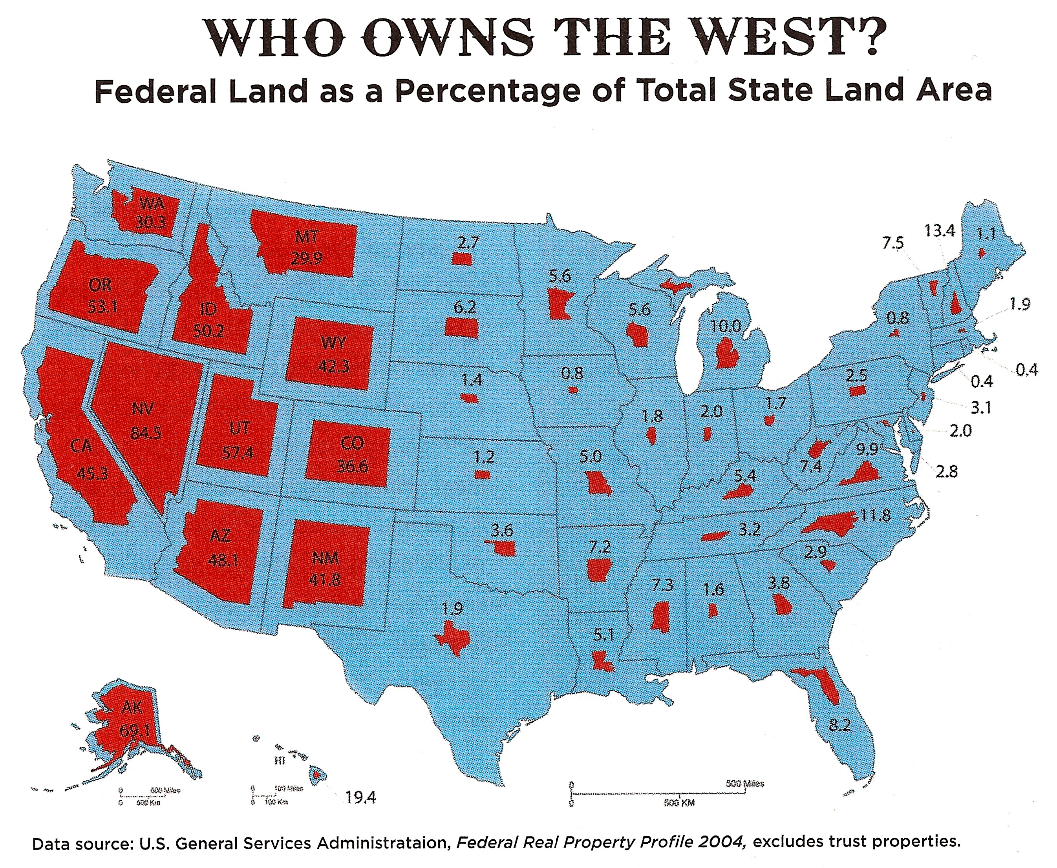

Slide 37
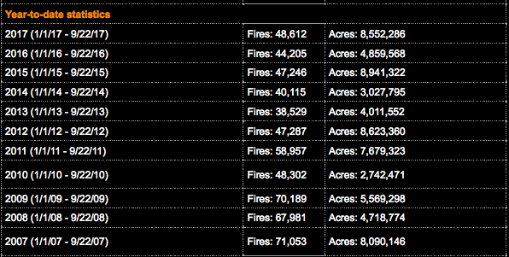
Acres Burned

Slide 38

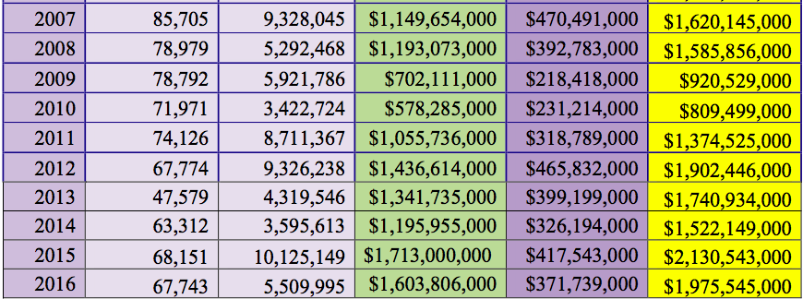
Suppression Costs of Wildfire

Slide 39
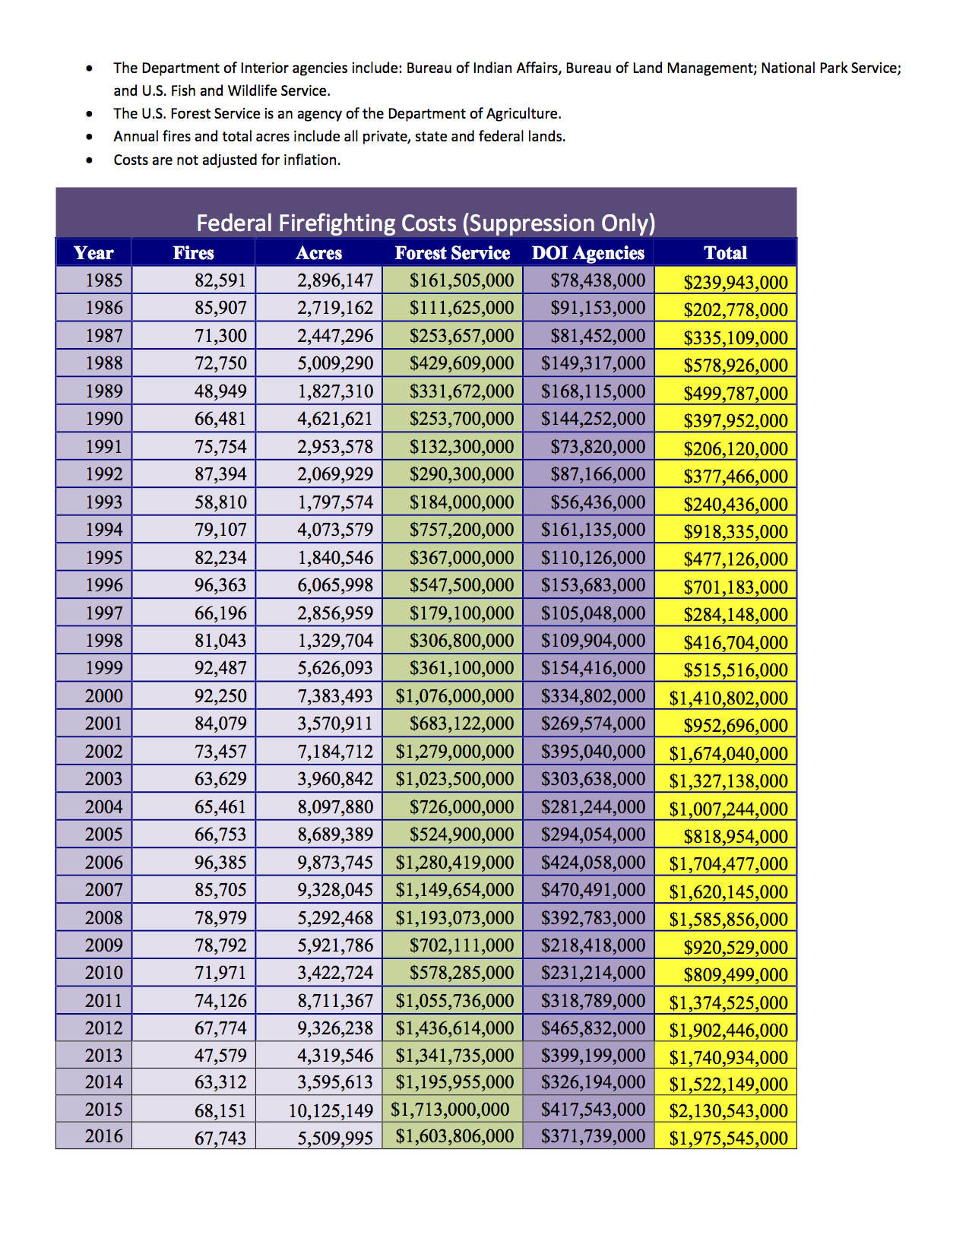

Slide 40
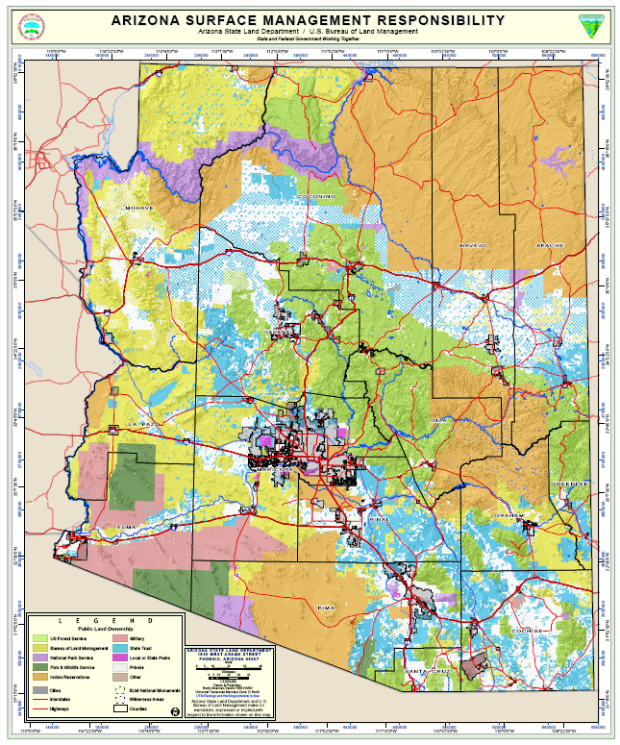

Slide 41


Slide 42
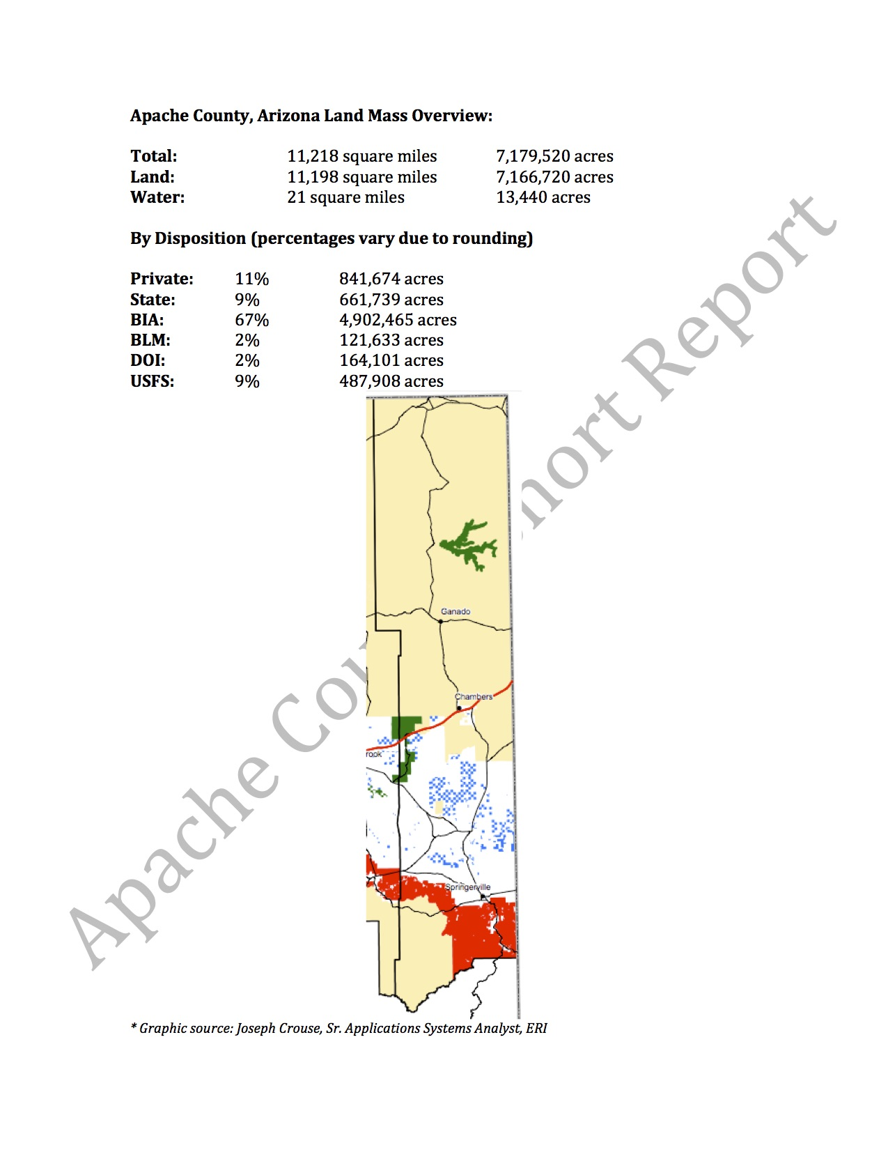

Slide 43
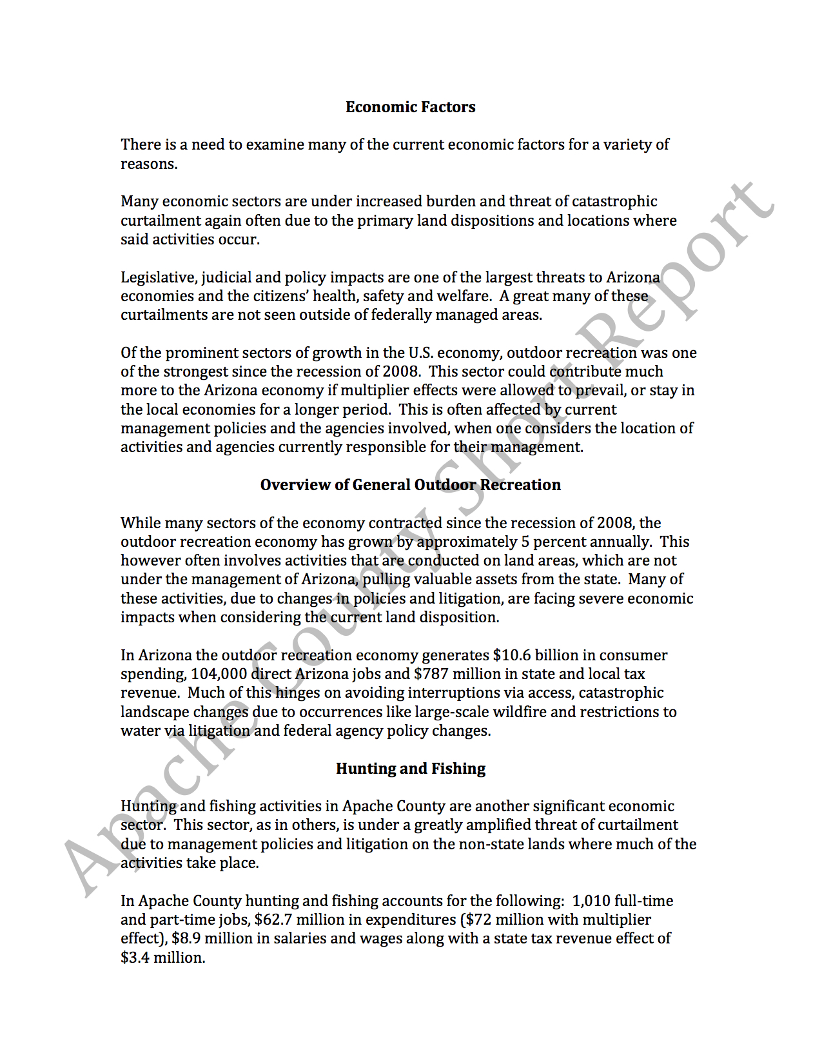

Slide 44
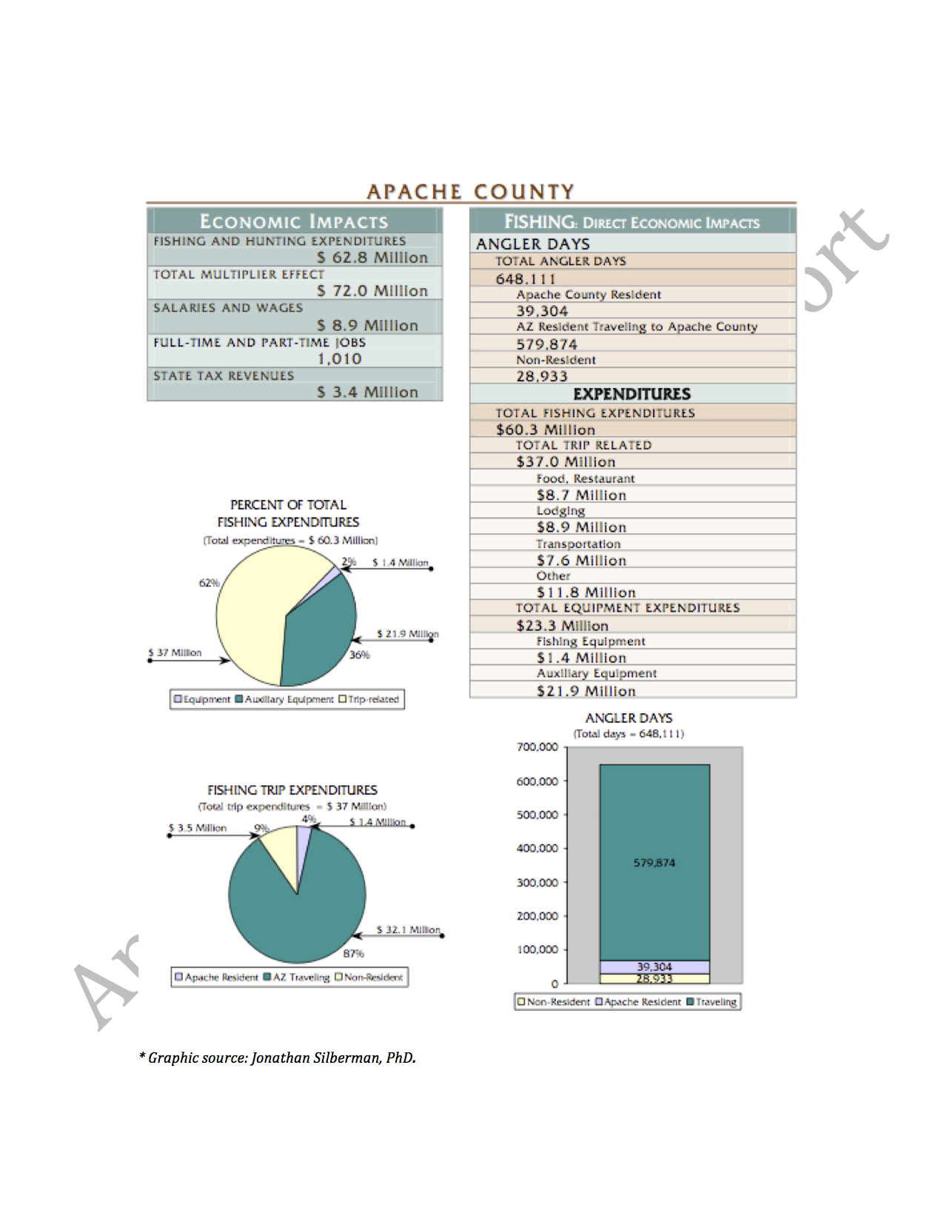

Slide 45
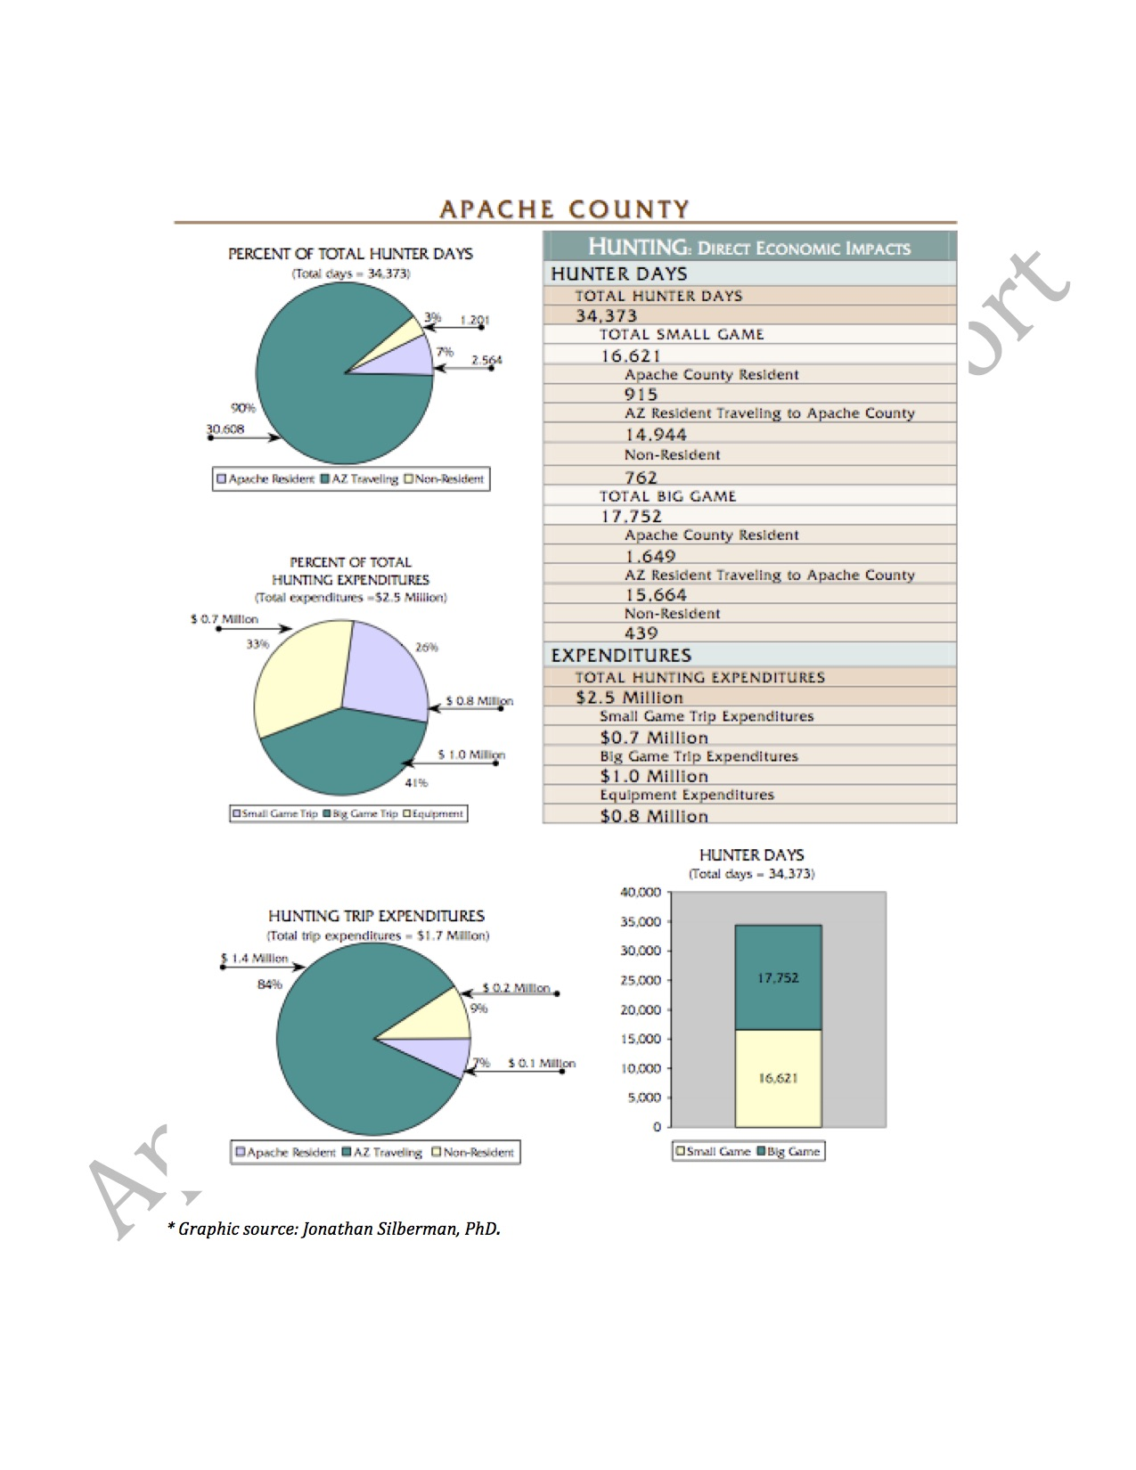

Slide 46
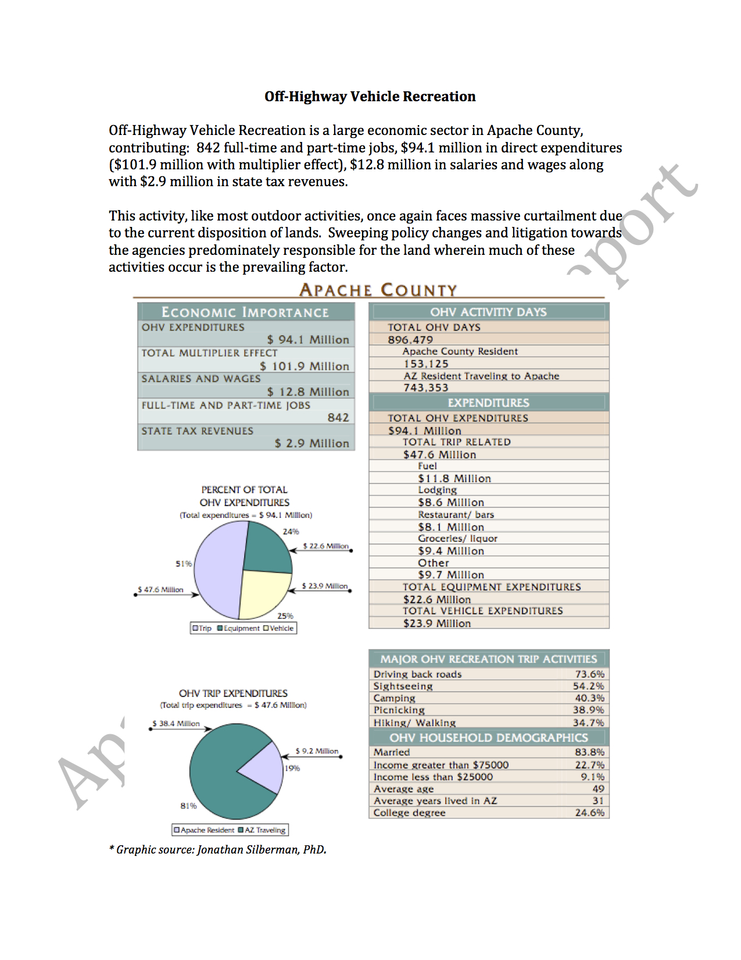

Slide 47
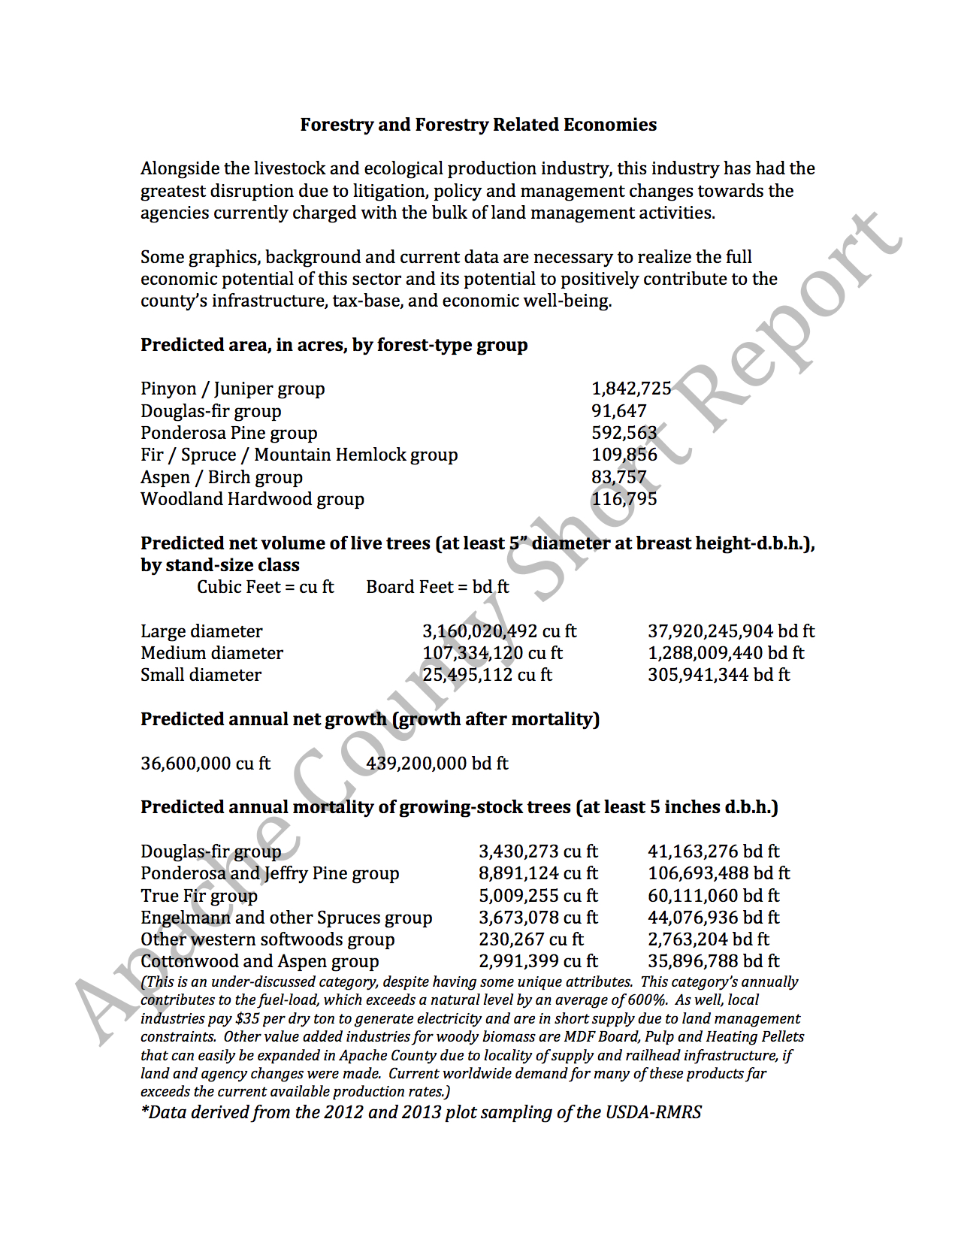

Slide 48
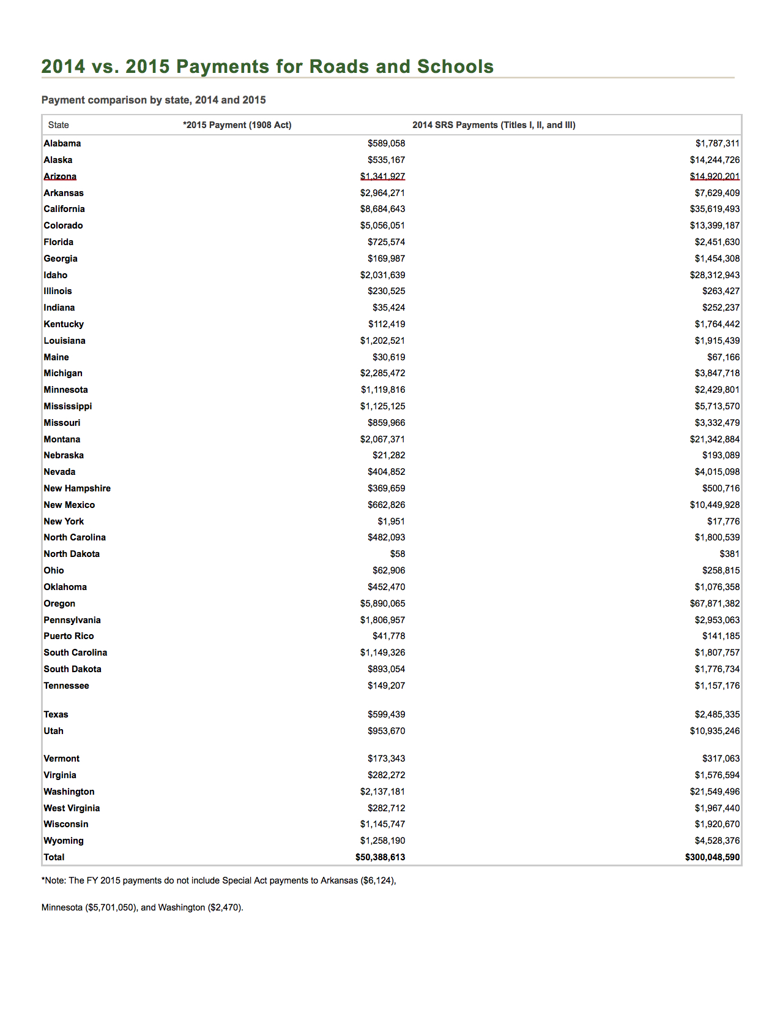

Slide 49
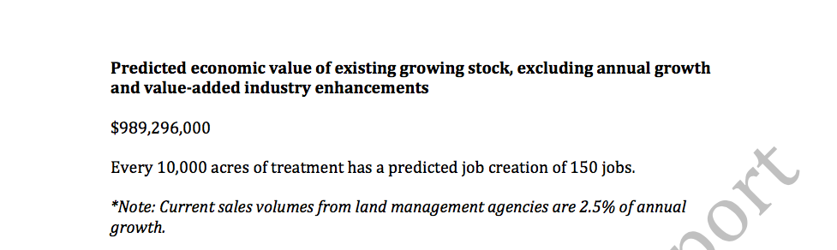

Slide 50
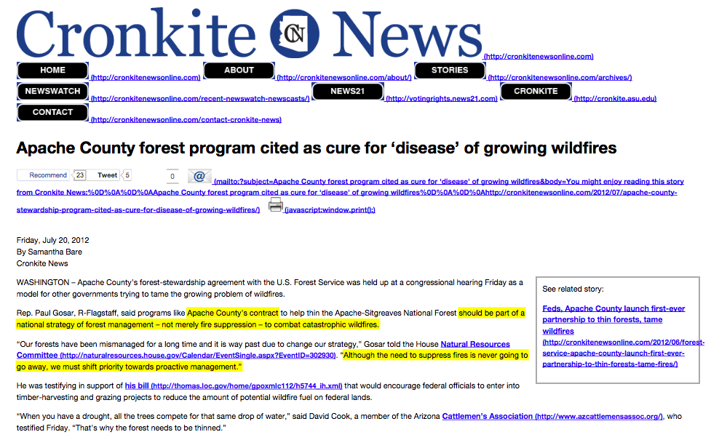

Solutions

Slide 51
Solutions
Apache County’s forest-stewardship agreement with the U.S. Forest Service was held up at a congressional hearing Friday as a model for other governments trying to tame the growing problem of wildfires.
Rep. Paul Gosar, R-Flagstaff, said programs like Apache County’s contract to help thin the Apache-Sitgreaves National Forest should be part of a national strategy of forest management – not merely fire suppression – to combat catastrophic wildfires.

Slide 52
Through the Congressional Western Caucus, continue to seek comprehensive reform of the Endangered Species Act (ESA), National Environmental Policy Act (NEPA) and a realignment of agencies duties under their Congressional Charters and Organic Documents.

Slide 53
Solutions
Divestiture, Disposal or “realignment” of federally managed lands to the states and their respective state management agencies.
AZDFFM, AZGFD, AZDA, AZDWR, etc.

Slide 54
Solutions

Slide 55
Untreated vs. Treated

Slide 56
Untreated vs. Treated

Slide 57


Slide 58
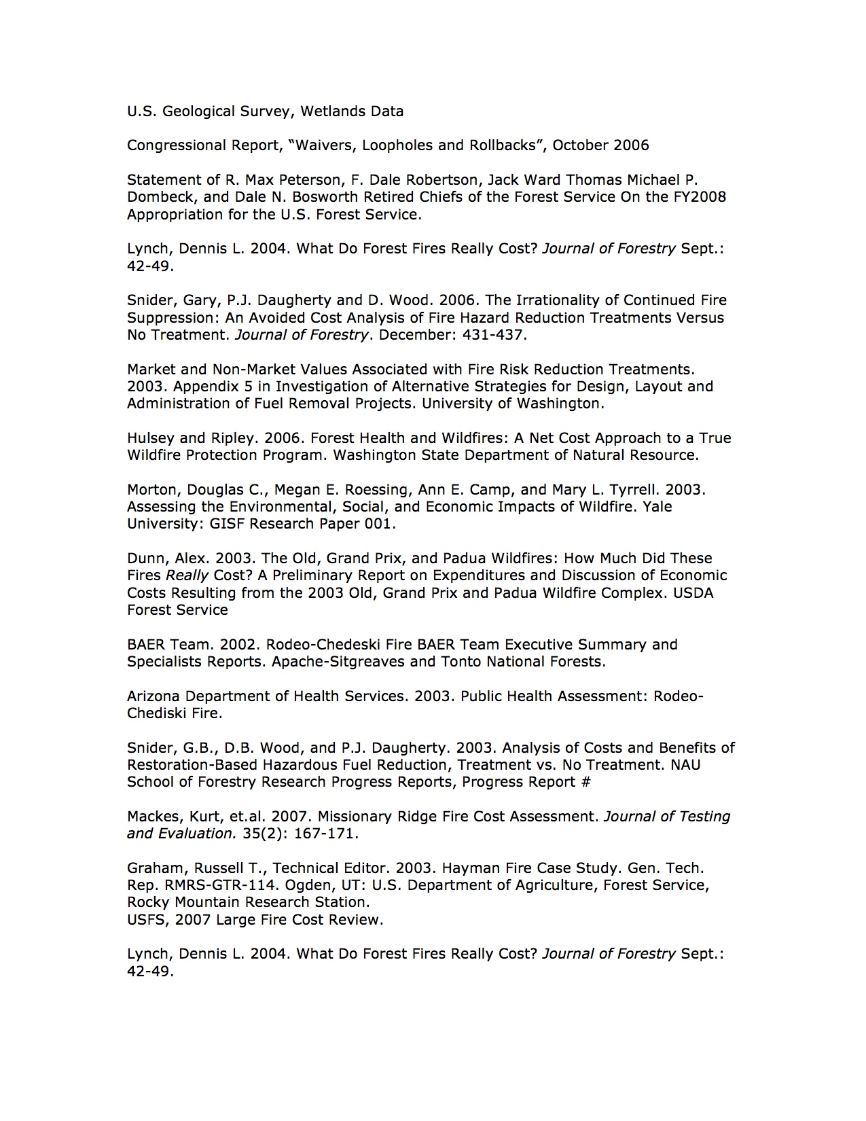

Slide 59
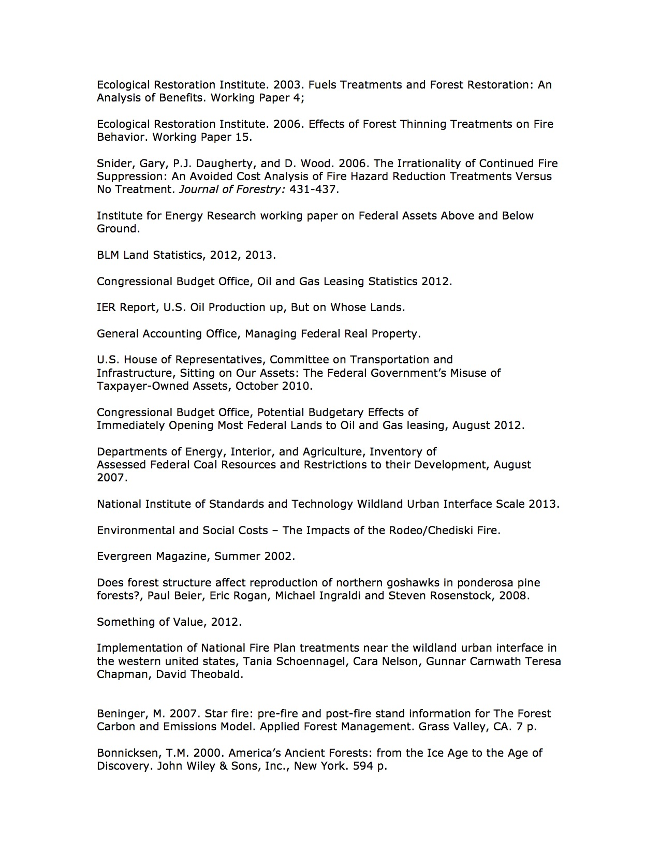

Slide 60
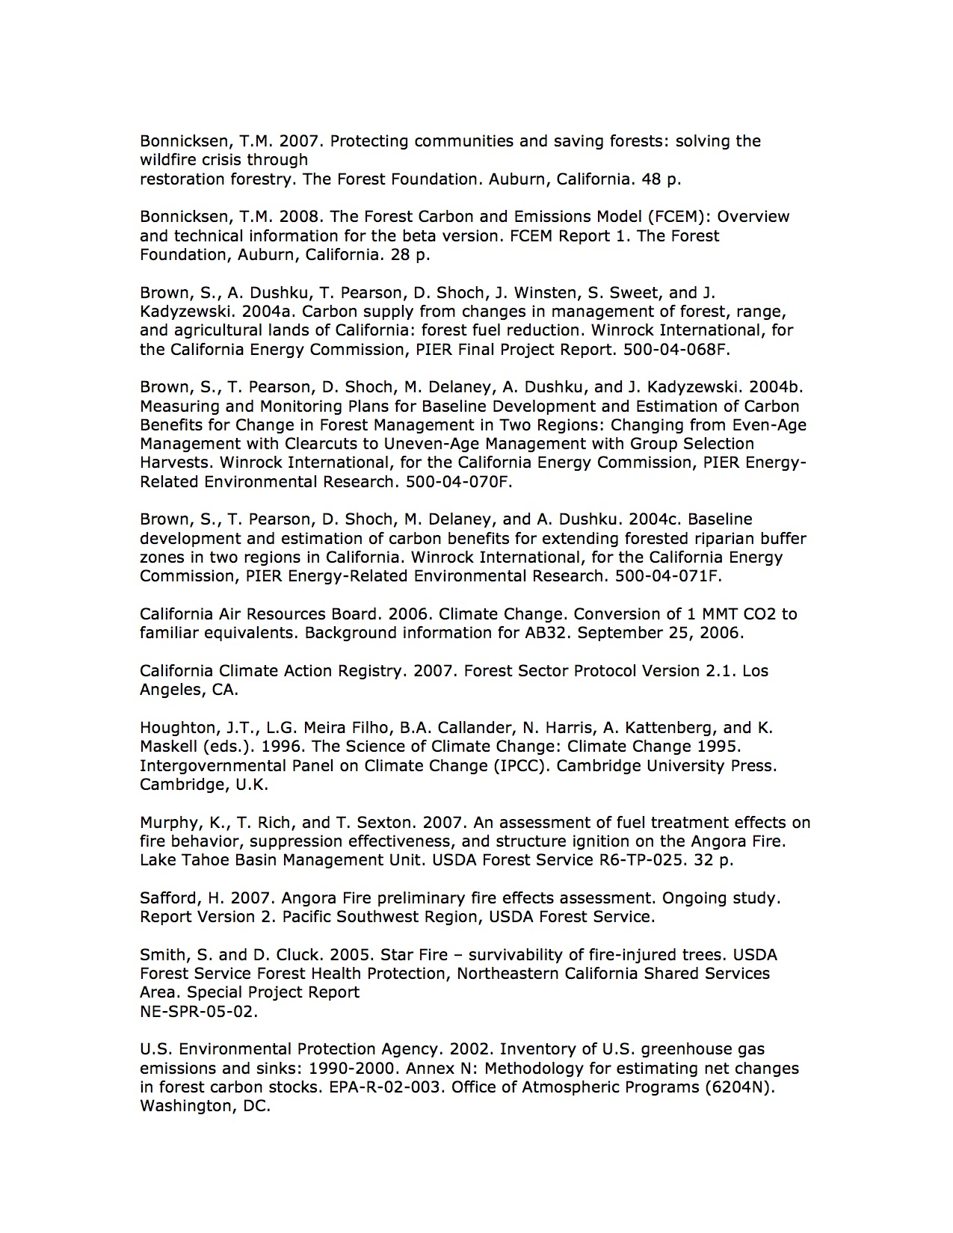

Slide 61
