Slide 1
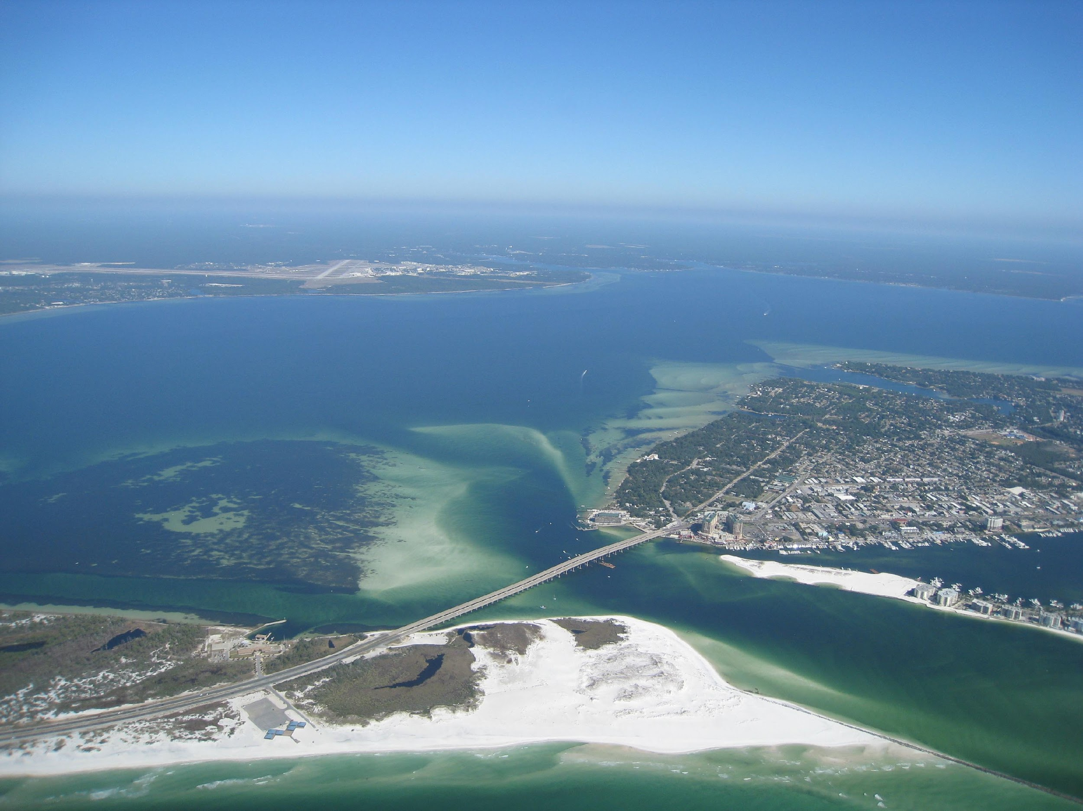
OCWOC WATERSPORT SAFETY
Things to keep in mind

Slide 2
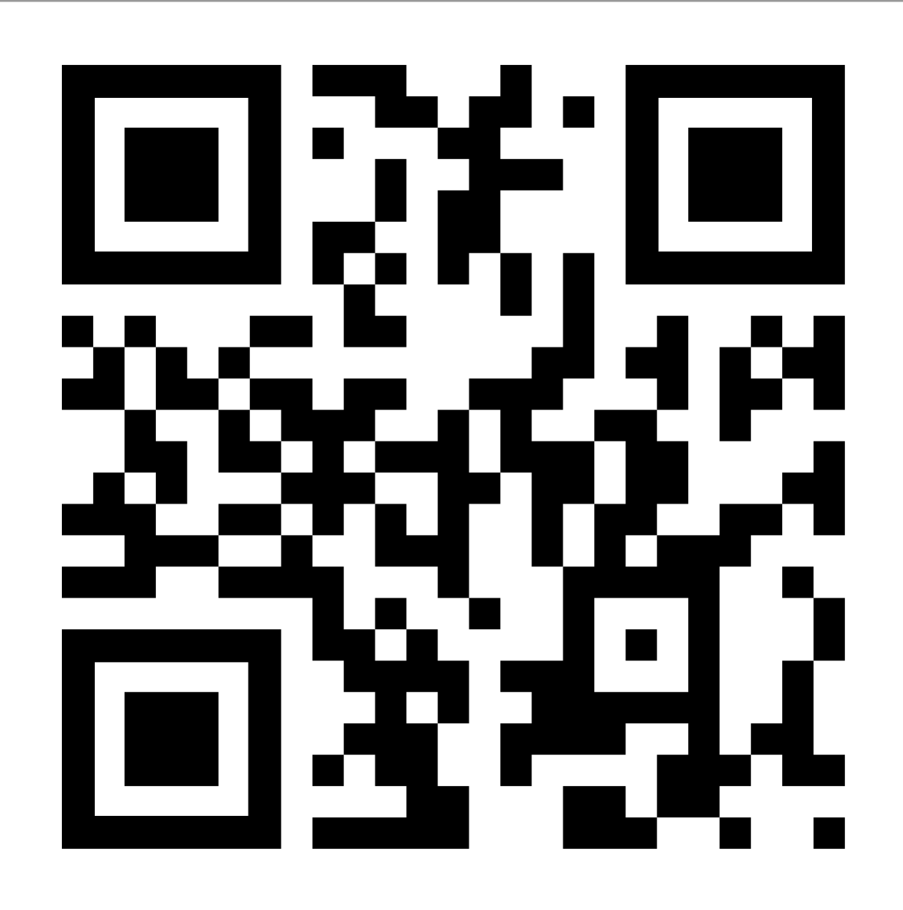
OCWOC OBJECTIVES:
Website
Share knowledge & resources with industry stakeholders
Protect the interests of watersport operators
Enhance the safety of boating with public-private cooperation
Become a good steward of the community

Slide 3
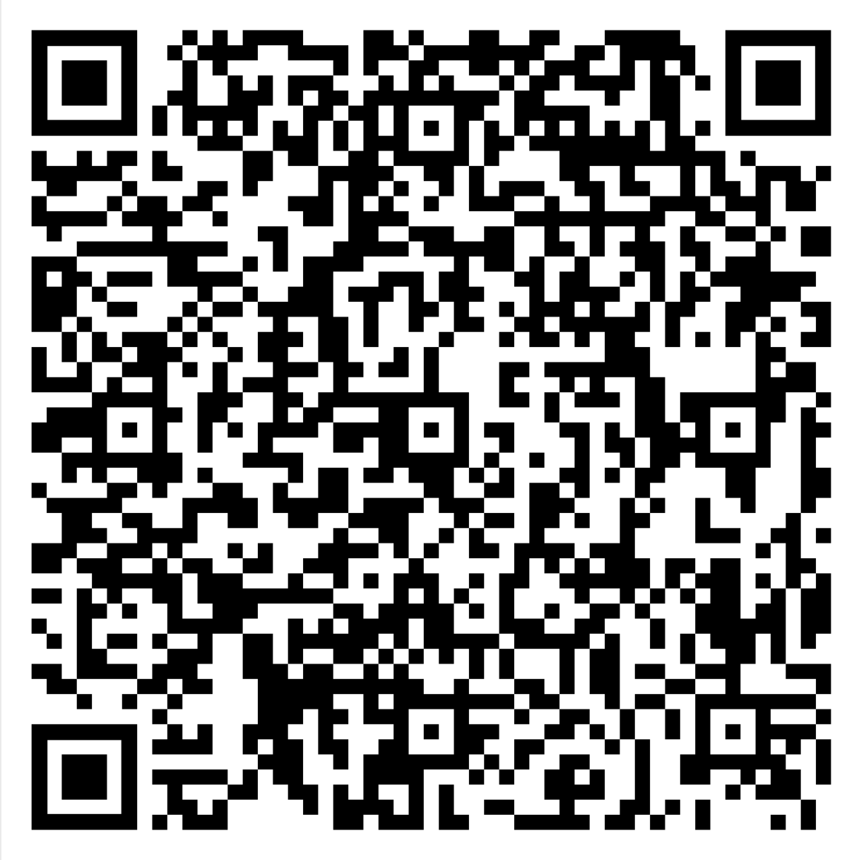
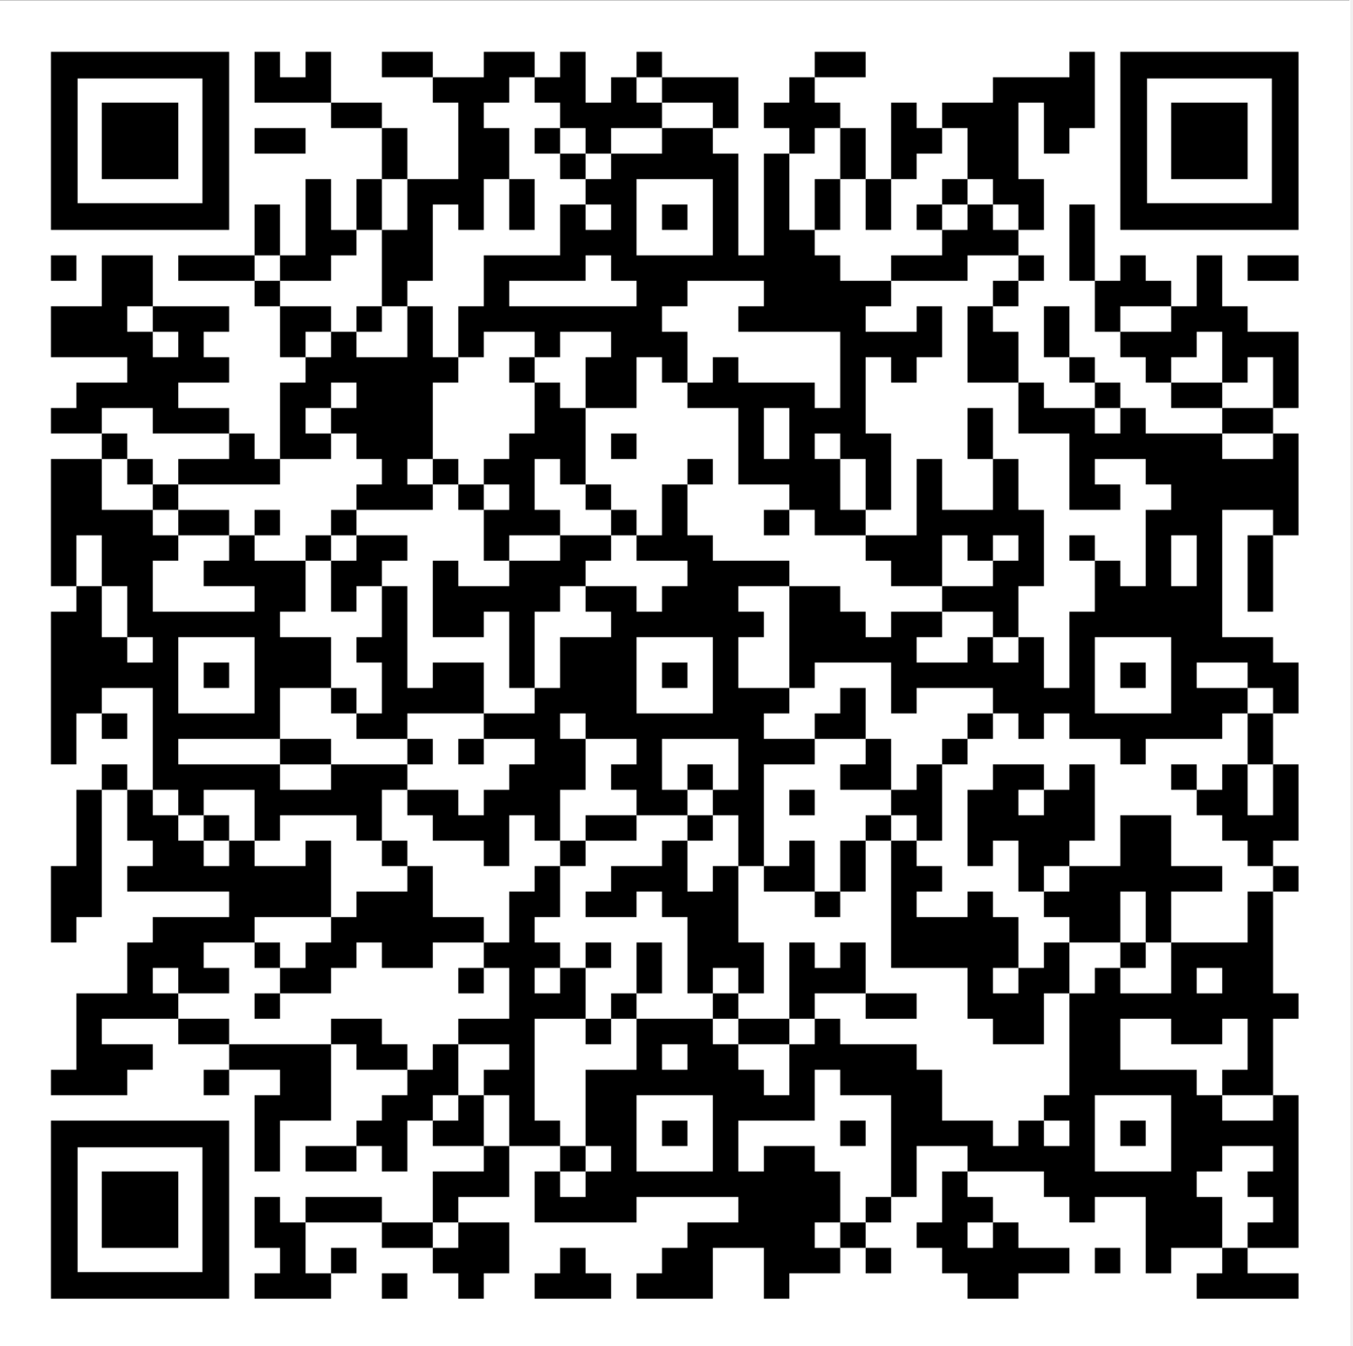
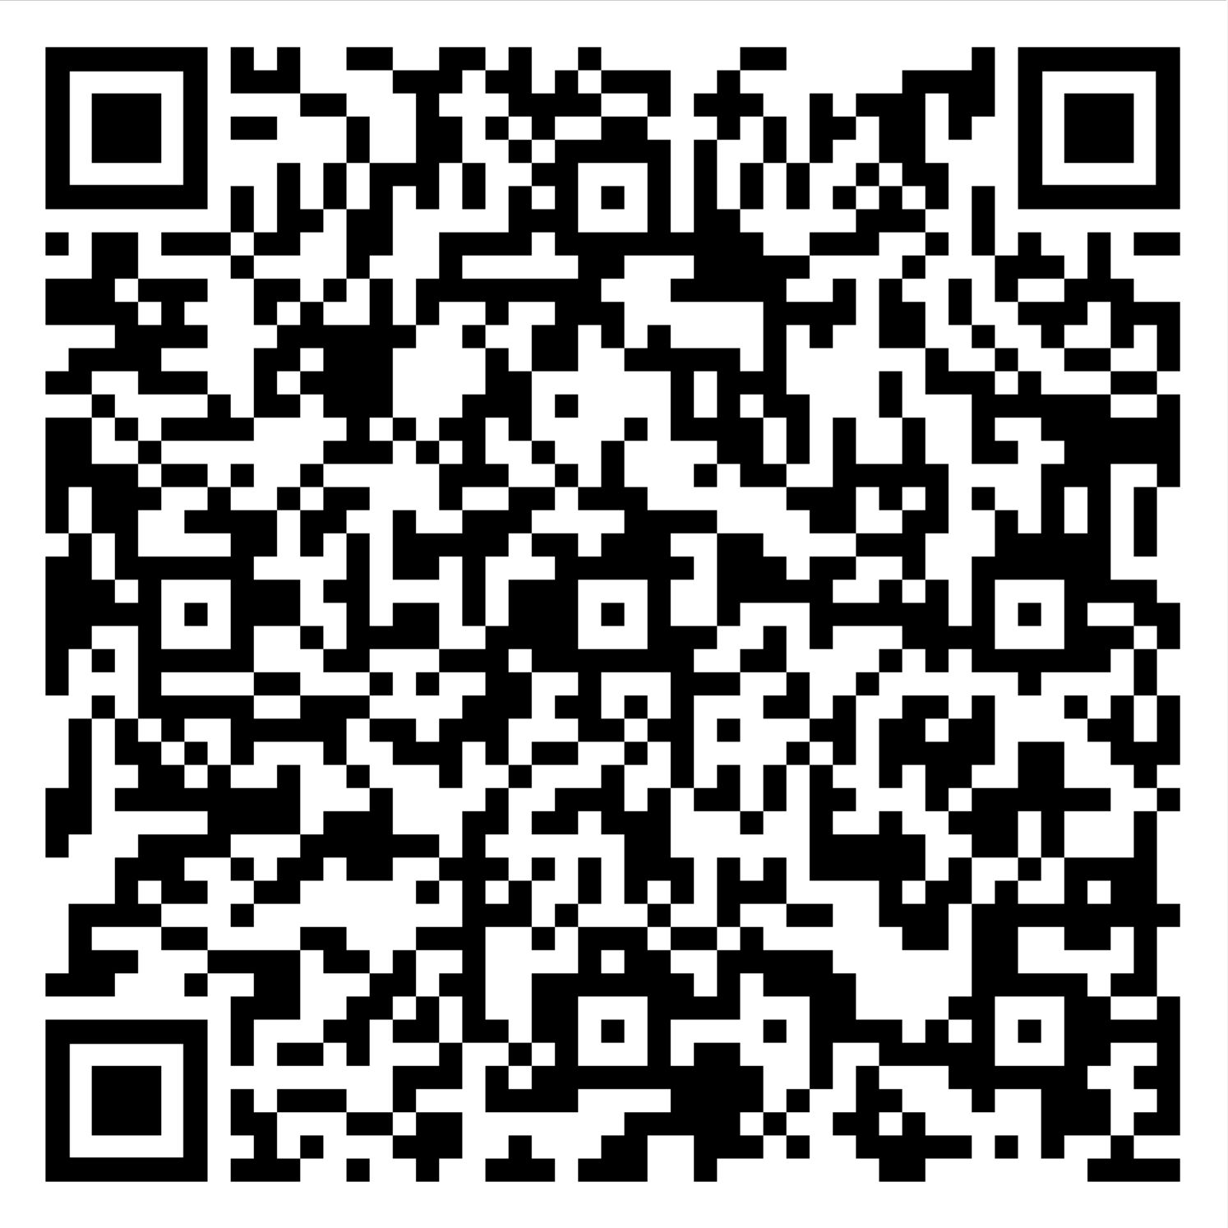
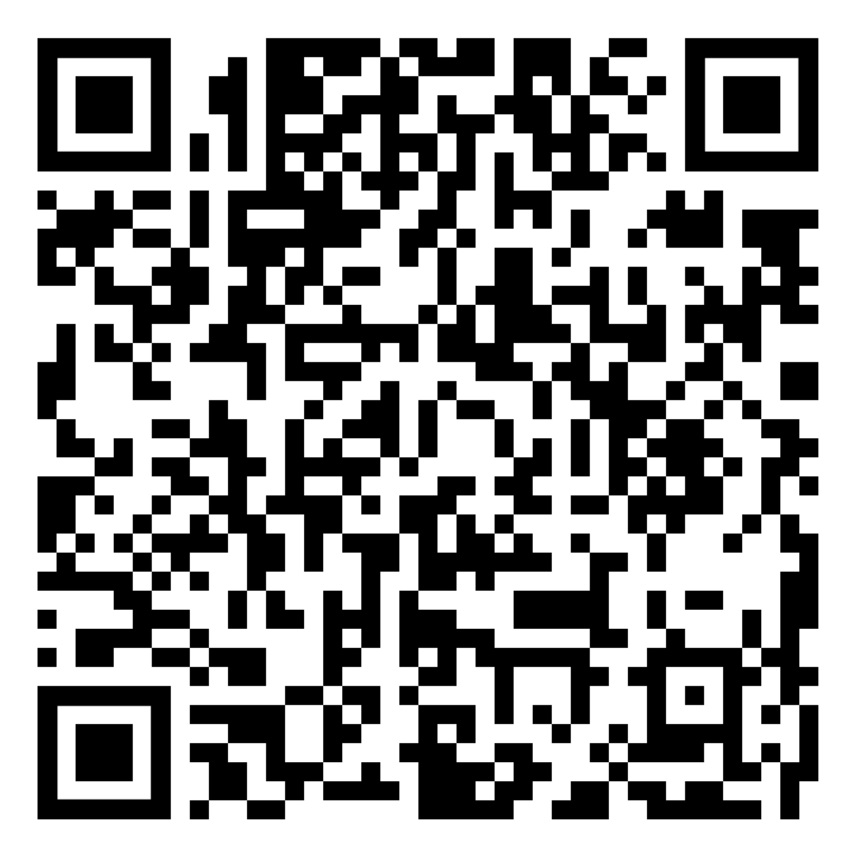
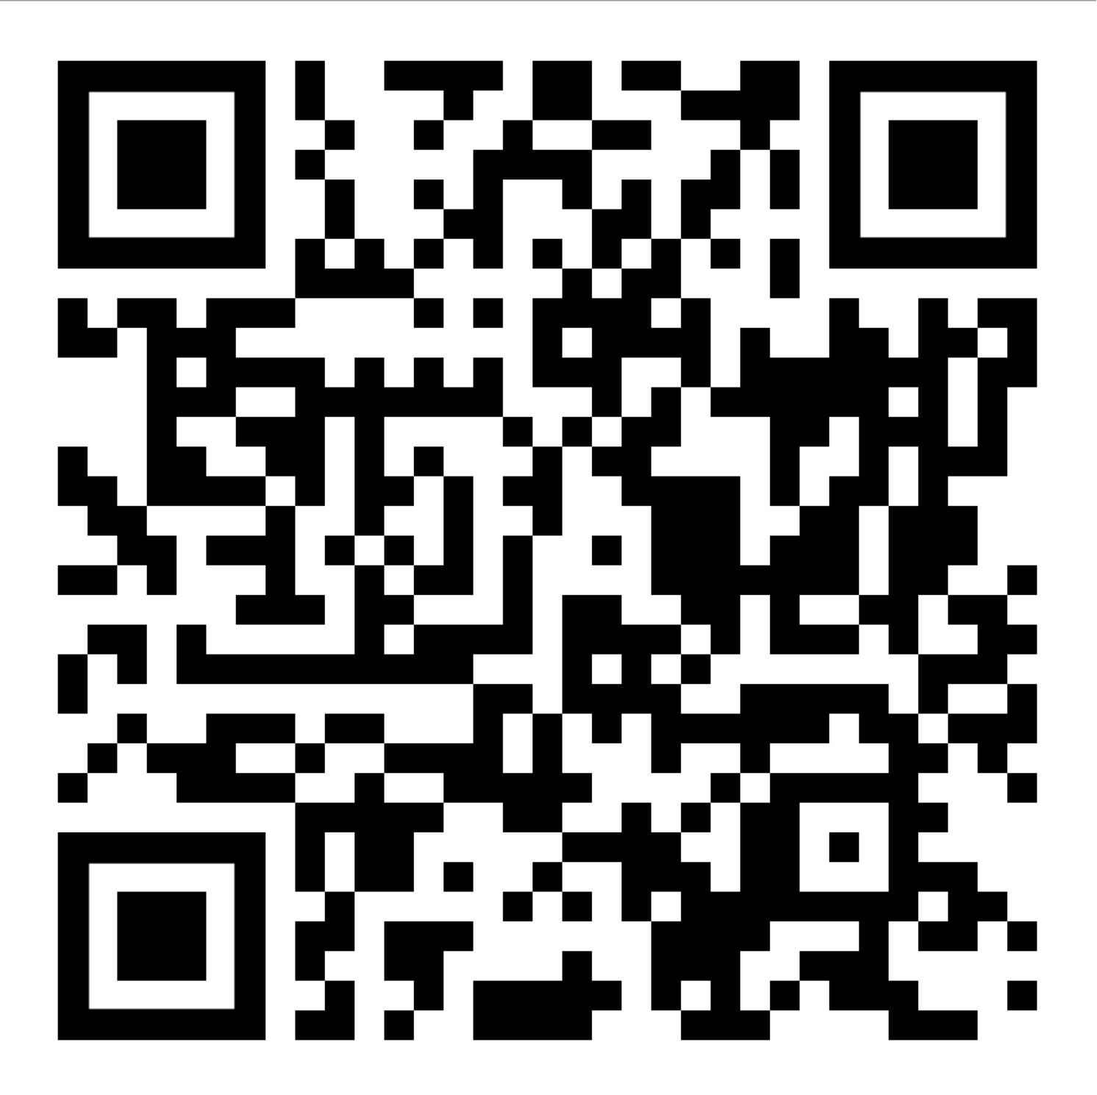
ORDINANCES IN PLACE
City of Destin –
City of Fort Walton Beach -
Okaloosa County –
Crab Island –
FWC Livery -

Slide 4

WRIST BAND SYSTEM

Slide 5
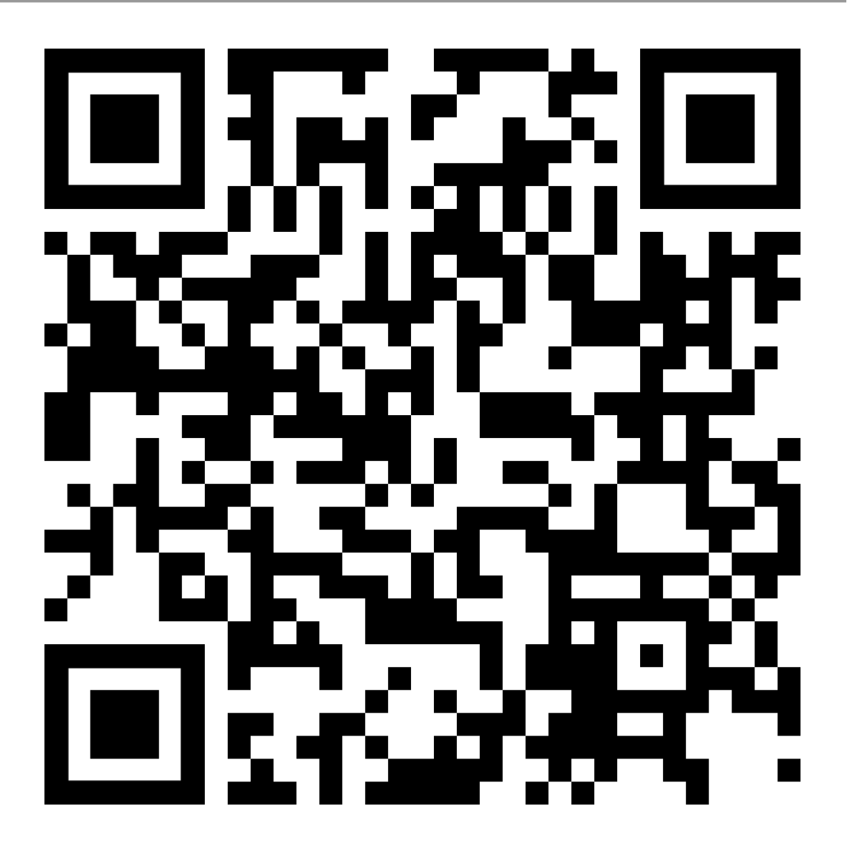
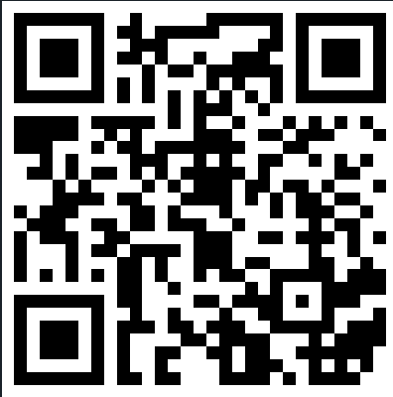
SAFETY VIDEOS
  Waverunner Safety Video
  Navigational Safety Video
  Pontoon Boat Safety Video
    Goal – to complete before Summer season

Slide 6
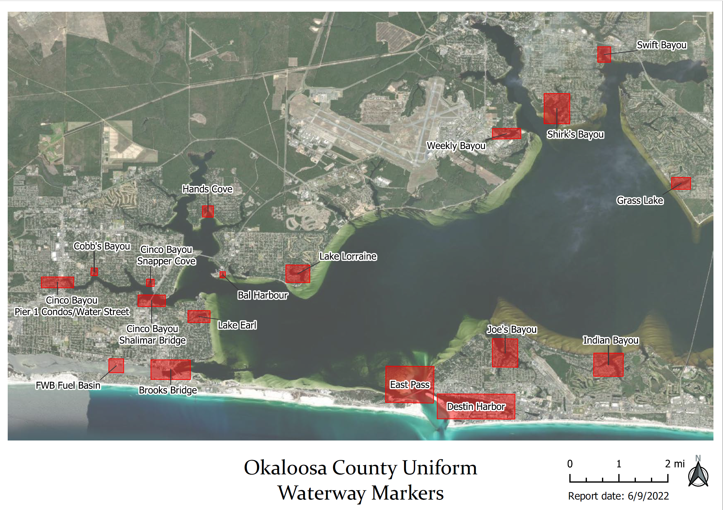
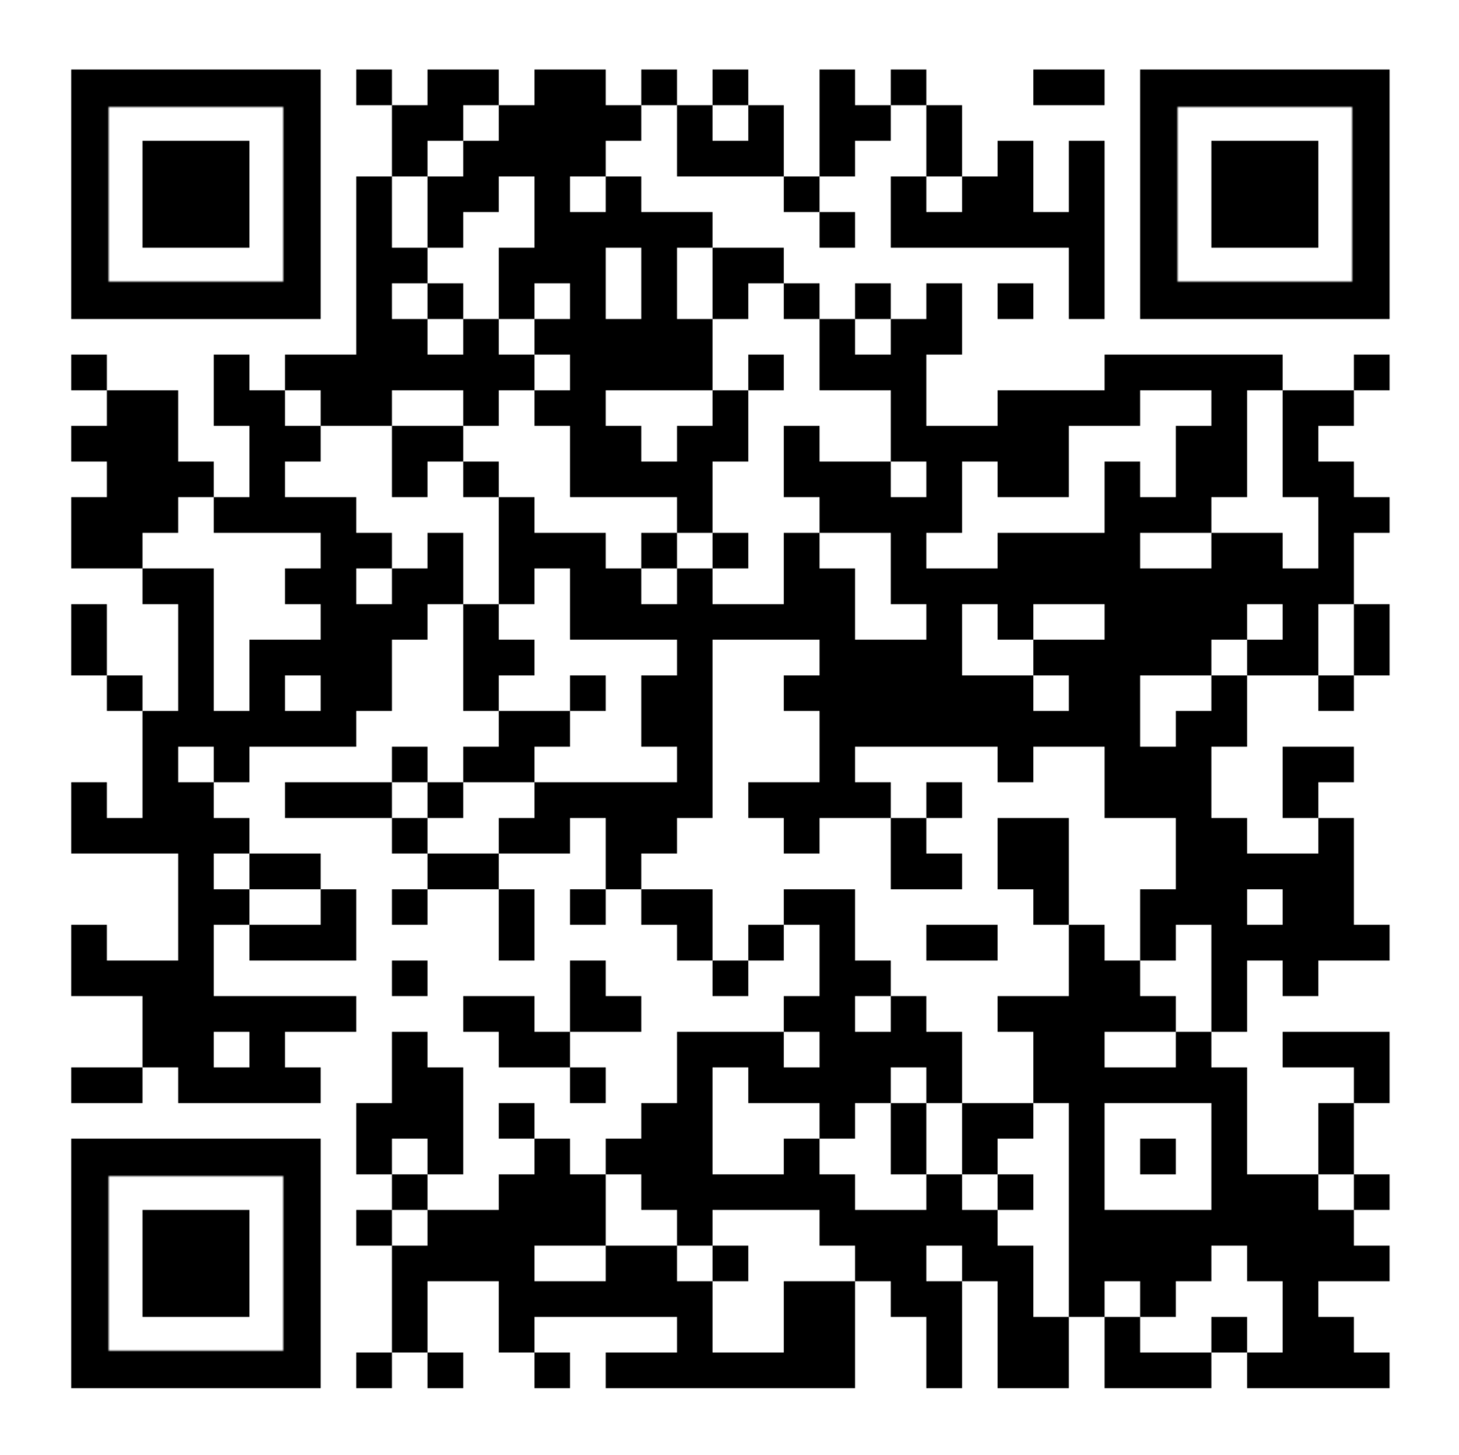
COUNTY NO WAKE ZONE MAP
Download here

Slide 7
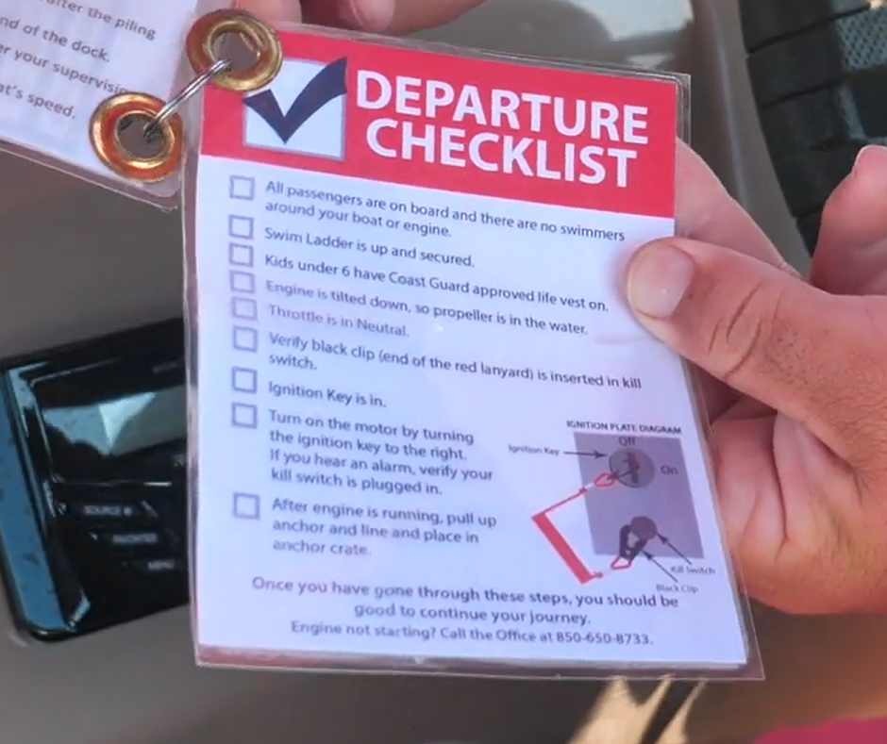
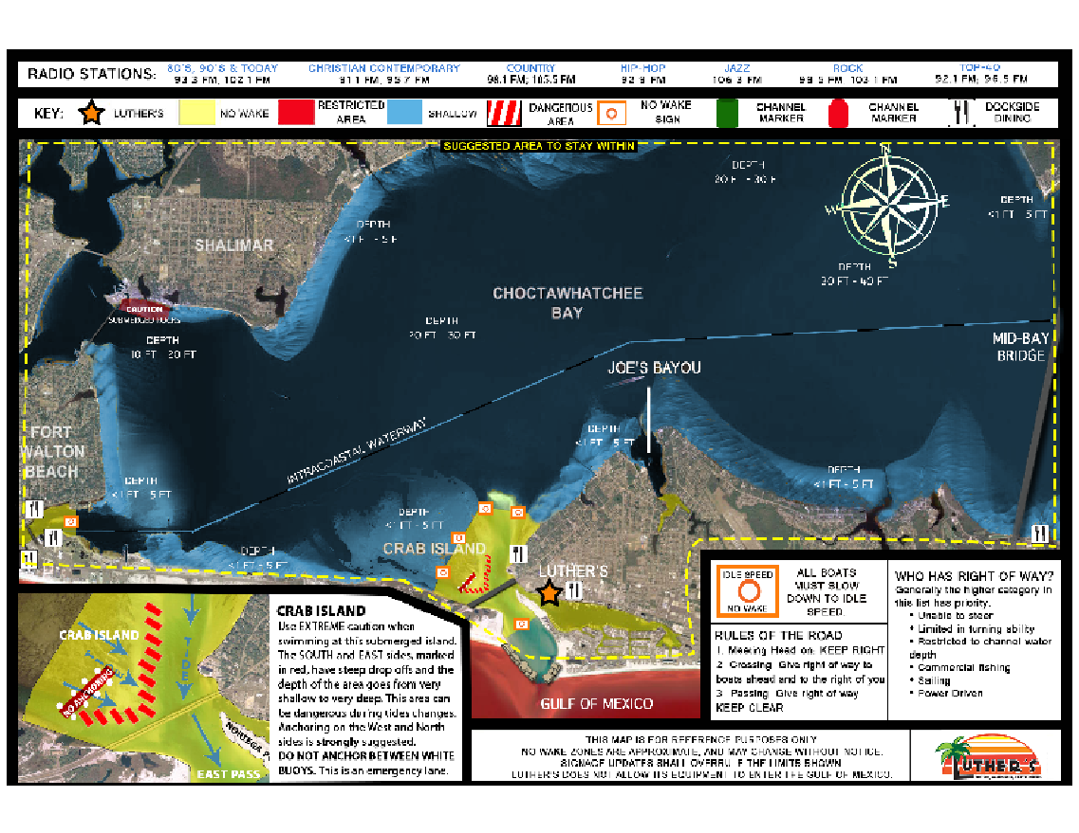
DETAILED WATERWAYS MAP

Slide 8
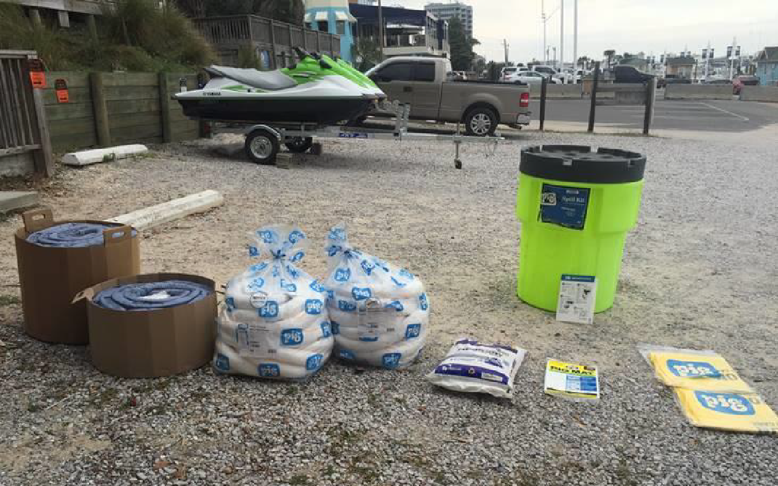
FUEL CONTINGENCY/OIL ABATEMENT PLAN
Oil Sorbent Hydrocarbon Containment Boom to go around the longest vessel on the property
Hydrocarbon Absorbent Pads
Granular Absorbent

Slide 9
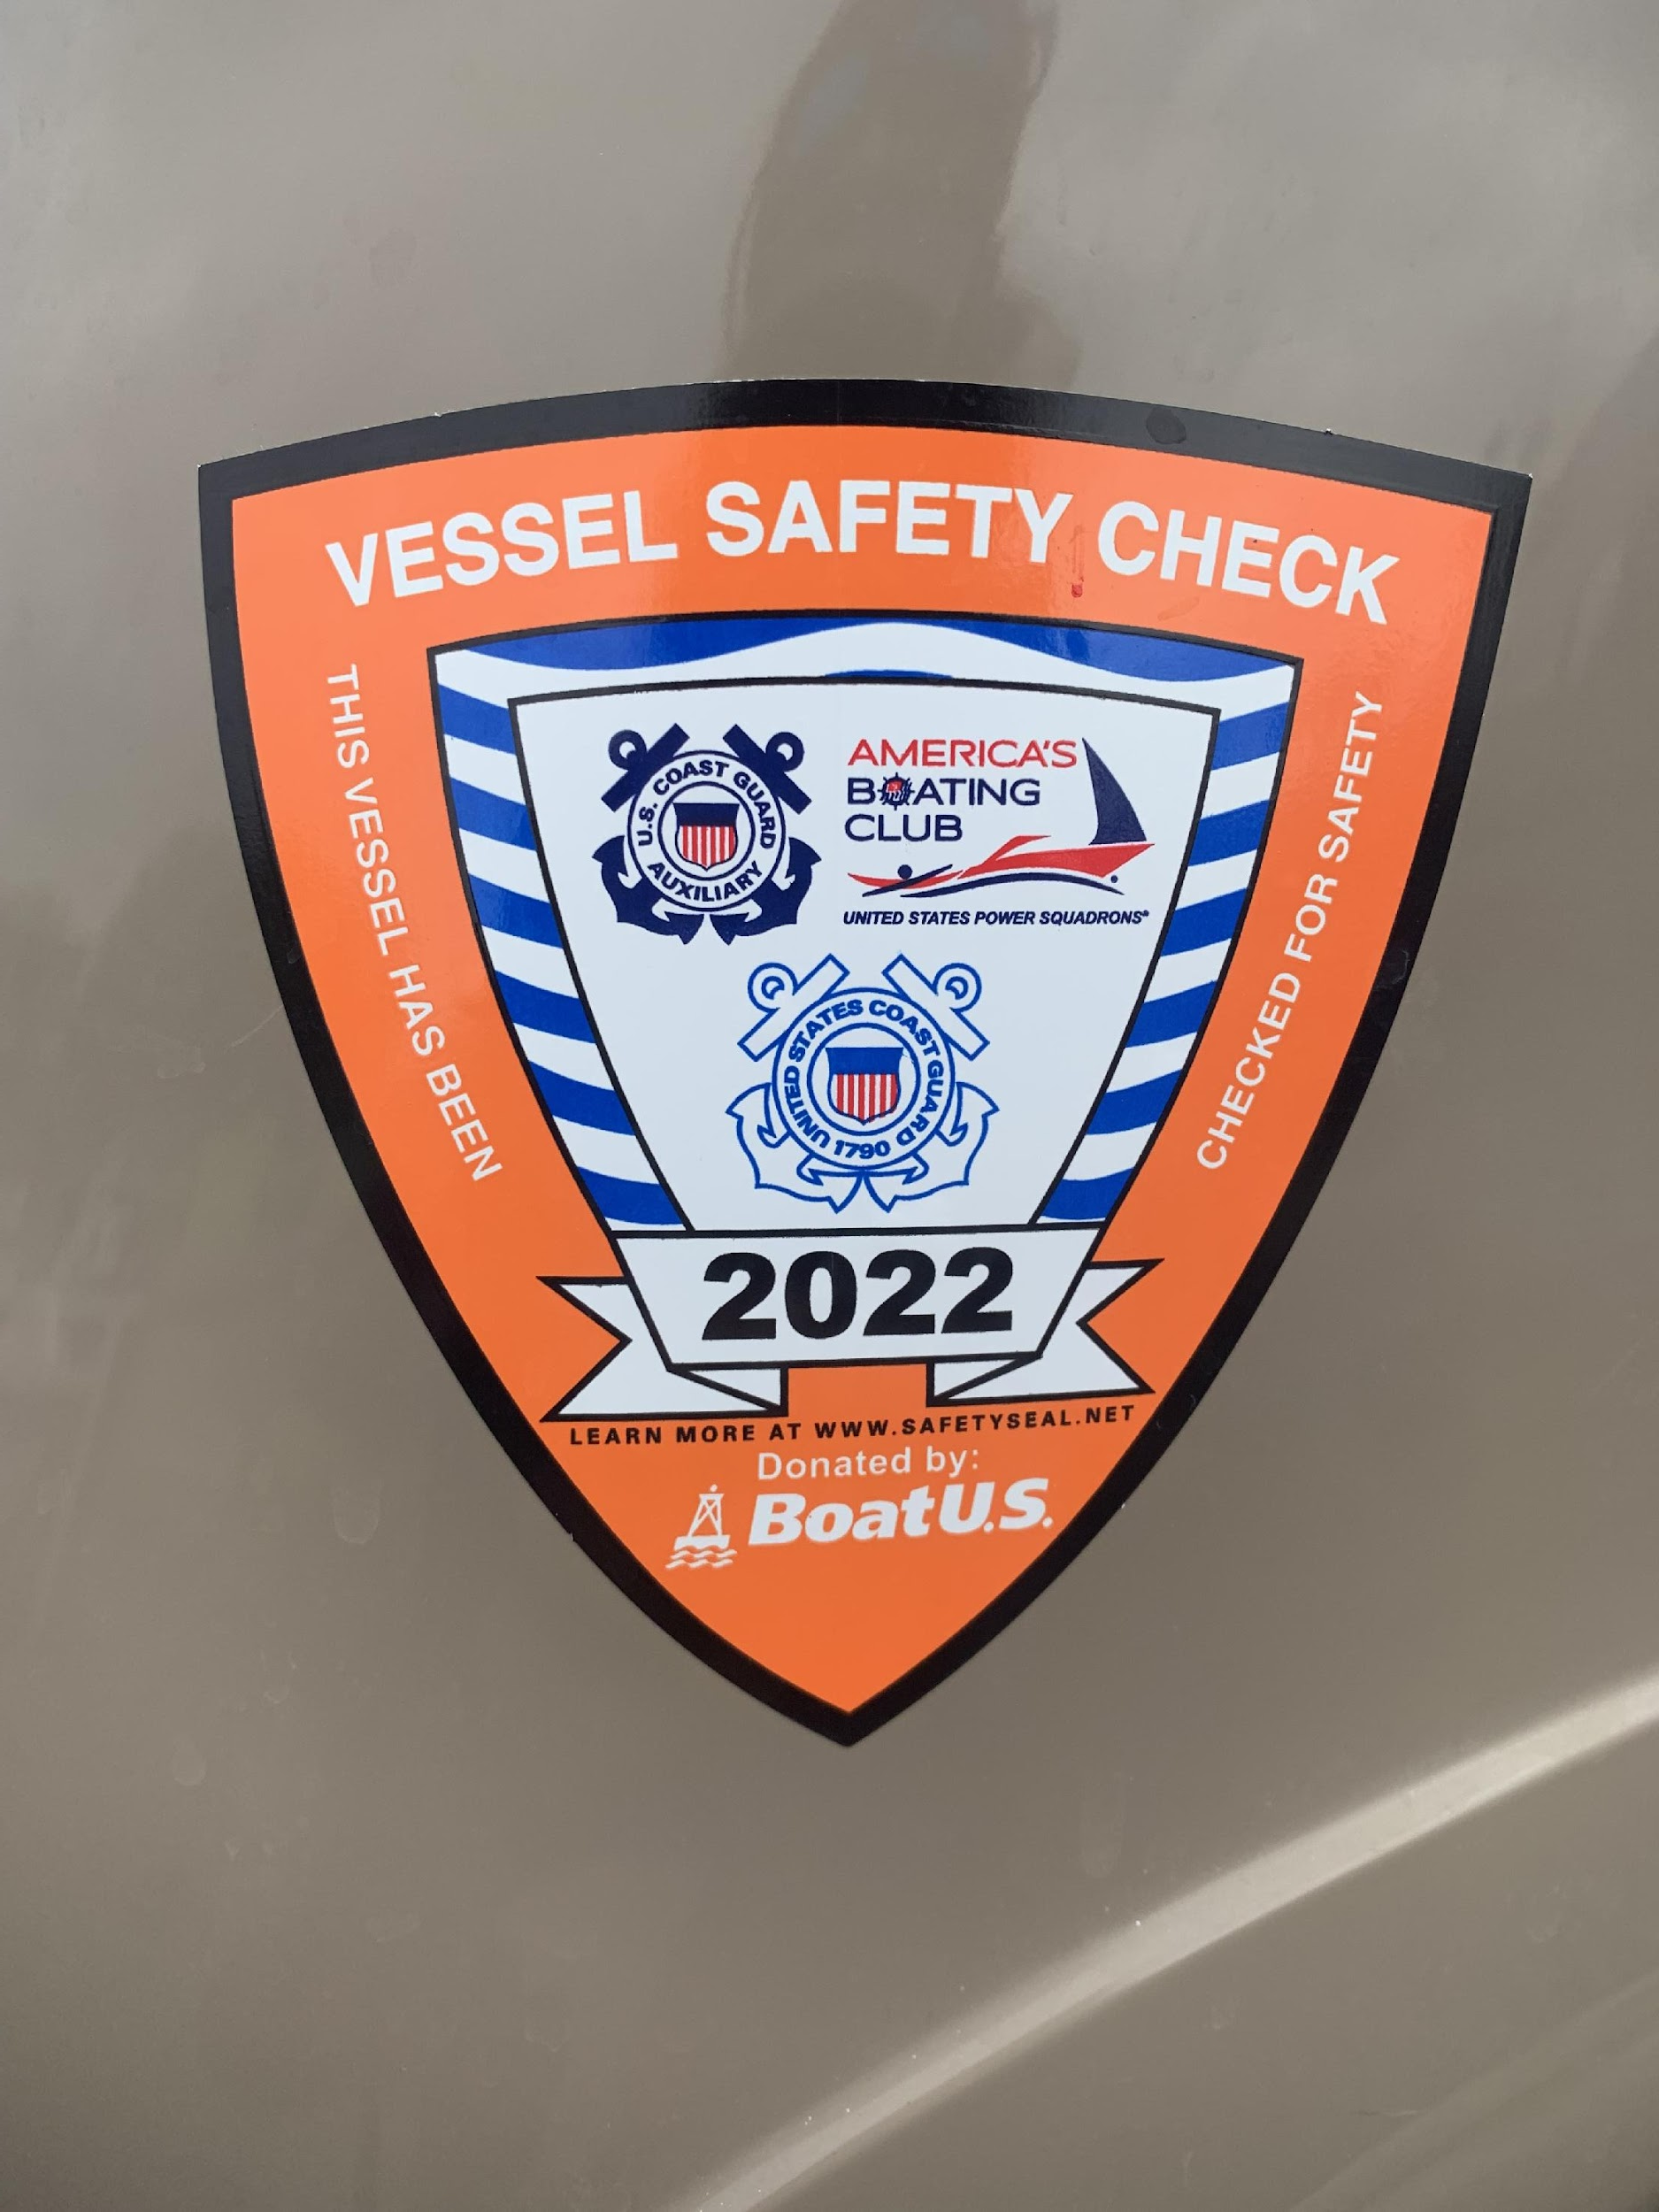
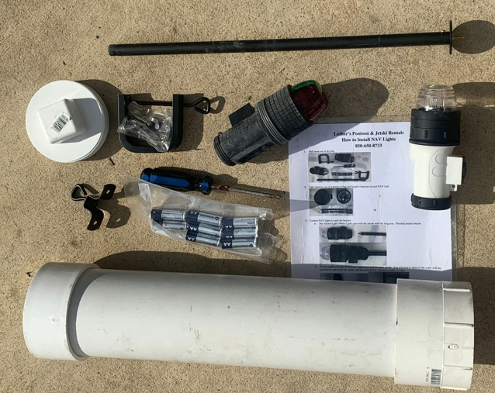
U.S.G.G. AUXILIARY VESSEL SAFETY CHECK
Coast Guard Auxiliary Safety Inspection
If NAV lights are an issue of failing, use battery operated in a watertight container

Slide 10




SAFETY STICKERS
OCWOC sticker:
Each membership will include a sticker for all your registered vessels.
Passenger capacity sticker
Watch your Step sticker

Slide 11
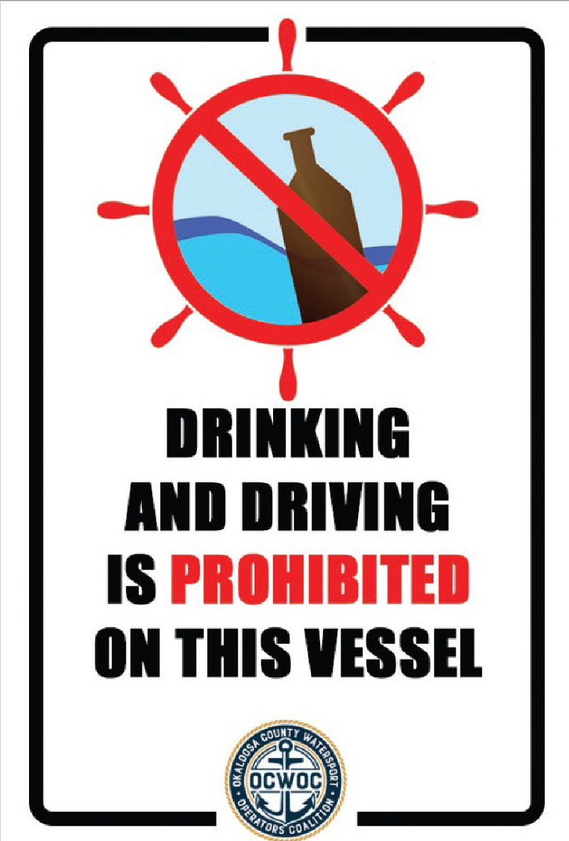
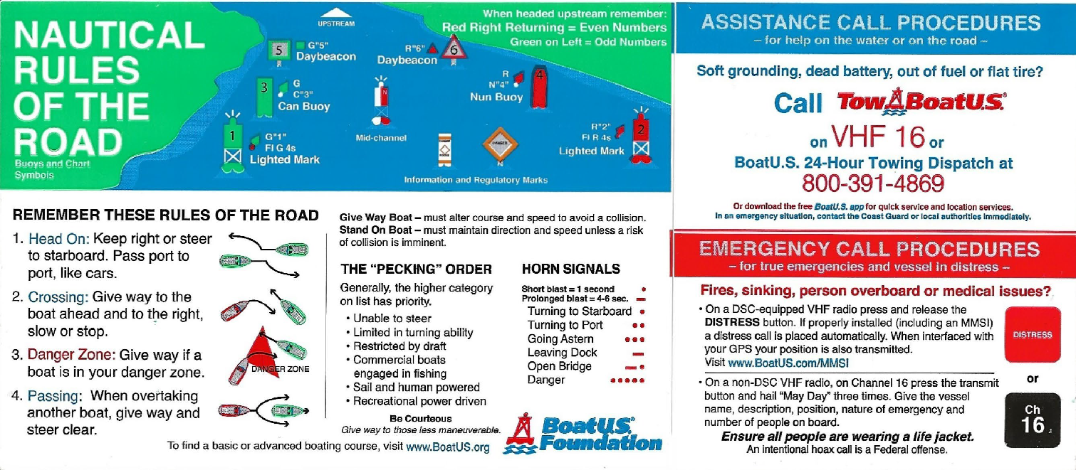
SAFETY STICKERS
No drinking & driving sticker
Rules of the Road sticker

Slide 12

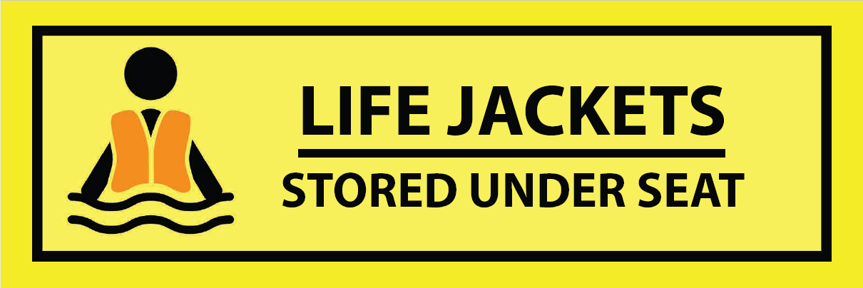
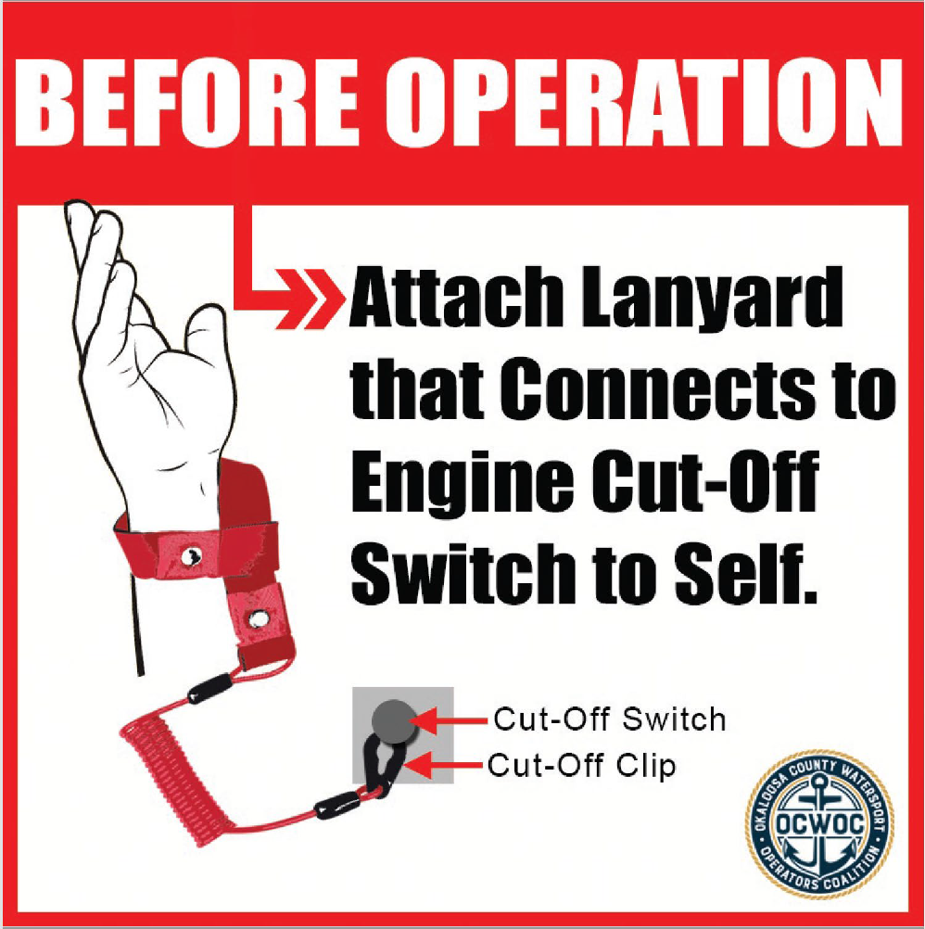
SAFETY STICKERS
Example of some Safety
equipment location stickers
Engine Cut-off Switch Lanyard Sticker

Slide 13
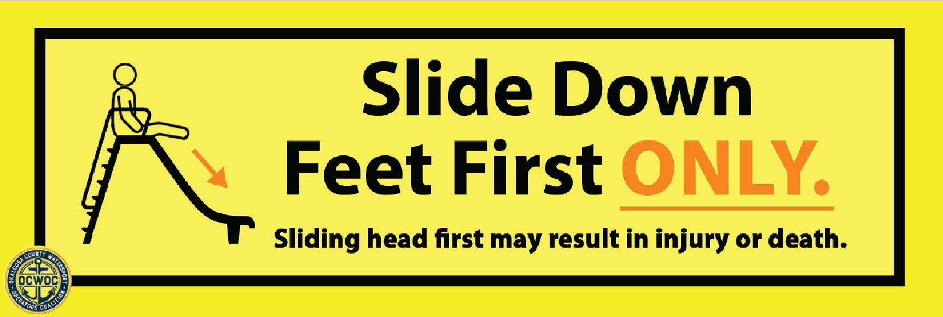
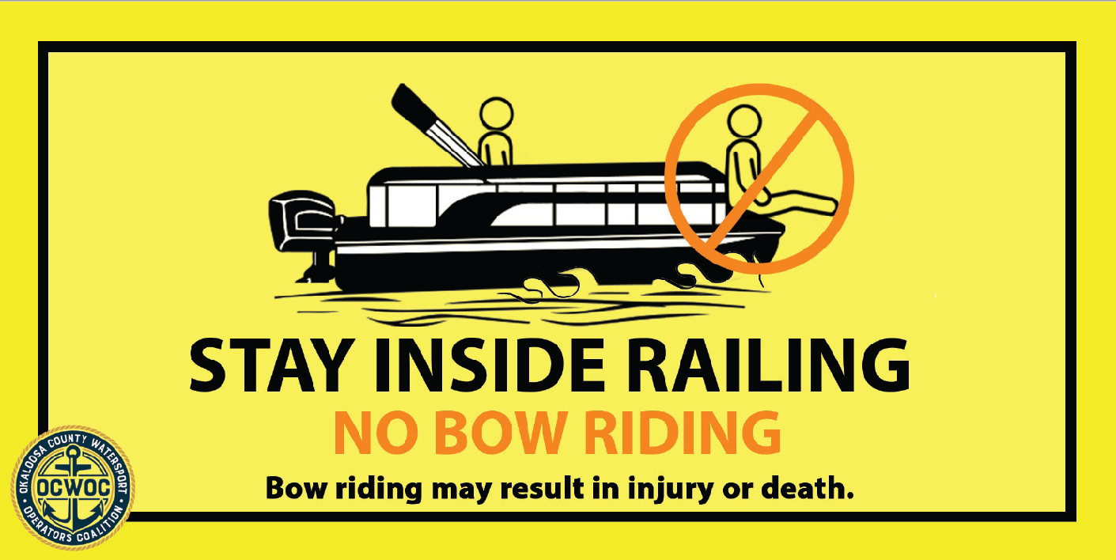
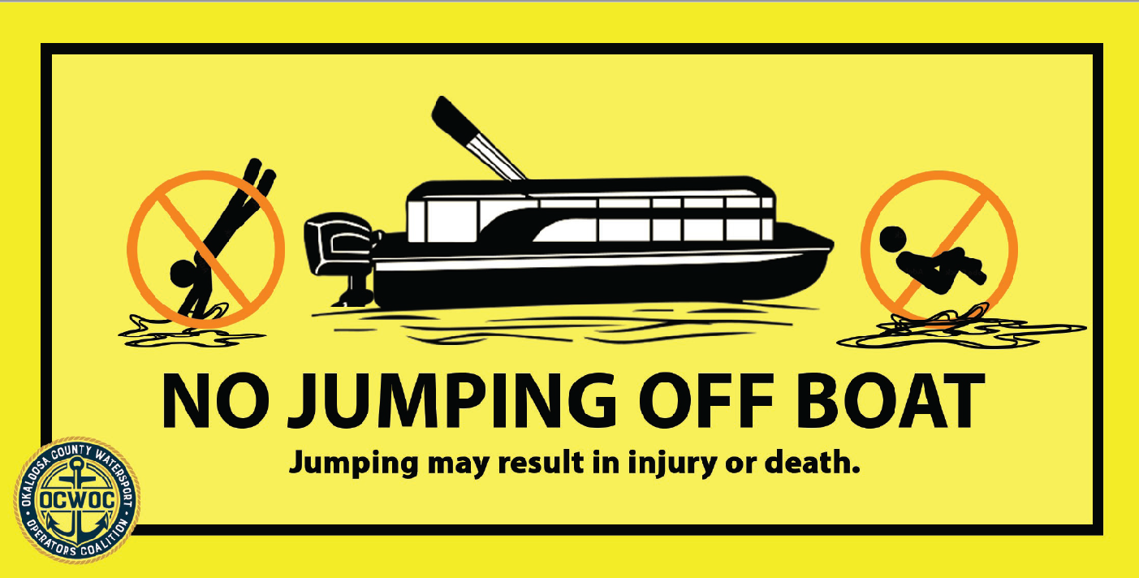
SAFETY STICKERS
Slide down Feet First sticker
Stay inside railing sticker
No jumping off boat sticker

Slide 14
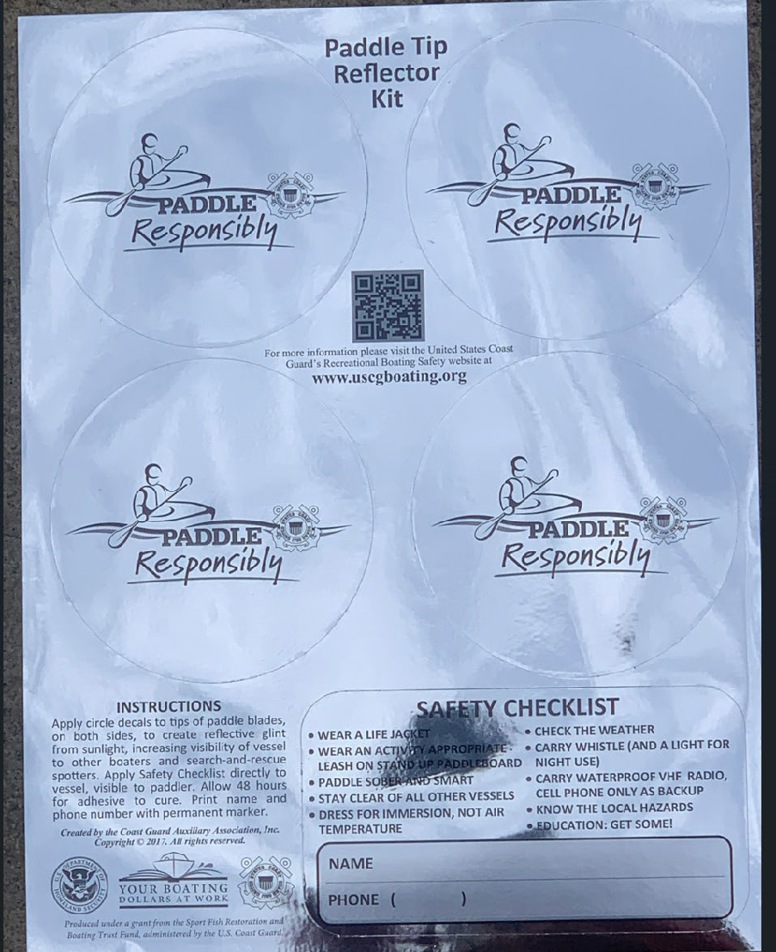
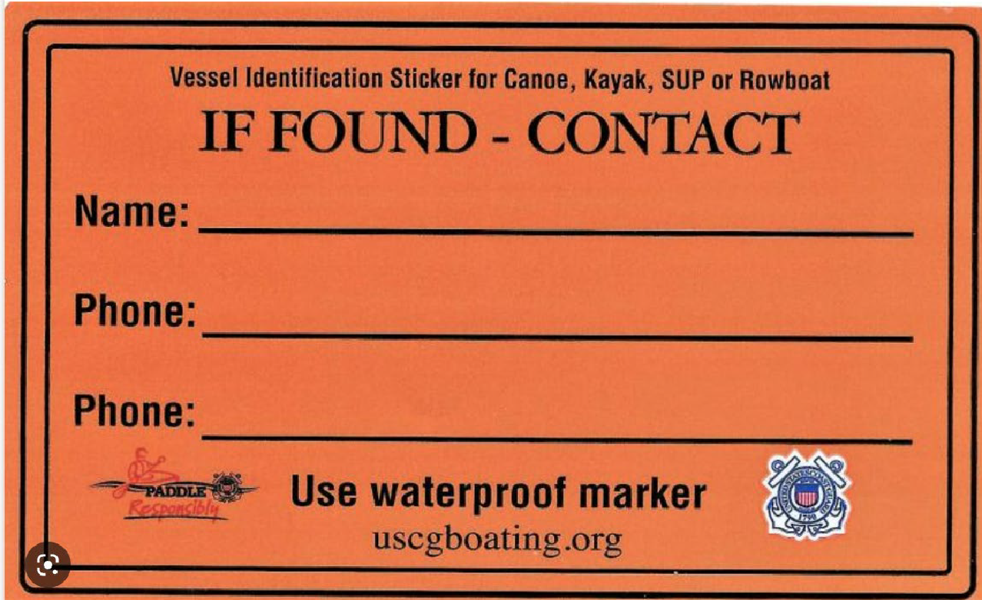
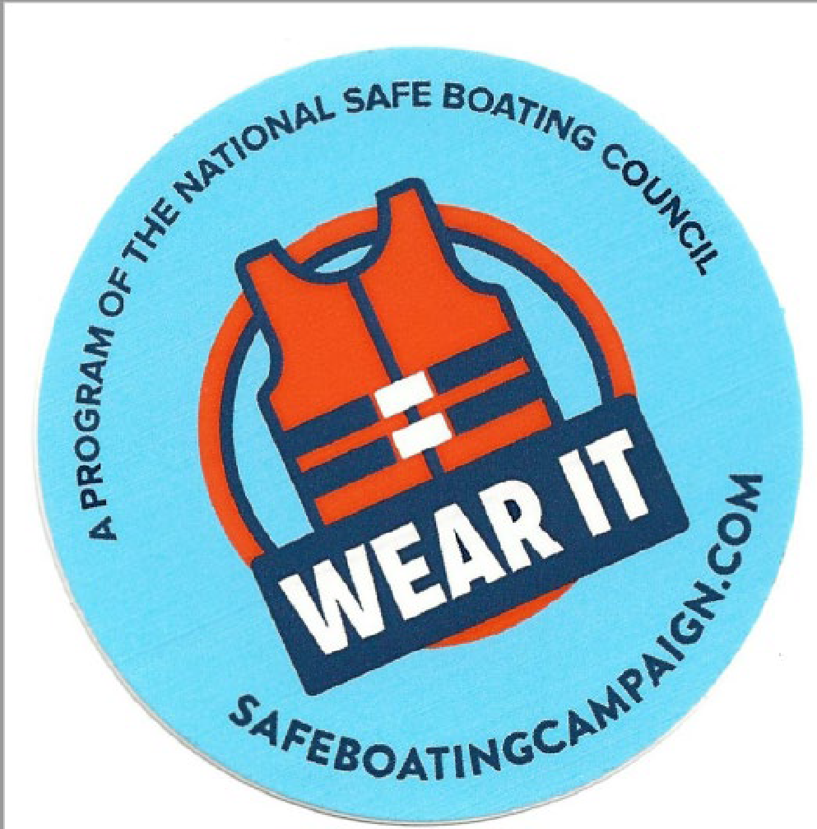
SAFETY STICKERS
Paddlecraft reflective sticker
If found paddlecraft sticker
Life Jacket wear it sticker

Slide 15
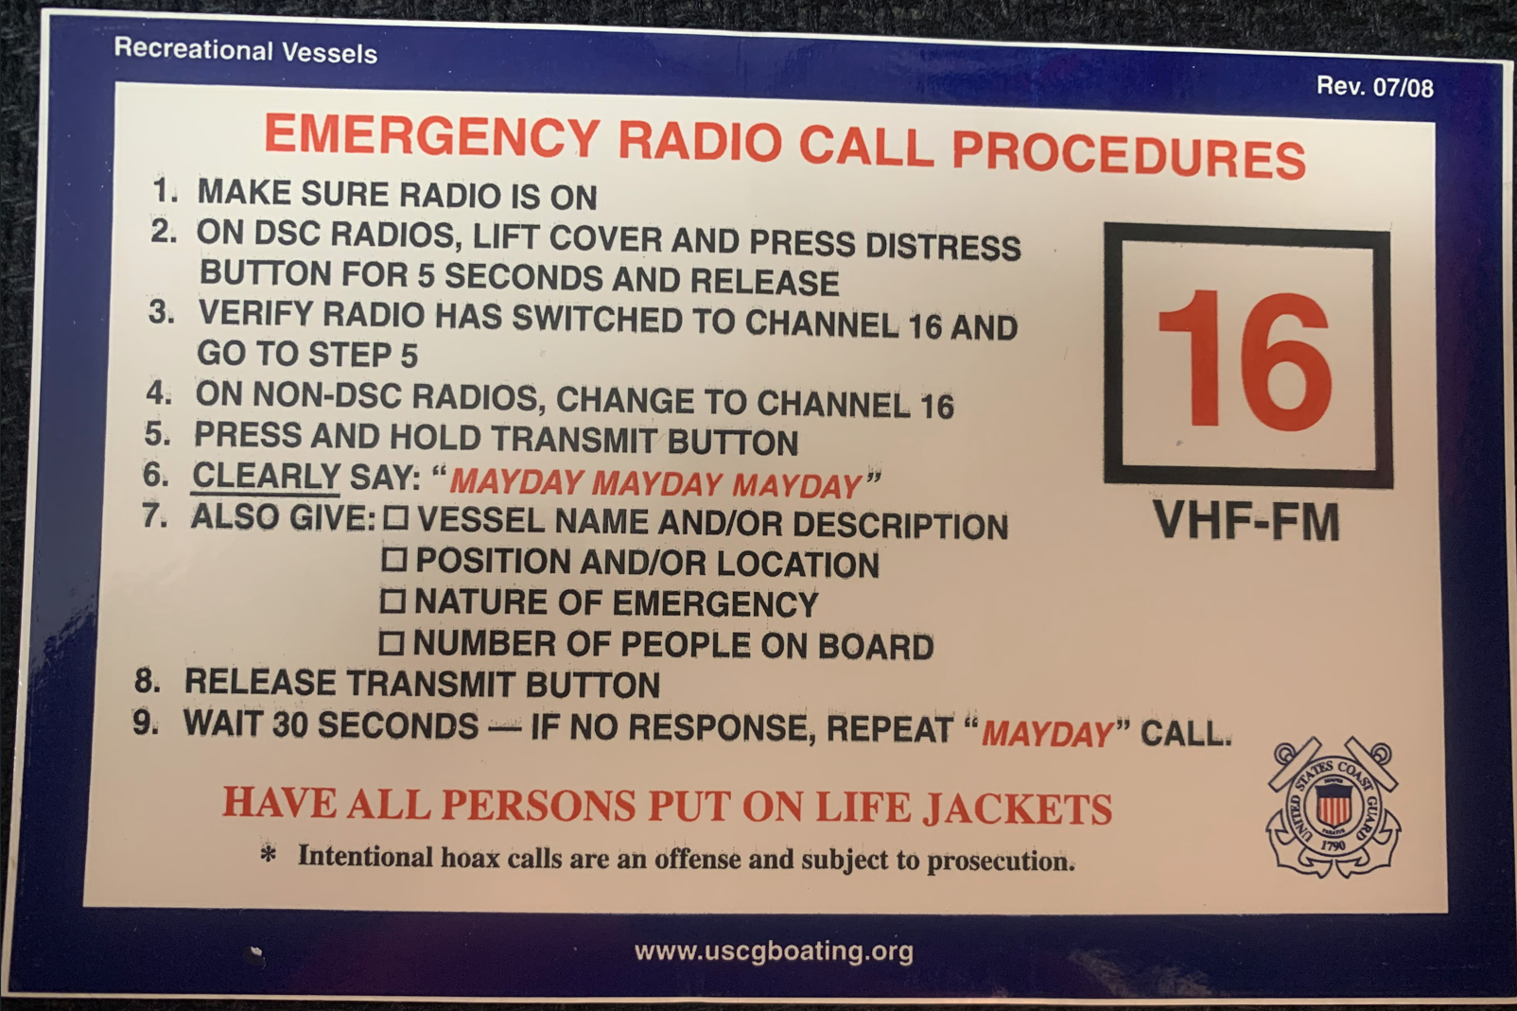
SAFETY STICKERS
VHF Procedures sticker

Slide 16
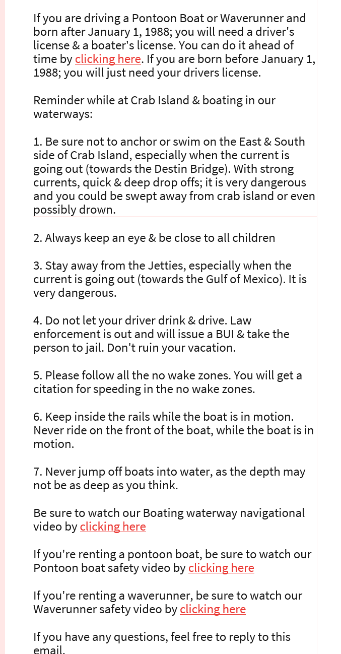
USING TECHNOLOGY
Online Waivers – ability to get information to all customers
ahead of time, instead of just main
person making reservation
Map of waterways
Pre-training videos
Give boating & Crab Island Safety tips to all passengers
ahead of time.

Slide 17
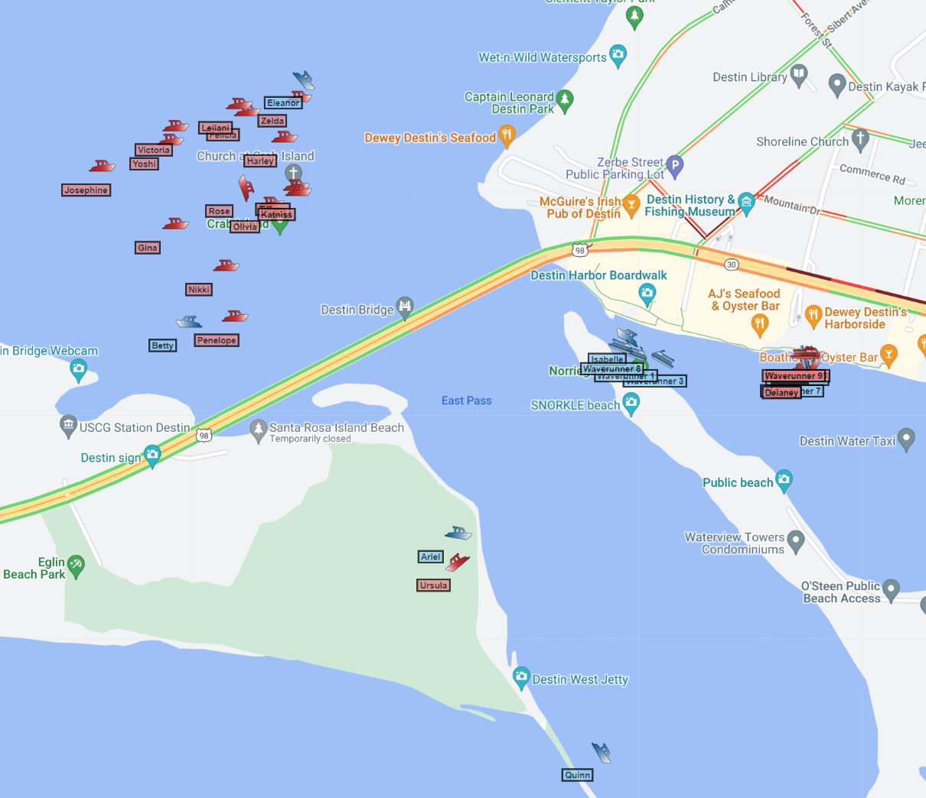
GPS & GEOFENCING
GPS & Geofencing
Know where vessels are at all times

Slide 18
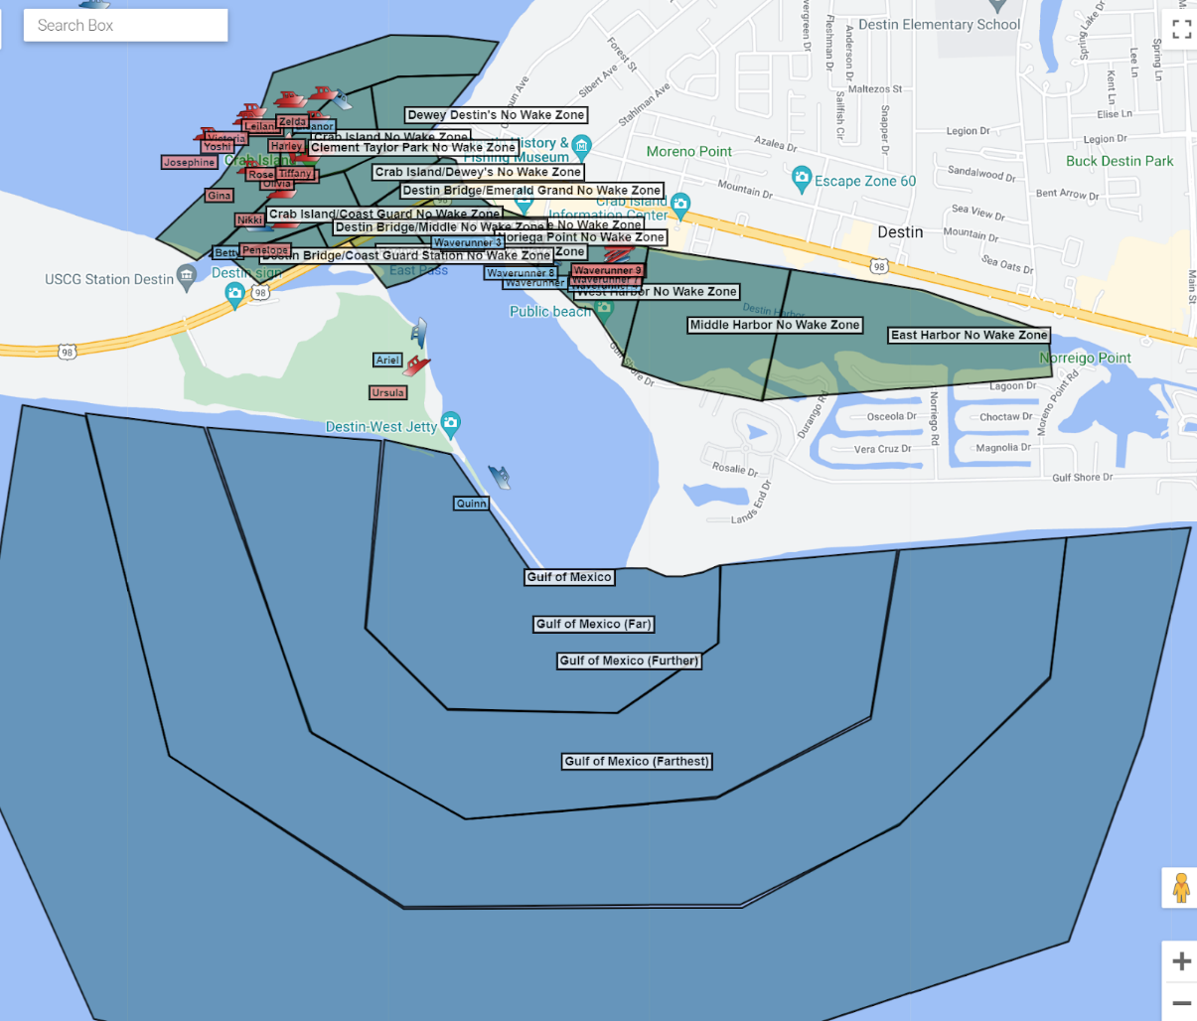
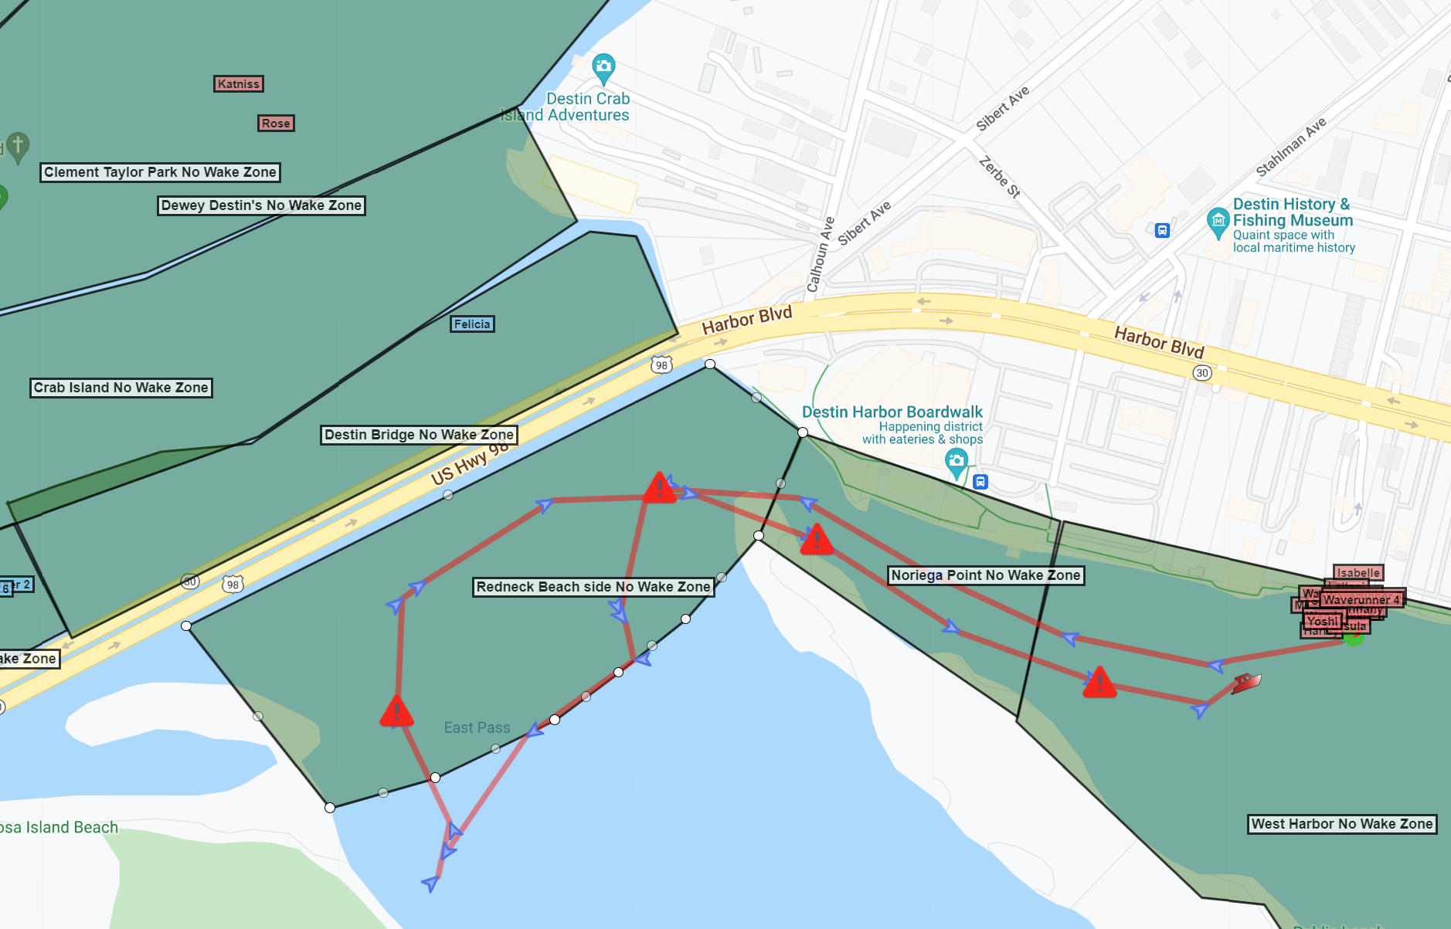
GPS & GEOFENCING
GPS & Geofencing
Know when vessel is speeding in no wake zones
Know when vessel goes out of bounds, such as Gulf of Mexico

Slide 19
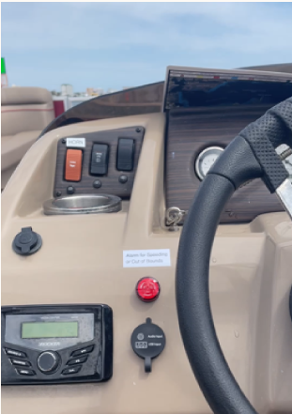
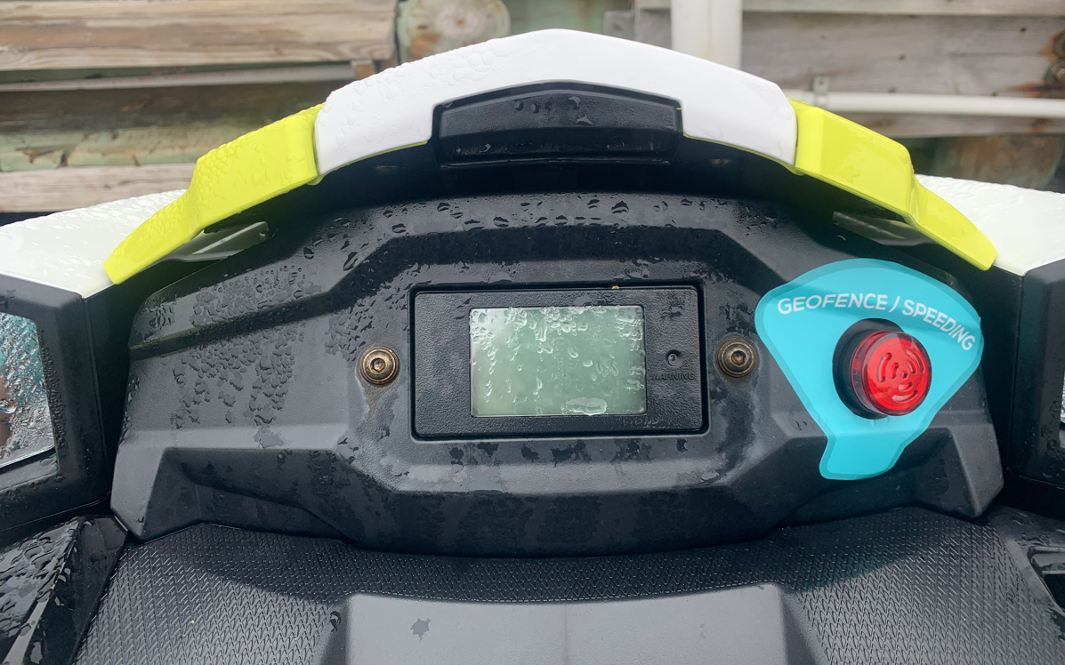
GPS & GEOFENCING
GPS & Geofencing
Alarm that will go off on vessel, so customer knows

Slide 20
BOAT OKALOOSA WATERSPORT INFORMATION APP

Slide 21
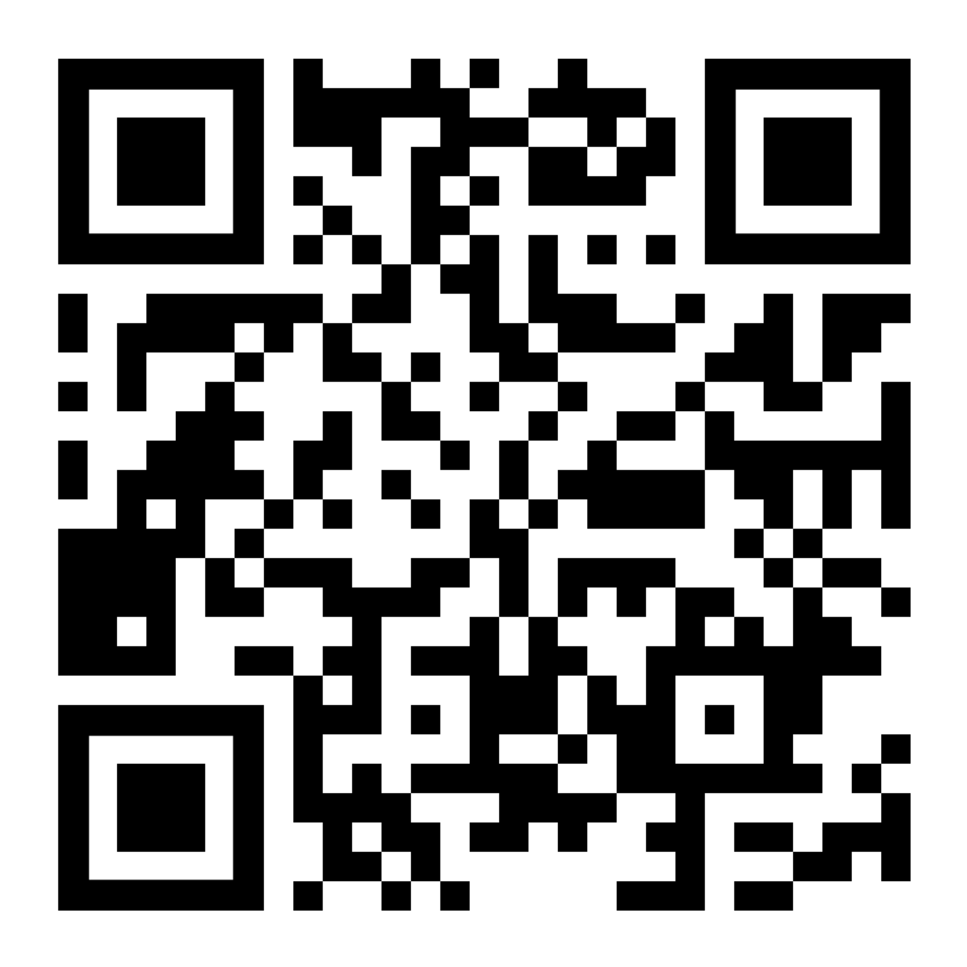
HOW TO BECOME A OCWOC MEMBER?
We ask all watersport businesses to becomes a member
Funding is used to develop/promote safety, such as these safety videos & safety stickers
Scan here to get more info

Slide 22
THANK YOU
Any questions or comments

