Slide 1
Washington Update
Bob Blancato
Executive Director, NANASP
April 4, 2019

Slide 2
Introduction
Convening highlights
Funding for FY 2020
OAA reauthorization to date
Medicare Advantage updates
Vaccine issue

Slide 3
Nourishing Partnerships
Nourishing Partnerships convening held in DC on March 28
About creating a sustainable future for community nutrition and aging programs
Collaboration between NANASP and the NRCNA (MOWA)
48 total attendees from 15 states, including Shirley Chao from MA
NANASP role distinct in many ways
Meredith Whitmire as project manager
Six NANASP board members attended
Lance Robertson opened, offering a robust endorsement of the congregate nutrition programs, their value, and their future
Bob Blancato and Ellie Hollander closed, but the action and substance was in between

Slide 4
Convening Breakouts
Four breakouts on these topics:
Root Cause Analysis: having participants in small groups break down the “whys” behind two problem statements:
  Congregate meal programs are increasingly not perceived as relevant to support successful aging in place.
  Participation in congregate meal programs is declining across the country.
Asset Mapping: inviting participants in small groups to create individual mind maps of the elements of their programs (funding, partners, competitors, barriers, and opportunities) and share composite maps with the full group

Slide 5
Convening Breakouts
Solutions and Opportunities: held as a small group brainstorming session with the goal of prioritizing feasible ideas and visions for the future of congregate programs, using work from breakouts 1 and 2, by sharing ideas and dot voting
Call to Action: a small-group discussion format to discuss concrete action steps

Slide 6

Convening Follow-Ups
Many good ideas and solutions emerged for the future of the program
Initial proceedings out in early May to participants; final proceedings in early summer
Major session at NANASP conference scheduled for May; virtual forums scheduled for June and early July

Slide 7
Funding for FY 2020
Schedule a little off this year
Budget late due to longest ever government shutdown
Trump budget felt like Groundhog Day
  Some of the same programs he sought to eliminate before, seeking to do again: SCSEP, CDBG, CSBG, SSBG, LIHEAP
OAA, despite Congress giving it a vote of confidence and increasing its funding by over $130 million over the past 2 years, would see its spending slashed by over $35 million
Small consolation: IIIB and IIIC were flat funded, no cuts: but you tell me, based on realities of operating, how big a cut is that?

Slide 8
FY 2018-FY 2020 Funding for Aging-Related Programs
Program | FY18 Final | FY19 Final | FY20 Trump Proposed
OAA Title IIIC Nutrition Totals | $896.7 million | $906.7 million | $906.7 million
OAA Title IIIB HCBS | $385 million | $385 million | $385 million
OAA Title V SCSEP | $400 million | $400 million | 0
OAA VI Native Americans Nutrition | $33.2 million | $34.2 million | $34.2 million
Family Caregiver Support Program | $180 million | $180.6 million | $150 million
Senior Corps | $202.1 million | $208.1 million | 0
Comm. Services Block Grant (CSBG) | $715 million | $725 million | 0
Comm. Develop. Block Grant (CDBG) | $3.3 billion | $3.3 billion | 0
Social Services Block Grant | $1.7 billion | $1.7 billion | 0
LIHEAP (Home Energy Assistance) | $3.64 billion | $3.69 billion | 0
Elder Justice Initiative | $12 million | $12 million | $10 million
SHIP (Medicare Assisters) | $49.1 million | $49.1 million | $36 million

Slide 9
Funding Status
Work is already underway in House and Senate on both budget and appropriations
Wonderful development with flip of House—Rosa DeLauro as Chair of Labor-HHS Appropriations Subcommittee
She is a long-time and sustained fan of nutrition programs
Conn. folks know it, and it’s known nationally
Key is what replaces the 2 year budget agreement: are caps lifted again or do we revert back?
Could mean difference between continued increases and return to sequestration

Slide 10
Funding Status
Dear Colleague letter
Reps. Bonamici (D-OR), Deutch (D-FL), Loebsack (D-IA) and Stefanik (R-NY) headlined a letter signed by 130 House members asking for a 10% increase for IIIC nutrition programs
NANASP-MOWA position is the 10% increase
Could be fast moving process

Slide 11

What to Do?
Focus on NE members on Appropriations beside DeLauro:
  On House side, Reps. Chellie Pingree of Maine, Katherine Clark of Mass.
  On Senate side, Senator Collins, and Democrats Senator Leahy (top Dem) along with Sens. Jack Reed and Christopher Murphy
Message to them: reject the Trump budget for OAA and support a 10% increase for nutrition programs. Make contact over Easter recess and beyond
Ultimately, key is what House does—levels need to be set high so in compromise, we still come out ahead

Slide 12
OAA Reauthorization
Scheduled for this year
Developments to date
Rep. Bobby Scott is now Chair of Education and Labor; Rep. Suzanne Bonamici is Chair of the Civil Rights and Human Services Subcommittee (with jurisdiction over OAA)
Senate pretty much same, except Sen. Enzi is now Chair of the HELP Primary Health and Retirement Security Subcommittee (with jurisdiction over OAA)
No indication of Admin plans
Could take one of 3 approaches: status quo; principles; full-blown legislative proposal

Slide 13
OAA Reauthorization
House: Reps. Joe Courtney and Jahana Hayes* (CT) and Lori Trahan (MA)
Senate: Sens. Collins, Sanders, Murphy, Warren and Hassan (all on subcommittee!)
Includes new staff
To date, lot of interest demonstrated in the OAA reauthorization
NANASP and MOWA are members of LCAO, which has turned in recommendations to House/Senate, such as:
  Evaluation of per meal reimbursement rates at state and regional levels
  Simplifying and clarifying process for existing authority to transfer funds between Title III C1 and C2

Slide 14
Other Ideas Being Looked At
Transfer
  NANASP is interested in transfer out of C into B only being used for nutrition-related services
  Admin on other hand has proposed unlimited transfer authority in all of III (B, C, D, E)
Greatest social need
Main message at this time: We want the Older Americans Act reauthorized on a bipartisan basis for between 3 and 5 years with necessary modernizations to have its programs utilized by older adults 60 and over. We also want to protect nutrition dollars from being diverted for activities not related to nutrition

Slide 15
OAA Timetable
Always with caveat that things can change
Member-level meeting on House side going on right now
What to look for:
  Administration position: how do they weigh in? Principles, full-blown legislative proposal or silent?
  How bipartisan can it be start to finish?
  Formula fight?
Look for hearings as early as May

Slide 16
Medicare Advantage
Enrollment in Medicare Advantage has nearly doubled over the past decade, from 18% of Medicare beneficiaries to 34%, and is expected to continue growth
Uptake is slower in rural areas—provider network can be an issue

Slide 17
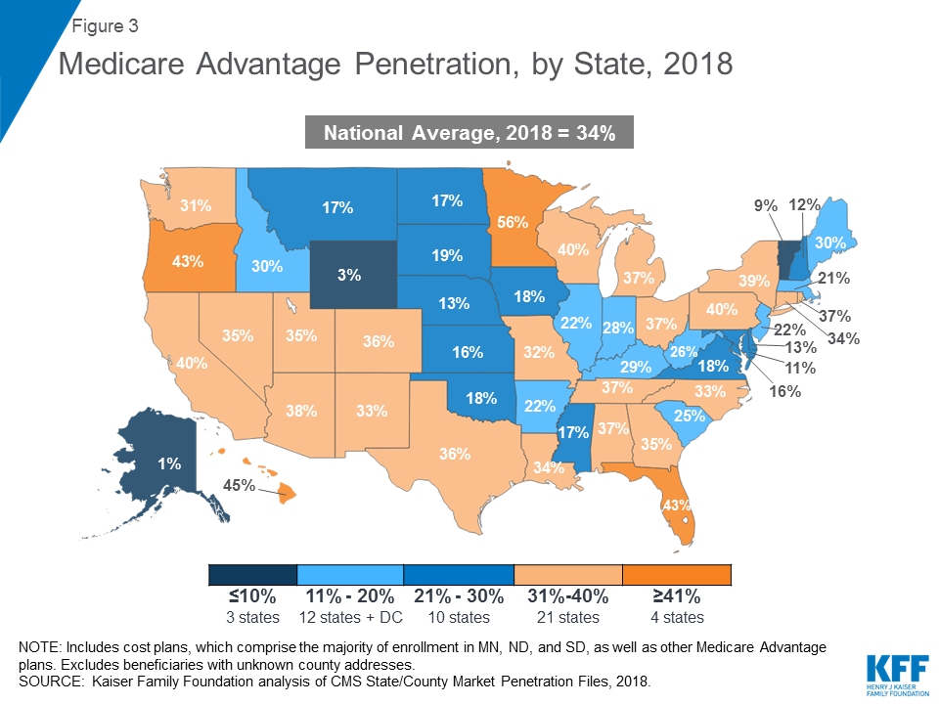

Slide 18
Medicare Advantage and Nutrition Opportunities
On Monday, CMS issued its final plan information for 2020 plans
Came after a lot of work and comments related to draft call letter
Says that plans may provide an expanded array of supplemental services, including home-delivered meals, food, and produce, to “chronically ill” beneficiaries
Specifically says that ACL-funded CBOs may receive MA contracts
Key is two-fold:
  What is a home delivered meal and what it isn’t
  How many MA plans take advantage? Right now participation rate on supplemental benefits is low, less than 10 percent
More information as we have it…

Slide 19
Vaccine Coverage
Over the years NANASP in particular working with other groups succeeded in 2014 in getting Medicare to provide coverage for a more modern pneumococcal vaccine
It came after some good old-fashioned advocacy with an advisory group to the Centers for Disease Control called ACIP whose recommendation to have it covered proved pivotal
Since it began to be covered under Medicare, claims for coverage for this vaccine rose from 14.8% of beneficiaries in 2015 to 31.8% in 2016

Slide 20
Vaccine Coverage
Rumors are out there that the ACIP group is now thinking of reversing their recommendation about coverage
That could lead to an end of Medicare coverage, at a time when:
  Mortality due to influenza and pneumonia increased the most in 2017 in the wake of an especially deadly flu season
  And every year in the US at least 1 million people get pneumonia and 18,000 or more older adults die from it
The next meeting of ACIP is set for late June in Atlanta
I expect as I have before to present live testimony

Slide 21
What You Can Do
Asking two things here today
If you support continued coverage—and have older adults who have received the better vaccine—send me that information to include in my testimony
Also, need social media and letters to the editor, etc. asking support for continued coverage

Slide 22
Closing
One of reasons I love to come here is how engaged and responsive you are as providers and advocates
It is the advocate part I want to focus on
The list of issues we have to focus on is like a diner’s menu
But you of course cannot order it all
Key is prioritize but always know there is a place for every one of you in advocacy

Slide 23
Closing
Our job as national associations is to keep you up to date when you need to weigh in and provide you the tools to do your work—such as our Take Action page on the NANASP website
Your job, which many of you do so well, is to keep in regular contact with your House and Senate members, especially those on key committees and subcommittees to keep these issues like funding and reauthorization as local issues
Thanks for what you do
And of course—let’s all keep on doing it!

Slide 24


All Aboard! for the 2019 NANASP Annual Conference
May 15-17, 2019
Get ready to embark on a conference experience like no other on the historic
Queen Mary in Long Beach, CA
Visit www.nanasp.org for more information and to register!

Slide 25
Resources
NANASP Advocacy: nanasp.org/take-action
NANASP Conference: nanasp.org/NANASP2019Conference
NANASP Protect Seniors vaccines page: nanasp.org/protect-seniors
Nourishing Partnerships site: futureofcongregate.com
Administration for Community Living: acl.gov
Capitol Switchboard: 202-224-3121
rblancato@matzblancato.com

