Slide 1

Everyone’s a Fundraiser
How to Raise Money
& be Comfortable Doing It!
Barrie J. Atkin, president
Atkin Associates LLC
New England Regional Elderly Nutrition Conference
Friday, April 5, 2019

Slide 2

RAISING MORE
(possible topics)
  Why People Give
  Why Should They Give to YOU
  Are You Ready to Raise Money?
  Asking for Money
  Donor-Centered Communications
  Thanking and Acknowledgements
  Grant Writing
  Communications
  Involving Board & Friends Groups
  Resources
Notes:
About Audience (EDs? Development? Which topics are they most interested in?)
HOW MANY OF YOU HAVE FRIENDS GROUPS? OR A NON-PROFIT?

Slide 3
Why are YOU here?
My organization needs to raise more money
We don’t have a fundraising plan
We’re not comfortable asking for money
We’re interested in learning more best practices
Other?

Slide 4
What’s your knowledge level?
What’s your comfort level?
Knowledge of Fundraising |  | Low | High
Comfort Asking for Money | High | Quadrant 2 (low knowledge, high comfort) | Quadrant 4 (high/high)
 | Low | Quadrant 1 (low/low) | Quadrant 3 (high knowledge, low comfort)

Slide 5

How do you feel about Asking for Money?

Slide 6


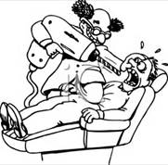
How do you feel about
ASKING for money?
What are your concerns?
What are your fears?
Why is it so hard to ask for money?

Slide 7
Why do People Give?

Slide 8
Why people give (partial list)
#1 Reason: Because they’re asked.
Because they have a connection to the person who asks
Because they care about the cause
Because they believe in the organization, the leadership, etc.
Because they want to make a difference or leave a legacy
Social activities
For Tax deductions
Because of some experience in their past
Because they feel it’s their duty
Because they feel it’s a blessing to do so
Because it makes them feel better about themselves
Because they are asked!

Slide 9
Are You Ready To
Raise Money?

Slide 10
Why should [fill in the blank] give your Organization money?
What’s special about your organization?
Do you have a good team?
Do you convey passion, confidence, credibility?
Do they have a CONNECTION (or affinity) to you or your organization?
How will you use the money?
What results or outcomes will you achieve?
What can you offer in return for the money?
Notes:
Success breeds success. Fake it until you make it. (We’ll talk more about confidence later.)

Slide 11

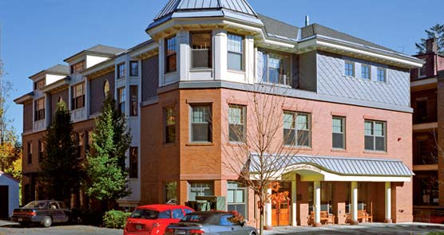
Why should people/organizations support your organization?

Slide 12
Conduct a Realistic Self Assessment
What are your organization’s strengths & weaknesses?
Who are your customers?
How do you benefit your clients, your community?
Do you have a strategic plan?
Notes:
Whether individuals, organizations, foundations, corporations – Invest / Give to success.

Slide 13


Do you have a PLAN?
Elevator Pitch
Website
Strategic Plan (3 to 5 year goals)
Executive Summary
One year Operating Plan
Cash Flow Projection
Fundraising Plan
Notes:
Test out that Executive Summary. Does it sing? Do you reach hearts and minds?

Slide 14
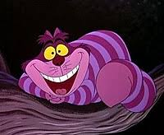
Do you really NEED a Plan?
If you don’t know where you’re going, “then it doesn’t matter which way you go.”
If you don’t know where you’re going,
any road will get you there.
- Lewis Carroll
“If you don’t know where you’re going, you’ll end up somewhere else.” - Yogi Berra

Slide 15
IMPORTANCE OF INDIVIDUAL GIVING
(and asking Individuals)
In the U.S., individual donors represent
75% of charitable giving.
People give to people.

Slide 16
How do YOU feel about Giving?
Do you make philanthropic gifts?
Why?
How does it make you feel?
What influences whether you give?

Slide 17
Do you Practice
Donor-Centric Philanthropy?
Simone Joyaux and Tom Ahern: The Donor Centric Pledge (partial list)
A prerequisite for above-average donor retention is a well-planned donor-centric communications program that begins with a welcome.
Donors want to make a difference in the world—and our mission is one of many means to that end.
We earn the donor’s trust by reporting on our accomplishments and efficiency.
Asking a donor why she or he gave a first gift to us will likely lead to an amazingly revealing conversation.
No one “owes” us a gift just because our mission is worthy.
We waste that potential when donors are not promptly thanked.
https://www.simonejoyaux.com/downloads/DonorCentricPledge.pdf

Slide 18
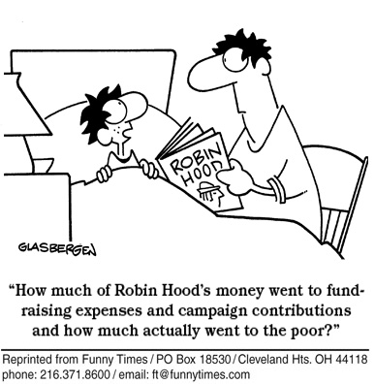
Tell donors how their money will be used
And what impact it will have

Slide 19


The Best way to Cultivate Prospects
Get to know your Prospects
Ask questions
LISTEN
(How has your organization helped them or people they know?)
Notes:
Each prospect is different. What are their interests? How has the Senior Center helped them?

Slide 20

How to Feel GOOD about asking for money
It’s NOT about arm-twisting or obligation
It’s about giving people who are inclined to give money, an opportunity to support a cause that:
They care about
Makes them feel good
    Matches their interests and passions
They will give money.
Why not to YOUR organization?
Notes:
Nobody HAS to give to our organization
It’s about creating an opportunity and a situation where the prospect WANTS to give to us/our organization.
It’s about engagement, cultivation and Relationships!

Slide 21
Create Comfort about Asking
Role Play
Practice
Have a plan
Prepare (learn about your prospect)
Start with people whom you’re comfortable with
Use a Buddy System
Be passionate about your cause
Be personal and sincere

Slide 22
The Ask
The right person at the right time at the right place for the right amount.
The Right Person: A peer, a friend, a colleague, someone they respect.
The Right Time: When you know about them. After some cultivation. When they’re ready. When they’re familiar with the organization.
The Right Place: Usually their home or office. Wherever they feel comfortable.
The Right Amount: A specific amount. How much will depend upon the individual and the situation.
Convey purpose of gift, benefit
and why this gift is a good match for this donor/investor.

Slide 23
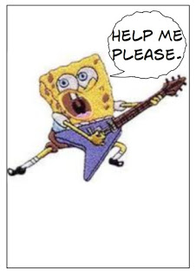

Fundraising Mantra
If you want money, ask for advice
If you want advice, ask for money

Slide 24

When they Say “No!”
Thank them for their time!
Ask for feedback
Ask if you may stay in touch
Ask for suggestions of others who might be interested in your organization
A NO is not always a NO forever

Slide 25
Thank you’s & Acknowledgements
Notes:
Thank them often. Ratio of 3 to 1

Slide 26
Purposes of a Thank You Letter
Show appreciation / Express gratitude
Acknowledge the donor
Share how the donation will be used – how THEIR donation makes a difference
Share information about the organization
Further engage the donor
Tax receipt

Slide 27
Value of a Personal Thank You
From a study of 2,250 new direct mail donors:
220 received a thank you phone call from a Board Member within 48 hours of their gift.
Others received standard written acknowledgements
Those who received a thank you call
Gave 40% more in a second gift
70% were still giving two years later
More than 80% of the other donors had quit giving 2 years later
Source: The Osborne Group, Inc. (Karen Osborne) www.theosbornegroup.com
http://www.papilia.com/stewardship/slides/Papilia_Stewardship_Webinar.pdf
Notes:
Something board can do!

Slide 28
Do you have a THANK YOU Policy?
How quickly are donors thanked in writing?
When do you call them?
How often are donors thanked before asking for another gift?

Slide 29
Lots of Ways to Thank
Notes:
When you ask your board members to raise money – what happens? What if you ask them to THANK someone?
Phone donors – just because. Ruthann Dobek reports: At Brookline senior Center, the first time they did this, people were very surprised and appreciative.

Slide 30


Make a connection without a direct ask
Notes:
The Brookline Rotary was putting on a fundraiser for a community organization. A donor for the Brookline Senior Center won. This gave Ruthann opportunity to send out a note: I hear you won Dancing with the Stars at the Brookline Rotary. I’m a big fan of yours. You’ll have to come dance at the Senior Center.”

Slide 31
Board Involvement

Slide 32

Your Board doesn’t want to Fundraise?!
Create a separate Advisory Board or Development Committee
Establish guidelines on how people can help “fundraise” in other ways
Job description – address expectations for fundraising or other ways to volunteer
Make it easy – Pair people up

Slide 33



EVERYONE is a Fundraiser
Match people to Skills / Interests
Make signs?
Maintain a database?
Plan an event or a menu?
Pick entertainment?
Address invitations?
Write thank you’s?
Help put together information package for prospects
Make it easy. Make it fun.

Slide 34


Communications
Make it EASY for people to donate
Distribute reply envelopes
Let people know how money will be used
Is your website current? Does it say 2018?
How do you answer your phone?

Slide 35

Wording Tips
“Because of you”
“Thanks to your generosity”
Use “You” more than “We”
Show results and impact
Showcase your success and theirs

Slide 36
Share Stories
Testimonials
Pictures
Video
Post successes on Facebook

Slide 37
“Storytelling and the Art of Email Writing” by Colin Holtz and Steve Daigneault
Compelling stories set up a conflict or a problem and make it clear that the donor is the one who can make something change. Here is an example the authors used:
“What if every week were an incredible week? A week when you felt meaning and purpose. A week when you know that you were literally changing the world for the better.
“That's what it's like for U.S. Fund for UNICEF's monthly Pledge Donors. Every month, they support UNICEF's programs with a modest amount. And in return, they can be confident that with less than a dollar a day, they're saving innocent, vulnerable children from pain and suffering."

Slide 38
Appeal to Both Sides of the Brain
EMOTIONS
  Anger
  Ego Gratification
  Exclusivity
  Fear
  Greed / Value proposition (e.g., matching gift)
  Guilt
  Flattery
  Exclusivity
  Salvation
  FACTS
Notes:
Anger
Ego Gratification
Exclusivity
Fear
Greed / Value proposition (e.g., matching gift)
Guilt
Flattery
Exclusivity
Salvation
Anger
Ego Gratification
Exclusivity
Fear
Greed / Value proposition (e.g., matching gift)
Guilt
Flattery
Exclusivity
Salvation

Slide 39
What do Individual Solicitation, Events, Bequests and Grant Writing have in common?
They’re all about relationships
About cultivation
About clarity of communication
Passion and Results

Slide 40
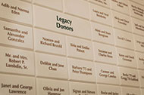
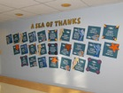
Bequests & Memorial Gifts
Make a big deal out of each bequest
  Legacy Club
  Honor People while they are alive!
  Provide bequest language
Memorial gifts
  “in lieu of flowers”
  Events
  Wall of honor
Notes:
Have you received any?

Slide 41
You CAN increase Donations in Many Ways
Do good Work & Publicize it!
Let people know what you need. How they can help. That the government (or other source) doesn’t pay for everything!
Put your requests everywhere: Website, donor newsletters, rack cards
Notes:
Ruthann says that the Brookline Senior Center has received bequests from people that they didn’t know that well. That didn’t the Center that much. But were impressed with the work the Center does.

Slide 42
Getting Repeat Gifts
Why did they donate?
What is their motivation?
Is there a time (or time frame) when they might donate again?
What appeals to the donor?
  Facts? Emotions? Stories? Combination?
Is there a way to involve them in your organization?

Slide 43
Grant-Writing Guidelines
Thoroughly read the entire RFP (request for proposal) before you begin
Make sure you fit the qualifications.
If you’re not sure, ask!
Make sure your budget fits with your objectives and the grant guidelines.
Start preparing early. Do not wait until the last minute.
Answer what’s asked

Slide 44
The BIGGEST MISTAKES in Fundraising
Not Listening to the DONOR
NOT ASKING
Not Acknowledging the DONOR
Not Thanking the DONOR
NOT ASKING

Slide 45
Final Comments
Fundraising Mantra:
“If you want money, ask for advice.
If you want advice, ask for money.”
If YOU don’t ask your prospect for money, they will give their money to some other cause.
GIVE people the opportunity to connect with your organization.
If they’re not interested, practice “Bless & Release”.

Slide 46


Remind Yourself of Your Vision & Goals
Why you’re doing this!
After all, it’s NOT Just about the money!

Slide 47
A Few Resources
Network for Good
https://www.networkforgood.com/non-profit-fundraising-resources/
The Ask: For Business, For Philanthropy, For Everyday Living
by Laura Fredricks
Ask Without Fear by Mark Pitman
Asking: A 59-minute Guide to Everything Board Members, Volunteers, and Staff Must Know to Secure the Gift by Jerold Panas
Yes you can raise money but only if you know the right stuff
http://www.thelennyzakimfund.org/wp-content/uploads/2018/04/Yes_you_can_raise_money-Spring_2016.pdf
(30 pages of excellent advice! From Simone Joyaux)
Fund Development Library from Simone Joyaux
https://www.simonejoyaux.com/learning-center/free-download-library/fund-development/

Slide 48
What’s your knowledge level?
What’s your comfort level?
Knowledge of Fundraising |  | Low | High
Comfort Asking for Money | High | Quadrant 2 (low knowledge, high comfort) | Quadrant 4 (high/high)
 | Low | Quadrant 1 (low/low) | Quadrant 3 (high knowledge, low comfort)

Slide 49
QUESTIONS?
COMMENTS?

Slide 50

Special Offer for NERENC Attendees
FREE 30 Minute Consultation
WHAT DID YOU WANT TO LEARN TODAY
THAT YOU DIDN’T?
What’s on YOUR Mind? Let’s talk!
Barrie@AtkinAssociates.com
781.788.6600 www.AtkinAssociates.com

