Slide 1
Leveraging Data in the Changing Healthcare Landscape
PROPRIETARY

Slide 2
Agenda
Introduction
Data
What is it?
What is driving the need?
VNA Case Study
Challenges we face
What have we learned?
What data should we capture?
How do we capture this data?
How do we share this data?
PROPRIETARY

Slide 3
Introduction
We analyze data in our lives continually.
Shopping
Best value for $ spent
Reviews
CarFox
Groceries
Organic
Non GMO
Makes sense for healthcare
Personal experience
CarFax!

Slide 5
Analyzing the data

Slide 6
Data in Healthcare
What is Data in Healthcare?
Vast quantities of information related to patients consolidated and analyzed to:
Identify trends
Provide evidence
Identify areas of improvement
Notes:
Identify trends
Provide evidence
Identify areas of improvement

Slide 7
“In God we trust. All others must bring data.” – W. Edwards Deming, statistician, professor, author, lecturer, and consultant.

Slide 8
What is Driving the Need for Data?
Rising Costs
Silver Tsunami
Limited Funding
Unprecedented Demand
Increasing Competition
Patient Outcome Incentives
Evidence Driven Decision Making
17.6%
Healthcare Expenses
=
of GDP
Almost $600 billion more than the expected benchmark
Notes:
Rising Costs
“After more than 20 years of steady increases, healthcare expenses now represent 17.6 percent of GDP —nearly $600 billion more than the expected benchmark for a nation of the United States' size and wealth.”
Patient Outcome Incentives
Healthcare providers are getting paid based on patient outcomes, they have a financial incentive to share data that can be used to improve the lives of patients while cutting costs for insurance companies.
Evidence Driven Decision Making
Physicians rely on large swathes of research and clinical data as opposed to solely their schooling and professional opinion.

Slide 9
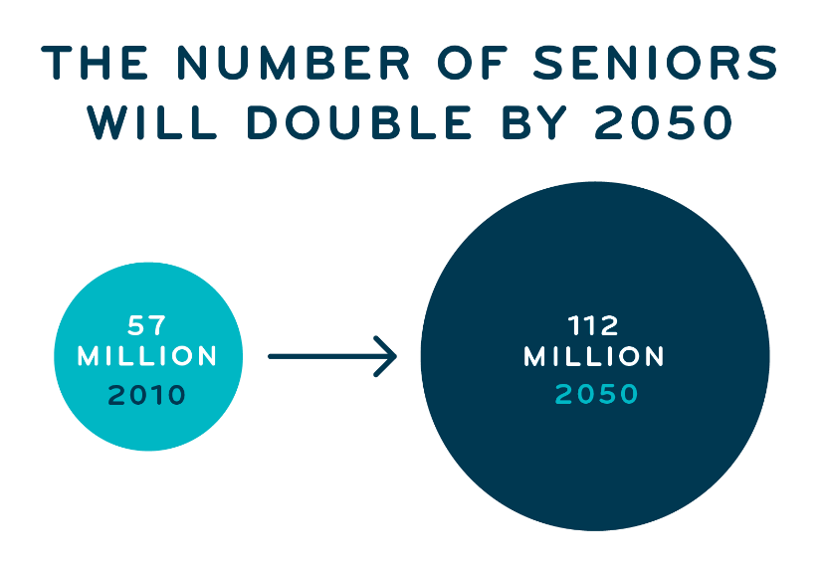
Silver Tsunami
Population Growth
10,000/day through 2030
Live into 80’s
Increased Life Expectancy
Poverty
Hunger
Discontinue Driving
Physical & Social Isolation
Loss of Independence
Health Care Costs

Slide 10
Challenges that VNA in Dallas Faced
“What does it all mean? What’s the impact?”
How do I quantify the real-world effect of Meals on
Wheels?
How do you differentiate and signal the value created by your organization?
What impact does this have on the community at large?
Our mission: Analyze the MoW program to determine impact, quantify ROI, and ground donation discussions in data.

Slide 11
HOW DID WE QUANTIFY IMPACT?
The power of simulation modeling
Models are used across multiple industries
By developing models to represent the systems we are trying to understand, we can:
Run hundreds of thousands simulations to understand possible outcomes
Test different hypothesis to understand the impact of choices
Run optimizations to find the best alternatives

Slide 12
HOW DID WE QUANTIFY IMPACT?
Combining data for rich insights
Modeling VNA’s clientele
Our team was able to model the impact of the Meals on Wheels program through a combination of different data sets: VNA, public, and research.
Cost model
Health-state calibration (disease state localization)
Virtual Population Generation
Disease modeling
Diet composition research

Slide 13
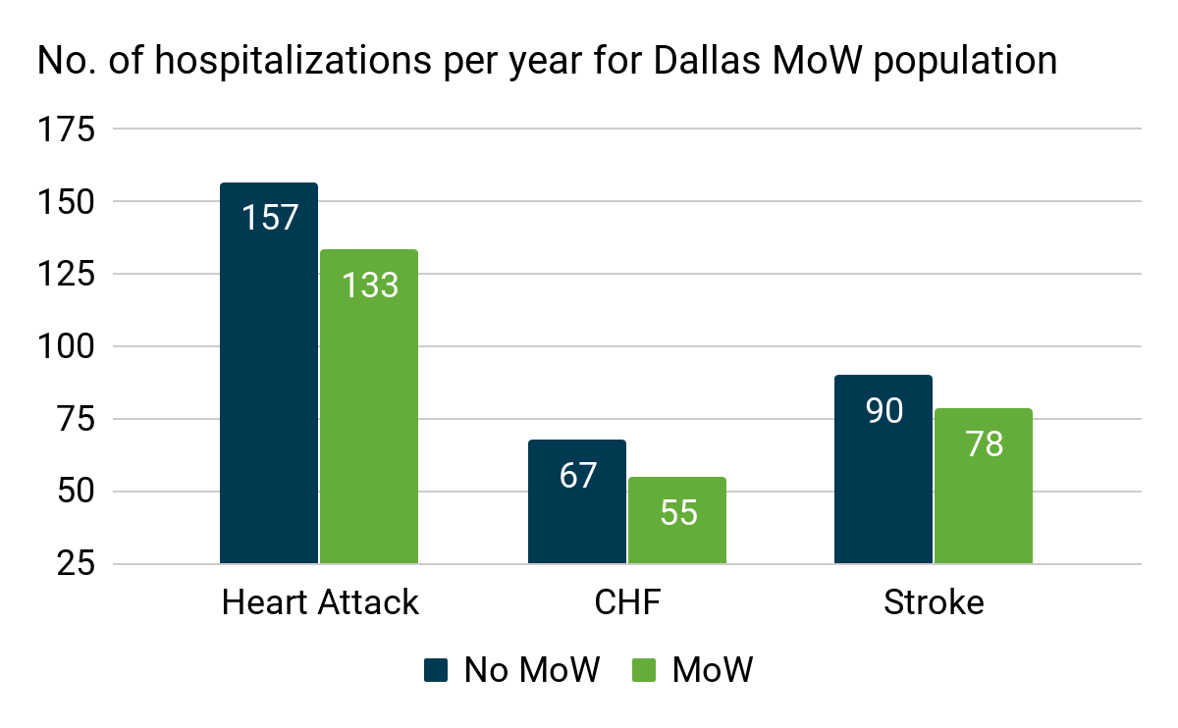
WHAT DID THEY DISCOVER?
MoW Reduces Healthcare Costs by ~7% in Dallas
The MOW program is estimate to prevent 24 heart attacks, 12 congestive heart failure hospitalizations, and 12 strokes per year

Slide 14
Executive Summary
The estimated value of a VNA meal is AT LEAST $8.87, resulting in a 48% ROI* on the meal investment and has the potential to lower healthcare costs by 7% annually for the conditions modelled
The level of detail we were able to model for different conditions will allow VNA to target discussions with different stakeholders with specific areas of interest
Of the estimated overall $2,218 in health care savings achieved through the MOWs program the top contributors accounting for the cost savings were :
Cardiovascular** conditions accounting for 21%
Dementia accounting for 25%
Home health and SNF utilization accounting for 48%
Loneliness had a 25% reduction in prevalence, the largest out of the measure categories
*48% ROI assumes a $6/meal cost
**Conditions include: stroke, heart attack, congestive heart failure with and without hospitalization, coronary heart disease, angina, and hypertension

Slide 15
What Are Our Challenges?
What data should be collected?
How should data be collected?
How should data be integrated?
How should data be shared?
Privacy and HIPAA compliance
Notes:
Data integration is a significant challenge that isn’t completely solved. Technology has come a long way in helping to solve this problem.
Data transmission methodologies and standards are helping, but many organizations require data in different formats.
One key element to any sharing of data is the security of the data itself. HIPAA compliance is crucial. Make sure to never send data to anyone unless you are 100% sure the data transmission is secure.
Let’s talk more about this…

Slide 16
What Is Data In The Aging Services World?
Referrals for service
Patient information
Billing for services provided
Notes:
Referrals for service
The more straight forward data that is the easiest of the elements to capture.
Patient Information
Capturing the right data for the right clients. Understanding clients health conditions can help guide this direction.
Key standardized indicators are also crucial for the payors to know.
Billing for services provided
Transmission of data back to the payor for reimbursement
Show evidence that services that were authorized have in fact been provided. Then

Slide 17
Referral From The Payor
Service authorizations and re-authorizations
Unique referral codes assigned to every client referred to your agency
Authorization numbers must align with the service deliveries for billing purposes
ICD codes
International Classifications of Diseases
Most service authorizations will include an ICD code that validates the clients need for service
Unique patient ID’s
Medicaid numbers
Insurance carrier member ID

Slide 18
Tracking Patient Information
Unique opportunity to capture patient data
Nobody has access to your clients like you do
Chronic health conditions can guide data to capture
Consolidate and Analyze Data To:
Identify issues or concerns
Analyze trends
Provide evidence
Identify areas of improvement
Notes:
Unique Opportunity to Capture this data
Your drivers see your clients up to 5 days per week. That’s an amazing opportunity to monitor and measure changes in the clients condition.
Chronic health conditions
Based upon the clients health condition, certain data points may be crucial to track and understand. The referral from the healthcare provider should indicate the clients condition. Based upon this condition, certain data can be tracked over the course of time.
Identify trends
Potentially help to prevent epidemics, cure disease, reduce waste and cut down costs
Examples – The Mayo clinic has patients from all over the world with rare diseases and/or multiple diagnosis with conflicting treatment options. There is more information than a human doctor can evaluate.
Provide evidence
Relationships between medical intervention and health outcomes
Relationships between health outcomes and money
Identify areas of improvement
Allows strategic planning to improve processes and procedures, resulting in better care

Slide 19
Standardized Data Capture
Without standards, same data is captured differently
Example: Date
08/29/2018
8/29/2018
8/29/18
08/29/18
Tuesday, August 29, 2018
2018/08/29
Notes:
80% of Data is unstructured and that’s not the real problem, the real problem is that our structured data is inconsistently identified or defined.

Slide 20
Social Determinants of Health
Notes:
It’s good to understand the importance of SDOH and how it’s being used to effect client outcomes.
We have the opportunity to capture many of the Social Determinants of Health through our intake and assessment tracking.
Shelter, Food, Healthcare, Social interaction.

Slide 21
Evidence-Based Approaches & Data-Based Decision Making
=
Lowered Costs & Better Care

Slide 22
Even a few simple interventions can have an when
ENORMOUS IMPACT
SCALED UP

Slide 23
How Do We Capture This Data?

Slide 24
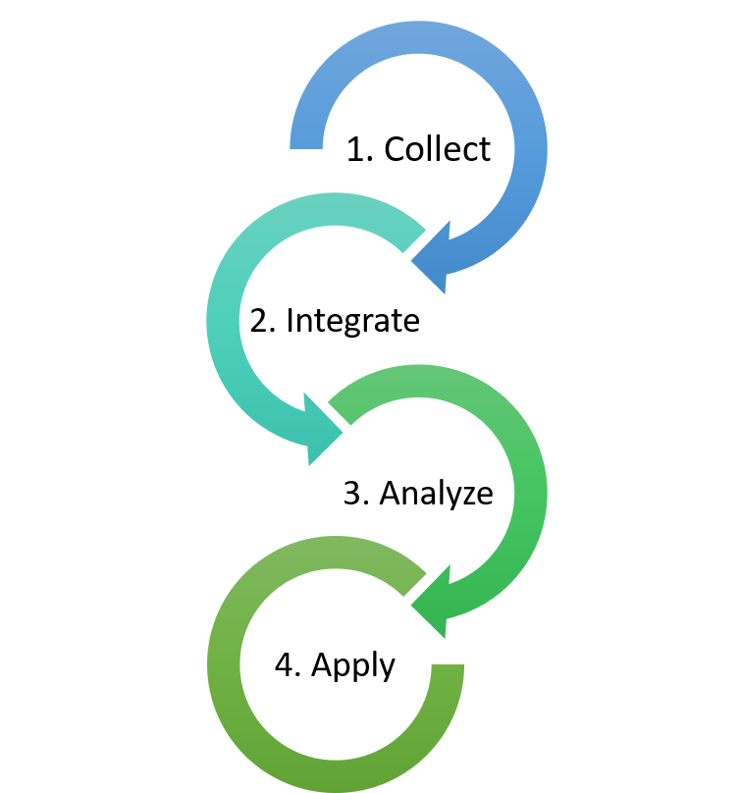
Technology
Software Applications with Databases
Spreadsheets will not be effective
Lots of data to capture and we need a clean and effective way to do it
Centralized Databases
Visibility across multiple providers
Visibility across the national network
Incorporated Data Analytic Tools
Workflow Engines
Enhanced Messaging
Messages sent to appropriate people based upon certain actions

Slide 25
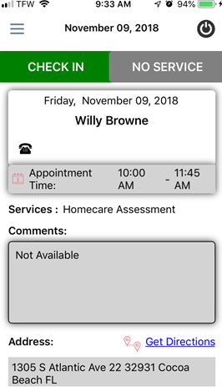
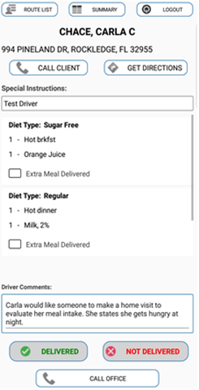
Technology (cont’d)
Electronic Visit Verification
Mobile Technology
Capture data at the point of delivery
Location of delivery, date/time of delivery, signatures of the client, additional delivery comments
Identify changes of the clients condition

Slide 26
Who Do We Share Data With?
Payors
Healthcare Insurance Companies
Care Coordinators
Partners
Meals on Wheels America
West Health Institute
Hospitals
Physicians

Slide 27
How Do We Share Data?
Integrated Data
Integration with other technology platforms i.e. healthcare provider databases, ADT systems, etc.
Data sharing is critical in this process
It is also dangerous. We must understand the legalities of data sharing
If data is being shared with the payor, it can be identifiable
The payor wants to know which of their patients have health alerts
Notes:
ADT = Admit, Discharge, Transfer

Slide 28
HIPAA Compliance
Ensure data capture and data sharing is safe and secure
Most service providers don’t fully understand data security
Find technology partners that can verify data security best practices
It’s more than just the database to be concerned about
Physical
Technical
Administrative
Healthcare entities have more stringent guidelines than you’re are used to

Slide 29
Recap
We already have the “gold”
Or at least some of the gold…
Access to the clients you have is unprecedented
We are already on our way
Now is the time to get involved

Slide 30
This is a text box
This is a text box

