Slide 1


Finding the Right Pitch to Sell your Program to Health Care Systems or Plans

Slide 2












Thank You To Our Partners

Slide 3

Overview of the HLCE
Vision: Transform the healthcare delivery system. Medical systems, community-based social services, and older adult will collaborate to achieve better health outcomes and better healthcare, both at sustainable costs.
Key Features:
* Statewide Provider network of diverse community based organizations * Centralized referral, technical assistance, fidelity, & quality assurance
* Multi-program, multi-venue, multicultural across the lifespan approach
* Centralized entity for contracting with statewide payors
* Diversification of funding for sustainability
* EBP integration in medical home, ACO and other shared settings
Notes:
WHAT IS HLCE?

Slide 4
Overview of the HLCE
“…creating an integrated delivery system in which health care systems, community-based social services and older adults collaborate as partners to improve care and lower costs,”
Jim Roosevelt, CEO Tufts Health Plan
“With all eyes on health care reform, this new model has the potential to set the stage for national change in the way health care is delivered and embraced.” (http://mahealthyagingcollaborative.org/hlce/)
Notes:
WHAT IS HLCE?

Slide 5
Overview of the HLCE
Network Hub
Training and TA
Community based provider network
90 + EBP providers
Aging and Disability
Business Development
Grant Writing
EBP administration: Healthy IDEAS
Statewide Licensure
Marketing and Outreach
Data and IT
Quality Assurance
Multicultural
18+
Health Care Contracts
Other Contracts (SUA, DPH, Consulting)
EBP Development: Healthy Eating
Innovation Center: HUD contract
Notes:
WHAT IS HLCE?

Slide 6
Total Program Participants
January 1 – December 31, 2017
7037 Participants
596 Workshops
14.6% increase in Participants since 2016

Slide 7
Where Workshops happen
259 sites
91 Community Partners
2.3 workshops per site
2.8 workshops per partner

Slide 8
Additional Outputs
38% of participants come from Health Care Referrals (Up from 27% in 2016)
431 Active Leaders (at least one workshop per year)
Average leader: 2.7 workshops annually
62.3% leaders = stipend volunteers (Average $250-$300 per workshop)
Most Prevalent Chronic Conditions:
  Arthritis
  Heart Disease
  Diabetes
  Depression
  Hypertension

Slide 9
Outcomes
Health care utilization savings of $713.80 per patient
Significant improvements in self-assessed health, quality of life, fatigue, pain, and shortness of breath
Decreased depression symptoms
Increased odds of participating in physical activity
Significantly reduced risks of ER visits, from 18-13%
Significantly lower odds of hospitalization in 6 months from 14-11%
Improved member compliance with individual care plans
Improved member satisfaction with health care plan

Slide 10
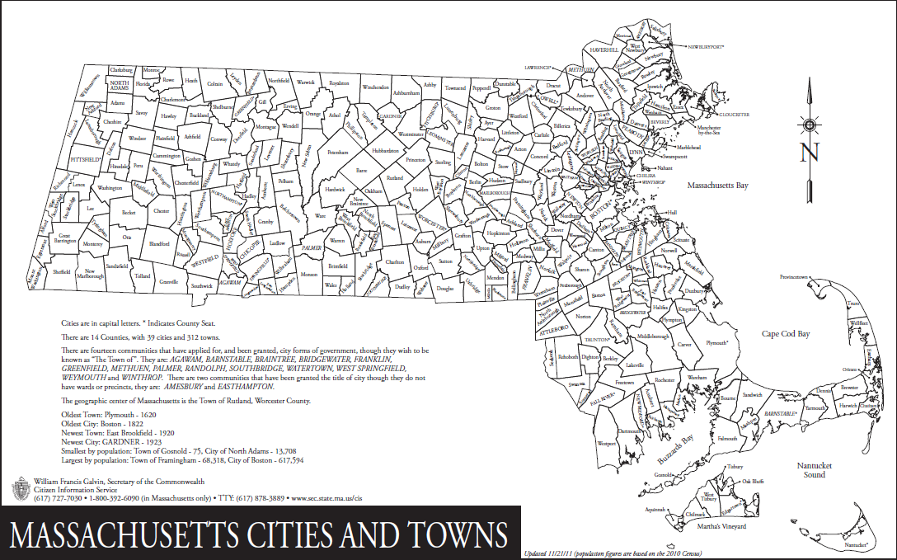
HLCE Provider Network
Statewide Provider Network: Beyond Aging
AAA/ASAPs
COAs
ILCs
Multicultural Organizations
Faith Based Organizations
YMCA
QIN/QIO
Community Health Centers
Notes:
Deliverables at start of project

Slide 11

Our Partnership Path
Statewide capacity:
47,000 + Participants
2018:
First Housing Contract
2013:
Building a Community Provider Network: Tufts Health Plan Foundation & Hartford
2016:
First Contract – Senior Whole Health
2007:
Statewide Community Coaltion
April 2006:
First CDSMP Master Training

Slide 12
Value to Payors
Integrated Provider Network
Community Value Proposition
Defined Service Delivery Package

Slide 13
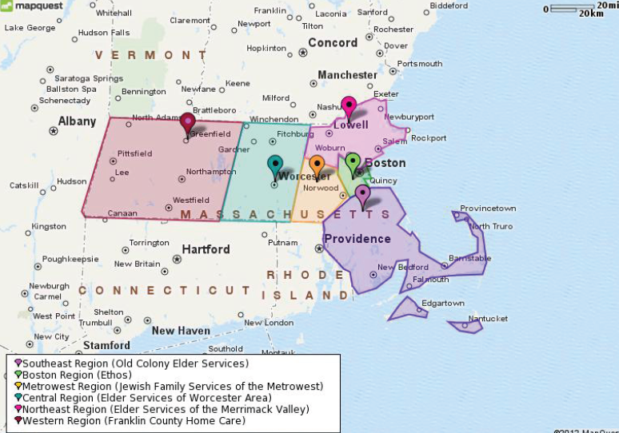
Integrated Provider Network
Statewide capacity through contracted relationships more than 80 diverse community organizations organized in seven (7) regional collaboratives
Aging Service Network
Public Health
Housing
Faith-based
VNA
Community Health Centers
YMCA

Slide 14
Defined Delivery Package
A Matter of Balance
Healthy IDEAS
Powerful Tools for Caregivers
Savvy Caregiver
Walk with Ease
Fit and Strong
Diabetes Prevention Program
Enhanced Wellness/Fitness
Healthy Eating
Stanford CDSME Suite
  CDSMP
  Diabetes
  Tomando
  Pain
  Cancer
  Positive
  others

Slide 15

Build vs. Buy: Your Value Proposition
Always ask, “What keeps you up at night?”

Slide 16
Integrated Provider Network
Solving a problem, not providing a service
EXISTING COMMUNITY RELATIONSHIPS
Connection to resources
Single Contract for all regions/programs
Marketing and Outreach
Feedback loops
Training & Technical Assistance
Quality & Efficiency through Centralized Infrastructure
Continuous Quality Improvement (PDSA)

Slide 17

Network Success: Contracting with Health Care
Medicare Advantage Special Needs Plan — A comprehensive health care plan for seniors who have both Medicare and MassHealth Standard.
Senior Care Options — A comprehensive health care plan offering the same benefits as our Medicare Advantage Special Needs Plan for seniors with MassHealth Standard only.
Dual Eligible

Slide 18
Network Success: Contracting with Health Care
First MCO to reimburse per participant
Single contract for all regions/programs
14 Evidence-based Programs
Bifurcated rate (recognizes cost and value)
  50% when member contacted
  50% upon program completion
Data collection and Feedback

Slide 19
Referrals
Referrals
Self referral via HLCE website, email or phone
Self referral via subcontracted community partners
Provider /plan referral to HLCE website, email or phone
Provider referral to subcontracted community partners
HLCE direct outreached to identified registry from provider/plan

Slide 20
Network Success: Increase Outreach
82 referrals
Internal SWH registry
12 completers
13.4% translation from referrals
78% completion rate
14 attendees
17% translation rate from initial referrals
All called with MI techniques
Recent Workshop:
A Matter of Balance
Boston, MA
Low income housing
Chinese Speaking

Slide 21
Network Successes
Successful Grant Applications
  ACL Falls
  ACL CDSMP
  AARP Foundation
  Local Health Plan Foundations
Increased reimbursement to Community Partners
  25% increase in reimbursement rate
Expanded Service Package
  Caregiver Support Programs
  Nutrition evidence-informed program
  1:1 in home interventions
Increased capacity
  22% increase in # of workshops across the state over 18 month period

Slide 22
Outcomes: Towards a More Sustainable Model
-John A. Hartford
-Tufts HPF
Notes:
Deliverables at start of project

Slide 23

Key Learnings: Health Care Partnerships
Start to build it before they come
Address provider’s core needs/problems
Diverse referral streams
Look at outcomes broadly
  Health
  Activation
  Satisfaction
Ongiong QI
Remain Flexible

Slide 24


Slide 25

Contact Information
  Jennifer Raymond
  Chief Strategy Officer
  Director, Healthy Living Center of Excellence
  jraymond@esmv.org
  www.healthyliving4me.org

