Slide 1

Foods, nutrients and dietary patterns for healthy aging
Katherine L Tucker, PhD Professor of Nutritional Epidemiology University of Massachusetts Lowell

Slide 2
Changes in dietary needs with aging
Lower energy requirement
Less efficient absorption and utilization of many nutrients
Chronic conditions and medications affect nutrient requirements
Challenge:
–High nutrient density diet is needed

Slide 3

Challenges in obtaining a nutrient dense diet
Loss of appetite
Changes in taste and smell
Oral health decline
Mobility constraints
Low income

Slide 4
Impact of food intake on Health
Physical function
Cognitive function
Bone health
Vascular function
Immune system
Eye health
Risk of diabetes, heart disease, cancer

Slide 5
Protein Intake and Aging
Muscle mass declines with aging
Current recommendations remain the same for older adults as for younger adults, 0.8 g/kg/d
Moderately higher protein intake of 1.0-1.3 g/kg/d may be required to maintain nitrogen balance and offset decreased efficiency of protein synthesis, and impaired insulin action with aging
Some concern that higher protein intake may increase risk of impaired renal function.

Slide 6
Protein
% Below Estimated Average Requirement (EAR),
NHANES 2010-11
100%
80%
60%
40%
20%
13%
1%
4%
1%
0%
51-70
71+
Male
Female

Slide 7
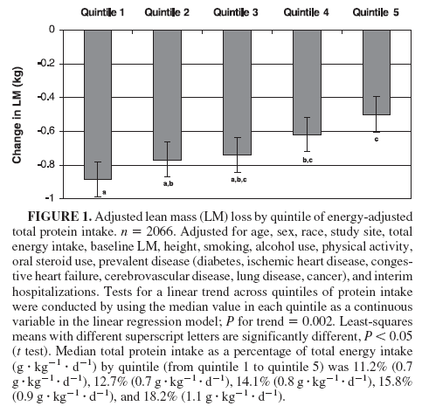
Protein intake and sarcopenia: Health, Aging, and Body Composition Study
Men & women, 70-79
3-y changes in LM
Those in highest quintile of protein intake lost 40% less LM than those in lowest quintile
Houston et al. Am J Clin Nutr. 2008;87:150 –5.

Slide 8
Adjusted 4-year Bone Loss by Protein Intake Quartile (%)
Framingham Osteoporosis Study
0
femoral neck lumbar spine
-0.5
-1
-1.5
-2
1
-2.5 2
3
-3 ⁴
*
**
-4
-4.5
-5
**
*P<.05; **P<.01, adjusted for age, sex, weight, physical activity, smoking, alcohol, calcium intake, caffeine, estrogen use (women)
Hannan et al. J Bone Min. Res. 2000;15:2504 –12.

Slide 9
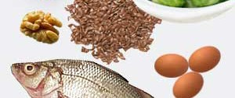
Omega-3 fatty acids
Intakes tend to be low and imbalanced with n-6 fatty acids
Associated with heart disease, also with cognitive decline and asthma
Only major source of DHA and EPA is fish
ALA from flax seeds, walnuts

Slide 10
N3 = ALA + EPA+ DHA
% Below Adequate Intake (AI), NHANES 2011-12
100%
80%
60%
40%
36%
18%
18%
20%
15%
0%
51-70
71+
Male
Female

Slide 11
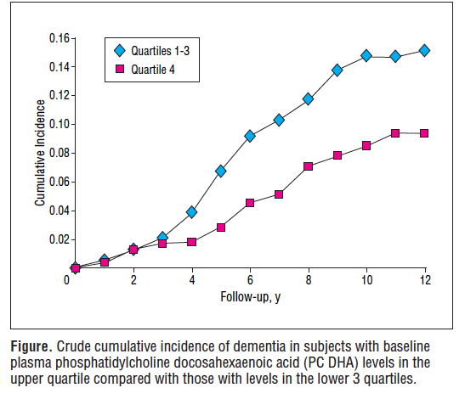
Shaeffer E et al. Arch Neurol. 2006;63:1545-1550

Slide 12
Cognitive Factor Scores and n-3 Fatty Acid intake in Boston homebound elders
β
P
Memory score
Basic¹ 0.093
Full² 0.084
0.04
0.07
EPA + DHA
Attention score
Basic¹ 0.131
EPA + DHA Full³ 0.128
0.003
0.005
adjusted for age and sex, education and total energy intake, use of fish oil supplement
model 1+ b-vitamin status, sat fat intake, HDL, acculturation, and apoe4 allele.
model 1+ b-vitamin status, sat fat intake, HDL, acculturation, alcohol intake, multivitamin use, and apoe4 allele.
EPA= Eicosapentaenoic Acid ; DHA= Docosahexaenoic Acid
Arsenault L, PhD Dissertation, Tufts University, 2009

Slide 13
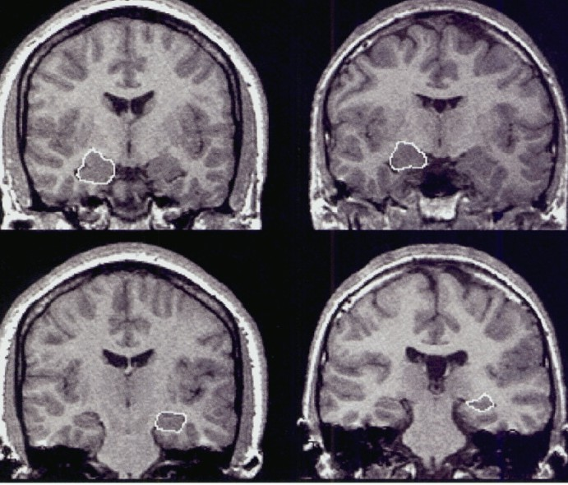
Hippocampal Volume (as % ICV)
in the NAME study (n=286)
Dietary Intake of DHA+EPA
(mg/day)
β (95% CI)
for a doubling of exposure
P
0.005 (0.001 – 0.01) 0.023
Adjusted for age, sex, race, education, homecare agency, total energy, fish-oil, apoE4, smoking and drinking status, physical activity, saturated fat, total cholesterol + plasma folate, B6, B12, C, and E
Arsenault L, PhD Dissertation, Tufts University, 2009

Slide 14
Total Brain Volume (as % ICV)
β (95% CI)
for a doubling of exposure
Exposure Variable
P
Dietary Intake (mg/day)
EPA+DHA
Model 1 (n=303)
0.52 (0.04 – 0.99)
0.033
Model 2 (n=288)
0.57 (0.09 – 1.05)
0.020
Plasma Phospholipid (mol%)
DHA
Model 1 (n=247)
1.42 (0.02 – 2.81)
0.046
Model 2 (n=242)
1.56 (0.17 – 2.95)
0.028
Model 1 = age, sex, race, education, homecare agency, total energy, fish-oil use, apoE4, smoking and drinking status, physical activity, saturated fat, total cholesterol
Model 2 = model 1 + plasma concentrations of folate, B6, B12, C, and E
Arsenault L, PhD Dissertation, Tufts University, 2009

Slide 15
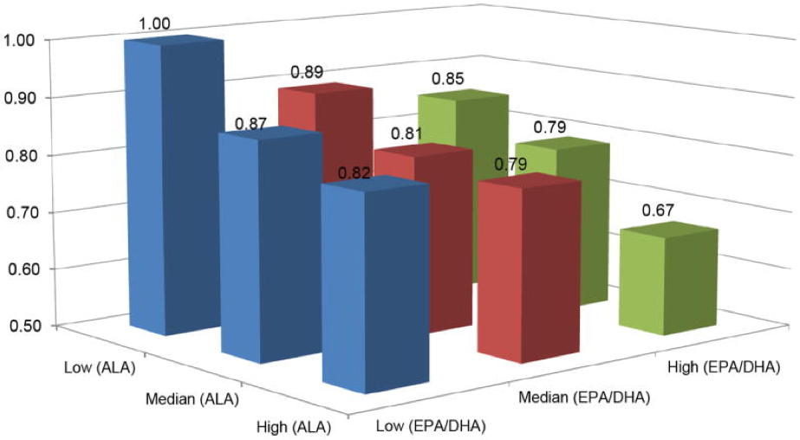
N-3 fatty acid intake and CVD mortality in Singapore
Koh 2015 Eur J Prev Cardiol

Slide 16
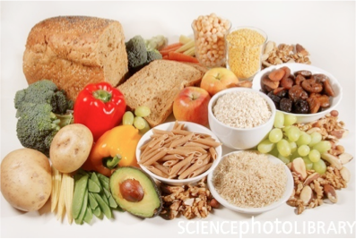
Dietary fiber
Important for intestinal health
Protection against heart disease and other metabolic conditions
Maintaining a healthy microbiome

Slide 17
Dietary Fiber
% Below AI, NHANES 2011-12
100%
92%
90%
89%
80%
77%
60%
40%
20%
0%
51-70
71+
Male
Female
NHANES 2011-2012
www.uml.edu

Slide 18
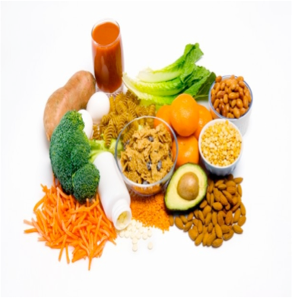
Folate
Important for DNA methylation and preventing high homocysteine
Some older adults do not meet the RDA
others exceed the UL of 1000 ug for folic acid.
  Accelerated effects of vitamin B12 deficiency
  Increased risk of some cancers
  Increased risk of cognitive decline
www.uml.edu

Slide 19
Change in Figure Copying Score by
Folate Quartile
0.4
*
0.2
*
0
1
2
3
4
-0.2
Adj Mean Change
-0.4
-0.6
-0.8
-1
Adj for age and education
* p<0.05
Tucker 2005 Am J Clin Nutr

Slide 20
Homocysteine and 3 y change in figure copy score
The Normative Aging Study of men
0.3
0.2
0.1
0
-0.1
-0.2
-0.3
-0.4
*
<9
9--11
>11
-0.5
nmol/L
Tucker 2005 Am J Clin Nutr

Slide 21
Homocysteine and Incident Dementia
The Framingham Study
0.2
Cumulative Incidence
0.15
tHcy Q1- 3
tHcy Q4
0.1
0.05
0
0 1 2 3 4 5 6 7 8 9 10 11 12
Years
Sheshadri 2008 N Engl J Med

Slide 22
Folate DFE
% Below EAR
100%
80%
60%
40%
26%
20%
7%
8%
4%
0%
51-70
71+
Male
Female

Slide 23
Folic Acid (Diet and Supplements)
% above UL
100%
80%
60%
40%
20%
2%
2%
4%
2%
0%
51-70
71+
Male
Female

Slide 24
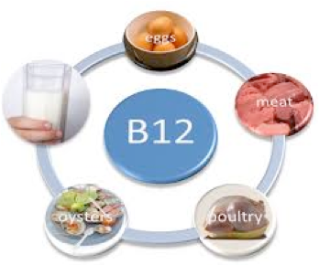
Vitamin B12
Important for protecting nerves
Deficiency leads to peripheral neuropathy, balance disturbances, cognitive disturbances, and disability
Inadequacy leads to high homocysteine, and risk of heart disease
Major cause is poor absorption due to decreased stomach acidity so meeting the RDA is not sufficient for many

Slide 25
Vitamin B12
% Below EAR, NHANES 2011-12
100%
80%
60%
40%
20%
8%
9%
2%
0%
0%
51-70
71+
Male
Female

Slide 26
Framingham Offspring Study Prevalence of Low B12 (<250 umol/L)
25
20
19.7
%
15
10
5
0
8.2
non-supp users
supp users
Tucker 2000 Am J Clin Nutr
www.uml.edu

Slide 27
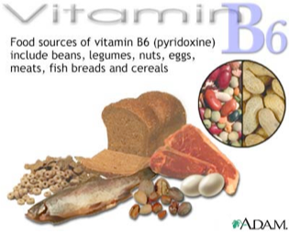
Vitamin B6
Important for numerous metabolic reactions
Inadequacy may lead to
  High homocysteine
  Impaired immune function
Has been associated with
– Impaired cognitive function
–
Depression

Slide 28
Vitamin B6
% Below EAR, NHANES 2011-12
100%
80%
60%
40%
39%
28%
20%
8%
7%
0%
51-70
71+
Male
Female

Slide 29
Massachusetts Hispanic Elders Study
% Low Plasma PLP (Vitamin B6)
45
40
35
30
25
20
15
10
5
42
36
% <35 nmol/L
% <20 nmol/L
16
11
0
Hispanic
non-Hispanic white

Slide 30
The Normative Aging Study
Figure Copying Score by Vitamin B6
0.3
0.2
0.1
**
**
0
*
-0.1
-0.2
-0.3
-0.4
-0.5
-0.6
<46 <2.1
46-85 2.1-3.1
>85 >3.1
-0.7
plasma PLP (nmol/L) diet (ug/d)
* P<0.05 ** P<0.01
Tucker 2005 Am J Clin Nutr 627-35
www.uml.edu

Slide 31
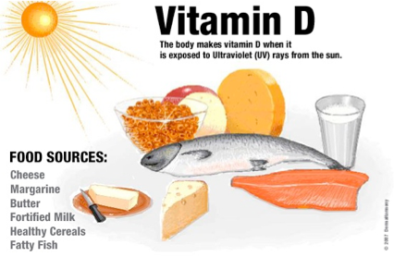
Vitamin D
Associated with
  osteoporosis
  neurologic conditions
  diabetes and other metabolic conditions
Older adults are at high risk of inadequacy
  Dietary deficiency
  Less exposure to sunlight
  Decreased skin synthesis
  Decreased capacity of kidneys to convert vitamin D into active form
Food sources are limited:
  fortified milk, fatty fish

Slide 32
Vitamin D
% Below EAR, NHANES 2011-12
100%
98%
97%
95%
95%
80%
51-70
71+
Male
Female

Slide 33
Nutrition and Memory in Elders Study
Homebound older adults in Boston
Non-Blacks Blacks
Total (n=209) Total (n=109) 74.5 (8.3) 71.5 (7.4) **
Age (years)
Female Sex (%)
69.4
78.9
65.1§
32.5 (8.7)**
69.6
HS Graduate (%) BMI (kg/m²)
History of Smoking (%)
83.7
29.8 (6.4)
67
Current Drinking (%)
45.5
50.5
39.8**
92.5**
22.9
Diabetes Mellitus (%)
25.8
Hypertension (%)
79.1
Reduced kidney function (%)
30.1
25(OH)D <10ng/ml %
11.5
20.2**
25(OH)D 10-20ng/ml %
42.1
48.6
25(OH)D >20ng/ml
46.4
31.2*
Buell JS, J Geron*to^{P}l<M⁰e^{.0}d^{5,}S*c*i^{P}. <20⁰0^{.0}9^{1, ***P<0.001}

Slide 34
25OHD and Cognitive Factors
Tertiles of 25OHD and Executive Function Factor
0.1
P for trend <0.001
Factor Score
0.05
0
-0.05
-0.1
-0.15
<10ng/ml
10-20ng/m l
>20ng/ml
Tertiles of 25OHD and Attention/Processing Factor
0.2
P for trend <0.03
Factor Score
0.1
0
-0.1
-0.2
-0.3
<10ng/ml 10-20ng/m l >20ng/ml
Buell 2009, J Gerontol: Med Sci

Slide 35
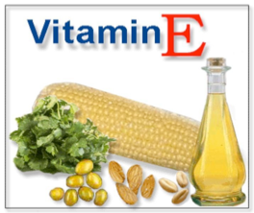
Vitamin E
Important as antioxidant and for immune function
Current RDA is 15 mg of alpha-tocopherol
Very few individuals meet this from diet
Other tocopherols in foods are also important
Best sources are nuts and seeds (almonds, sunflower seeds), plant oils

Slide 36
Vitamin E
% Below EAR
100%
97%
90%
80%
74%
69%
60%
40%
20%
0%
51-70
71+
Male
Female

Slide 37
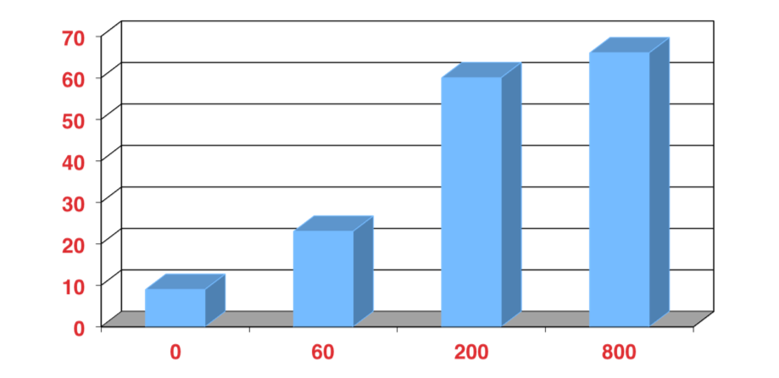
Effect of Vitamin E on DTH Skin Response
% change in DTH
Vitamin E (mg)
Meydani S, JAMA 1997
www.uml.edu

Slide 38
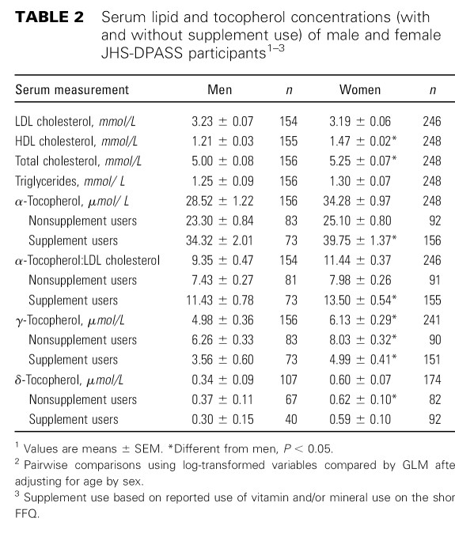
Talegawkar wetwawl. .2u0m07l..eJdNu

Slide 39
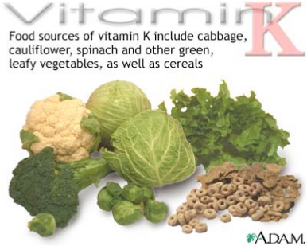
Vitamin K
Important for blood clotting
Also important for bone health
Best sources are green leafy vegetables, plant oils

Slide 40
Vitamin K
% Below AI, NHANES 2011-12
100%
80%
71%
60%
51%
53%
40%
38%
20%
0%
51-70
71+
Male
Female

Slide 41
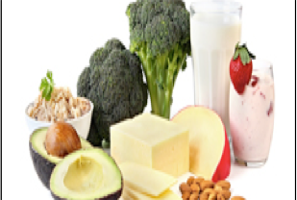
Calcium
Needed for optimal bone status
Contributes to blood pressure control
Too much can also be a risk

Slide 42
Calcium
% Below EAR, NHANES 2011-12
100%
80%
78%
66%
65%
60%
40%
38%
20%
0%
51-70
71+
Male
Female

Slide 43
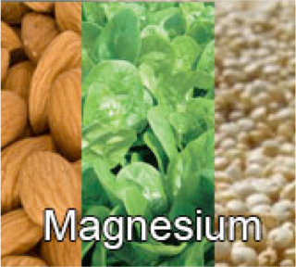
Magnesium
important for regulation of potassium and calcium
part of bone structure
protects blood pressure
low intake associated with diabetes risk

Slide 44
Magnesium
% Below EAR, NHANES 2011-12
100%
80%
65%
64%
60%
54%
42%
40%
20%
0%
51-70
71+
Male
Female

Slide 45

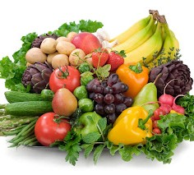
Potassium
Main intracellular cation, important for optimizing cellular function
Affects neural transmission, muscle contraction and vascular tone
Insufficient intakes contribute to hypertension, CVD, kidney stones and osteoporosis

Slide 46
Potassium
% Below AI, NHANES 2011-12
100%
100%
99%
100%
86%
80%
60%
51-70
71+
Male
Female

Slide 47
Mean 4-year BMD change by Mg/K intake quartile, men
Mean 4-y BMD changes (g/cm²)
b
0.04
0.02
0
-0.02
-0.04
-0.06
-0.08
-0.1
Q1 Q2 Q3 Q4
b
b
a
a
Neck
Troc
Ward
Radius
BMD Sites

Slide 48
Dietary Patterns
USDA Healthy Eating Index
DASH diet
Mediterranean Diet

Slide 49
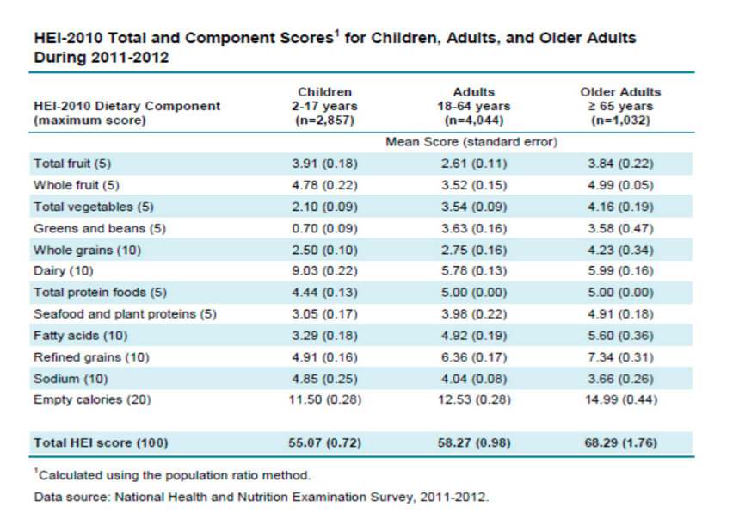
Healthy Eating Index 2010
(mean (SE)
*
*
https://www.cnpp.usda.gov/healthyeatingindex
www.uml.edu

Slide 50
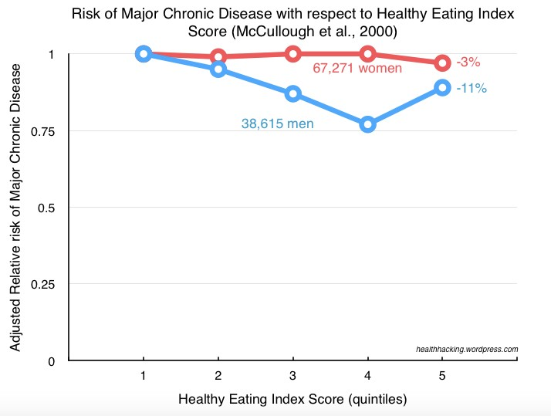

Healthy Eating Index
www.uml.edu

Slide 51
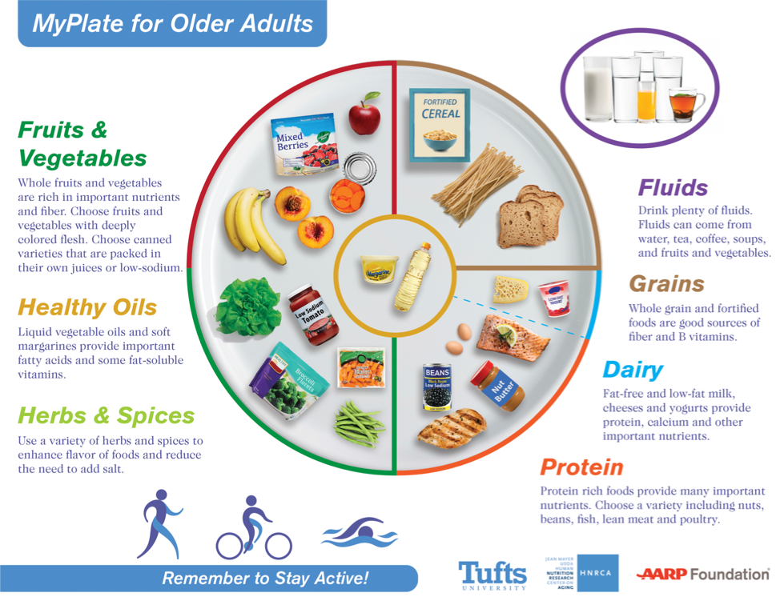
http://hnrca.tufts.edu/myplate/
www.uml.edu

Slide 52
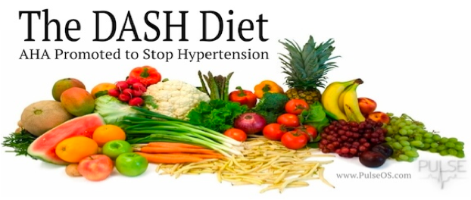
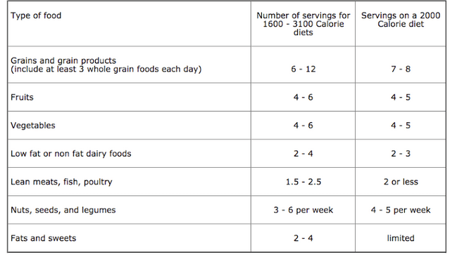
www.uml.edu

Slide 53
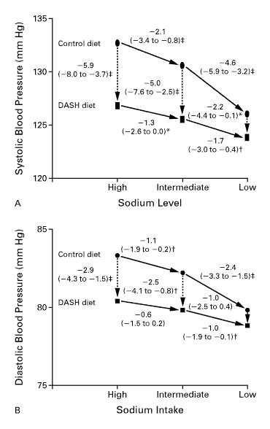
Sacks 2001 NEJM
www.uml.edu

Slide 54
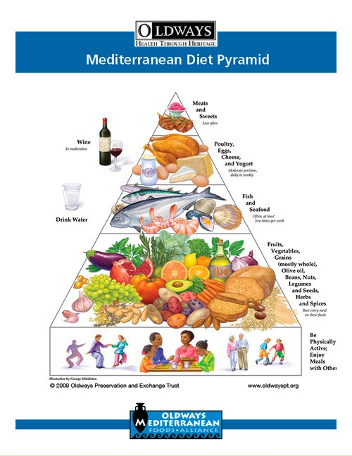

Slide 55
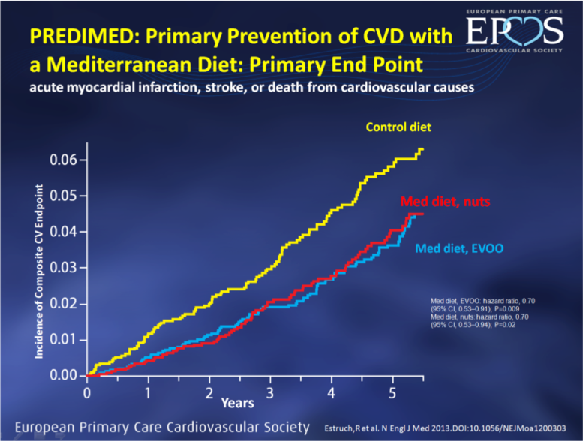
The Predimed Study

Slide 56
Dietary Quality Scores and Cardiometabolic Outcomes in older Puerto Rican adults
DASH HEI Med diet
WC
0.05
ns
-0.16 ns
-0.52
<0.05
BMI
-0.07 ns
-0.04 ns
-0.23
<0.01
Insulin resistance
-0.002 ns
-0.02 ns
-0.05
<0.05
Inflammation
-0.01 ns
-0.02 ns
-0.131
<0.05
Mattei 2017 J. Nutr

Slide 57
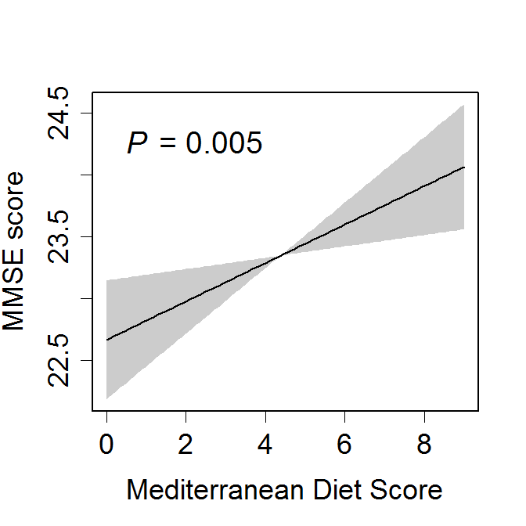
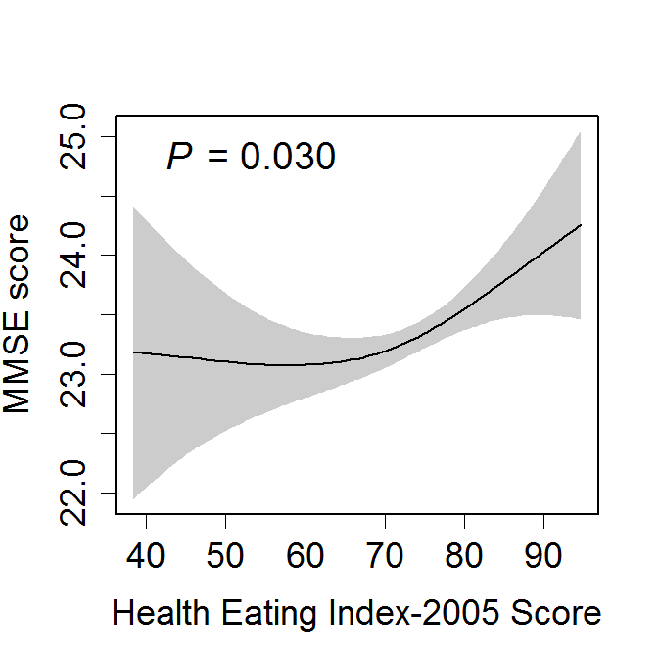
Associations between dietary score and MMSE score
(Ye 2013, JAND)
www.uml.edu

Slide 58
Recommendations for older adults
Fruit and vegetables
  Vitamin C, carotenoids, folate, vitamin B6, magnesium, potassium, dietary fiber
Nuts and legumes
  Protein, vitamin B6, magnesium, dietary fiber
Fish
  Protein, n3 fatty acids
Low-fat dairy products (milk or yogurt)
  Protein, magnesium, calcium, potassium, vitamin B12, and vitamin D (fortified)
Whole grains
  Vitamin B6, magnesium, dietary fiber
  Fortified breakfast cereals provide crystalline vitamin B12
Extra virgin olive oil
  Monounsaturated fats, polyphenols
Limit
  Refined grains and foods high in sugar, solid fats, and sodium
www.uml.edu

