Slide 1

Launched Conduit for Change, LLC in 2008. 17 years+ professional coaching experience, 33+ years of collective career experience.
Master’s Degree in Coaching: Health and Wellness Coaching from the Maryland University of Integrative Health
ICF Certified PCC plus many more certifications.
Published book From Chaos to Calm :: Leading Change From the Inside Out in 2018 and 2020.
I bring a comprehensive, evidence-based approach to coaching, combining advanced academic knowledge with presence-based, experiential, somatic, client-centered techniques.
My integrative coaching approach blends positive psychology, neuroscience, behavior science, health and wellness, mindfulness and creative process to deliver sustainable results.
Integrative Approach: Focuses on the whole system, helping clients integrate their emotional, mental, spiritual, and physical well-being. As an integrative coach, I tailor each session to address specific goals, using scientifically-backed techniques and frameworks.
Inspired Results + Data: My approach is grounded in the latest research on coaching effectiveness, ensuring measurable improvements in goal achievement, emotional well-being, and overall quality of life for clients.
Annelies M Gentile, MA, PCC
Integrative Life and Leadership Coach, Speaker, Author, Artist, Interfaith Minister
conduitforchange.com

Slide 2

Understanding Coaching
How Integrative Coaching
Can Help You and Your Clients Thrive
What it is
What it’s not
What to look for
How coaching can enhance outcomes and wellbeing
Live Focus Coaching Session (10 min)
  → What do you want to tend in your personal or professional life?

Slide 3
Understanding the Key Differences Between Therapy and Coaching
What are your experiences with coaching?

Slide 4
Understanding the Key Differences Between Therapy and Coaching
Psychotherapy is a form of treatment aimed at relieving emotional distress and mental health illness. Provided by any of a variety of trained professionals: psychiatrists, psychologists, social workers, or licensed counselors. This guided support is past and present-focused aimed at healing through resolving psychological difficulties or mental health issues. https://www.psychologytoday.com/us/basics/therapy
State Licensed
Offers clinical treatment
Healing past trauma or managing current illness
Covered by insurance
Requires education and continuing education
  An ICF Coach offers a professional partnership, a thought-provoking, creative process aimed to inspire clients to maximize their personal and professional potential. This impactful process is client-driven, present and future-focused. Designed for growth, coaching helps to achieve specific goals and enrichment, transforming how you think, live, and thrive. https://coachingfederation.org/get-coaching/coaching-for-me/what-is-coaching/
  Training Certified
  Offers creative conversation and accountability
  Forward-focused, client-driven, goal-oriented
  Aimed to evoke potential
  Personal or professional investment
  Requires education and continuing education

Slide 5
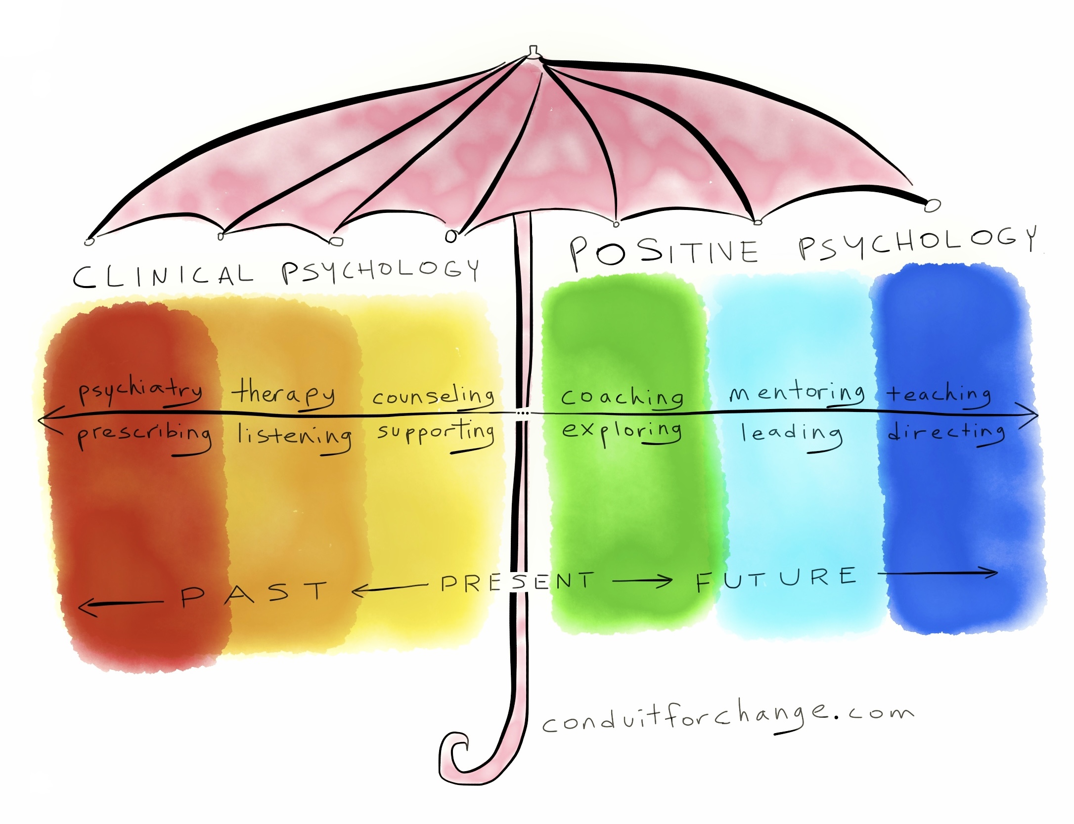
A 2019 study found that while therapy worked on processing past traumas, coaching helped clients feel more empowered. https://www.researchgate.net/publication/228368927_Evidence-based_coaching_Flourishing_or_languishing

Slide 7
Coaching can have healing benefits through empowerment, future vision, and action-oriented results.
Coaching is a transformative journey where you discover your true potential.
You’re in the driver’s seat, in control of the destination, but beside you is a trusted navigator — your coach — helping you see new possibilities, find alternate routes, and ensure you don’t lose focus.
This partnership empowers you to unlock answers you already have within, while also challenging you to go further than you imagined.
At its heart, coaching is about exploration. It’s a process that stirs up creativity, fuels personal growth, and maximizes both professional and personal potential.
Through powerful questioning and insightful dialogue, your coach supports you in discovering your own solutions, whether for life decisions, career shifts, or business challenges.
Coaching cultivates deep, lasting change.
https://coachingfederation.org/get-coaching/coaching-for-me/what-is-coaching/
Coaching is NOT Therapy

Slide 8
Impacts of Coaching
BEHAVIOR CHANGE: Coaching can help individuals achieve lasting behavior change. A study published in Psychology of Coaching and Mentoring reveals that 70% of clients experience measurable improvements in behavior following coaching. https://www.academia.edu/72795310/International_Coaching_Psychology_Review
PROFESSIONAL DEVELOPMENT: Data shows that coaching can lead to improved leadership skills, increased employee engagement, and higher productivity in a work context. Specifically, executive coaching resulted in 53% higher team performance. https://www.ccl.org/leadership-solutions/leadership-coaching/executive-coaching
PERSONAL IMPROVEMENT: Recent BetterUp study shows significant area of development for most participants is introspection. This is a foundational skill for both personal and professional development. Improving mental fitness, confidence, self-awareness, resilience, self-efficacy, work-life balance, emotional regulation and increased mental health. Within the first three months with a coach, BetterUp members saw a 38% decrease in languishing, among other dimensions of mental health, life satisfaction, purpose, and social connection improve. https://www.betterup.com/blog/benefits-of-coaching

Slide 9
Impacts of Coaching
HEALTHY LIFESTYLE: Research shows coaching has proven useful in enhancing personal insight and in shaping and reinforcing desired behavior within many different contexts. In recent years, coaching has received special attention as a method to improve healthy lifestyle behaviors. It is well-known that having the insight and resources needed to make choices that foster a healthy lifestyle. https://pmc.ncbi.nlm.nih.gov/articles/PMC4015179/
IMPROVE CAREER OUTCOMES: Although the science of coaching is still evolving, enough research has shown impact and support for coaching. Results indicate that career and workplace coaching is effective in achieving positive organizational outcomes and is an effective intervention for improving workplace outcomes. https://pmc.ncbi.nlm.nih.gov/articles/PMC10597717/
INCREASE WELLBEING: Coaching has been found to increase emotional well-being and reduce stress, as confirmed by a study in the Journal of Positive Psychology. Coaching resulted in a 30% increase in life satisfaction. https://www.researchgate.net/publication/300845383_The_Efficacy_of_Coaching

Slide 10
What to look for…
There are MANY different types of Coaches.
Many are trained and certified.
Some are “professional” with NO credentials.
LOOK FOR… Coaches with certifications and training such as from the (ICF) International Coaching Federation.
(ACC) Associate Certified Coach, (PCC) Professional Certified Coach and (MCC) Master Certified Coach or (NBHCC) National Board Health Certified Coach.
There are many training programs, and many more popping up daily! Some are ICF approved.
There are many qualified schools similar to ICF that have been long standing certifying bodies.
Be wary of “weekend-warrior” trained coaches! However… they could simply be an expert in a field who wants to add coaching to their career. Not always “bad.”
Do your research before hiring or referring a coach.

Slide 11
What to look for…
Coach trained certification from a qualified school
Experience in the field 5 years or more
Expertise in the area you want support in

Slide 12
Leverage Coaching for…
Compliment to Therapy: Coaching can complement therapy by focusing on future goals, personal development, and strength-building.
Self-Empowerment: Coaching encourages you to actively work toward their future goals, fostering empowerment and long-term growth.
Reduce Burnout: Benefit from coaching to manage burnout and increase job satisfaction and enjoy a healthy work-life balance.
Career Change: Utilize an experienced career coach to help you sift through new career ideas and paths for success.
Health and Wellness: Improve your wellbeing, mindset and achieve health goals through support, encouragement and behavior change with a health and wellness coach.
Improve Leadership: An executive coach will support your position as a leader.
Spiritual Growth: Explore relationship to faith and creative expression in an uncertain world, nourish hope through a spiritual or creativity coach.
There are MANY coaches that cover lots of areas of need. Do your research.

Slide 13
Annelies M Gentile, MA, PCC
I help you remember who you are.
Why Choose Me as Your Integrative Life and Leadership Coach?

Slide 14

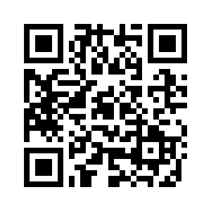
Integrative Life and Leadership Coaching with Annelies
I help you embrace change with courage, creativity, wellbeing and grace.
Coaches 1-1 with individuals, groups, families and teams
Creates custom talks for conferences, workplace wellness programs
Leads integrative retreats for wellbeing, creative expression and grief
Health and Wellness Coaching with Annelies can be covered by HSA and FSA (health and flexible savings accounts)
Get the book! →

Slide 15


Let’s stay in touch!
LinkedIN
Youtube
Facebook
Instagram
Join my newsletter!
conduitforchange.com
annelies@conduitforchange.com
919-345-8396

Slide 16
Live Focus Coaching Session (10 min)
→ What do you want to tend in your personal or professional life?

