Slide 1
Proposed Facilities of Amenity Centre
1 | Children’s play area/Open Gym
2 | Open space for Cafeteria (24*7)
3 | Parking Facility with EV charging station
4 | Biogas plant
5 | Rainwater harvest

Slide 2
Proposed Facilities of Amenity Centre
6 | Provision for Essential shop | Curio shops, and other essentials for travelers
7 | Solar roof panel | Roof of EV Station
8 | ATM counter
9 | First Aid
10 | Permission for Hoardings/Advertisements | On income sharing basis

Slide 3
PROPOSED MODEL FOR
AMENITY CENTRE

Slide 4
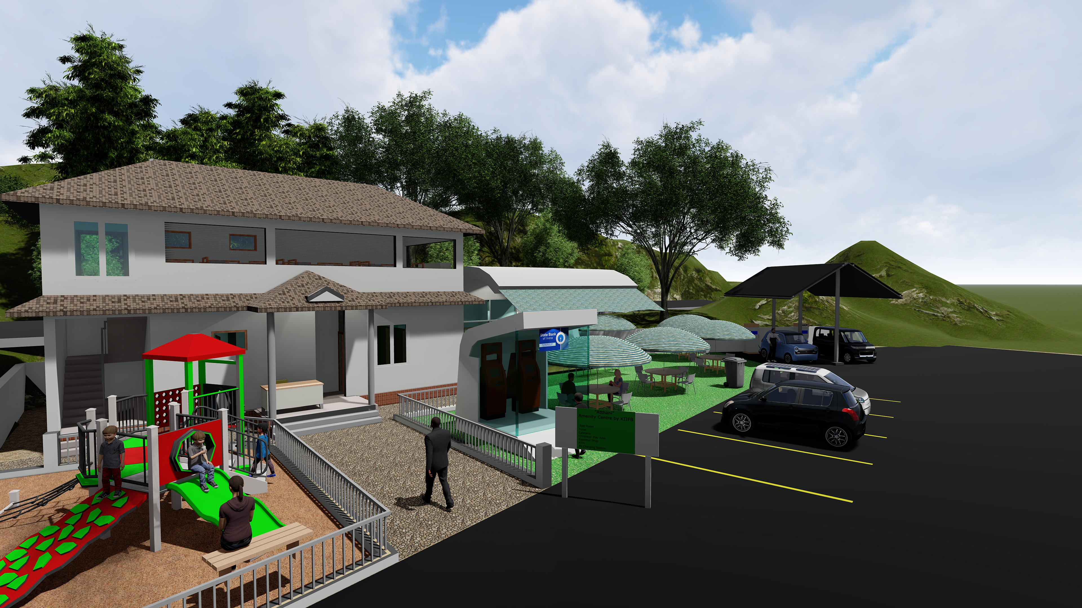

Slide 5
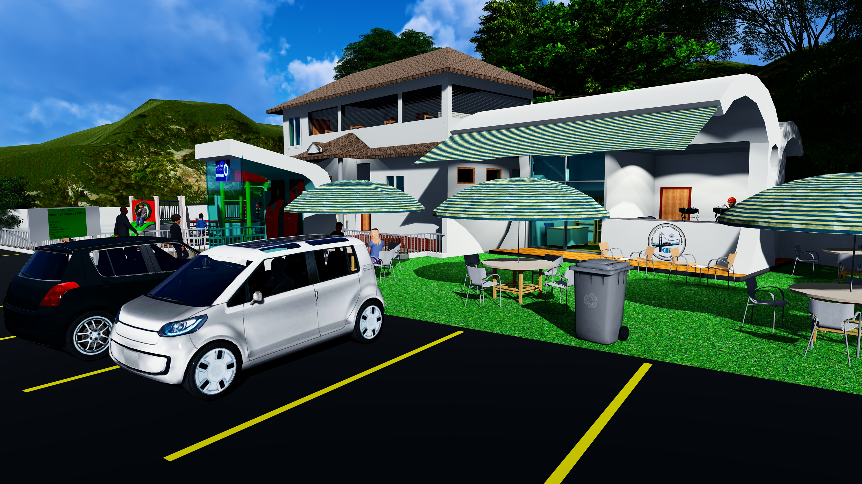

Slide 6
