Slide 1


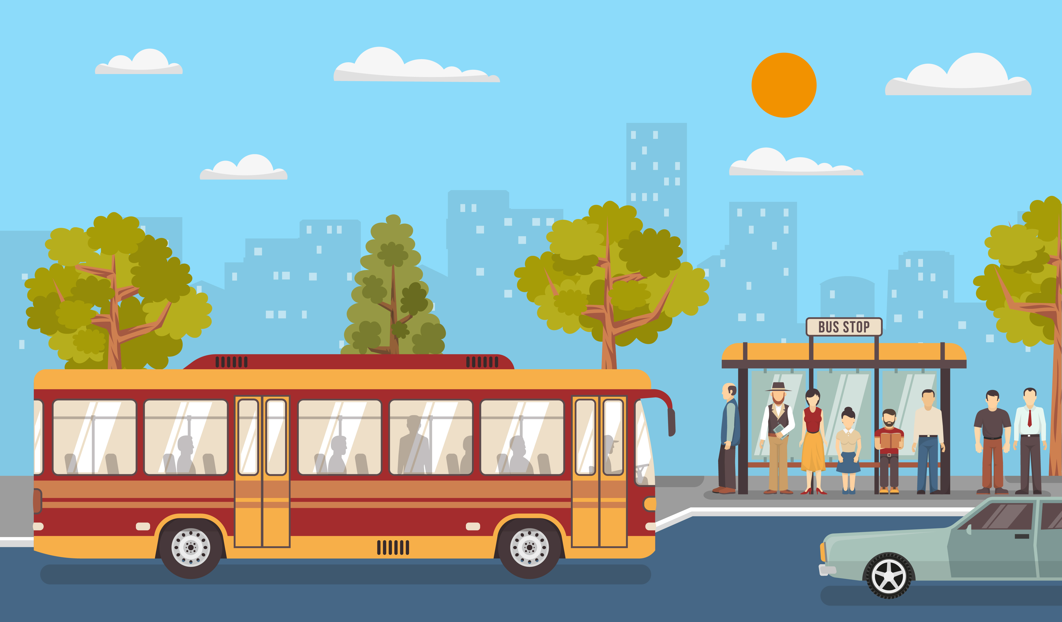

A Revenue Generation model for KIIFB funded roads

Slide 2
REDUCES AIR POLLUTION
INCREASES FUEL EFFICIENCY
REDUCES TRAFFIC CONGESTION
TIME SAVING
SAFETY
BUS STOPS WITH IMPROVED FACILITIES
ATTRACTS COMMUTERS
PROMOTES PUBLIC TRANSPORTATION SYSTEM

Slide 3
WHAT IS OUR PROPOSAL?

Slide 4
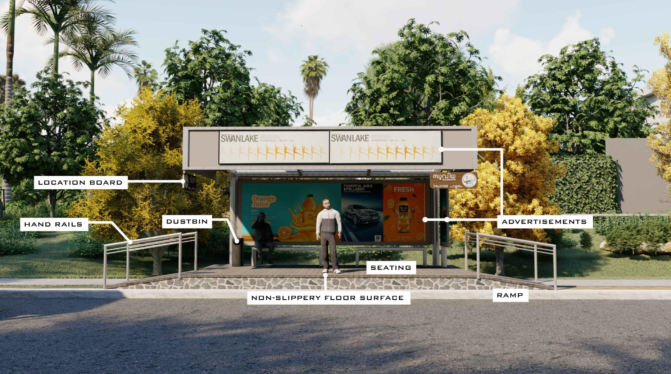

Slide 5
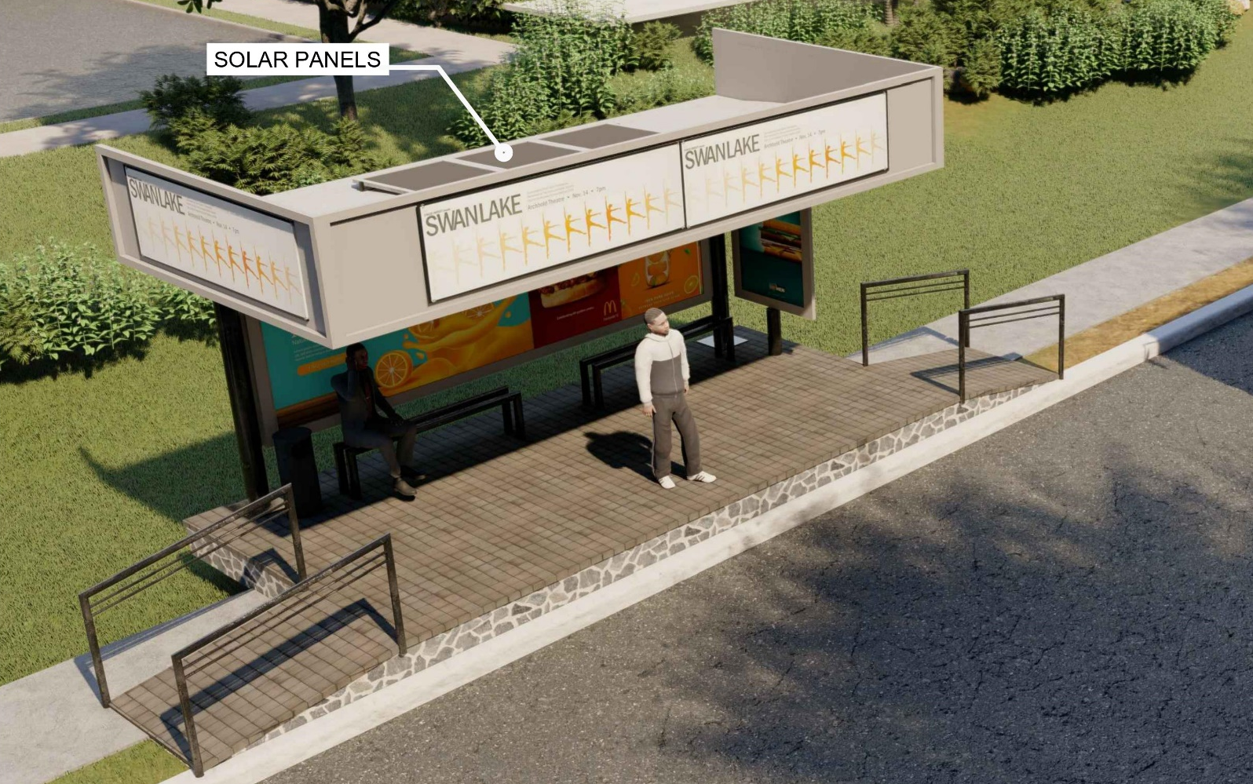

Slide 6
FACILITIES INCLUDED
Charging Port
Drinking water
Ramp with handrails
FM radio
Wi-Fi
Helpline Number Display
Seating facility
Solar Roofing
24*7 CCTV

Slide 7

PROPOSED NAME BOARD FOR THE BUS SHELTER
PROVIDED AT THE SIDE AND FRONT PORTIONS OF THE BUS SHELTERS
SPECIFIES LOCATION NAME IN BOTH MALAYALAM AND ENGLISH
WHITE RETRO-REFLECTIVE MATERIAL FOR NIGHT VISIBILITY

Slide 8
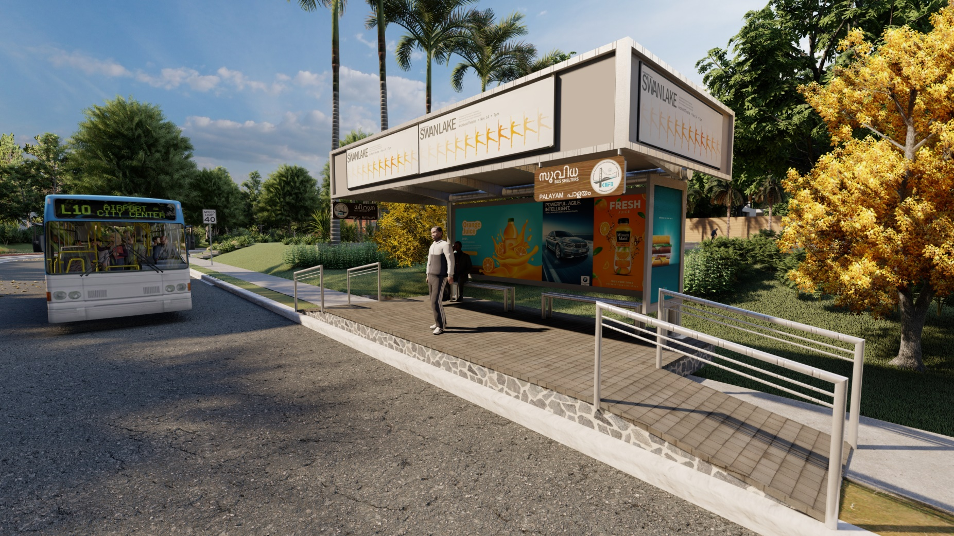

Slide 9
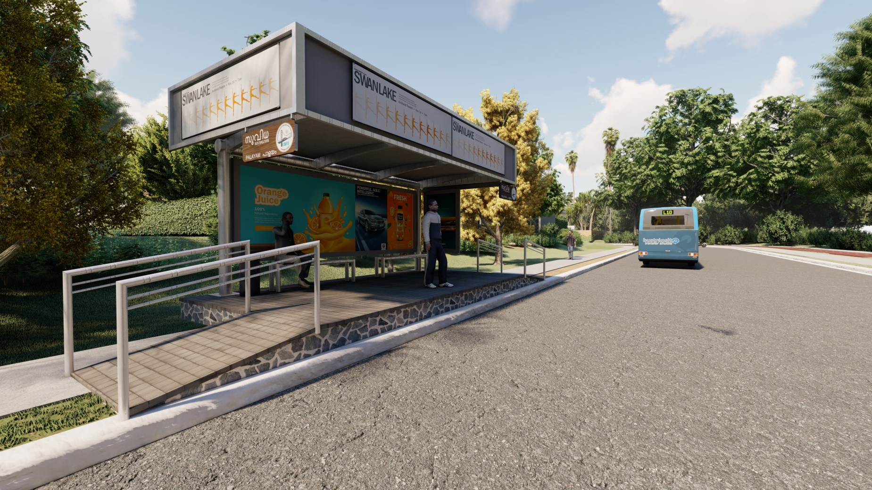

Slide 10
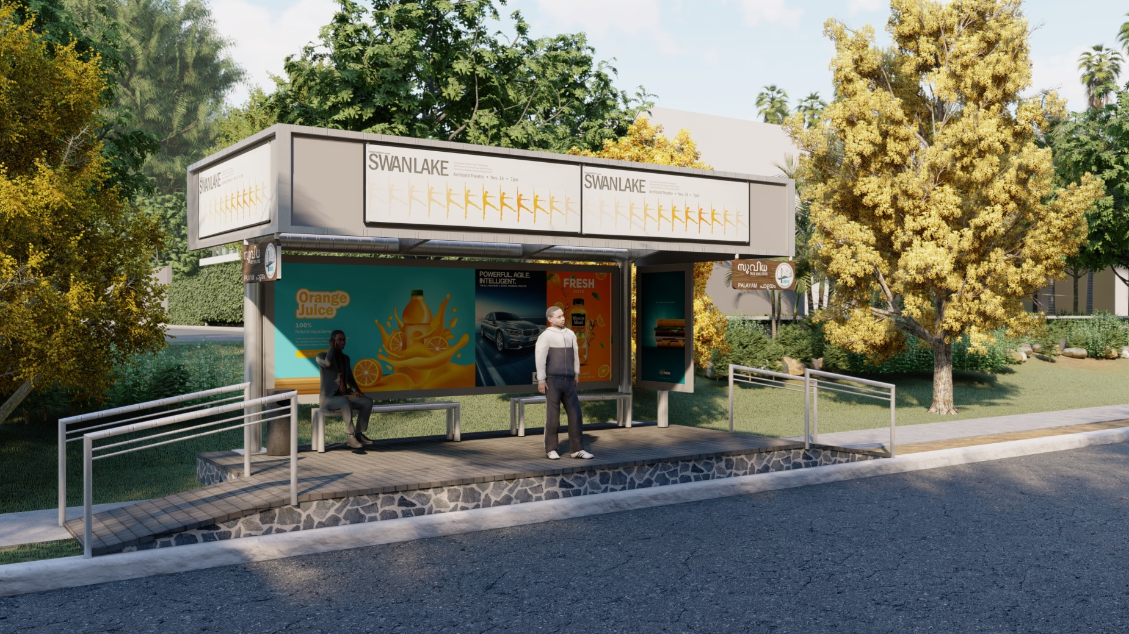

Slide 11
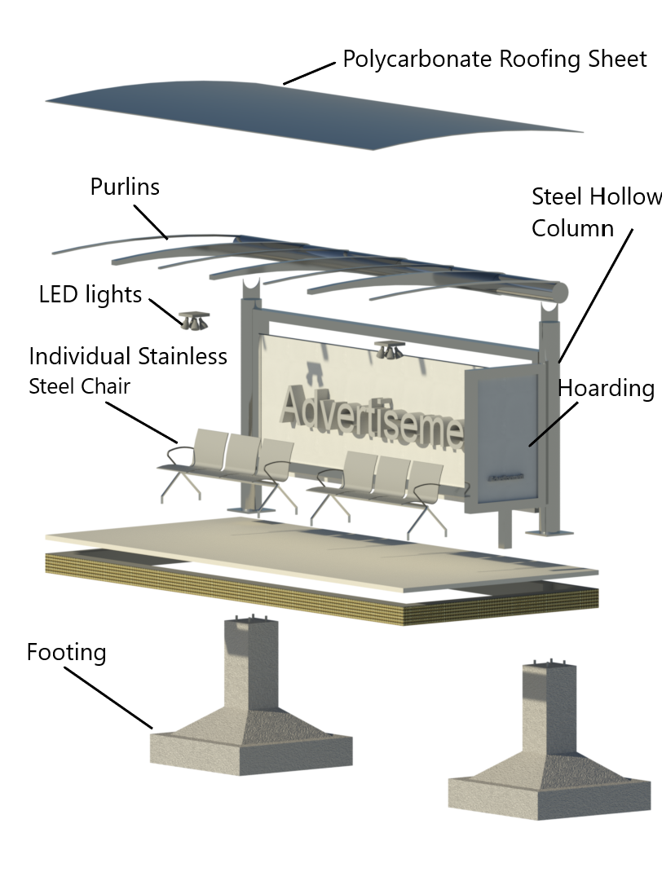
Pop up Ads

