Slide 1




Massachusetts Psychosis Access and Triage Hub
Emily Gagen, PhD
M-PATH Director

Slide 2
The Challenge
Research has shown that the quicker individuals with psychosis get into treatment, the better their long-term outcomes. Early treatment is life changing.
Clinicians often don’t know how best to respond when working with an individual with symptoms of psychosis.
Massachusetts has an extensive network of specialized programs for youth and young adults with psychosis, but it can be difficult for families and clinicians to navigate this system.

Slide 3
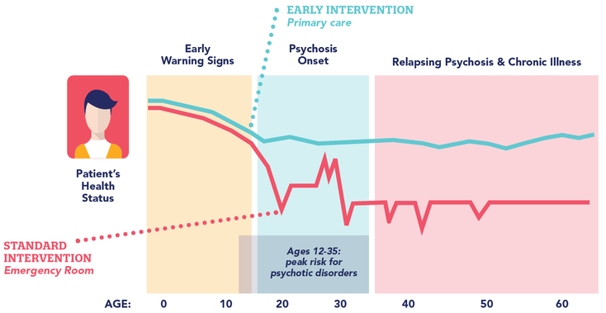

www.psychosisscreening.org

Slide 4
The Challenge
Research has shown that the quicker individuals with psychosis get into treatment, the better their long-term outcomes. Early treatment is life changing.
Clinicians often don’t know how best to respond when working with an individual with symptoms of psychosis.
Massachusetts has an extensive network of specialized programs for youth and young adults with psychosis, but it can be difficult for families and clinicians to navigate this system.

Slide 5
Psychosis
Sometimes associated with hospitalization
Clinical High Risk (CHR-p)
A constellation of symptoms involving changes in mood, thinking, and perceptions
Genetic risk / family history also a factor
A significant disruption in functioning
Most people who develop psychosis experience other mental health concerns earlier in life.
Signs of clinical high risk for psychosis can be reliably identified and increasing research supports effectiveness of early treatment.
About 10-25% will develop a psychotic disorder in next 2-3 years.

Slide 6
Signs To Consider
Drop in grades/work performance
Trouble concentrating
Decline in self-care
Social withdrawal
Unusual or intense ideas
Suspiciousness
Sensitivity to sights/sounds
Feeling like your mind is “playing tricks on you”
A close relative with serious mental illness (especially psychosis)
Borrowed from Dr. Michelle Friedman-Yakoobian

Slide 7

Psychosis-Informed Care
Helping providers feel more confident in assessing and treating psychosis in adolescents and young adults
Resources, information, and consultation

Slide 8
Psychosis-Informed Care
Normalize
Unusual perceptual experiences (psychotic-like experiences) are common and part of many different clinical issues and presentations (e.g., psychotic disorders, trauma, substance use).
Early intervention and engagement in treatment lead to significantly improved long-term outcomes for people with persistent psychotic experiences. Approaches that include choice, collaboration, empowerment, and (when appropriate) engagement of family tend to work best.
Open Door
Because people are often reluctant to reveal these experiences, inquire and respond with an “open door” – being curious, thoughtful, and empathic, without needing to be the voice of reality or assuming there are safety concerns.
Because these experiences can be a part of many different clinical issues, a careful differential diagnosis is often the best approach; this may require some tolerance of uncertainty.
Open Mind
Engagement

Slide 9
The Challenge
Research has shown that the quicker individuals with psychosis get into treatment, the better their long-term outcomes. Early treatment is life changing.
Clinicians often don’t know how best to respond when working with an individual with symptoms of psychosis.
Massachusetts has an extensive network of specialized programs for youth and young adults with psychosis, but it can be difficult for families and clinicians to navigate this system.

Slide 10
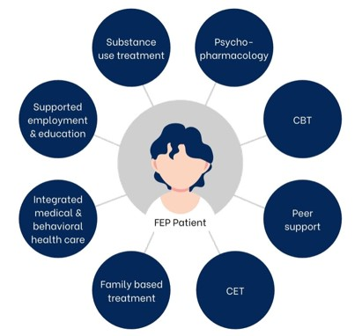
Coordinated Specialty
Care

Slide 11
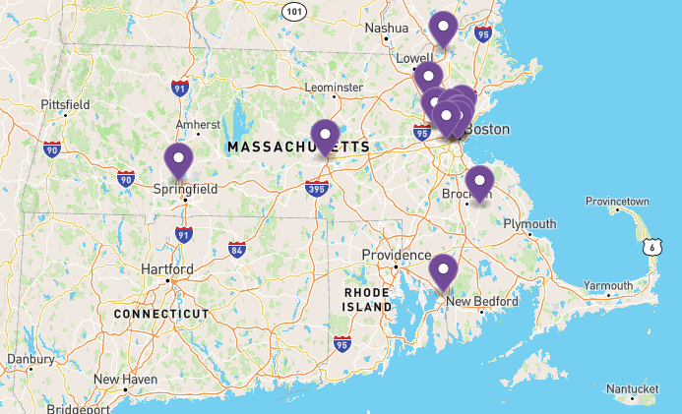

Slide 12


Massachusetts Psychosis Access and Triage Hub
A free referral and triage hub for clinical high risk and early psychosis services in Massachusetts (under age 30)
Consultation for medical and mental health professionals
Referral support for young people and their loved ones
(617) 927-9809
mpath@brooklinecenter.org
www.mpathcares.org

Slide 13
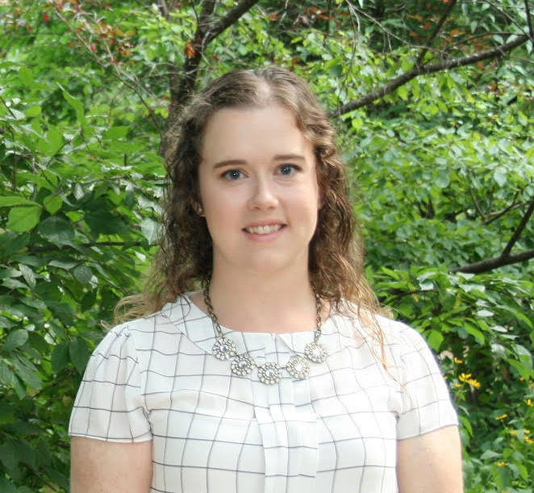

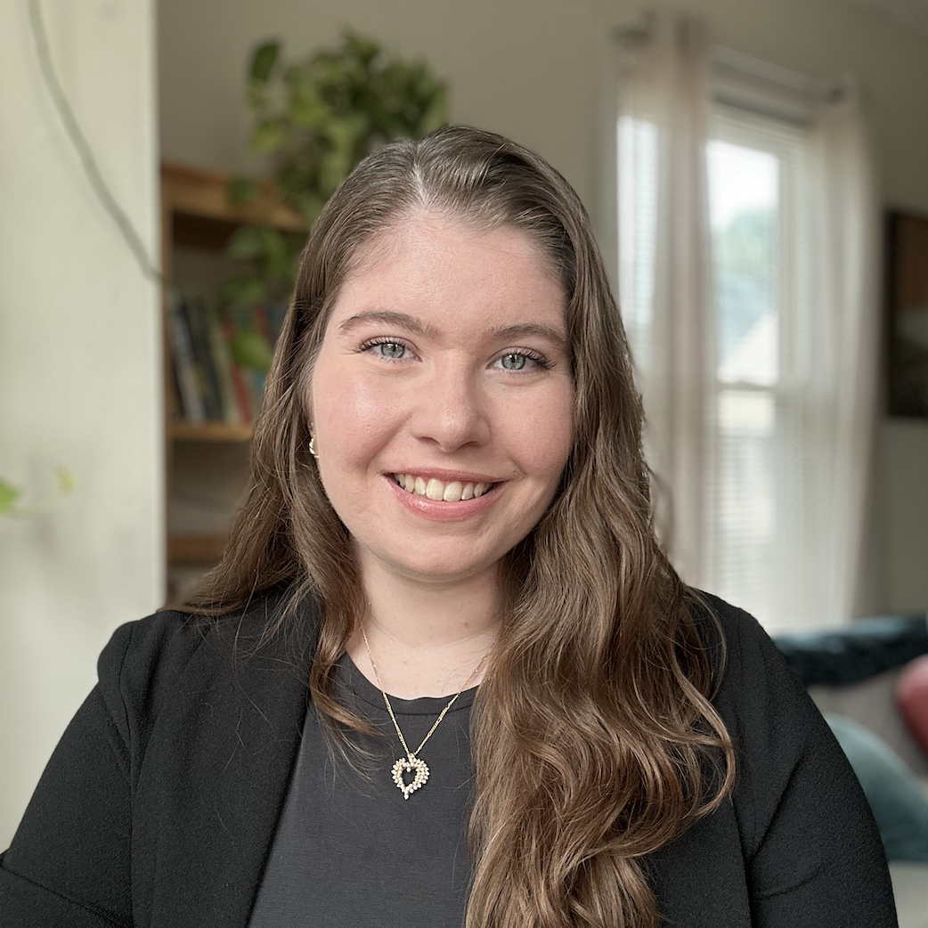
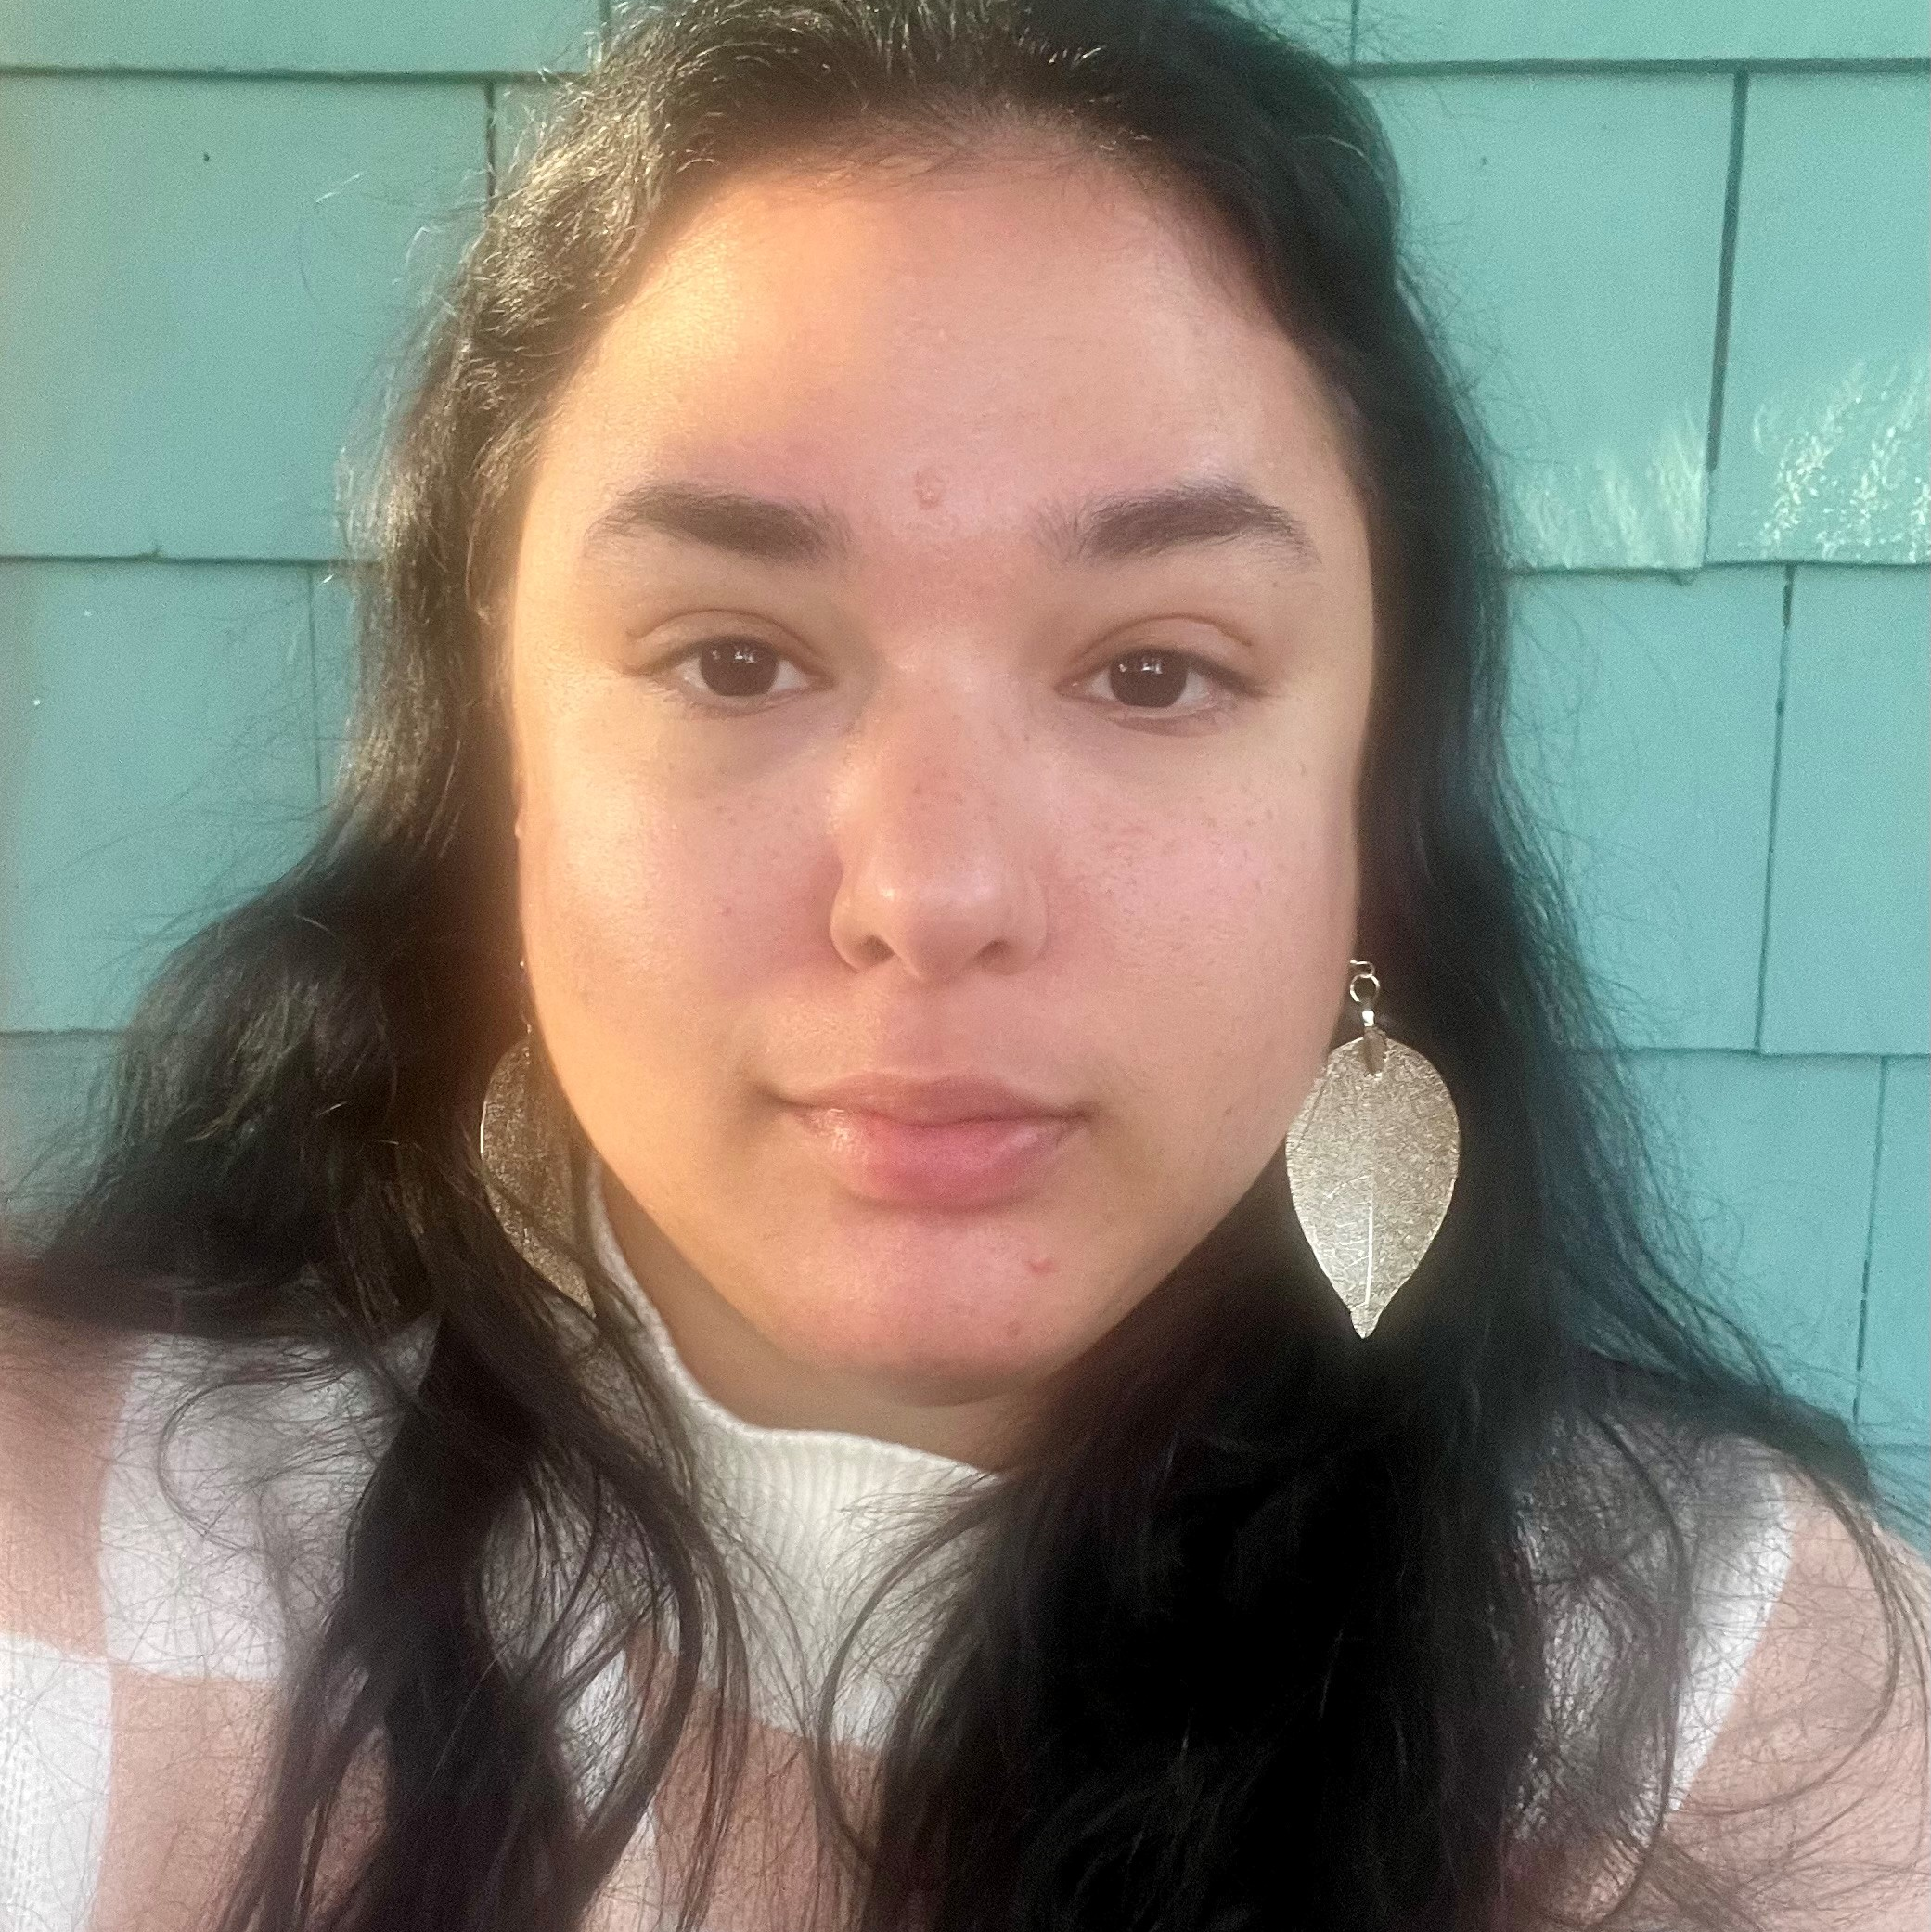
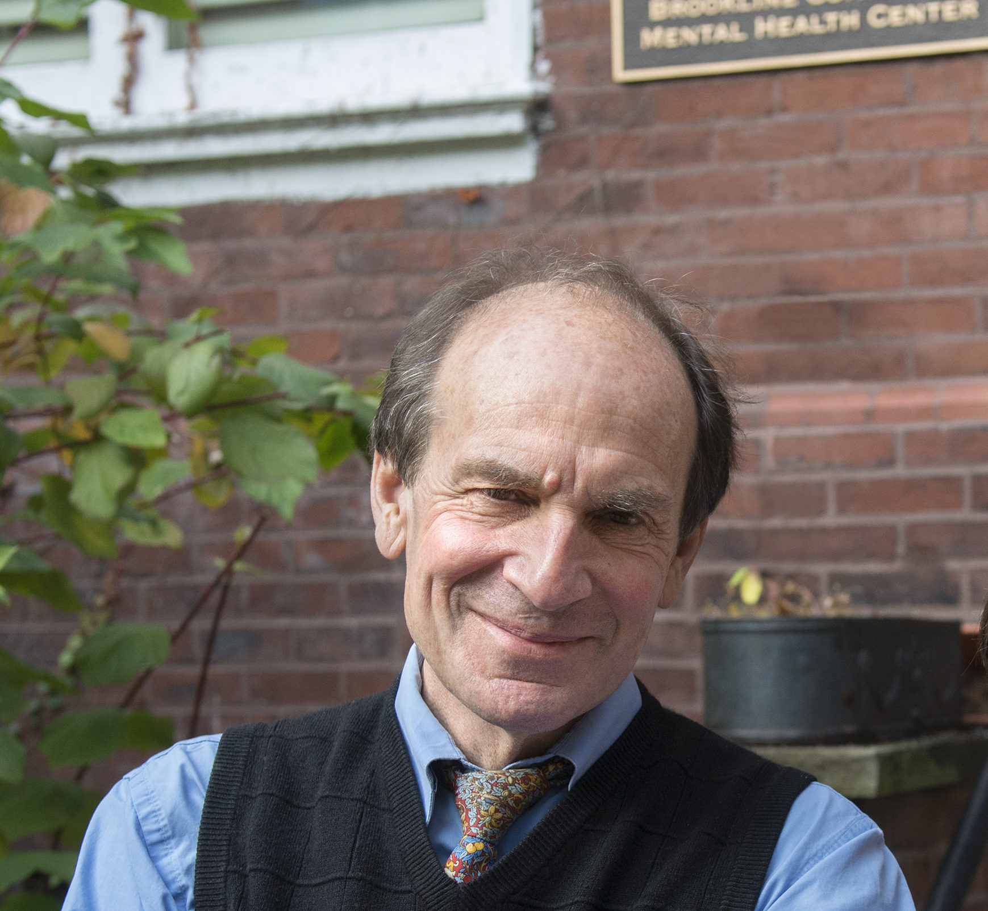




Our Team
Emily Gagen, PhD
Director
Rebecca Wlcek, BA
Program Coordinator
Charlene Flynn, LMHC
Clinician/Care Coordinator
Natalia Nodiff
Young Adult Peer Mentor
Currently
Hiring!
Henry White, MD
Founder, Lead Consultant
Jessica Stern, MD
Co-Founder,
Psychiatric Consultant
Amanda Weber, PhD
Psychological Consultant
Family
Partner

Slide 14
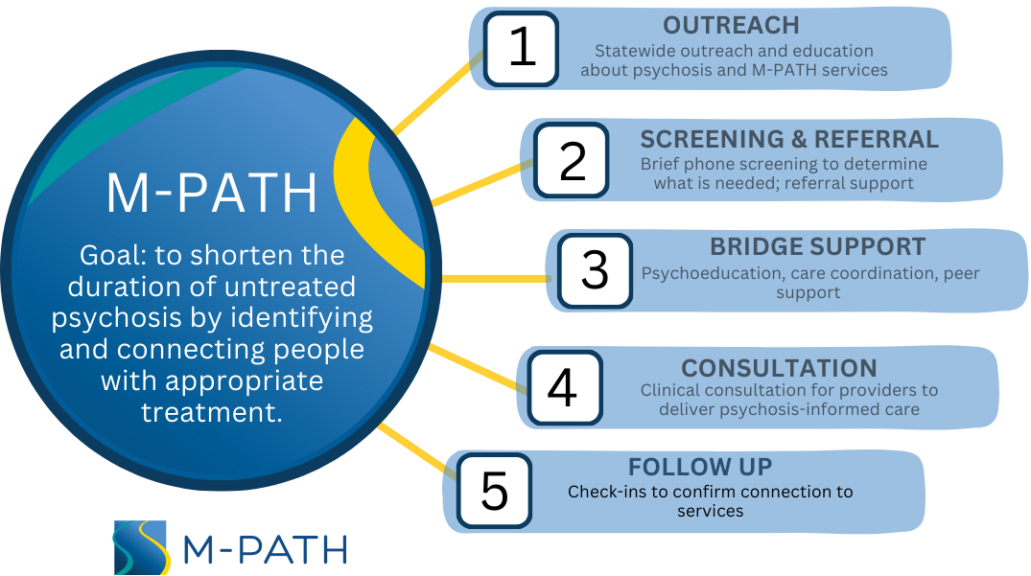

Slide 15
How We Can Help
For Providers
For Clients & Families
Diagnostic consultation and education regarding risk for psychosis and early psychosis
Ongoing consultation for long-term work with youth and families with early psychosis
Facilitation of referral to specialized psychosis treatment
Psychosis-informed care
Triage to help determine which services would be the best fit
Navigation to coordinated specialty care, including first episode or clinical high risk for psychosis programs
Care coordination and support throughout the referral process
Peer and family support and education

Slide 16


How To Connect
With Us
Call, email, or complete online contact form
Quick (10-15 minute) phone call to gather info
Zoom consultation
Connect with young person/family
Assist with CHR/FEP referral
Provide community resources
(peer support, groups, etc.)
(617) 927-9809
mpath@brooklinecenter.org
www.mpathcares.org

Slide 17
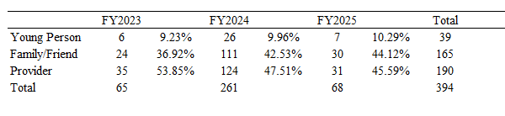
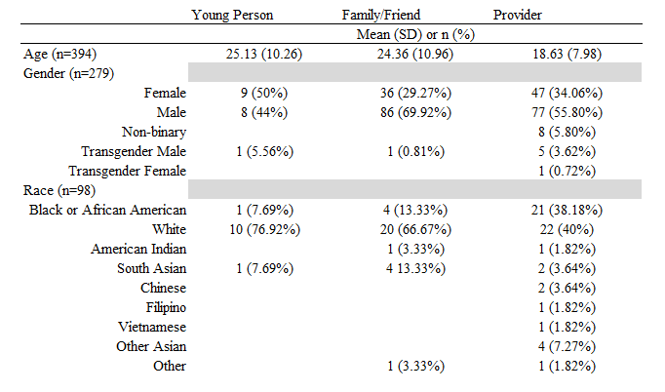

Slide 19
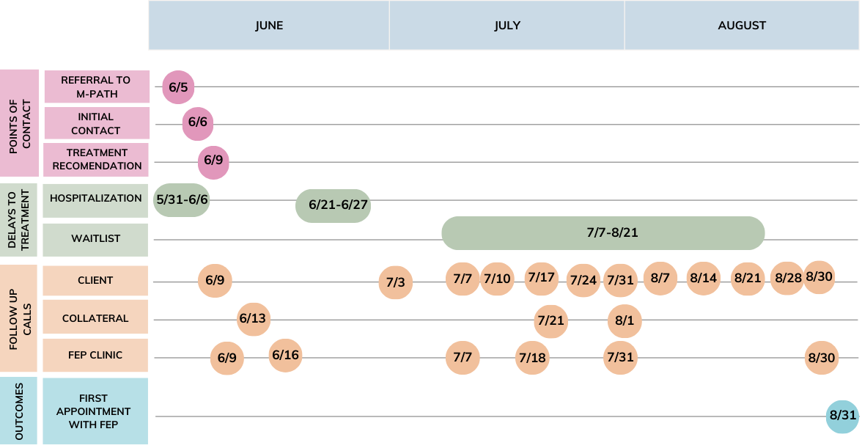

Slide 20
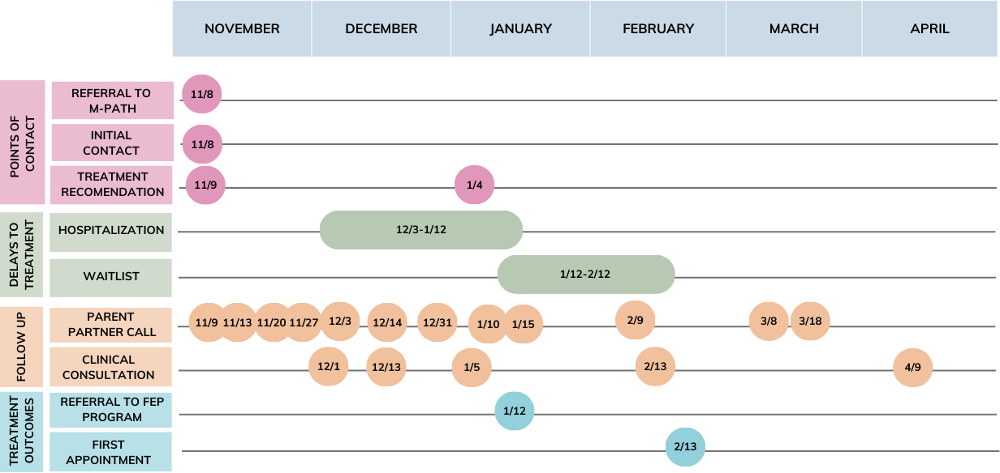

Slide 21

Future Presentation Opportunities
Symptoms of psychosis and clinical high risk for psychosis
Prevalence
Screening and assessment
Principles of psychosis-informed care
  How to discuss symptoms with clients and family
  Differential diagnosis questions
Specialized treatment options

Slide 22
Massachusetts Psychosis Access and Triage Hub
A free referral and triage hub for clinical high risk and early psychosis services in Massachusetts (under age 30)
Consultation for medical and mental health professionals
Referral support for young people and their loved ones
(617) 927-9809
mpath@brooklinecenter.org
www.mpathcares.org

