Slide 1
Relational Clinical Supervision and Psychosis

Slide 2

Why focus upon clinical supervision and psychosis?
Importance of early outreach in outcomes for individuals in order to shorten the Duration of Untreated Psychosis (DUP)
First three years after onset is thought to be a critical period in which symptoms are more responsive to treatment
Prolonged delay in getting treatment may result in poorer symptomatic and functional recovery

Slide 3

Why focus upon clinical supervision and psychosis?
Many individuals exit graduate programs feeling underprepared to assess and treat conditions which include psychosis, especially in the early stages.
Well trained therapists who are grounded in skills associated with identifying, assessing and treating mental health conditions which include psychosis, could increase protective conditions for many of their clients through opportunities for early intervention.

Slide 4

Risks associated with delay in identifying and treating psychosis
Negatively impacts important developmental tasks
Can increase social isolation
Increased vulnerability to coping with substances
Increased vulnerability to traumatic events
Increased vulnerability towards involvement with criminal justice system
Increased vulnerability to depression and suicide

Slide 5

My entry into thinking about clinical supervision
Experiences as a trainee and as a student of psychology
Experience of seeing acuity customarily referred out in college counseling practicums while working in community mental health settings
Decision to focus on the subject for my dissertation :
Significant and Impactful Experiences of Clinical Supervision: Experiences of Connection and Disconnection in the Current Cultural Clearing

Slide 6

What is clinical supervision?
Relationship with opportunities for mentorship and teaching
Practice central to the training of psychotherapists
Space to define and explore best practices including ethical guidelines of profession
Opportunity to explore cultural and systemic spheres that trainees and their clients are negotiating contextual to treatment and professional development milestones

Slide 7
My assumptions about clinical supervision
Clinical supervision plays a critical role in training as it transmits, amplifies and brings to light particular practices, attitudes and values.
The relationship between the supervisor and supervisee is central to accomplishing the goals of successful clinical supervision.
Clinical supervision is an inherently emotional learning experience
Emotional safety which includes the capacity for trust is key for supervisees to take the necessary risks required for growth

Slide 8

Multicultural maps activity
The language we use, the issues we deem worthy of examination, the happenings we identify as problems and solutions, the information we consider data, the procedures we believe to be scientifically proper-all are embedded in a specific cultural terrain.
Cushman, P. (2011). So who’s asking? Politics, hermeneutics, and individuality. In R. Frie & W. Coburn (Eds.), Persons in context: The challenge of individuality in theory and practice (pp. 21-40). New York, NY: Routledge.

Slide 9

The importance of trust in the supervisory relationship
“I think they need to feel trust and to feel safe to consult. And when they don’t feel like
they can, that’s also when clients are impacted. So, it’s not even just about my
supervisees’ well-being. I feel like everybody in the system, and also ultimately clients,
get impacted when supervisees don’t feel like they have a place to explore their feelings,
and what’s coming up for them, and their questions, or to feel like they can take risks
from what we talk about in supervision and to take it out there with clients and try
something new. And so I feel like that safety piece is critical.”

Slide 10

The importance of being able to make mistakes
To live in a world without forgiveness…is to make of life an instant fossil record, each imperfect action instantly ossifying us into a failed promise of personhood
“I know that supervisees need to be able to feel safe, to take risks to share their vulnerabilities and that it’s in that place where they can grow.”
(…) there isn’t the expectation for people to know everything [the] hope [is] that supervision is a time where people can ask questions and to say, “It’s okay to make mistakes. We all are learning.” And to hopefully hold a place where it’s not shameful to talk about the questions of, “Did I do this right?” Or, “I think I made a mistake.”

Slide 11
Literature
Hamm, J. A., Leonhardt, B. L., Wiesepape, C., & Lysaker, P. H. (2023). Supervision of psychotherapy for psychosis: A meaning-making approach. Psychological Services, 20(2), 326–334. https://doi.org/10.1037/ser0000677

Slide 12

Challenges for supervisees surrounding early psychosis
Tendency for clinicians and trainees to feel deskilled when encountering psychotic or subclinical symptoms
Assumption that the practices which they have mastery over don’t apply with psychosis
Experiences of fear, dread and dissociation away from psychotic features
Finding the balance with assessment processes

Slide 13
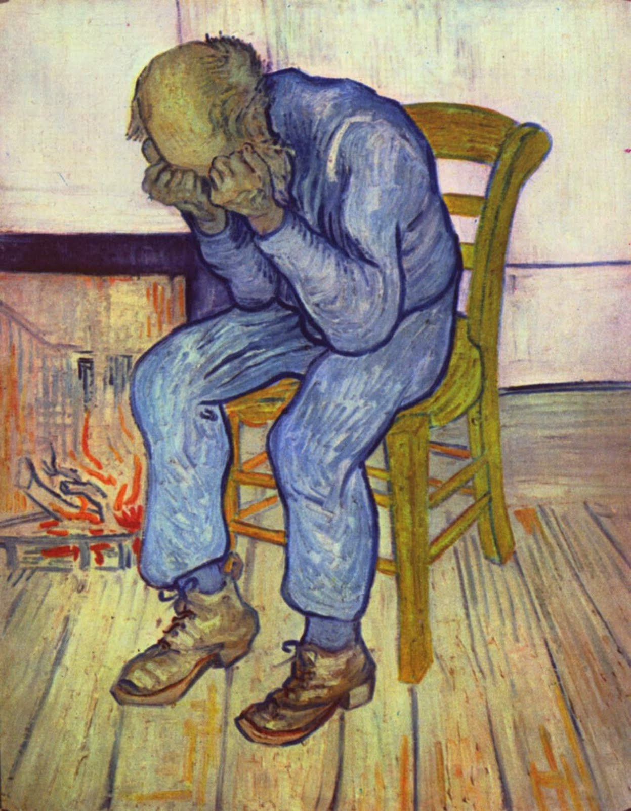
Challenges for supervisees surrounding early psychosis
Protective instinct of supervisee may increase hesitance around diagnosis due to stigma
Lack of practice including psychosis with more familiar differentials/clinical presentations
There may be confusion about what is possible regarding therapeutic relationship building and nature of the therapy itself with clients
There may be a learning curve about how to effectively participate in a wrap-around approach
There may be a sense of overwhelm in connecting to higher levels of care and how to navigate a crisis.

Slide 14

Protective factors in relational supervision
Offers a foundation from which to better facilitate:
Mentorship
Appropriate risk taking
Communication
Learning
Safety

Slide 15

Working with families
Incredibly important in terms of outcomes and treatment planning
Supporting supervisees to listen well and deeply while creating clear systems of communication
To be thoughtful about diversity of experiences among family members (grief, anger, worry)
To be aware of and respectful of cultural values, perspectives on care

Slide 16

Questions or comments?
Please feel free to stay in touch!
Cailin Qualliotine, PsyD
cqualliotine@amherst.edu
cqpsych@gmail.com

Slide 17
Literature
Gazzola, N., & Thériault, A. (2007). Relational Themes in Counselling Supervision: Broadening and Narrowing Processes. Canadian Journal of Counselling and Psychotherapy, 41, 228-243.
Hamm, J. A., Leonhardt, B. L., Wiesepape, C., & Lysaker, P. H. (2023). Supervision of psychotherapy for psychosis: A meaning-making approach. Psychological Services, 20(2), 326–334. https://doi.org/10.1037/ser0000677
Itzhaky, H., Karin, N. & Ribner, D.S. Supervision of Therapy with Patients Diagnosed as Psychotic. Clinical Social Work Journal 29, 147–158 (2001). https://doi.org/10.1023/A:1010326019344
Lysaker, Paul & Buck, Kelly & Pattison, Michelle & Beasley, Rhianna & Hillis-Mascia, Jaclyn & Hamm, Jay. (2019). Supervision in the Psychotherapy of Schizophrenia: Awareness of and Mutual Reflection upon Fragmentation. American journal of psychoanalysis. 79. 284-303. 10.1057/s11231-019-09198-y.

