Slide 1
Measuring the Impact of Care Farming
Autism and Psychosis
John Knutsen, Ph.D.
Director of Research
ServiceNet Inc.
January 22, 2025

Slide 2

Outline of Talk
  Why?
  Defining the terms and overview
  Brief history of autism and psychosis
  Prevalence
  Diagnosis/Assessment
  Treatment

Slide 3
Why Autism and Psychosis?

Slide 4
Why Autism and Psychosis?
Autism spectrum disorders and psychosis spectrum disorders are separate conditions with clinically distinct profiles:

Slide 5
Why Autism and Psychosis?
Autism spectrum disorders and psychosis spectrum disorders are separate conditions with clinically distinct profiles:
  Autism is typically diagnosed in early childhood and individuals tend to maintain a relatively balanced level of functioning

Slide 6
Why Autism and Psychosis?
Autism spectrum disorders and psychosis spectrum disorders are separate conditions with clinically distinct profiles:
  Autism is typically diagnosed in early childhood and individuals tend to maintain a relatively balanced level of functioning
  Psychosis-related conditions are typically diagnosed in adolescence/early adulthood and individuals tend to experience steep declines in functioning

Slide 7
Why Autism and Psychosis?
Autism spectrum disorders and psychosis spectrum disorders are separate conditions with clinically distinct profiles:
  Autism is typically diagnosed in early childhood and individuals tend to maintain a relatively balanced level of functioning
  Psychosis-related conditions are typically diagnosed in adolescence/early adulthood and individuals tend to experience steep declines in functioning
However,
  Both conditions share a range of overlapping characteristics that can make recognizing psychosis in autism challenging

Slide 8
Why Autism and Psychosis?
And
  Most individuals with autism (~74%) live with at one least co-occurring condition (Khachadourian et al., 2023)

Slide 9
Why Autism and Psychosis?
And
  Most individuals with autism (~74%) live with at one least co-occurring condition (Khachadourian et al., 2023)
  Individuals with autism are three to six times more likely to develop schizophrenia than their neurotypical counterparts (Jutla, Foss‐Feig, & Veenstra‐VanderWeele, 2022)

Slide 10
Why Autism and Psychosis?
And
  Most individuals with autism (~74%) live with at one least co-occurring condition (Khachadourian et al., 2023)
  Individuals with autism are three to six times more likely to develop schizophrenia than their neurotypical counterparts (Jutla, Foss‐Feig, & Veenstra‐VanderWeele, 2022)
  A recent metanalysis on the occurrence of psychosis in adults with ASD reported a rate of psychotic disorders that is at least ten times higher than in the general population (Gesi et al., 2024)

Slide 11
Why Autism and Psychosis?
Difficulties differentiating between psychotic symptoms and core characteristics in autism

Slide 12
Why Autism and Psychosis?
Difficulties differentiating between psychotic symptoms and core characteristics in autism
High rates of psychosis spectrum conditions in autism

Slide 13
Why Autism and Psychosis?
Difficulties differentiating between psychotic symptoms and core characteristics in autism
High rates of psychosis spectrum conditions in autism
Scant attention in scientific and clinical literature
Limited guidance on how to diagnose and treat psychosis in individuals with autism

Slide 14
Why Autism and Psychosis?
Imperative to further our knowledge and understanding of autism and psychosis to improve diagnosis, care and support for individuals and their families

Slide 15
Outline of Talk
  Why?
  Defining the terms and overview
  Brief history of autism and psychosis
  Prevalence
  Diagnosis/Assessment
  Treatment

Slide 16
Autism:
A heterogeneous neurodevelopmental condition characterized by two broad domains

Slide 17
(APA, 2013)
Autism
Social reciprocity and social communication
Repetitive, restricted behaviors and interests; hyper/hypo reactivity to sensory input
Notes:
Social Reciprocity includes: Interaction; Social awareness; Social motivation; Social cognition; and appropriate management of atypical behaviors in social settings
RRBs: a heterogeneous cluster of behavioral symptoms that include restricted interests, preoccupation with parts of objects, repetitive motor mannerisms, insistence on sameness, sensory behaviors, and strict adherence to specific routines or rituals. Use example!

Slide 18
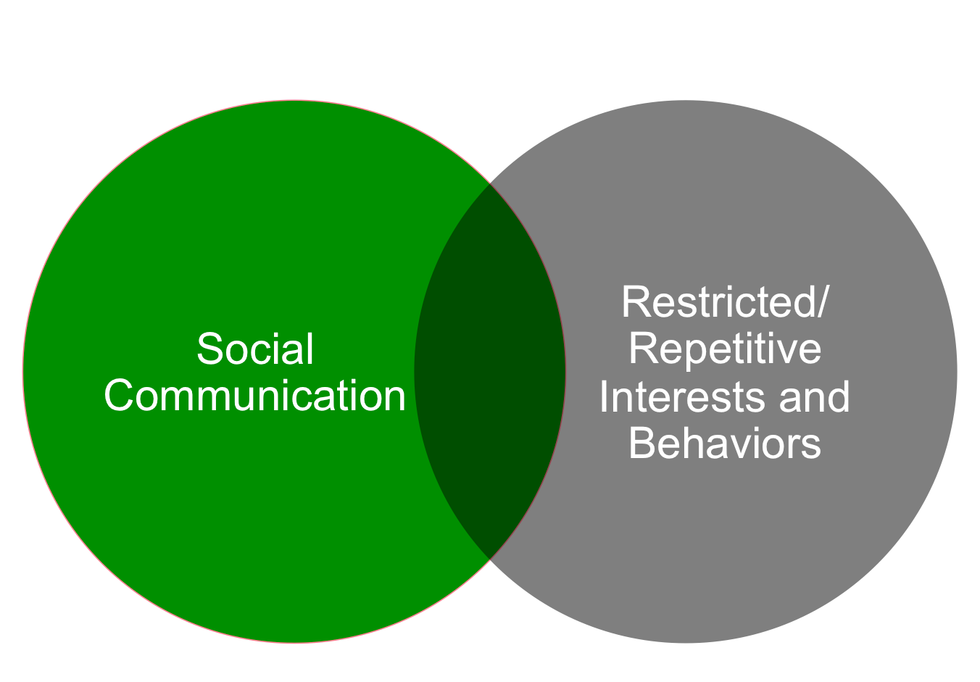

Autism Spectrum Condition (ASC)
Social (pragmatic) communication disorder
Stereotypic movement disorder

Slide 19
Autism Overview
Average prevalence between 1%-2% (Asia, Europe, and North America)
Average age of diagnosis (in US) ~ 4 yrs
Found to occur in all racial, ethnic, and socioeconomic groups
  Minority groups tend to be diagnosed later and less often
No known etiology
  Strong genetic component, but also influenced by environment
No known ‘cure’*
  Myriad interventions available with varying evidence for effectiveness
  (Baio et al., 2018)

Slide 20
Autism Overview
Associated with intellectual disability (ID; IQ <70) in 31%, borderline range ID in 25% (IQ 71–85), and 44% of children have IQ scores in the average/above average range (i.e., IQ >85)
  Autism symptoms more pronounced in individuals with co-occurring ID
Typically associated with additional neurodevelopmental, cognitive, behavioral and emotional differences
No genetic or biological test to diagnose autism
Roughly four times more likely to be diagnosed in boys (~1 in 23) than in girls (~1 in 87)
(CDC, 2020)

Slide 21
Autism Overview
Dimensional/spectrum condition: each person with autism has a distinct set of strengths and challenges
Some people with autism may require significant support in their daily lives, others may need less support, and some live entirely independently
Often accompanied by sensory sensitivities, medical issues such as GI disorders, seizures or sleep disorders, as well as mental health challenges such as anxiety, depression and attention issues
(CDC, 2020)

Slide 22
Psychosis:
Characterized by impairments/disruptions in perceptions, thoughts, and emotions

Slide 23
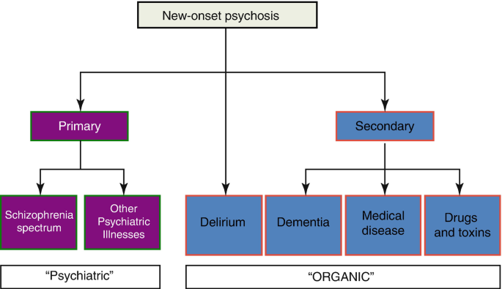
Psychosis Overview
Two broad categories
Notes:
Delerium: Psychosis caused by medical issues; a mental state in which the client becomes temporarily confused, disoriented, and not able to think or remember clearly. It usually starts suddenly and can indicate the onset of a life-threatening medical condition. Sometimes referred to as ICU/post-surgery psychosis

Slide 24
Psychosis Overview
Two broad categories

Slide 25
Psychosis Overview
Schizophrenia Spectrum and Other Psychotic Disorders (DSM-5 TR):
Schizotypal (Personality) Disorder
Delusional Disorder
Brief Psychotic Disorder
Schizophreniform Disorder
Schizophrenia
Schizoaffective Disorder
Substance/Medication-induced Psychotic Disorder
Psychotic disorder due to another medical condition
Catatonia
Other Specified Schizophrenia Spectrum and Other Psychotic Disorder
Unspecified Schizophrenia Spectrum and Other Psychotic Disorder

Slide 26
Psychosis Overview
Between 1.5%-3.5% will meet dx criteria for a psychotic disorder: a significantly larger number will experience at least one psychotic symptom in their lifetime
Median age of onset is between 14.5 and 26 years
Can happen to anyone
No known etiology
  Strong genetic component, but also influenced by environment
No known ‘cure’
  Number of treatments/interventions available with varying evidence for effectiveness

Slide 27
Psychosis Overview
Associated with accelerated cognitive decline and additional neurodevelopmental, behavioral and emotional differences
No genetic or biological test to diagnose psychotic disorders
Differences between people assigned male or female sex at birth: age of onset; premorbid functioning; negative and affective symptoms; and substance use*
(Giordano et al., 2021)
Notes:
* Most of these findings are for schizophrenia specifically

Slide 28
Psychosis Overview
Dimensional/spectrum condition: psychosis is inherently heterogeneous—significant variation in how it is expressed and experienced across individuals
A longer duration of untreated psychosis (DUP) leads to poorer outcomes
Significantly earlier mortality (compared to general population)
Physical comorbidities may occur in up to 75% of individuals with a psychosis spectrum condition
Notes:
DUP: the period from onset of psychotic symptoms to the initiation of treatment; Young people experiencing first-episode psychosis (FEP) are 24 times more likely to die within the year of diagnosis than their age-matched peers AND die 13 to 15 years earlier than the general population

Slide 29
Outline of Talk
  Why?
  Defining the terms and overview
  Brief history of autism and psychosis
  Prevalence
  Diagnosis/Assessment
  Treatment

Slide 30
Autism and psychosis share an extended and complex history

Slide 31
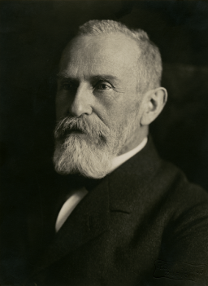
Autism origins: Eugen Bleuler (1911)
Coins term autism from Greek word autos meaning “self”
Used to describe the inward, self-absorbed aspects
(social withdrawal) of schizophrenia in adults
“Schizophrenics, who have no more contact with the outside world, live in a world of their own. They have encased themselves with their desires and wishes… This detachment from reality, together with the relative and absolute predominance of the inner life, we term autism (Bleuler, 1911 [emphasis mine])”
Notes:
Eugen Bleuler: Swiss psychiatrist

Slide 32
Autism origins: Eugen Bleuler (1911)
Schizophrenia is “not a disease in the strict sense,
but appears to be a group of diseases… Therefore
we should speak of schizophrenias in the plural”
Notes:
Eugen Bleuler: Swiss psychiatrist

Slide 33
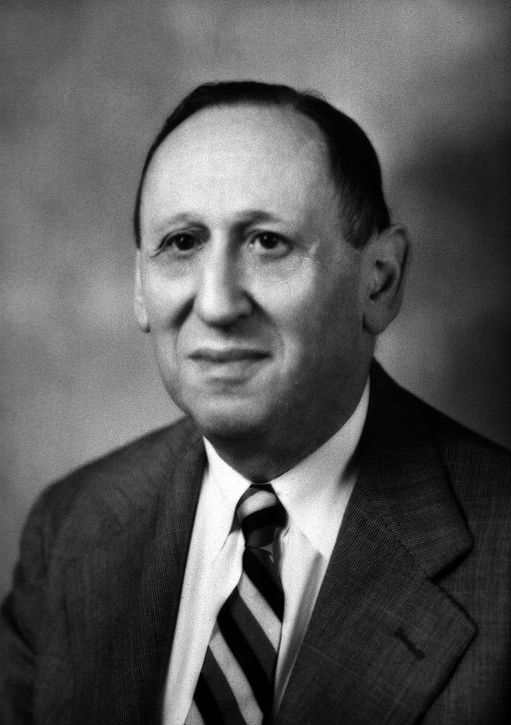
Leo Kanner (1943): Early Infantile Autism
Case series reporting 11 children (8 boys, 3 girls)
Congenital in nature (constitutional origin)
Two Fundamental Characteristics
Lack of interest in social world (autism)
Resistance to change (insistence on sameness)
“The outstanding, ‘pathognomonic’ fundamental disorder is in the children’s inability to relate themselves in the ordinary way to people and situations from the beginning of life”
Speculated that autism could be early-onset form of schizophrenia (1949)
Notes:
The prevailing view of the day, based on Freudian psychology, had been that autism was due to poor parenting, with much of the blame placed on ‘frigid’ mothers accused of rejecting their children.

Slide 34
Autism Definition
DSM-I (1952) & DSM-II (1968) No Autism/Pervasive Developmental Disorder (PDD)
Closest term: Schizophrenic Reaction (Childhood Type)
no distinction between ASD and childhood schizophrenia
characterized by “autistic, atypical, and withdrawn behavior”

Slide 35
Autism = Schizophrenia?
Rutter (1970)
Proportion of children with autism developed epilepsy in late adolescence
No association between schizophrenia and epilepsy*
Rutter (1972, p. 327)
Schizophrenia: “a withdrawal into fantasy, but this is not what happens in the syndrome of autism. The schizophrenic may retreat from reality into fantasy, but the autistic child does not retreat, rather he fails to develop social relationships—a crucial distinction”
Kolvin (1971)
Two disorders were characterized by different ages of onset and independent developmental trajectories
Notes:
Kolvin (1971) (autism symptoms are observable in early childhood, but schizophrenia symptoms typically do not manifest until late adolescence or early adulthood

Slide 36
Autism Definition
DSM-I (1952) & DSM-II (1968) No Autism/Pervasive Developmental Disorder (PDD)
Closest term: Schizophrenic Reaction (Childhood Type)
DSM-III (1980) PDD: Childhood Onset PDD,
Infantile Autism, Atypical Autism
- No-comorbid psychosis
DSM-IV (1994) Autism is a PDD with early onset of a triad of features
Comorbid schizophrenia spectrum conditions reinstated

Slide 37
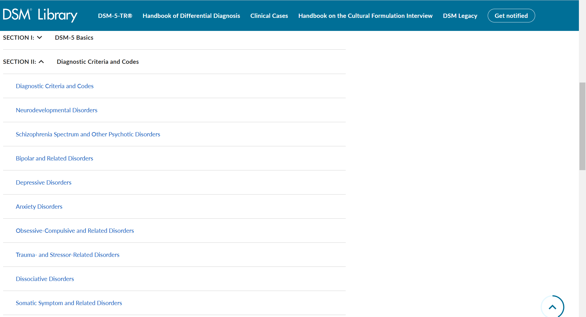

Autism Definition

Slide 38
Outline of Talk
  Why?
  Defining the terms and overview
  Brief history of autism and psychosis
  Prevalence
  Diagnosis/Assessment
  Treatment

Slide 39
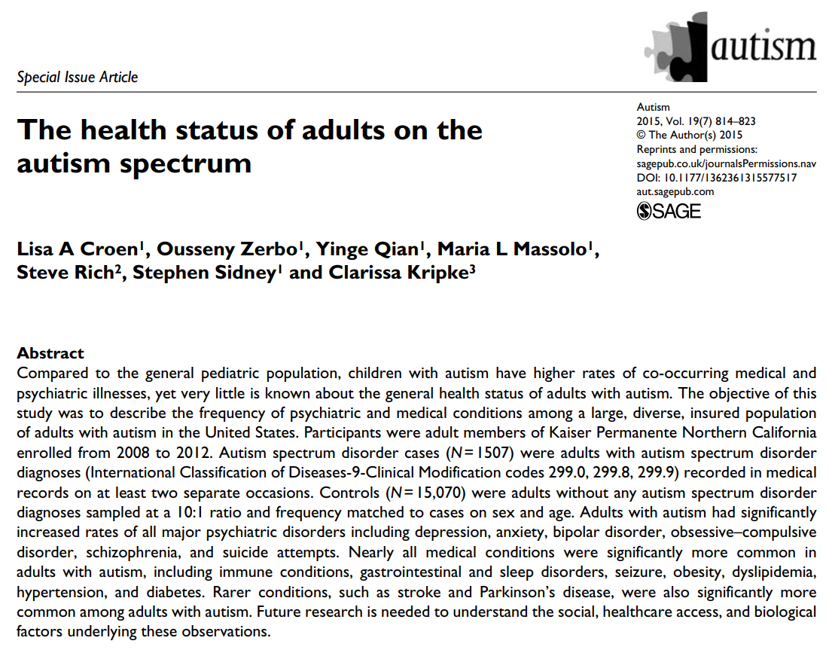

Slide 40


Slide 41
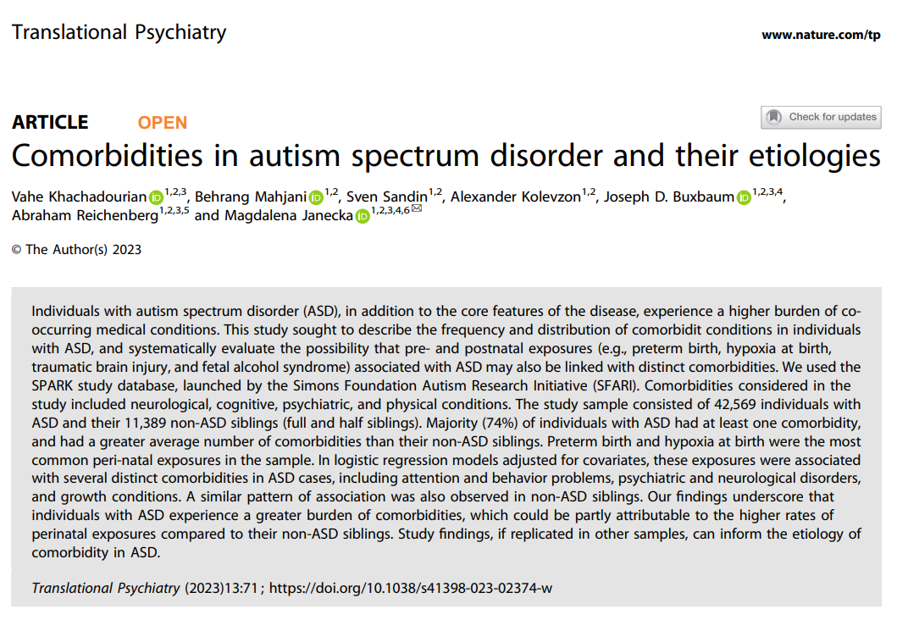
CO-OCCURRING CONDITIONS AND TREATMENT

Slide 42
CO-OCCURRING CONDITIONS AND TREATMENT

Slide 43
Co-Occurring Psychosis in Autism
De Giorgi et al. (2019). Prevalence of non-affective psychoses in individuals with ASD: a systematic review
Fourteen studies w/ a weighted pooled prevalence assessed at 9.5%
Hossain et al. (2020). Prevalence of comorbid psychiatric disorders among people with ASD: a systematic review and meta-analysis
Prevalence ranged from 4% to 67% (8 reviews)
Varcin et al. (2022). Occurrence of psychosis and bipolar disorder in adults with autism: a systematic review and meta-analysis
Fifty-three studies w/ estimated pooled prevalence of 9.4% for psychosis and 7.5 % for BPD
Ferrara et al. (2023). FEP and ASD: a scoping review
Prevalence of ASD in FEP ranges from 3.6% to 9%

Slide 44
Outline of Talk
  Why?
  Defining the terms and overview
  Brief history of autism and psychosis
  Prevalence
  Diagnosis/Assessment
  Treatment

Slide 45
(APA, 2013)
Autism
Social reciprocity and social communication
Repetitive, restricted behaviors and interests; hyper/hypo reactivity to sensory input
Notes:
Social Reciprocity includes: Interaction; Social awareness; Social motivation; Social cognition; and appropriate management of atypical behaviors in social settings
RRBs: a heterogeneous cluster of behavioral symptoms that include restricted interests, preoccupation with parts of objects, repetitive motor mannerisms, insistence on sameness, sensory behaviors, and strict adherence to specific routines or rituals. Use example!

Slide 46
Psychosis
Positive symptoms (5 domains)
Negative symptoms (5 domains)
(APA, 2013)

Slide 47
Positive symptoms: Symptoms that are in addition to typical behavior
5 Domains
Delusions
Hallucinations
Disorganized
thought
Disorganized
speech
Disorganized
behavior

Slide 48
Negative symptoms: Symptoms in which a person has deficits in expected behaviors
5 Domains
Blunted/flat affect
Alogia
Avolition
Asociality
Anhedonia
Notes:
blunted affect (diminished emotional expression), alogia (reduction in quantity of words spoken), avolition (reduced goal-directed activity due to decreased motivation), asociality, and anhedonia (reduced experience of pleasure)

Slide 49
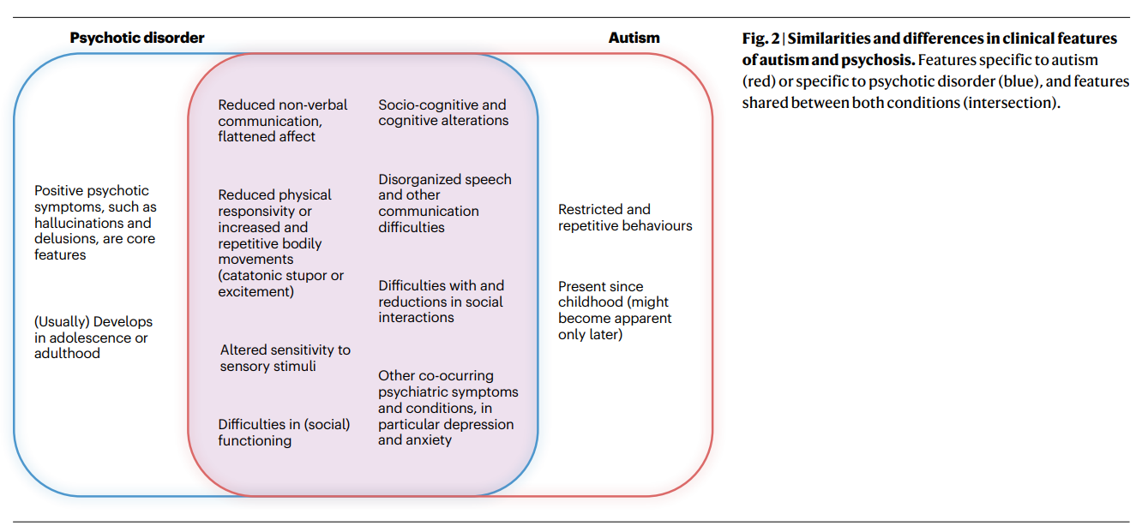
Similarities and Differences
(Schalbroeck et al. 2023)

Slide 50
Co-Occurring Psychosis in Autism: Potential Confounds
Positive Symptom Examples:
Hallucinations vs hypersensitivity to external stimuli (heightened sensory processing) in autism
  E.g., hearing electricity in the walls or seeing nearly microscopic airborne particles in the air

Slide 51
Co-Occurring Psychosis in Autism: Potential Confounds
Positive Symptom Examples:
Hallucinations vs hypersensitivity to external stimuli (heightened sensory processing) in autism
  E.g., hearing electricity in the walls or seeing nearly microscopic airborne particles in the air
Hallucinations vs concretism in autism
  E.g., responding to “do you hear voices that are not there” with “yes” (b/c they are referring to the radio)

Slide 52
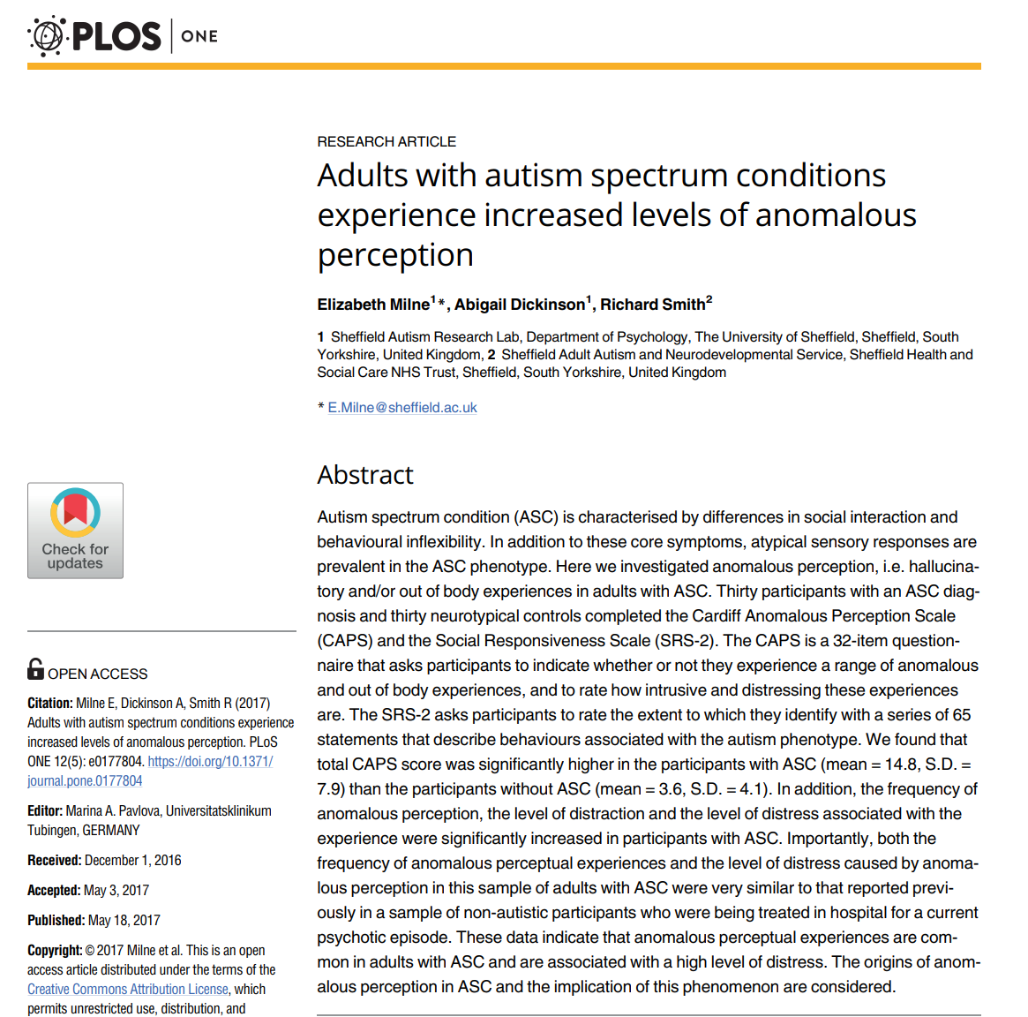

Slide 53
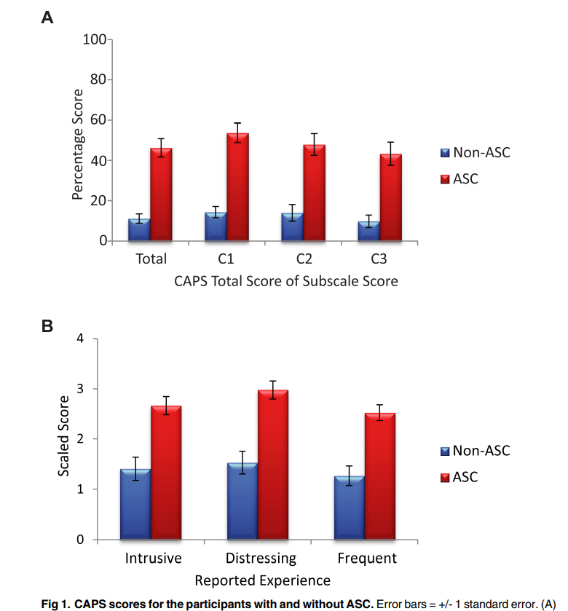
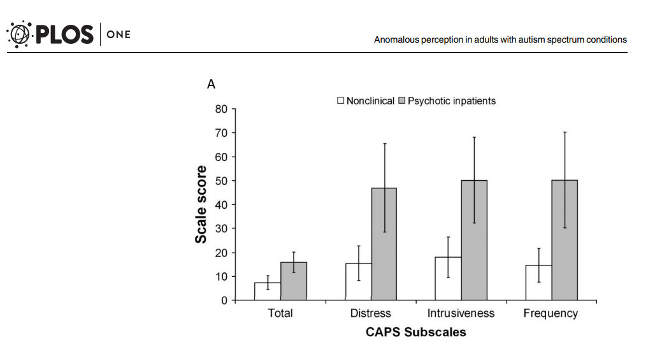

Slide 54
Co-Occurring Psychosis in Autism: Potential Confounds
Positive Symptom Examples
Delusions vs theory of mind (ToM)—both groups demonstrate ToM challenges, however

Slide 55
Co-Occurring Psychosis in Autism: Potential Confounds
Positive Symptom Examples
Delusions vs theory of mind (ToM)—both groups demonstrate ToM challenges, however
  Psychosis—ToM is typically not impaired prior* to a psychotic experience
  Autism—ToM differences are considered developmental in origin
  E.g., challenges with ToM (reading intentions in others for instance) can be conflated with paranoia

Slide 56
Co-Occurring Psychosis in Autism: Potential Confounds
Positive Symptom Examples
Delusions vs theory of mind (ToM)—both groups may demonstrate ‘paranoid’ thoughts about being persecuted or discriminated against, however

Slide 57
Co-Occurring Psychosis in Autism: Potential Confounds
Positive Symptom Examples
Delusions vs theory of mind (ToM)—both groups may demonstrate ‘paranoid’ thoughts about being persecuted or discriminated against, however
  High bullying rates in autism make this a rational fear, based on prior traumas

Slide 58
Co-Occurring Psychosis in Autism: Potential Confounds
Negative Symptom Examples:
Amotivation and avolition in psychosis
  Reduced sharing of emotion or lack of social initiation
  Diminished emotional expression
  Reduced eye contact
  Restrictions in facial expressions, gestures, and prosody

Slide 59
Co-Occurring Psychosis in Autism: Potential Confounds
Negative Symptom Examples:
Amotivation and avolition in psychosis
  Reduced sharing of emotion or lack of social initiation
  Diminished emotional expression
  Reduced eye contact
  Restrictions in facial expressions, gestures, and prosody
Social communication and social-emotional reciprocity differences in autism
  Reduced sharing of emotion or lack of social initiation
  Diminished emotional expression
  Reduced eye contact
  Restrictions in facial expressions, gestures, and prosody

Slide 60
Psychosis Assessment in Autism
No instruments designed to assess psychosis in autism

Slide 61
Psychosis Assessment in Autism
No instruments designed to assess psychosis in autism
Challenge: That a co-occurring psychosis dx is made only when symptoms are not better explained by primary autism dx

Slide 62
Psychosis Assessment in Autism
No instruments designed to assess psychosis in autism
Challenge: That a co-occurring psychosis dx is made only when symptoms are not better explained by primary autism dx
Red flags:
  perceptual abnormalities or beliefs and exhibits behaviors that seem different from baseline
  change in social, cognitive, or adaptive functioning from baseline
  collateral information is key!

Slide 63
Psychosis Assessment in Autism
No instruments designed to assess psychosis in autism
Challenge: That a co-occurring psychosis dx is made only when symptoms are not better explained by primary autism dx
New onset of symptoms and decline in functioning are key
  E.g., “An individual with [ASC] or communication disorder must have symptoms that meet full criteria for schizophrenia, with prominent hallucinations or delusions for at least 1 month, in order to be diagnosed with schizophrenia as a comorbid condition” (APA, 2013, p. 105)

Slide 64
Outline of Talk
  Why?
  Defining the terms and overview
  Brief history of autism and psychosis
  Prevalence
  Diagnosis and Assessment
  Treatment

Slide 65
Treatment for Psychosis in Autism
Little to no data on optimal treatment in literature

Slide 66
Treatment for Psychosis in Autism
Little to no data on optimal treatment in literature
The clinical complexity of autism requires comprehensive, coordinated interdisciplinary treatment and interventions (see, e.g., Fulceri et al., 2023, for a review)

Slide 67
Treatment in Autism
The Lancet Commission on the future of care and clinical research in autism (Lord et al., 2020)

Slide 68
Treatment in Autism
The Lancet Commission on the future of care and clinical research in autism (Lord et al., 2020)
Critical need for a “comprehensive and coordinated” approach to autism treatment and care
Better primary health care, mental health services, and evidence-based guidelines for the evaluation and treatment of co-occurring conditions

Slide 69
Treatment in Autism
The Lancet Commission on the future of care and clinical research in autism (Lord et al., 2020)
Recommend a “stepped-care” and personalized health model approach

Slide 70
Treatment in Autism
The Lancet Commission on the future of care and clinical research in autism (Lord et al., 2020)
Recommend a “stepped-care” and personalized health model approach
  treatment and support takes into account the preferences, needs of individuals and families at each step and are nested within communities, cultures, and social systems

Slide 71
Treatment in Autism
The Lancet Commission on the future of care and clinical research in autism (Lord et al., 2020)
Recommend a “stepped-care” and personalized health model approach
  treatment and support takes into account the preferences, needs of individuals and families at each step and are nested within communities, cultures, and social systems
  case management that includes education and community partners

Slide 72
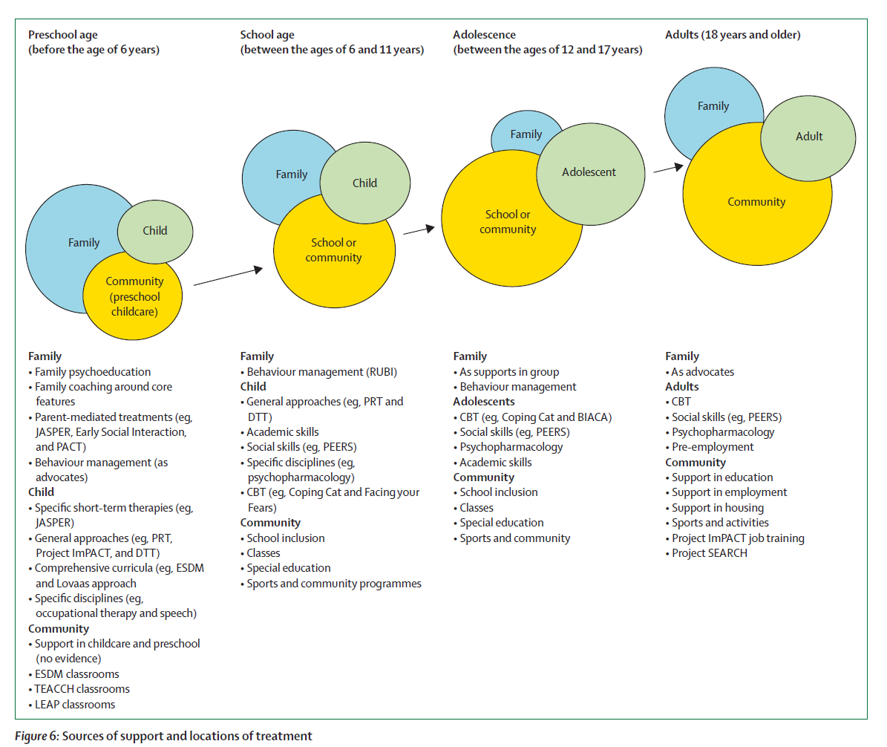

Slide 73
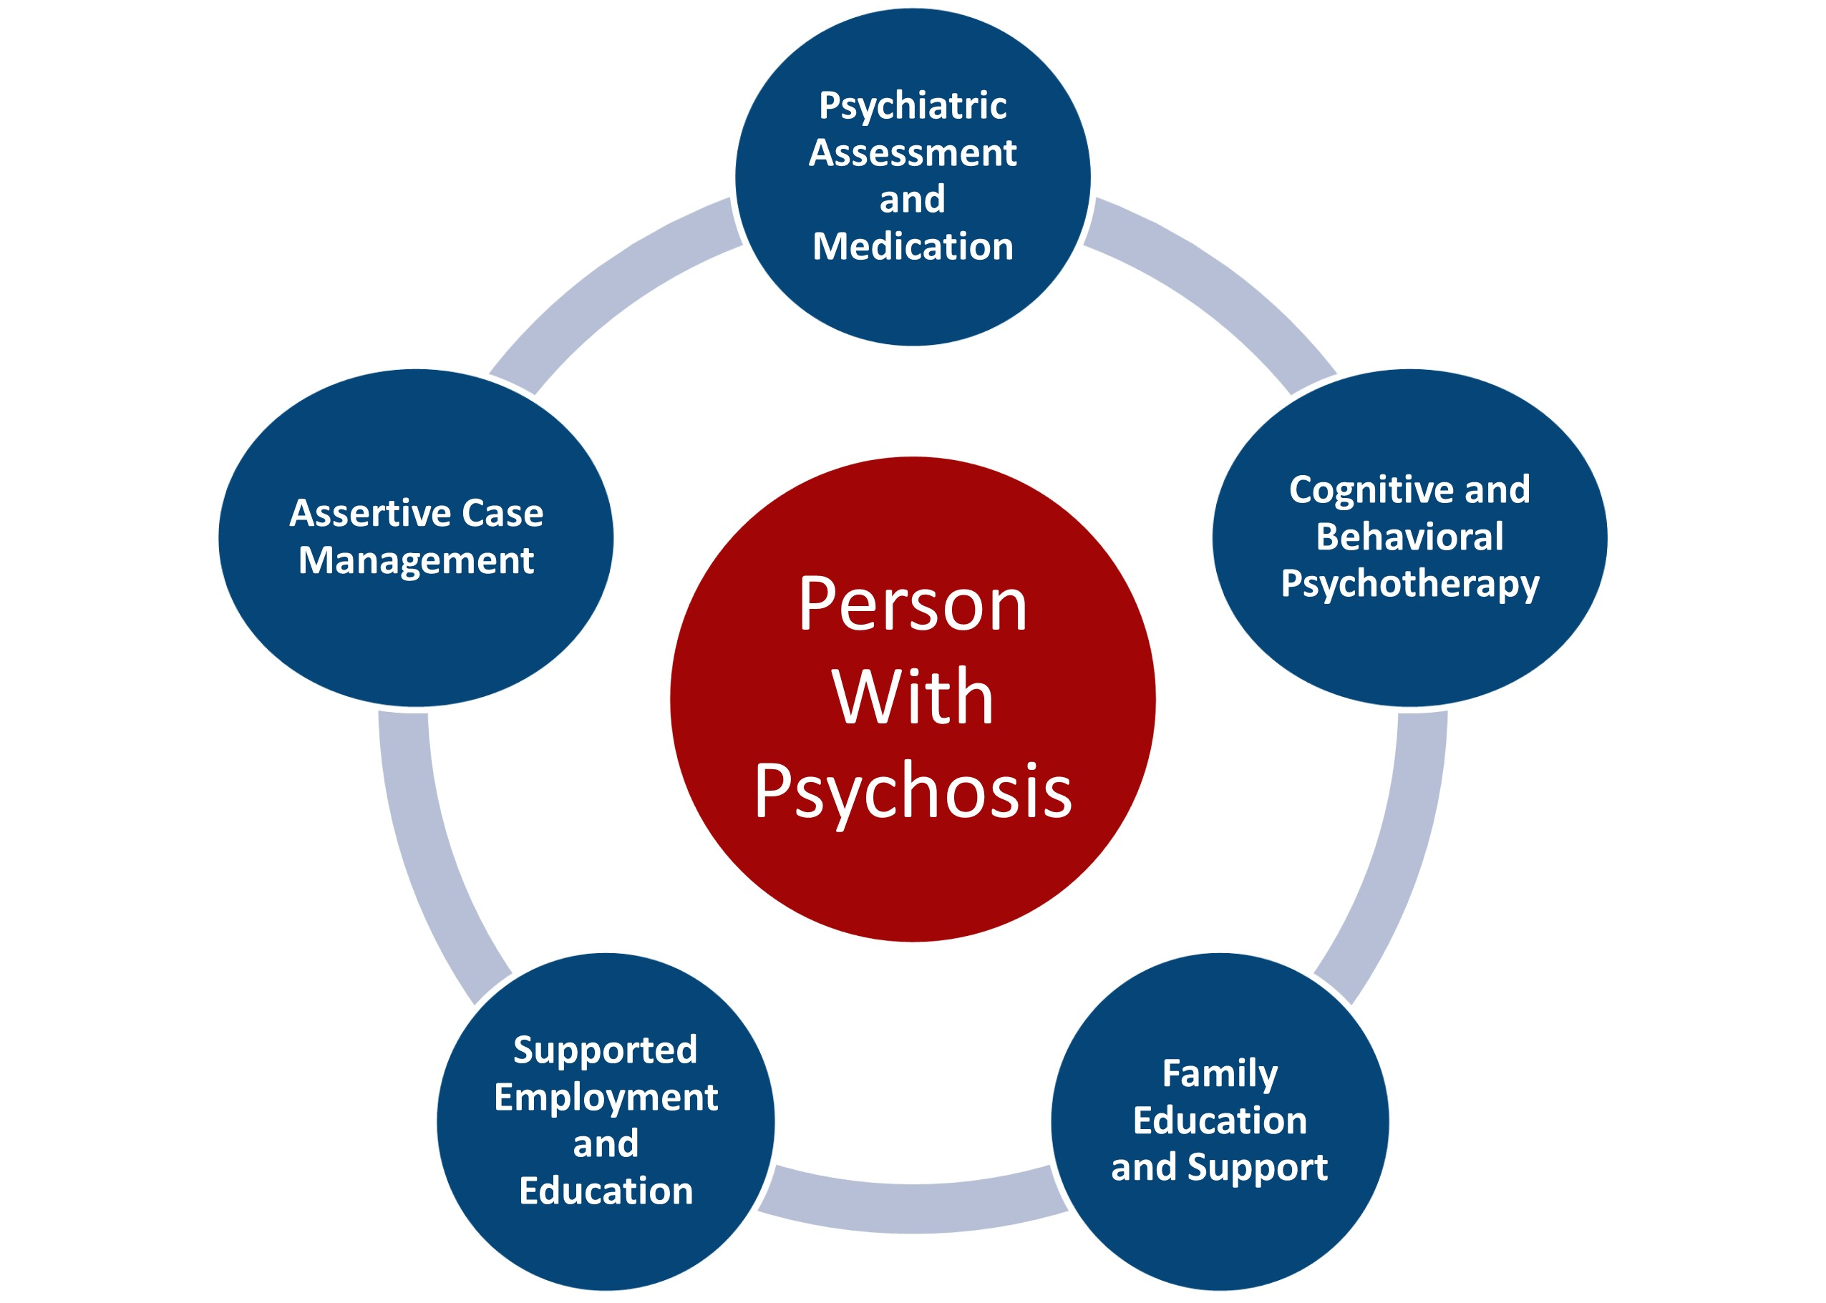
Coordinated Specialty Care in Psychosis
Courtesy of NIMH

Slide 74
Measuring the Impact of Care Farming
Thank you!
Notes:
MAPNET: Massachusetts Psychosis Network for Early Treatment

Slide 75
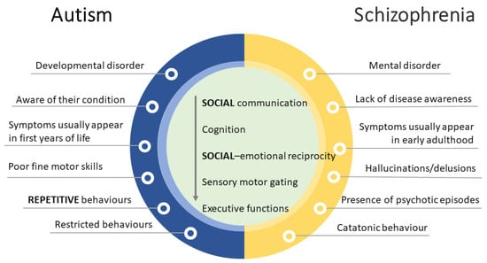
SIMILARITIES and DIFFERENCES
László et al. (2023)

