Slide 1
What to Know about Substance Use and Psychosis
Julie M. McCarthy, PhD
January, 2025

Slide 2
Disclosures: Consultant, Custom Learning Designs, Inc. © 2025 McLean Hospital Corporation All Rights Reserved

Slide 4
Agenda
1. Substance Use Patterns and Psychosis
2. Risk Factors
3. Treatment Options
4. Future Directions

Slide 5
Substance Use Patterns and Psychosis

Slide 6
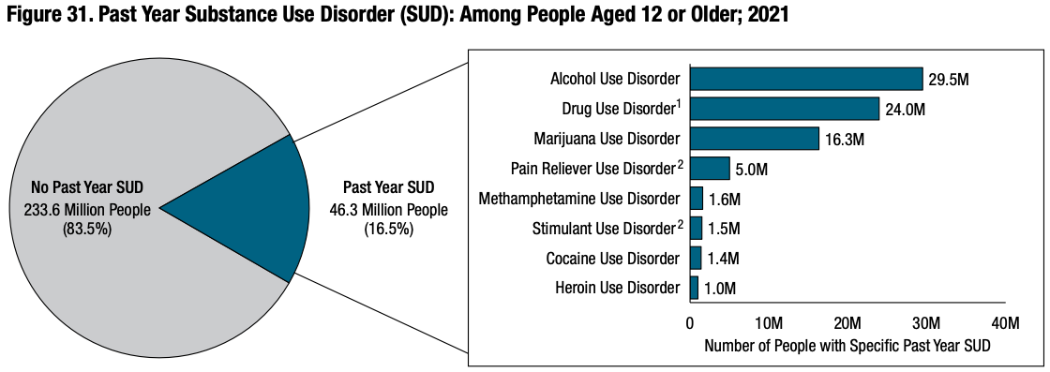
National Substance Use Disorder Rates - 2021
National Survey on Drug Use and Health (NSDUH) 2021
Notes:
Levi, L., Bar-Haim, M., Winter-van Rossum, I., Davidson, M., Leucht, S., Fleischhacker, W. W., Park, J., Davis, J. M., Kahn, R. S., & Weiser, M. (2023). Cannabis Use and Symptomatic Relapse in First Episode Schizophrenia: Trigger or Consequence? Data From the OPTIMISE Study. Schizophrenia Bulletin, 49(4), 903–913. https://doi.org/10.1093/schbul/sbad033

Slide 7
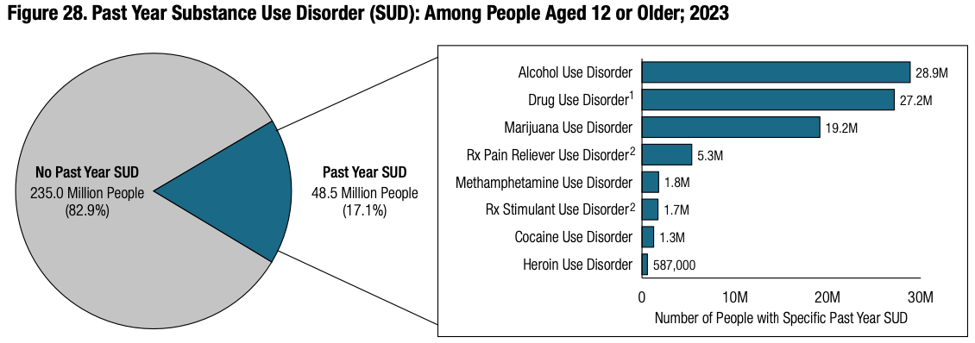
National Substance Use Disorder Rates - 2023
National Survey on Drug Use and Health (NSDUH) 2023
Notes:
Cannabis use disorder increased by about 3 million people in the past 2 years (2021 to 2023).
Miech, R. A., Johnston, L. D., Patrick, M. E., O'Malley, P. M., Bachman, J. G., & Schulenberg, J. E. (2023). Monitoring the Future National Survey Results on Drug Use, 1975-2022: Secondary School Students. Institute for Social Research.

Slide 8
DSM-5 Substance Use Disorder
More or longer use than intended
Difficulty cutting down
Lots of time getting, using, recovering
Cravings/urges to use
Work, home, school problems
Relationship problems
Giving up important activities
Repeated use in dangerous situations
Physical or psychological problems
Tolerance
Withdrawal symptoms
MILD
2 – 3 symptoms
MODERATE
4 – 5 symptoms
SEVERE
6+ symptoms
Notes:
Higher risk for SSD than ED visits involving alcohol and cannabis controlling for comorbid substance use and mental health conditions.
https://jamanetwork.com/journals/jamapsychiatry/fullarticle/2825649
This Photo by Unknown Author is licensed under CC BY

Slide 9
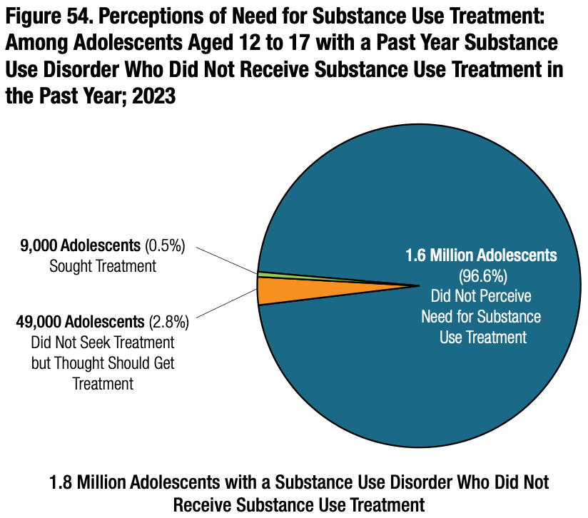
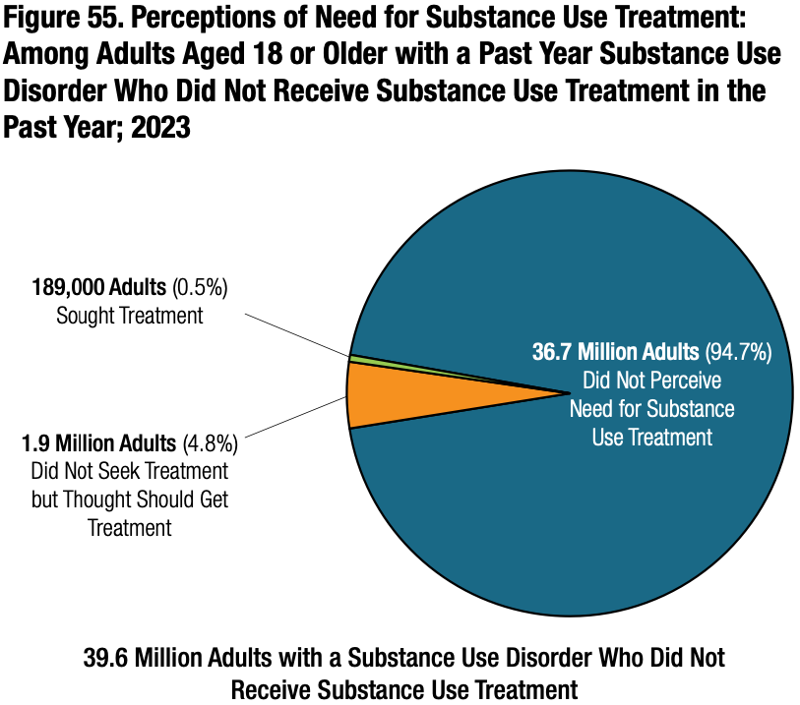
National Survey on Drug Use and Health (NSDUH) 2023

Slide 10
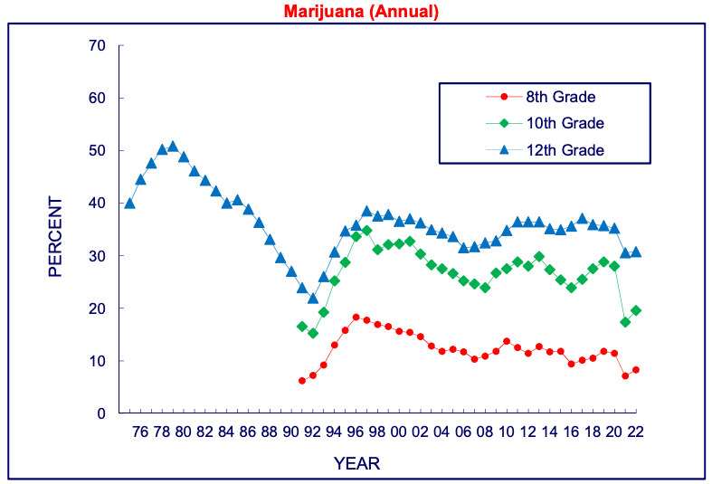
Youth Cannabis Use - Annual
The Monitoring the Future study, the University of Michigan 2022
Notes:
Miech, R. A., Johnston, L. D., Patrick, M. E., O'Malley, P. M., Bachman, J. G., & Schulenberg, J. E. (2023). Monitoring the Future National Survey Results on Drug Use, 1975-2022: Secondary School Students. Institute for Social Research.

Slide 11
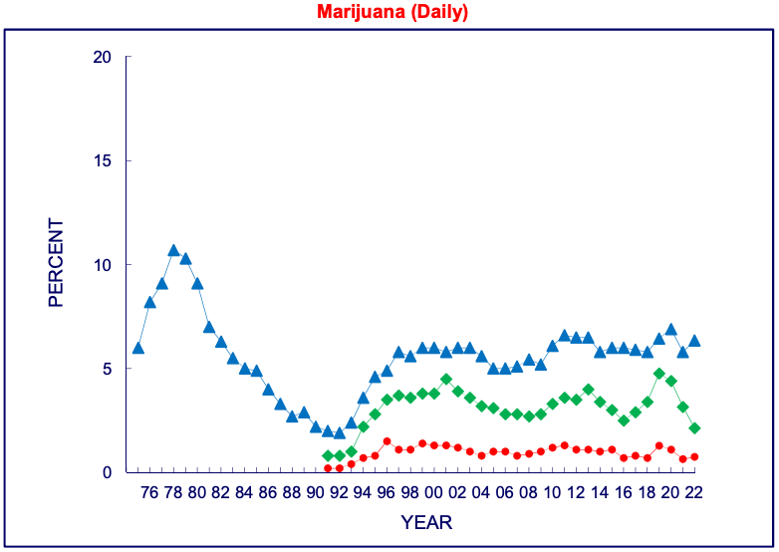
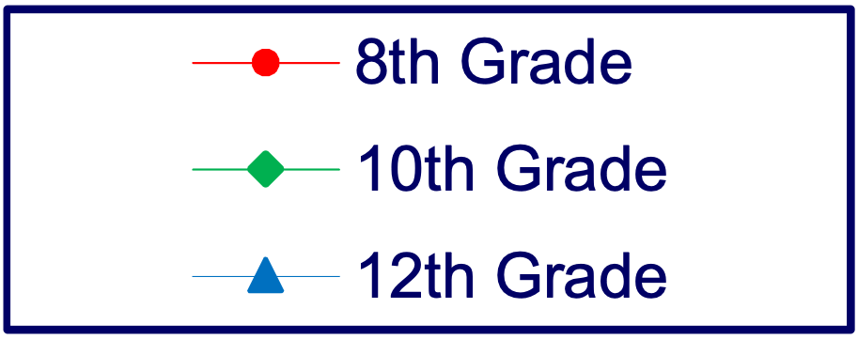
Youth Cannabis Use - Daily
The Monitoring the Future study, the University of Michigan 2022
Notes:
Miech, R. A., Johnston, L. D., Patrick, M. E., O'Malley, P. M., Bachman, J. G., & Schulenberg, J. E. (2023). Monitoring the Future National Survey Results on Drug Use, 1975-2022: Secondary School Students. Institute for Social Research.

Slide 12
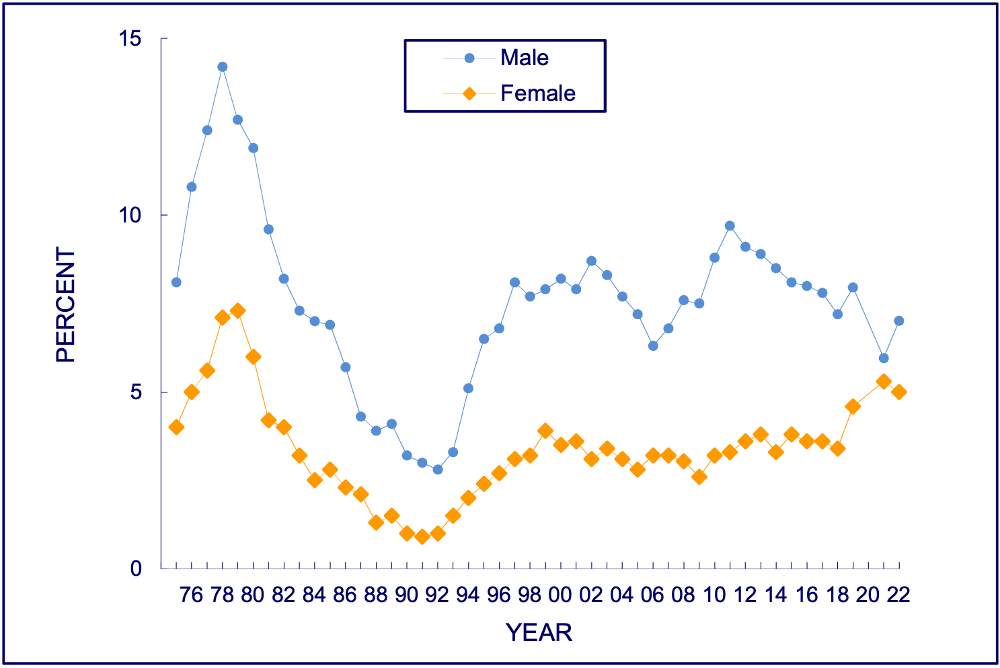
Youth Cannabis Use - Daily by Gender
The Monitoring the Future study, the University of Michigan 2022
Notes:
Miech, R. A., Johnston, L. D., Patrick, M. E., O'Malley, P. M., Bachman, J. G., & Schulenberg, J. E. (2023). Monitoring the Future National Survey Results on Drug Use, 1975-2022: Secondary School Students. Institute for Social Research.

Slide 13
State Cannabis Legalization
Longitudinal study from 2011-2021 of 110,256,536 people enrolled in employer-sponsored health insurance
States with legalized medical cannabis
42.7% increase in CUD *increases were higher in women
88.6% increase in cannabis use poisoning
States with legalized recreational cannabis
31.6% increase in cannabis use poisoning
Jayawardhana et al., 2024 JAMA Psychiatry
Notes:
Increases in CUD were also larger for ages 35-44. The results held true when analyzing data pre-pandemic, through 2019, too.

Slide 14
State Cannabis Legalization
Cannabis commercialization associated with immediate increase in rates of ED visits for cannabis-induced psychosis
Immediate increases were seen only for youth above ages 19–24 but not below ages 15–18, the legal age of purchase
Results were similar for men and women
Myran et al., 2023 Molecular Psychiatry
Notes:
Myran, D.T., Pugliese, M., Roberts, R.L. et al. Association between non-medical cannabis legalization and emergency department visits for cannabis-induced psychosis. Mol Psychiatry 28, 4251–4260 (2023). https://doi.org/10.1038/s41380-023-02185-x

Slide 15
Cannabis Patterns in Year 1 of FEP Treatment
20%
28%
29%
23%
Wright et al., 2023 Eur Arch Psychiatry Ciln Neurosci
Notes:
consistent users (used prior to the study and reported using at least 3 of the 12 months)
sporadic users (used prior to the study and reported using 1 or 2 of the 12 months)
RAISE NAVIGATE still showed greater clinical gains than community care, so we can still improve outcomes for people with ongoing cannabis use.
N=344 classified into one of the 4 groups based on use during the first year.
Consistent and sporadic users were younger. Those who stopped using were older.
Sporadic users had highest depression and lowest baseline fx and improved less during tx in neg emo and intrapsychic foundations e.g., motivation and sense of purposes than non-users.
Sporadic users in NAVIGATE improved more in overall symptoms and fx than those who received community care. Consistent users didn’t tend to differ in trajectories from non-users.

Slide 16
Cannabis and Developing Psychosis and CHR State
Cannabis is associated with earlier age of onset of psychosis (Large et al., 2011; Myles et al., 2012).
Lifetime cannabis use and current cannabis use disorder are associated with the clinical high risk (CHR) state (Carney et al., 2017; Fusar-Poli et al., 2017).
Current cannabis use (26.7%), lifetime cannabis use (52.8%), cannabis use disorders (12.8%) (Carney et al., 2017).
Mixed results on whether cannabis use is associated with individuals with CHR transitioning to psychosis (Groening et al., 2024).
Carney et al., 2017; Fusar-Poli et al., 2017; Groening et al., 2024; Large et al., 2011; Myles et al., 2012
Notes:
Large et al., 2011 didn’t find that alcohol would confound this relationship.
Myles et al, 2016 didn’t find that tobacco use would confound this relationship either.
M. Large, S. Sharma, M.T. Compton, T. Slade, O. Nielssen. Cannabis use and earlier onset of psychosis: a systematic meta-analysis
Arch. Gen. Psychiatry, 68 (6) (2011), pp. 555-561, 10.1001/archgenpsychiatry.2011.5
H. Myles, N. Myles, M. Large. Cannabis use in first episode psychosis: meta-analysis of prevalence, and the time course of initiation and continued use
Aust. N. Z. J. Psychiatry, 50 (3) (2016), pp. 208-219, 10.1177/0004867415599846

Slide 17
Substance-Induced Psychosis Transition to Schizophrenia
25% transition from substance-induced psychosis to SZ
36% transition from brief, atypical and not otherwise specified psychosis to SZ
Highest rates of transition to SZ for
Cannabis 34%
Hallucinogens 26%
Amphetamines 22%
Lower rates of transition to SZ for
Opioid 12%
Alcohol 10%
Sedative 9%
Murrie et al., 2020 Sz Bulletin
Notes:
Large et al., 2011 didn’t find that alcohol would confound this relationship.
Myles et al, 2016 didn’t find that tobacco use would confound this relationship either.
M. Large, S. Sharma, M.T. Compton, T. Slade, O. Nielssen. Cannabis use and earlier onset of psychosis: a systematic meta-analysis
Arch. Gen. Psychiatry, 68 (6) (2011), pp. 555-561, 10.1001/archgenpsychiatry.2011.5
H. Myles, N. Myles, M. Large. Cannabis use in first episode psychosis: meta-analysis of prevalence, and the time course of initiation and continued use
Aust. N. Z. J. Psychiatry, 50 (3) (2016), pp. 208-219, 10.1177/0004867415599846
Transition rates were slightly lower in older cohorts but were not affected by sex, country of the study, hospital or community location, urban or rural setting, diagnostic methods, or duration of follow-up.
Benjamin Murrie, Julia Lappin, Matthew Large, Grant Sara, Transition of Substance-Induced, Brief, and Atypical Psychoses to Schizophrenia: A Systematic Review and Meta-analysis, Schizophrenia Bulletin, Volume 46, Issue 3, May 2020, Pages 505–516, https://doi.org/10.1093/schbul/sbz102

Slide 18
Cannabis and Psychosis Relapse
N=446 FEP clients in European OPTiMiSE study.
N=282 or 63% of original sample had symptomatic remission after 10 weeks of antipsychotic treatment; 47.5% n=134 of those completed a 1-year follow-up.
Cannabis use increased risk for relapse compared with non-use even for those who were taking their antipsychotic medications.
Cannabis use preceded psychotic symptomatic worsening and worsening of social functioning.
Levi et al., 2023 SZ Bulletin
Notes:
Levi, L., Bar-Haim, M., Winter-van Rossum, I., Davidson, M., Leucht, S., Fleischhacker, W. W., Park, J., Davis, J. M., Kahn, R. S., & Weiser, M. (2023). Cannabis Use and Symptomatic Relapse in First Episode Schizophrenia: Trigger or Consequence? Data From the OPTIMISE Study. Schizophrenia Bulletin, 49(4), 903–913. https://doi.org/10.1093/schbul/sbad033

Slide 19
Substance Use Disorder in Schizophrenia Additional Risks
Higher rates of self-harm (Sara et al., 2014)
Higher rates of mortality (Lähteenvuo et al., 2021; Rosen et al., 2008)
Any substance use disorder comorbidity, especially multiple drug use and alcohol use associated with higher rates of mortality (Lähteenvuo et al., 2021)
Lähteenvuo et al., 2021 Acta Psychiatr Scand; Rosen et al., 2008 Psychiatr Serv; Sara et al., 2014 Aust N Z J Psychiatry
Notes:
Sara GE, Burgess PM, Malhi GS, Whiteford HA, Hall WC. Stimulant and other substance use disorders in schizophrenia: Prevalence, correlates and impacts in a population sample. Australian & New Zealand Journal of Psychiatry. 2014;48(11):1036-1047. doi:10.1177/0004867414533838
Lähteenvuo, M., Batalla, A., Luykx, J.J., Mittendorfer-Rutz, E., Tanskanen, A., Tiihonen, J. and Taipale, H. (2021), Morbidity and mortality in schizophrenia with comorbid substance use disorders. Acta Psychiatr. Scand., 144: 42-49. https://doi.org/10.1111/acps.13291
Rosen, C. S., Kuhn, E., Greenbaum, M. A., & Drescher, K. D. (2008). Substance abuse–related mortality among middle-aged male VA psychiatric patients. Psychiatric Services, 59(3), 290-296.

Slide 20
Hallucinogens
Hallucinogen-involved emergency department visits are associated with higher risk of being diagnosed with a schizophrenia spectrum disorder in the next 3 years (3.99%) compared with the general population (0.15%).
Higher risk for schizophrenia spectrum disorders in the next 3 years than emergency department visits involving alcohol and cannabis.
Myan et al., 2024 JAMA Psychiatry
Notes:
Higher risk for SSD than ED visits involving alcohol and cannabis controlling for comorbid substance use and mental health conditions.
https://jamanetwork.com/journals/jamapsychiatry/fullarticle/2825649
This Photo by Unknown Author is licensed under CC BY

Slide 21
Prescription Stimulants
Rx stimulant use is associated with earlier age of onset for psychosis vs. no use (20.5 vs. 24.6 years) in N=205 inpatients with psychosis.
40% reported rx stimulant use preceding psychosis (Moran et al., 2015).
Amphetamines are associated with higher risk of psychosis than methylphenidate in N=221,846 patients rx a stimulant for ADHD (Moran et al., 2019).
Past-month prescribed amphetamine use increased odds of psychosis and mania episode 2.68x vs. no use (N=4,122).
Higher doses of amphetamines have a 5.38-fold increased odds of psychosis of mania (Moran et al., 2024).
Moran et al., 2015 J Psychiatr Res; Moran et al., 2019 NEJM; Moran et al., 2024 Amer J Psychtr
Notes:
Rx stimiulants:
Dextroamphetamines e.g., Aderral, Mydayis
Methylphenidate e.g., Ritalin, Concerta
Moran, L. V., Masters, G. A., Pingali, S., Cohen, B. M., Liebson, E., Rajarethinam, R. P., & Ongur, D. (2015). Prescription stimulant use is associated with earlier onset of psychosis. Journal of Psychiatric Research, 71, 41-47. https://doi.org/https://doi.org/10.1016/j.jpsychires.2015.09.012
- 40% reported stimulant use prior to psychosis
Moran, L. V., Ongur, D., Hsu, J., Castro, V. M., Perlis, R. H., & Schneeweiss, S. (2019). Psychosis with Methylphenidate or Amphetamine in Patients with ADHD. New England Journal of Medicine, 380(12), 1128-1138. https://doi.org/doi:10.1056/NEJMoa1813751
Moran, L. V., Skinner, J. P., Shinn, A. K., Nielsen, K., Rao, V., Taylor, S. T., … Ongur, D. (2024). Risk of Incident Psychosis and Mania With Prescription Amphetamines. American Journal of Psychiatry, 181(10), 901–909. https://doi.org/10.1176/appi.ajp.20230329

Slide 22
Cannabis & Stimulants
N=192 FEP participants followed for 10 years (Kries et al., 2024)
4 trajectories:
Stable psychotic remission 54.2%
Delayed psychotic remission 15.6%
Psychotic relapse 78%
Persistent psychotic symptoms 22.4%
All unfavorable trajectories had more schizophrenia diagnoses, higher symptom severity, and longer duration of untreated psychosis.
Delayed remission and relapse groups showed dose-dependent effects with cannabis but not stimulants.
Delayed remission group reported higher rates of frequent cannabis and stimulant use during the first five follow up years.
Relapse group reported higher rates of sporadic stimulant use throughout entire follow-up period.
Kreis et al., 2014 SZ Research
Notes:
Kreis, I., Lagerberg, T. V., Wold, K. F., Åsbø, G., Simonsen, C., Flaaten, C. B., Engen, M. J., Lyngstad, S. H., Widing, L. H., Ueland, T., & Melle, I. (2024). Behind the heterogeneity in the long-term course of first-episode psychosis: Different psychotic symptom trajectories are associated with different patterns of cannabis and stimulant use. Schizophrenia Research, 271, 91–99. https://doi.org/10.1016/j.schres.2024.07.006
2 and 3 showed dose-dependent effects with cannabis but not stimulants w/ delayed psychotic remission having higher rates of frequent cannabis and stimulant use during the first 5 follow up years; psychotic relapse: higher rates of sporadic stimulant use throughout the entire follow-up period.
The persistent psychosis trajectory was less clearly linked to substance use during the follow-up period.
- Preventing stimulant use while reducing cannabis use may already yield positive effects.

Slide 23
Substance Use and Medication Adherence
Substance use may have a greater association with psychosis relapse risk in the context of lower medication adherence (Colizzi et al., 2016; Schoeler et al., 2017).
In N=205 FEP patients, 44% showed poor medication adherence and 55% did not reach psychosis remission (Colizzi et al., 2016).
Nicotine dependence and cannabis use after psychosis onset predicted poor adherence and non-remission.
Substance use can be related to increased psychosis relapse risk even with good antipsychotic medication adherence (Levi et al., 2023).
In N=245 FEP patients, 37% relapsed in the next 2 years. Continued cannabis use predicted worse outcome (e.g., risk of relapse, number of relapses, length of relapse, and care intensity at follow-up (Schoeler et al., 2017).
Colizzi et al., 2016 Schizof Res; Levi et al.l, 2023 Schizor Bull Schoeler et al., 2017 Lancet Psychiatry
Notes:
Colizzi, M., Carra, E., Fraietta, S., Lally, J., Quattrone, D., Bonaccorso, S., Mondelli, V., Ajnakina, O., Dazzan, P., Trotta, A., Sideli, L., Kolliakou, A., Gaughran, F., Khondoker, M., David, A. S., Murray, R. M., MacCabe, J. H., & Di Forti, M. (2016). Substance use, medication adherence and outcome one year following a first episode of psychosis. Schizophrenia Research, 170(2), 311–317. https://doi.org/10.1016/j.schres.2015.11.016
- with poor med adherence mediating effects between nicotine and cannabis use on non-remission.
Schoeler, T., Petros, N., Di Forti, M., Klamerus, E., Foglia, E., Murray, R., & Bhattacharyya, S. (2017). Poor medication adherence and risk of relapse associated with continued cannabis use in patients with first-episode psychosis: a prospective analysis. The Lancet. Psychiatry, 4(8), 627–633. https://doi.org/10.1016/S2215-0366(17)30233-X
Medication adherence partly mediated effect of continued cannabis use on relapse
Levi, L., Bar-Haim, M., Winter-van Rossum, I., Davidson, M., Leucht, S., Fleischhacker, W. W., Park, J., Davis, J. M., Kahn, R. S., & Weiser, M. (2023). Cannabis Use and Symptomatic Relapse in First Episode Schizophrenia: Trigger or Consequence? Data From the OPTIMISE Study. Schizophrenia Bulletin, 49(4), 903–913. https://doi.org/10.1093/schbul/sbad033
- and people with schizophrenia spectrum disorders in general can experience psychotic relapse even on antipsychotic medications.
Rubio, J. M., Schoretsanitis, G., John, M., Tiihonen, J., Taipale, H., Guinart, D., Malhotra, A. K., Correll, C. U., & Kane, J. M. (2020). Psychosis relapse during treatment with long-acting injectable antipsychotics in individuals with schizophrenia-spectrum disorders: an individual participant data meta-analysis. The Lancet. Psychiatry, 7(9), 749–761. https://doi.org/10.1016/S2215-0366(20)30264-9

Slide 24
Three Hypotheses for Cannabis and Psychosis
Shared Vulnerability
Self-Medication
Contributing Risk
Osborne et al., 2024 JAMA Psychiatry
Notes:
Although there is no agreed upon definition of first episode psychosis, generally it is thought of as having experienced the first occurrence of psychosis symptoms. Having those symptoms first occur in the past 1-3 years is typical criteria for entry into most first episode psychosis clinics; however, some will accept clients with a first episode within the first 5 years or have no upper limits. Age of onset occurs slightly earlier for men than women on average with many psychosis occurring in late teens and early 20s for many clients. There are up to 40% of clients who may develop their first episode of psychosis later in life after age 40.

Slide 25
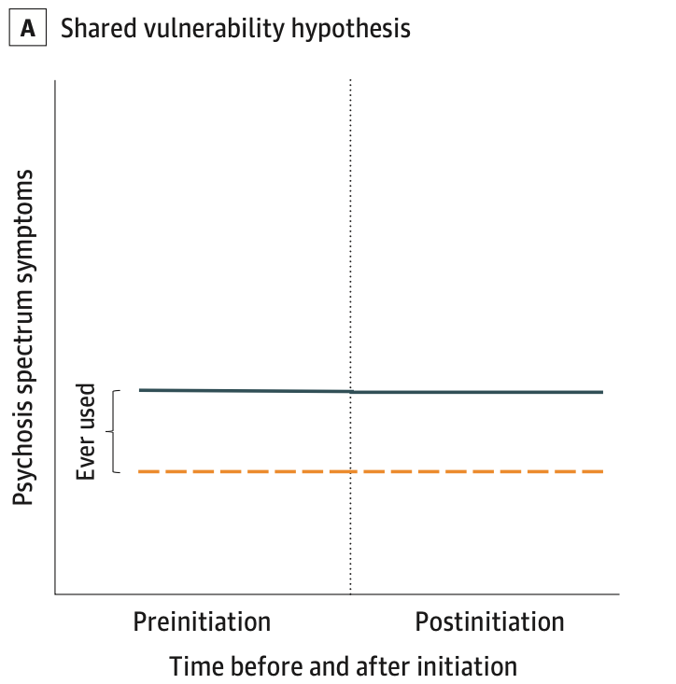
Three Hypotheses for Cannabis and Psychosis
Shared Vulnerability
Osborne et al., 2024 JAMA Psychiatry
Notes:
Although there is no agreed upon definition of first episode psychosis, generally it is thought of as having experienced the first occurrence of psychosis symptoms. Having those symptoms first occur in the past 1-3 years is typical criteria for entry into most first episode psychosis clinics; however, some will accept clients with a first episode within the first 5 years or have no upper limits. Age of onset occurs slightly earlier for men than women on average with many psychosis occurring in late teens and early 20s for many clients. There are up to 40% of clients who may develop their first episode of psychosis later in life after age 40.

Slide 26
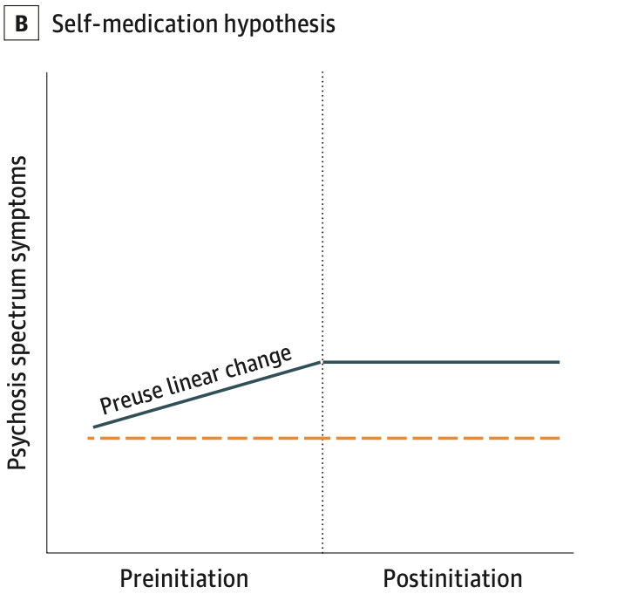
Three Hypotheses for Cannabis and Psychosis
Self-Medication
Osborne et al., 2024 JAMA Psychiatry
Notes:
Although there is no agreed upon definition of first episode psychosis, generally it is thought of as having experienced the first occurrence of psychosis symptoms. Having those symptoms first occur in the past 1-3 years is typical criteria for entry into most first episode psychosis clinics; however, some will accept clients with a first episode within the first 5 years or have no upper limits. Age of onset occurs slightly earlier for men than women on average with many psychosis occurring in late teens and early 20s for many clients. There are up to 40% of clients who may develop their first episode of psychosis later in life after age 40.

Slide 27
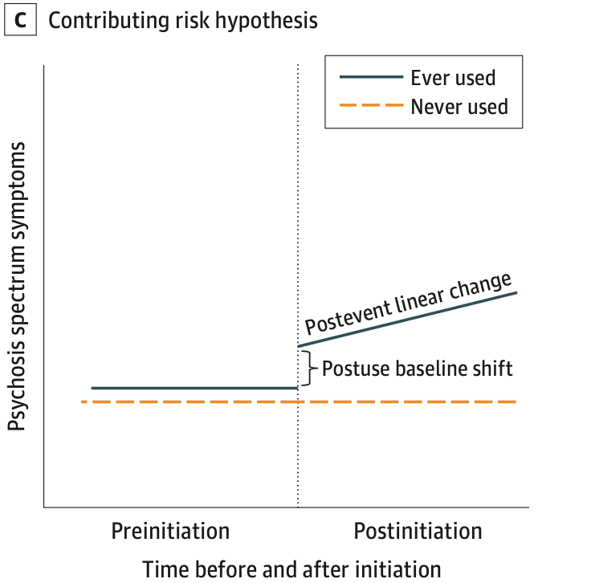
Three Hypotheses for Cannabis and Psychosis
Contributing Risk
Osborne et al., 2024 JAMA Psychiatry

Slide 28
Three Hypotheses for Cannabis and Psychosis
Adolescent Brain Cognitive Development (ABCD) Study
N=11,858 participants aged 9 to 10 years at baseline followed across 4 years
Adolescents using cannabis at any point in the study had more psychosis spectrum symptoms and more distress from those symptoms compared with those who never used cannabis
Number of psychosis spectrum symptoms and distress from those symptoms increased leading up to cannabis initiation
<- Shared vulnerability hypothesis
<- Self-medication hypothesis
*Any nicotine or alcohol use was also associated with having more psychosis spectrum symptoms
Osborne et al., 2024 JAMA Psychiatry
Notes:
Contributing risk hypothesis – they did not find evidence supporting this hypothesis, which may be because in childhood and early adolescence, daily and high-volume cannabis use is less common than later in adolescent and early adulthood.

Slide 29
Motives for Substance Use
Coping
Pleasure
Social
Boredom
Petros et al., 2023 J Dual Diagnosis
Notes:
Ryan Petros, Denise D. Walker, Adam Pierce & Maria Monroe-DeVita (2023) Scoping Review of Cannabis-Reduction Psychosocial Interventions and Reasons for Use among Young Adults with Psychosis, Journal of Dual Diagnosis, 19:2-3, 124-150, DOI: 10.1080/15504263.2023.2226024

Slide 30
Risk Factors

Slide 31
Risk Factors for Substance Use in Adolescents
Individual:
High impulsivity
Pain catastrophic
Homework completeness
Total screen time
Maltreatment or negative upbringing
Psychiatric disorders (e.g., conduct problems, MDD)
Previous e-cigarette exposure
Behavioral addiction
Low-perceived risk; high-perceived accessibility
Family
Prenatal maternal smoking
Poor maternal psychological control
Low parental education
Negligence
Poor supervision
Uncontrolled pocket money
Presence of family members using substances
Community
Peers with substance use disorder
Nawi et al., 2021 BMC Public Health
Notes:
Nawi, A.M., Ismail, R., Ibrahim, F. et al. Risk and protective factors of drug abuse among adolescents: a systematic review. BMC Public Health 21, 2088 (2021). https://doi.org/10.1186/s12889-021-11906-2

Slide 32
Protective Factors of Substance Misuse in Adolescents
Individual:
Optimism
High level of mindfulness
Social phobia
Strong beliefs against problematic substance use
Desire to maintain health
Family
High paternal awareness of drug misuse
Community
School connectedness
Strong religious beliefs
Structured activity
Nawi et al., 2021 BMC Public Health
Notes:
Nawi, A.M., Ismail, R., Ibrahim, F. et al. Risk and protective factors of drug abuse among adolescents: a systematic review. BMC Public Health 21, 2088 (2021). https://doi.org/10.1186/s12889-021-11906-2

Slide 33
Moderators for Cannabis Use and Psychosis Relationship
Younger age of first cannabis use (e.g., <25 years of age)
Adolescent cannabis use
More frequent cannabis use (e.g., daily, weekly)
Higher potency cannabis
Childhood trauma
Other substance use
Di Forti et al., 2015 Lancet Psychiatry; Groening et al., 2024 Psychiatry Research
Notes:
Robinson T, Ali MU, Easterbrook B, Hall W, Jutras-Aswad D, Fischer B. Risk-thresholds for the association between frequency of cannabis use and the development of psychosis: a systematic review and meta-analysis. Psychological Medicine. 2023;53(9):3858-3868. doi:10.1017/S0033291722000502
van der Steur, S. J., Batalla, A., & Bossong, M. G. (2020). Factors moderating the association between cannabis use and psychosis risk: A systematic review. Brain Sciences, 10(2), 97. doi: 10.3390/brainsci10020097
Sideli, L., Quigley, H., La Cascia, C., & Murray, R. M. (2020). Cannabis use and the risk for psychosis and affective disorders. Journal of Dual Diagnosis, 16(1), 22–42. doi: 10.1080/15504263.2019.1674991
Di Forti, Marconi et al. (2015) studied 410 patients with their first episode of psychosis and 390 healthy controls and found that those using high-potency cannabis on a daily basis were five times more likely than nonusers to experience a psychotic disorder; use of cannabis resin was not related to an increased risk of psychosis, likely due to the lower THC concentration and the presence of an equivalent amount of CBD (Di Forti, Marconi et al., 2015).
Groening, J. M., Denton, E., Parvaiz, R., Brunet, D. L., Von Daniken, A., Shi, Y., & Bhattacharyya, S. (2024). A systematic evidence map of the association between cannabis use and psychosis-related outcomes across the psychosis continuum: An umbrella review of systematic reviews and meta-analyses. Psychiatry research, 331, 115626. https://doi.org/10.1016/j.psychres.2023.115626

Slide 34
Risk Factors for Psychosis
Biological family history of psychiatric disorders
Schizophrenia/schizoaffective disorders
Bipolar Disorder
Environmental factors
Growing up in an urban area
Trauma
Especially childhood trauma
Gender differences in trauma types
Cannabis
Especially daily use
During adolescence
High potency
Synthetics
Notes:
https://media.istockphoto.com/id/1226406906/photo/woman-worker-have-online-consultation-using-video-call.jpg?s=612x612&w=0&k=20&c=iGqbnomgu5NJtGjh7BgtTOTWQIY8ugrz0mROGJPVoaE=

Slide 35
Treatment Options

Slide 36
Reasons for Reducing or Stopping Substance Use
Health
Income
Family
Lobbana et al., 2010 Social Science & Medicine
Notes:
Lobbana, F., Barrowclough, C., Jeffery, S., Bucci, S., Taylor, K., Mallinson, S., ...Marshall, M. (2010). Understanding factors influencing substance use in people with recent onset psychosis: A qualitative study. Social Science & Medicine, 70, 1141-1147.

Slide 37
Coordinated Specialty Care
Core principles
Assessment and medication
Cognitive and behavioral psychotherapy
Family education and support
Supported employment and education
Assertive case management
(Peer specialists)
NIMH
Notes:
https://www.nimh.nih.gov/news/science-news/2023/raise-ing-the-standard-of-care-for-schizophrenia-the-rapid-adoption-of-coordinated-specialty-care-in-the-united-states

Slide 38
Screening Tools: Drugs
DAST-10: Drug Abuse Screening Test
10-item self-report measure yes/no
Score range: 0-10
1-2 low (monitor, reassess at later date)
3-5 moderate (further investigation)
6-8 substantial (intensive assessment)
9-10 severe (intensive assessment)
CUDIT-R: Cannabis Use Disorder Test - Revised
8-items
Score range: 0-32
8-11 hazardous cannabis use
12+ possible cannabis use disorder
CUDIT-R Adamson et al., 2010 Drug Alc Dep; DAST-10 Skinner et al., 1982 J Subst Abuse Treat
Notes:
https://cde.nida.nih.gov/instruments
Adamson, S. J., Kay-Lambkin, F. J., Baker, A. L., Lewin, T. J., Thornton, L., Kelly, B. J., & Sellman, J. D. (2010). An improved brief measure of cannabis misuse: the Cannabis Use Disorders Identification Test-Revised (CUDIT-R). Drug and alcohol dependence, 110(1-2), 137-143.
Skinner HA (1982). The Drug Abuse Screening Test. Addict Behav 7(4):363-371. Yudko E, Lozhkina O, Fouts A (2007). A comprehensive review of the psychometric properties of the Drug Abuse Screening Test. J Subst Abuse Treatment 32:189-198.

Slide 39
Screening Tools: Alcohol
AUDIT: Alcohol Use Disorders Identification Test
10-item self-report measure
Score range: 0-40
1-7 low-risk
8-14 hazardous alcohol use
13+ (women) or 15+ (men) likely moderate-severe alcohol use disorder
AUDIT-C: Alcohol Use Disorders Identification Test - Concise
3-item self-report measure
Score range: 0-12
3+ (women) or 4+ (men) hazardous alcohol use
AUDIT Bradley et al., 2003 Arch Intern Med; AUDIT-C Bush et al., 1998 Arch Intern Med
Notes:
Scoring the AUDIT
The AUDIT has 10 questions and the possible responses to each question are scored 0, 1, 2, 3 or 4, with the exception of questions 9 and 10 which have possible responses of 0, 2 and 4.
The range of possible scores is from 0 to 40 where 0 indicates an abstainer who has never had any problems from alcohol. A score of 1 to 7 suggests low-risk consumption according to World Health Organization (WHO) guidelines. Scores from 8 to 14 suggest hazardous or harmful alcohol consumption and a score of 15 or more indicates the likelihood of alcohol dependence (moderate-severe alcohol use disorder).
Results from the original WHO study showed that the term “drink” in questions 2 and 3 encompassed amounts of alcohol ranging from 8 grams to 13 grams. Where a standard drink is defined as an amount outside this range (e.g. 20 grams) it is recommended that the response categories are modified accordingly.
https://auditscreen.org/about/scoring-audit/
Bradley KA, Bush KR, Epler AJ, et al (2003). Two brief alcohol-screening tests From the Alcohol Use Disorders Identification Test (AUDIT): Validation in a female Veterans Affairs patient population. Arch Intern Med. 163:821-9.
Bush K, Kivlahan DR, McDonell MB, et al (1998). The AUDIT alcohol consumption questions (AUDIT-C): an effective brief screening test for problem drinking. Ambulatory Care Quality Improvement Project (ACQUIP). Arch Intern Med. 158:1789-95.

Slide 40
Individual Resiliency Training
Orientation
Assessment/Initial Goal Setting
Education about Psychosis
Healthy Lifestyles
Developing a Wellness Plan
Processing the Psychotic Episode
Developing Resiliency-Standard Sessions
Building a Bridge to Your Goals
Dealing with Negative Feelings
Coping with Symptoms
Substance Use
Having Fun and Developing Good Relationships
Developing Resiliency – Individualized Sessions
https://navigateconsultants.org/manuals.html

Slide 41
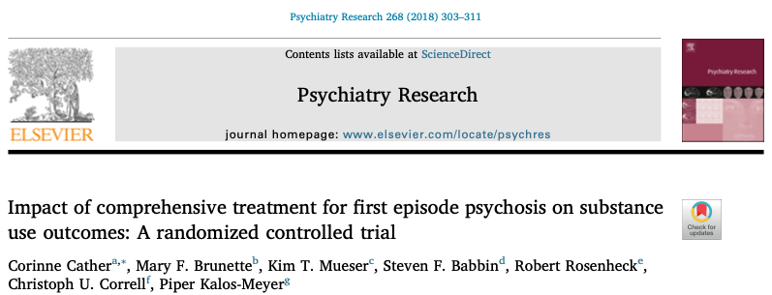

Slide 42
Treatments for Cannabis Use and Early Psychosis
Contingency Management (CM)
CIRCLE RCT: CM with psychoeducation – no benefit over treatment as usual and high attrition (Johnson et al., 2019; Rains et al., 2019)
28-day trial of CM and supportive therapy (MI, psychoeducation, coping skills) feasible and somewhat higher rates of cannabis abstinence for those with SZ (Rabin et al., 2018)
Feasible but only a small number of people testing negative (Sigmon et al., 2000; Sigmon et al., 2006)
Notes:
The longer the “duration of untreated psychosis,” the worse the outcomes.
Barriers that can delay the start of treatment include: lack of awareness or insight of symptoms, declining help, few clinicians available or long waitlists, and limited resources like time, finances, and transportation.
Psychosis can have a significant impact on both the client and their family, so it is important to get them the support they need as soon as possible.

Slide 43
Treatments for Cannabis Use and Early Psychosis
Motivational Interviewing (MI)
4-6 individual sessions, 3 optional group sessions, 2-4 optional booster sessions vs. TAU = Reduced joints per week and greater confidence to change cannabis use. No difference at 1-year follow-up (Bonsack et al., 2011).
Adapting Teen Marijuana Check Up to FEP 2 sessions individual sessions (Bennett et al., actively recruiting).
Notes:
The longer the “duration of untreated psychosis,” the worse the outcomes.
Barriers that can delay the start of treatment include: lack of awareness or insight of symptoms, declining help, few clinicians available or long waitlists, and limited resources like time, finances, and transportation.
Psychosis can have a significant impact on both the client and their family, so it is important to get them the support they need as soon as possible.

Slide 44
Treatments for Cannabis Use and Early Psychosis
MI + Cognitive Behavioral Therapy
10-session vs. TAU + self-help = No difference for cannabis use (Baker et al., 2006)
10-session with a 3-mo booster session vs. 10-session psychoeducation = No difference in cannabis reduction outcomes (Edwards et al., 2003, 2006)
7-session CapOpus vs. TAU = No effect on days of cannabis use. For people using at baseline and at least half of the past 30 days reported fewer joints per month. No differences at 4-mo follow-up (Hjorthoj et al., 2013)
12 sessions + 6-week booster session vs. TAU = No cannabis reduction but better quality of life (Madigan et al., 2013)
12 sessions, 24 sessions, TAU = No difference in cannabis reduction (Barrowclough et al., 2014)
Psychoeducation 3 vs. 8 sessions = Some promise with n=7 abstinent at 12 months of the n=10 with baseline cannabis use (Bucci et al, 2010)
16-week vs. TAU = Greater decrease in cannabis use severity at faster rate with better decrease in frequency/amount (González-Ortega et al., 2022)
Notes:
The longer the “duration of untreated psychosis,” the worse the outcomes.
Barriers that can delay the start of treatment include: lack of awareness or insight of symptoms, declining help, few clinicians available or long waitlists, and limited resources like time, finances, and transportation.
Psychosis can have a significant impact on both the client and their family, so it is important to get them the support they need as soon as possible.
Wang et al., 2022 https://www.psychiatrist.com/jcp/motivational-interviewing-for-psychosis-plus-sud/
Wenyue Wang, MPhil; Anson Kai Chun Chau, MA; Paul Kong, MSSc; Xiaoqi Sun, PhD; Suzanne Ho-wai So, PhD
J Clin Psychiatry 2022;83(1):21r13916

Slide 45
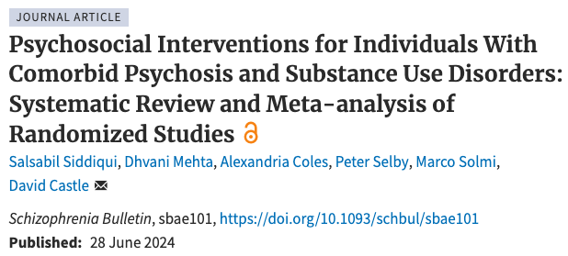

Slide 46
Family Impact
Need for better family member communication due to substance use and psychosis problems
Worry about the relative’s relationships with other family members and friends
Worry about the impact of substance use on the psychotic disorder
Caregiver burden
Fear of enabling substance use
Ambivalence and minimizing substance use compared to other recovery challenges
McCarthy et al., In press J Dual Disorders

Slide 47
Family Impact
Desire for and barriers to relative engaging in treatment
Lack of communication with relative and exclusion from treatment
Desire for information on how to support the relative
“I have been asking from the day he got to [the hospital]…for some sort of parent support or therapy or something to help me help him…I’m not really sure the best way to react…I don’t know if I’m making it worse.”
- Family member
McCarthy et al., In press J Dual Disorders

Slide 48
Family Education
Psychosis
Medication
Coping with Stress
Basic Facts about Alcohol and Drugs
Healthy Lifestyle
Facts about Developing Resilience
Effective Communication
Developing a Plan for Staying Well
Developing a Collaboration with Mental Health Professionals
A Relative’s Guide to Supporting Recovery from Psychosis
https://navigateconsultants.org/manuals.html

Slide 49
Treatments for Cannabis Use and Early Psychosis
Family Skills Training
Family Motivational Interviewing (Smeerdijk et al., 2012, 2014, 2015)
12-session bi-monthly group vs. TAU = Led to lower quantity and frequency of cannabis use maintained at 15-month follow-up; family members reported reduced distress and burden.
Difficult to fit into families’ schedules given the number of sessions and total length (6-months).
Community Reinforcement and Family Training for Early Psychosis and substance use (CRAFT-EP) (McCarthy et al., 2022; McCarthy et al., in prep.)
8-session 1-on-1 coaching = In single-arm pilot CRAFT-EP reduced family depression, anxiety, and stress, while improving personal and relationship happiness with loved one.
CRAFT-EP vs. TAU = results pending.
Notes:
The longer the “duration of untreated psychosis,” the worse the outcomes.
Barriers that can delay the start of treatment include: lack of awareness or insight of symptoms, declining help, few clinicians available or long waitlists, and limited resources like time, finances, and transportation.
Psychosis can have a significant impact on both the client and their family, so it is important to get them the support they need as soon as possible.

Slide 50
Crafting Support Project Family Webinars Thurs 5-6pm ET
April 11 How to Partner with Law Enforcement
May 9 CRAFTing Skills for Families
June 13 Recovery with Peer Specialists
July 11 Motivational Interviewing for Loved Ones
August 8 Mental Health First Aid
September 12 Empowering Caregivers through Psychosis Education and Skills-
Training: An Overview of the Psychosis REACH Direct-to-Consumer
Training Program
October 10 How to Talk About Medications for Psychotic Disorders and More
November 14 Family Recovery Night: Sharing Stories of Hope
Notes:
https://media.istockphoto.com/id/1226406906/photo/woman-worker-have-online-consultation-using-video-call.jpg?s=612x612&w=0&k=20&c=iGqbnomgu5NJtGjh7BgtTOTWQIY8ugrz0mROGJPVoaE=

Slide 51
CSP 2023-2024 Family Webinars Now Online
https://www.youtube.com/@craftingsupportproject

Slide 52
1-on-1 Coaching
Who : McLean families
What: Up to 8 weekly 1-on-1 sessions with a coach
Where: Zoom
When: Offered through 2025
How: Email Julie McCarthy, PhD jmccarthy@mclean.harvard.edu
Cost: Free (or insurance-based TBD)

Slide 53
Future Directions

Slide 54
Opportunities
Clinical high risk for psychosis
Prevention
Community engagement in research

Slide 55
Summary
Cannabis alone does not cause psychosis
Cannabis, stimulants, and hallucinogens are associated with increased risk for psychosis
Today, there is no gold standard treatment for co-occurring substance use and psychosis.
Motivational interviewing, CBT, contingency management, and family interventions may offer short-term support.

Slide 56
Acknowledgments
Mass General Brigham McLean and MGH
Dost Öngür, MD, PhD
Roger Weiss, MD
James Hudson, MD
Janet Wozniak, MD
Emily Carol, PhD
Cori Cather, PhD
Cheryl Foo, PhD
Justin Shepherd, MA
Patrick Kelly
Max Cook
Julia Merchant
Taylor Stacy
McLean Division of Psychotic Disorders Research Advisory Board
External Colleagues
Kim Mueser, PhD (BU)
Robert Meyers, PhD (UNM)
Nicole Kozloff, MD (CAMH)
Asher Weller, MD (CAMH)
National Institute of Drug Abuse
K23DA050808
Philanthropy Support
Gift to the Division of Psychotic Disorders
Andrea Wood
Mary Grace Shinners
Hadley Heinrich
Eleanor Sultana
Megan Liew
Edoardo Bianchi
Kyle Cuklanz
Emily Yang
Tahira Jessop
Renata Botello
Prachi Patel

Slide 57
Thank You
Julie M. McCarthy, PhD
jmccarthy@mclean.harvard.edu

