Slide 1
Alata Tree
Buddha’s Coconut Tree

Slide 2
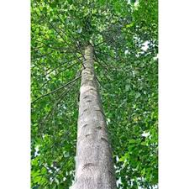
Alata tree Stem

Slide 3
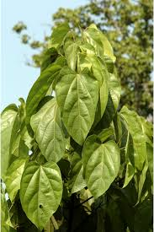
Alata tree Leaves

Slide 4
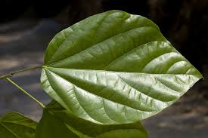
Alata Leagf

Slide 5
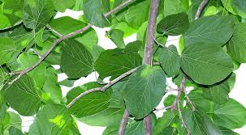
Alata tree branches

Slide 6
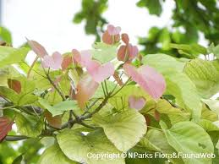
Alata tree new pink leaves

Slide 7
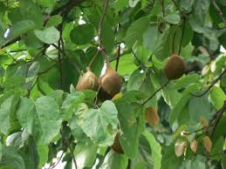
Alata tree fruits

Slide 8
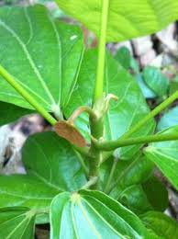
Alata tree

Slide 9
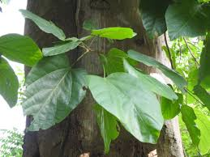
Alata tree stem

Slide 10
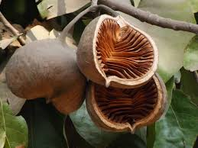
Alata tree fruit in two parts

Slide 11
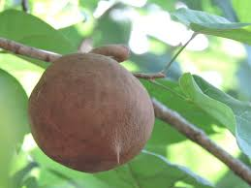
Alata tree fruit

